Slide 1
Single-line diagram
Md hasemi rafsan jani shohan
Id 191-33-849

Slide 2
In power engineering, a single-line diagram (SLD), also sometimes called one-line diagram, is a symbolic representation of a three-phase electric power system.^{[1]}
The one-line diagram has its largest application in power flow studies. Electrical elements such as circuit breakers, transformers, capacitors, bus bars, and conductors are shown by standardized schematic symbols.^{[1]} Instead of representing each of three phases with a separate line or terminal, only one conductor is represented.
It is a form of block diagram graphically depicting the paths for power flow between entities of the system. Elements on the diagram do not represent the physical size or location of the electrical equipment, but it is a common convention to organize the diagram with the same left-to-right, top-to-bottom sequence as the switchgear or other apparatus represented. A one-line diagram can also be used to show a high level view of conduit runs for a PLC control system.

Slide 3
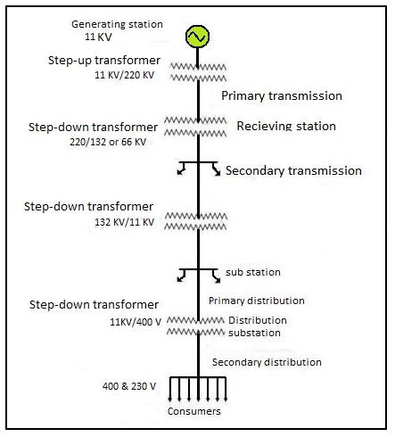

Slide 4
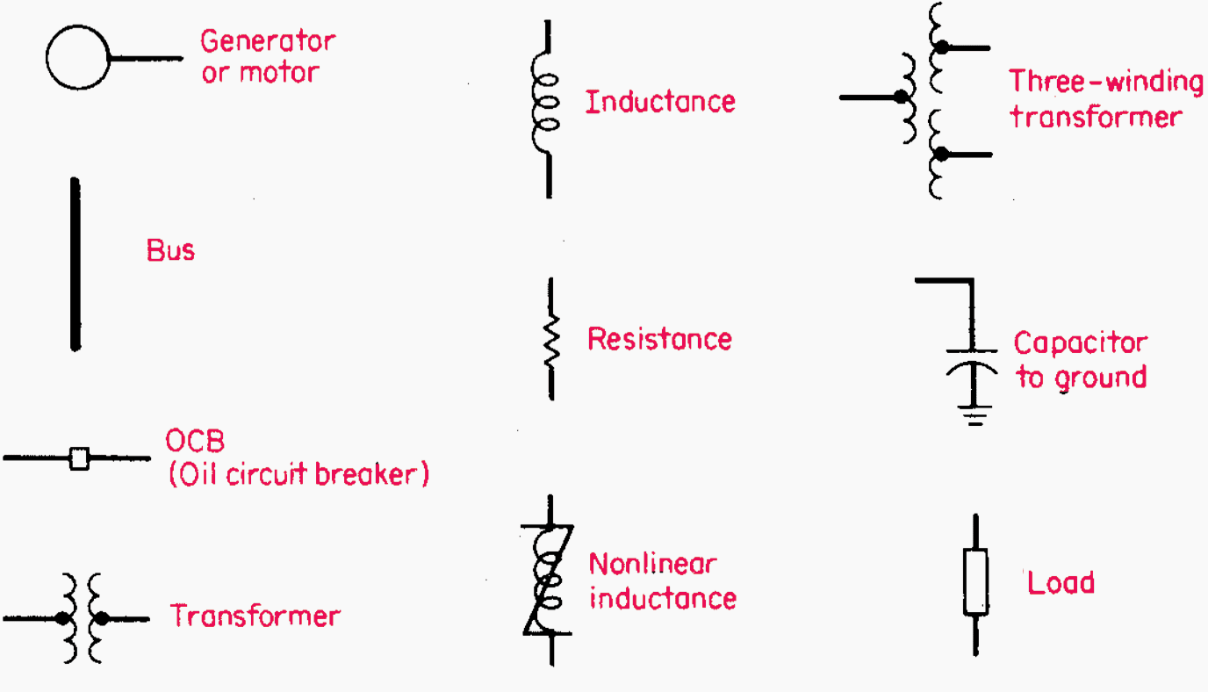
Components of single line diagram

Slide 5
Advantage of single line diagram
A one-line diagram is usually used along with other notational simplifications, such as the per-unit system. A secondary advantage to using a one-line diagram is that the simpler diagram leaves more space for non-electrical, such as economic, information to be included.

Slide 6
THANK YOU

