Slide 1
Open loop and close loop system
Md borhan Uddin
191-33-922

Slide 2
Open-Loop Systems
Open-Loop Systems
Open-loop systems tend to be simple and inexpensive as they do not provide feedback from the machine movement to the controller. In other words, open-loop systems act solely on the basis of the input and do not use feedback from the output to self-correct while the test is running. Thus, the test procedure entered into an open-loop controller may vary due to external disturbances, like noise, without the operator noticing. The data acquired from a universal testing machine with an open-loop controller may be imprecise.
In materials testing, when running systems with an open-loop controller, keeping the speed constant might become a problem as there is no direct feedback to monitor and regulate control. The speed of the machine might change during a test due to various reasons, and the open loop system does not have a feedback control to let the controller know of these changes. The test will run at a modified speed without the machine or the operator noticing. This is a problem especially if tests are to be run per ASTM standards or in any test where the speed has to be kept constant.

Slide 3
Close loop system
Closed-Loop Systems
Universal testing machines with closed-loop control systems have a feedback loop that continuously sends information from the closed-loop controller to the motor and also from the motor to the closed-loop controller. This constant feedback allows certain variables such as the load rate and the stress rate to remain as specified throughout the tests. Closed-loop systems provide higher accuracy due to the ability to react immediately to possible changes.
Below is a diagram showing how closed-loop testing systems operate. All ADMET testing equipment comes with a closed loop-controller.

Slide 4
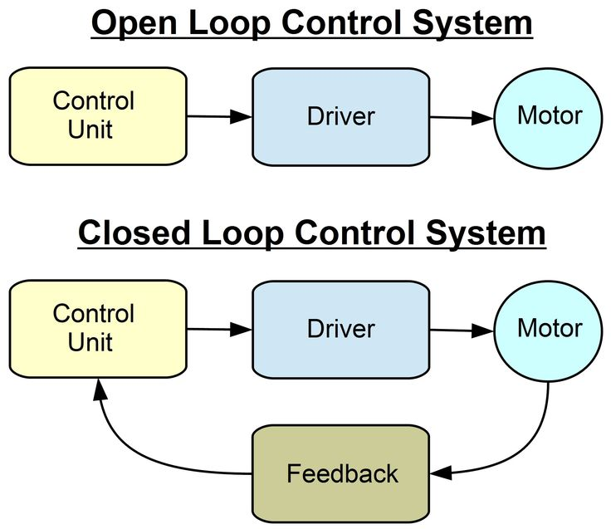

Slide 5
Thank you

