Slide 1
Faults in power system
Md borhan Uddin
191-33-922

Slide 2
Fault An event occurring on an electric system such as a short circuit, a broken wire, or an intermittent connection.
In an electric power system, a fault or fault current is any abnormal electric current. For example, a short circuit is a fault in which current bypasses the normal load. An open-circuit fault occurs if a circuit is interrupted by some failure. ... In a "ground fault" or "earth fault", current flows into the earth

Slide 3
Types of faults
Types of Faults
Open Circuit Faults
Causes
Effects
Short Circuit Faults
Causes
Effects
Symmetrical and Unsymmetrical Faults
Symmetrical Faults
Unsymmetrical Faults
Protection Devices against Faults
Fuse
Circuit Breaker
Protective Relays
Lighting Arrestor

Slide 4
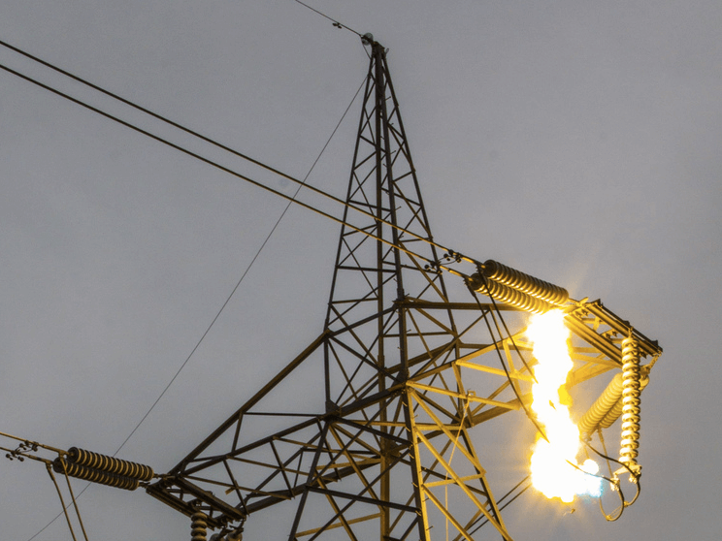
High voltage transmission line fault

Slide 5
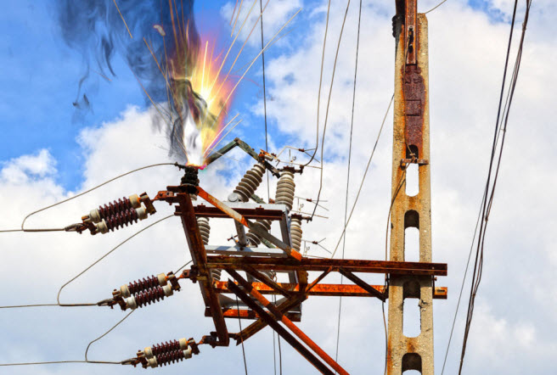
Fuse or protection device faults

Slide 6
Thank you

