Slide 1


KM Informatics and AI
Abdominal Cold-Region Segmentation
From Korean Medicine palpation expertise to objective thermal-imaging AI
Rafsan Jany (02513052)
Integrated Program (3rd Semester)
01

Slide 2

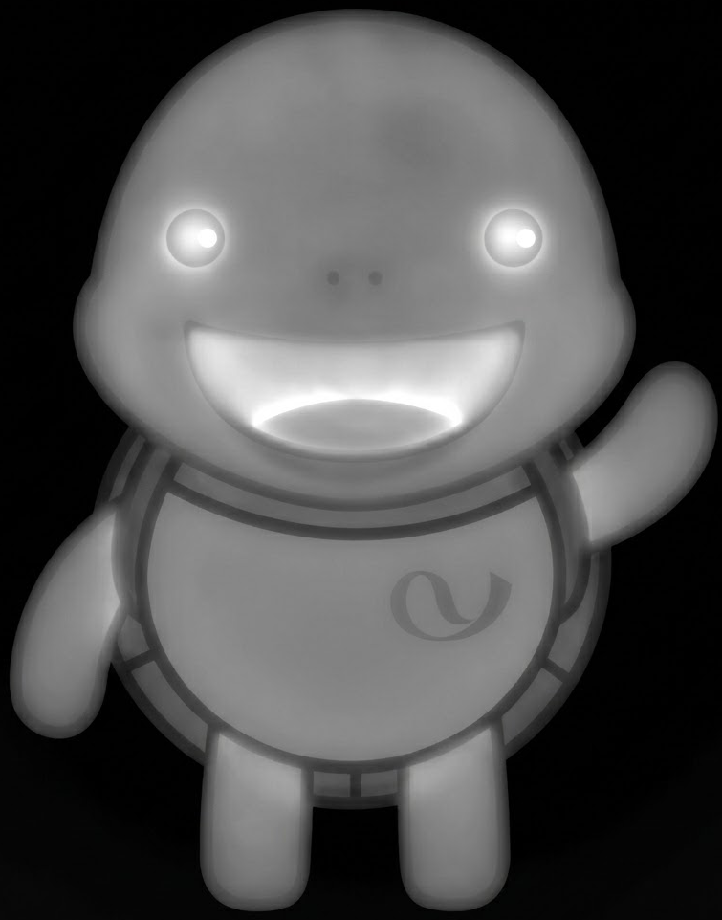

Basic Idea
Clinical signal
Imaging proxy
AI target
“Feeling of cold” during abdominal palpation
FIR thermal image of abdominal region
Pixel-level cold-region mask reproducible across subjects
abdominal
01

Slide 3
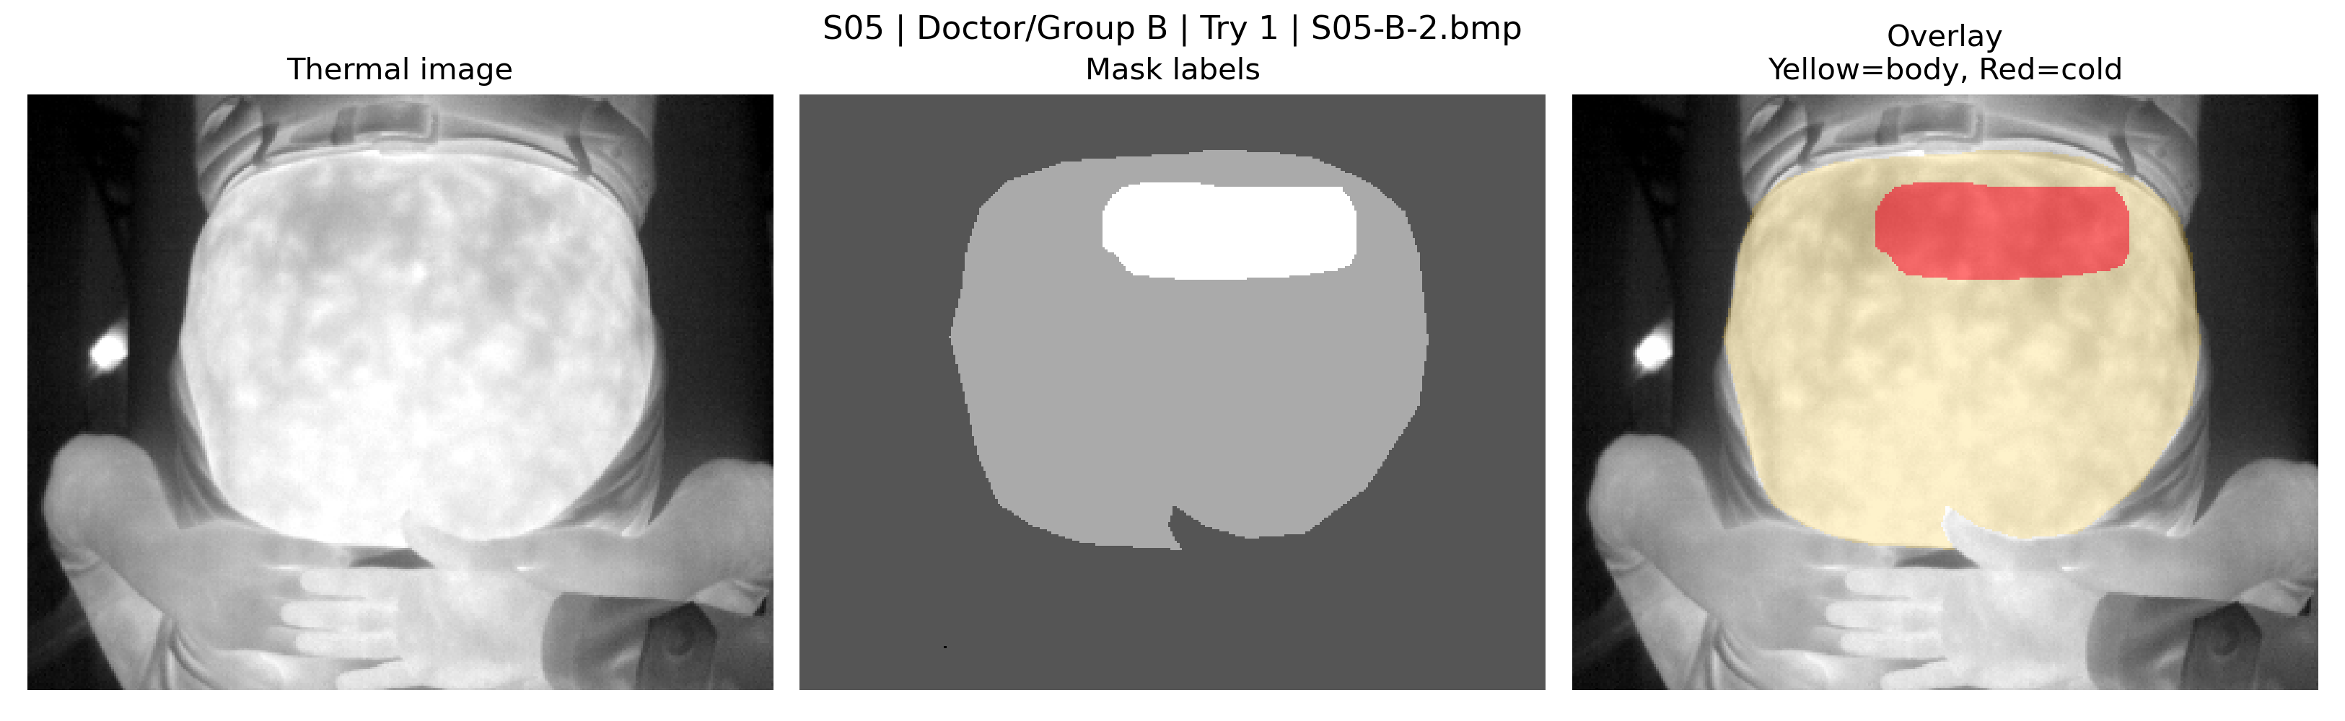
Problem statement
The target is not simply “dark pixels”; it is a clinically meaningful cold pattern.
Input
Output
Clinical
interpretation gap
FIR thermal abdomen image
Cold-region mask
matching KM doctor judgement
Core question
Can thermal-image AI reproduce palpation-informed cold-region annotation in a leakage-free, subject-independent setting?
02

Slide 4
Motivation
Why this problem matters clinically and technically.
1
2
3
4
Standardize
Quantify
Scale
Validate
Reduce practitioner-to-practitioner variability in cold-region judgement.
Turn a subjective palpation cue into a measurable thermal mask and area.
Enable repeatable screening using portable FIR cameras and AI inference.
Create evidence-based links between KM diagnosis and image biomarkers.
Project impact target
A non-contact, reproducible, AI-assisted cold-region assessment that supports KM doctors rather than replacing clinical decision-making.
03

Slide 5
Clinical meaning of “abdominal coldness”
In this project, coldness is a clinical judgement, not just a thermometer threshold.
Thermal image signal
KM palpation signal
AI target
surface temperature distribution
relative local temperature difference
spatial pattern within abdomen
presence or absence of cold sensation
pressure response during palpation
flatness, distension, and body context
cold-region mask consistent with annotation
uncertainty where doctors disagree
quantitative area and shape descriptors
What camera sees
What doctors infer
What model should learn
04

Slide 6
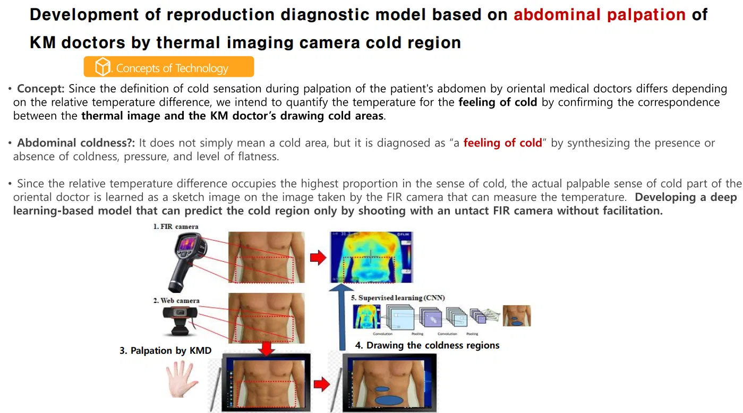
Original project workflow
Clinical annotation bridges thermal imaging and deep learning.
Known from project notes: FIR thermal imaging, visual reference capture, KM palpation, manual cold-region drawing, and CNN-based segmentation target.
05

Slide 7
Literature review I — Thermal imaging and cold/perfusion patterns
Paper titles and tiny bibliography anchors for the medical meaning of cold-region analysis.
Cold sensation CAD
Abdominal thermography review
“Convolutional neural network-based computer-aided diagnosis in Hiesho (cold sensation)”
“Abdominal Cutaneous Thermography and Perfusion Mapping after
Caesarean Section: A Scoping Review”
Wang T. et al., Computers in Biology and Medicine, 145:105411, 2022. DOI:10.1016/j.compbiomed.2022.105411
Childs C. & Soltani H., IJERPH, 17(22):8693, 2020. DOI:10.3390/ijerph17228693
Use here: thermographic patterns can support cold-sensation diagnosis, but the paper is classification/CAD
rather than pixel segmentation.
Use here: abdominal thermal maps are physiologically connected to perfusion/wound-risk interpretation,
not simple brightness thresholding.
Lower-abdomen perfusion dynamics
KM Cold–Heat biomarker
“Cutaneous Perfusion Dynamics of the Lower Abdomen in Healthy Normal Weight,
Overweight and Obese Women”
“Clinical Utility of Abdominal-Peripheral Temperature Difference Measured via Infrared
Thermography as an Objective Biomarker for Cold-Heat Pattern Identification”
Childs C. et al., IJERPH, 20(6):5100, 2023.
Kim S. et al., Korean Journal of Acupuncture, 42(3):163–172, 2025. DOI:10.14406/acu.2025.010
Use here: lower-abdomen thermal response varies by subject physiology, supporting our need for subject-wise validation.
Use here: supports abdominal/peripheral IRT temperature differences as objective KM-pattern biomarkers.
Takeaway: Use thermal literature to justify the clinical target: cold region = interpreted thermal/perfusion pattern, not merely low pixel intensity.
06

Slide 8
Literature review II — Low-data medical segmentation
Paper titles and tiny bibliography anchors for building a careful baseline before GenAI.
Classic low-data baseline
Strong baseline recipe
“U-Net: Convolutional Networks for Biomedical Image Segmentation”
“nnU-Net: a self-configuring method for deep learning-based biomedical image segmentation”
Ronneberger O., Fischer P., Brox T., MICCAI / LNCS 9351:234–241, 2015.
Isensee F. et al., Nature Methods, 18(2):203–211, 2021.
Use here: U-Net was built for precise biomedical segmentation from few annotated images using augmentation and skip
connections.
Use here: baseline strength depends on preprocessing, augmentation, validation and postprocessing—not architecture alone.
Few-shot / universal prior
GenAI for ultra-low data
“UniverSeg: Universal Medical Image Segmentation”
“Generative AI enables medical image segmentation in ultra low-data regimes”
Butoi V.I. et al., ICCV, 2023.
Zhang L. et al., Nature Communications, 2025. DOI:10.1038/s41467-025-61754-6
Use here: support-set segmentation motivates comparing pretrained/few-shot priors when task-specific masks are scarce.
Use here: GenAI augmentation is relevant only after a clean leakage-free baseline is established.
Takeaway: For 7 subjects, the first claim must be a fair LOSO baseline; advanced models are meaningful only under the same leakage-free protocol.
07

Slide 9
Literature review III — Multiple annotations and uncertainty
Paper titles and tiny bibliography anchors for using doctor disagreement correctly.
Soft consensus labels
Annotator reliability + consensus
“Using Soft Labels to Model Uncertainty in Medical Image Segmentation”
“Learning from multiple annotators for medical image segmentation”
Silva J.L. & Oliveira A.L., arXiv:2109.12622 / Brainlesion LNCS, 2021–2022.
Zhang L. et al., Pattern Recognition, 138:109400, 2023. DOI:10.1016/j.patcog.2023.109400
Use here: convert multiple annotations into probabilistic labels; uncertainty becomes supervision rather than label noise.
Use here: models expert consensus and annotator reliability when multiple noisy masks exist for the same image.
Rater-aware prompting
Ambiguity-aware semi-supervision
“Multi-rater Prompting for Ambiguous Medical Image Segmentation”
“Annotation Ambiguity Aware Semi-Supervised Medical Image Segmentation”
Wang J. et al., IEEE BIBM, 2024 / arXiv:2404.07580.
Kumari S. & Singh P., CVPR, 2025.
Use here: shows how rater identity and disagreement can be encoded without treating all hard masks as independent truth.
Use here: supports the idea that ambiguous expert labels can generate diverse plausible masks, especially in low-label regimes.
Takeaway: If 12 annotations exist for one FIR image, group them into a soft consensus and uncertainty map instead of training 12 contradictory hard labels.
KM abdominal cold-region segmentation • literature framing
08

Slide 10
Dataset Description
The next task is a dataset audit, because current metadata is incomplete.
Subject | Avg body pixels | Avg cold pixels | Comment
S05 | 29464 | 1323 | large body, moderate cold
S06 | 15443 | 1402 | one extreme cold outlier
S07 | 16550 | 1561 | large variation
S08 | 16078 | 417 | small cold, one empty mask
S09 | 13150 | 334 | small cold
S10 | 9319 | 260 | very small cold
S11 | 13192 | 2032 | large cold
Patients / subjects : 7 subjects
Doctors: 4 KM doctors
Annotation repeats: : 3 tries per doctor
Image type: FIR thermal abdomen image, grayscale
Target label: Doctor-marked cold-region mask
Important actual data problems:
56 cases have image-mask shape mismatch
1 case has empty body and empty cold
1 case has extremely large cold fraction
very tiny cold cases exist
09

Slide 11
Dataset audit: required before further modeling
We need to determine exactly what one training sample means.
1
File inventory
4
Duplicate image check
Count FIR images, masks, naming patterns, dimensions, label values.
Detect identical or near-identical thermal images across annotations.
2
Pairing verification
5
Agreement analysis
Confirm image-mask alignment and whether masks map to identical image captures.
Compute doctor/try variability, soft consensus, and uncertainty maps.
3
Identity structure
6
QC flags
Extract patient, case, doctor, try, and capture/session identifiers.
Find empty masks, abnormal labels, tiny/huge cold masks, body/cold mismatch.
Audit outputs
CSV tables + visualization grids: file inventory, pairing check, duplicate check, label statistics, agreement maps, problem-case list.
10

Slide 12
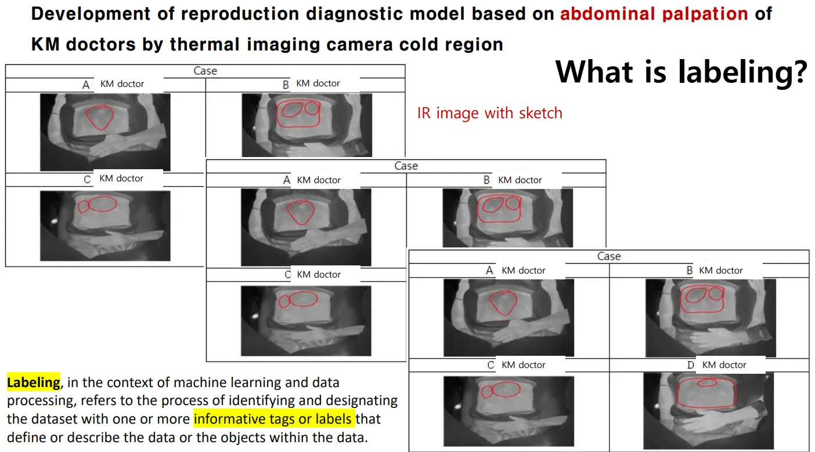
Dataset focus: annotation variability
Multiple doctors and repeated annotations may encode clinical uncertainty.
What to measure
within-doctor repeat consistency
between-doctor agreement
common cold core vs uncertain boundary
whether annotations use same thermal image or repeated captures
whether large disagreements follow patient/session pattern
Decision rule after audit
If 12 masks belong to one image: build soft consensus and uncertainty; if they are separate captures: keep capture-level grouping.
11

Slide 13
Method gate: when to start experiments
The method should be selected only after the dataset structure is clear.
1
Audit complete
Image-mask pairs, duplicates, labels, and subject/case/doctor/try IDs verified.
2
Annotation mode chosen
Single GT, soft 12-mask consensus, doctor-specific model, or uncertainty-aware training.
3
Evaluation protocol fixed
LOSO is mandatory: no subject overlap, threshold chosen only on validation subject.
4
Baseline clean
Hierarchical body+cold baseline reruns reproducibly with all CSVs and failure tables.
5
Advanced methods
Only then compare transfer learning, MedSAM-style priors, diffusion/GAN augmentation.
12

Slide 14
Current presentation boundary
Methods and results will be added after the dataset audit.
This deck covers now
To add later
Problem statement and visualization
Clinical motivation and expected value
Literature framing for thermal imaging, low-data segmentation, and multi-rater labels
Dataset audit questions and required outputs
Dataset audit findings with actual tables and visualization grids
Clean LOSO baseline design and metrics
Failure analysis subject-by-subject and image-by-image
Controlled experiments: transfer learning, MedSAM/GenAI augmentation, uncertainty model
Core message
The project is promising, but the dataset must be understood before we can make a defensible modeling claim.
13

Slide 15
Key references for this section
Short literature anchors used in the presentation draft.
1.
Wang et al. (2022). Convolutional neural network-based computer-aided diagnosis in Hiesho (cold sensation). Computer Methods and Programs in Biomedicine.
2.
Childs et al. (2020). Abdominal Cutaneous Thermography and Perfusion Mapping after Caesarean Section: A Scoping Review. IJERPH.
3.
Childs et al. (2023). Cutaneous Perfusion Dynamics of the Lower Abdomen in Healthy Volunteers. IJERPH.
4.
Ronneberger et al. (2015). U-Net: Convolutional Networks for Biomedical Image Segmentation. MICCAI.
5.
Silva & Oliveira (2021). Using Soft Labels to Model Uncertainty in Medical Image Segmentation.
6.
Zhang et al. (2023). A Soft Label Method for Medical Image Segmentation / multi-rater soft-label modeling.
Project source note: user-provided PROJECT_EXPLANATION.md and project visual materials were used for the clinical workflow and dataset framing.
14

