Slide 1
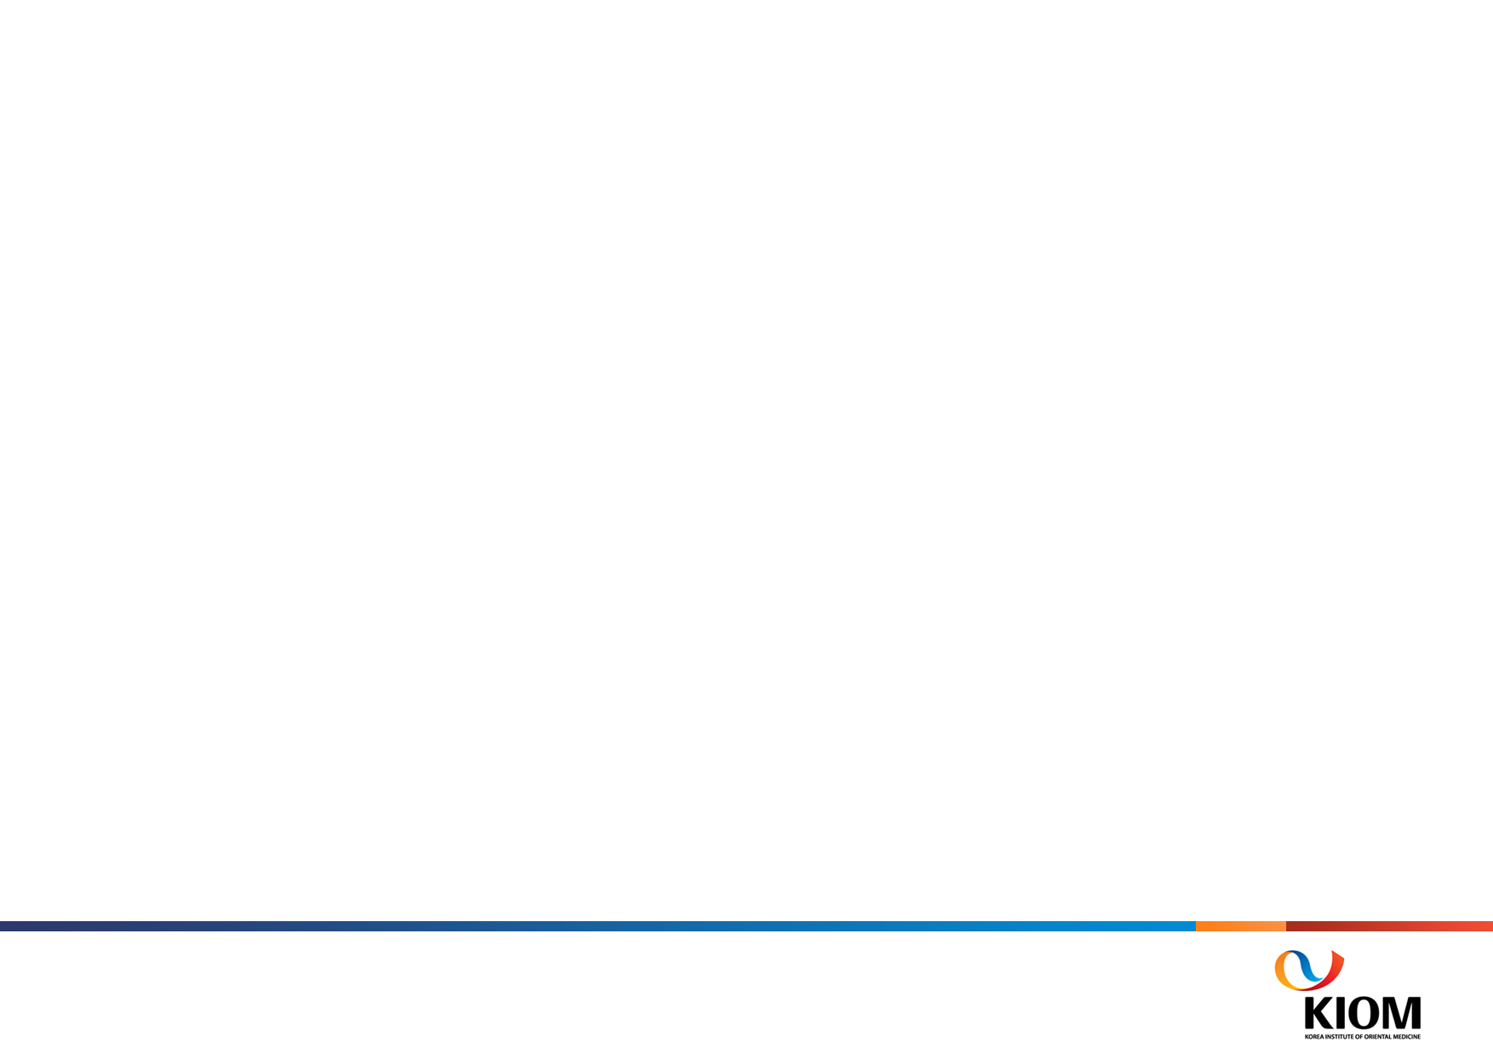

Applying Various Processing Methods with FFT
Compare 3 types of FFTs
FFT + Sliding Window Approach
Rafsan Jany
Korean Convergence Medical Science

Slide 2
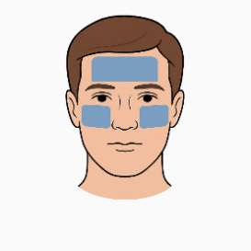
Experiment Paths For FFT
Sub 1
Sub 2
Sub 3
Sub 4
Sub 5
Sub 46
Sub 47
Sub 48
Sub 49
Mean RGB
Extraction
All ROI
1. CHROM Signal 2. CHROM++ Signal 3. CHROM, POS, LGI 4. Eulerian Amplified 5. ICA Component 1 6. ICA Component 2
7. ICA Component 3 8. ICA1 + ICA2 + ICA3 9. ICA1+ICA2 10. ICA1+ICA3 11. ICA2+ICA3 12. Kalman Green 13. Kalman POS
14. Kalman POS + Kalman Green 15. LGI Signal 16. MotionComp CHROM 17. PBV Signal 18. PCA Component 1 19. PCA Component 2 20. PCA Component 3 21. PCA1 + PCA2 + PCA3 22. PCA1+PCA2 23. PCA1+PCA3 24. PCA2+PCA3 25. POS Signal
26. POS++ + Wavelet POS + POS++ Adaptive 27. POS++ Signal 28. Wavelet POS
FFT
Multi-Harmonic FFT
Welch FFT
Normal HR
Z Scored Based HR
Threshold based HR

Slide 3
Variation of FFT
Feature / Method | Normal FFT | Welch FFT | Multi-Harmonic FFT
Main Purpose | Raw frequency decomposition | Smooth PSD estimation | Robust HR estimation using harmonics
How It Works | Single FFT over full signal | Averaged FFTs of overlapping segments | Combines energy at fundamental & harmonics
Variance (Noise) | High | Low | Medium–Low (uses structure)
Frequency Resolution | High (if signal is long) | Lower (due to short segments) | Medium–High
Robust to Noise | No | Yes | Yes
Uses Harmonics | No | No | Yes
Best For | Clean, stationary signals | Noisy or non-stationary signals | Non-sinusoidal signals (e.g., rPPG)
Output | Frequency spectrum | Power Spectral Density (PSD) | Weighted harmonic-based HR score
Complexity | Low | Medium | Medium–High

Slide 4
Results For FFT
Top 5 Frequency-Domain Setups by GT-HR Diff:
Signal Channel Frequency Method Mean Abs Error
ICA1 + ICA2 + ICA3 Welch 14.731844
ICA1+ICA2 Welch 15.031063
PCA Component 3 Welch 15.714656
Kalman Green Welch 16.689656
ICA Component 1 FFT 19.235750

Slide 5
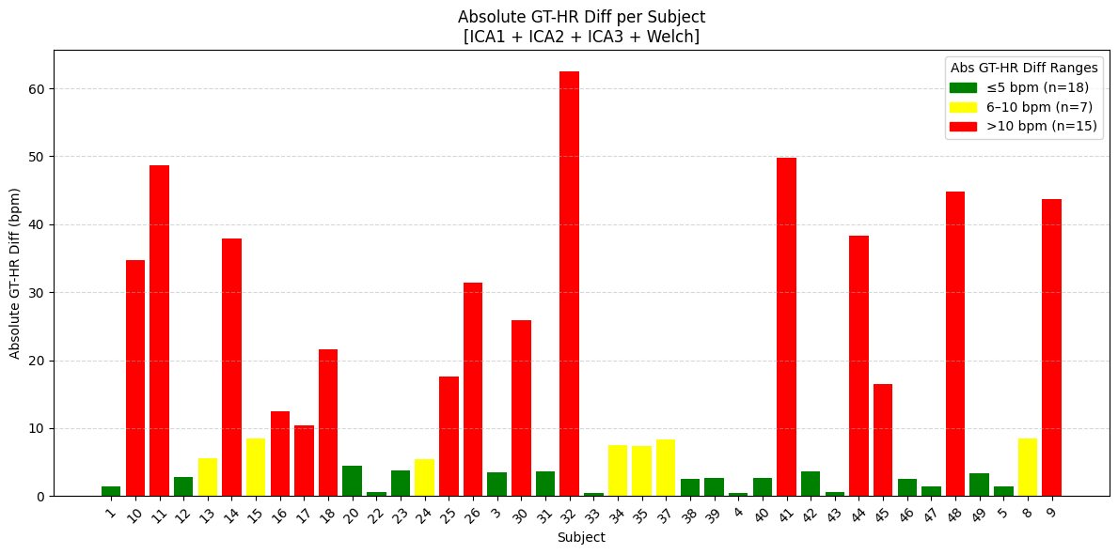
Results For FFT

Slide 6
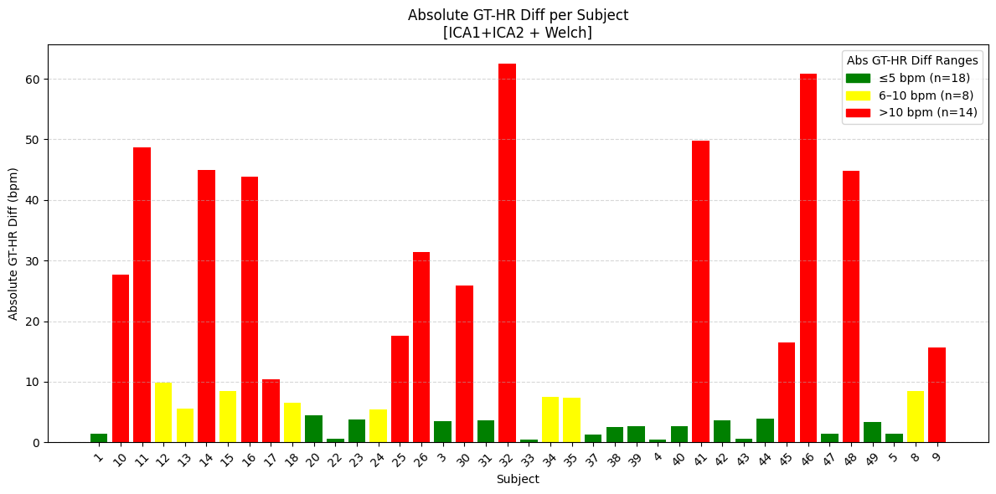
Results For FFT

Slide 7
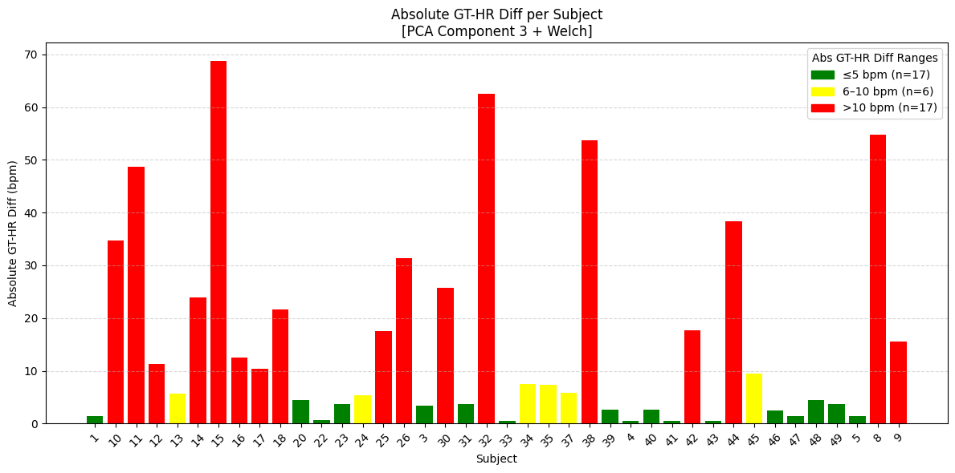
Results For FFT

Slide 8
Experiment Paths For FFT with 2 & 8 sec sliding Window
Sub 1
Sub 2
Sub 3
Sub 4
Sub 5
Sub 46
Sub 47
Sub 48
Sub 49
CHROM, POS
Mean RGB
Extraction
All ROI
8 Sec Sliding Window For
Full Length Video
2 Sec Sliding Window For
300 Frames
Welch FFT
Welch FFT
Threshold based HR
Threshold based HR

Slide 9
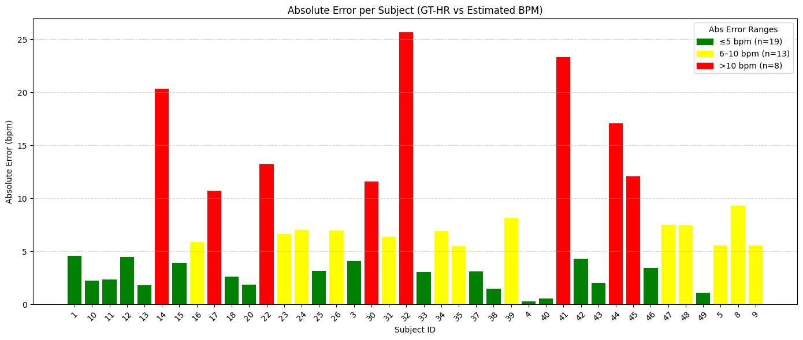
Results For FFT CHROM
Top 2 sec Window For 10 sec Video
MAE (Mean Absolute Error): 6.38 bpm
RMSE (Root Mean Square Error): 8.73 bpm
Mean Error: +0.54 bpm (on average, predicted HR is slightly lower than GT)

Slide 10
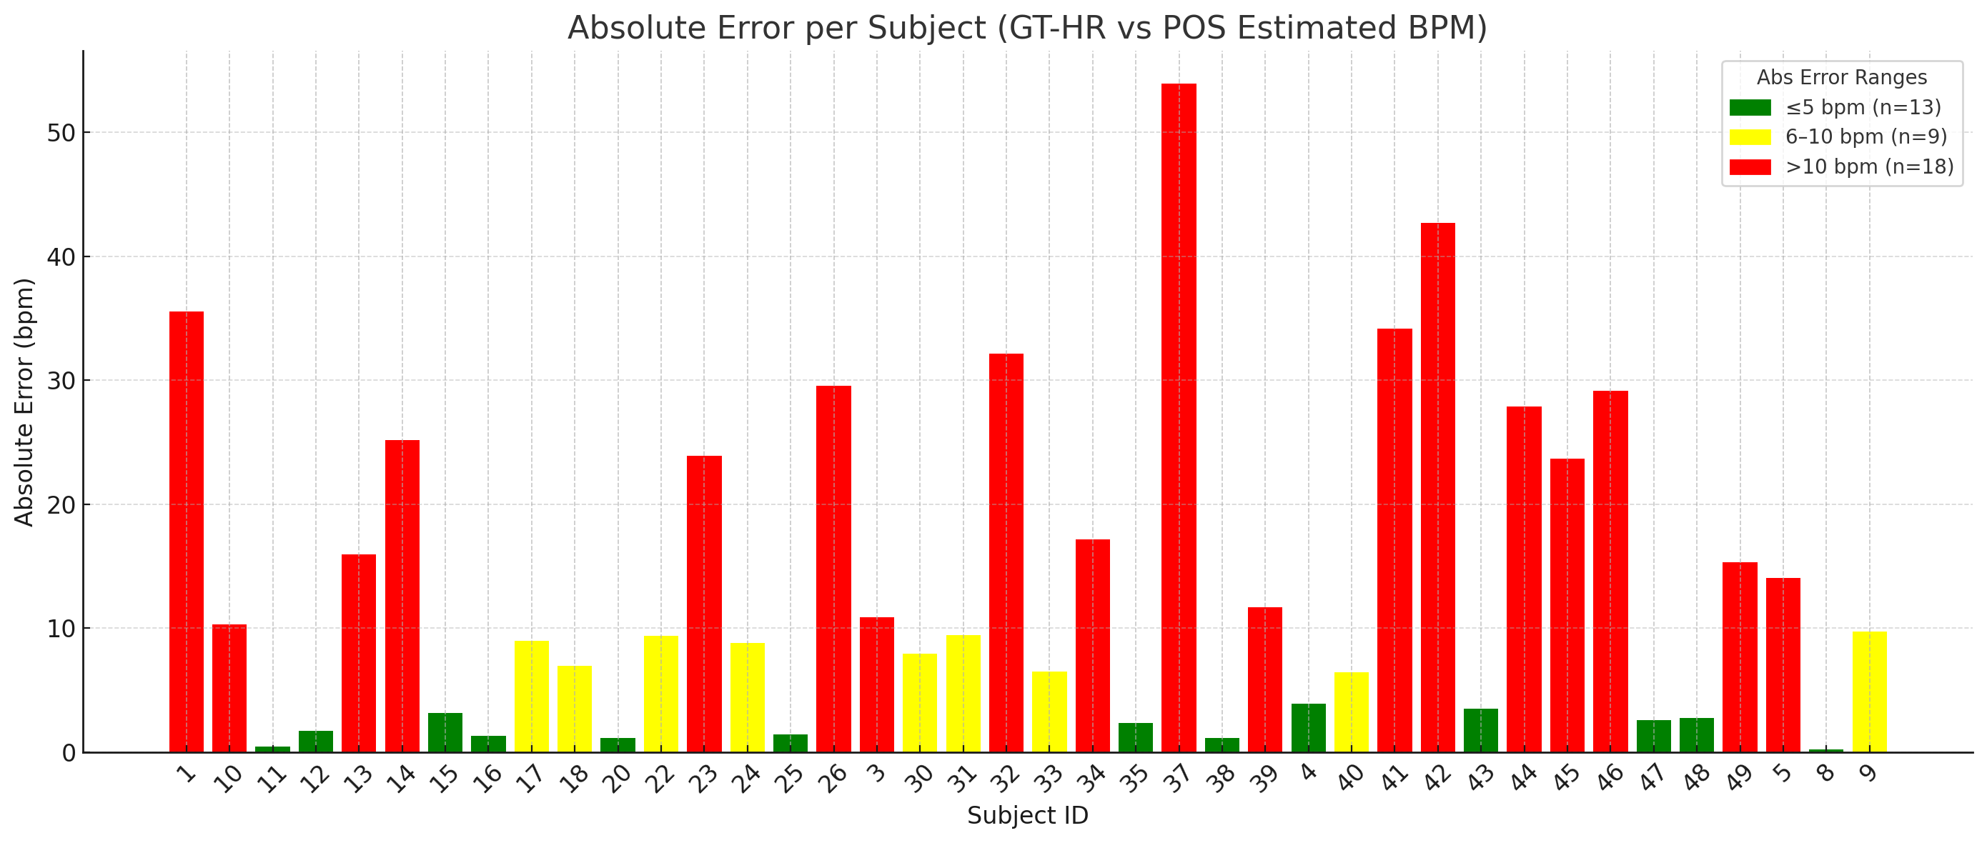
Results For FFT POS
Top 2 sec Window For 10 sec Video
MAE (Mean Absolute Error): 13.81 bpm
RMSE (Root Mean Square Error): 19.03 bpm
Mean Error: -2.02 bpm (POS tends to overestimate HR slightly)

Slide 11
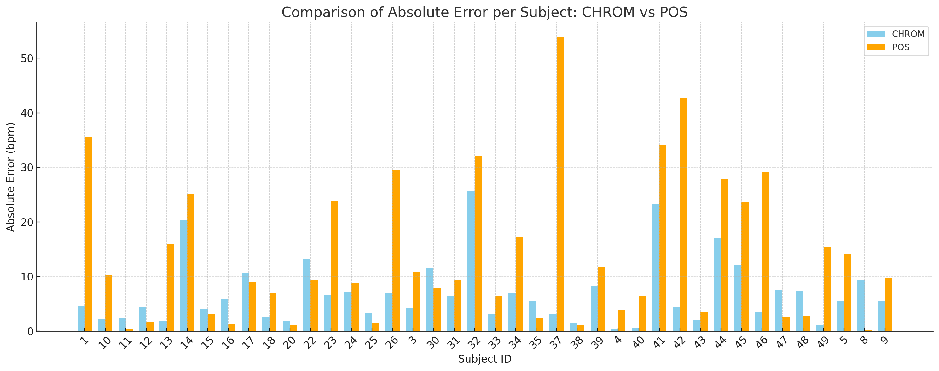
Results For FFT POS vs CHROM

Slide 12
Results For CHROM 8 Sec Full Length
Top 8 sec Window For Full Video
MAE (Mean Absolute Error): 1.82 bpm
RMSE (Root Mean Square Error): 3.45 bpm

Slide 13
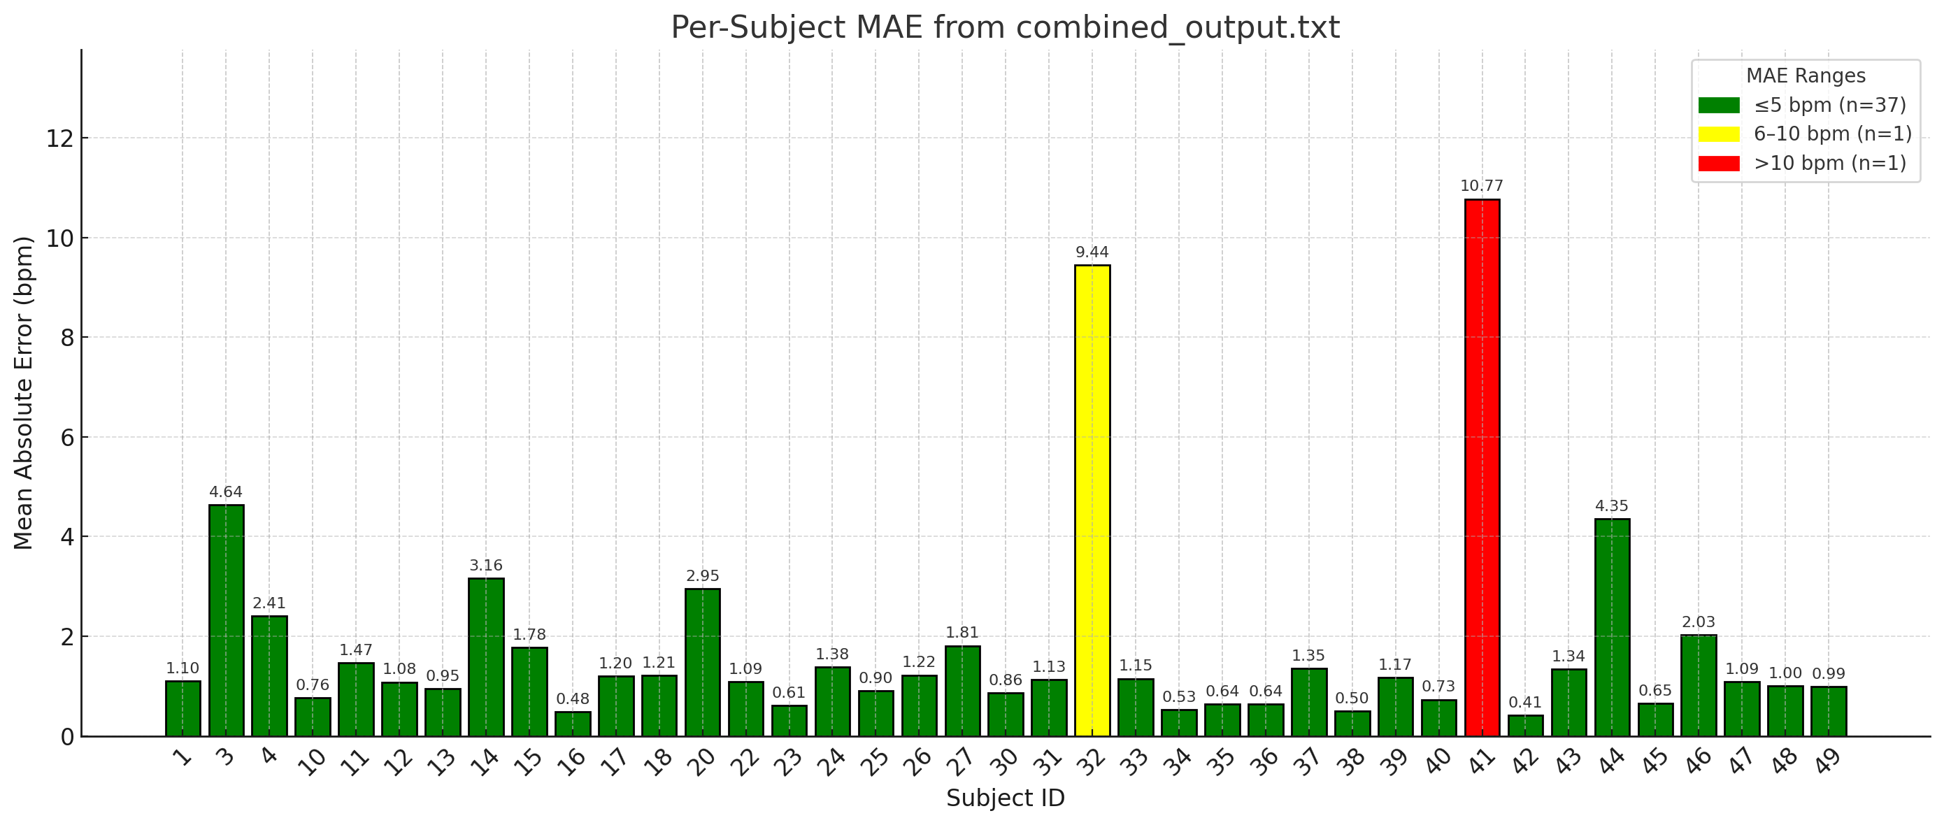
Results For CHROM 8 Sec Full Length
Top 8 sec Window For Full Video
MAE (Mean Absolute Error): 1.82 bpm
RMSE (Root Mean Square Error): 3.45 bpm

Slide 14
More Experiment Paths For FFT with Sliding Window
Sub 1
Sub 2
Sub 3
Sub 4
Sub 5
Sub 46
Sub 47
Sub 48
Sub 49
Other Signal Channels
Mean RGB
Extraction
All ROI
8 Sec Sliding Window For
Full Length Video
2/3 Sec Sliding Window
For
300 Frames
Welch FFT
Welch FFT
Threshold based HR
Threshold based HR

Slide 15
More Experiment Paths
Sub 1
Sub 2
Sub 3
Sub 4
Sub 5
Sub 46
Sub 47
Sub 48
Sub 49
CHROM, POS, LGI
ICA1+ICA2
Kalman POS + Kalman Green
LGI Signal
PCA1+PCA3
PCA2+PCA3
Mean RGB
Extraction
Eulerian
Amplified
ICA1+ICA2
PBV
Signal
POS++ + Wavelet POS + POS++ Adaptive
PCA1 + PCA2 + PCA3
All ROI
ICA1 + ICA2 + ICA3
ICA2+ICA3
PCA1+PCA2
5 Peak Detection Methods
Median
Heuristic Approaches
Normal HR
Z Scored Based HR
Threshold based HR

