Slide 1


Referenced Based Implementation And Evaluation
FFT Based HR Calculation and Evaluation Through pyVHR
Peak Ditection Algorithm Tunning Based on GT BVP
Rafsan Jany
Korean Convergence Medical Science

Slide 2

Dissecting pyVHR Library
Ground Truth
Line 0: [values of the BVP signal]
Line 1: [values of instantaneous HR] ← (not used)
Line 2: [timestamps for each frame]
BVP Signal
STFT (winsize sec)
Mean RGB
Extraction
CHROM
Max PSD in [0.65–4.0Hz]
BVP Signal
Convex Hull
The Convex-hull extractor considers the skin region as the convex-hull of a set of the 468 facial fiducial points delivered by the MediaPipe face mesh
(Lugaresi et al., 2019).
Welch FFT (winsize sec)
BPM Estimated
Using Mean
BPM Estimated
Using Median
BPM Ground
Truth
Using Mean
BPM Ground
Truth
Using Median
MAE
BPM
MAE
BPM

Slide 3
Why STFT And Welch?
Purpose: Convert the entire continuous ground truth BVP signal into a time-resolved BPM Track [1,2]
Why STFT?
STFT allows tracking how frequency content evolves over time
Each BPM estimate corresponds to a short window (8 sec) with 1 sec stride (default)
It's suitable when the goal is to generate a BPM time series, not just one global value
Purpose: Compute dominant frequency in each estimated BVP window [1,3]
Why Welch?
Welch gives a smooth, low-variance estimate of the power spectral density (PSD)
It is typically used when signal is assumed quasi-stationary within a window
pyVHR runs this on each BVP block extracted by rPPG → typically 8-second segments
Use Case | Method Used | Purpose
GT BPM | STFT | Best for time-localized frequency tracking (sliding BPM over time)
Estimated BPM | Welch | Find the dominant heart rate in each short window
[1] Boccignone G, Conte D, Cuculo V, D'Amelio A, Grossi G, Lanzarotti R, Mortara E. pyVHR: a Python framework for remote photoplethysmography.
PeerJ Comput Sci. 2022 Apr 15;8:e929. doi: 10.7717/peerj-cs.929. PMID: 35494872; PMCID: PMC9044207.
[2] Ming-Zher Poh, Daniel J. McDuff, and Rosalind W. Picard, "Non-contact, automated cardiac pulse measurements using video imaging and blind source separation.,
" Opt. Express 18, 10762-10774 (2010)
[3] F. Peng, X. -w. Zhu and M. Long, "An ROI Privacy Protection Scheme for H.264 Video Based on FMO and Chaos," in IEEE Transactions on Information Forensics and Security,
vol. 8, no. 10, pp. 1688-1699, Oct. 2013, doi: 10.1109/TIFS.2013.2259819

Slide 4
pyVHR Challenges
Availability:
GPU Supported Version works For Linux Based OS Currently.[4]
- Tried Using Chat GPT To Fix the Issue:
CPU Supported Version Has Some Dependencies Issues For cusignal [4].
Changes Required Inside pyVHR Library:
- Disable cupy Usage
- Edit sig_processing.py
- Remove cusignal Dependency
that confirms cusignal cannot be installed via pip on your system (as expected). It’s only officially available through NVIDIA’s RAPIDS conda channels and requires a full CUDA + Linux/WSL2 setup.
[4] https://github.com/rapidsai/cusignal

Slide 5
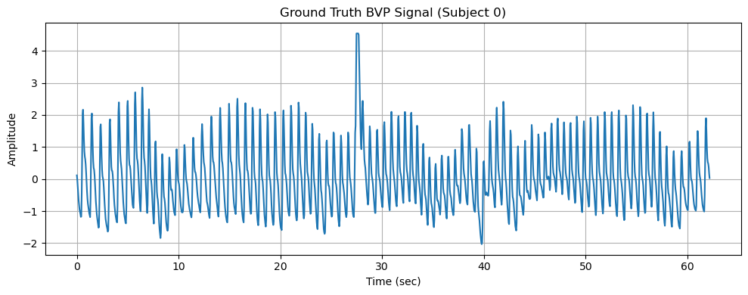
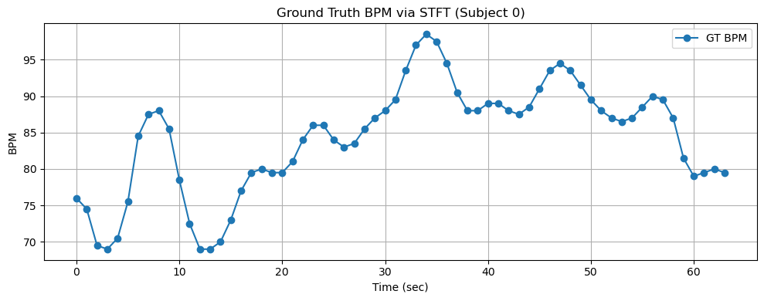
Ground Truth BVP Signal

Slide 6
Sliding Window Mechanism Used rPPG
Parameter | Value
Video length | 10 seconds
Frame rate | 30 FPS
Total frames | 300
Window size | 3 seconds = 90 frames
Stride | 1 second = 30 frames
Overlap | 2 seconds = 60 frames
Window | Start Time | Start Frame | End Time | End Frame
1 | 0s | 0 | 3s | 89
2 | 1s | 30 | 4s | 119
3 | 2s | 60 | 5s | 149
4 | 3s | 90 | 6s | 179
5 | 4s | 120 | 7s | 209
6 | 5s | 150 | 8s | 239
7 | 6s | 180 | 9s | 269
8 | 7s | 210 | 10s | 299
Frame Index (0 to 299):
Fmares:
Window 1: [0 ............................................. 89]
Window 2: [30 ..............................................119]
Window 3: [60 ..............................................149]
Window 4: [90 ..............................................179]
Window 5: [120 ............................................209]
Window 6: [150 ............................................239]
Window 7: [180 ............................................269]
Window 8: [210 ............................................299]
Frame Index (0 to 299):
Duration
Window 1: [0 .. 3 ]
Window 2: [1 .. 4]
Window 3: [2 .. 5]
Window 4: [3 .. 6]
Window 5: [4 .. 7]
Window 6: [5 .. 8]
Window 7: [6 .. 9]
Window 8: [7 .. 10]

Slide 7
Sliding Window Mechanism Used rPPG
Parameter | Value
Video length | 10 seconds
Frame rate | 30 FPS
Total frames | 300
Window size | 8 seconds = 240 frames
Stride | 1 second = 30 frames
Overlap | 7 seconds = 210 frames
Window | Start Time | Start Frame | End Time | End Frame
1 | 0s | 0 | 8s | 239
2 | 1s | 30 | 9s | 269
3 | 2s | 60 | 10s | 299
Frame Index (0 to 299):
Fmares:
Window 1: [0 ............................................. 239]
Window 2: [30 ..............................................269]
Window 3: [60 ..............................................299]
Frame Index (0 to 299):
Duration
Window 1: [0 .. 8 ]
Window 2: [1 .. 9]
Window 3: [2 .. 10]

Slide 8
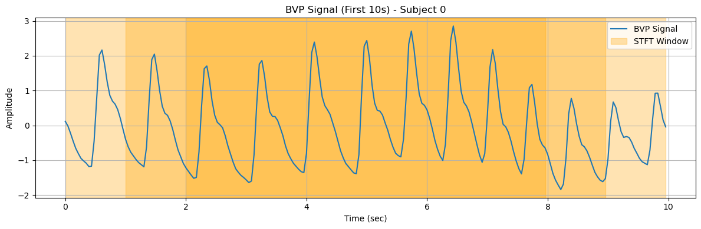
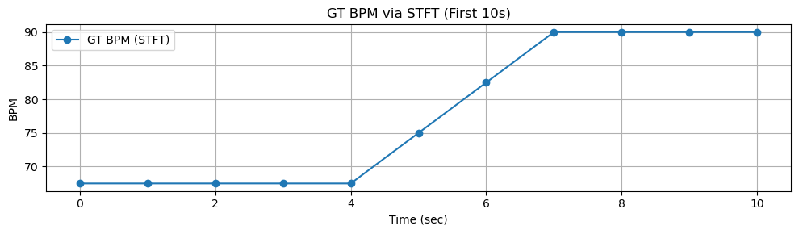
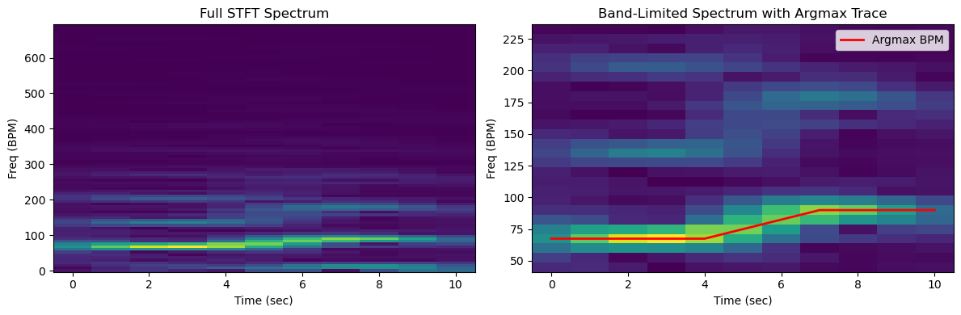
Ground Truth BVP Signal First 10 Sec

Slide 9
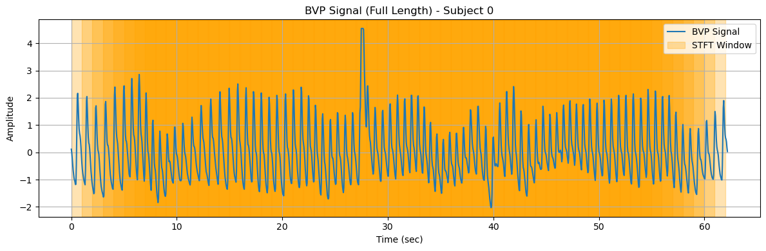
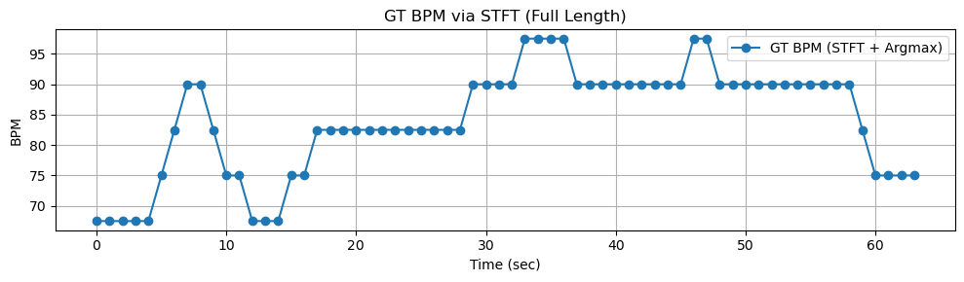
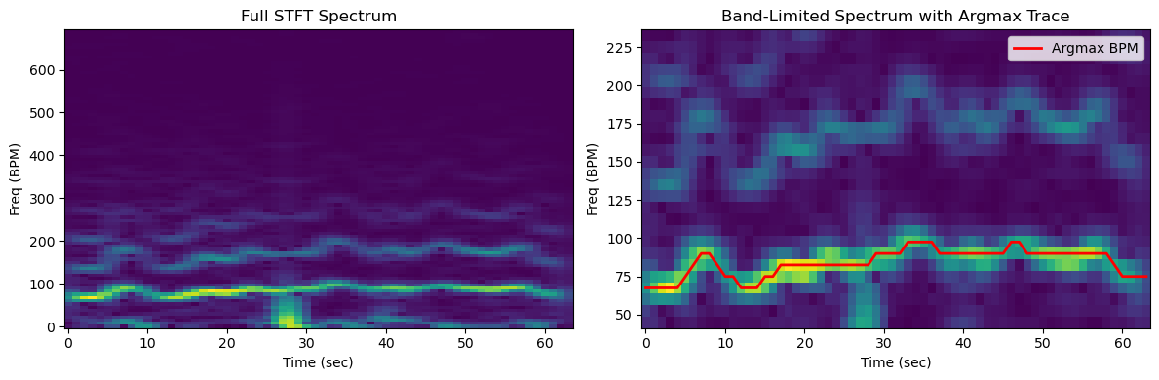
Ground Truth BVP Signal Full Length

Slide 10
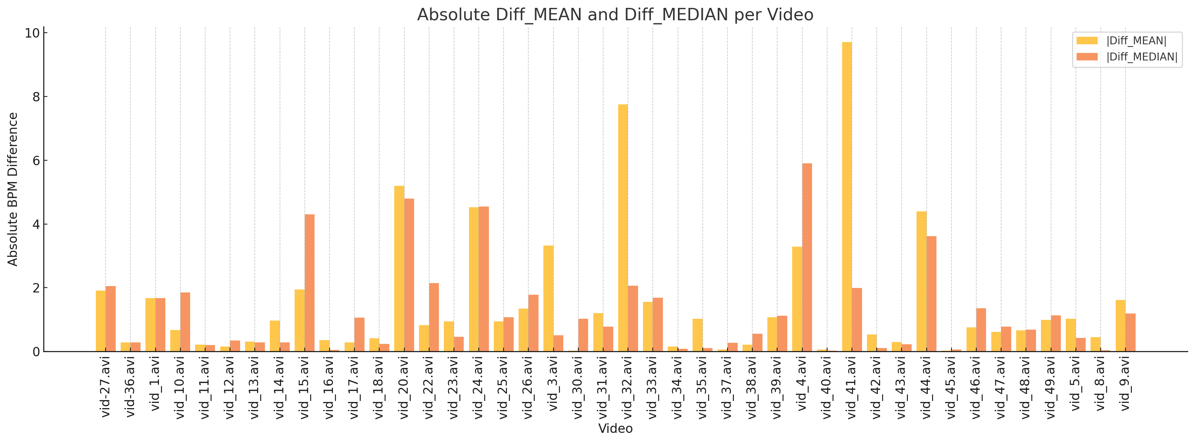
Applying Solved Workflow of pyVHR on UBFC
MAE Using MEAN : 1.518333 BPM
MAE Using MEDIAN: 1.265714 BPM

Slide 11
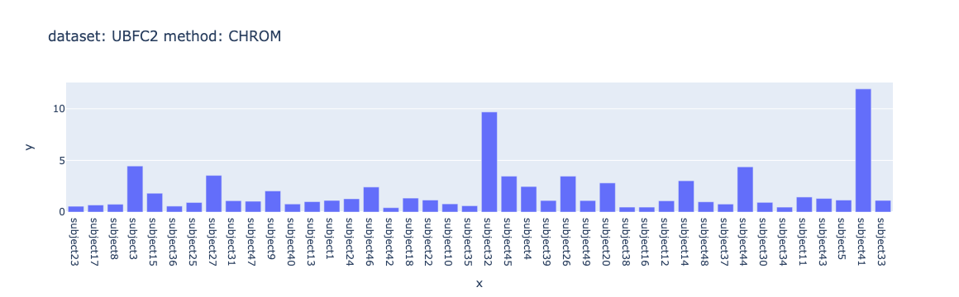
From pyVHR Repository On UBFC
MEANS STD MEDIANS
MAE 5.27 12.99 1.88

Slide 12
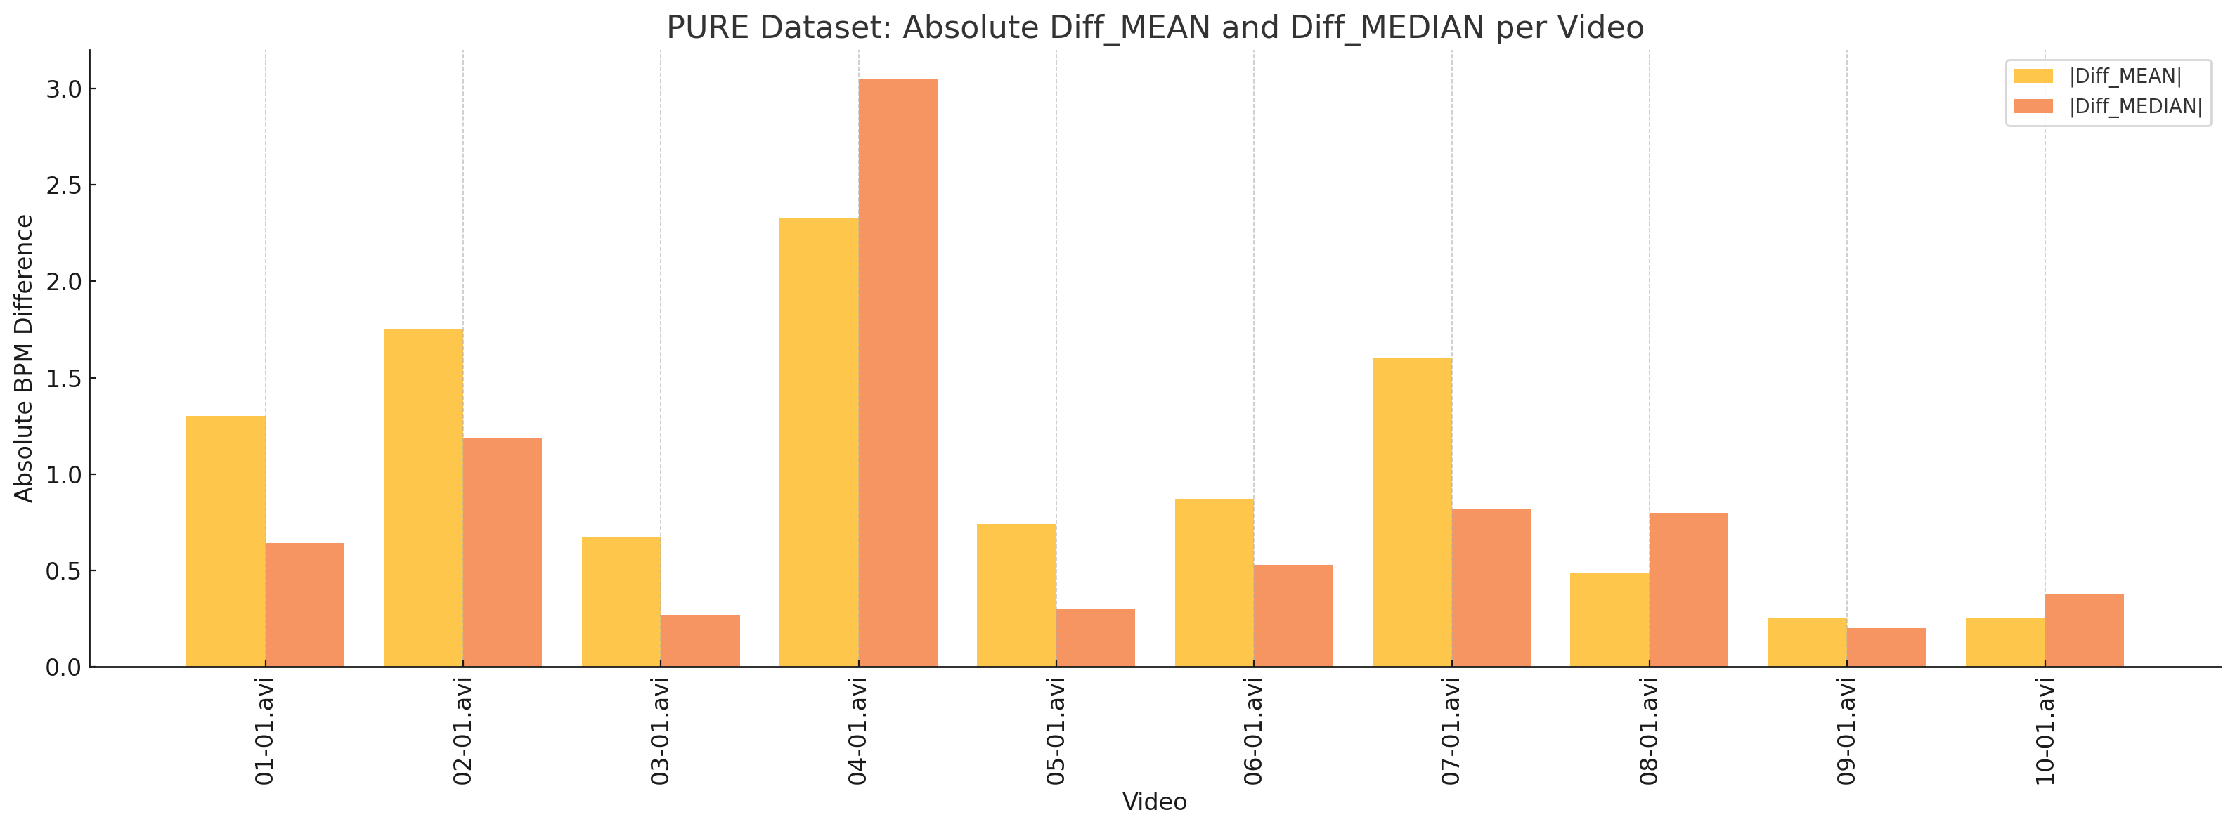
Applying Solved Workflow of pyVHR on PURE(steady)
MAE Using MEAN : 1.024 BPM
MAE Using MEDIAN: 0.817 BPM

Slide 13
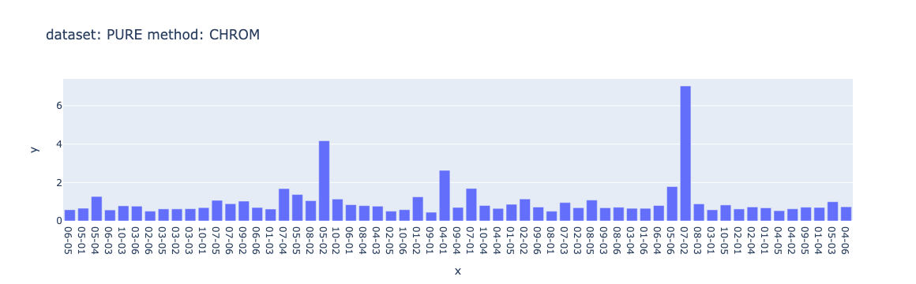
From pyVHR Repository On PURE(steady)
MEANS STD MEDIANS
MAE 7.37 9.75 2.24

Slide 14
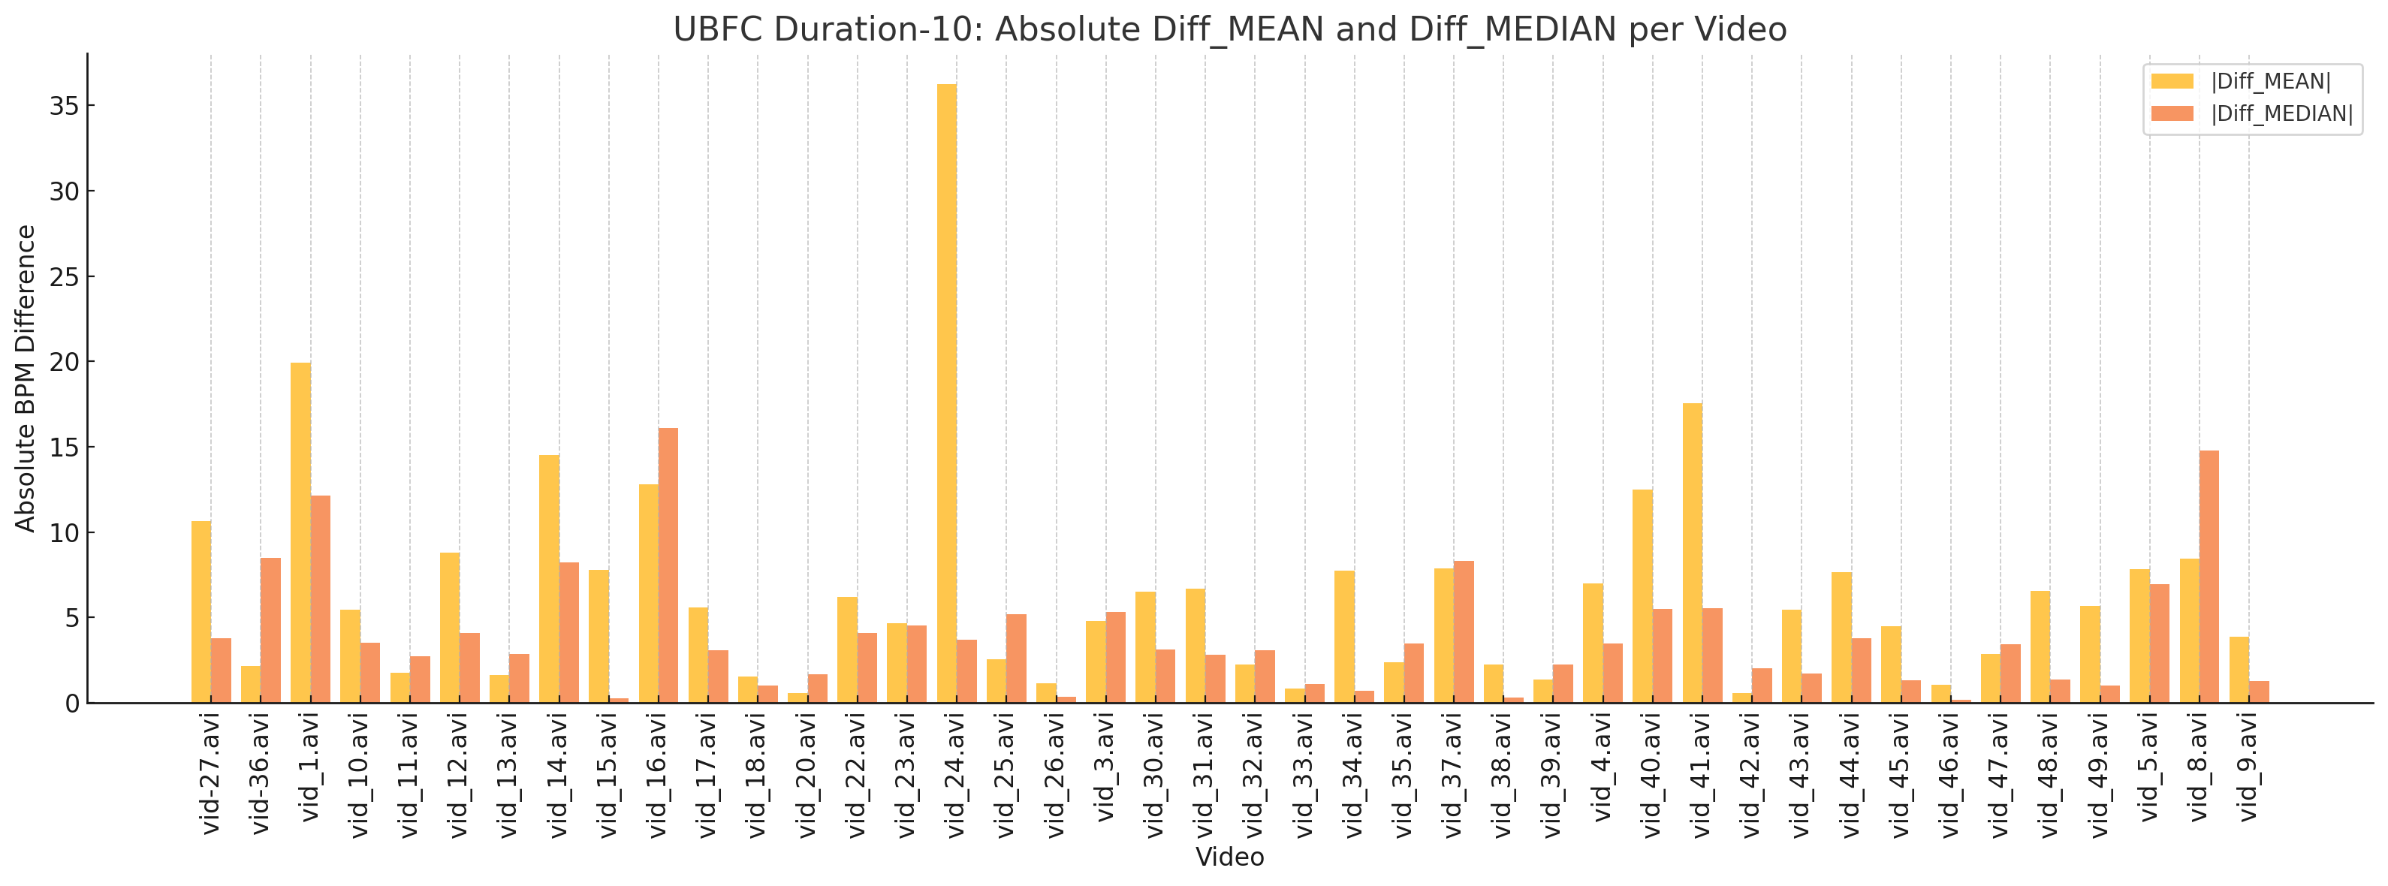
UBFC For window Size: 3 sec For 10 sec long
MAE Using MEAN : 6.62 BPM
MAE Using MEDIAN: 4.0277 BPM

Slide 15
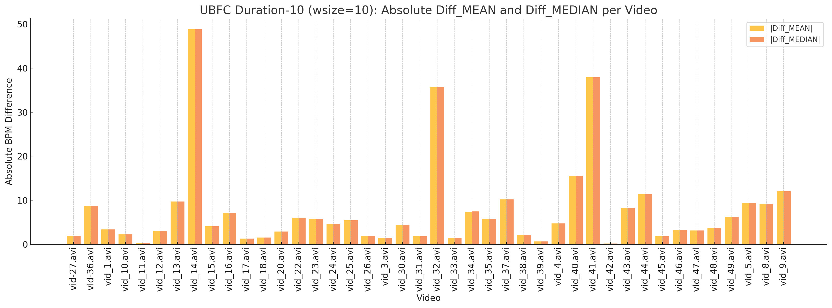
UBFC For window Size: 10 sec For 10 sec long
Average MAE Using MEAN : 7.54 BPM
Average MAE Using MEDIAN: 7.54 BPM

Slide 16
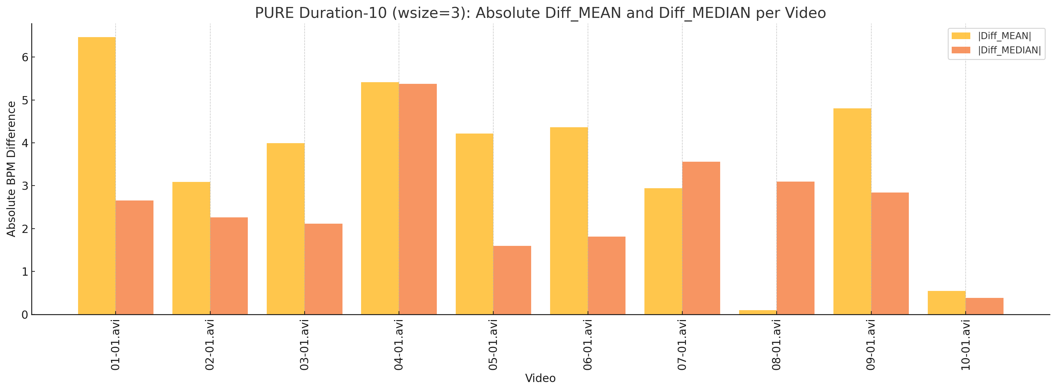
PURE For window Size: 3 sec For 10 sec long
Average MAE Using MEAN : 3.59 BPM
Average MAE Using MEDIAN: 2.56 BPM

Slide 17
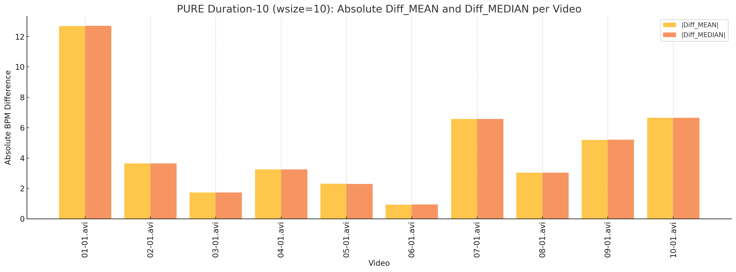
PURE For window Size: 10 sec For 10 sec long
Average MAE Using MEAN : 4.60 BPM
Average MAE Using MEDIAN: 4.60 BPM

Slide 18
pyVHR Peak Detection Hybrid Experiment
pyVHR Framework
Ground Truth
Line 0: [values of the BVP signal]
Line 1: [values of instantaneous HR] ← (not used)
Line 2: [timestamps for each frame]
Mean RGB
Extraction
CHROM
BVP Signal
BVP Signal
Peak Detection
Peak-to-Peak Interval
BPM Calculation
scipy_find_peaks
Tunned
ampd
BPM Estimated
Using Median/Mean
BPM Ground Truth
Using Median/Mean
Peak Detection Experiments
Turning
MAE
BPM
17

Slide 19
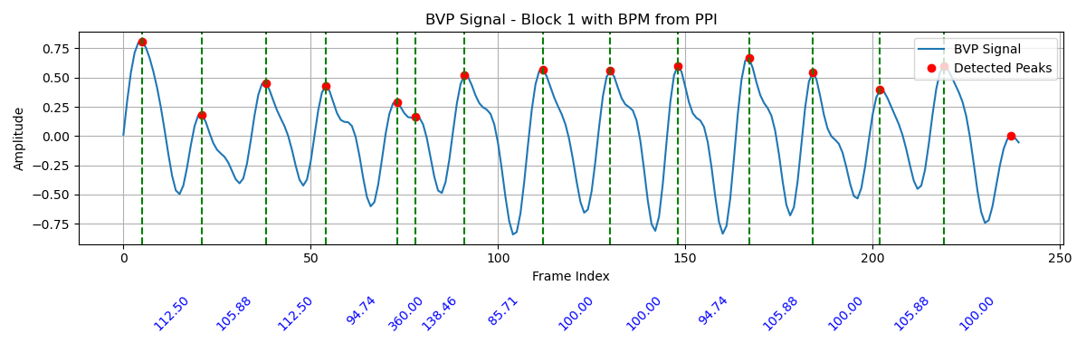
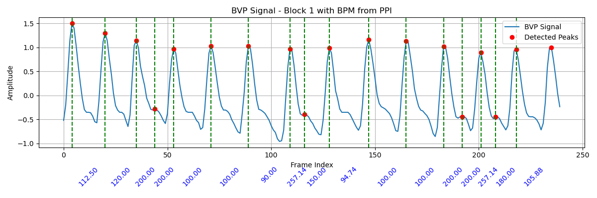
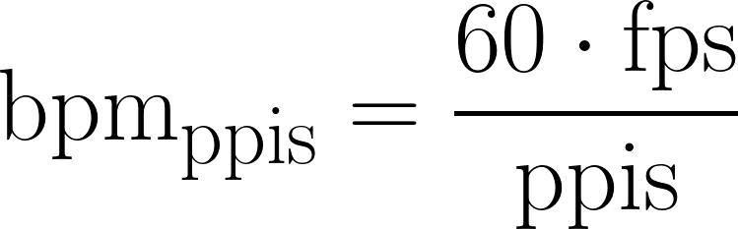
PPI BPM Calculation Algorithm
Input BVP
Peak Detection
scipy_find_peaks
Tunned
ampd
Peaks
Calculate Peak-to-Peak Intervals (PPIs)
Median BPM across PPIs
Median BPM for the block
Mean BPM across PPIs
Mean BPM for the block
[4] Poh, M.-Z., et al. (2010). "Monitoring of Heart Rate Variability from a Video Using Remote Photoplethysmography.
" IEEE Transactions on Biomedical Engineering.
[5] Khan, U., et al. (2015). "Remote Photoplethysmography Using a Low-Cost Camera for Heart Rate Measurement.“
IEEE Transactions on Biomedical Engineering.
18

Slide 20
Default Peak Algo Result: GT_BVP vs CHROM_BVP [Sub 36]
MAE Using MEAN : 68.90 BPM
MAE Using MEDIAN: 23.62 BPM
19

Slide 21
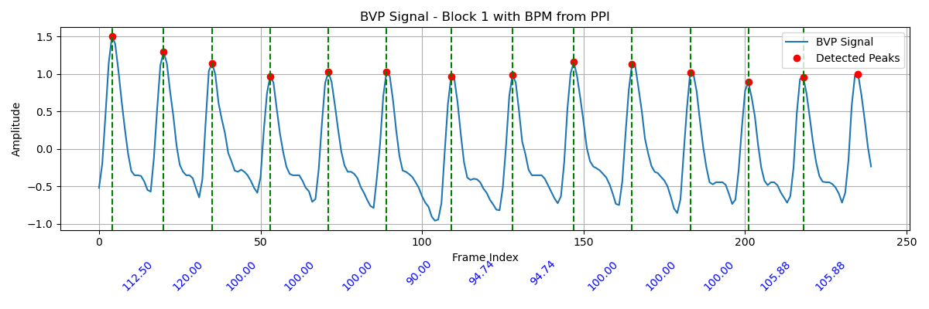
Peak Detection Algorithm Tunning -> Ground Truth BVP [Sub 36]
SciPy peak find
peak setup:
Distance:– Default,
Prominence:-Default
SciPy peak find
peak setup:
Distance:– 10,
Prominence:- 0.5
20

Slide 22
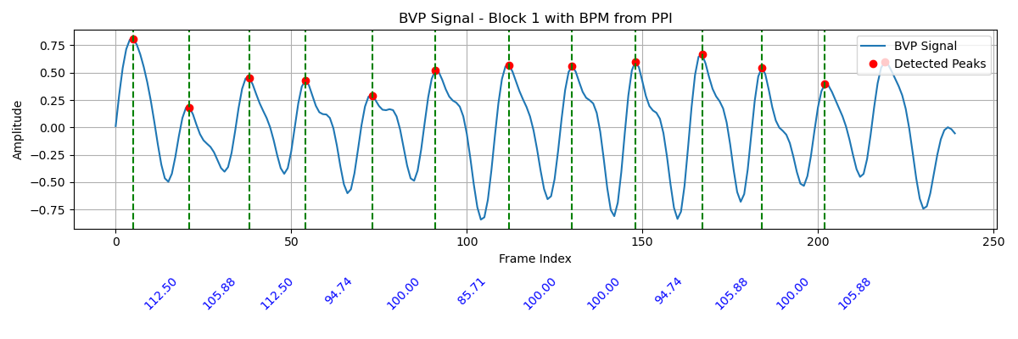
Peak Detection Algorithm Tunning -> CHROM BVP [Sub 36]
Scipy peak find
peak setup:
Distnce:– Dfault,
Prominence:-Default
Scipy peak find
peak setup:
Distnce:– 10,
Prominence:- 0.5
21

Slide 23
After Tunning Result: GT_BVP vs CHROM_BVP [Sub 36]
MAE Using MEAN : 0 BPM
MAE Using MEDIAN: 0.338 BPM
22

Slide 24
Experiment With Suspicious Subject [Sub 32]
Highest Error Blocks:
Peak Detection Algorithm: Default SciPy Peak Finder
Peak Detection Algorithm: Tunned SciPy Peak Finder
Highest Error Block:
Peak Detection Algorithm: Default AMPD Peak Finder
Peak Detection Algorithm: Tunned AMPD Peak Finder
Block | GT BPM | EST BPM | Error | MAE
55 | 105.34 | 162.81 | 57.46 | 11.61
Block | GT BPM | EST BPM | Error | MAE
55 | 105.34 | 105.348 | 0 | 6.85
Block | GT BPM | EST BPM | Error | MAE
52 | 205.20 | 44.86 | 160.33 | 60.26
Block | GT BPM | EST BPM | Error | MAE
52 | 111.93 | 111.93 | 0 | 2.91
23

Slide 25
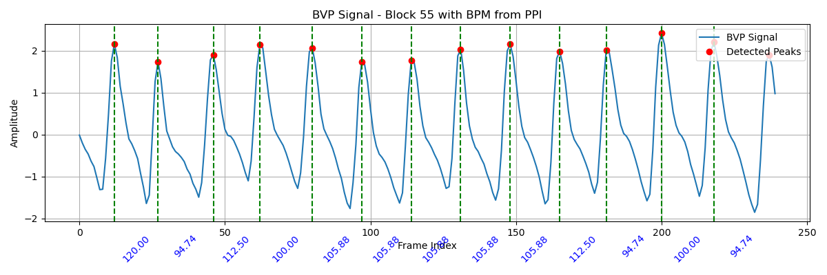
Before/After Tunning SciPy Peak Finder: GT BVP
24

Slide 26
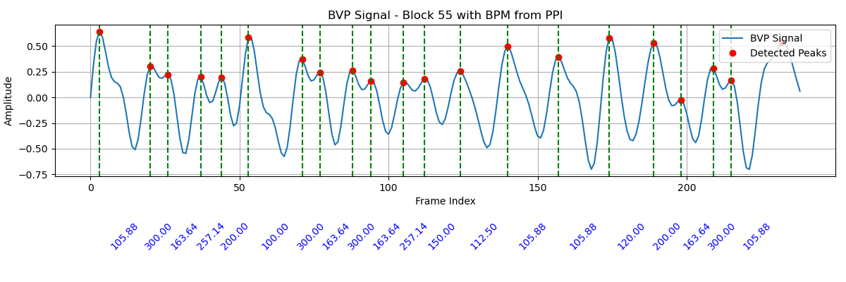
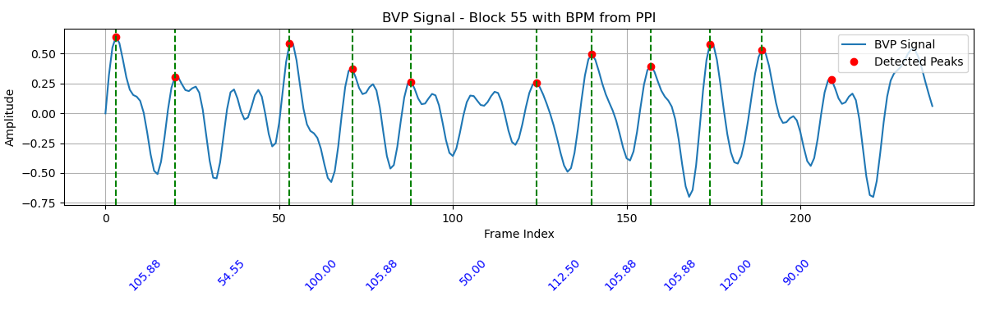
Before/After Tunning SciPy Peak Finder: EST BVP
25

Slide 27
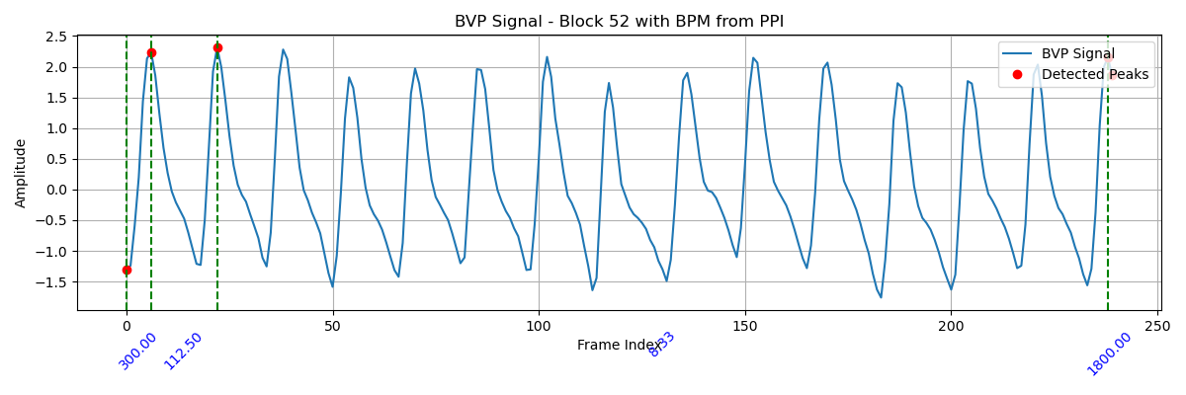
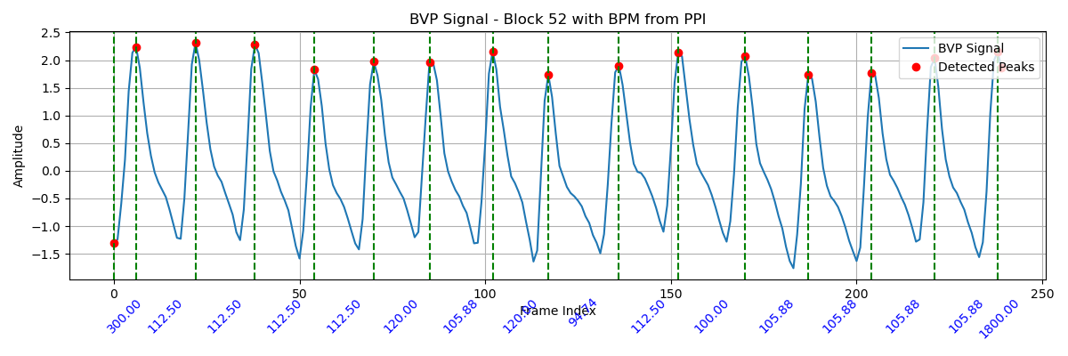
Before/After Tunning AMPD Peak Finder: GT BVP
26

Slide 28
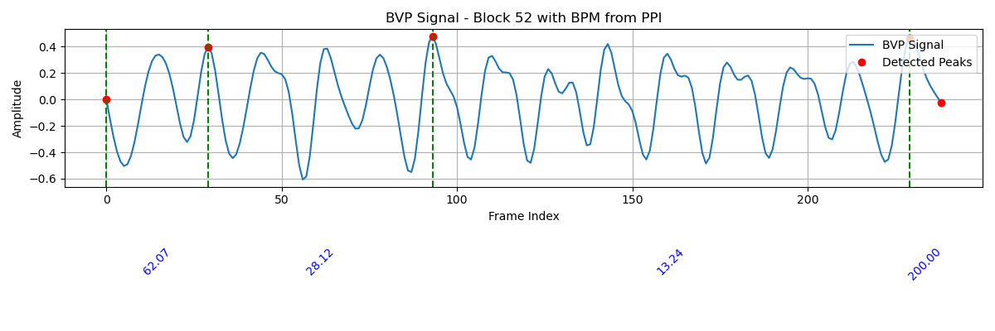
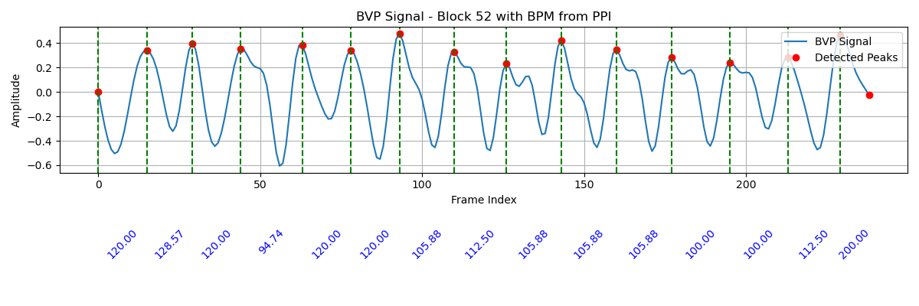
Before/After Tunning AMPD Peak Finder: EST BVP
27

