Slide 1
Deep Learning Model Experiment
For rPPG
Week-2
Rafsan Jany (02513052)
Korean Convergence Medical Science

Slide 2
Experimental DL Models
MTTS_CAN Backbone
PhysNet
MTTS_CAN + Transformer (partially trained)
MTTS_CAN+LSTM+Transformer
Multi Branch CNN + Attention Transformer
MTTS_CAN + Resnet + Transformer
Landmark Guided MTTS_CAN(partially trained)
Transformer Enhanced Landmark Guided MTTS_CAN
Dual Stream MTTS_CAN
PhysNet (partially trained)
Enhanced PhysNet (Transformer Block)

Slide 3
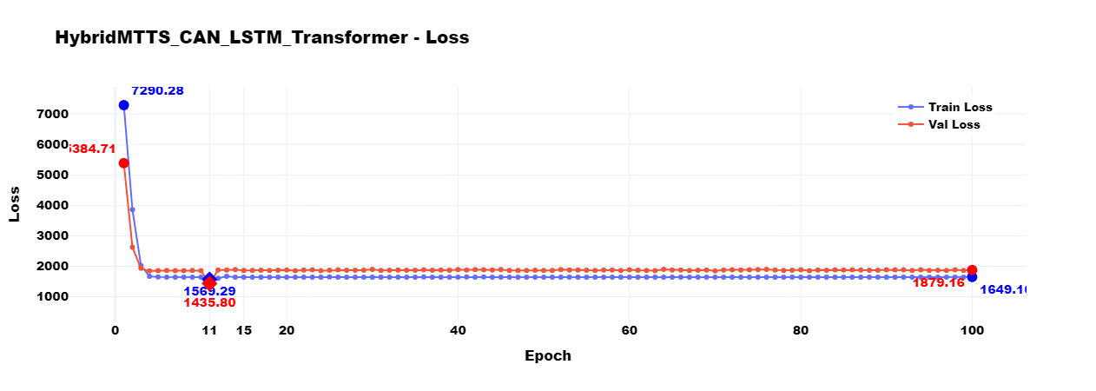
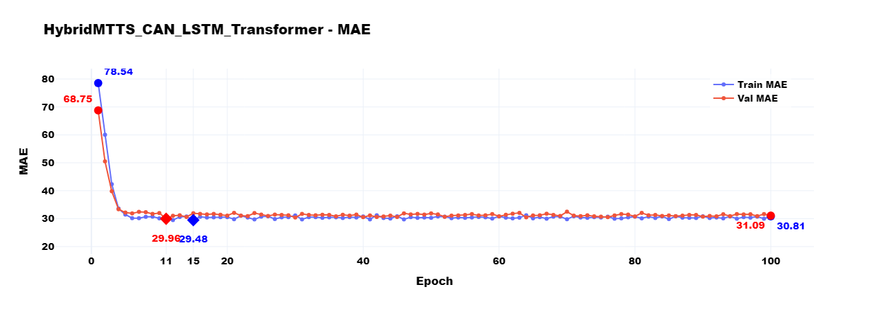
MTTS_CAN + Transformer

Slide 4
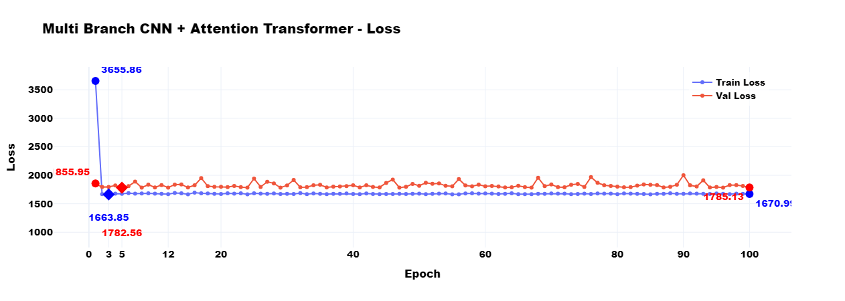
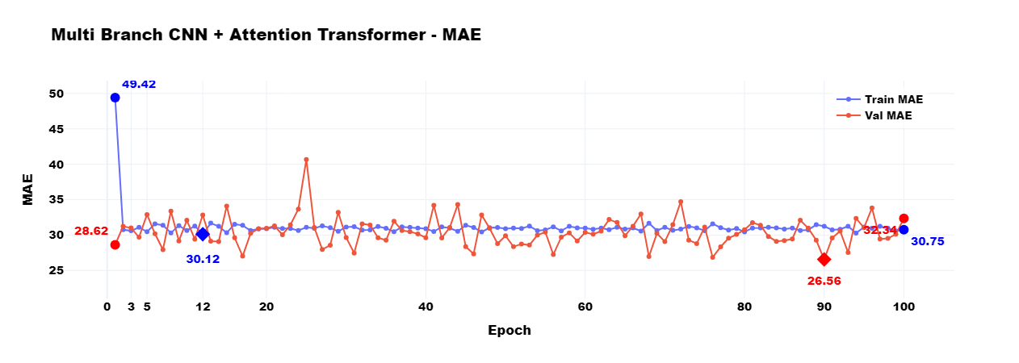
Multi Branch CNN + Attention Transformer

Slide 5
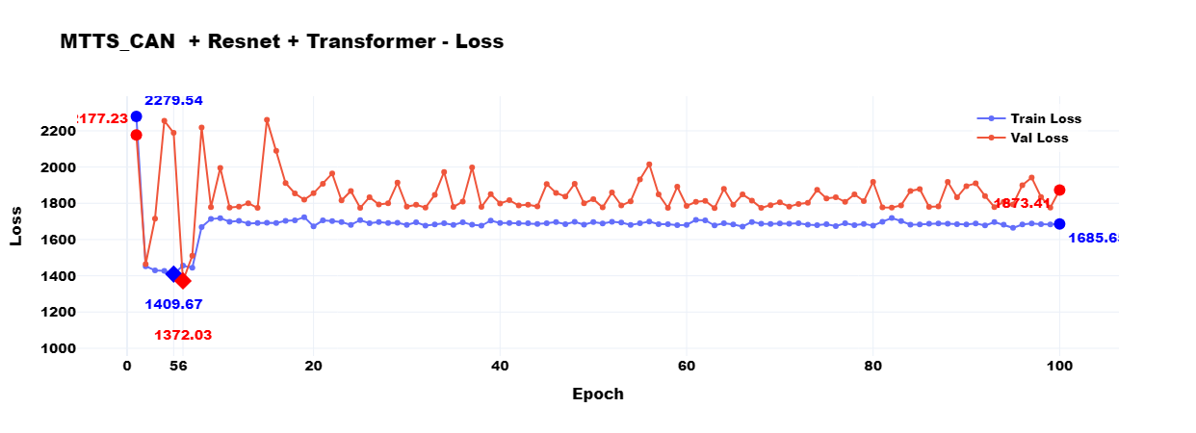
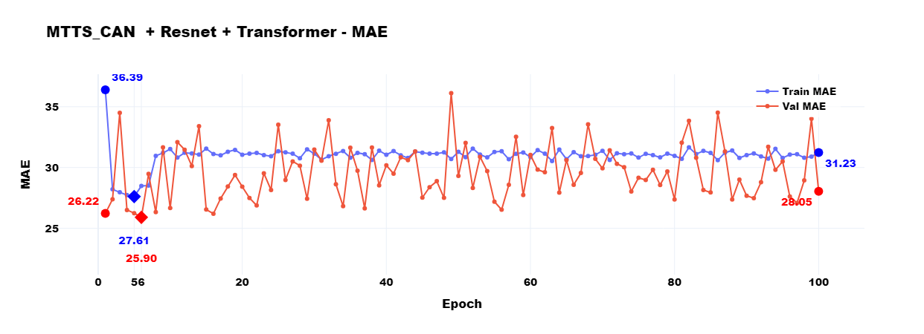
MTTS_CAN + Resnet + Transformer

Slide 6
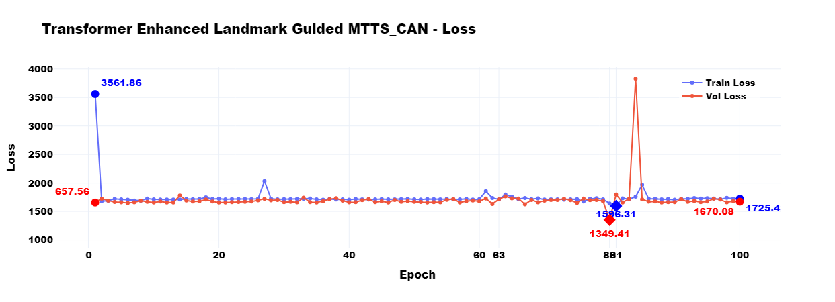
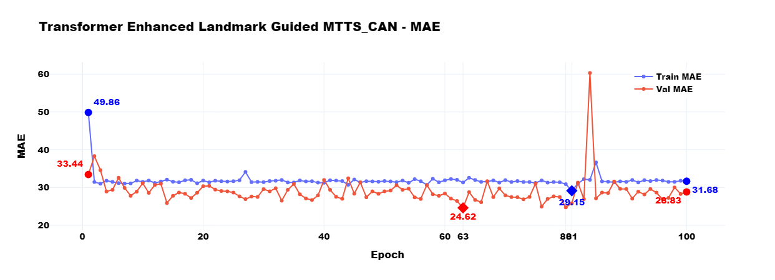
Transformer Enhanced Landmark Guided MTTS_CAN

Slide 7
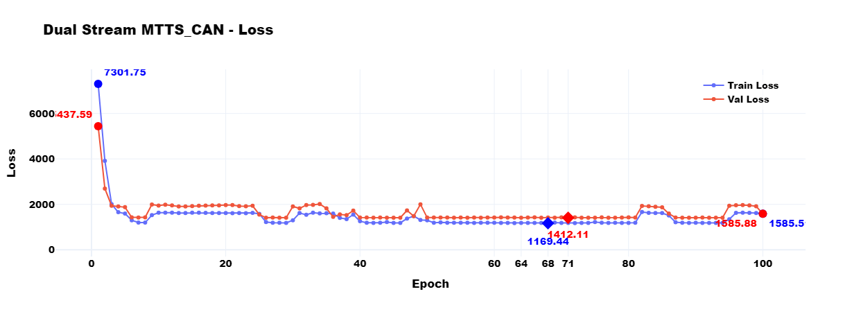
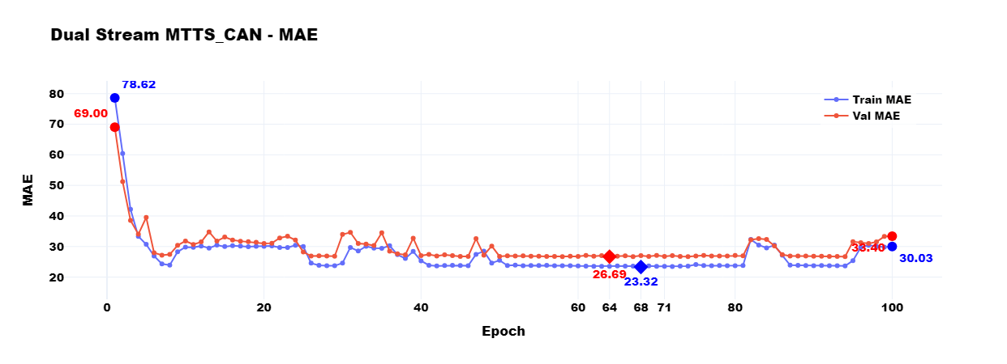
Dual Stream MTTS_CAN

Slide 8
Enhanced PhysNet (With Transformer Block)

Slide 9
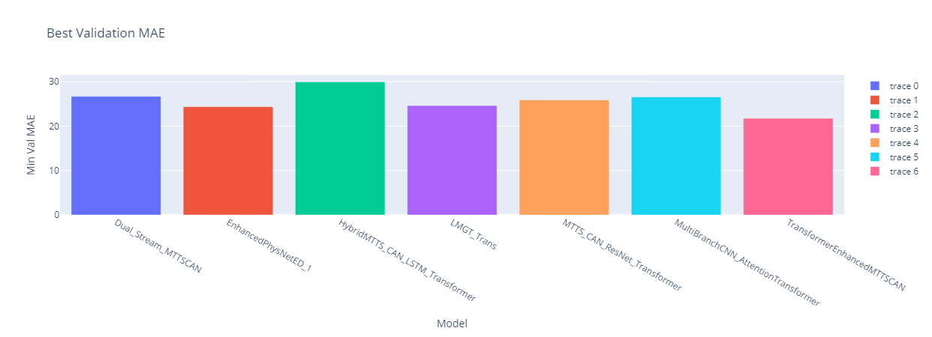
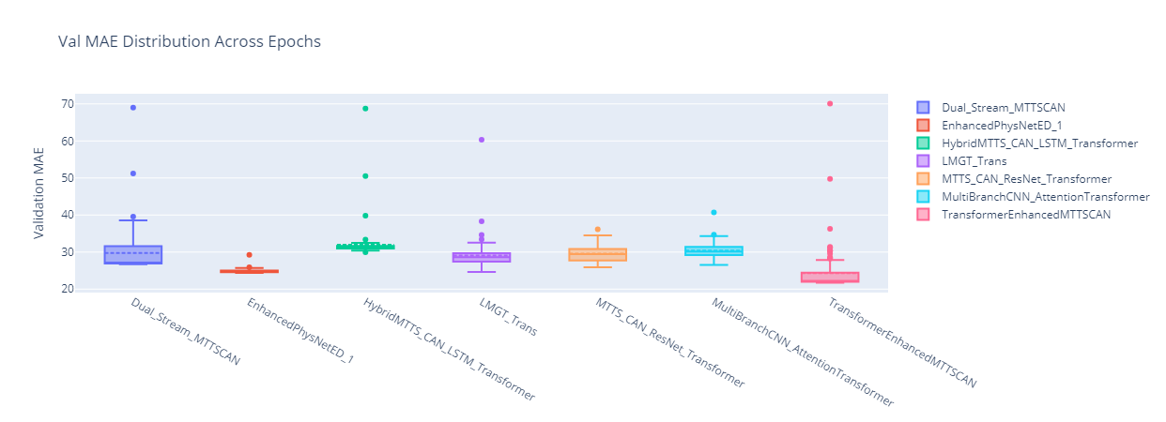
Enhanced PhysNet (With Transformer Block)

Slide 10
Comparison (No model is perfect yet)
Model | Best MAE Rank | Stability | Notes
Transformer Enhanced MTTSCAN | 🥇 Best | ✅ Very stable | Best performer with low MAE. Need dropout tuning or data augmentation.
Enhanced PhysNet | 🥈 Very Good | ✅ Extremely stable | Consistently low error. Need to fine-tune learning rate.
Transformer Enhanced Landmark Guided MTTS_CAN | 🥉 Moderate | ✅ Quite stable | Balanced model. Need deeper fusion or add temporal block.
Multi Branch CNN Attention Transformer | 4th | ✅ Acceptable stability | Decent model with moderate MAE. Need to add attention calibration or feature fusion.
MTTS_CAN ResNet Transformer | 5th | ⚠️ Slightly unstable | Good architecture, higher MAE. Reduce overfitting with regularization.
Dual Stream MTTSCAN | 6th | ❌ Unstable | High variance, some high MAE. Need to tune architecture and apply temporal smoothing.
Hybrid MTTS_CAN LSTM Transformer | ❌ Worst | ❌ Very unstable | High error, poor stability. Need to rework model fusion, optimize training.

Slide 11
Model Architecture

Slide 12
Next Plan
Hyper - Parameter Tuning
(batch size, learning rate, optimizer, loss function)
Architectural Tuning (Layer-Perceptron Tuning)
Enhancing PhysNet (Adding Landmark Guidance, Transformer Blocks etc)
Exploring RGB-NIR Camera dataset
Base Model Tuning
Trying New Backbone
- DeepPhys: Spatio-temporal representation learning for rPPG
- EfficientPhys: Lightweight model for mobile rPPG

Slide 13
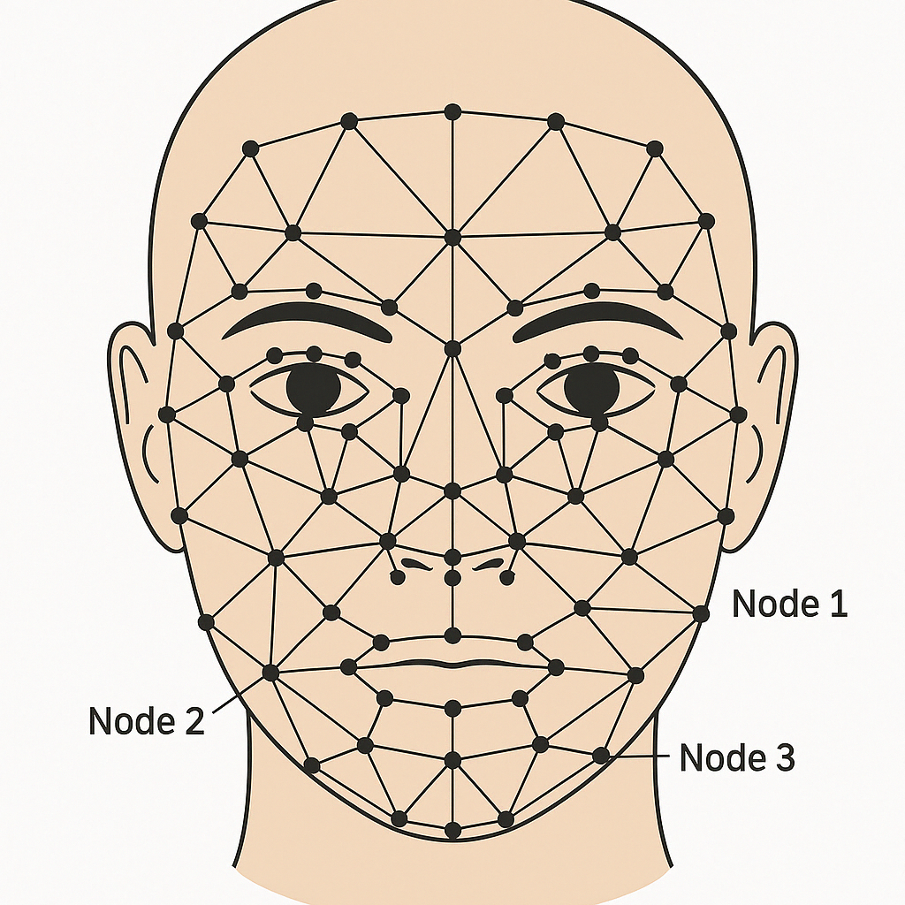
Proposal For Graph Neural Net Method
Spatio-Temporal Graph Neural Network (ST-GNN)
Landmark-aware GNN (Variant of ST-GNN)

Slide 14
Proposal For Graph Neural Net Method
Spatio-Temporal Graph Neural Network (ST-GNN)
Instead of treating video as pixel grids, model the face as a graph, where:
Nodes = Facial landmarks (e.g., 68 points)
Feature = (x, y) or (Δx, Δy)
Edges = anatomical or learned connections
Node feature dim = Small (2–4 dims, pure motion/position)
Graphs evolve over time (sequence of landmark graphs)
Graph type = 3D spatio-temporal graph (time is another graph dimension)
This allows the model to track movement across specific face regions, which is crucial for rPPG where blood-flow-related motion is very subtle and localized.
Landmark-aware GNN (Variant of ST-GNN)
A Landmark-aware GNN combines facial landmark-based graph modeling (from GNN) with appearance-based features (from CNN) to create a hybrid model that is both spatially structured and appearance-aware.
Nodes =Facial landmarks (same 68)
Feature = [x, y, CNN_patch_feature]
Edges = anatomical or learned connections
Node feature dim = Larger (e.g., 2 + 128 CNN features = 130 dims)
Graphs evolve over time (sequence of landmark graphs)
Graph type = Spatial graph per frame + sequence model for time (Transformer/LSTM)
CNN_patch_feature
They are CNN-based embeddings taken from small regions (patches) of the face around each landmark point in each video frame. These features capture:
Color changes (important for rPPG)
Texture and illumination
Subtle movements (e.g., skin stretch, blood flow)

Slide 15
Thanks
Any questions?

