Slide 1
BIS Regression and Classification
With
MiUNet-Hybrid Architecture

Slide 2
Experiment Setup
We constructed three cohorts from VitalDB under a common eligibility: adults (age ≥ 18) with concurrent BIS/BIS (index) and BIS/EEG1_WAV (EEG) recordings. Surgical time windows were restricted to opstart–opend. EEG was bandpass-filtered at 0.5–50 Hz (4th-order Butterworth, zero-phase) and segmented into 10 s windows with 2 s stride; per-window z-scoring was applied. The label was the BIS value at the end of each window (estimation). Modality tags were inferred from track presence as proxies: cases with Orchestra/PPF20_CE or Orchestra/RFTN50_CE were tagged “TCI,” cases with volatile expiration tracks (e.g., Primus/EXP_DES) were tagged “volatile,” and cases with both or neither were tagged “mixed” or “unknown.” We defined: (A) modality-agnostic (all eligible), (B) volatile-only (volatile present, TCI absent), and (C) TCI-only (TCI present, volatile absent). Track presence was used only for cohorting/stratification, not as model inputs. We performed patient-wise cross-validation within each cohort and assessed cross-cohort generalization (Train-A→Eval-B/C; Train-B→Eval-C; Train-C→Eval-B). Performance was summarized by MAE, RMSE, and Concordance Correlation Coefficient, with additional stratified analyses by modality for cohort A.

Slide 3
Data Set Preparing
Dataset A : Modality-agnostic (general model) [1000 Subjects]
all eligible adult cases with BIS + EEG (most realistic).
Dataset B : Volatile-only (vaporizer workflows) [800 Subjects]
cases with volatile agent tracks and without TCI tracks.
Dataset C : TCI-only (propofol/remifentanil Ce-guided) [1000 Subjects]
cases with TCI (propofol/remifentanil) tracks and without volatile tracks.

Slide 4
Data Set Preparing: A
Approach A — Modality-agnostic (general model).This cohort includes all adult cases that have the required BIS index and EEG waveform, regardless of how anesthesia was delivered. In practice, that means you keep volatile, TCI, mixed, and unknown-modality cases together and train a single model without feeding any drug/device tracks as inputs. The value of A is realism and scale: it mirrors the heterogeneity of real operating rooms and usually yields the largest sample size, which stabilizes training and improves statistical power. The trade-off is that the data are more diverse—EEG dynamics, EMG contamination, surgical phases, and recording habits vary across devices and sites—so optimization can be slightly harder and performance may differ across subgroups. Interpreting results from A works best when you also examine slices by modality (volatile vs TCI) to reveal domain gaps. If the goal is a broadly deployable DoA model, A is the natural baseline; you can fairly claim “general-purpose” performance while transparently reporting how it behaves across modalities.

Slide 5
Data Set Preparing: B
Approach B — Volatile-only (vaporizer workflows).This cohort keeps only cases where volatile agent tracks are present and removes any case with TCI tracks (and typically excludes mixed cases) so that the remaining EEG reflects inhalational anesthesia workflows. The benefit is a more homogeneous cohort: volatile agents often produce relatively stereotyped EEG patterns during maintenance (strong alpha with dose-dependent slowing), which can make learning easier and sometimes lift in-domain metrics. However, B sacrifices external validity and sample size: it won’t represent TCI rooms, and it can inherit site/device biases because inclusion depends on whether volatile tracks were logged. Unknown-modality cases are usually excluded to keep the cohort “pure,” but that further reduces data. Models trained under B typically perform well within volatile cases yet degrade when evaluated on TCI cohorts, quantifying a domain shift. The right way to present B is as a focused model for volatile settings, with clear scope and limitations.

Slide 6
Data Set Preparing: C
Approach C — TCI-only (propofol/remifentanil Ce-guided).This cohort retains cases with TCI effect-site tracks and removes volatile and mixed cases, isolating propofol/remifentanil workflows. Like B, C creates a homogeneous learning problem, but it is often the smallest cohort because TCI logging is less ubiquitous than basic monitors. EEG under propofol-dominant TCI can differ meaningfully from volatile anesthesia (stronger frontal alpha with characteristic beta/slow dynamics and different EMG profiles), so a C-trained model can capture TCI-specific structure and calibrate well in those rooms. The cost is narrow applicability: it usually generalizes poorly to volatile cases, and results may reflect device or site practices tied to Orchestra usage. When reporting C, position it as a TCI-focused model; emphasize in-domain performance, acknowledge reduced sample size (and higher variance across folds), and use cross-cohort tests to show how much performance drops when the model is applied outside TCI environments.

Slide 7
Cohort: What and Why Reference
Approach | What it includes (definition) | Why use this cohort | Key references
A — Modality-agnostic | All adult cases with BIS/BIS and BIS/EEG1_WAV, regardless of anesthetic modality (volatile, TCI, mixed, unknown). | Largest, most realistic cohort; mirrors real OR heterogeneity. Use it to build a general DoA model and then report performance stratified by modality. | VitalDB dataset description and scale (6,388 cases). (Nature, vitaldb.net) • Official track list showing BIS/BIS and BIS/EEG1_WAV. (vitaldb.net, PhysioNet) • Domain/dataset-shift background—why cross-cohort tests matter. (MIT Press Direct)
B — Volatile-only | Adults with volatile agent tracks (e.g., Primus/EXP_DES; extend to EXP_SEV/ENF if present) and no TCI tracks; exclude mixed. | More homogeneous EEG under inhalational agents; simpler learning problem; report as a volatile-room model (limited external validity). | Sevoflurane/frontal alpha & slow oscillations (characteristic volatile EEG). (PMC) • VitalDB docs/track names for identifying volatile tracks. (vitaldb.net)
C — TCI-only | Adults with TCI effect-site tracks (e.g., Orchestra/PPF20_CE, Orchestra/RFTN50_CE) and no volatile tracks; exclude mixed. | Homogeneous propofol/remifentanil workflows; calibrates well for TCI rooms; report as a TCI-focused model (limited to that setting). | Propofol-specific EEG signatures during loss/return of consciousness (slow–alpha dynamics). (PNAS) • VitalDB docs/track names for identifying TCI Ce tracks. (vitaldb.net)

Slide 8
Experiment matrix
Within-cohort performance (main): A-internal: Train A → Eval A (primary general model) B-internal: Train B → Eval B (volatile-specific) C-internal: Train C → Eval C (TCI-specific) Cross-cohort generalization (domain tests): Train A → Eval B and Eval C (does the general model hold up?) Train B → Eval C (volatile → TCI transfer) Train C → Eval B (TCI → volatile transfer

Slide 9
The BIG Why?
Can one model cover both modalities? If not, where does it fail (volatile or TCI)? Do we need separate models or adaptation for deployment?

Slide 10
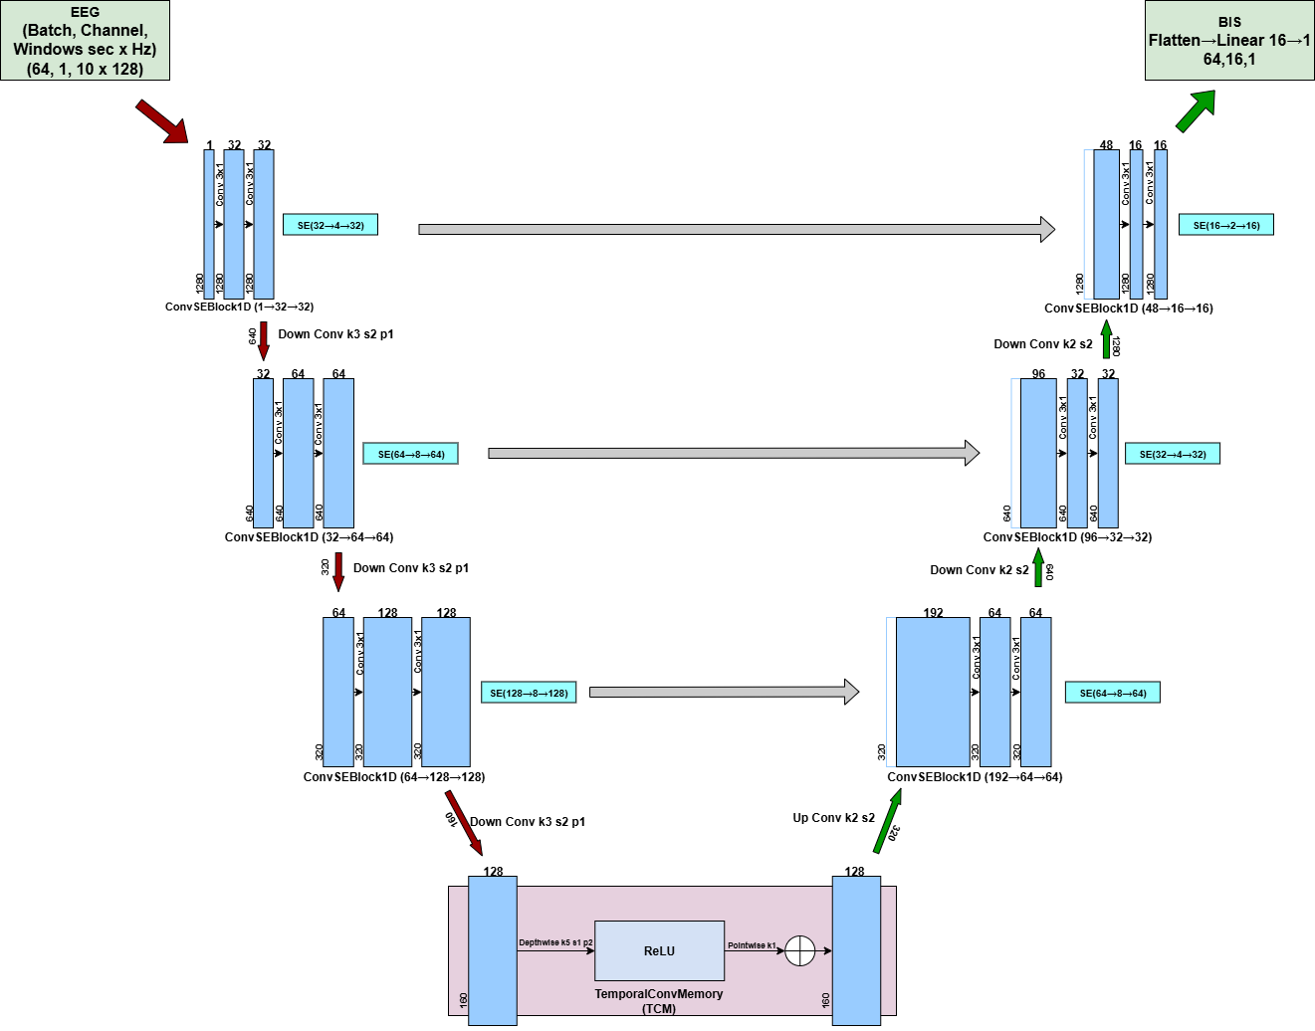
Model Architecture
We propose EdgeBIS-U-TCM, a lightweight 1-D U-Net with squeeze-and-excitation (SE) and a temporal memory bottleneck for BIS regression from a 10-s, single-channel EEG (128 Hz). The encoder applies paired 3×13×1 Conv-BN-ReLU layers at three scales (T=1280/640/320) with SE attention, followed by stride-2 temporal downsampling. A bottleneck TemporalConvMemory performs depthwise temporal filtering (𝑘=5k=5) and pointwise channel mixing with a residual skip. The decoder mirrors the encoder with transposed convolutions (𝑘=2,𝑠=2k=2,s=2) plus interpolation, concatenates the corresponding encoder features, and refines them with SE-augmented conv blocks. A global average pooling across time and a linear layer produce a window-level BIS estimate. The network has 0.27 M parameters (~1.08 MB fp32) and runs in ~10 ms per window on CPU, enabling bedside deployment while preserving accuracy through multi-scale temporal features and adaptive channel reweighting.

