Slide 1
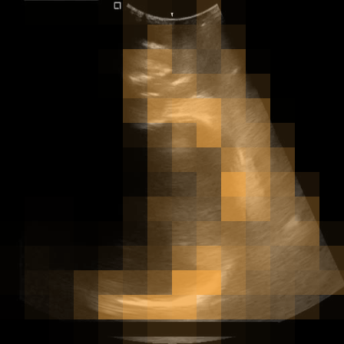
Learning where to mask
Reinforcement-learned masking policies for V-JEPA pretraining on intrapartum ultrasound video
Motion map of one training clip
Project summary
Notes:
This deck summarises the project so far: what V-JEPA is, how we changed its masking, how pretraining behaved, and what the classification test shows.

Slide 2



The method runs end to end; its benefit is not yet shown
What we built
What we observed
Where it stands
A masking policy that learns where V-JEPA should hide video patches, trained with reinforcement learning
Two versions: REINFORCE places mask blocks; PPO with trajectory attention picks the visible tokens
All pretraining runs completed; PPO needed stability fixes first
Both policies stayed close to random masking
PPO token masking ran in about 17 GB, against 35 to 45 GB for block masking
Frame classification: no pretrained model clearly beats an untrained encoder
Pretraining loss does not track feature quality
The evaluation setup is the next thing to fix
Status: a working, stable implementation and an evaluation pipeline; evidence of better features is still missing.
Notes:
One-slide summary. The engineering works: both learned-masking variants train alongside V-JEPA. The scientific claim is still open: the policies behave almost randomly and the classification probe does not separate the models.

Slide 3
Background
1
The data, how V-JEPA learns, and how it normally chooses its masks

Slide 4
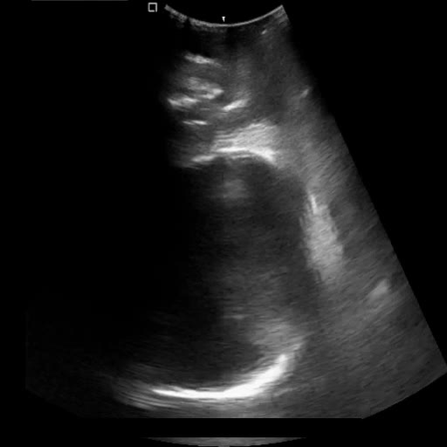
The data: intrapartum ultrasound videos with plane labels
434
40
300
training videos
266 SP, 168 NSP
validation videos
2,870 labelled frames
test videos
8,665 labelled frames
Task
Classify each frame as standard plane (SP) or non-standard plane (NSP)
Labels
Training: one label per video. Validation and test: one label per frame, with both classes inside each video
One frame of a training video
512 x 512 greyscale at 24 fps. Training videos have 9 to 778 frames; test videos 20 to 70. Source: IUGC 2024 dataset (MICCAI).
Notes:
Pretraining uses only the 434 training videos, without labels. Note the label difference between splits: it matters later for the classification results.

Slide 5
V-JEPA learns by predicting hidden parts of a video as features
Video clip
16 frames, 224 px
Patch tokens
8 x 14 x 14 = 1,568
Mask
hide most tokens
Context encoder
sees visible tokens
Predictor
guesses hidden features
This project changes this step
Target encoder
sees the whole clip; a slow moving-average copy of the context encoder
L1 loss
predicted vs target
No pixels are reconstructed. Gradients update the context encoder and the predictor; the target encoder follows as a moving average.
Notes:
V-JEPA is a joint-embedding predictive architecture. The clip is cut into 1,568 tokens. Most are hidden. The context encoder sees the rest, and the predictor must produce the features that the target encoder computes for the hidden tokens. Our work only changes how the mask is chosen.

Slide 6
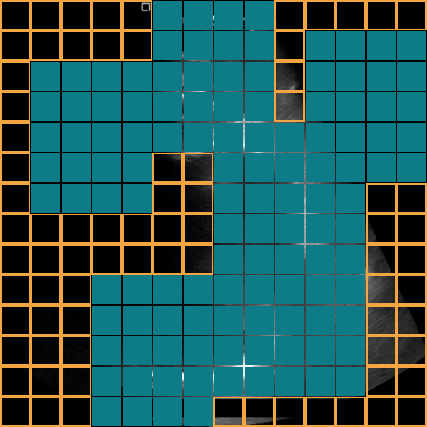



Standard V-JEPA places its mask blocks at random
Random multi-block masks
One mask uses 8 small blocks (15% of the frame each); a second uses 2 large blocks (70% each)
Blocks span the whole clip
Each block covers all 8 time slices, so the model cannot copy the answer from another frame
Placement ignores content
Block positions are uniformly random, by the same rule for every video
Question: can a model learn where masking is most useful for these videos?
Illustration: teal patches are hidden, outlined patches stay visible
Notes:
In the stock recipe, block sizes and positions are sampled at random. Ultrasound frames have large static regions, so random placement may spend many masks on uninformative background. That motivates a learned policy.

Slide 7
Our modification
2
A masking policy trained with reinforcement learning, in two versions

Slide 8

A policy chooses the mask and learns from V-JEPA's loss
1
2
Policy scores every patch
one score per token of the clip
Sample a mask
higher scores are chosen more often
Why reinforcement learning?
Choosing a mask is a discrete decision, so the V-JEPA loss cannot be back-propagated into the policy
The policy therefore learns from rewards computed from that loss
Two versions were built: REINFORCE and PPO
Repeated at every training step
4
3
Loss becomes the reward
the policy is nudged toward better masks
V-JEPA trains on that mask
encoder and predictor update as usual
Notes:
The policy and V-JEPA train together. The policy has its own optimiser. Because sampling a mask is not differentiable, we use policy-gradient methods.

Slide 9
Version 1: REINFORCE decides where the mask blocks go
1
Score every patch
A small transformer score, plus a learned weight times the motion map
2
Place the blocks
Block centres are sampled from the scores; block sizes stay random as in V-JEPA
3
Reward
Minus the clip's prediction loss, so easier masks earn more
4
Update
REINFORCE with a moving-average baseline and an entropy bonus
Real motion map of a training clip: brighter patches change more between frames
Notes:
This is the first design. It keeps V-JEPA's block structure and only learns block placement. The motion map is a cheap stand-in for optical flow: the mean absolute difference between consecutive frames, pooled to the patch grid.

Slide 10
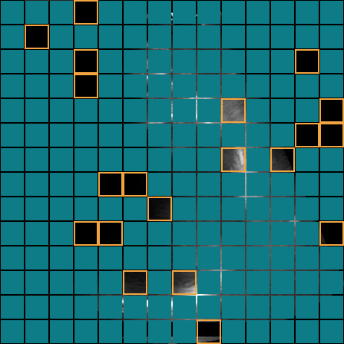
Version 2: PPO picks which tokens stay visible
1
Input The encoder's own patch embeddings of the clip
2
Actor A trajectory-attention block follows each patch through time and scores it
3
Action Sample 156 of 1,568 tokens to keep visible; the other 1,412 become targets
4
Reward Each target token's prediction loss, so harder tokens earn more
5
Update PPO with a critic network; the first 10 epochs use random masks
Illustration: 10% of patches stay visible (outlined); the other 90% are predicted
Adapted from TATS (Rai et al., ICCV Workshops 2025), which was designed for VideoMAE pixel reconstruction.
Notes:
The second design ports the TATS token sampler to V-JEPA. The main change from the original is the reward: prediction error in feature space instead of pixel reconstruction error. The critic predicts the expected reward of a clip, and the advantage is reward minus that prediction.

Slide 11
The versions differ in what they choose and reward
 | REINFORCE | PPO (TATS-style)
Chooses | Where the rectangular mask blocks go | Which individual tokens stay visible
Looks at | Small transformer plus a frame-difference motion map | Trajectory attention over encoder embeddings
Reward | Lower prediction loss: favours easy masks | Higher per-token loss: favours hard masks
Learning rule | REINFORCE with a moving-average baseline | PPO: actor, critic and clipped updates
Visible context | About 270 and 55 tokens in the two masks | 156 tokens (10%) in one mask
Origin | Designed in this project | Ported from TATS (VideoMAE) to V-JEPA
The two rewards point in opposite directions, so a final method has to commit to one hypothesis.
Notes:
Side-by-side view. The visible-context numbers for REINFORCE are from the end of training. Note the opposite reward directions: version 1 rewards easy masks, version 2 rewards hard ones.

Slide 12
The first PPO run crashed; four fixes made it stable
First run, epoch 11
1
Normalised policy input
2
Probability floor
5.6 to 0.1
Encoder embeddings grew large and made the untrained policy almost deterministic. A LayerNorm removed this root cause.
Every token keeps a small chance of being picked, so log-probabilities stay bounded.
policy entropy within about 20 steps
2.7 x 10¹⁵
3
Bounded PPO loss
4
Repeatable scoring
policy loss just before the crash
Clamped ratio, dual-clip for negative advantages, and updates with non-finite gradients are skipped.
Attention landmarks are chosen deterministically, so the update sees the same scores as sampling.
Scores became NaN and mask sampling failed.
Result: 290 PPO epochs completed with no skipped updates and no low-entropy warnings.
Notes:
The crash came from unbounded per-token log-probabilities once the policy became sharp. The deeper cause was that the policy started nearly deterministic because encoder embeddings had grown large during the ten warm-up epochs. These fixes are additions to the reference TATS implementation.

Slide 13
Pretraining results
3
Cost, loss curves, and what the two policies actually learned

Slide 14
All runs share one training setup; only the masking changes
ViT-L/16
16 x 224 px
Run | Masking | GPU memory | Time per step
Plain V-JEPA | Random blocks | 34.7 GB | 1.06 s
REINFORCE | Learned block placement | 45.3 GB | 0.63 s
PPO | Learned token selection | 17.1 GB | 0.55 s
encoder
frames per clip
24
300 x 300
clips per batch
epochs x steps
1 x A100
434
PPO keeps only 156 tokens visible, so the context encoder does much less work.
GPU per run
training videos
Single runs on a shared cluster at different times: memory is reliable, timings are indicative only.
Notes:
Memory and time are the peak values logged at the end of each run. The plain V-JEPA and REINFORCE runs were done months apart on different nodes, so compare the timings loosely.

Slide 15
All runs show the same loss pattern: a drop, then a rise
Loss falls to about 0.02 to 0.04 early, then climbs and levels off
Mean of the last 20 epochs: plain 0.068, REINFORCE 0.055, PPO 0.089
The prediction target keeps changing, so a rising loss does not mean worse features
Runs with different masks cannot be ranked by loss
Average loss per epoch, 5-epoch moving average. PPO epochs 1 to 10 use random token masks.
Notes:
V-JEPA predicts the output of a target encoder that is itself changing. Early in training the features are very uniform and easy to predict; as they become richer the loss rises. This happens in the plain run too, so it is not caused by the learned masking. PPO also rewards hard masks, which pushes its loss up by design.

Slide 16
Both policies stayed close to random masking
-0.28
REINFORCE motion weight at epoch 300 (started at 1.0): it learned to avoid moving regions
7.18 of 7.36
REINFORCE entropy at epoch 300 against the maximum, which means uniform random
6.48 of 7.36
PPO entropy at epoch 300: a mild preference, still close to uniform
A positive weight sends masks toward motion; a negative weight sends them away.
Notes:
Entropy measures how spread out the policy's choice is over the 1,568 tokens. Both policies end near the maximum. The REINFORCE reward favours easy masks, which explains why its motion weight turned negative. With one PPO pass per batch, the PPO policy changes slowly.

Slide 17
Classification
4
Testing the frozen encoders on the standard-plane task

Slide 18
A linear classifier on frozen features labels every frame
1
2
3
4
5
Frozen encoder
pretrained weights are never updated
16-frame windows
slide along each video, 8 frames apart
One feature per 2 frames
average of the 196 patch tokens
Linear classifier
trained on the training videos
Select, then report
settings chosen on validation, scored on test
31,448
2,870
8,665
training samples, each with its video's label
validation frames, each with its own label
test frames, each with its own label
The test set is never used to choose anything. Metrics: accuracy, balanced accuracy, F1 and AUROC.
Notes:
This is frame classification, because validation and test labels are per frame. A frozen encoder with a linear probe measures the quality of the pretrained features. Each of the 8 time slices of a window covers two frames, so neighbouring frame pairs share a feature.

Slide 19
No pretrained model clearly beats an untrained encoder
PPO at 300 epochs has the best balanced accuracy (0.60)
The untrained encoder has the best AUROC (0.69)
Plain V-JEPA and REINFORCE are close to chance
All differences are small next to the distance from a useful classifier
Frame-level results on the test set (8,665 frames). Chance level is 0.50 for both metrics.
Notes:
The key comparison is against the untrained encoder. If pretraining produced clearly better features for this task, every pretrained model should beat it. That is not what we see, so these numbers do not yet support a claim for any of the methods.

Slide 20
Full results: validation and test for every model
Model | Val balanced acc. | Val AUROC | Test accuracy | Test balanced acc. | Test F1 | Test AUROC
Untrained encoder | 0.710 | 0.834 | 0.605 | 0.560 | 0.729 | 0.694
Plain V-JEPA, 300 epochs | 0.634 | 0.692 | 0.525 | 0.479 | 0.675 | 0.476
REINFORCE, 300 epochs | 0.586 | 0.592 | 0.484 | 0.519 | 0.315 | 0.548
PPO, 300 epochs | 0.713 | 0.808 | 0.617 | 0.601 | 0.681 | 0.647
PPO, 34 epochs | 0.720 | 0.795 | 0.586 | 0.561 | 0.680 | 0.598
Best value in each column is in teal. Always predicting the majority class gives 0.556 test accuracy. Classifier settings were chosen by validation balanced accuracy.
Notes:
Reference table. Validation scores are higher than test for most models, partly because the classifier settings were selected on validation and the validation set has only 40 videos.

Slide 21
Stopping at the lowest-loss epoch did not give better features
Epoch 34
had the lowest loss (0.032) in the 300-epoch PPO run once the policy was active, so PPO was retrained to stop there.
Epoch 9
had the lowest loss (0.027) in that rerun, and epoch 34 reached 0.042. The minimum moves from run to run.
The 34-epoch model is slightly worse on test. Pretraining loss is not a reliable way to choose a checkpoint here.
Notes:
The 34-epoch run used the same learning-rate, weight-decay and momentum schedules as the 300-epoch run and simply stopped early. Its lowest loss came during the random-mask warm-up, and its features are not better than the 300-epoch model.

Slide 22
Training and test ask the classifier different questions
Training
Validation and test
Video A
Video C
Video B
SP and NSP frames come from different videos. A classifier can separate them by how a recording looks, without learning what a standard plane is.
SP and NSP frames sit in the same video, a few frames apart. The classifier has to detect the moment the view changes.
SP frame
NSP frame
Also likely to hurt: averaging patch tokens discards spatial detail, and the probe reads consecutive frames while pretraining used every 4th frame.
Notes:
This is the most likely explanation for the weak scores, and it is a hypothesis, not a measured result. The probe may learn a recording-level shortcut on the training set that is useless inside a single test video. So the weak scores probably say more about the probe setup than about the encoders.

Slide 23
What we can and cannot conclude
1
The pipeline works end to end
Learned masking trains alongside V-JEPA in both versions, and PPO is stable after the fixes
2
Neither policy learned a clear strategy
Both stayed near uniform; REINFORCE drifted away from motion
3
Token masking with PPO is the cheapest run
About 17 GB of GPU memory, which leaves room for larger batches or several masks per clip
4
The benefit of learned masking is still open
The current probe cannot separate the models from an untrained encoder
Notes:
Be direct about status: the contribution so far is a working, stable implementation of learned masking for a latent-prediction video model, plus an evaluation pipeline. The evidence for better representations is not there yet.

Slide 24


Next steps: fix the evaluation first, then strengthen the policy
Evaluation
Method
Use an attentive probe instead of averaging patch tokens, as in V-JEPA's own evaluation
Report a within-video metric, such as AUROC computed per test video
Add a random-token baseline to separate the policy from the change in mask type
Run several PPO passes per batch so that updates actually change the policy
Commit to one reward direction: easy masks or hard masks
Try group-based advantages (GRPO) in place of the weak critic
Match video names exactly in the pretraining data loader
Notes:
Evaluation comes first because, without a probe that can tell models apart, no change to the method can be judged. The last method item refers to the loader matching file names by prefix, which may load some videos twice and skip others.

