Slide 1
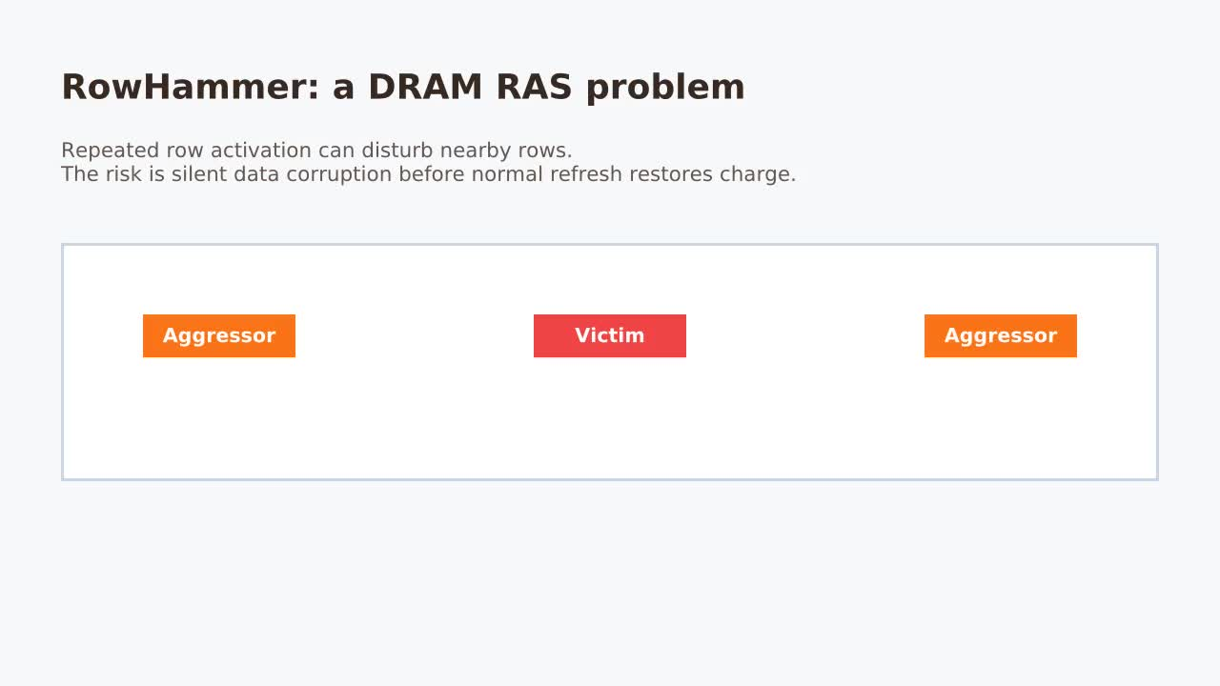
RowHammer: DRAM RAS Problem

Slide 2
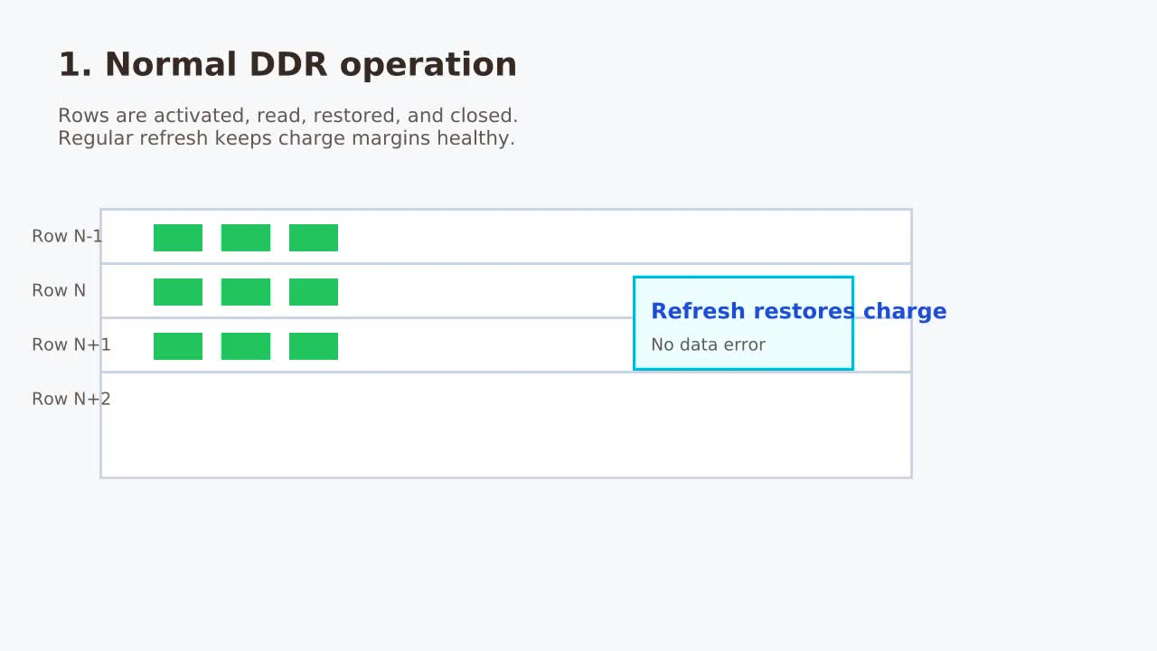
Normal DDR Operation

Slide 3
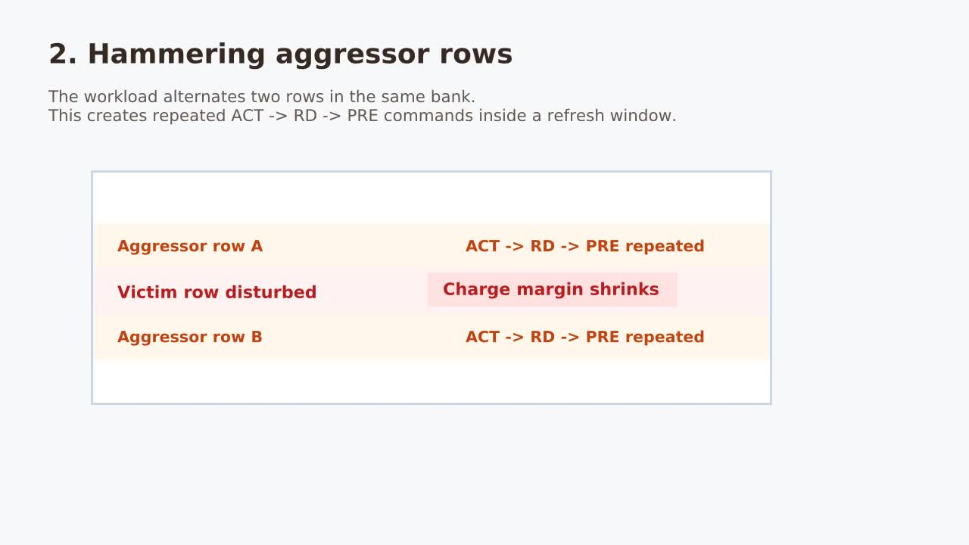
Hammering Aggressor Rows

Slide 4
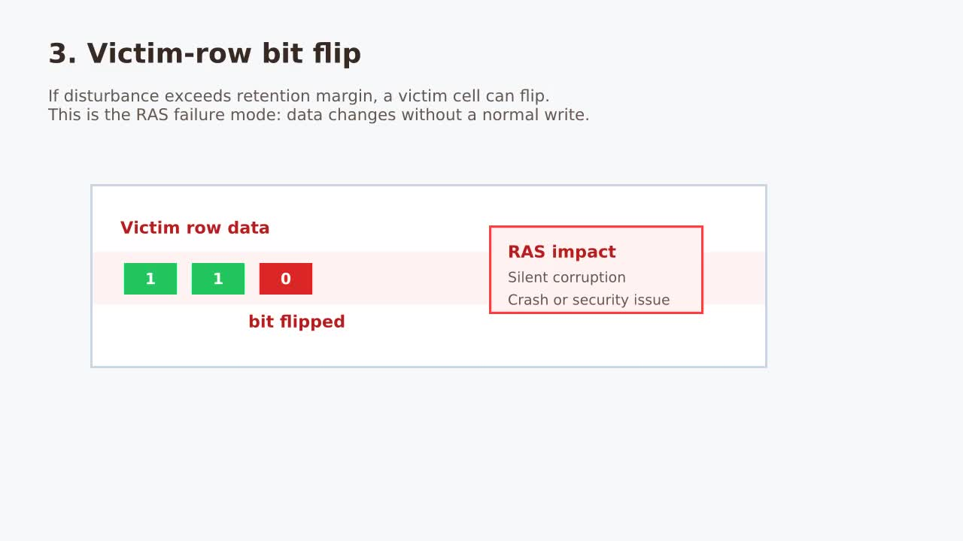
Victim-Row Bit Flip

Slide 5
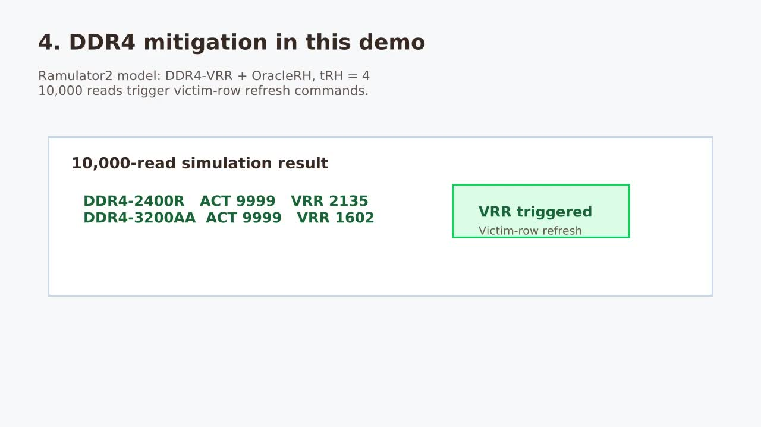
DDR4 Mitigation Demo

Slide 6
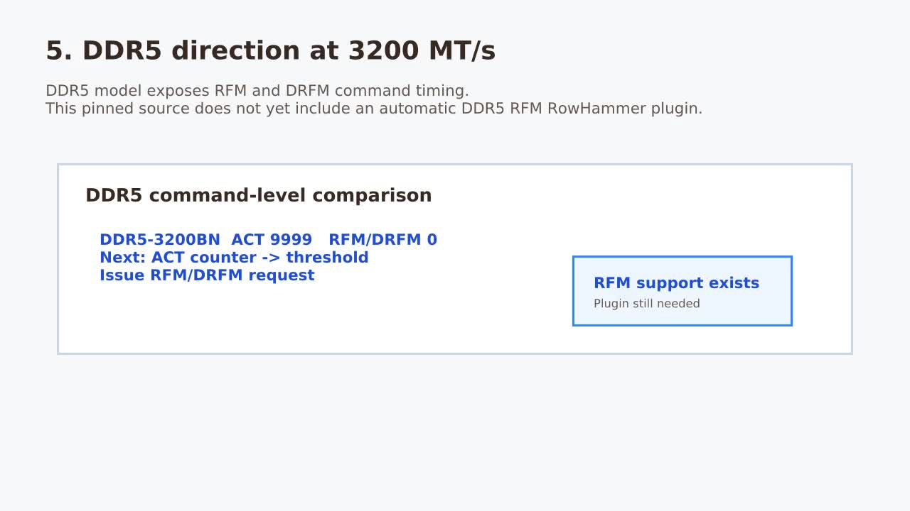
DDR5 Direction at 3200 MT/s

Slide 7
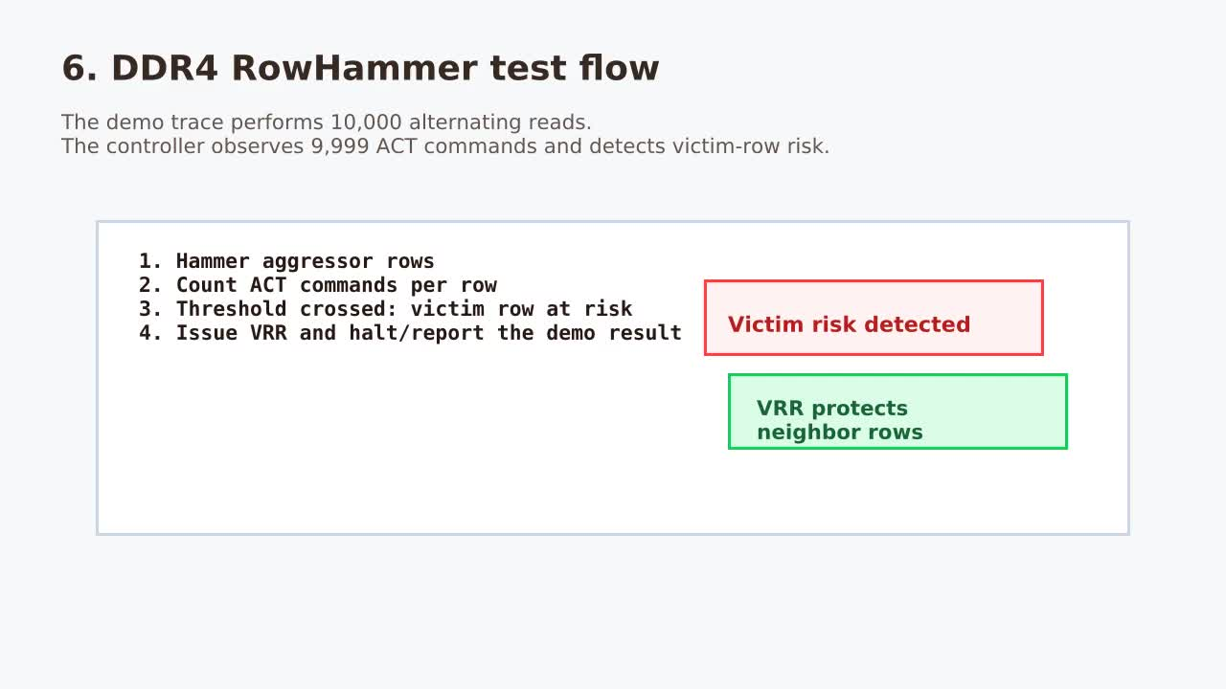
DDR4 RowHammer Test Flow

Slide 8
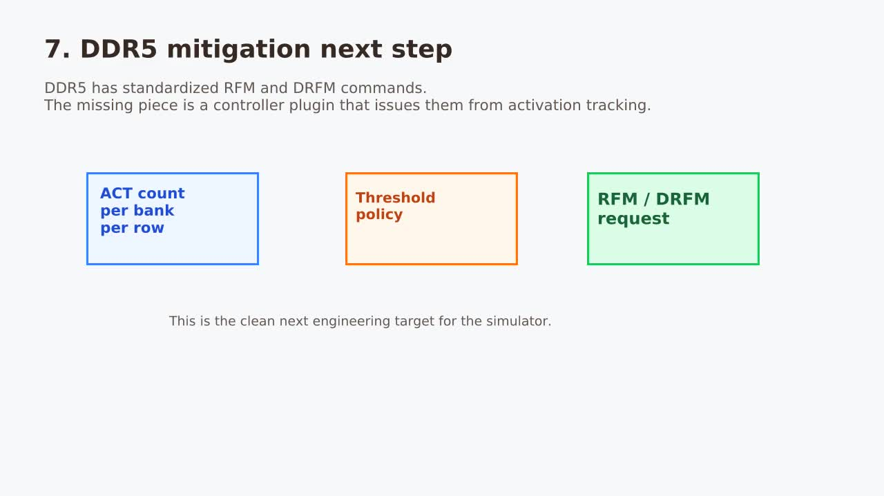
DDR5 Mitigation Next Step

Slide 9
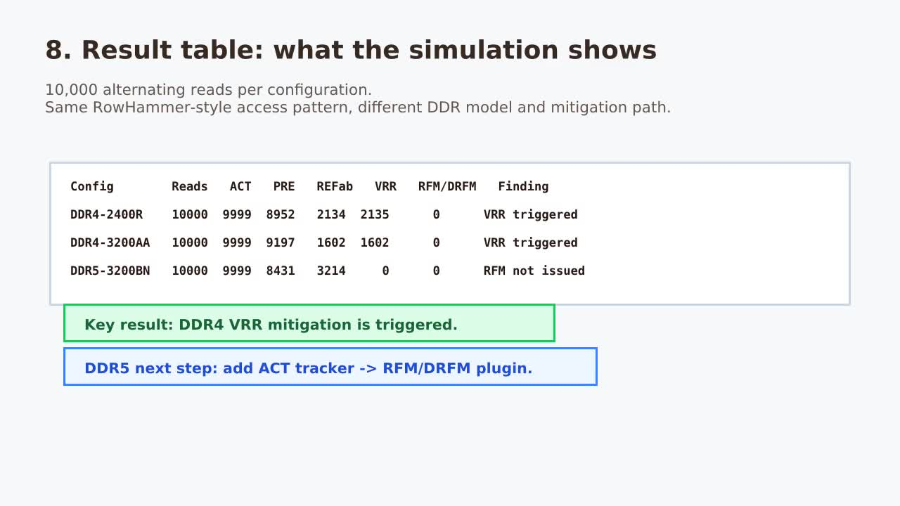
Result Table and Findings

