Slide 1
Introduction
Name: KARN GUPTA
College: GOVERNMENT COLLEGE OF ENGINEERING, NAGPUR
Branch: COMPUTER SCIENCE AND ENGINEERING
Year: SECOND YEAR

Slide 2
Mini Project
Dataset-https://raw.githubusercontent.com/Rag3karn/Rag3karn/main/heart_disease(Major%20project1).csv
Performed in Google colab
Screenshots starts from the next page.

Slide 3
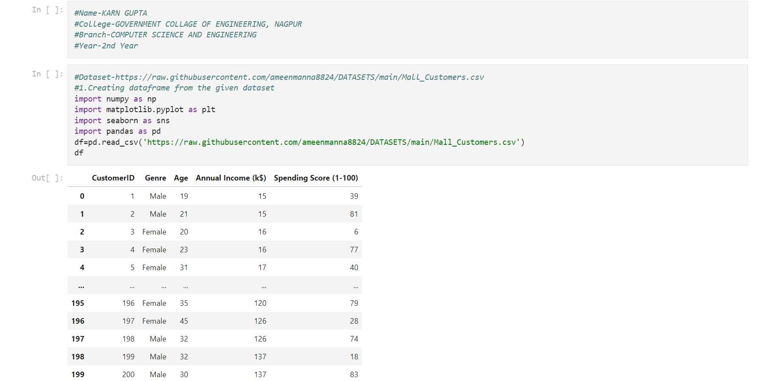

Slide 4
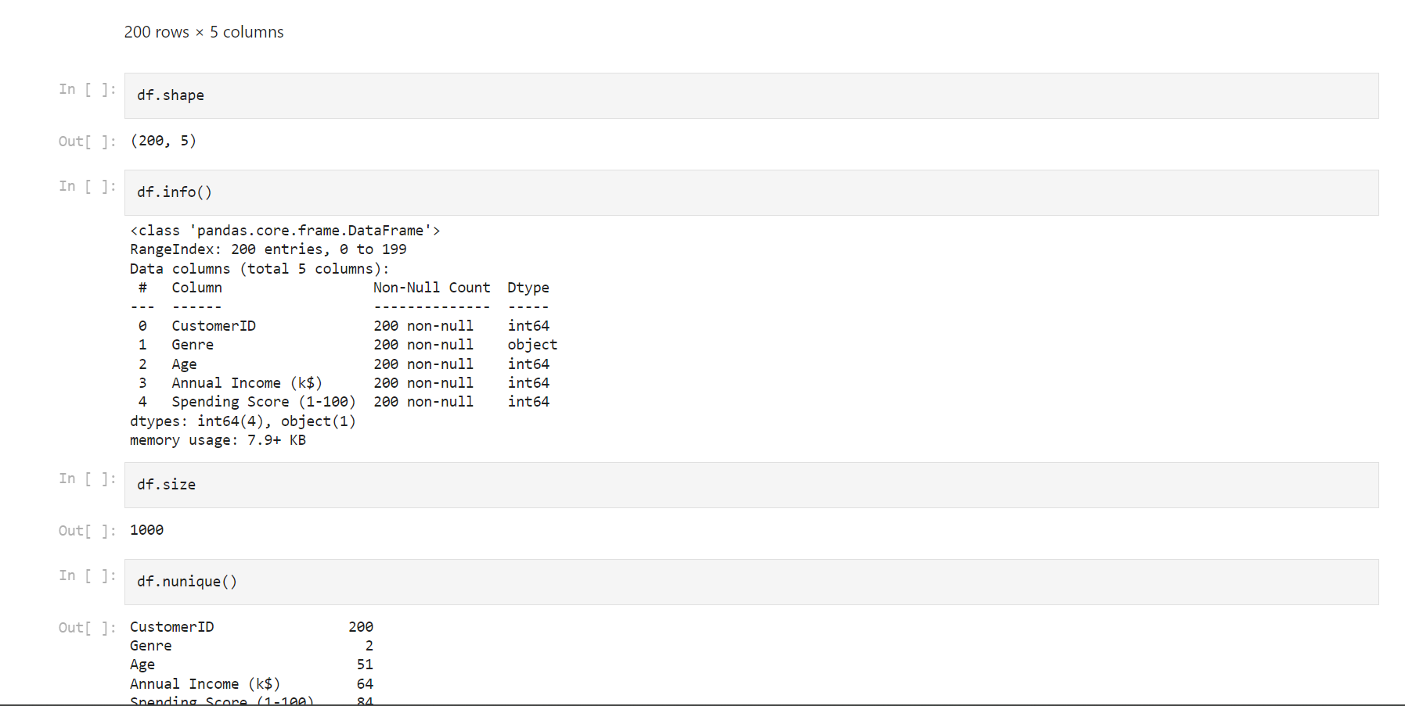

Slide 5
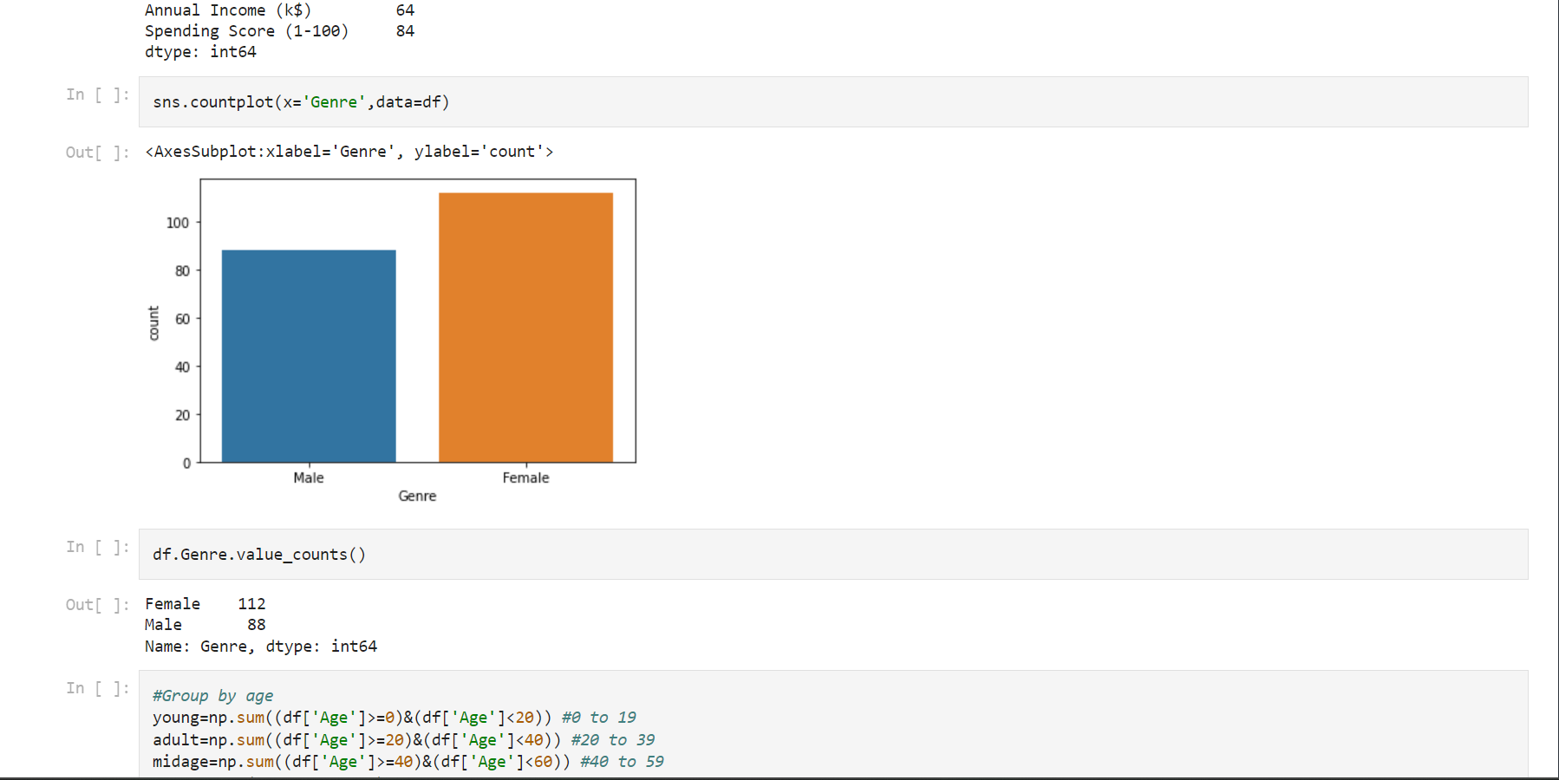

Slide 6
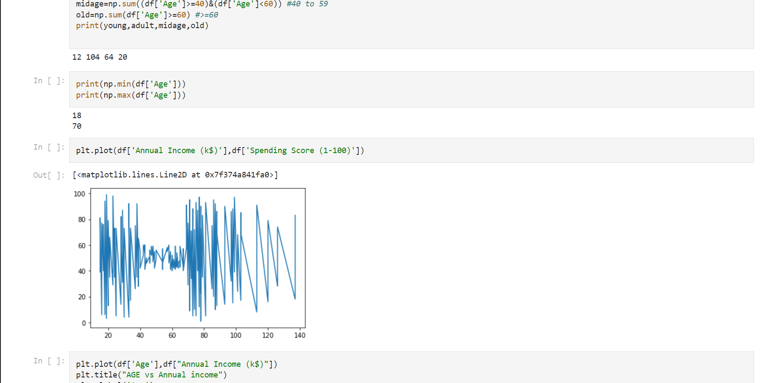

Slide 7
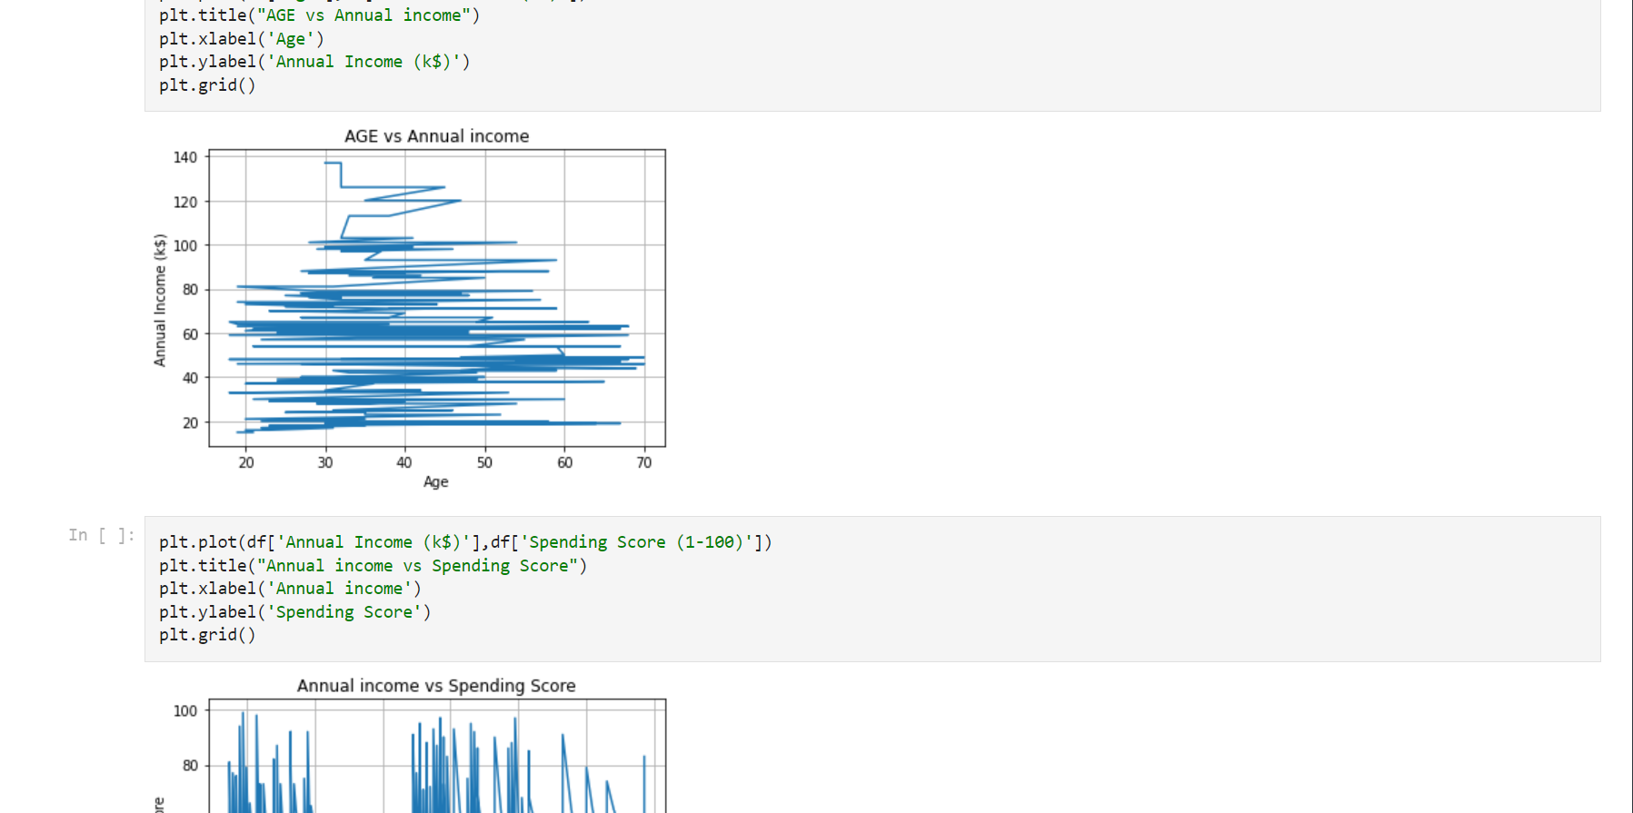

Slide 8
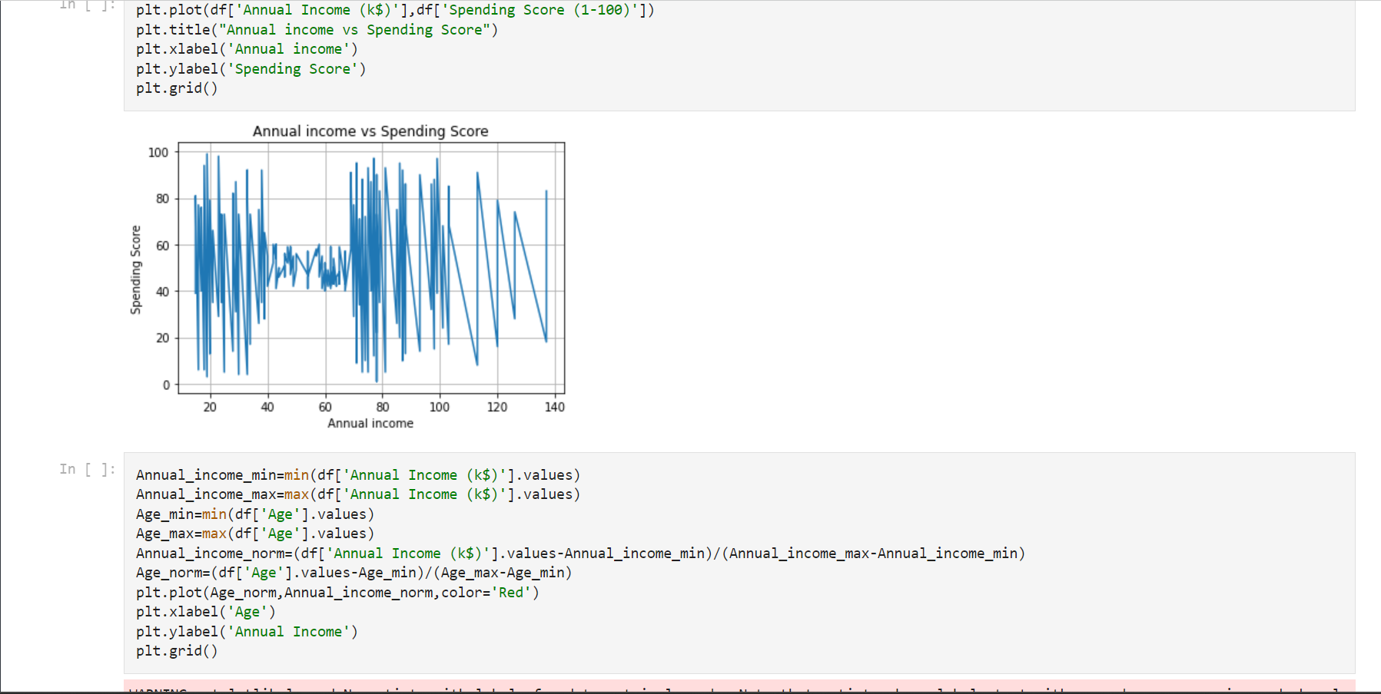

Slide 9
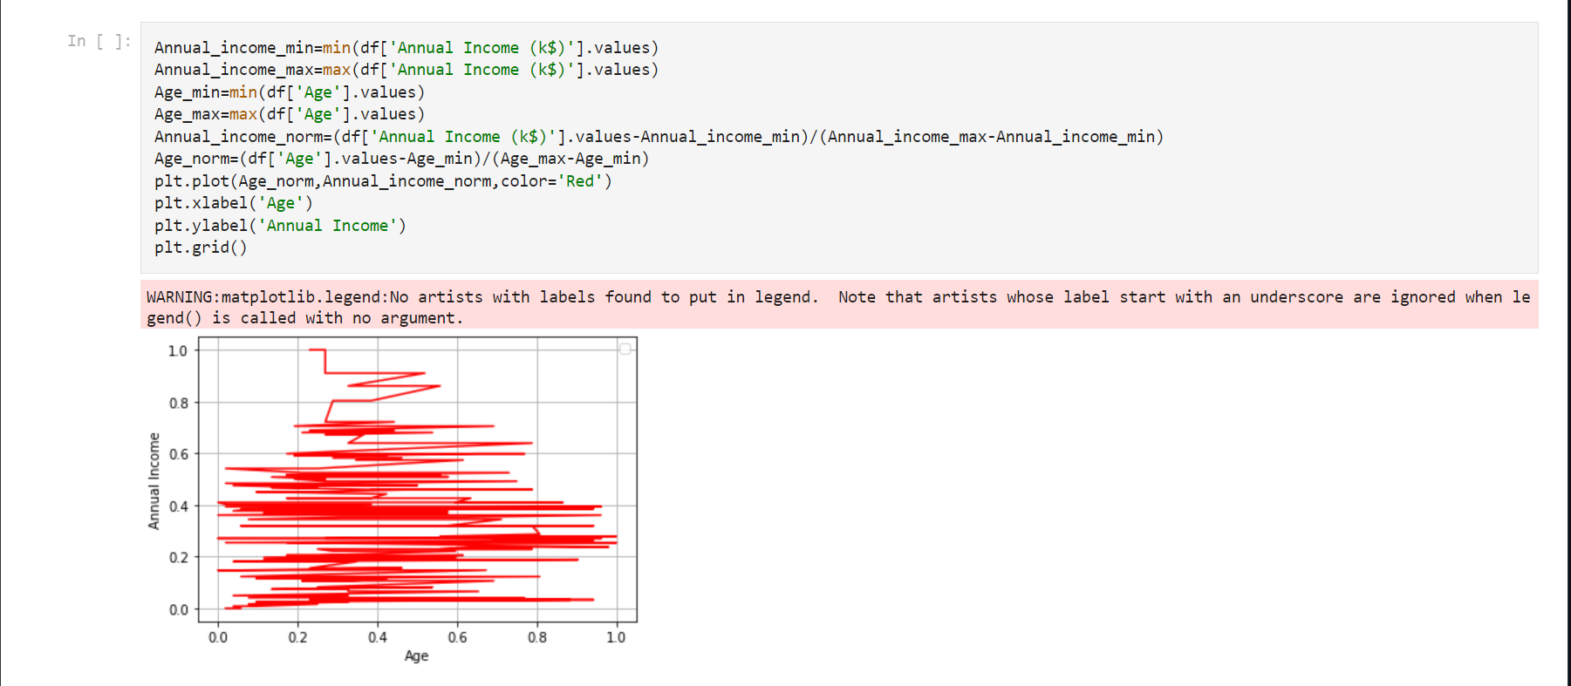

Slide 10
Major Project
Major Project 1- This project consists of application of a CLASSIFIER/REGRESSOR to the given dataset.
Dataset-https://raw.githubusercontent.com/Rag3karn/Rag3karn/main/heart_disease(Major%20project1).csv
Major Project 2-This project consists of application of EDA to the given dataset and come up with 15 different conclusions.
Dataset-https://raw.githubusercontent.com/Rag3karn/Rag3karn/main/APY(Major%20Project2).csv

Slide 11

Major Project 1 (Video clip)

Slide 12
Major Project 2 (Video Clip)

Slide 13
Github link-https://github.com/Rag3karn/Rag3karn.git
This was my one month internship with Rinex Technologies.
Linkdlin-www.linkedin.com/in/karngupta2

Slide 14
Thank you

