Slide 1
Applied Cryptography
21AIE431
DUAL ENCRYPTION

Slide 2
Team Members
M. D. S. Rama Saran | CB.EN.U4AIE21034
Akshayaa B K | CB.EN.U4AIE21002
Gajula Sri Vatsanka | CB.EN.U4AIE21010
R. Sai Raghavendra | CB.EN.U4AIE21049

Slide 3
Contents:
Dual Encryption - Storage
Dual Encryption – Secure Chat

Slide 4
DUAL ENCRYPTION? RSA+AES

Slide 5
RSA

Slide 6
RSA ALGORITHM
KEY GENERATION:
Generate two large distinct prime numbers, p and q.
Let n = p*q.
Let m = φ(n) = (p − 1)(q − 1). (φ is totient function).
Choose a small number e, co prime to φ(n), with GCD(m, e)=1 and 1<e<m
Find d which satisfies d x e mode m = 1.
Public key = {e, n} Private key = {d, n}

Slide 7
What is φ(n)?
The totient function calculates the number of positive integers less than or equal to "n" that do not share any common factors (other than 1) with “n”.
The totient function φ(n) can be defined as follows:
φ(n) = the count of positive integers k, where 1 ≤ k ≤ n, and gcd(n, k) = 1
For example, if we calculate φ(8), we are determining the number of positive integers from 1 to 8 that are coprime to 8:
φ(8) = {1, 3, 5, 7}
There are four positive integers (1, 3, 5, and 7) that are coprime to 8, so φ(8) = 4.

Slide 8
Decryption
Encryption
Cipher = (message)^{e} mod n
message = (cipher)^{d} mod n

Slide 9
AES

Slide 10
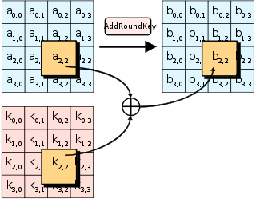
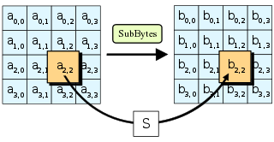
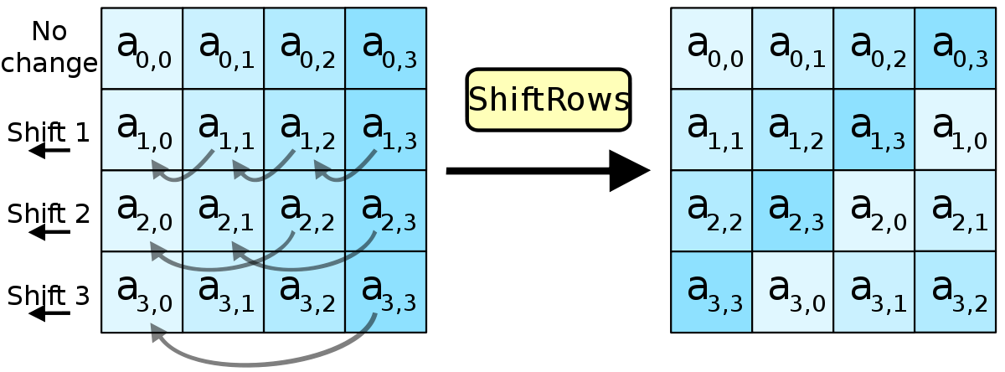
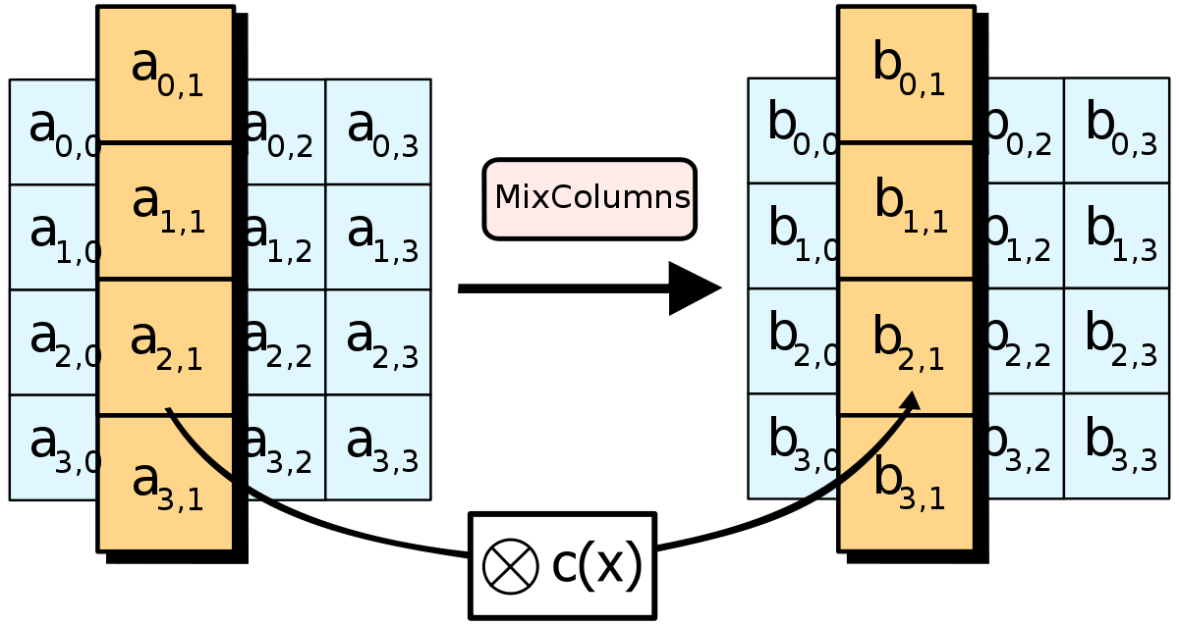
AES ENCRYPTION
PLAIN TEXT
RoundKey
AddRoundKey
1st Round
SubBytes
ShiftRows
Repeat Nr-1 Round
MixColumns
RoundKey
AddRoundKey
SubBytes
ShiftRows
Last Round
RoundKey
AddRoundKey
CIPHER TEXT

Slide 11
CIPHER TEXT
AES DECRYPTION
RoundKey
AddRoundKey
1st Round
InvShiftRows
InvSubBytes
Repeat Nr-1 Round
RoundKey
AddRoundKey
InvMixColumns
InvShiftRows
InvSubBytes
Last Round
RoundKey
AddRoundKey
PLAIN TEXT

Slide 12
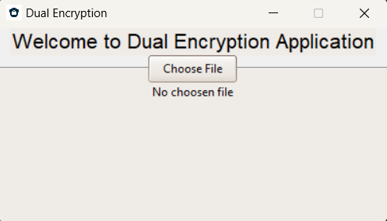
Dual-Encryption Storage

Slide 13
DUAL-ENCRYPTION STORAGE FLOW CHART
INPUT FILE
ENCRYPTION
DECRYPTION
RSA
AES KEY
RETRIEVE ENCRYPTED AES KEY AND RSA KEYS ALONG WITH FILE
ENCRYPT FILE USING AES ALGORITHM
PUBLIC KEY
DECRYPT AES KEY USING RSA ALGORITHM
PRIVATE KEY
ENCRYPT AES KEY USING RSA ALGORITHM
AES KEY
STORE ENCRYPTED AES KEY AND RSA KEYS
DECRYPT FILE USING AES ALGORITHM
STORE ENCRYPTED FILE[.AES]
STORE DECRYPTED FILE[.AES]

Slide 14
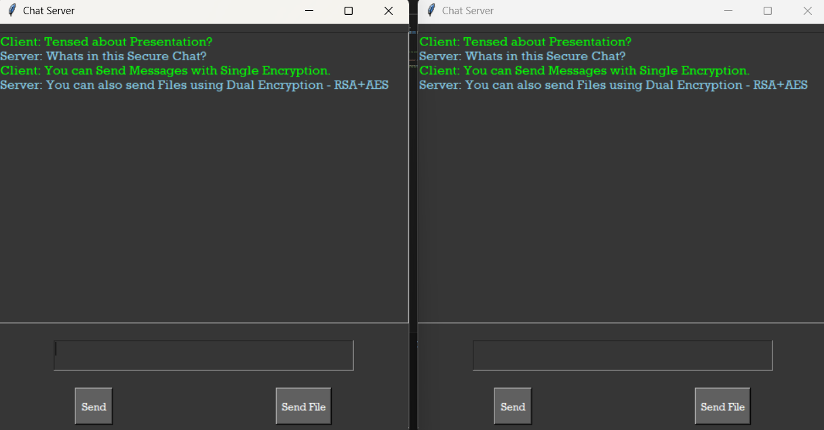
Dual-Encryption Secure Chat

Slide 15
DUAL-ENCRYPTION SECURE CHAT FLOW CHART
SERVER
CLIENT
RSA KEY GENERATION EXCHANGE OF PUBLIC KEY
RSA KEY GENERATION EXCHANGE OF PUBLIC KEY
ENCRYPT MSG USING CLIENT PUBLIC KEY USING RSA
ENCRYPT MSG USING SERVER PUBLIC KEY USING RSA
MESSAGE TRANSFER
DECRYPT MSG USING SERVER PRIVATE KEY USING RSA
DECRYPT MSG USING CLIENT PRIVATE KEY USING RSA
SELECT INPUT FILE AND ENTER AES KEY
SELECT INPUT FILE AND ENTER AES KEY
ENCRYPT THE FILE WITH AES KEY USING AES ALGORITHM
ENCRYPT THE FILE WITH AES KEY USING AES ALGORITHM
ENCRYPT AES KEY USING CLIENT PUBLIC KEY AND TRANSFER
ENCRYPT AES KEY USING SERVER PUBLIC KEY AND TRANSFER
FILE TRANSFER
RECEIVE FILE AND ENCRYPTED AES KEY
RECEIVE FILE AND ENCRYPTED AES KEY
DECRYPT THE AES KEY USING SERVER PRIVATE KEY
DECRYPT THE AES KEY USING CLIENT PRIVATE KEY
DECRYPT THE FILE WITH DECREYPTED AES KEY
DECRYPT THE FILE WITH DECREYPTED AES KEY

Slide 16
Thank You!

