Slide 1
Mathematics for Intelligent Systems 4 21MAT212
05/’23
Term Project
Batch-A Group-09

Slide 2




SANGAM GANESH BABU
CHALLA YOGANANDHA REDDY
[CB.EN.U4AIE21056]
[CB.EN.U4AIE21008]
RANGISETTI SAI RAGHAVENDRA
Gajula Sri Vatsanka
[CB.EN.U4AIE21049]
[CB.EN.U4AIE21010]

Slide 3
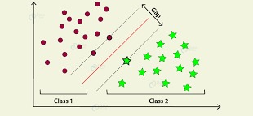
WHAT IS SVM ?
Support vector machines (SVMs) are a set of supervised learning methods used for classification, regression and outliers detection.
SVMs can efficiently perform a non-linear classification.
SVM classifier is the backbone of the support vector machine concept and, in general, is used as algorithm to solve classification problems.

Slide 4
Supervised
Supervised learning is when you train a machine learning model using labelled data. It means that you have data that already have the right classification associated with them. One common use of supervised learning is to help you predict values for new data.
Supervised learning needs supervision to train the model, which is similar to as a student learns things in the presence of a teacher. Supervised learning can be used for two types of problems: Classification and Regression.

Slide 5
Unsupervised
Unsupervised learning is when you train a model with unlabeled data. This means that the model will have to find its own features and make predictions based on how it classifies the data.
Unsupervised learning does not need any supervision. Instead, it finds patterns from the data by its own.
Unsupervised learning can be used for two types of problems Clustering and Association

Slide 6
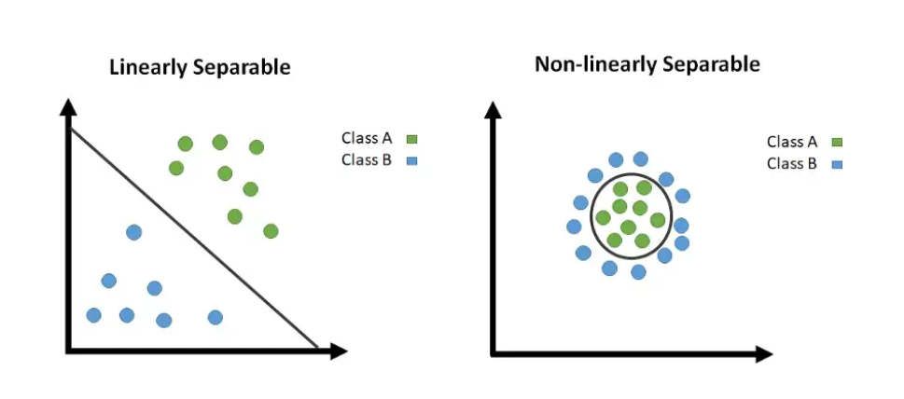
Linear and non linear svm

Slide 7
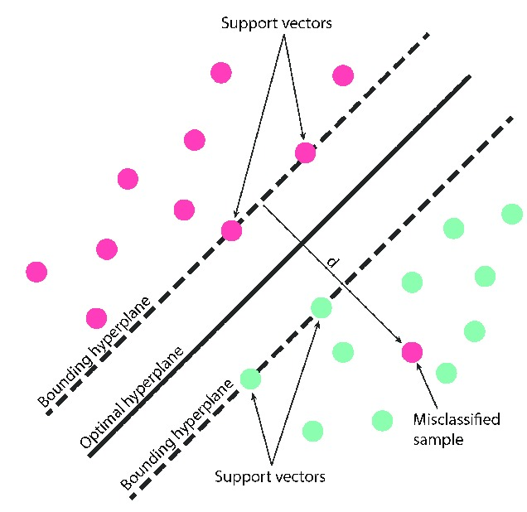
What does Svm do?
SVM works by mapping data to a high-dimensional feature space so that data points can be categorized, even when the data are not linearly separable.
In SVM divides the data into two classes, not only two it can be multiple classes from which we can classify or regress the data easily
The above division of the data into multiple classes is done by SVM by constructing the HYPERPLANE ,it gets the maximum separation between the classes.

Slide 8
Types of svm
Hard Margin
Soft Margin
Hard margin
The term "hard margin" refers to the scenario where the SVM classifier seeks to find a hyperplane that perfectly separates the training data into different classes without allowing any misclassification. In other words, it aims to achieve a clear separation between classes by enforcing strict constraints on the margin.
Soft Margin
"soft margin" refers to a relaxation of the strict requirement for perfect separation in the training data. Soft margin SVM allows for some misclassification or overlapping of data points by introducing a parameter called the "slack variable.“
The introduction of the slack variable allows data points to be on the wrong side of the margin or even on the wrong side of the hyperplane. The slack variable represents a measure of how much a particular data point violates the margin or is misclassified. By allowing some margin violations, soft margin SVM finds a compromise that allows for more flexibility in handling complex or noisy datasets.

Slide 9
REAL WORLD APPLICATIONS
Support Vector Machines (SVMs) are a versatile and powerful machine learning algorithm used for both classification and regression tasks. Here are some common applications of SVM:
Text categorization and sentiment analysis
Image classification
Handwriting recognition
Bioinformatics
Fraud detection
Face detection and recognition
Medical diagnosis

Slide 10
Hand writing recognition
SVMs have been successfully applied to recognize handwritten characters in optical character recognition (OCR) systems. They can learn to distinguish different handwriting styles and accurately classify handwritten letters or digits

Slide 11
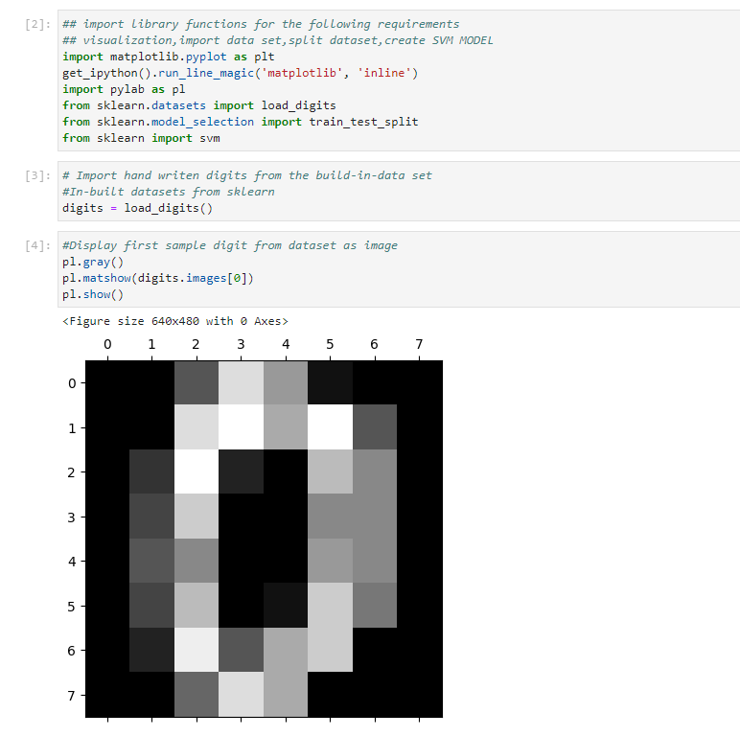

Slide 12
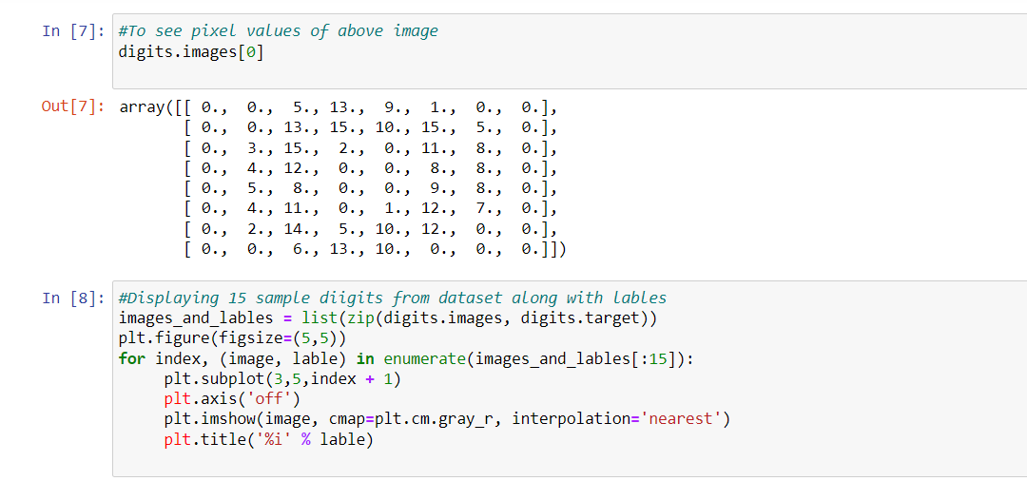

Slide 13
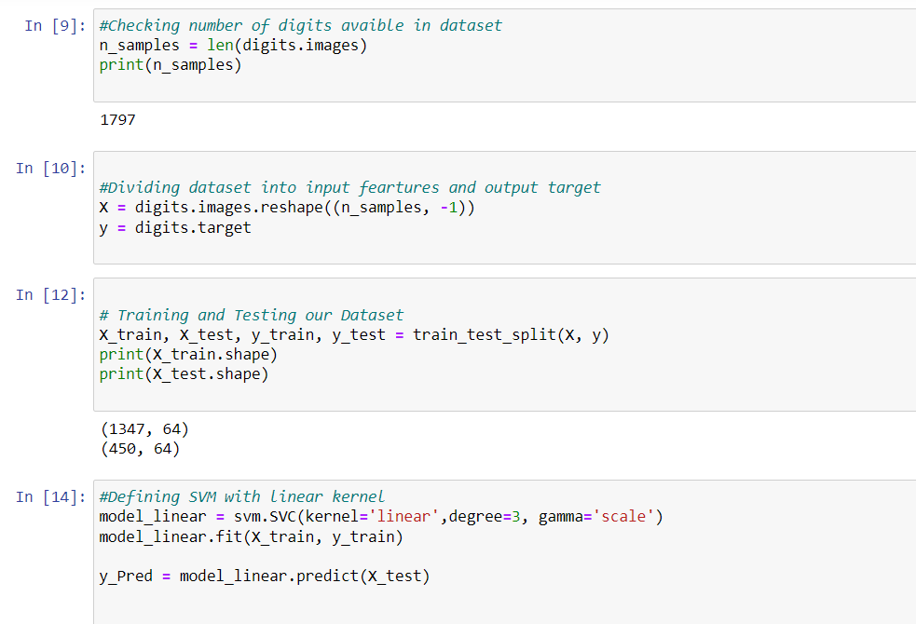

Slide 14
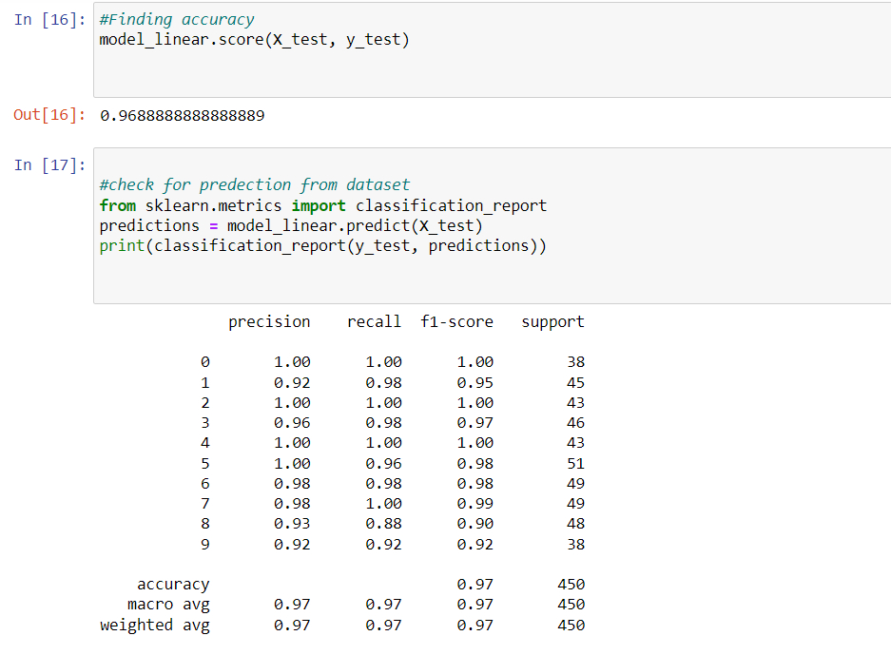

Slide 15
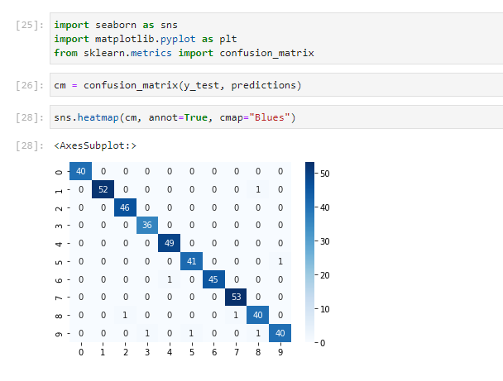

Slide 16
WHAT IS ADMM?

Slide 17

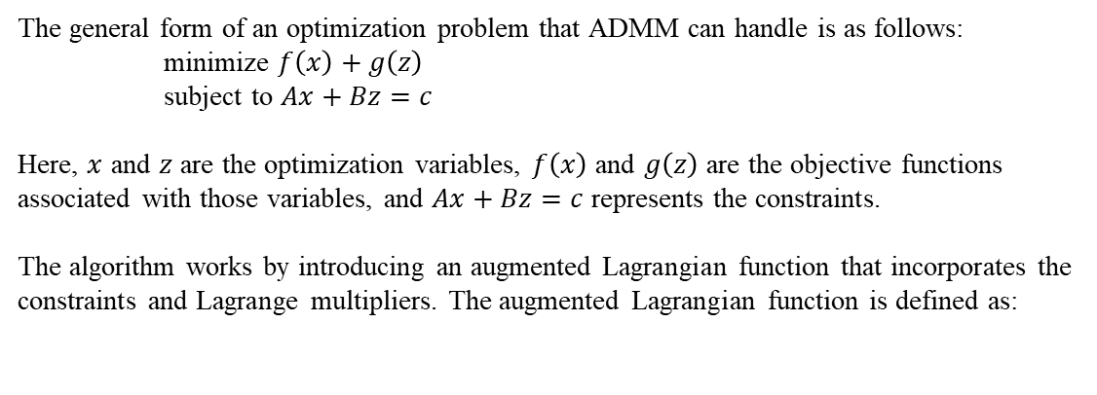
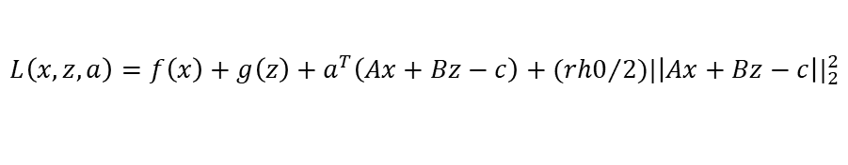
The general form of an optimization problem that ADMM can handle is as follows:
minimize $f\left(x\right)+g\left(z\right)$
subject to $Ax+Bz=c$
Here, $x$ and $z$ are the optimization variables, $f\left(x\right)$ and $g\left(z\right)$ are the objective functions associated with those variables, and $Ax+Bz=c$ represents the constraints.
The algorithm works by introducing an augmented Lagrangian function that incorporates the constraints and Lagrange multipliers. The augmented Lagrangian function is defined as:
$$L\left(x,z,a\right)=f\left(x\right)+g\left(z\right)+a^{T}\left(Ax+Bz−c\right)+({rh0}/{2)|\left|Ax+Bz−c\right||_{2}^{2}}$$

Slide 18
The ADMM algorithm involves the following steps:
Initialize the variables x, z, and a (the augmented Lagrangian multiplier).
Update x by minimizing the augmented Lagrangian function L(x, z, a) with respect to x, while keeping z and a fixed.
Update z by minimizing L(x, z, a) with respect to z, while keeping x and a fixed.
Update the Lagrange multiplier a by updating it based on the difference between Ax + Bz and c.
Repeat steps 2-4 until convergence criteria are met.

Slide 19
Basis Pursuit using ADMM
Basis pursuit is a sparse approximation problem that aims to find the sparsest solution that satisfies a set of linear constraints. It is commonly used in signal processing and compressed sensing applications.
Formally, given a matrix A and a vector b, the basis pursuit problem can be stated as:
minimize ||x||_1
subject to Ax = b
Here, x is the sparse vector we want to find, ||x||_1 denotes the L1 norm of x (sum of absolute values of its elements), A is a known matrix, and b is a known vector.
By solving the basis pursuit problem using ADMM, we can find a sparse solution x that satisfies the linear constraints Ax = b while minimizing the L1 norm of x.

Slide 20
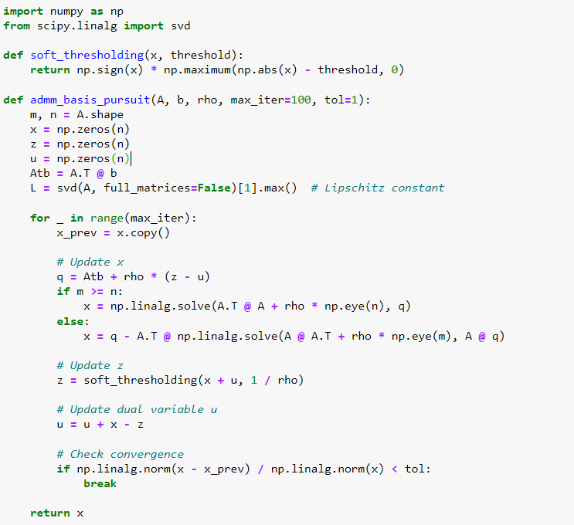
Basis Pursuit using ADMM Python code:

Slide 21
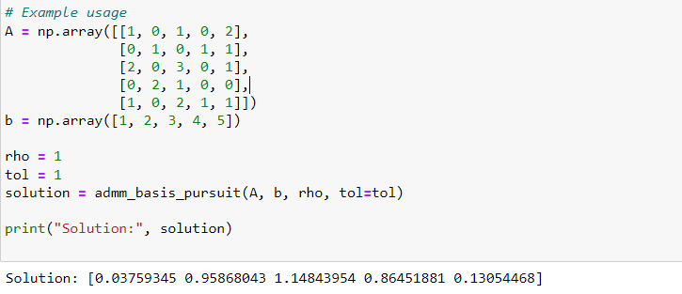

Slide 22
Lasso (Least Absolute Shrinkage and Selection Operator) Regression using ADMM
Lasso, which stands for Least Absolute Shrinkage and Selection Operator, is a popular regularization technique used in regression analysis.
It combines both regression and variable selection by adding a penalty term to the ordinary least squares (OLS) cost function.
The penalty term encourages the model to select only the most relevant features and to shrink the coefficients of less important features towards zero.
Least Square regression:
Min(sum of the squared residuals + alpha*(|slope|)

Slide 23
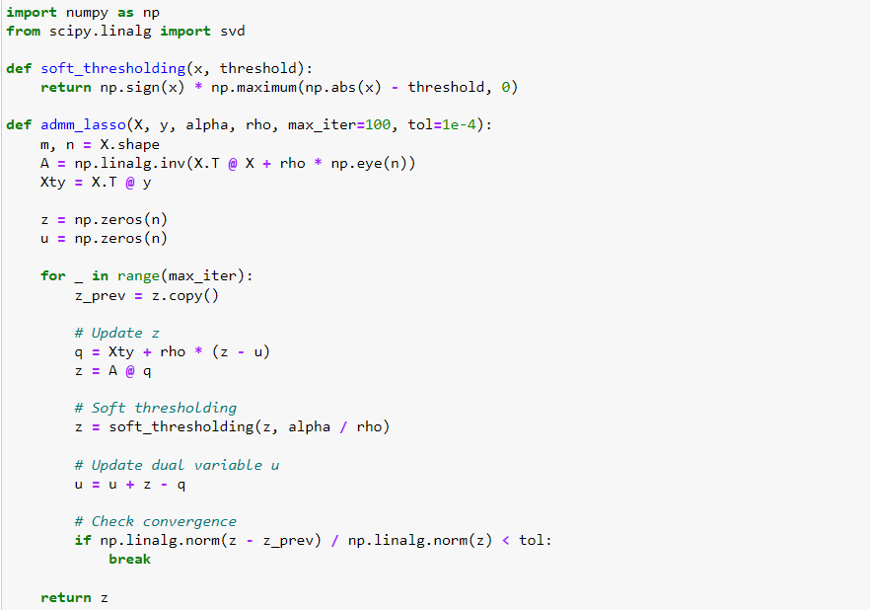

Slide 24
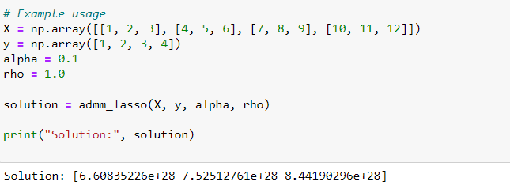

Slide 25
Thank you

