Slide 1
Python for Machine Learning
21AIE205
Batch-A-Group-09
TERM PROJECT

Slide 2




SANGAM GANESH BABU
CHALLA YOGANANDHA REDDY
[CB.EN.U4AIE21056]
[CB.EN.U4AIE21008]
RANGISETTI SAI RAGHAVENDRA
Gajula Sri Vatsanka
[CB.EN.U4AIE21049]
[CB.EN.U4AIE21010]

Slide 3
Lung Cancer prediction
Using
KNN
LOGISTIC REGRESSION

Slide 4
—MOTIVATION
Lung cancer is often not diagnosed until it has advanced, which makes it more difficult to treat. By identifying individuals at high risk for lung cancer, doctors can perform screenings and catch the disease in its early stages, increasing the chances of a successful treatment.

Slide 5
DATASET DESCRIPTION:
The dataset that is being used in this code is a collection of Lung-cancer.
Number of Rows = 309
Number of Columns = 16

Slide 6
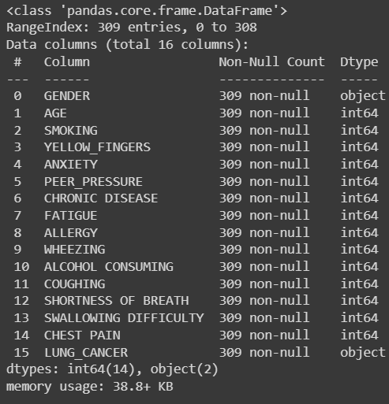
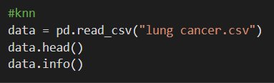
Processing the data:

Slide 7
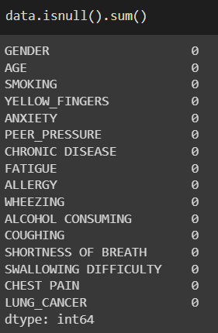
And, then we are checking are there any missing values in the data.

Slide 8
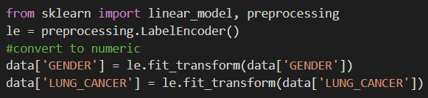
Here, we are transferring the data which is in alphabetical from into numeric form.

Slide 9
KNN K-Nearest Neighbors Algorithm.
K-Nearest Neighbor (KNN) is a supervised machine learning algorithm used for classification and regression. The basic idea behind the KNN algorithm is to find the K number of training examples that are closest to the new input data point and use the majority class among those K examples as the prediction for the new data point.
KNN algorithm can be used for both classification and regression problems. For classification, the output is a class membership (predicted class label), and for regression, the output is the property value for the object.
In KNN algorithm, the value of K is chosen by the user and it can be any positive integer. Larger the value of K, smoother decision boundary will be and fewer chances of overfitting.
The KNN algorithm is considered to be a lazy learning algorithm because it doesn't learn a discriminative function from the training data but memorizes the training dataset instead.
KNN algorithm is simple, easy to implement and it's one of the most popular machine learning algorithms.

Slide 10
LOGISTIC REGRESSION
It is used for predicting the categorical dependent variable using a given set of independent variables.
Logistic regression predicts the output of a categorical dependent variable. Therefore the outcome must be a categorical or discrete value. It can be either Yes or No, 0 or 1, true or False, etc. but instead of giving the exact value as 0 and 1, it gives the probabilistic values which lie between 0 and 1.
Logistic Regression is much similar to the Linear Regression except that how they are used. Linear Regression is used for solving Regression problems, whereas Logistic regression is used for solving the classification problems.
In Logistic regression, instead of fitting a regression line, we fit an "S" shaped logistic function, which predicts two maximum values (0 or 1).

Slide 11
RESULTS
STEP 1 : PRE PROCESSING THE DATA

Slide 12
IMPORTING ALL THE REQUIRED LIBRARIES
import numpy as np
import matplotlib.pyplot as plt
import pandas as pd
import seaborn as sns
from sklearn.model_selection import train_test_split
from sklearn.metrics import accuracy_score
from sklearn.metrics import confusion_matrix
from sklearn.metrics import classification_report

Slide 13
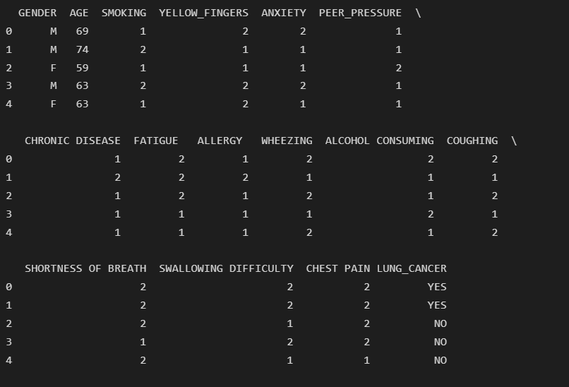
data = pd.read_csv("lung cancer.csv")
data.head()

Slide 14
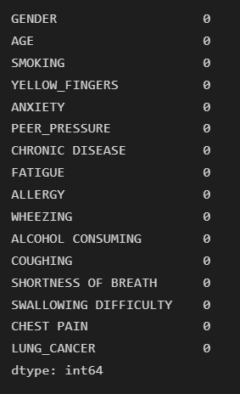
CHECKING FOR NULL VALUES AND REPLACING THEM
data.isnull().sum()

Slide 15
Replace the Categorical values
from sklearn import linear_model, preprocessing
le = preprocessing.LabelEncoder()
#convert to numeric
data['GENDER'] = le.fit_transform(data['GENDER'])
data['LUNG_CANCER'] = le.fit_transform(data['LUNG_CANCER'])

Slide 16
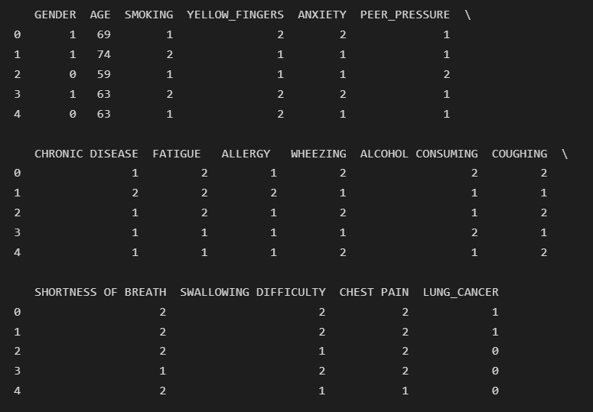
data.head()

Slide 17
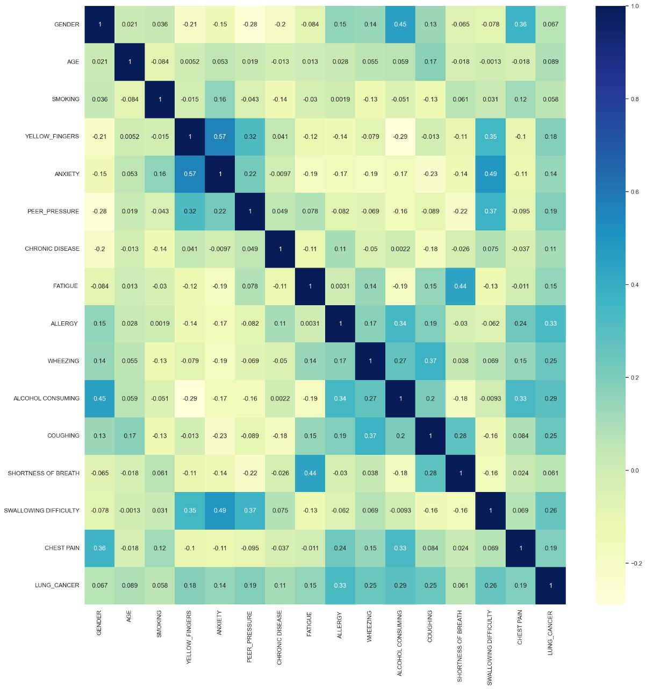
FINDING THE CORRELATION
data.corr()
Fig, ax = plt.subplots(figsize=(20,20))
sns.heatmap(data.corr(), cmap="YlGnBu", annot=True)

Slide 18
Training and splitting of the data.
#split the data into features and target
X = data.iloc[:, :-1].values
y = data.iloc[:, -1].values
#split the data into training and testing sets
X_train, X_test, y_train, y_test = train_test_split(X, y, test_size=0.2, random_state=3)

Slide 19
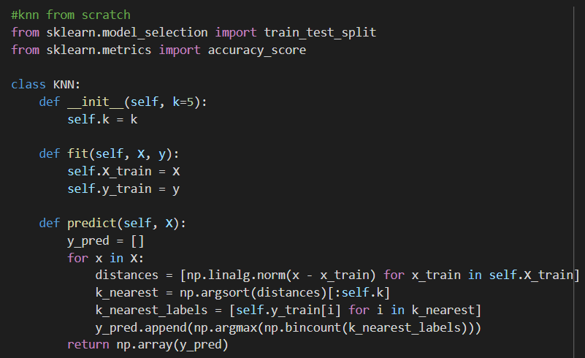
K-Nearest Neighbour algorithm from scratch

Slide 20

Accuracy Score
#knn
knn = KNN(k=2)
knn.fit(X_train, y_train)
predictions = knn.predict(X_test)
accuracy = accuracy_score(y_test, predictions)
print("Accuracy: ", accuracy)

Slide 21
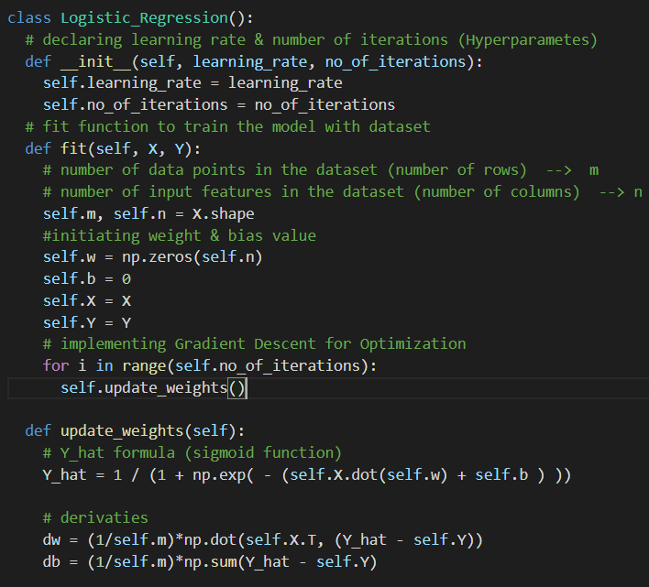
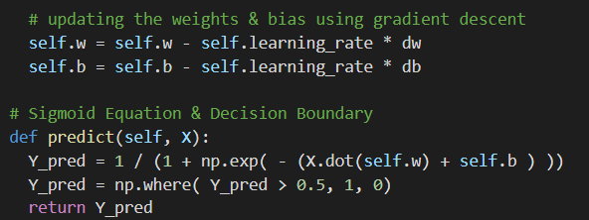
Logistic regression from Scratch

Slide 22

# initialize logistic regression model
clf = LogisticRegression(learning_rate=0.1, num_iterations=1000)
# fit the model to the training data
clf.fit(X_train, y_train)
# predict on test data
y_pred = clf.predict(X_test)
# print accuracy
print('accuracy_score')
print(accuracy_score(y_test,y_pred))

Slide 23
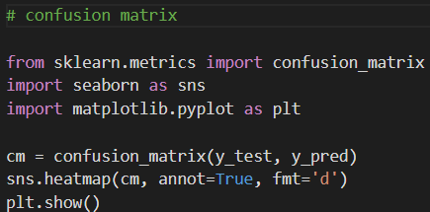

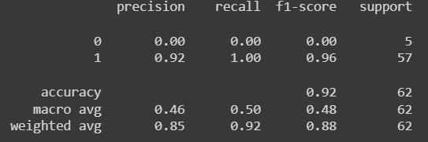
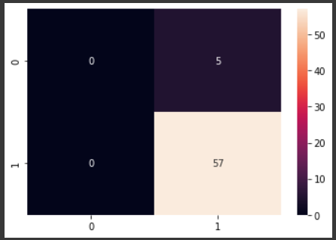
Confusion Matrix and Classification Report

Slide 24
Thank you
`

