Slide 1



DATA STRUCTURES AND ALGORITHMS – 2
21AIE203
Batch-A Group - 09
Term Project Evaluation

Slide 2




Presented By
SANGAM GANESH BABU
CHALLA YOGANANDHA REDDY
[CB.EN.U4AIE21056]
[CB.EN.U4AIE21008]
RANGISETTI SAI RAGHAVENDRA
Gajula Sri Vatsanka
[CB.EN.U4AIE21049]
[CB.EN.U4AIE21010]

Slide 3
Implementation of Phonebook using TRIE Data Structure.

Slide 4
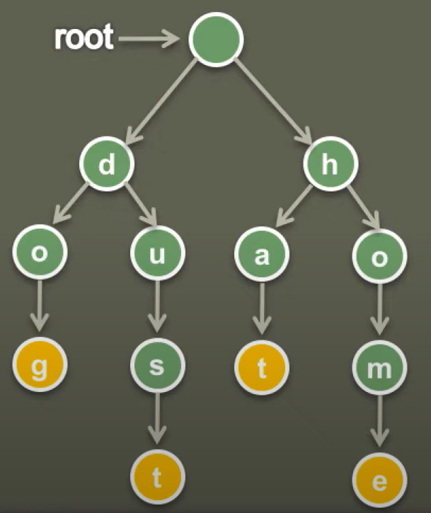
What is a Trie?
Trie basically comes from the word Retrieval.
The main purpose of this data structure is to retrieve stored information very fast.
Trie with 4 words –
Dog
Dust
Hat
home

Slide 5
Trie Data Structure :
A Trie (prefix tree) is a tree-based data structure that is used to store an associative array where the keys are sequences (usually strings).
It is also known as a prefix tree because it stores the prefixes of keys.
Each node in the Trie represents a single character in a key, and each edge represents a character transition from one node to another.
The Trie is a compact data structure that can be used to implement many different types of data structures, such as dictionaries and spell-checking algorithms.

Slide 6
Properties:
The root node represents an empty string and doesn't have any data.
Each subsequent level of the Trie represents a single character in the key.
The last node of a key represents the end of the key and is marked as such.
The Trie can be searched quickly because each character in the key is used to traverse the Trie.
The Trie can be used to implement many different types of data structures, such as dictionaries, spell-checking algorithms, and autocomplete features.

Slide 7
Advantages:
Space-efficient
Fast Prefix Search
Easy Insertion and Deletion
Suitable for Dictionary or Autocomplete
Suitable for IP routing
Disadvantages:
Increased Space Complexity
Higher Time Complexity for Searching
Extra space
Not suitable for large datasets
Not suitable for exact match

Slide 8
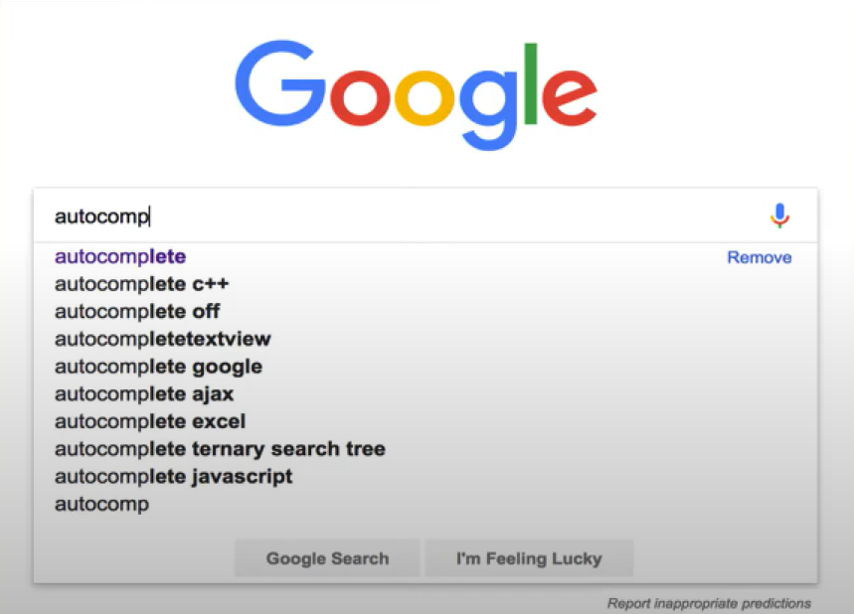
Applications - Auto-Complete words
Autocomplete feature is implemented by Tries.
Many websites have used autocomplete feature, which suggest user rest of the word, while user is typing

Slide 9
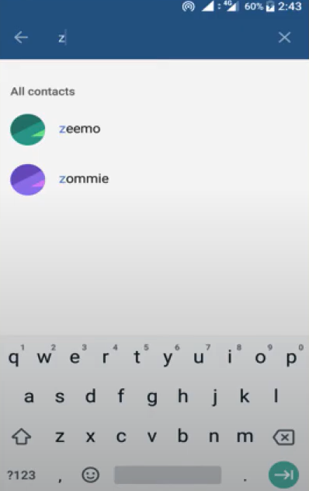
Applications - Search Contacts in phone
Searching a person contact number in contact list is efficiently implemented by Trie. As soon as user enters letters the application auto suggest the name of the person.

Slide 10
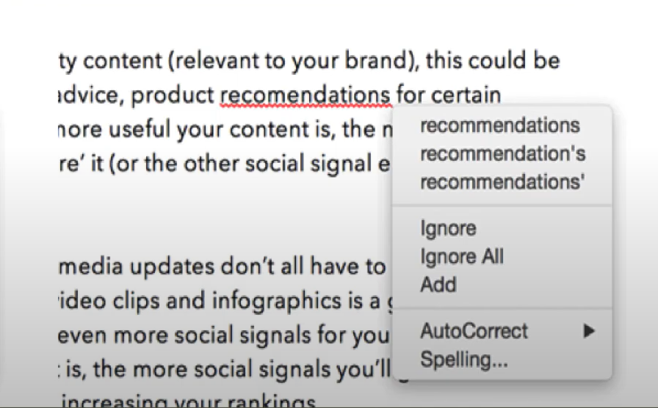
Applications - Spell Checking
Tries help to check and correct word spelling entered by user. In case user doesn't know exact spelling it auto suggest the correct spelling.

Slide 11
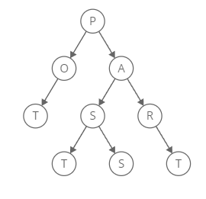
Example: POT,PAST,PART,PASS

Slide 12
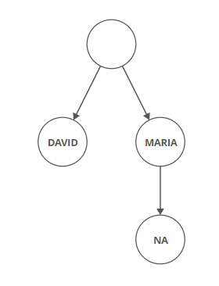
Radix Trees:
A Radix tree is also like a trie data structure ,but it saves space by combining nodes together if they only have one child.
Example: -
Maria ,Marina ,David

Slide 13
Phonebook
A phonebook, also known as a telephone directory, is a list of phone numbers and associated information such as names, addresses, and other contact details. Phonebooks can be in the form of physical books or digital databases. They provide a way for people to look up phone numbers and contact information for individuals or businesses. Phonebooks are typically organized alphabetically by last name or by category (such as businesses or government agencies).

Slide 14
Code

Slide 15
VIDEO PRESENTATION LINK: BATCHA_GROUP9(DSA TERM-PROJECT)
Batch - A _Group - 09

Slide 16
Thanks!

