Slide 1

Intelligence to Biological Systems-3
Term Project
Presented By
Batch-A Group-09

Slide 2




SANGAM GANESH BABU
CHALLA YOGANANDHA REDDY
[CB.EN.U4AIE21056]
[CB.EN.U4AIE21008]
RANGISETTI SAI RAGHAVENDRA
Gajula Sri Vatsanka
[CB.EN.U4AIE21049]
[CB.EN.U4AIE21010]

Slide 3
Phylogenetic Algorithms
It’s Applications

Slide 4
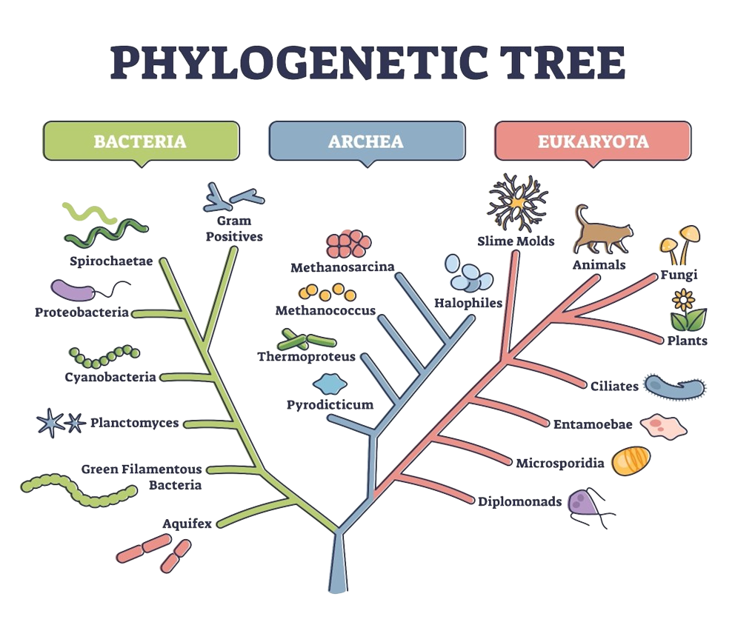


Phylogenetics is the study of evolutionary relationships among different organisms. One of the main methods used in phylogenetics is the construction of evolutionary trees, also known as phylogenetic trees or cladograms. These trees represent the branching pattern of evolutionary descent and are used to inter evolutionary relationships among different species.
There are many different algorithms that can be used to construct phylogenetic trees, each with its own strengths and weaknesses.
The most commonly used algorithms are:
Maximum likelihood
Bayesian inference
Maximum compatibility
Distance-based methods
Neighbor joining (NJ)

Slide 5
Maximum likelihood: This method estimates the tree that is most likely to have generated the observed data, based on a model of evolution.
Bayesian inference: This method uses Bayes' theorem to estimate the probability of different trees given the observed data.
Maximum compatibility: This method uses combinatorial optimization algorithms to find the most compatible tree that explains the observed data.
Distance-based methods: These methods construct trees based on the pairwise genetic distances between different species.
Neighbor joining: NJ algorithm is a widely used method for constructing phylogenetic trees, based on the distance between species. NJ is a greedy algorithm, which endeavors to minimize the sum of all the branch lengths of the resulting tree.
Each of these algorithms has its own assumptions and requires different computational resources, so the choice of algorithm will depend on the size and complexity of the data set and the goals of the analysis.

Slide 6
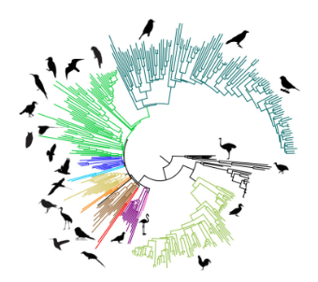
Methods of Phylogenetic Tree Construction
Phylogenetic tree generation consists of sequence alignment where the resulting tree reveals alignment can influence the tree formation.
Alignment-based methodologies are probably the most widely used tools in sequence analysis problems
They consist of arranging two sequences
A phylogenetic tree is formed as an outcome of sequence analysis performed on the DNA or RNA strings
Sequence comparison reveals the patterns of shared history between species, helping in the prediction of ancestral states.
The comparison of sequences also helps in understanding the biology of living organisms which is required to find similarity and relationship among species.
Alignment method
Highlight their common symbols and substrings
Based on alignment parameters including insertion, deletions and gaps which play a pivotal role in the construction of the phylogenetic tree.
Supertree of Birds

Slide 7
Sequence Alignment
Sequence alignment is a method to identify homologous sequences
It is categorized as pairwise alignment in which only two sequences are compared at a time whereas in multiple sequence alignment more than two sequences are compared.
Sequence alignment is a technique used in phylogenetics to compare and align DNA, RNA or protein sequences from different species.
The goal of sequence alignment is to identify regions of similarity and evolutionary relationships between the sequences.
The aligned sequences can then be used to construct a phylogenetic tree, which shows the evolutionary relationships and divergence times between the different species.
There are several methods for sequence alignment, including global alignment, local alignment, and multiple sequence alignment.
Each method has its own strengths and weaknesses and is used depending on the specific research question and dataset.

Slide 8
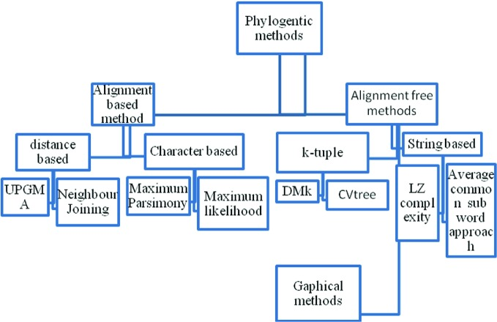
Figure gives a hierarchical view of various methods for phylogenetic tree building
Hierarchical view of phylogenetic methods

Slide 9
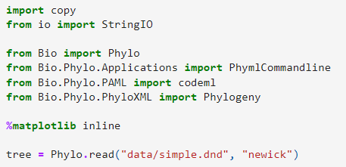


Code:
Printing the tree object as a string gives us a look at the entire object hierarchy.
Output

Slide 10


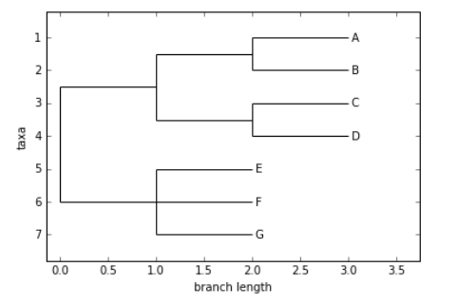
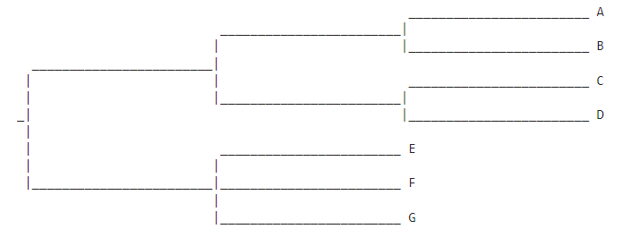
The function draw ASCII creates a simple ASCII-art (plain text) dendrogram. This is a convenient visualization for interactive exploration, in case better graphical tools aren’t available.
Code:
create a graphic using the draw function
Code:
Output
Output

Slide 11
Character-Based Methods
Character-based methods in phylogenetics are methods that use discrete, observable characters (such as morphological or molecular characters) to infer evolutionary relationships between different species.
One common character-based method is parsimony analysis, which is based on the principle of parsimony, which states that the simplest explanation for a set of observations is the most likely to be correct. Parsimony analysis constructs a phylogenetic tree that requires the smallest number of character state changes to explain the observed character data.
Another common character-based method is maximum likelihood analysis, which uses statistical models to infer the most likely tree that explains the observed character data. This method requires a model of character evolution, such as the Jukes-Cantor model or the Kimura 2-parameter model, which describe the probability of different character state changes over time.
Both parsimony and likelihood-based methods are widely used in phylogenetics, and each has its own strengths and weaknesses. Depending on the research question, the characteristics of the dataset, and the assumptions of the model, one method may be more appropriate than the other.

Slide 12
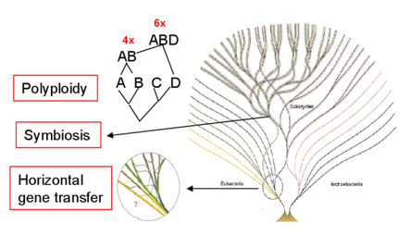
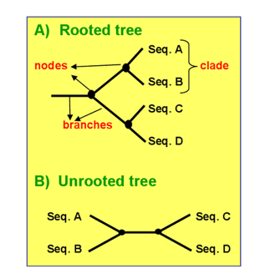
Construction of Phylogenetic Trees
Distance based methods
Character based methods
Construction and editing of a MSA
Selection of a submission model
Tree building
UPGMA - unweighted pair group method with Arithmetic mean
Neighbor-joining
Maximum Parsimony
Maximum Likelihood
The software used for phylogenetic Analysis
MEGA - Molecular Evolutionary Genetics Analysis
PHYLIP - PHYLogeny Inference Package
PAUP - Phylogenetic Analysis Using Parsimony

Slide 13
Steps for preparing the Phylogenetic Tree
Selection of an organism or a gene family
Selection of appropriate molecular markers
Amplification
Sequencing
Assembly
Alignment
Evolutionary model
Phylogenetic Analysis
Construction of a Tree
Evolution of a Phylogenetic Tree

Slide 14
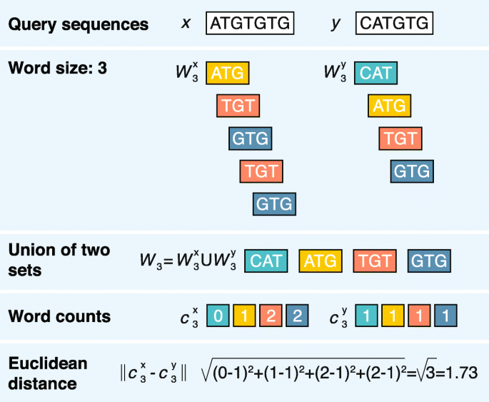
Alignment-Free Methods for Sequence Analysis
Alignment-free methods proposed in recent years.
These include k-tuple based on the word frequencies, methods that represent the sequence without using the word frequencies, i.e. compression algorithms
probabilistic methods and information theory-based
method.
In the k-tuple method, a genetic sequence is represented by a frequency vector of fixed length subsequence and the similarity or dissimilarity measures that are generally based on the frequency vector of subsequence.
The probabilistic methods represent the sequences using the transition matrix of a Markov chain of a pre-specified order.
The Euclidean distance
AFC of word-based distance between two sample DNA sequences ATGTGTG and CATGTG

Slide 15



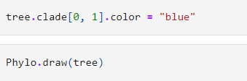
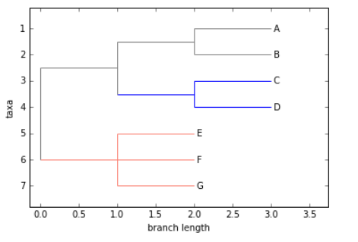
Code:
Coloring branches within a tree
Output

Slide 16
Applications
Alignment-Based Versus & Alignment-Free Sequence Comparison in phylogenetics
In phylogenetics, alignment-based and alignment-free methods are both used to infer evolutionary relationships among different species. Alignment-based methods involve aligning the sequences of interest, such as DNA or protein sequences, and comparing the similarities and differences to infer evolutionary relationships.
These methods often use dynamic programming algorithms, such as the Needleman-Wunsch or Smith-Waterman algorithms, to align the sequences.
These methods may be less sensitive to the effects of insertions, deletions, and substitutions, which are common in evolutionary sequences.
It's worth noting both alignment-based and alignment-free methods have their own advantages and disadvantages, and researchers use both methods depending on the specific research question and the availability of computational resources.

Slide 17
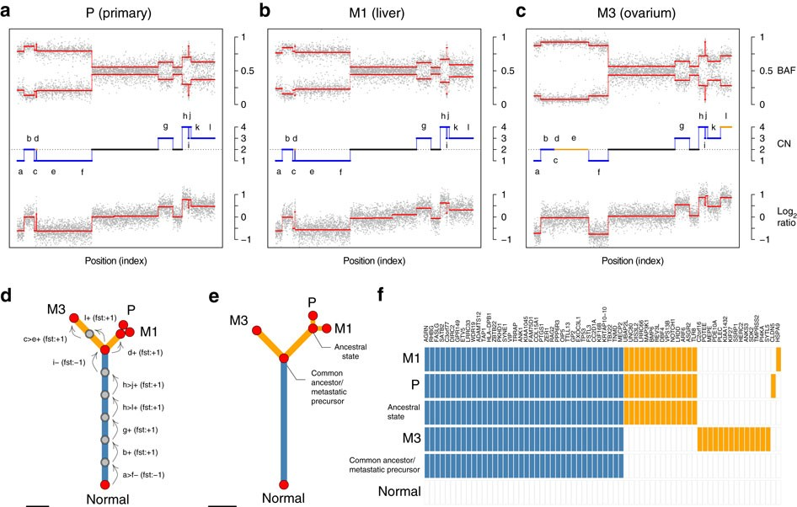

Application of Phylogenetics in Cancer Studies
Cancer research is considered one of the most significant areas in the medical community. Mutations in genomic sequences are responsible for cancer development and increased aggressiveness in patients.
The combination of all such genes mutations, or progression pathways, across a population can be summarized in a
phylogeny describing the different
evolutionary pathways and also used in
finding breast cancer subtypes based on
gene data.
Phylogenetic methods can solve the
problem of class prediction by using a
classification tree. Phylogenetic methods
give us a deeper understanding of
biological heterogeneity among cancer
subtype.
Phylogenetic inference from SNVs and CNAs.

Slide 18
Conclusion for Phylogenetics
The topic that we covered mainly focuses on the various methods of sequence analysis to generate phylogenetic trees. The limitations associated with sequence alignment methods lead to the development of alignment-free sequence analysis. However, most of the existing alignment-free methods are unable to build an accurate tree so more refinement is required in alignment-free methods. The phylogenetic study is not limited to species evolution, but disease evolution as well. Extending phylogenetic to disease diagnosis can give birth to new treatment options and understanding its progression.

Slide 19
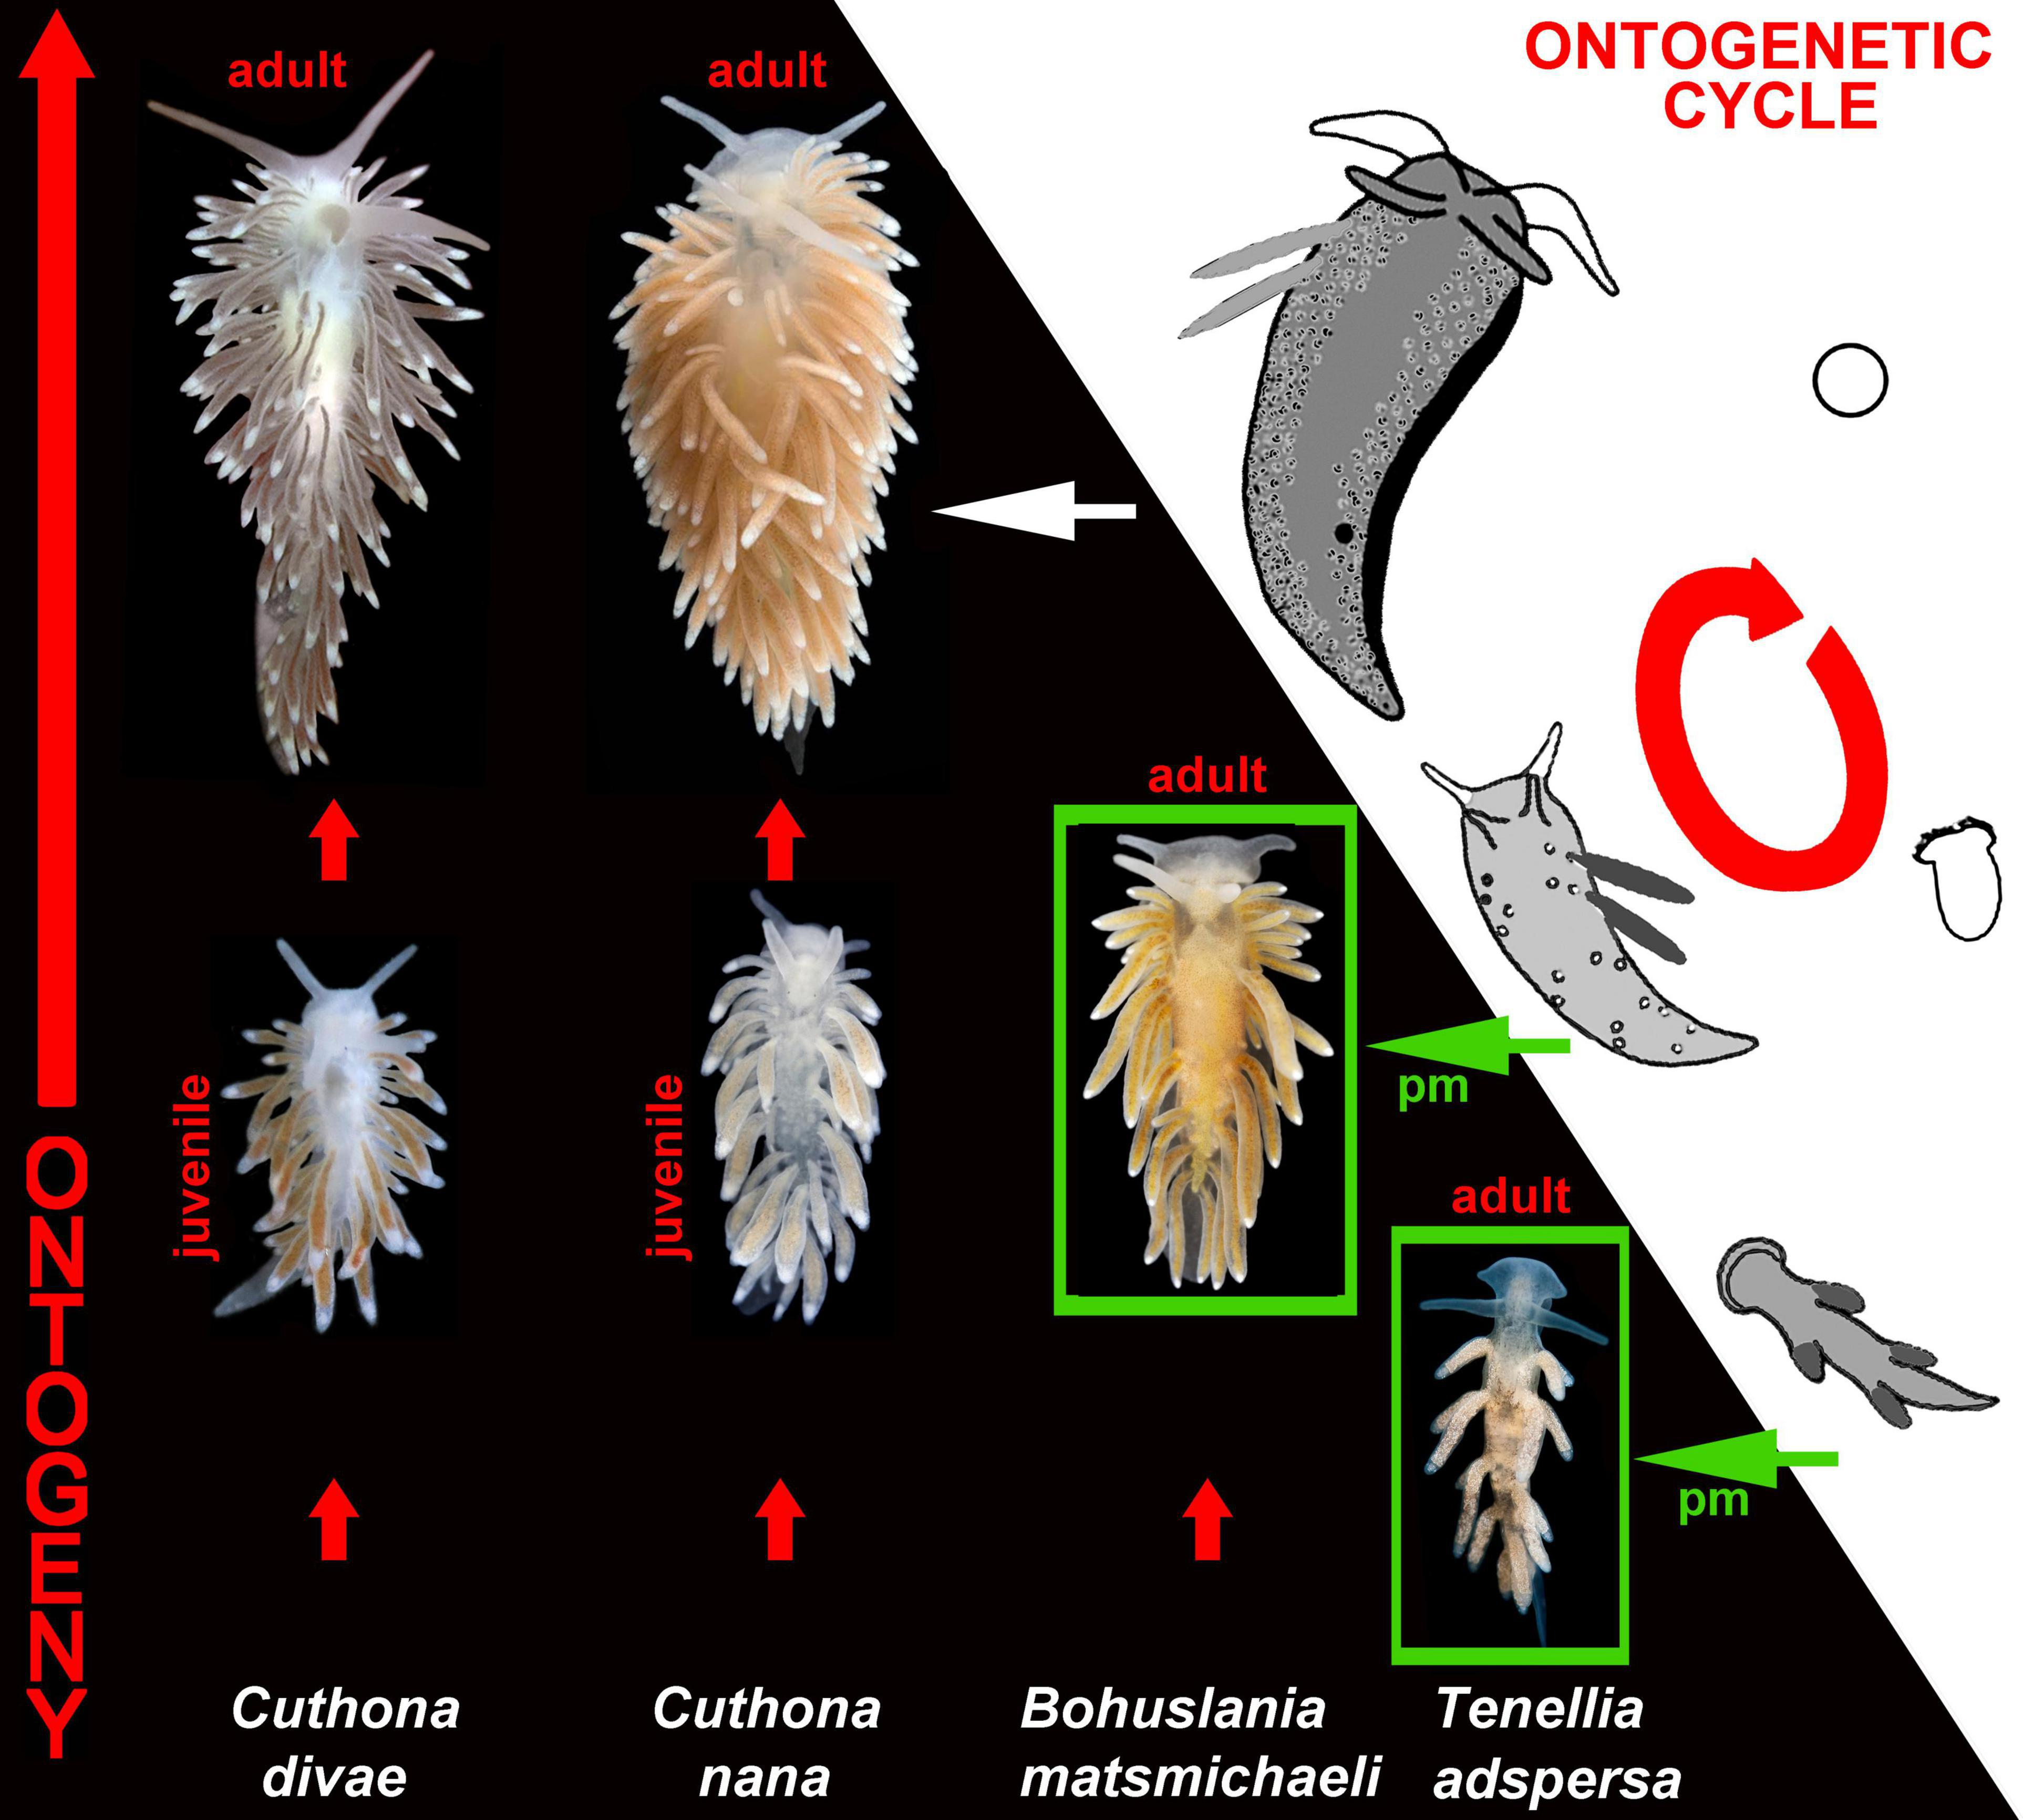
Ontogeny
Ontogeny refers to the development of an individual organism from conception to maturity. This includes the growth and differentiation of cells, tissues, and organs, as well as the changes in physiology and behavior that occur over the life span of the organism. It begins at the time of fertilization and includes all the developmental events at the time of birth and thereafter.
Ontogenetic-and-evolutionary linkage through the modifications of the ontogenetic cycles of aeolidacean nudibranchs.

Slide 20
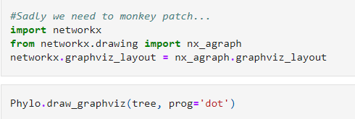
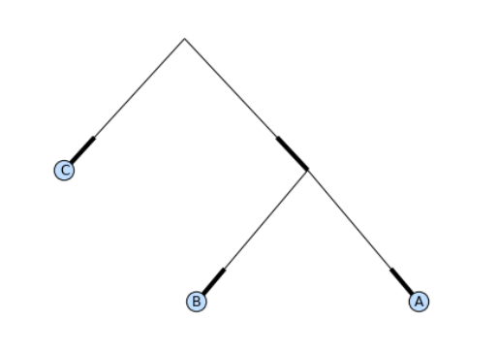
Code:
Output

Slide 21

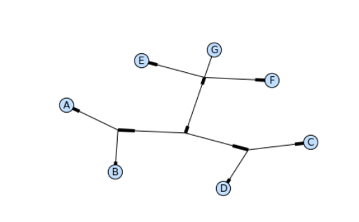
Code:
Output

Slide 22
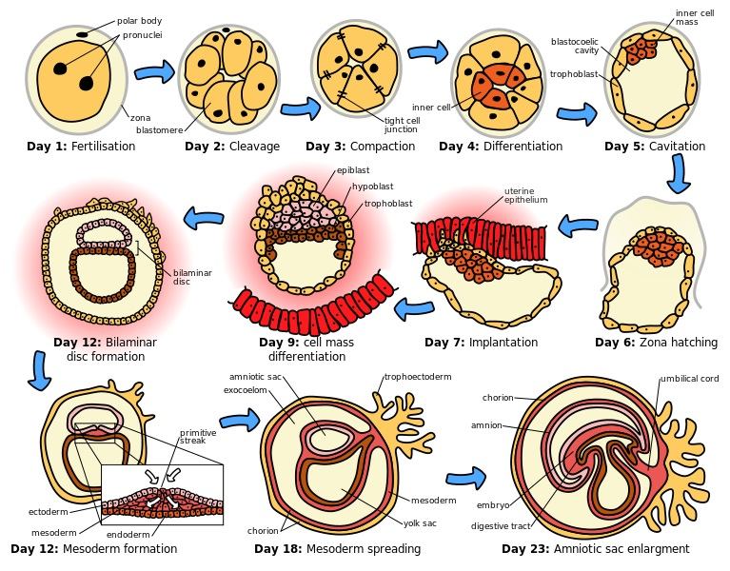
Ontogenesis and morphogenesis are the other two names used for ontogeny. Generally, all of these developmental events start with the fertilization of male and female gametes, forming the zygote. Then, the zygote undergoes cleavage and compaction prior to differentiation.
Differentiation starts with the formation of the blastula in a process known as blastulation. In mammals, the blastula is the blastocyst, consisting of trophoblast, inner cells mass, and blastocoelic cavity. After that, the blastula undergoes implantation. Next, further differentiation of the inner cell mass forms the three germ layers, ectoderm, mesoderm, and endoderm, forming the gastrula in a process known as gastrulation.

Slide 23
ONTOGENY VERSUS PHYLOGENY
ONTOGENY
PHYLOGENY
The development of an organism is defined as Ontogeny while phylogeny refers to how the organisms have evolved.
The study of relationships among different groups of organisms and their evolutionary development
The development or development history of an individual organism
Gives the development history of an organism within its own lifetime
Gives the evolutionary history of a species
Describes how a chicken came to life starting from a single cell
Describes the evolutionary process of Gallus gallus.

Slide 24
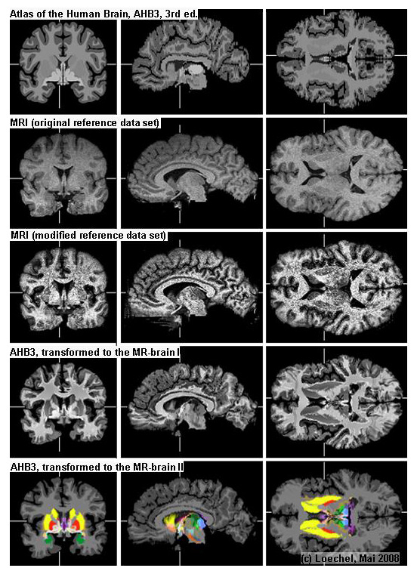
Let us take an example of a chicken, the ontogeny will explain the entire development cycle of the chicken right from the single cell. Now let's take an example of an ostrich and assume that it descended from the family of chickens, phylogeny will explain how the chicken evolved into an ostrich, i.e., it will explain the evolutionary process.
The Connection between Ontogeny and Phylogeny
The evolution of the human brain over millions of years and its development over the course of one lifetime are inextricably linked. In fact, the best way to get an overview of the stages through our brain passed in the course of evolution through which it passes as an individual develops.
The phrase “ontogeny recapitulates phylogeny” was coined by Ernst Haeckel in 1866 and for many decades was accepted as natural law. Haeckel meant it in the strict sense: that an organism, in the course of its development, goes through all the stages of those forms of life from which it has evolved.

Slide 25
Modern biology now rejects this dogmatic perspective. Though recognizing that human beings evolved from fish and reptiles, biologists cannot discern in our development any stages that correspond precisely to those of a fish or a reptile.
Conclusion for Ontogeny
The development and growth of an individual organism, is that it is a complex and dynamic process that begins at fertilization and continues throughout the organism's life. It involves changes in both physical characteristics and behavior, and is influenced by both genetic and environmental factors. Understanding ontogeny is important for understanding the overall development and functioning of organisms, and can have practical applications in fields such as medicine and agriculture.

Slide 26

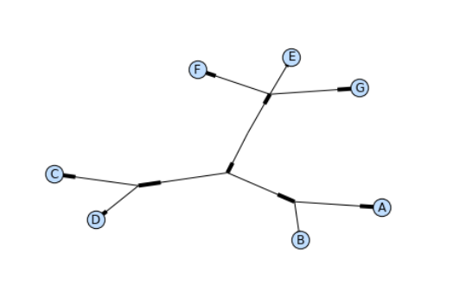
Code:
Output

Slide 27

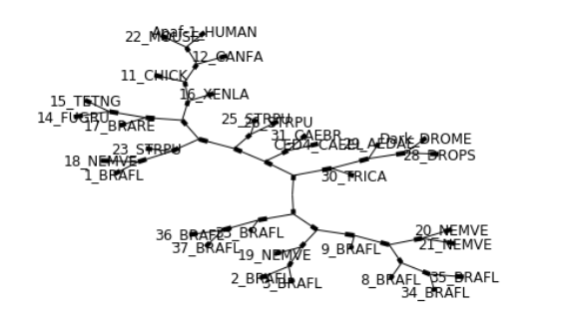
Code:
Output

Slide 28
Thanks

