Slide 1
TERM PROJECT
Batch-A-Group-09
Mathematics of Intelligent Systems-3

Slide 2




SANGAM GANESH BABU
CHALLA YOGANANDHA REDDY
[CB.EN.U4AIE21056]
[CB.EN.U4AIE21008]
RANGISETTI SAI RAGHAVENDRA
Gajula Sri Vatsanka
[CB.EN.U4AIE21049]
[CB.EN.U4AIE21010]

Slide 3
QUADRATIC PROGRAMMING

Slide 4

What is Quadratic Programming? & What is the use of Quadratic Programming in real world

Slide 5
Quadratic programming (QP) is the problem of optimizing a quadratic objective function and is one of the simplest form of non-linear programming.
Programming problems
Non-Linear programming
Convex
Linear programming
Quadratic programming
The objective function can contain bilinear(x*y) or up to second order polynomial terms and the constraints are linear and can be both equalities and inequalities.

Slide 6
USE OF QUADRATIC PROGRAMMING IN REAL WORLD
Used in signal and image processing.
Model predictive control.
Extensively used in finance ,as variance ,used to measure risk ,is a function containing squares.

Slide 7
Where this Non-Linear programming problem can occur in practical situations ?
a)Gasoline Blending
b)Sales Revenue
c)Portfolio selection problem
d)Safety Stock inventory levels

Slide 8
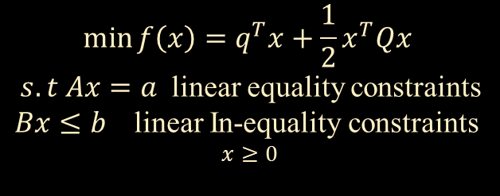
Formulation
A general quadratic programming formulation contains a quadratic objective function and linear equality and inequality constraints
$$\min{f\left(x\right)=q^{T}x+\frac{1}{2}x^{T}Qx}$$
$s.t Ax=a$ linear equality constraints
$Bx≤b$ linear In-equality constraints
$$x≥0$$
When there is only inequality constraints, the Lagrangian is
$$Bx≤b$$
$L\left(x,λ,μ\right)=q^{T}x+\frac{1}{2}x^{T}Qx+λ^{T}\left(Ax−a\right)+μ^{T}\left(Bx−b\right)=0$
Here q contains all the (singly differentiated) linear terms and Q contains (twice differentiated) Quadratic terms . Here q is gradient and Q is Hessian Matrix.
Any constants contained in the objective function are left out of the general formulation. The one-half in front of the quadratic term is included to remove the coefficient that results from taking the derivative of a second-order polynomial.

Slide 9



Solutions can be tested for optimality using Karush-Kuhn-Tucker conditions just as is done for other nonlinear problems: Condition 1: sum of gradients is zero: $∇L\left(x^{∗},λ^{∗},μ^{∗}\right)=q^{T}+ x^{T}Q+{λ^{∗}}^{T}A+{μ^{∗}}^{T}B$
Condition 2: all constraints satisfied: $Ax^{∗} −a=0$
$$Bx^{∗} −b ≤0$$
Condition 3: complementary conditions:
$$x^{T},λ^{T},μ^{T} ≥0$$
$$μ^{T}(Bx −b)=0$$

Slide 10
APPLICATIONS
^{Quadratic knapsack problem}
In the standard knapsack problem, there are a number of items with different weights and values, and the items are selected based on which combination yields the highest overall value without exceeding the overall weight limit of the knapsack.
In the quadratic knapsack problem, the objective function is quadratic or, more specifically, bilinear, and the constraints are the same as in the typical knapsack problem.
QKP's are used in designing email servers and to optimize the locations of "nodes" in applications such as positioning transportation hubs like airports and train stations.
Additionally, the problem can model situations in which a limited number of people are assigned to complete specific objectives that require them to interact.

Slide 11
Model predictive control
Quadratic programming also has important applications in chemical engineering.
Model predictive control (MPC) is a group of algorithms that help manage production in chemical plants by dictating production in each batch. While often formulated as linear programs because the resulting models are more stable, robust and easier to solve, MPC models are sometimes made with quadratic programming.
As an example of its utility, quadratic programming was used by Di Ruscio in an MPC algorithm for a thermomechanical pulping process, which a method for making paper.

Slide 12

LEAST SQUARES
Least squares regression is one of the most common types of regression, and works by minimizing the sum of the squares of the difference between data points and a proposed fit.
Quadratic optimization is one method that can be used to perform a least squares regression and is more flexible than most linear methods. One formulation for a quadratic programming regression model is as follows
$$\min{e^{1}Ie }$$
$$e=Y−Xβ$$
In this model, $β$and $e$ are the unknown regression parameters, I is an identity matrix, and X and Y contain data about the independent and dependent variables respectively.

Slide 13
Solution methods
There are few Methods to solve this Quadratic Equations with equality and inequality constrains.
We use
Baele’s Method.
Wole’s Method.

Slide 14



USING BAELE’S METHOD TO SOLVE QUADRATIC PROGRAMMING PROBLEM
$$f\left(x\right)=cx+\frac{1}{2}x^{T}Qx$$
[Q is symmetric and b,c are real vectors]
$$s.t Ax≤b \& x>0$$
Does not involve the Kuhn tucker condition.
It involves the partitioning the variables into $xbasic$ and $xnon−basic$.
Express $xB \&$ objective function f in terms of x_{NB} variables.
Always express objective function as maximum form.
Not applicable for Minimum problem.

Slide 15
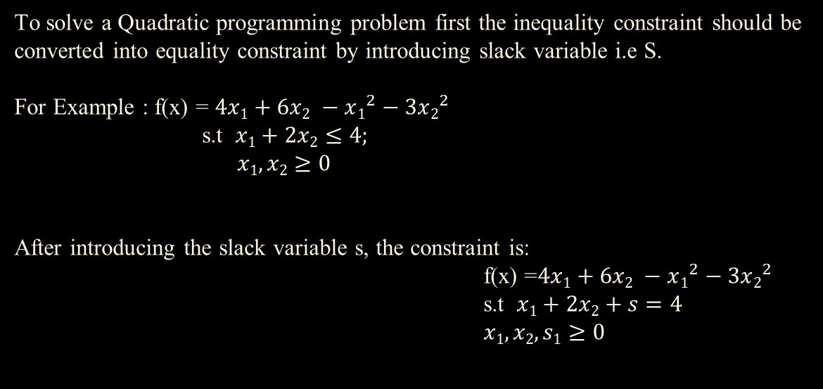
To solve a Quadratic programming problem first the inequality constraint should be converted into equality constraint by introducing slack variable i.e S.
For Example : f(x) = $4x1+6x2 −x1^{2}−3x2^{2}$
s.t $x1+2x2≤4;$
$x1,x2≥0$
After introducing the slack variable s, the constraint is:
f(x) =$4x1+6x2 −x1^{2}−3x2^{2}$
s.t $x1+2x2+s=4$
$x1,x2,s1≥0$

Slide 16
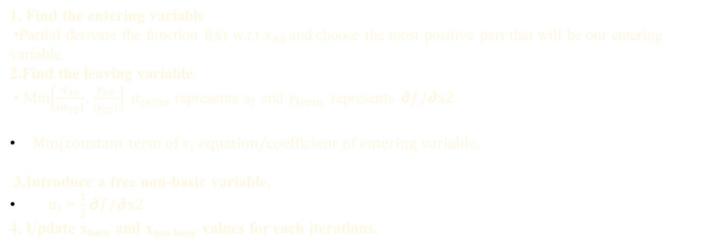
Extension of Simplex method
• It is used for solving the Non-linear programming problem.
It is a solution method.
Steps to be followed to do extension of Simplex method
1. Find the entering variable
•Partial derivate the function f(x) w.r.t $xNB$ and choose the most positive part that will be our entering variable.
2.Find the leaving variable.
• Min$\left\{\frac{α_{10}}{\left|α_{12}\right|},\frac{γ_{20}}{\left|γ_{22}\right|}\right\} α_{term}$ represents s₁ and $γ_{term }$ represents 𝟃$f/\text{∂}$x2
Min{constant term of s₁ equation/coefficient of entering variable.
3.Introduce a free non-basic variable.
u₁ = $\frac{1}{2}\text{∂}f/\text{∂}\text{x}\text{2}$
4. Update x_{basic} and x_{non-basic} values for each iterations.

Slide 17
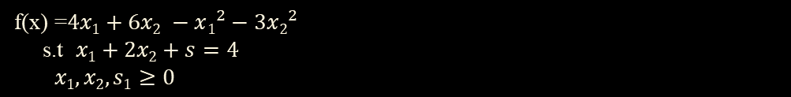
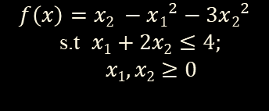
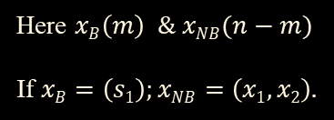

EXAMPLE :
$$f\left(x\right)=x2 −x1^{2}−3x2^{2}$$
$$\text{s}\text{.}\text{t} x1+2x2≤4;$$
$$x1,x2≥0$$
Standard form :
f(x) =$4x1+6x2 −x1^{2}−3x2^{2}$
s.t $x1+2x2+s=4$
$x1,x2,s1≥0$
$$m=1 n=3$$
CONSTRAINTS DECISION VARIABLES
Here $xB\left(m\right) \& xNB(n−m)$
If $xB=\left(s1\right);xNB=\left(x1,x2\right).$

Slide 18

WORKING RULE:
STEP-1:
Express $xB \& f in terms of xNB as s1 x1,x2$
S₁ = $4−x1−2x2$
f = $4x1+6x2−x1^{2}−3x2^{2}$
STEP-2:
Find the entering Variable.
Do the partial derivative of the f w.r.t $xNB$ = ($x1,x2$)
𝟃$f/\text{∂}$x₁ =$−2x1+4$; 𝟃$f/\text{∂}$x₂ = $−6x2+6$
At this point $xNB$ = 0
𝟃$f/\text{∂}$x₁ =$4$; 𝟃$f/\text{∂}$x₂ = $6$
Our question is maximization so we need to take most +ve part i.e $x2$ . $x2$ is the entering variable.

Slide 19
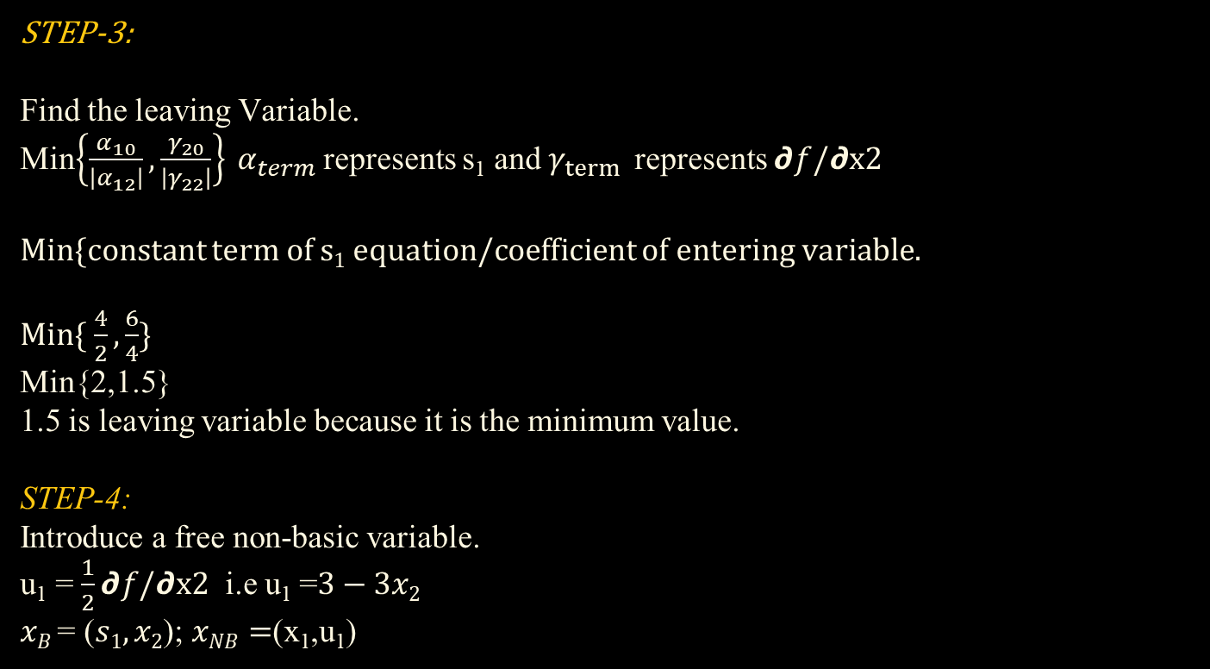
STEP-3:
Find the leaving Variable.
Min$\left\{\frac{α_{10}}{\left|α_{12}\right|},\frac{γ_{20}}{\left|γ_{22}\right|}\right\} α_{term}$ represents s₁ and $γ_{term }$ represents 𝟃$f/\text{∂}$x2
Min{constant term of s₁ equation/coefficient of entering variable.
Min{ $\frac{4}{2},\frac{6}{4}\}$
Min{2,1.5}
1.5 is leaving variable because it is the minimum value.
STEP-4:
Introduce a free non-basic variable.
u₁ = $\frac{1}{2}\text{∂}f/\text{∂}\text{x}\text{2}$ i.e u₁ =$3−3x2$
$xB$ = ($s1,x2$); $xNB=$(x₁,u₁)

Slide 20
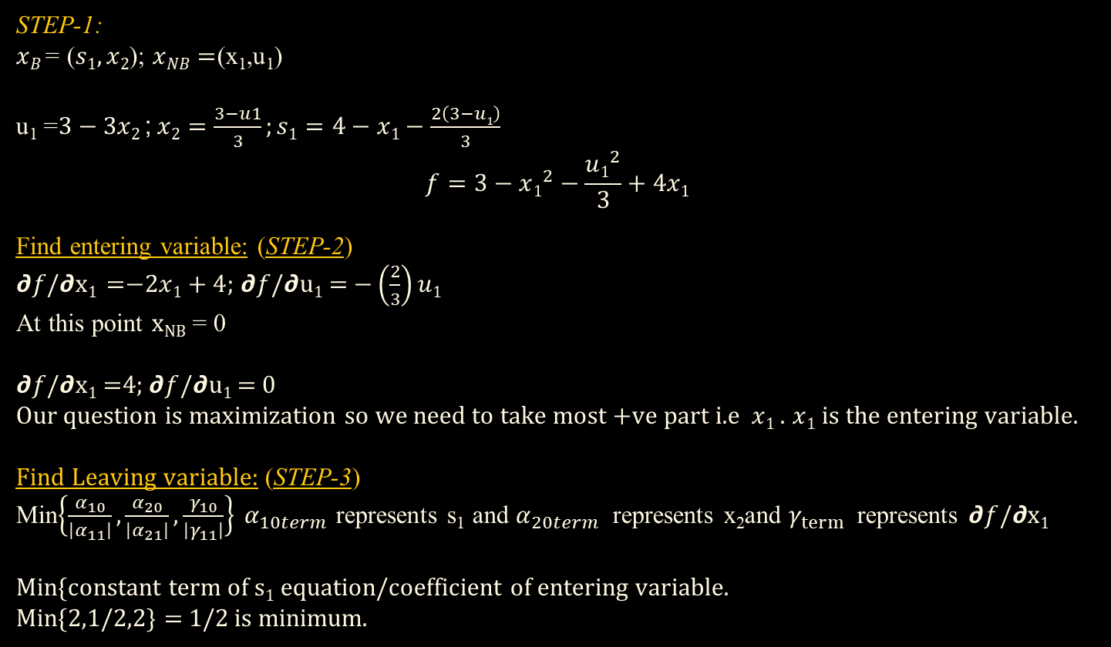
Iteration-2
STEP-1:
$xB$ = ($s1,x2$); $xNB=$(x₁,u₁)
u₁ =$3−3x2$;$x2=\frac{3−u1}{3};s1=4−x1−\frac{2\left(3−u1\right)}{3}$
$$f=3−x1^{2}−\frac{u1^{2}}{3}+4x1$$
Find entering variable: (STEP-2)
𝟃$f/\text{∂}$x₁ =$−2x1+4$; 𝟃$f/\text{∂}\text{u}\text{1}$ = $−\left(\frac{2}{3}\right)u1$
At this point $xNB$ = 0
𝟃$f/\text{∂}$x₁ =$4$; 𝟃$f/\text{∂}\text{u}\text{1}$ = $0$
Our question is maximization so we need to take most +ve part i.e $x1$ . $x1$ is the entering variable.
Find Leaving variable: (STEP-3)
Min$\left\{\frac{α_{10}}{\left|α_{11}\right|},\frac{α_{20}}{\left|α_{21}\right|},\frac{γ_{10}}{\left|γ_{11}\right|}\right\} α_{10term}$ represents s₁ and $α_{20term}$ represents x₂and $γ_{term }$ represents 𝟃$f/\text{∂}$x₁
Min{constant term of s₁ equation/coefficient of entering variable.
Min{2,1/2,2} = 1/2 is minimum.

Slide 21

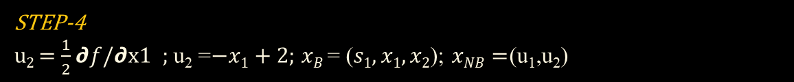
STEP-4
u₂ = $\frac{1}{2}\text{∂}f/\text{∂}\text{x}\text{1}$ ; u₂ =$−x1+2$; $xB$ = ($s1,x1,x2$); $xNB=$(u₁,u₂)
Iteration-3
STEP-1:
$xB$ = ($s1,x2,x1$); $xNB=$(u₁,u₂)
u₂ =$2−x1$;$x1=2−u2;s1=u2+\frac{2\left(u1\right)}{3}$; $x2=1−\frac{u1}{3}$
$$f=7−u2^{2}−\frac{u1^{2}}{3}$$
Find entering variable: (STEP-2)
𝟃$f/\text{∂}$u₁ = $−\left(\frac{2}{3}\right)u1$; 𝟃$f/\text{∂}\text{u}\text{2}$ = $−2u2$
At this point $xNB$ = 0
𝟃$f/\text{∂}$u₁ =$0$; 𝟃$f/\text{∂}\text{u}\text{2}$ = $0$
x_{B} is optimal.
X₁ = 2;x₂ = 1; s1=0 & max f = 7

Slide 22
MATLAB CODE
% Define the objective function coefficients
Q = [2, 0; 0, 1];
q= [-1, -2];
% Define the inequality constraint
A = [1, 1];
b = [2];
% Define the equality constraint
Aeq = [0, 1];
beq = 1;
% Solve the QP
x = quadprog(Q, q, A, b, Aeq, beq);
% Extract the optimal solution
disp(x);

Slide 23
This code defines the objective function as 1/2*x'*H*x + f'*x, subject to the inequality constraints A*x <= b and the equality constraint Aeq*x = beq, with variable bounds lb <= x <= ub. The function quadprog returns the solution x.
Note that, this function is only available in Matlab Optimization Toolbox, if you don't have it, you need to use other optimization libraries such as CVX, Yalmip, etc.

Slide 24
THANK YOU☺!

