Slide 1

Advanced Computer Networks GROUP-14A
HealthCare Networks

Slide 2
TEAM MEMBERS
M. RAMA SARAN | CB.EN.U4AIE21034
AKSHAYAA B K | CB.EN.U4AIE21002
GAJULA SRI VATSANKA | CB.EN.U4AIE21010
R. SAI RAGHAVENDRA | CB.EN.U4AIE21049

Slide 3
Introduction
Computer networks are the backbone of healthcare systems, facilitating seamless communication among medical devices and systems
Robust networks contribute to improved patient care by enabling real-time monitoring, efficient data management, and timely decision-making by healthcare providers
Networks link medical devices, electronic health records, and diagnostic tools, creating an interconnected healthcare ecosystem for comprehensive patient management
Unique challenges, such as security and interoperability, coexist with opportunities for transformative technologies in healthcare networking
The evolution from basic connectivity to advanced technologies reflects a progression toward sophisticated and interconnected healthcare infrastructures

Slide 4
Introduction (Contd.)
The presentation covers key topics related to healthcare networking, including architecture, data exchange, security, and future trends
Adherence to standards ensures compatibility, interoperability, and compliance with regulatory requirements for managing patient data
Networks contribute to personalized healthcare delivery, remote monitoring, and enhanced patient outcomes with a patient-centric focus
Introduction to emerging technologies like IoT, fog computing, and machine learning highlights their potential impact on the future of healthcare networks
Collaboration among healthcare stakeholders, IT professionals, and network specialists is crucial for building robust and effective healthcare network infrastructures

Slide 5
01
“Reducing latency in healthcare IoT to enable timely and efficient exchange of critical patient data for improved diagnosis and treatment.”
PROBLEM STATEMENT

Slide 6
Problem Definition
Healthcare IoT systems face significant latency issues hindering the timely exchange of critical patient data
Delayed data transmission affects the efficiency of diagnosis, treatment, and overall patient care
Immediate access to patient data is essential for timely decision-making by healthcare providers
Existing latency hampers the ability to respond promptly to critical medical situations
Latency contributes to the creation of data silos, preventing seamless integration of information across healthcare devices
Fragmented data impedes comprehensive patient analysis and hinders collaborative care

Slide 7
Problem Definition (Contd.)
Diagnostic accuracy and treatment effectiveness depend on the availability of up-to-date patient information
Latency-related delays compromise the precision of medical interventions and can impact patient outcomes
Latency issues may compromise data security, especially when transmitting sensitive patient information
Addressing latency is crucial for maintaining the confidentiality and integrity of healthcare data
Existing latency challenges contribute to operational inefficiencies, leading to delayed response times and potential errors
Streamlining data transmission is essential for improving overall healthcare system performance

Slide 8
Proposed Methodology
Collecting health data (body temperature, heart rate, blood pressure, SpO2) through sensors connected to ESP32 Wi-Fi modules
Utilizing MQTT protocol to transmit real-time data from sensors to the IoT gateway for initial processing
Employing MQTT for efficient communication between the IoT gateway and fog cloud, minimizing latency in data transmission
Conducting data analysis in fog nodes for early anomaly detection in received health data
Instantly sending SOS messages to caregivers via MQTT in case of abnormal health data patterns

Slide 9
Proposed Methodology (Contd.)
Creating a duplicate of the received health data, encrypting it, and applying lossless compression
Transmitting the encrypted and compressed data to the main cloud using the HTTP protocol for secure and efficient storage
The main cloud receiving, decrypting, and analyzing the overall health data for comprehensive insights
Sending final analysis reports to doctors and patient guardians, facilitating informed healthcare decisions
Enhancing the overall system architecture to enable timely and efficient exchange of critical patient data
Improving diagnostic capabilities and treatment decisions through reduced latency in healthcare IoT communication

Slide 10
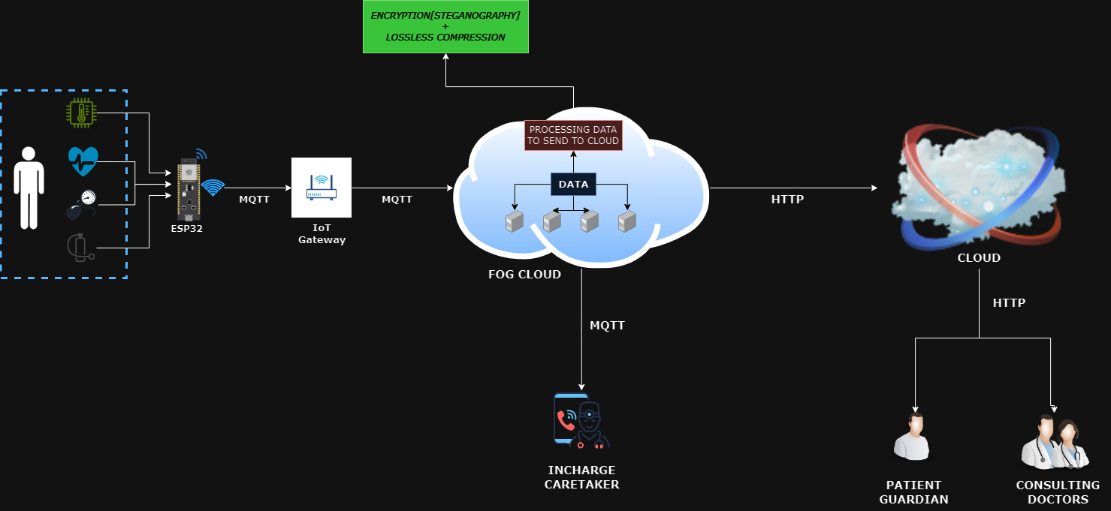
Proposed Methodology (Contd.)

Slide 11
Tools Identified
Sensors:
Microcontroller: ESP32 WIFI Module
IoT Gateway (Sensors to gateway): OpenIoT, Eclipse Kura
Fog Cloud Server: Cisco IOx
Encryption: Open SSL and pycryptodome libraries
Compression: zlib library for lossless compression
Databases: MySQL, MongoDB
Cloud: AWS, Azure, Google Cloud
Body Temperature Sensor: DS18B20 Digital Temperature Sensor
Heart rate Sensor: MAX310100 Sensor
Blood Pressure Sensor: MPX5050DP Blood Pressure Sensor
SpO2 Sensor: MAX310100 Sensor

Slide 12
Conclusion
Proposed architecture addresses healthcare IoT latency, enabling timely data exchange for improved outcomes
Integration of advanced sensors, ESP32, MQTT, and fog computing optimizes real-time data collection and transmission
Anomaly detection and SOS messaging enhance responsiveness to critical medical situations, ensuring patient safety
Dual data path with encryption and compression ensures secure, efficient storage in the main cloud
Tools like OpenIoT, Eclipse Kura, Cisco IOx, and cloud services create a comprehensive ecosystem supporting the proposed methodology
Focus on data integrity, security, and reduced latency positions the architecture for modern healthcare IoT systems
Continuous improvement and testing will refine the architecture, ensuring real-world effectiveness in healthcare scenarios
Represents a significant step towards advancing healthcare technologies for more efficient, secure, and responsive patient care systems

Slide 13
Related Works
S.No. | Title
1. | Fog Computing for Smart Healthcare data Analytics: An Urgent Necessity
2. | Intelligent Behavior Of Fog Computing With IOT For Healthcare System

Slide 14
Future Scope
Blockchain Security Measures:
Enhance security via blockchain, ensuring secure and transparent management of patient health data, addressing privacy and integrity concerns
Expanded Health Monitoring:
Integrate wearable devices for a holistic view of patient health, broadening the scope of monitored data in real-time
5G Technology Integration:
Explore 5G's potential to improve data transmission speeds, supporting more connected devices in healthcare environments
Home Health Monitoring System:
Implementing this system for personal health monitoring at home, enabling proactive healthcare management for loved ones

Slide 15
02
“Enhance the security infrastructure of healthcare networks by proactively identifying and mitigating Man-in-the-Middle (MITM) attacks”
PROBLEM STATEMENT

Slide 16
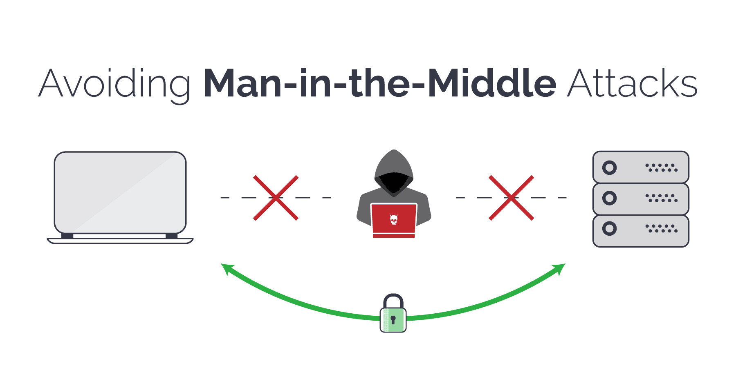
Problem Definition
A Man-in-the-Middle (MiTM) attack is a cyber attack wherein the attacker covertly intercepts and relays messages between two parties
The deceived parties, unaware of the interception, believe they are communicating directly with each other during the attack
The attack is a type of eavesdropping in which the attacker intercepts and then controls the entire conversation.

Slide 17
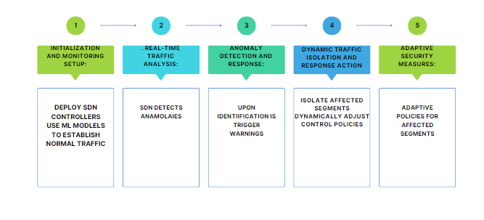
Proposed Methodology
MITIGATION USING SDN

Slide 18
Proposed Methodology (Contd.)
Data Plane:
Processes and forwards network traffic while adapting to reroute traffic per control plane instructions
Mitigates Man-in-the-Middle (MITM) attacks through dynamic traffic rerouting
Application Plane:
Operates independently, ensuring secure data transmission using enforced secure communication channels
Relies on access controls established by the control and data planes
Control Plane:
Monitors traffic and identifies anomalies with machine learning
Triggers alerts and instructs the data plane for dynamic traffic isolation and adaptive access controls

Slide 19
Proposed Methodology (Contd.)
IMAPACT ON QoS PARAMETERS
1.Traffic Prioritization
Positive Impact: The approach might temporarily impact QoS by reallocating bandwidth to prioritize critical healthcare traffic, safeguarding its transmission during the threat response phase
Negative Impact: If access control policies restrict or isolate critical healthcare devices inadvertently, it could affect their access to necessary bandwidth, potentially impacting QoS
2. Latency and Delay:
Positive Impact: Swift response mechanisms can contain threats faster, minimizing network congestion and potential latency caused by the attack
Negative Impact: Restricting communication for affected devices might lead to delays in their operations, impacting the responsiveness required for critical healthcare applications

Slide 20
Tools Identified
Tool Category | Tool Names / Examples
SDN Controller Platforms | OpenDaylight, ONOS (Open Network Operating System)
Network Monitoring and Analysis | Wireshark
Machine Learning and Anomaly Detection | Scikit-learn, TensorFlow, PyTorch
Security and Access Control | Firewalls, Intrusion Prevention Systems (IPS), VPN Solutions
Encryption and Secure Communication | Transport Layer Security (TLS) Implementation, IPsec
Network Segmentation and Isolation | SDN Switches, VLAN Configuration Tools
Compliance and Policy Enforcement | Policy Enforcement Solutions

Slide 21
Conclusion
Real-Time Threat Mitigation:
The solution enables real-time anomaly detection and response, swiftly isolating affected traffic and applying adaptive access controls to contain potential MITM attacks. This proactive approach minimizes the impact on critical healthcare services and data.

Slide 22
Related Works
Eom, W.J.; Song, Y.J.; Park, C.H.; Kim, J.K.; Kim, G.H.; Cho, Y.Z. Network Traffic Classification Using Ensemble Learning in Software-Defined Networks. In Proceedings of the 2021 International Conference on Artificial Intelligence in Information and Communication (ICAIIC), Jeju Island, Korea, 13–16 April 2021; pp. 89–92. [Google Scholar] [CrossRef]
S. Dong and M. Sarem, "DDoS Attack Detection Method Based on Improved KNNWith the Degree of DDoS Attack in Software-Defined Networks," in IEEE Access, volume 8, pp. 5039-5048, 2017.

Slide 23
03
“To improve the performance of unauthorized access prevention and data breach mitigation in healthcare networks” a)Spoofing Attacks
PROBLEM STATEMENT
Notes:
Why did I choose this problem? Read more at: https://economictimes.indiatimes.com/tech/technology/around-5-lakh-people-potentially-fall-victim-to-phishing-scams-in-india-report/articleshow/98393025.cms?utm_source=contentofinterest&utm_medium=text&utm_campaign=cppst
It is very important in healthcare networks to prevent this from happening because in healthcare networks sensitive information(patient details, contact information) of patient is stored if its stolen attackers might get the personal information of patient it will be big problem for patients so to prevent this I took this problem.

Slide 24
Problem Definition
Spoofing attacks in healthcare networks can take various forms, and attackers may employ different techniques to deceive systems and gain unauthorized access or manipulate data
Improved QOS Parameters
Security
Data Integrity
Notes:
There are various types of spoofing attacks which are IP spoofing, email spoofing, MAC spoofing, DNS spoofing, caller ID spoofing, Bluetooth spoofing. an attacker manipulates the source address in the IP header of network packets to make it appear as if they are originating from a trusted source. This can be used to bypass access controls and gain unauthorized access to healthcare systems.

Slide 25
Proposed Methodology
Using machine learning models
Ensemble learning refers to the technique of combining the predictions of multiple machine learning models
To improve overall performance and accuracy
For each new data point, predictions are made by all the individual models
The final prediction is often the average or a majority vote of the individual predictions

Slide 26
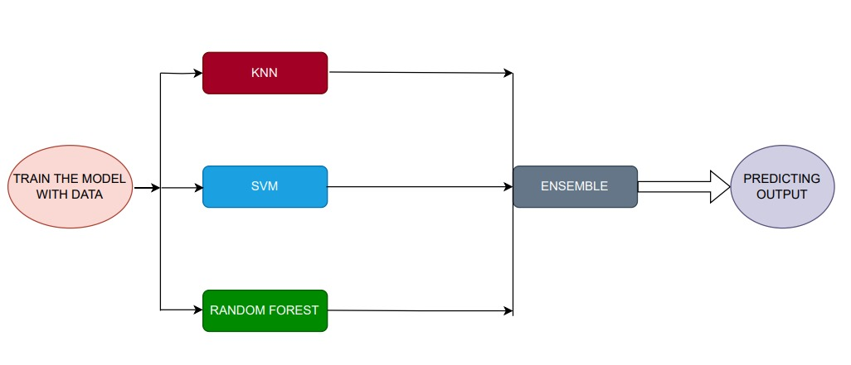
Proposed Methodology (Contd.)
Notes:
Random forest decision tree root node feature splitting internal node leaf node traverse integrated in security infrastructure,svm hyperplane best seperates the diff classes in featue space when new netw acti occur evaluate the feature associa with the insta UNSW-NB15 Dataset

Slide 27
Tools Identified
Scikit-Learn
TensorFlow
PyTorch
IDPS (Snort)
Wireshark
Firewall Why these tools?
These tools provide a wide range of machine learning algorithms and frameworks suitable for different tasks, allowing flexibility in algorithm selection.
Notes:
Signature based detection identify known patterns of attack signatures rule based configuration real time alerting firewall filter and control incoming outgoing packets prevent attacks ns,sacandaut, encyr,educat

Slide 28
Conclusion
The proposed spoofing prevention methodology for healthcare networks utilizing machine learning model
Represents a adaptive approach to strengthen the security of sensitive data
By integrating a set of ML algorithms, like Random Forest, SVM, KNN
To build a strong system that can recognize and stop different types of spoofing attacks

Slide 29
Future Scope
Integrate explainable artificial intelligence (XAI) techniques into the existing methodology
To make the decision-making process of machine learning models more transparent and interpretable
XAI is particularly important in scenarios where understanding the rationale behind AI predictions is crucial, such as in healthcare.
Notes:
Incorporate techniques for feature importance in ml models , Continuous Monitoring of Model Explainability:
Implement a system for continuous monitoring of the explaina bility of machine learning models. As the models are updated and retrained, ensure that the explanations remain consistent and aligned with the expectations of stakeholders.

Slide 30
04
“To improve the performance of interoperability in healthcare networks with respect to the following QoS parameters: Data Exchange Efficiency Semantic Interoperability Data Security and Privacy “
PROBLEM STATEMENT

Slide 31
Problem Definition
The challenge is to enhance the performance of interoperability within healthcare networks, focusing on three critical Quality of Service (QoS) parameters:
Data Exchange Efficiency:
Optimize speed and efficiency for timely and accurate information sharing among healthcare systems.
Semantic Interoperability:
Enhance compatibility and understanding of exchanged data to maintain consistent meaning and context.
Data Security and Privacy:
Address security and privacy concerns in healthcare data interoperability.
Safeguard sensitive patient information from unauthorized access and breaches.

Slide 32
Proposed Methodology
To address the outlined issues, the proposed methodology involves the implementation of advanced technologies and protocols in healthcare networks:
a. Data Exchange Efficiency:
Employing efficient data exchange protocols and standards
Implementing data compression techniques for faster transmission
Utilizing optimized network architectures to reduce latency
b. Semantic Interoperability:
Adopting standardized data formats and coding systems
Implementing ontologies and semantic models for improved data understanding
Ensuring consistent data mapping and translation between different healthcare information systems
c. Data Security and Privacy:
Implementing robust encryption mechanisms for data in transit and at rest
Incorporating access controls and authentication measures
Adhering to healthcare data protection regulations and standards

Slide 33
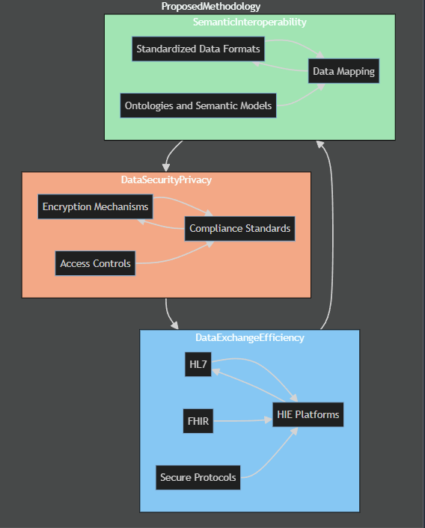
Proposed Methodology (Contd.)

Slide 34
Tools Identified
The following tools can be employed to implement the proposed methodology:
Health Level Seven International (HL7) for standardized data exchange.
Fast Healthcare Interoperability Resources (FHIR) for improved semantic interoperability.
Secure communication protocols (e.g., TLS/SSL) for data security.
Healthcare Information Exchange (HIE) platforms for efficient and secure data sharing
For encryption AES is used.

Slide 35
Conclusion
The proposed methodology aims to improve healthcare network interoperability by addressing QoS parameters.
Focus areas include data exchange efficiency, semantic interoperability, and data security/privacy.
Enhanced aspects lead to seamless and secure information exchange in healthcare.
Overall impact improves patient care and decision-making processes.

Slide 36
Future Scope
The future scope involves continuous advancements and innovations in healthcare interoperability, such as:
Integration of artificial intelligence (AI) for intelligent data mapping and interpretation.
Blockchain technology for enhancing data security and integrity.
Continued refinement of interoperability standards to keep pace with evolving healthcare requirements.
Exploration of emerging technologies to further optimize data exchange efficiency and semantic interoperability.

