Slide 1
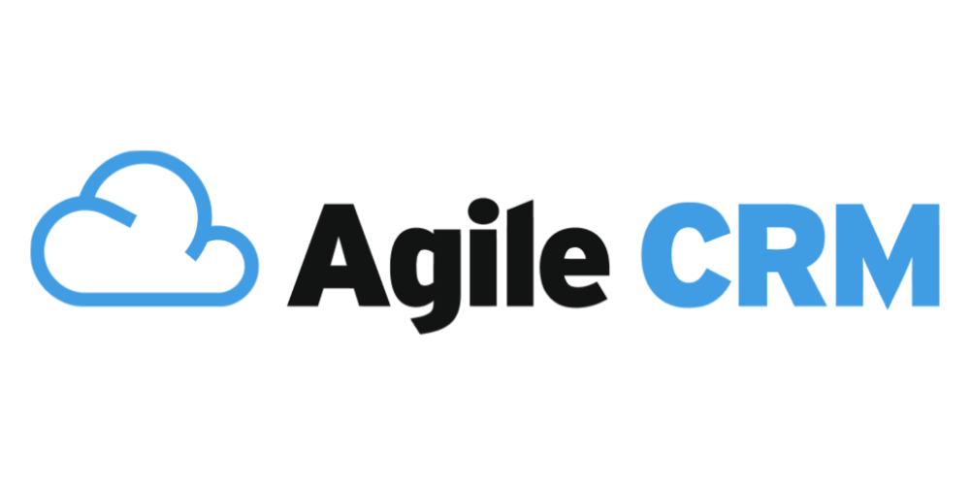
WM CloudStreams Provider - AgileCRM
Participants:
Team Z [Raga Deepika & Kartik Medavarapu]

Slide 2
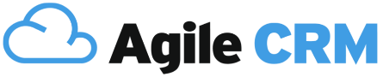
What is webMethods CloudStreams Provider for AgileCRM?
AgileCRM CloudStreams Provider can help you to achieve multiple functionalities of AgileCRM software via REST API. End user can directly use the connector (via drag & drop) from the list of provided connectors and choose the necessary operation. End user need not take the pain of developing the functionalities and can directly use them to manage his CRM application. Presently, out of multiple functionalities available (~60+), we are now able to achieve around ~20 functionalities with the developed WM connector. Below are the list of functionalities achieved in brief:
Operation | WM AgileCRM Connector | AgileCRM Feature
GET | contacts filterTasks getContactById getDealById getDealsByMilestone listDeals listTasks searchContactByEmail | /contacts /tasks/based /contacts/{id} /opportunity/{id} /opportunity/byMilestone /opportunity /tasks /contacts/search/email/{email}
PUT | updateContact updateContactLeadScore updateContactStarValue updateDeal updateTask | /contacts/edit-properties /contacts/edit/lead-score /contacts/edit/add-star /opportunity/partial-update /tasks/partial-update
POST | createContact createDeal createEvent createTask listCompanies createNotes | /contacts /opportunity /events /tasks /contacts/companies/list /notes
DELETE | deleteContact deleteDeal | /contacts/{id} /opportunity/{id}

Slide 3
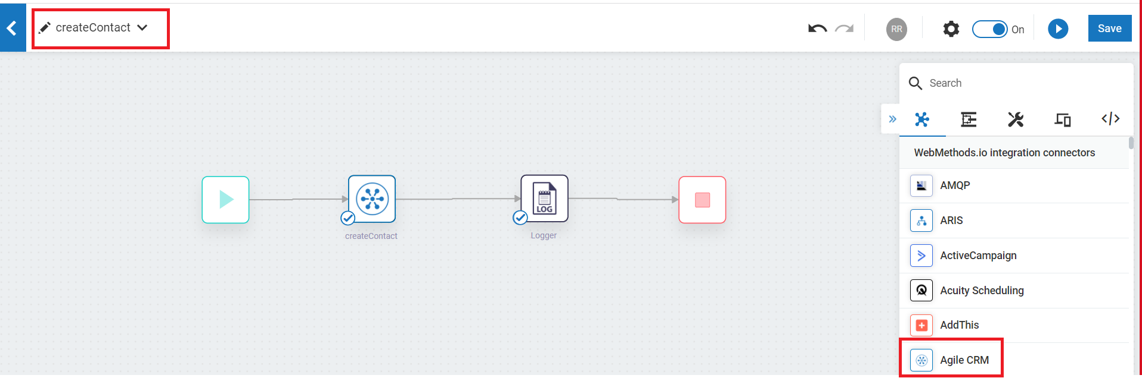
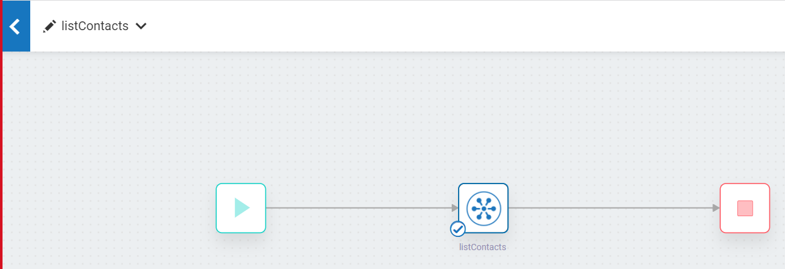
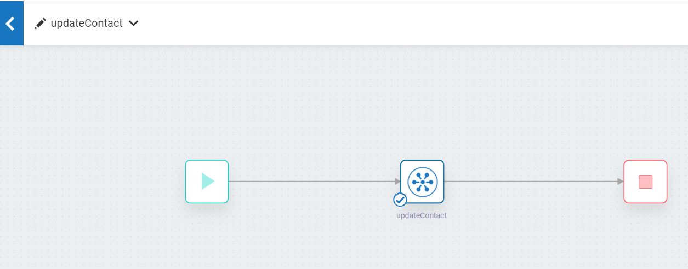

Screenshots for workflow
Below are workflows related to CRUD operations for Contacts feature in Agile CRM. Few other workflows are available in the Cloud tenant – wmioconnector

