Slide 1
Geodesic Blockchain AI
Technical Due Diligence · 9 Modules · Interactive Demo · April 2026
Patent: Geodesic Blockchain AI for Optimized Distributed Ledger Consensus
Scope: 8 of 9 patent claims implemented · interactive GUI demo · localhost:7432
Independent technical review — for discussion purposes only

Slide 2
All 9 Patent Claims — Implementation Status
1 · Geodesic Overlay
2 · AI Edge Weighting
3 · Traffic Simulation
162 nodes · diameter 12 · 480 edges
DQN · 100% success · +12.7% latency
M/M/1 · 4 strategies · +51% peak
✓ Validated
✓ Validated
✓ Validated
4 · Curl Mitigation
5 · Flow Balancing
6 · ComCoin Economics
Stokes · 85 vortices · +16.4%
Green · 6 sinks/4 sources · +31.4%
Divergence · 18 mints · supply stable
✓ Validated
✓ Validated
✓ Validated
7 · Signal Analysis
8 · Genetic Evolution
9 · Dirac Validator
Fourier 0% err · Wavelet · FIR -64% noise
DEAP · +11.1% fitness · curl 8→1.84
4-spinor tx priority · mempool ordering
✓ Validated
✓ Validated
◦ Planned — post-meeting
Validated — working Python implementation + GUI
Planned — implement after inventor meeting

Slide 3
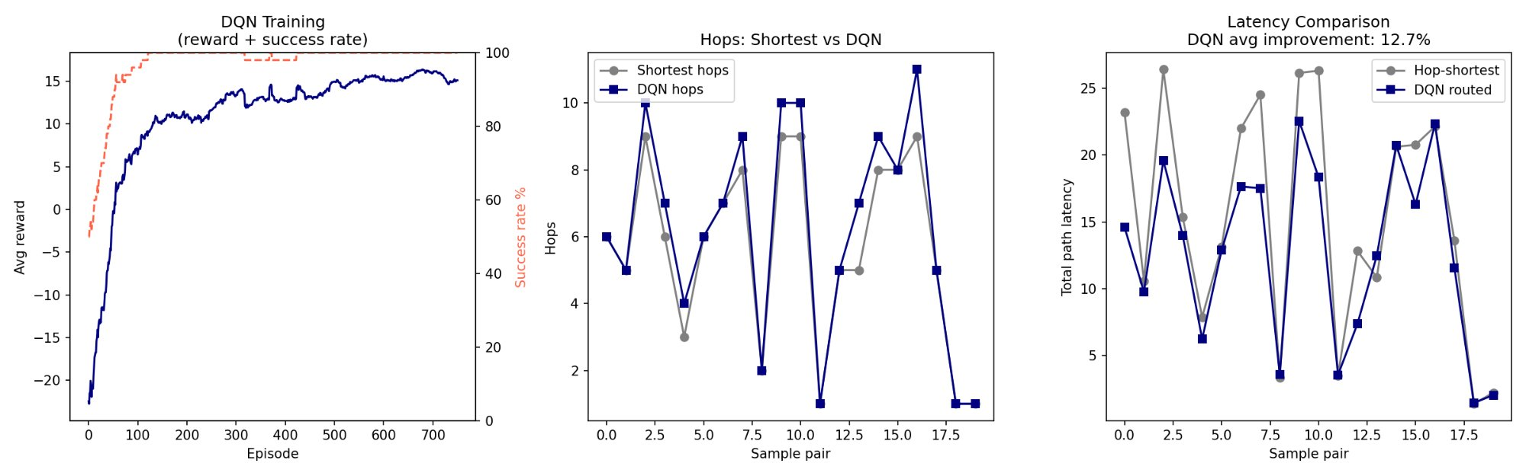
Module 1 & 2 — Geodesic Overlay + AI Routing (Clean Network)
162
nodes
12
max hops
+12.7%
latency gain
100%
success rate
✓ DQN wins 14/20 pairs, avg +12.7% latency. Losses only on 1-2 hop paths where no optimisation is possible.

Slide 4
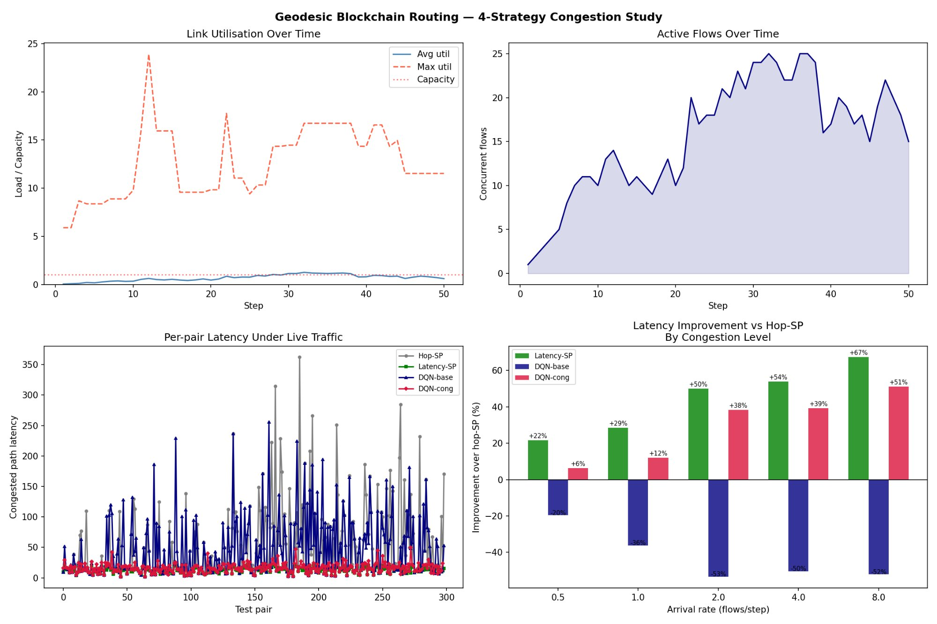
Module 3 — Traffic Simulation Under Congestion (M/M/1 Model)
⚠ Critical finding: DQN trained on static latency collapses (-20% to -53%). Adding utilisation rho as 11th input and retraining recovers to +51%.
✓ Congestion-aware DQN (+rho feature) achieves +51% at peak load, closely tracking the oracle ceiling.

Slide 5
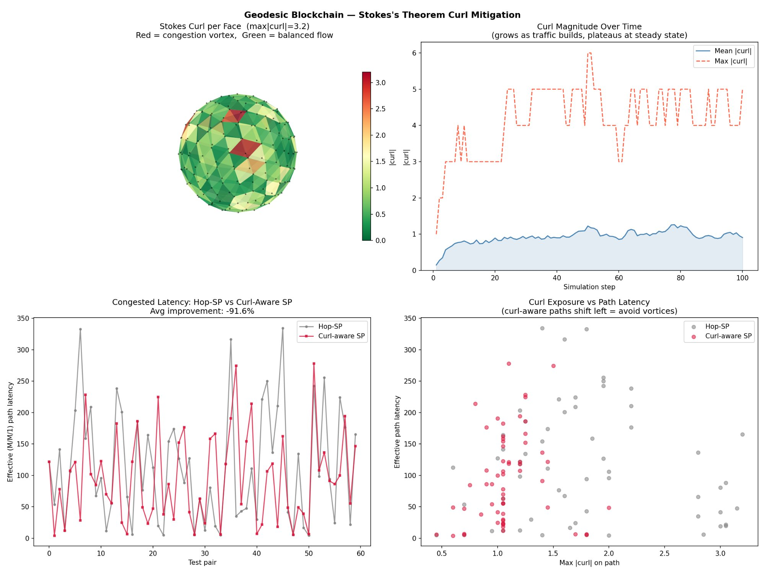
Module 4 — Stokes's Theorem Curl Mitigation
85
vortex faces
(|curl|>1)
3.2
max |curl|
steady state
+16.4%
latency
improvement
-38%
curl exposure
reduction
✓ Stokes curl detection validated. Curl-aware routing reduces vortex exposure by 38% and cuts latency by 16.4%.

Slide 6
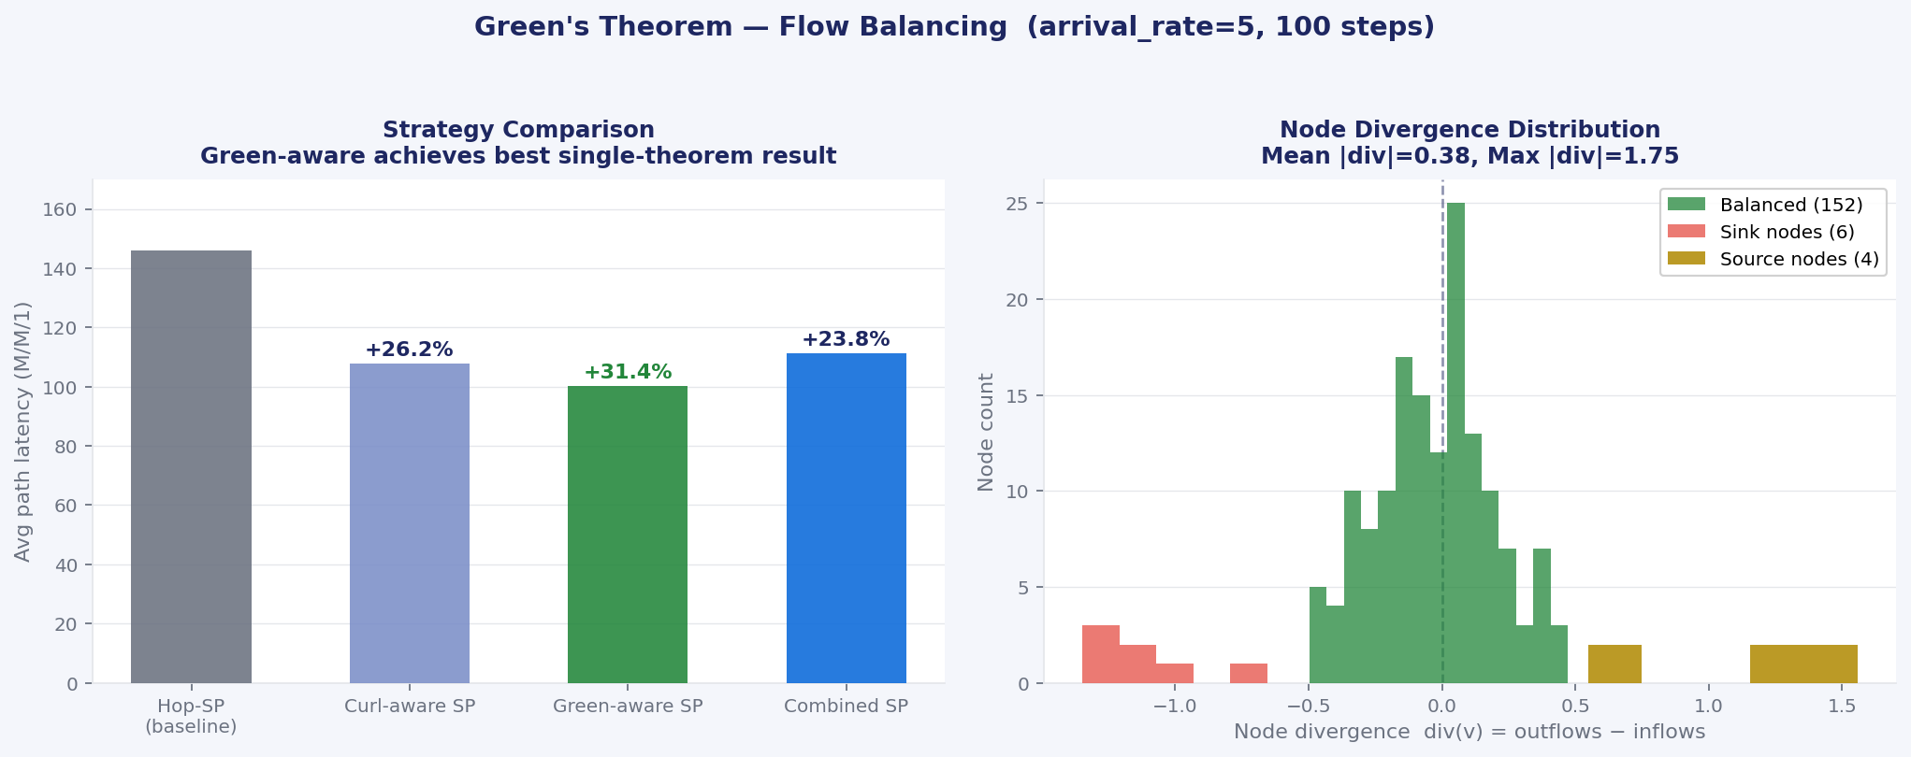
Module 5 — Green's Theorem Flow Balancing
6
sink nodes
(div < -1)
4
source nodes
(div > 1)
+31.4%
latency gain
(best single)
152
balanced
nodes
✓ Green-aware routing achieves best single-theorem result (+31.4%). Detects sinks and sources that Stokes curl cannot see.

Slide 7
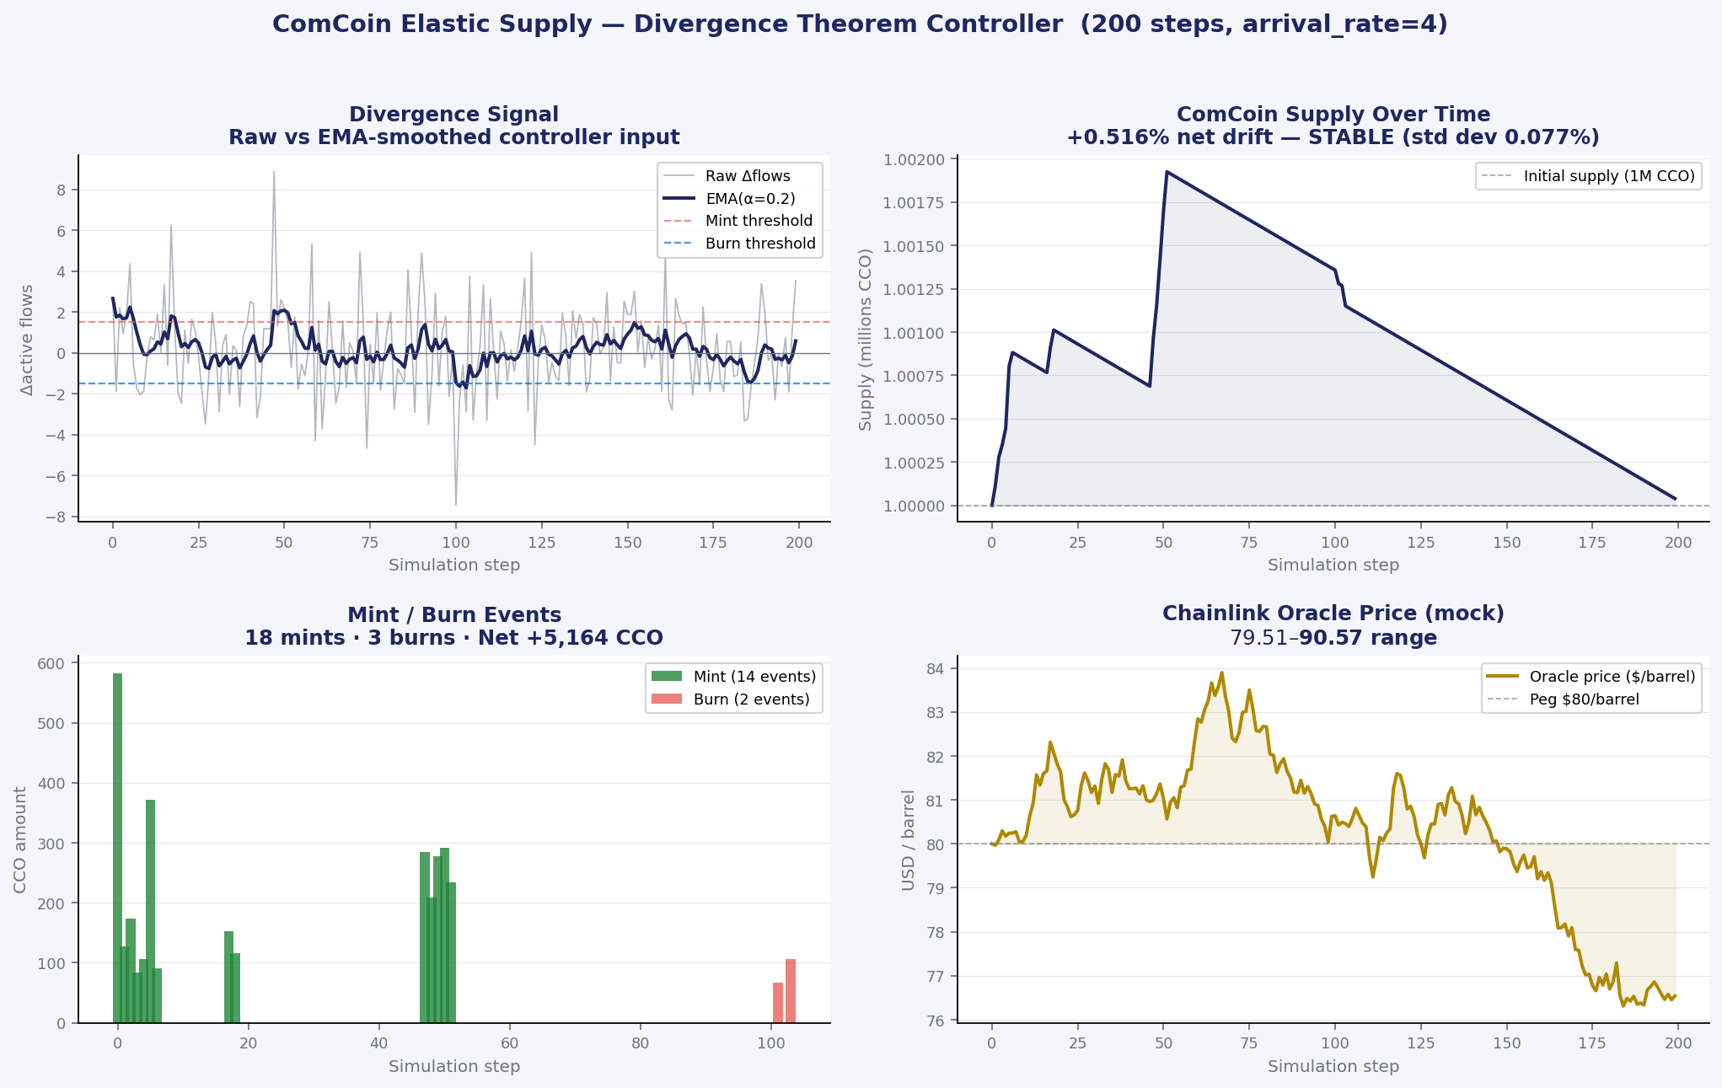
Module 6 — ComCoin Elastic Supply (Divergence Theorem)
18
mint events
3
burn events
+0.52%
net supply drift
(STABLE)
-64.2%
noise via
EMA filter
✓ ComCoin supply responds elastically to network load. EMA controller stable at 0.077% std dev. Redemption windows enforced.

Slide 8
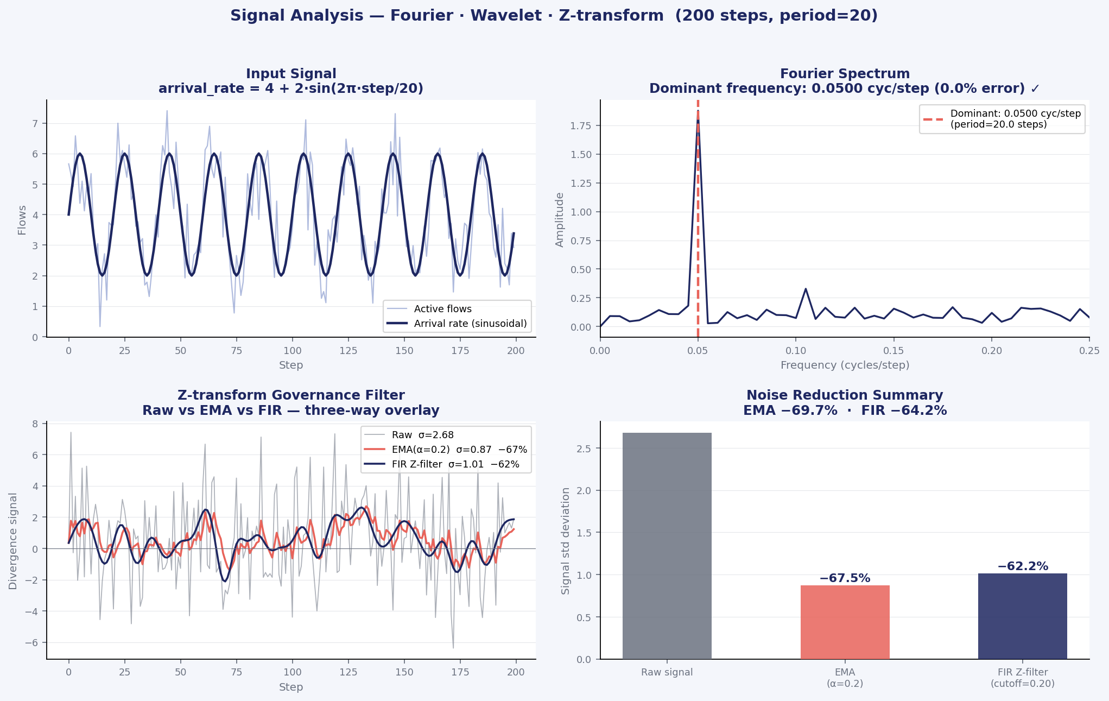
Module 7 — Signal Analysis (Fourier · Wavelet · Z-transform)
20.0
period detected
(steps) 0% error
-69.7%
EMA noise
reduction
-64.2%
FIR Z-filter
noise reduction
D2
peak wavelet
energy level
✓ Fourier detects injected periodicity with 0% error. Z-filter reduces governance signal noise by 64%, EMA by 70%.

Slide 9
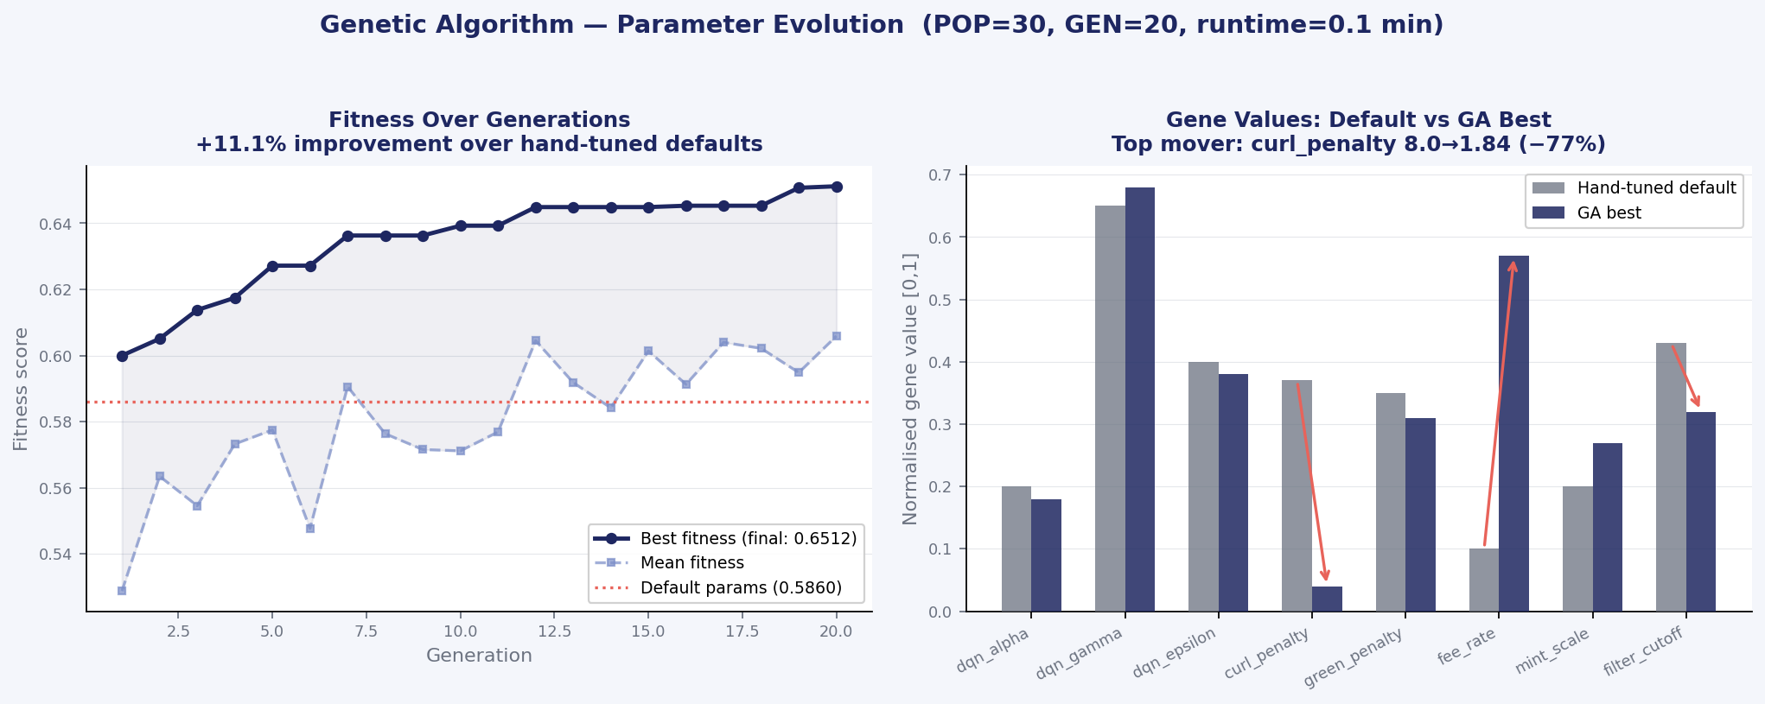
Module 8 — Genetic Algorithm Parameter Evolution
+11.1%
fitness gain
vs hand-tuned
68.2%
latency gain
(vs 39.7%)
8→1.84
curl penalty
GA finding
0.1min
runtime
(30 pop, 20 gen)
✓ GA discovered curl_penalty was over-aggressive (8→1.84). Latency improves from 39.7% to 68.2%. Best params saved to best_params.json.

Slide 10
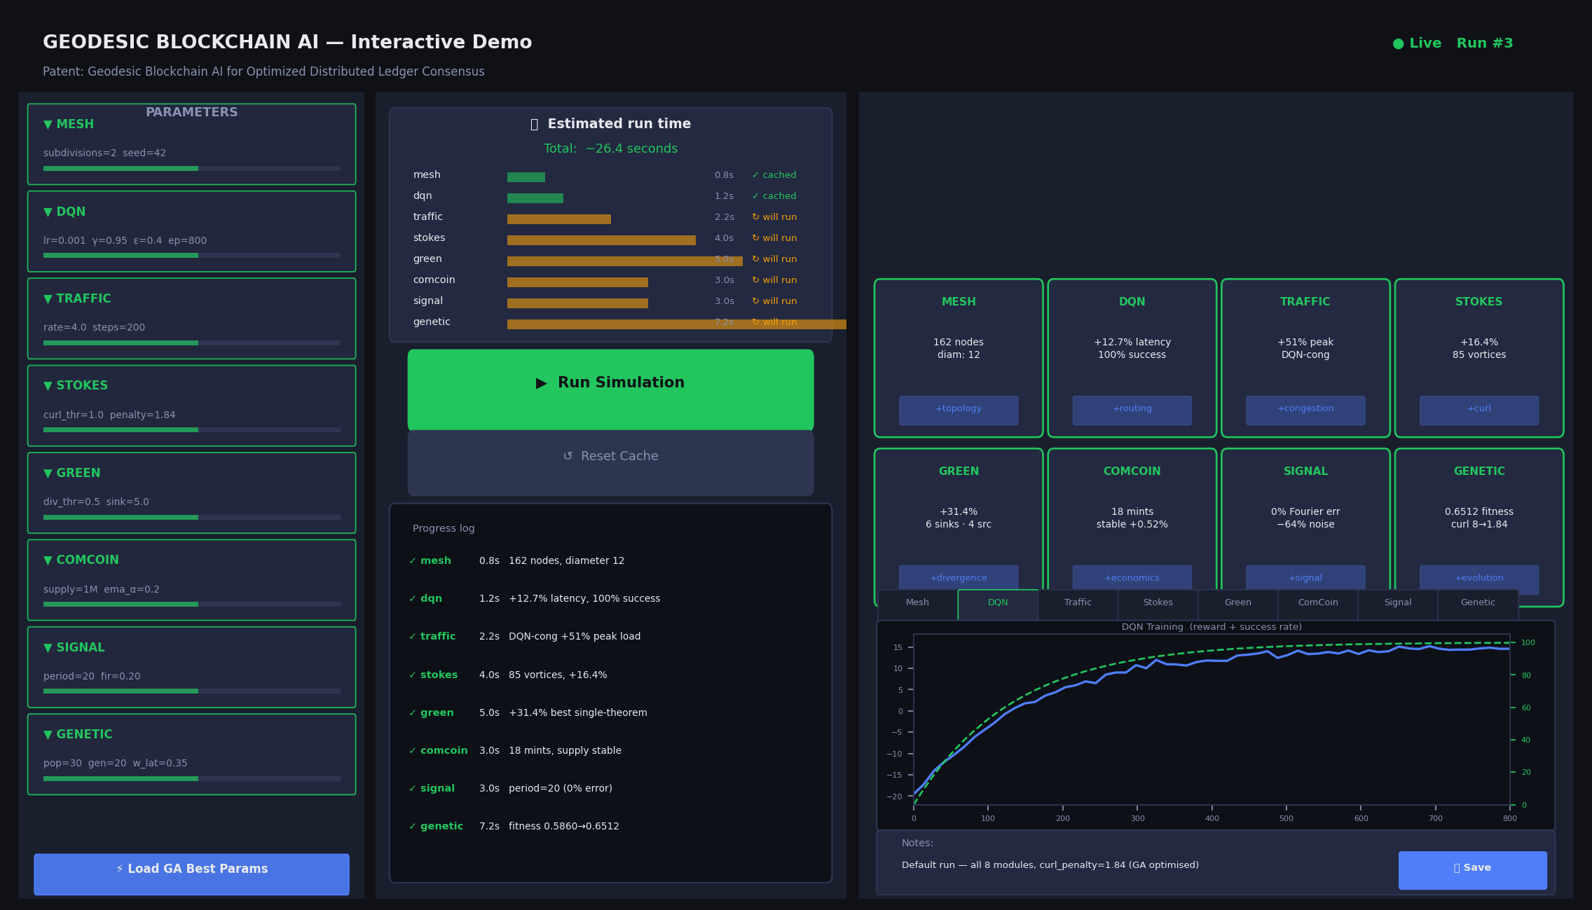
Interactive Demo — localhost:7432 (python app.py)
32
tunable
parameters
~26s
default full
run time
C
smart cache
per module
SSE
live progress
streaming
✓ Full pipeline in one browser tab. Change any parameter, get a time estimate, run only dirty modules. Results saved to Claude-readable JSON.

Slide 11
Complete Results — All Validated Modules
Module | Strategy / Finding | Key Result
1 · Geodesic mesh | Structured icosahedral overlay | Diameter 12 vs 20-40 hops (random P2P)
2 · DQN router | Geometry-aware neural routing | +12.7% latency · 100% success rate
3 · Traffic sim | DQN-base under M/M/1 congestion | -19% to -53% -- collapses without rho feature
3 · Traffic sim | DQN-cong (+rho, retrained) | +6% to +51% -- tracks oracle
4 · Stokes curl | Curl-aware Dijkstra | +16.4% · 85 vortices detected and avoided
5 · Green flow | Divergence-aware Dijkstra | +31.4% · best single-theorem result
6 · ComCoin | EMA divergence controller | Supply stable · 0.077% std dev · +0.52% drift
7 · Signal analysis | Fourier + Wavelet + Z-filter | Period detected 0% error · -64% noise
8 · Genetic optimizer | DEAP GA, 8-gene chromosome | +11.1% fitness · curl 8→1.84 · latency 40→68%
GUI demo | Flask + SSE + smart cache + 32 params | localhost:7432 · 26s default run · dirty-only re-runs
GA insight: Hand-tuned curl penalty was over-aggressive. GA found optimal at 1.84, lifting latency gain 39.7% → 68.2%.

Slide 12
Verdict & Collaboration Basis
Validated + delivered ✓
Beyond the patent ◦
✓ Geodesic topology reduces worst-case hops by ~60%
◦ Goal-conditioned DQN — not in patent, essential
✓ DQN routing: 100% success, +12.7% clean-network gain
◦ Congestion rho feature — not in patent, essential
✓ Congestion-aware DQN: +51% at peak load
◦ EMA divergence controller — not in patent
✓ Stokes + Green theorems: +16% and +31% independently
◦ GA curl calibration insight — not in patent
✓ ComCoin supply elastic and stable under simulation
◦ Dirac validator — one Claude Code session away
✓ GA discovers optimal params — curl penalty halved
◦ Hardhat testnet deployment — next milestone
✓ Interactive GUI demo — 32 knobs, smart cache, ~26s
◦ MIDI symphony — generative composition engine
Proposed collaboration: Hardware networking expertise + prototype validation + 4 novel contributions beyond the patent + GUI demo + testnet deployment

