Slide 1
PRACTICE MANAGEMENT SYSTEM
PRESENTED BY:
Deepak Katiyare
Aman Kukreti
Akshay Kadam
Ramakrishna Eega
Shaik Peer Saheb
Eresha
Vasavi Maddi
Veera Swapna Raga
Nasreen Shaik
Sriram Aleti
Nikhitha Gowrisetty
Amrutha Kottam

Slide 2
Contents
Introduction
Main Objective
Technology Stack
Application Design
Modules
Admin
Patient
Physician
Nurse
Microservices

Slide 3
Introduction
A web-based application used as an interface for the patients to book their appointment based on the available physician timings. The booked appointments can be accepted or rejected by the physician and the approved appointments will be listed for the nurse to enter basic diagnosis and health information.
Once the nurse completed entering basic diagnosis information of the patient for the visit, it will be queued to the doctor to further enter the medication details during his consultation with the patients and also patients can access their health record at any time.

Slide 4
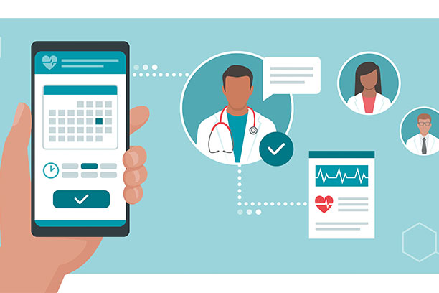
Main Objective
The main objective of this application is to provide patient a user friendly interface where he/she can easily book an appointment and can receive confirmation through mail and can view his/her health records at any point of time. So here the main concern is all about the patient.

Slide 5





Technology Stack
Frontend
Backend
+
+
HTTP Client & RxJS
Angular 15
Material UI
+
+
MySQL database
Spring Boot
Spring cloud

Slide 6







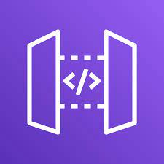
Contd..
CI/CD
AWS
+
+
GitHub
Docker
Jenkins
+
+
+
+
RDS
EC2
S3
EKS
API Gateway

Slide 7
Contd..
Others
Identity Management – Auth0
Testing – Junit with Mockito and Selenium
Monitoring Tools – Micrometer, Prometheus, Grafana
CodeCoverage – Jacoco code coverage

Slide 8
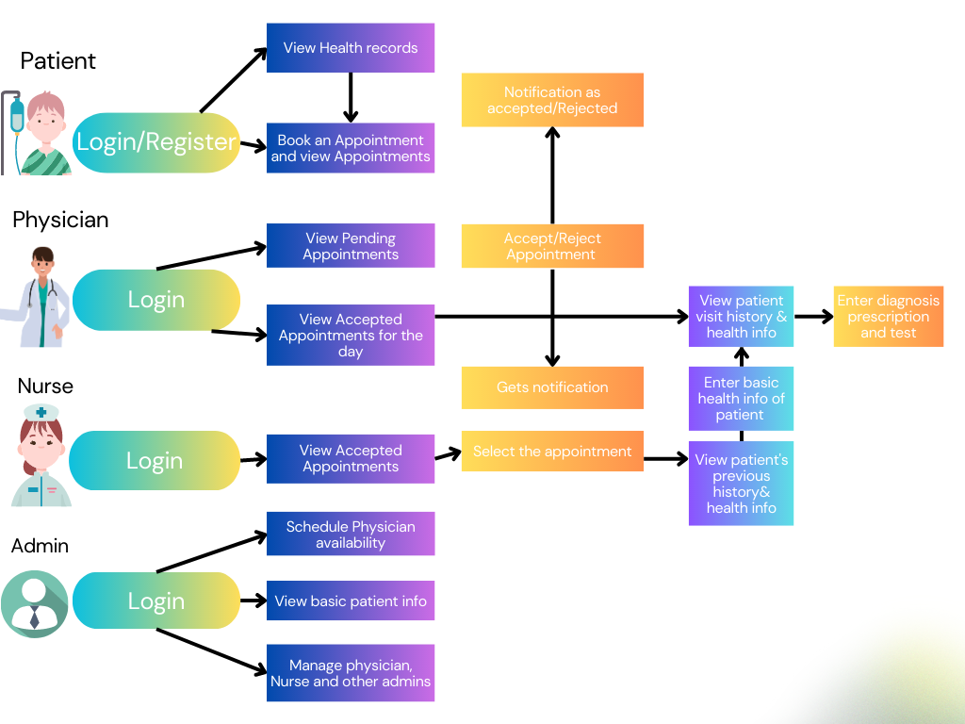
Application Design

Slide 9
Admin Module
Admin will login through Auth0.
An admin can also see basic information about patients and nurses.
An Admin is capable of managing physician availability.
Admin can add, delete and see physicians availability.
Admin is also responsible for managing other admins.

Slide 10
Patient Module
Patient can register once to book the appointment.
Once the registration is done then the patient can login through his/her
account.
Patient can book the appointment with specific physicians based on their
availability.
Patients can access their health record at any time.
Patients can also update their profile.
Patients can also download their reports in pdf format.

Slide 11
Physician Module
Physician will login through Auth0.
Physician has the ability to accept or reject the appointments which are
booked by patient.
Patient and nurse will get notification once the appointments are accepted by the physician.
Only patient will get notification if the appointment is rejected by the
physician.

Slide 12
Nurse Module
Nurse will login through Auth0.
Nurse will get notification once the appointments are accepted by the
physician.
Nurse can see all the accepted appointments along with basic details of patients.
Nurse will be capable of viewing the previous health history of patient and can do the basic diagnosis for respective patient.

Slide 13
Microservices
We have created total 6 microservices. Each microservice will have an entity layer, dto layer, repository layer, service layer, controller layer and also each microservice is having a layer for centralized exception handling and logging.
Authentication service
This service is used by patient module. In this we are having 2 endpoints one for registration of new patient and the other is for login.
Allergy service
This service is having all the different types of allergies. Nurse can add list of allergies a patient is having and these can be viewed by doctor while adding test and prescription details.

Slide 14
Contd..
PatientInfo Service
This service is also used by patient. Through this microservice we get all patients or a patient with particular id. This service also has a method to update patient basic details and to update patient password through OTP by using springboot mail dependency.
HealthRecords service
This service is used by many modules. By patient to view his/her health records, by nurse to add visit details and by physician to add test and prescription details.

Slide 15
Contd..
PhysicianAvailability service
Using this service we are getting all the physicians from Auth0 and in patient module a patient can view all the available physicians.
Appointment service
This service is used to book an appointment by a patient and nurse and physician can view all the appointments for a day and can know total number of appointments.
Notification service
This service is used to send mails to patient and nurse when an appointment is accepted and a notification is sent to only patient if an appointment is rejected by physician.

Slide 16
Deployment
In production environment we have used RDS as our database and kept all our frontend application is S3 bucket and deployed our microservices in Elastic Kubernetes Service and used Aws Api Gateway to redirect http to https and connected frontend with backend services. We installed Jenkins and Docker in ec2 to push our microservices into Docker using Jenkins pipeline.

Slide 17
Queries?

Slide 18
Thank You

