Slide 1
MONIMAN An overview of the current development BST/GBT/BK

Slide 2
MONIMAN
Modern Development Technologies
State-Of-The-Art Scientific Domain Knowledge
Geotechnical Best-practices
PLAXIS Python scripting API
Qt Designer & PyQt5 GUI
Modularized object-oriented Python programming
Librabry based properties and features for soils, anchors, struts, etc.
Process automation for creating calculation steps
Monitoring data incorporation
Geotechnical sensitivity analysis and back-analysis
Cost-driven design optimization
Metamodeling and machine learning approaches

Slide 3
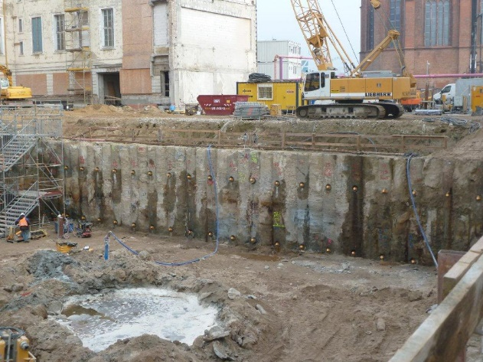
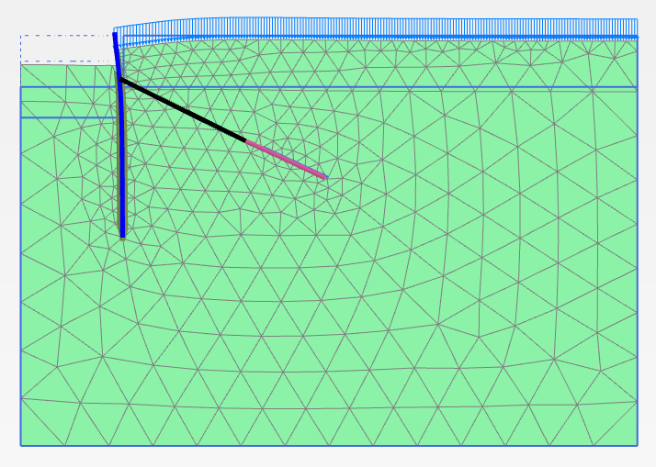
MONIMAN
Site
Digital twin (FEM calculation model)
Prognosis
MONIMAN
Model creation
Model sensitivity analysis
Model updating
Cost-driven design optimization
Monitoring
data

Slide 4
MONIMAN
Plaxman
Sensiman
Backman
Optiman
GUI & Utilities
Automate PLAXIS input and customize PLAXIS output
Perform sensitivity analysis of soil/structure parameters to the system
Back-calculate soil parameters by fitting modeled outputs to measurements
Optimize costs and system performance
User interface/ Communications/ File utilities/ Visualization utilities/ Saving and loading

Slide 5
MONIMAN – Plaxman
DESIGN PRINCIPLES:
Use PLAXIS scripting interface to interact with PLAXIS kernel more intensively
Use modern Python modules to manage a user-friendly GUI windows
Create material and structrue libraries based on literature and our engineering best practices
Try to balance: Complexity – Purpose – Ease-of-use
EXPECTATIONS:
Fully functional PLAXIS2D model (for retaining wall systems)
Model creation time is reduced to minutes
A Python script of the model for further use in Sensitivity- and Backanalysis, and Optimization

Slide 6

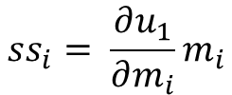


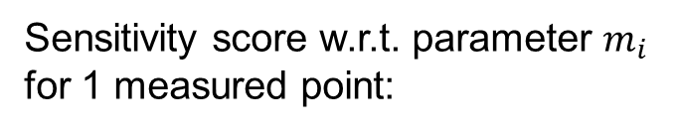

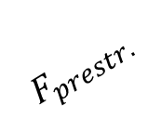

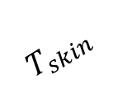
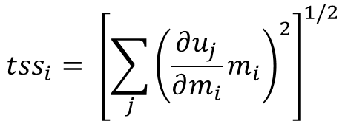



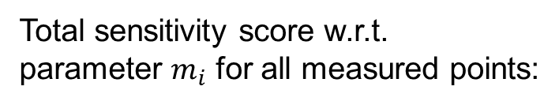
MONIMAN – Sensiman
$$u_{1}$$
How much is the influence of each model parameter to wall deflection?
Soil 1: $E, ν, c, φ, K_{0}$
$$u_{2}$$
$$u_{3}$$
Soil 2: $E_{oed}^{ref}, E_{50}^{ref}, E_{ur}^{ref}, ν, c, φ$
Sensitivity score w.r.t. parameter $m_{i}$
for 1 measured point:
$$F_{prestr.}$$
$$ss_{i}= \frac{∂u_{1}}{∂m_{i}}m_{i}$$
$$T_{skin}$$
Soil 3: $E, ν, c, φ$
Total sensitivity score w.r.t.
parameter $m_{i}$ for all measured points:
$$u_{M−1}$$
$$u_{M}$$
$$tss_{i}= {\left[\sum_{j}{{\left(\frac{∂u_{j}}{∂m_{i}}m_{i}\right)}^{2}}\right]}^{1/2}$$
Choose the most sensitive parameters for performing back-analysis.

Slide 7


MONIMAN – Sensiman
$$u_{1}$$
$$u_{2}$$
$$u_{1}$$
Soil 1: $E, ν, c, φ, K_{0}$
$$u_{3}$$
Soil 2: $E_{oed}^{ref}, E_{50}^{ref}, E_{ur}^{ref}, ν, c, φ$
Field measurement
$$F_{prestr.}$$
$$T_{skin}$$
Soil 3: $E, ν, c, φ$
$$parameter set$$
$$u_{M−1}$$
$$u_{M}$$
How to best visualize results?
This is a kind of back-analysis by brute-force search and visual inspection.

Slide 8






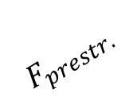

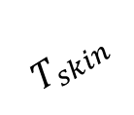



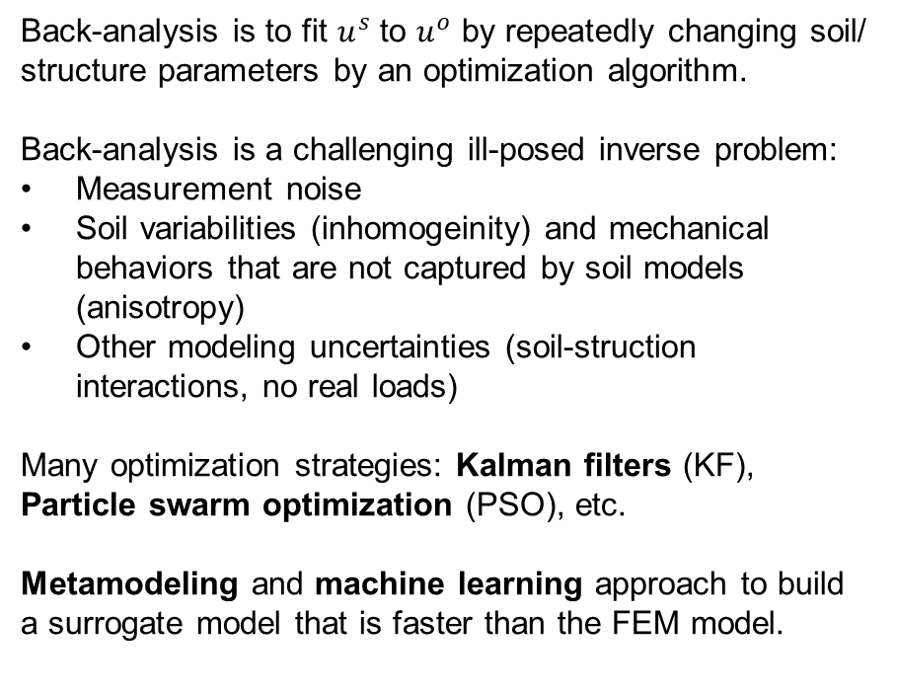
MONIMAN – Backman
$$u_{1}$$
Back-analysis is to fit $u^{s}$ to $u^{o}$ by repeatedly changing soil/ structure parameters by an optimization algorithm.
Back-analysis is a challenging ill-posed inverse problem:
Measurement noise
Soil variabilities (inhomogeinity) and mechanical behaviors that are not captured by soil models (anisotropy)
Other modeling uncertainties (soil-struction interactions, no real loads)
Many optimization strategies: Kalman filters (KF), Particle swarm optimization (PSO), etc.
Metamodeling and machine learning approach to build a surrogate model that is faster than the FEM model.
Soil 1: $E, ν, c, φ, K_{0}$
$$u_{2}$$
$$u_{3}$$
Soil 2: $E_{oed}^{ref}, E_{50}^{ref}, E_{ur}^{ref}, ν, c, φ$
$$F_{prestr.}$$
$$T_{skin}$$
Soil 3: $E, ν, c, φ$
$$u_{M−1}$$
$$u_{M}$$
Inclinometer: $u^{o}$
PLAXIS: $u^{s}$
Intelligent algorithms and automated process themselves help to back-calculate soil/ structure parameters in such a short time as possible.

Slide 9


MONIMAN – Optiman
Automated design optimization process taking into account material and execution costs.
How far can we go to reach most economic design?
$$Price €$$
$$System−relevant parameters$$

Slide 10
MONIMAN
Plaxman
Sensiman
Backman
Optiman
GUI & Utilities
Automate PLAXIS input and customize PLAXIS output
Perform sensitivity analysis of soil/structure parameters to the system
Back-calculate soil parameters by fitting modeled outputs to measurements
Optimize costs and system performance
User interface/ Communications/ File utilities/ Visualization utilities/ Saving and loading
5 months
~20 000 lines of code

Slide 11
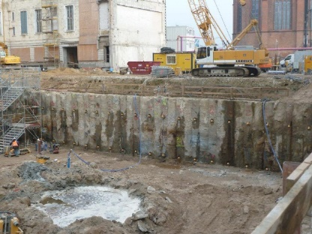
MONIMAN
Site
Digital twin (FEM calculation model)
Prognosis
MONIMAN
Model creation
Model sensitivity analysis
Model updating
Cost-driven design optimization
Monitoring
data
Development Technologies
Scientific Domain Knowledge
Geotechnical Best-practices
MONIMAN: Optimization-based tool to turn monitoring data into valuable design parameters that can help minimize the cost while securing the safe design.

