Slide 1
MONIMAN An overview of the current development BST/GBT/BK 03.2019

Slide 2
MONIMAN
Modern Development Tools
State-Of-The-Art Scientific Domain Knowledge
Geotechnical Best-practices
PLAXIS Python scripting API
Qt Designer & PyQt5 GUI
Modularized object-oriented Python programming
Librabry based properties and features for soils, anchors, struts, etc.
Process automation for creating calculation steps
Monitoring data incorporation
Geotechnical sensitivity analysis and back-analysis
Cost-driven design optimization
Metamodeling and machine learning approaches

Slide 3
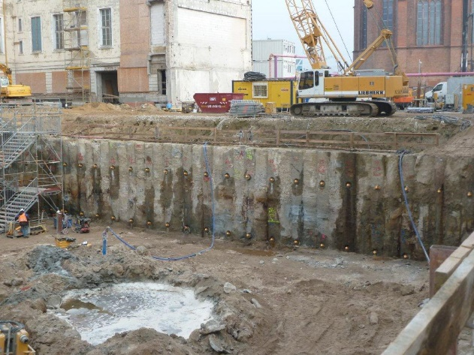
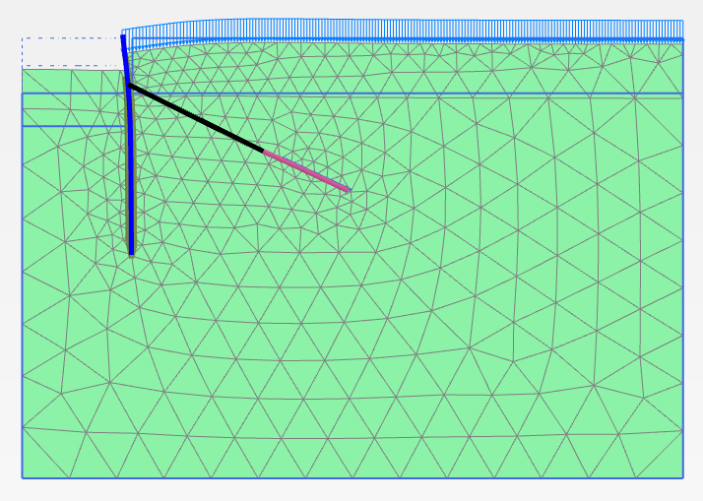
MONIMAN
Site
Digital twin (FEM calculation model)
Prognosis
MONIMAN
Model creation
Model sensitivity analysis
Model updating (back-analysis)
Cost-driven design optimization
Monitoring
data

Slide 4
MONIMAN
Plaxman
Sensiman
Backman
Optiman
GUI & Utilities
Automate PLAXIS Input & Output
Perform sensitivity analysis of soil/structure parameters to the system
Back-calculate soil parameters by fitting modeled outputs to site measurements
Optimize costs and system performance
User interface/ Communications/ File utilities/ Visualization utilities/ Saving and loading

Slide 5
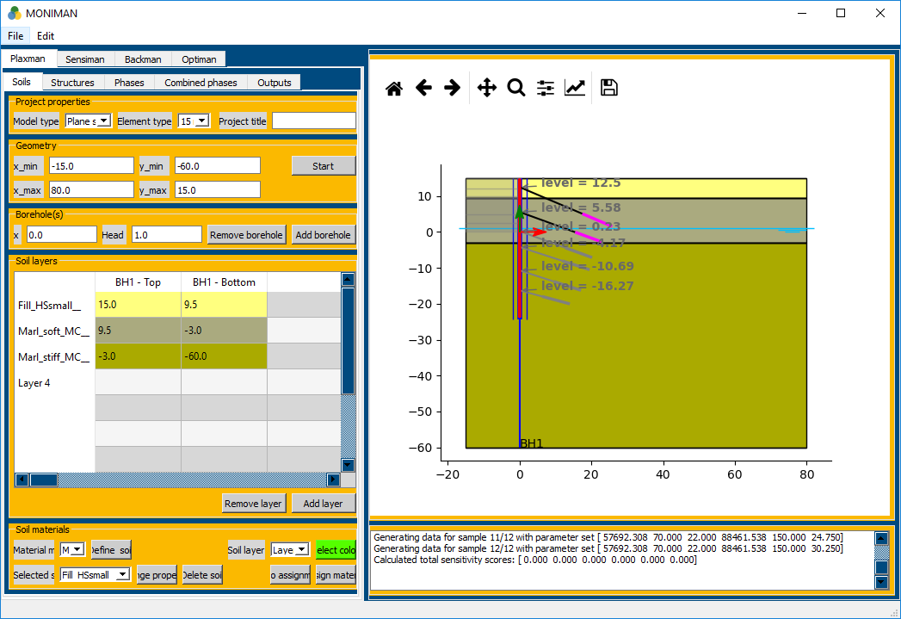
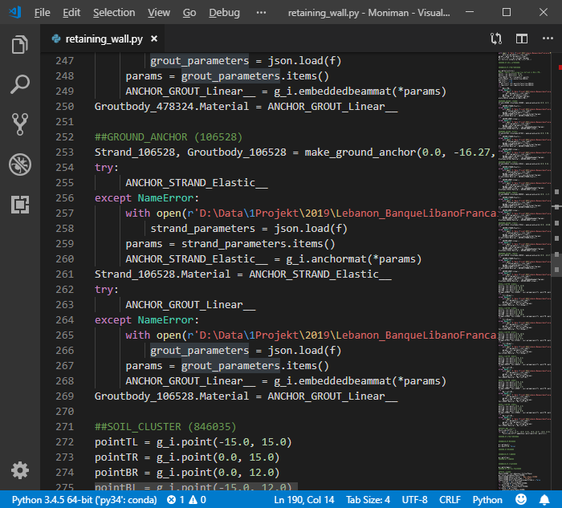
MONIMAN – Plaxman
Plaxis Remote Scripting with Python
Predefined soils/ structures to load
Model creation time is reduced to minutes
Fully functional: Soils>Structures>Phases>Outputs
A Python script of the model for further use in
Sensitivity analylsis,
Backanalysis, and
Design optimization
Reference project in Beirut

Slide 6
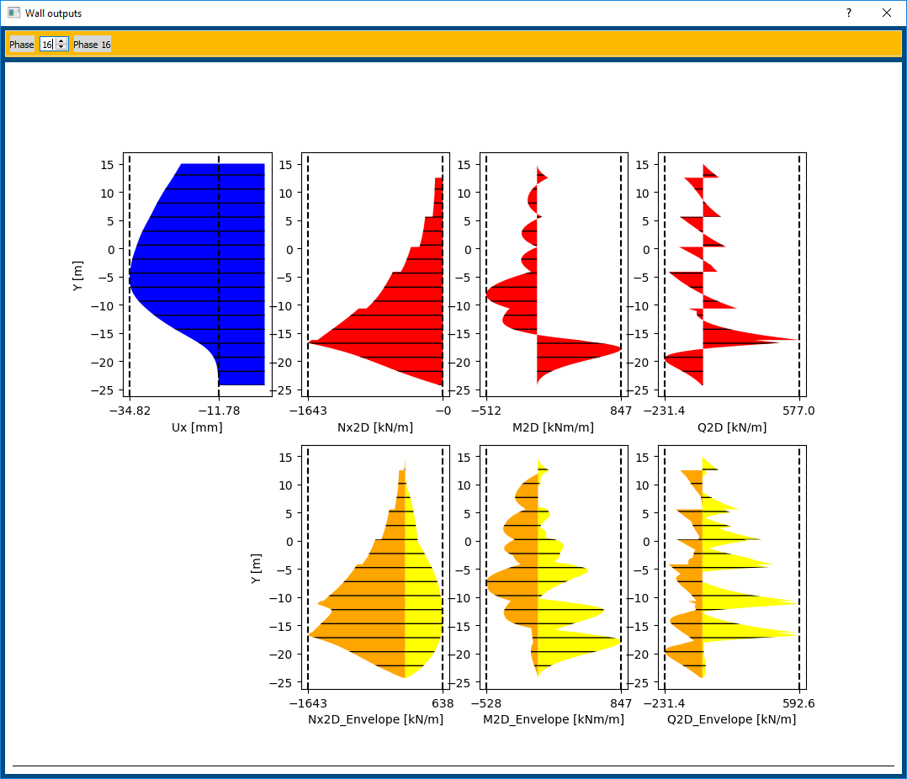
MONIMAN – Plaxman
Plaxis Remote Scripting with Python
Predefined soils/ structures to load
Model creation time is reduced to minutes
Fully functional: Soils>Structures>Phases>Outputs
Requested graphical and numerical outputs for dimensioning
Repeated model evalutions with updated model parameters for sensitivity analysis, back-analysis, and design optimizatoin.
Reference project in Beirut

Slide 7

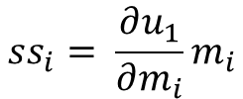


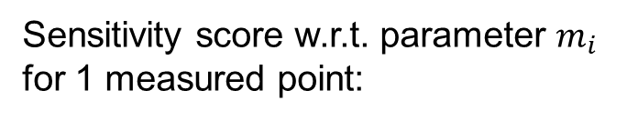

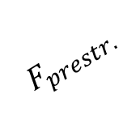


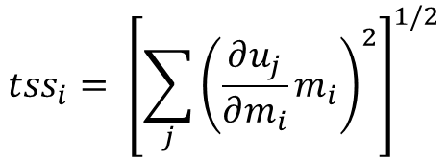



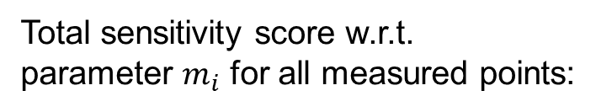
MONIMAN – Sensiman
Sensitivity analysis of system parameters to certain system responses
$$u_{1}$$
How much is the influence of each model parameter to wall deflection?
Soil 1: $E, ν, c, φ, K_{0}$
$$u_{2}$$
$$u_{3}$$
Soil 2: $E_{oed}^{ref}, E_{50}^{ref}, E_{ur}^{ref}, ν, c, φ$
Sensitivity score w.r.t. parameter $m_{i}$
for 1 measured point:
$$F_{prestr.}$$
$$ss_{i}= \frac{∂u_{1}}{∂m_{i}}m_{i}$$
$$T_{skin}$$
Soil 3: $E, ν, c, φ$
Total sensitivity score w.r.t.
parameter $m_{i}$ for all measured points:
$$u_{M−1}$$
$$u_{M}$$
$$tss_{i}= {\left[\sum_{j}{{\left(\frac{∂u_{j}}{∂m_{i}}m_{i}\right)}^{2}}\right]}^{1/2}$$
Choose the most sensitive parameters for performing back-analysis.

Slide 8
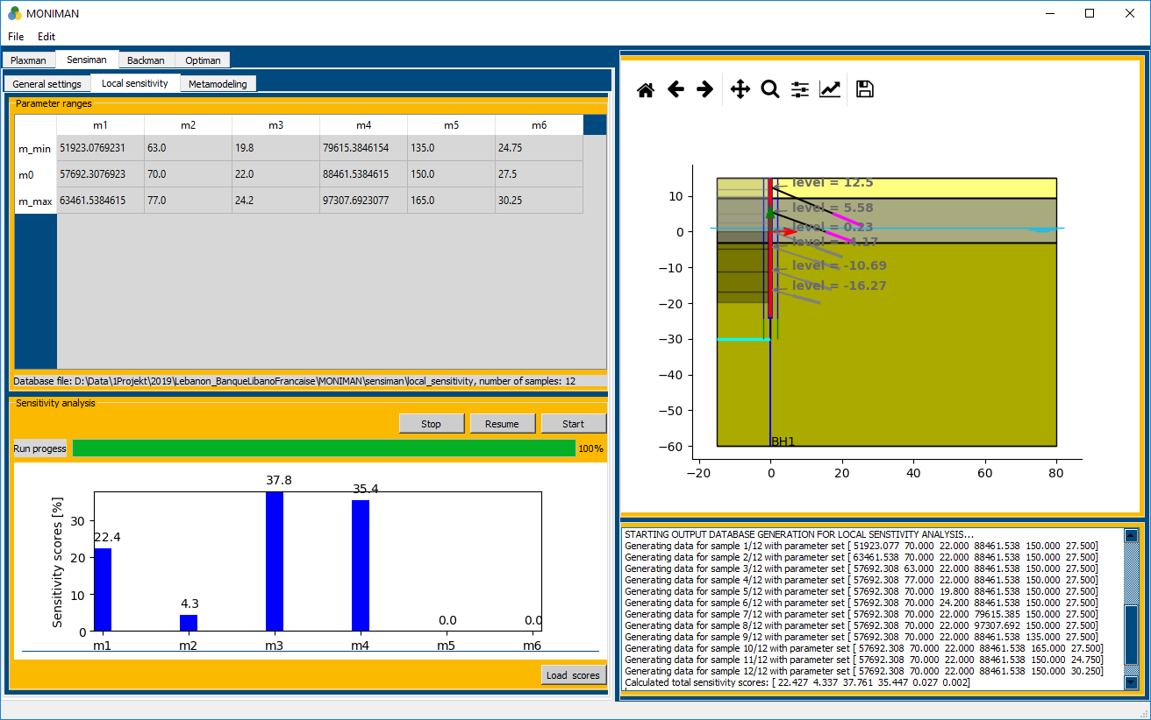






MONIMAN – Sensiman
Local sensitivity analyiss
Exc.
$$m_{1}= Gref_{2}$$
$$m_{2}=cref_{2}$$
$$m_{3}=φ_{2}$$
$$m_{4}= Gref_{3}$$
$$m_{5}=cref_{3}$$
$$m_{6}=φ_{3}$$

Slide 9
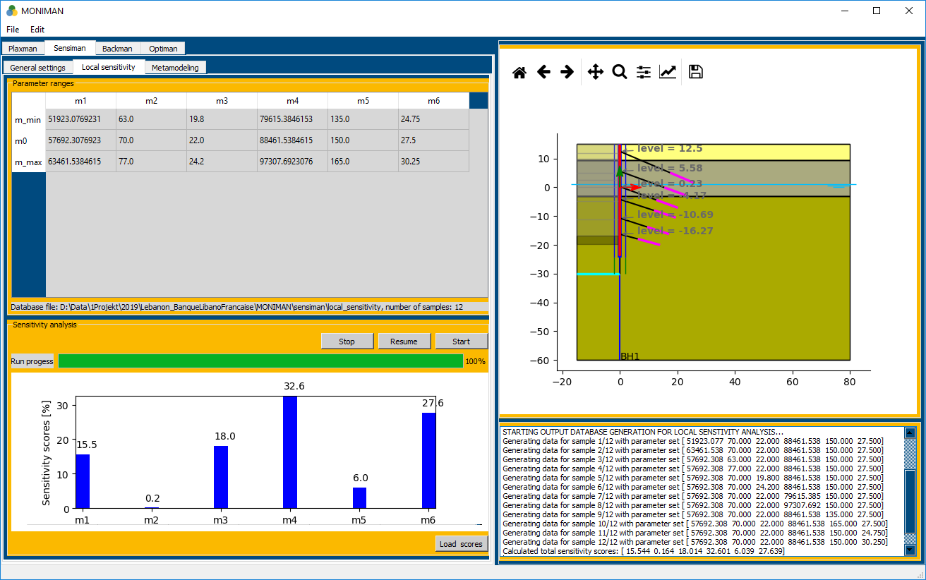
MONIMAN – Sensiman
Local sensitivity analyiss
$$m_{1}= Gref_{2}$$
$$m_{2}=cref_{2}$$
$$m_{3}=φ_{2}$$
Exc.
$$m_{4}= Gref_{3}$$
$$m_{5}=cref_{3}$$
$$m_{6}=φ_{3}$$

Slide 10
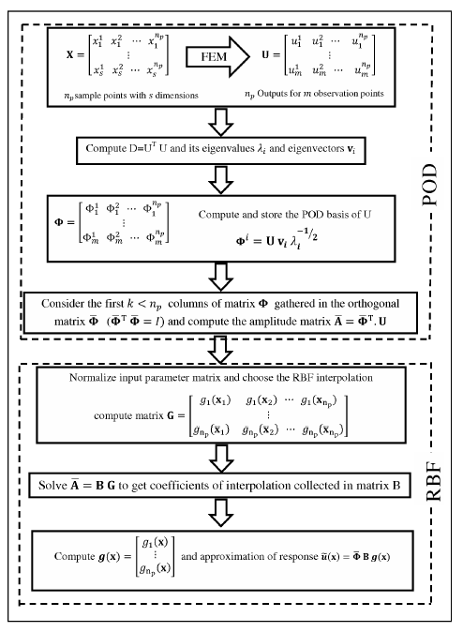
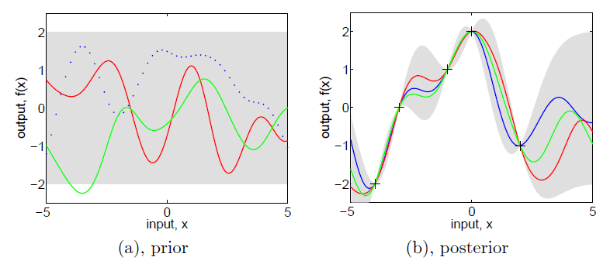
MONIMAN – Sensiman
Metamodel instead of FE model
Gaussian process (GP)
(Rasmussen and Williams, 2006)
Proper orthogonal decomposition (POD) + radial basis function (RBF) (Khaledi and Schanz, 2014)
On-going Master‘s thesis work: Mohammad Sanayei
Notes:
Williams, C.K. and Rasmussen, C.E., 2006. Gaussian processes for machine learning. Cambridge, MA: MIT Press.
Khaledi, K., Schanz, T. and Miro, S., 2014. Application of metamodelling techniques for mechanized tunnel simulation. Journal of Theoretical and Applied Mechanics, 44(1), pp.45-54.

Slide 11


MONIMAN – Sensiman
Metamodel instead of FE model
Evaluation time:
FE model : ~4 min.
Metamodel: ~1 millisec.
$$Gref_{2}, φ_{2}, Gref_{3}, cref_{3}, φ_{3}=$$
$$\text{[}\text{66133}\text{, }\text{24}\text{.}\text{7}\text{, }\text{87293}\text{, }\text{169}\text{.}\text{9}\text{, }\text{27}\text{.}\text{5}\text{]}$$
$$Gref_{2}, φ_{2}, Gref_{3}, cref_{3}, φ_{3}=$$
$$\text{[}\text{37842}\text{, }\text{17}\text{.}\text{0}\text{, }\text{115738}\text{, }\text{184}\text{.}\text{6}\text{, }\text{17}\text{.}\text{7}\text{]}$$
Metamodeling by Gaussian Process using 250 training samples + 30 testing samples

Slide 12
MONIMAN – Sensiman
Metamodel instead of FE model
Sampling
Model training
Model validation
Model deployment
Random sets of model parameters
Senstivity analysis
X
FE Model (PLAXIS)
Metamodel
(GP, POD)
Metamodel
(GP, POD)
Back-analysis
Y
Observables (Target data)
Design/ cost optimization
Why is metamodel beneficial?
Well-designed random sampling method (such as Latin Hypercube) helps reduce the sampling size yet cover the design (parameter) space
The result of one-time upfront efforts (FE simulations + training + validation) is used for demanding investigations that follow (sensitivity, back-analysis, design optimization)

Slide 13






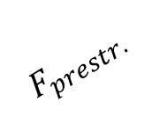





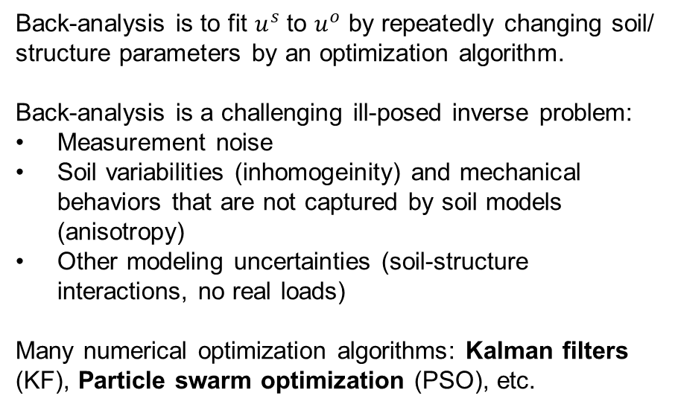
MONIMAN – Backman
Geotechnical back-analysis
$$u_{1}$$
Back-analysis is to fit $u^{s}$ to $u^{o}$ by repeatedly changing soil/ structure parameters by an optimization algorithm.
Back-analysis is a challenging ill-posed inverse problem:
Measurement noise
Soil variabilities (inhomogeinity) and mechanical behaviors that are not captured by soil models (anisotropy)
Other modeling uncertainties (soil-structure interactions, no real loads)
Many numerical optimization algorithms: Kalman filters (KF), Particle swarm optimization (PSO), etc.
Soil 1: $E, ν, c, φ, K_{0}$
$$u_{2}$$
$$u_{3}$$
Soil 2: $E_{oed}^{ref}, E_{50}^{ref}, E_{ur}^{ref}, ν, c, φ$
$$F_{prestr.}$$
$$T_{skin}$$
Soil 3: $E, ν, c, φ$
$$u_{M−1}$$
$$u_{M}$$
Inclinometer: $u^{o}$
PLAXIS: $u^{s}$
Numerical algorithms back-calculate soil/ structure parameters by fitting modeled outputs to measured site data using as few model evaluations as possible.

Slide 14
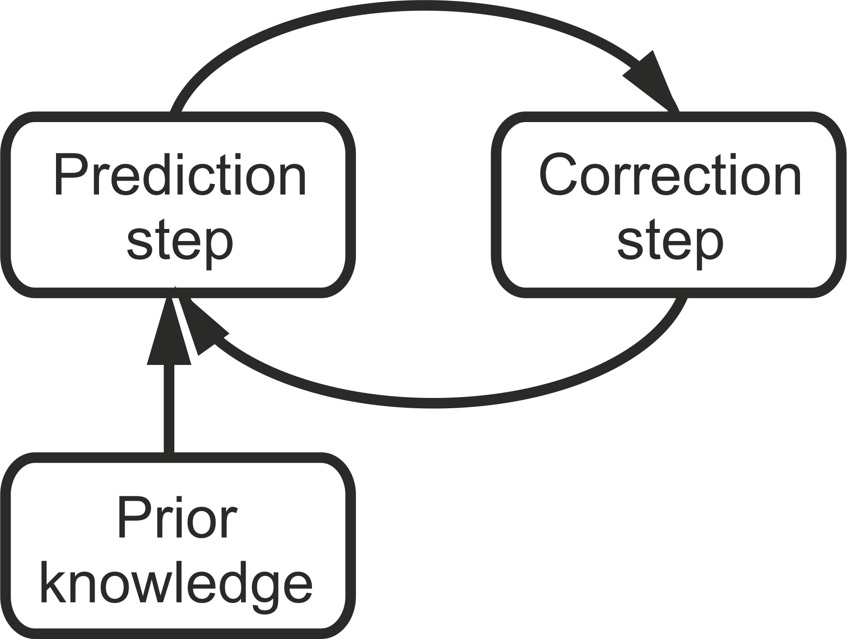

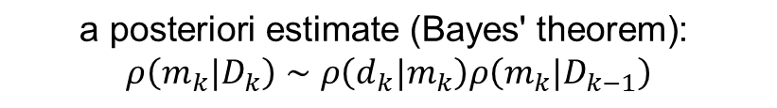


MONIMAN – Backman
Kalman filter for geotechnical back-analysis
$$\text{a} \text{priori} \text{estimate}\text{: }ρ\left(m_{k}|D_{k−1}\right)∼N\left(m_{k|k−1},P_{k|k−1}\right)$$
$$\text{model}\text{: }d=h\left(m\right)+v$$
$$\text{data}\text{: }ρ_{D}\left(d\right)∼N\left(d^{obs},R^{obs}\right)$$
$$\text{a} \text{posteriori} \text{estimate}\text{ (}\text{Bayes}\text{′ }\text{theorem}\text{): }$$
$$ρ\left(m_{k}|D_{k}\right)∼ρ\left(d_{k}|m_{k}\right)ρ\left(m_{k}|D_{k−1}\right)$$
$$\text{initial} \text{estimate}\text{: }ρ_{M}\left(m\right)∼N\left(m_{0},P_{0}\right)$$
Nguyen, L.T., Nestorović, T., Hölter, R. and Schanz, T., Identifying the geological scenario ahead of the tunnel face: The use of elastoplastic and elastodynamic responses. Geotec Hanoi 2016.

Slide 15
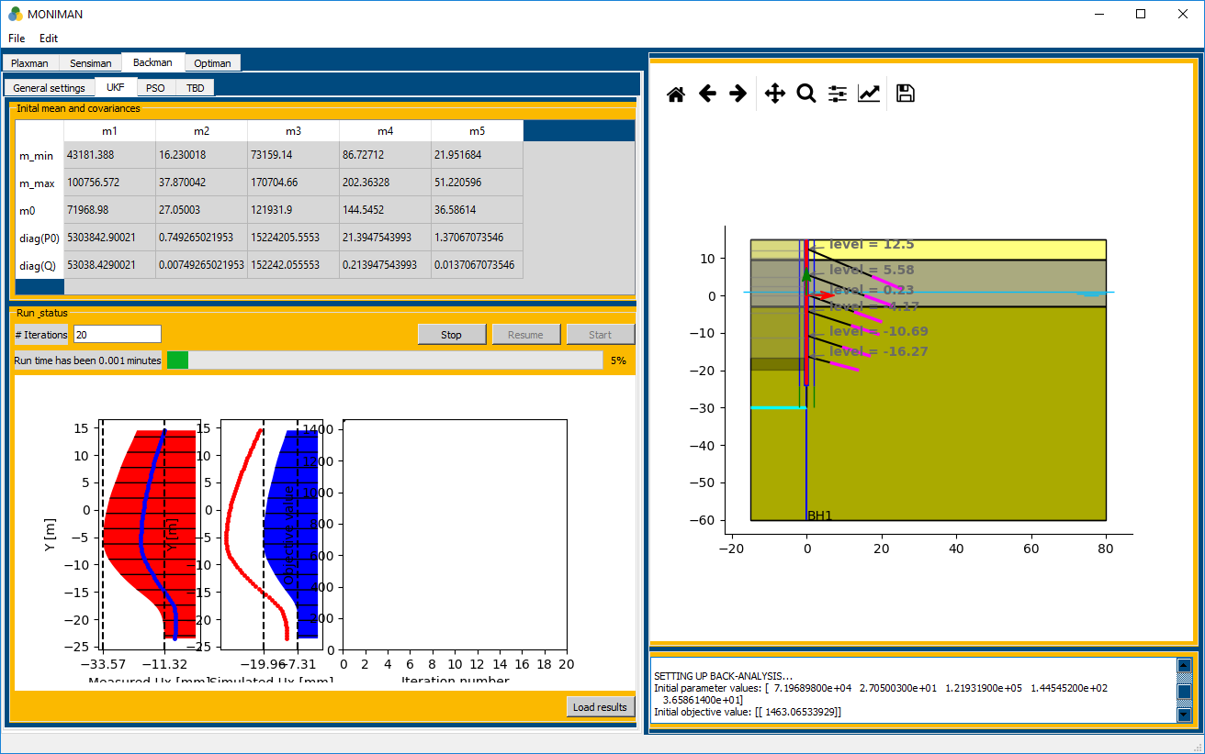
MONIMAN – Backman
Kalman filter for geotechnical back-analysis

Slide 16
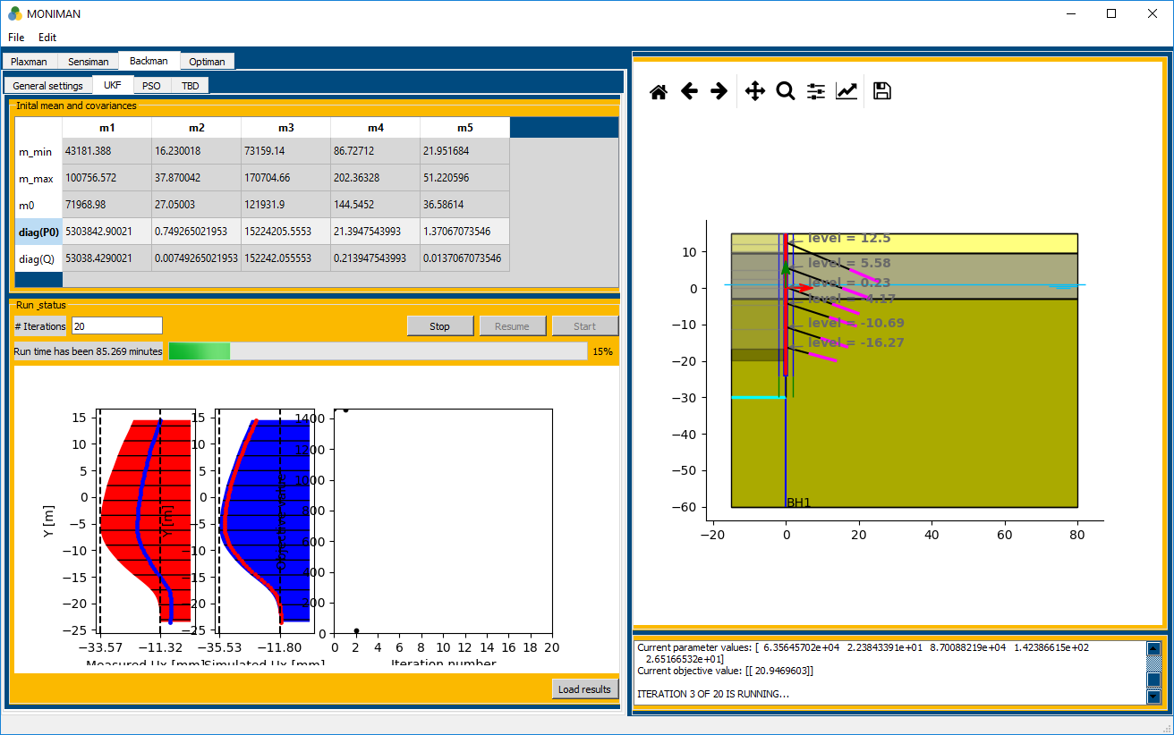
MONIMAN – Backman
Kalman filter for geotechnical back-analysis

Slide 17
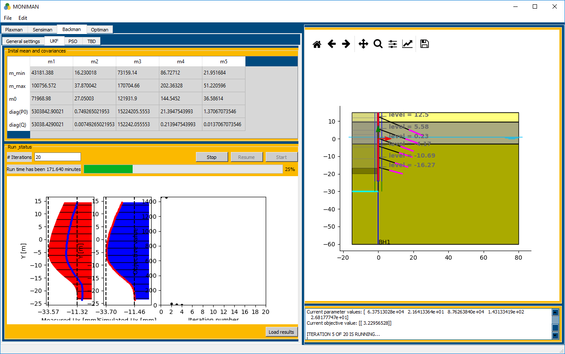
MONIMAN – Backman
Kalman filter for geotechnical back-analysis

Slide 18
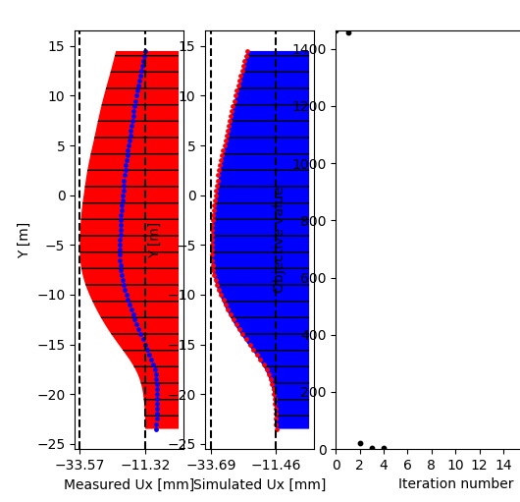
MONIMAN – Backman
Kalman filter for geotechnical back-analysis
target
initial
back-calculated
Parameter | Initial | Back-calculated | True | Deviation (%)
Gref_2 [kN/m^2] | 71968,98 | 63751,30 | 57692,30 | 9,50
Phi_2 [deg.] | 27,05 | 21,64 | 22,00 | 1,66
Gref_3 [kN/m^2] | 12193,90 | 87626,38 | 88461,53 | 0,95
Cref_3 [kN/m^2] | 144,54 | 143,13 | 150,00 | 4,79
Phi_3 [deg.] | 36,58 | 26,81 | 27,50 | 2,57
4 iterations * (2*number_of_parameters + 1) = 44 PLAXIS2D runs

Slide 19
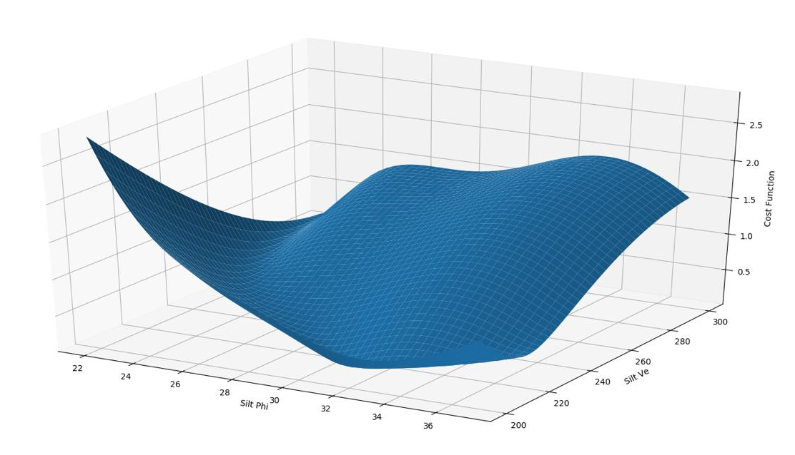
MONIMAN – Backman
Particle swarm optimization (PSO) for geotechnical back-analysis
Typical back-analysis‘ multi-minima objective function
https://cosmo-docs.phys.ethz.ch/cosmoHammer/user/pso.html
On-going Master‘s thesis work: Mohammad Sanayei

Slide 20


MONIMAN – Optiman
Design/ cost optimization
Automated design optimization process taking into account material and execution costs.
How far can we go to reach most economic design while still satisfying system behavior?
$$Price €$$
$$System−relevant parameters$$

Slide 21
MONIMAN
Plaxman
Sensiman
Backman
Optiman
GUI & Utilities
Model creation
Calculation and output
Sensitivity analysis
Metamodeling
Kalman filter
Particle swarm opt.
Design optimization
User interface
File management Visualization and report
Numbers
Lessons learned
6 months
20420 code lines
Modern development framework and librabries (OOP Python, PyQt5, numpy, matplotlib, pickle, json, etc.) help shorten development time
Modularized structure helps in mantainaning and extending functionalities of MONIMAN
Careful use of results in scientific publications and public-domain resources can be beneficial
User experience and feedback are valuable

Slide 22
MONIMAN
Site
Digital twin (FEM calculation model)
Prognosis
MONIMAN
Model creation
Model sensitivity analysis
Model updating
Cost-driven design optimization
Monitoring
data
MONIMAN: Optimization-based tool to turn monitoring data into valuable design parameters that can help to minimize the cost while securing safe design.

Slide 23
Thanks to members of the BK Department for great support and input! Thank you for your listening! Your comments/ questions are welcome.

