Slide 1

Chronic Kidney Disease (CKD) Prediction
Renal Health Predictors Group
Bhavya Reddy Ganta (002617747)
Keerthana Jagana (002699567)
Ragamalika Karumuri (002915012)
Srinivasa Pavan Ganesh Vasa (002709131)

Slide 2
BACKGROUND
Chronic Kidney Disease (CKD) is a condition where the kidneys gradually lose function over a period, usually months to years. This can lead to a buildup of waste products and fluids in the body, as well as an imbalance of important electrolytes. The disease can be caused by several factors, including diabetes, high BP, Hemoglobin and other diseases that affect the kidneys. The data is provided for almost 400 patients, and required to build an intelligent model that can predict if the patient will be prone to disease based on several medical parameters.
How important is to detect ckd:
CKD Prevalence:
CKD cases increased by 40% between 2010 and 2022.
Projected to keep rising due to aging population and health conditions.
Early Detection is Key:
Early detection and intervention can slow down the progression of CKD, reduce complications, and improve quality of life.
Regular screening for high-risk individuals is crucial.
Importance of Awareness:
Encouraging individuals to adopt healthier lifestyles can help prevent CKD.
Healthcare professionals play a key role in identification and management

Slide 3
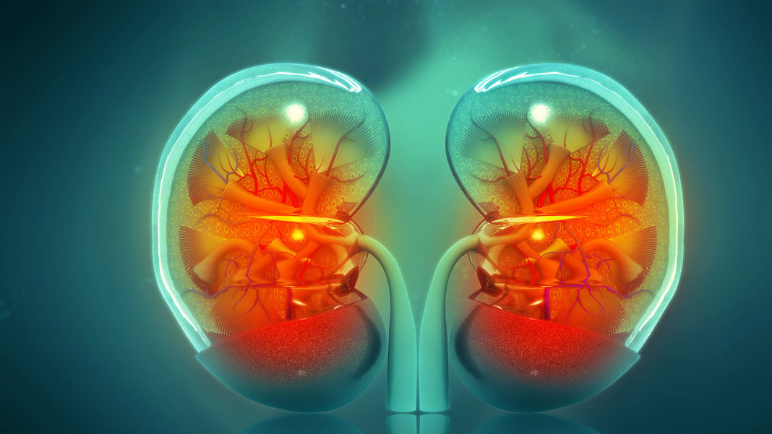
ABSTRACT:
The objective of this project is to diagnostically predict whether a patient is having chronic kidney disease or not, based on certain diagnostic measurements included in the dataset. The datasets consists of several medical predictor variables and one target variable, Classification.
AIM:
In this project we aim to develop a complete ML project with
Checking Data Quality by performing different EDA techniques
Feature Selection
Modeling - Training Models, Selecting Best Model, Hyperparameter Tuning
Model Interpretability
Reports and Visualizations

Slide 4



Approaching of project
Output is clear and Classification type (Yes or No)
So, it comes under Machine Learning → Supervised Learning → Classification

Slide 5
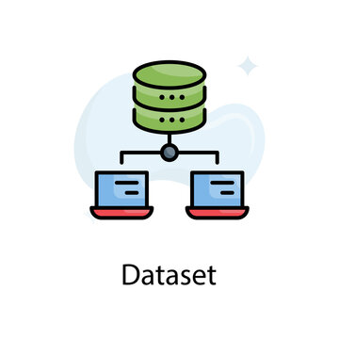
DATASET OVERVIEW
Data source – Kaggle
Link to the Dataset: Kaggle.com/ChronicKidneyDisease
Description:
The "Chronic Kidney Disease Prediction" dataset on Kaggle provides a collection of medical features including patient demographics, clinical measurements, and lab results. With the aim of aiding in the prediction of Chronic Kidney Disease, this dataset offers a valuable resource for building machine learning models that can assist in early detection and intervention strategies. Dataset can be utilized to develop accurate tools for identifying individuals susceptible to CKD, leading to enhanced healthcare practices and patient well-being.

Slide 6
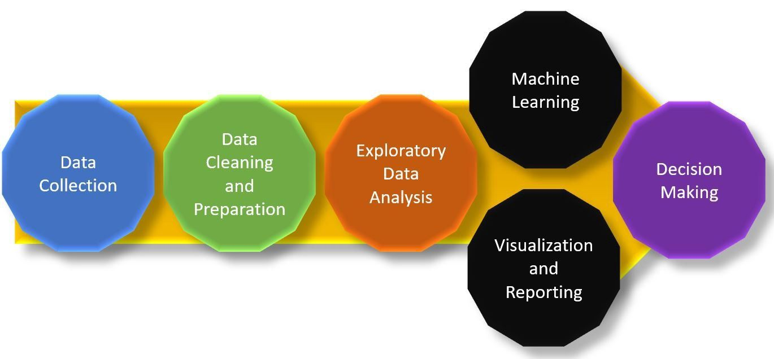
WORKFLOW
Data Cleansing: Cleaning and refining the dataset for analysis.
Data Transformation: Shaping and structuring the data for modeling.
Missing Value Imputation: Handling and filling in missing data.
Data Encoding: Converting categorical variables into numerical representations.
Feature Selection: Identifying and selecting relevant features.
Correlation Analysis: Exploring feature relationships and relevance.
Model Building and Evaluation:
Linear SVM Modeling: Creating a Linear SVM model.
kNN Modeling: Developing a k-Nearest Neighbors model.
Fine-Tuned kNN: Refining and optimizing the kNN model.
Polynomial SVM Modeling: Constructing a Polynomial SVM model.
Voting Classifier: Building an ensemble model using a Voting Classifier.
Random Forest Modeling: Creating a Random Forest Classifier model.

Slide 7

Conclusion
The primary goal of this project is to employ various machine learning algorithms to effectively classify and diagnose Chronic Kidney Disease patients. Through our analysis, we employed several techniques including Linear SVM, kNN, Polynomial SVM, Voting Classifier, and Random Forest Classifier.
Among these methods, the Voting Classifier and Random Forest Classifier demonstrated remarkable performance. They achieved the highest accuracy, reaching an impressive 98.75%, and a notable F1 score of 98.36%. These results underscore the effectiveness of these models in accurately predicting the presence of Chronic Kidney Disease.

Slide 8
THANK YOU !

