Slide 1

JavaScript Project Presentation
Project Title : Real-Time Corporate Task Management & Alert System
Course : React.js / Web Development Project
Student Name : Raga Priya .G
Roll No : 24BIT137
Department : B.Sc - IT
Mentor : Aravind

Slide 2
Project Overview & Objectives
The Concept: A high-performance MERN stack application designed to eliminate communication delays in corporate environments.
Core Goal: To move away from static email-based tasking to a real-time, event-driven notification system.
Learning Focus: Mastering React, Node.js, and the integration of WebSockets for live data streaming.

Slide 3
Real-World Problem & Solution
The Problem: Traditional manual systems often lead to "Notification Blindness" where employees miss urgent tasks due to cluttered inboxes.
The Solution: A dedicated "Command Center" (Manager Dashboard) that pushes alerts directly to a "My Assignments" view for employees.
Efficiency: Status tracking allows managers to see exactly when a task changes from "Pending" to "Seen."

Slide 4
System Architecture
Frontend: Built with React and Vite, utilizing Environment Variables (VITE_API_URL) to handle different hosting links.
Backend: A Node.js and Express server hosted on Render, communicating with a MongoDB database.
Live Sync: Powered by Socket.io, which allows the server to "push" data to the browser without the user having to refresh.

Slide 5
Key Modules & Functionality
Authentication: Role-Based Access Control (RBAC) that detects if a user is an "Admin" or "Employee" and redirects them accordingly.
Task Deployment: A creative modal form for managers to send "Common" (all-staff) or "Specific" (individual) alerts.
Directory: A live Employee Directory that pulls a list of all registered staff from the database to ensure accurate task targeting.

Slide 6
Technical Challenges & Solutions
The "401 Unauthorized" Issue: Encountered during deployment; resolved by synchronizing JWT_SECRET across the Render production environment.
State Persistence: Used localStorage to keep users logged in even if they close their browser or refresh the page.
CORS Management: Configured backend headers to allow secure communication only from your verified frontend URL.

Slide 7
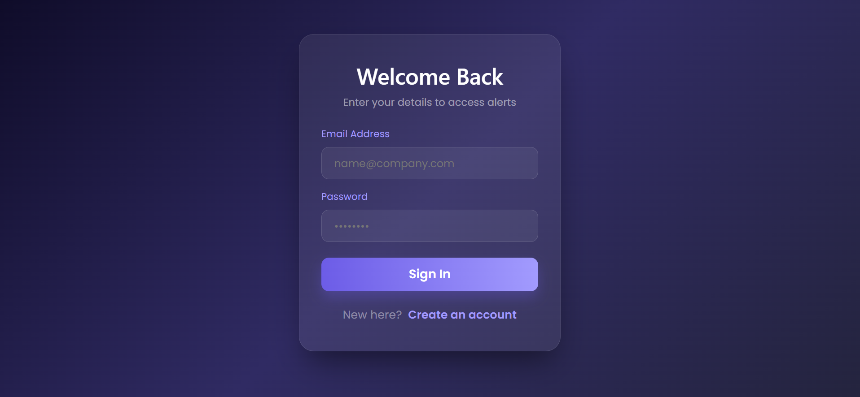
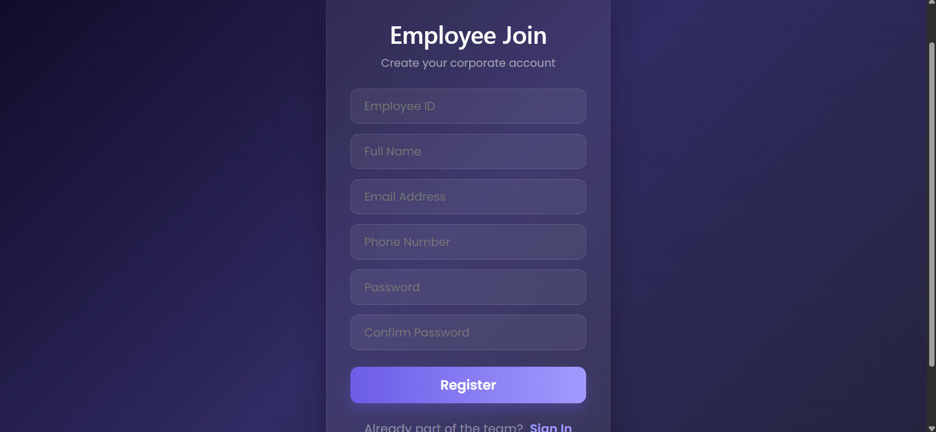
Output/Screenshot
LOGIN:
REGISTER

Slide 8
Thank You

