Slide 1

Welcome to Web Developement Course DAY-6

Slide 2
DAY-2 Topics
CSS Introduction
CSS types.
Colours.
Selectors.

Slide 3
Css
Cascading Style Sheets (CSS) is a language used to style web pages that contain HTML elements, defining how elements are displayed on webpages, including layout, colors, fonts, and other properties of the elements on a web page. CSS works by targeting HTML elements and applying style rules to define how they should be displayed, including properties like color, size, layout, and positioning.
There are three types of CSS which are given below:
Inline CSS
Internal or Embedded CSS
External CSS

Slide 4
Inline Css
<!DOCTYPE html>
<html>
<head>
<title>Inline CSS</title>
</head>
<body>
<p style="color:#009900;
font-size:50px;
font-style:italic;
text-align:center;">
GeeksForGeeks
</p>
</body>
</html>

Slide 5
Internal Css
<!DOCTYPE html>
<html>
<head>
<title>Internal CSS</title>
<style>
.main {
text-align: center;
}
.GFG {
color: #009900;
font-size: 50px;
font-weight: bold;
}
.geeks {
font-style: bold;
font-size: 20px;
}
</style>
</head>
<body>
<div class="main">
<div class="GFG"> GeeksForGeeks</div>
<div class="geeks">
A computer science portal for geeks
</div>
</div>
</body>
</html>

Slide 6
External Css
<!DOCTYPE html>
<html>
<head>
<title>External CSS</title>
<link rel="stylesheet" href="style.css">
</head>
<body>
<div class="main">
<div class="GFG">GeeksForGeeks</div>
<div id="geeks">
A computer science portal for geeks
</div>
</div>
</body>
</html>

Slide 7
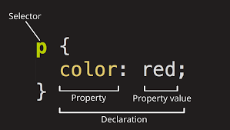
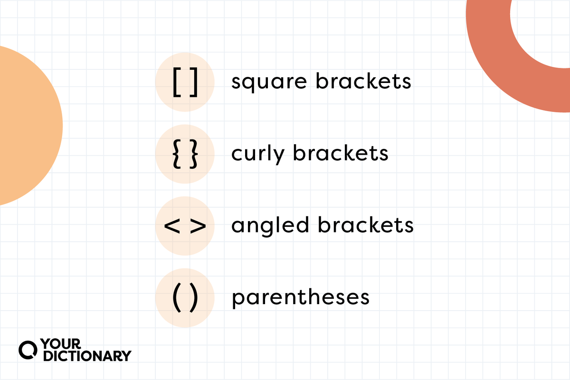
CSS Structure or syntax

Slide 8
selector
CSS selectors are used to "find" (or select) the HTML elements you want to style.
element Selector:
p { text-align: center; color: red; }
id Selector:
#idname { text-align: center; color: red; }

Slide 9
selector
group Selector:
H1,h2,h3 { text-align: center; color: red; }
Sibling Selector:
Decentense selector:
Adjusant sibling selector:
Child selector:

Slide 10
selector
class Selector:
.classname { text-align: center; color: red; }
universal Selector:
* { text-align: center; color: red; }

Slide 11
Color:

