Slide 1
Digital Portfolio
Student Name: Ragavan S
Register No: bruau2422k1179
NM ID: 22E69764EF48A14881A4DE0ADFF49468
Department: B.Sc. Computer Science
College: Government Arts and Science College, Avinashi

Slide 2
Agenda
Problem Statement
Project Overview
End Users
Tools and Technologies
Portfolio Design and Layout
Features and Functionality
Results and Screenshots
Conclusion
GitHub Link

Slide 3
Problem Statement
It is hard for students to show all their skills with just a paper resume. A paper resume can't show a person's talents well, especially for tech jobs. This project was created to solve that problem by making a website to showcase all my work in one place.

Slide 4
Project Overview
This project is a personal website that acts as my online resume. It introduces me as a Frontend Developer and Designer. The website is one single page that shows my skills, education, projects, and certificates in a simple and clear way.

Slide 5
End Users
This website is made for:
Companies and Recruiters: People who are looking to hire for jobs.
Other Developers: People who might want to work with me.
Teachers and Mentors: People who want to see my work.

Slide 6
Tools and Technologies
For Building the Website:
- HTML: To create the basic pages and content.
- CSS: To add colors, styles, and make it look good.
- JavaScript: To make the website interactive, like the buttons.
Other Tools:
- Boxicons: For the small icons you see on the site.
My Skills:
This project also shows my skills in managing my time, communicating ideas, and solving problems.

Slide 7
Portfolio Design and Layout
I designed the website to be simple and easy to use.
Layout: It's one long page with a menu at the top that helps you jump to different parts.
Look and Feel: It has a clean look with colors that are easy to read. I used 'cards' to organize my projects and skills.
Works on All Devices: The website looks good on computers, tablets, and phones.
Animations: When you scroll, you'll see some simple animations that make the site feel more alive.

Slide 8
Features and Functionality
Here are some things you can do on the website:
- Easy Navigation: The menu stays at the top so you can easily move around the page.
- Dark Mode: You can click a button to change the website to a darker color, which is easier on the eyes at night.
- Scroll Animations: As you scroll down, new sections appear with a nice effect.
- View My Work: You can see my projects and certificates and even download them.
- Contact Me: There is a simple form to send me a message.
- Quick Links: You can easily find links to my resume, LinkedIn, and GitHub.

Slide 9
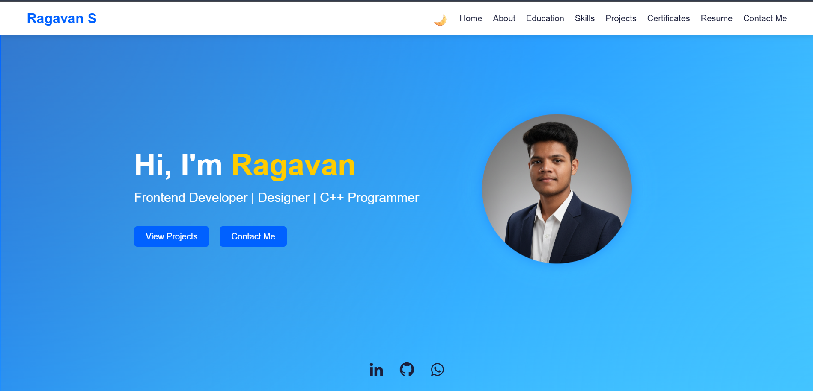
Results and Screenshots
This is the home page of my website.

Slide 10
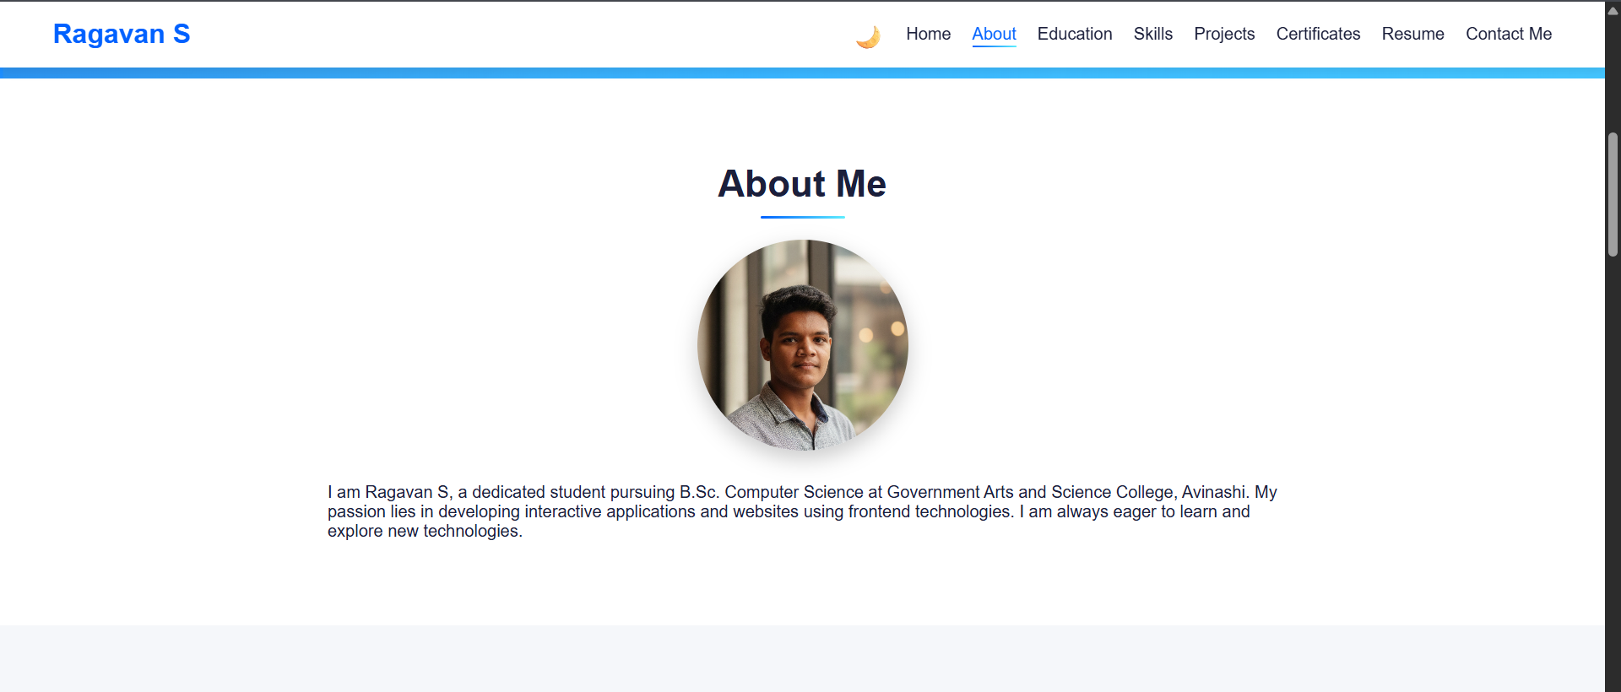
About me

Slide 11
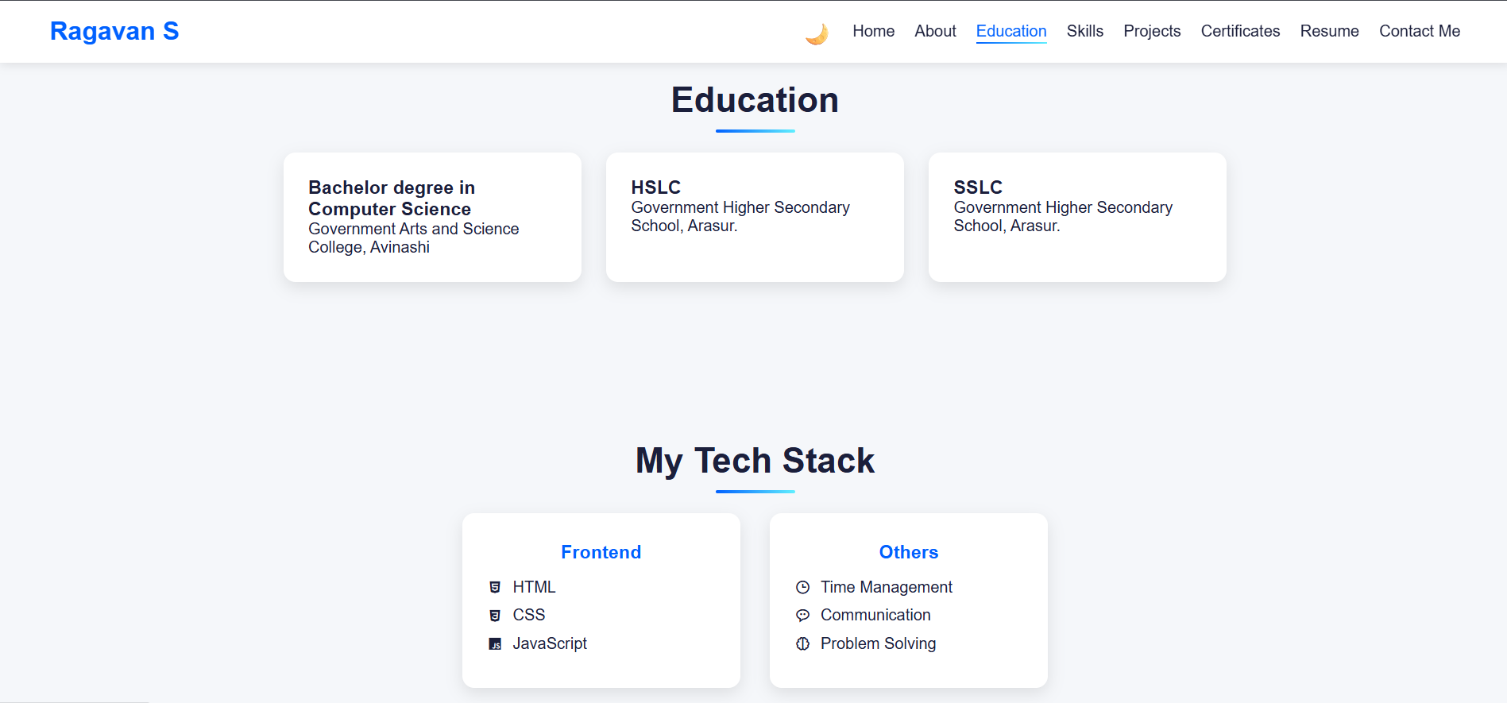
Education

Slide 12
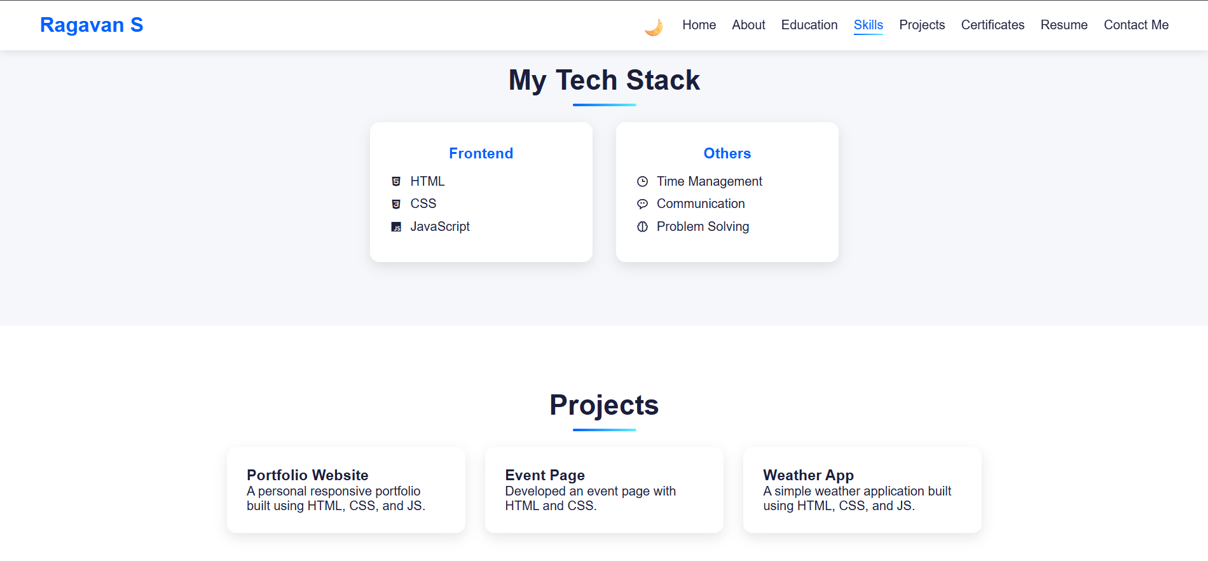
Skills and Projects

Slide 13
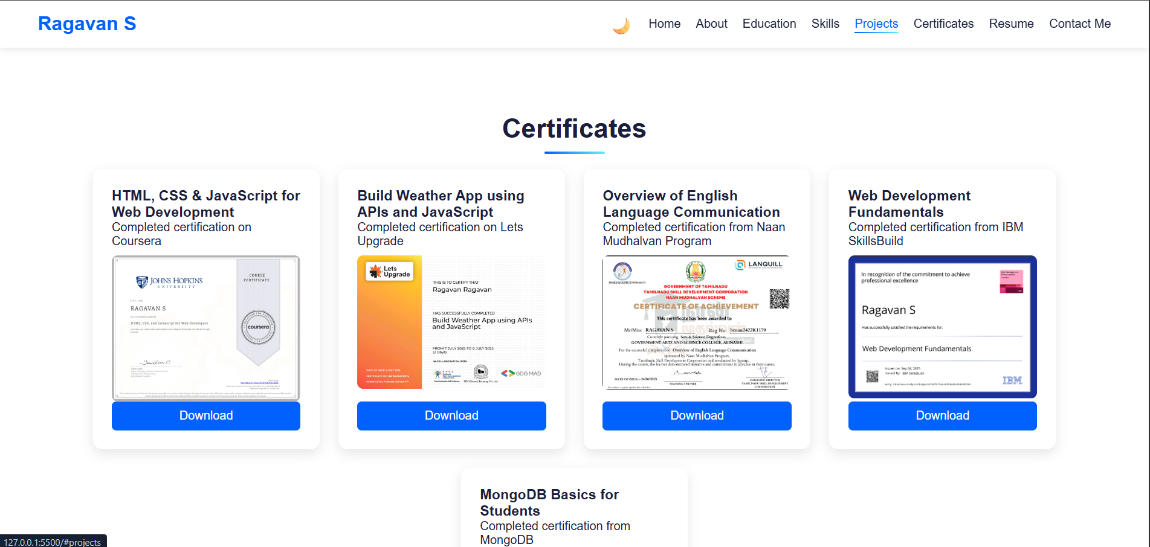
Certificates

Slide 14
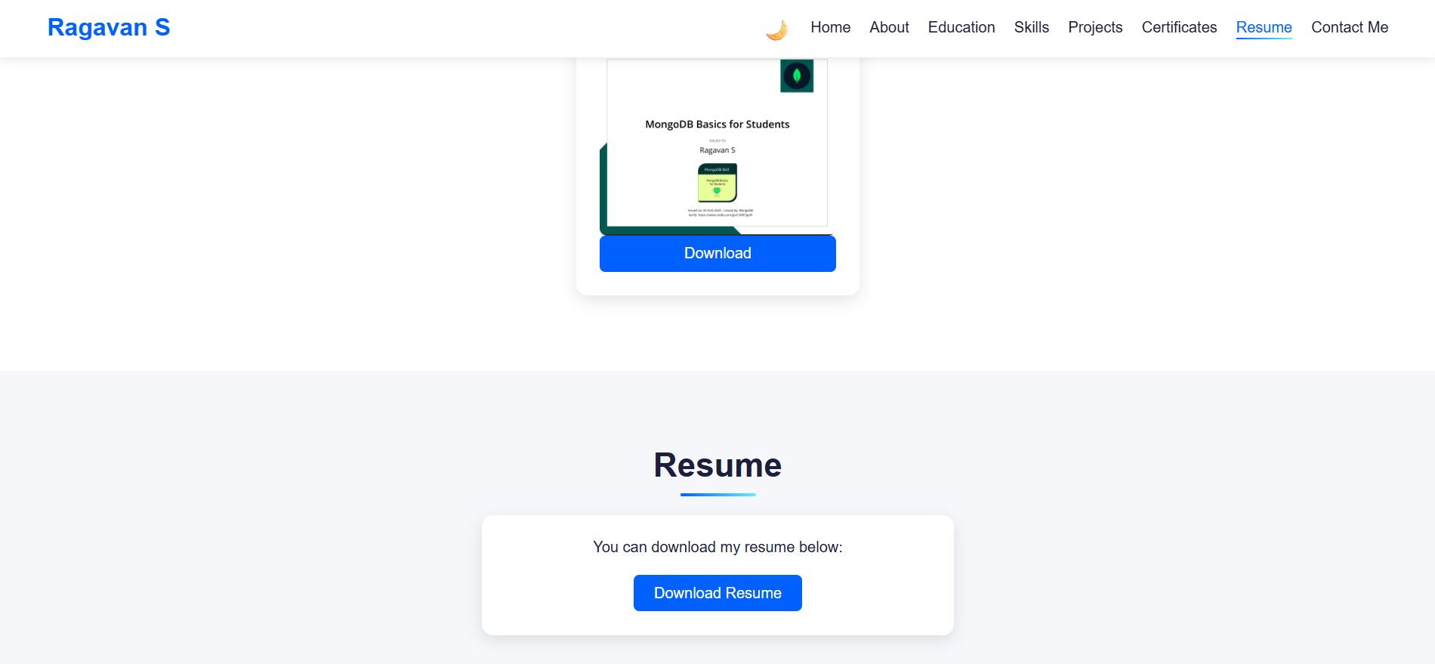
Resume

Slide 15
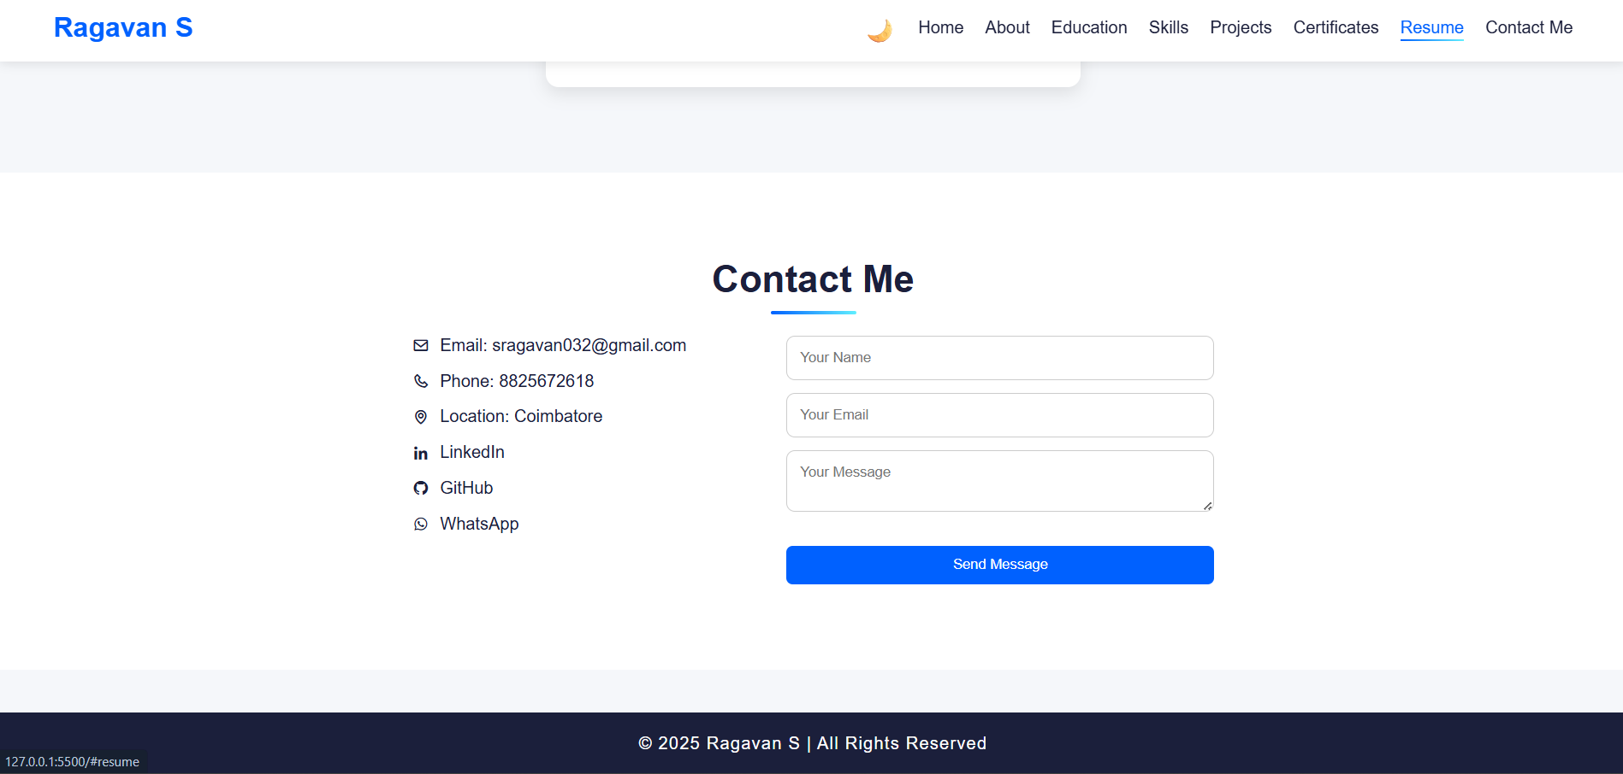
Contact me

Slide 16
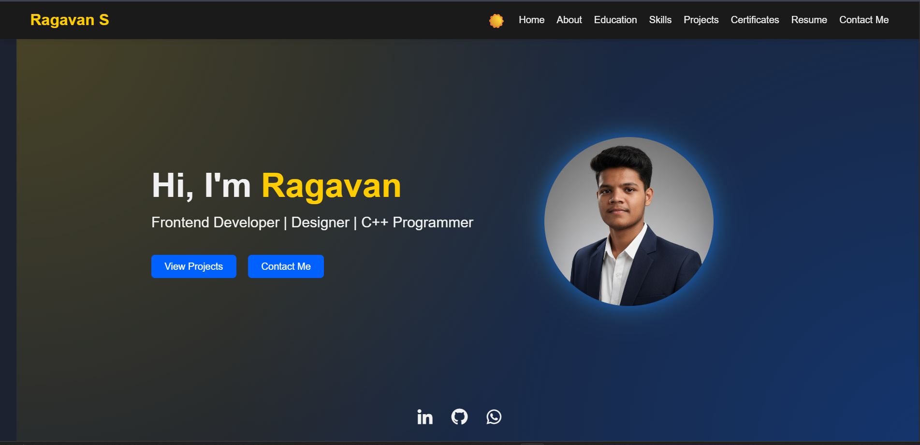
Dark mode

Slide 17
Conclusion
In the end, this project was a success. I created a good-looking website that shows all my skills and work in one place. It's a great tool to help me in my career and is much better than a simple paper resume.

Slide 18
GitHub Link
You can see all the code I wrote for this website on my GitHub page.
https://github.com/Ragavan360/Portfolio.git

