Slide 1
Software Testing

Slide 2
Software Testing Types
Manual Testing
Automation Testing

Slide 3
What is Software?
Software is a series of instruction for the computer that perform a particular task.
There are 2 types of Software-
1. System Software:- It is made of control program.
2. Application Software:- It is any program that process data for the user.

Slide 4
Why should software be tested
Humans make mistakes all the time
We humans can’t identify our mistakes in a work done by us. We should get someone else to check our work because another person may identify the mistakes done by us.
In the same way software developers may not identify the mismatches in a program or application implemented by them which can be identify by the another department called Software Test Engineer.

Slide 5
Cont…
Software testing is really required to point out the defects and errors that were made during the development phases
Testing looks at the all the area of that software by setting up test scenarios under control condition.
software should only be release after it has gone through a proper process of development, testing, bug fixing
It is tested because to see that it meets the customers needs and that it conforms to the standards.

Slide 6
Why is Testing Necessary?
To identify defects
Increase the overall Quality of the System
To reduce flaws in the component or system
The Testing is important since it discovers defects/bugs before the delivery to the client, which guarantees the Quality of the Software.

Slide 7
Cont…
Example-
Assume you are using a net banking application to transfer the amount to your friend’s account. So, you initiate the transaction, get a successful transaction message , and the amount also deducts from your account However, your friend confirms that his/her account has not received any credits yet..

Slide 8
Cont….
Likewise, your account is also reflecting the reversed transaction.
This will surely make you upset and leave you as an unsatisfied customer.

Slide 9
Benefits of Software Testing
Software testing helps in finalizing the software application against business requirements
Software testing makes sure that the testing is being done properly and hence the system is ready for the customers to use.
Below are few benefits of software testing.
- Finding the defects before delivery
- Gaines the confidence about quality
- To Prevent defects
- Ensure the requirements are delivered to client

Slide 10
What are the Testing Principles -
Exhaustive testing is not possible
Defect Clustering
Pesticide paradox
Testing shows a presence of Defects
Absence of Error-Fallacy
Early Testing
Testing is context dependent

Slide 11
Exhaustive Testing not possible
It is not possible to perform complete testing or exhaustive testing. For most systems, it is near impossible because of the following reasons:
1- The domain of possible inputs of a program is too large to be completely used in testing a system. There are both valid inputs and invalid inputs.

Slide 12
Cont…
2- The input domain of a system can be very large to be completely used in testing a program.
3-The design issues may be too complex to completely test. The design may have included implicit design decisions and assumptions. For example, a programmer may use a global variable or a static variable to control program execution.

Slide 13
Defect Clustering:-
Defect Clustering which states that a small number of modules contain most of the defects detected. This is the application of the Pareto Principle to software testing approximately 80% of the problems are found in 20% of the modules.
By experience, you can identify such risky modules. But this approach has its own problems
If the same tests are repeated over and over again, eventually the same test cases will no longer find new bugs.

Slide 14
Pesticide Paradox:-
Repeating the same test case will not find the new bugs
To overcome this, the test cases need to be regularly reviewed & revised, adding new & different test cases to help find more defects.

Slide 15
Testing shows a presence of defects-
1- Software testing reduce the presence of the defect.
2- Software testing talks about presence of the defects it doesn’t talks about absence of the defects.
3- Even multiple testing can never software is 100% bug free.
e

Slide 16
Absence of Error - fallacy
It is possible that software which is 99% bug-free is still unusable. This can be the case if the system is tested thoroughly for the wrong requirement. Software testing is not mere finding defects, but also to check that software addresses the business needs.
The absence of Error is a Fallacy i.e. Finding and fixing defects does not help if the system build is unusable and does not fulfill the user's needs & requirements.

Slide 17
Early Testing-
1-Testing should start as early as possible in the Software Development Life Cycle.
2- For the Better performance of the software testing will start at initial phase of the software development.

Slide 18
Testing is context dependent
Testing is approach depends on context of the Software developed.
2- Different types of software needs to be perform different types of testing

Slide 19
Quality / Quality Assurance / Quality Control:-session

Slide 20
What is Quality
Quality is briefly defined as a Degree of Excellence.
Quality of software saves good amoun of time and money.
Software quality is nothing but delivering a bug free application and delivered on time with all requirements.

Slide 21
Concept of Quality Application -
When defining application quality, several characteristics make up this concept for program evaluation. Software should have transferability, meaning it is easy to understand by all team members.

Slide 22
Cont…
Changeability - How easily systems can be changed to add new features.
Robustness - How resilient systems are.
Performance - How well systems operate in production environments.
Security - How secure systems are against cyber threats.

Slide 23
Quality Assurance-
Quality Assurance
Quality assurance can be defined as "part of quality management focused on providing confidence that quality requirements will be fulfilled.“
Quality Assurance is the set of activities that determine the procedures and standards to develop a product.

Slide 24
Quality Control-
Quality control can be defined as "part of quality management focused on fulfilling quality requirements.“
Quality Control refers to the activities and techniques to verify that the developed product is in conformance with the requirements. The ultimate output of both processes is to deliver a quality product.

Slide 25
Cont…
Quality Assurance | Quality Control
It is a process which deliberates on providing assurance that quality request will be achieved. A QA aim is to Prevent the defects. QA is the technique of managing Quality. | QC is a process which deliberates on fulfilling the quality request. A QC aim is to identify and improve the defects. QC is a method to verify Quality.

Slide 26
Quality Assurance | Quality Control
All team members are responsible for QA. QA means planning for doing a process. QA makes sure that you are doing the right things. QA is responsible for full Software Development Life Cycle. QA Example: Verification | Testing team is responsible a for QC. QC means Action for executing the planned process. QC makes sure the results of what you have done are what you expected. QC is responsible for Software testing life cycle. QC Example: Validation.

Slide 27
6 ways Testers Contribute to Quality-
1- Designing Better Test
2- Performing feature Reviews
3- Coverage Reviews
4- Building Automation
5- Discovering testing problems Early
6-Managing code reviews and pull Requests.

Slide 28
Software Testing metrics –
Software Testing Metrics are the quantitative measures used to estimate the progress, quality, productivity and health of the software testing process. The goal of software testing metrics is to improve the efficiency and effectiveness in the software testing process and to help make better decisions for further testing process by providing reliable data about the testing process.

Slide 29
What are the Types of Metrics-
Process Metrics
Product Metrics
Project Metrics

Slide 30
Cont…
Process Metrics: It can be used to improve the process efficiency of the SDLC ( Software Development Life Cycle)
Product Metrics: It deals with the quality of the software product
Project Metrics: It can be used to measure the efficiency of a project team or any testing tools being used by the team members

Slide 31
Example of Test Metrics-
Example –
A percentage test case executed.
To obtain the execution status of the test cases in percentage, we use the formula.
Percentage test cases executed=
(No of test cases executed/ Total no of test cases written) X 100
Likewise, you can calculate for other parameters like test cases not executed, test cases passed, test cases failed, test cases blocked, etc.

Slide 32
DEFECT MANAGEMENT- 2ND (Session)

Slide 33
What is Defect
A defect is a deviation or mismatch from the requirements
When actual result deviates from the expected result while testing a software application or product then it results into a defect.
Any deviation from the specification mentioned in the functional specification document is a defect.
Defect is also called bug, issue, incidents or problem

Slide 34
What is Defect Management
The Defect is an error occurred in the software any unexpected things comes with the software is called a defect. No software exists without defect or any bugs.
Defect management works in the parallel way of software development process.
Software testing team finds all the bugs and defect and report to developing a team to fix it.

Slide 35
Advantages of Defect Management-
The defect tracking assists you to ensure that the bugs found in the system really get fixed. Sure, it is great for developers and testers have a conversation & to recreate the issue together.
In defect management, the defect tracking, automated tools not only provide a channel to ensure follow through but also provide the valuable-metrics.
Having the tool in spot also sends notifications for the right individual when the bug needs to be tested, fixed, and marked as resolved.

Slide 36
Defect management process
There are 5 Types of Defect Management Process-
•Identification:
•Categorization:
•Prioritization:
•Resolution:
• Verification:

Slide 37
Types of Defect Management
1 Identification: This will be the first step to identify the defect in the process this can be done by the testing team and sometimes the customer can also tell you about the defect.
2 Categorization : After the defect is registered, then it passes to the desired person then checks it and categorize it that what type of defect it is and then move to the next step.

Slide 38
Cont…
3. Prioritization : According to the type of defect or severity of the defect. These defects are set of priorities for fixing it accordingly. It can handle through a formal channel or an individual team member who is working on defect can set its own priorities for fixing defects.
4. Resolution: Developer fixes the defect and places it in the same place from where it was identified.
5. Verification: As soon as the defect is fixed, the developing team verifies that defect is actually fixing and working in the smoothest way or not.

Slide 39
Defect Reporting:-
Defect Report also known as Bug Report, is a document that identifies and describes a defect detected by a tester.
The purpose of a defect report is to state the problem as clearly as possible so that developers can replicate the defect easily and fix it.
Defect Reporting is the main stage in software testing.
Defect reporting helps to better communicate, track and explain defects in detail

Slide 40
Cont…
Defect reporting in software testing is a process in which test managers prepare and send the defect report to the Management team for feedback on defect management process and defect status.
The defect reporting process is extremely important if you want to improve the Quality of your final product.

Slide 41
Advantages of Defect Tracking:-
Any issue in design, requirement, specifications and coding that cause incorrect results is called a bug. In a software development life cycle.
Tracking bugs is one of the most important steps and without which the entire process would be incomplete.
Bug tracking is important for every product to maintain quality, to save time and money. Selecting a right bug tracking tool can help you improve software quality assurance.

Slide 42
Cont…
1. Deliver High-Quality Product
2.Improve Return on Investment (ROI) by Reducing the Cost of Development
3.Better Communication, Teamwork and Connectivity
4.Detect Issues Earlier and Understand Defect Trends
5.Better Service and Customer Satisfaction.

Slide 43
Causes of Defects:-
Sometimes, software systems don’t work properly or as expected. There may be various reasons for the improper working of any software application including. The system user is making some mistake in using the system or software. Causes of software defects will be much more.
Software developers or system builders made some mistakes while designing and building the system, leaving some flaws in the software or system. And this is avoiding the system to work correctly.

Slide 44
Cont...
Error (Mistake): Any human action that can produce a wrong result.
Defect (Bug, Fault): A flaw in a component or whole system that may cause the system or particular component to fail to perform its intended function.
Failure: Deviation of any component or system from its expected function or result.

Slide 45
Bug Life Cycle
Bug Life Cycle starts with an unintentional software bug/behaviour and ends when the assigned developer fixes the bug.
A bug when found should be communicated and assigned to a developer that can fix it.
Once fixed, the problem area should be retested.
Also, confirmation should be made to verify if the fix did not create problems elsewhere.

Slide 46
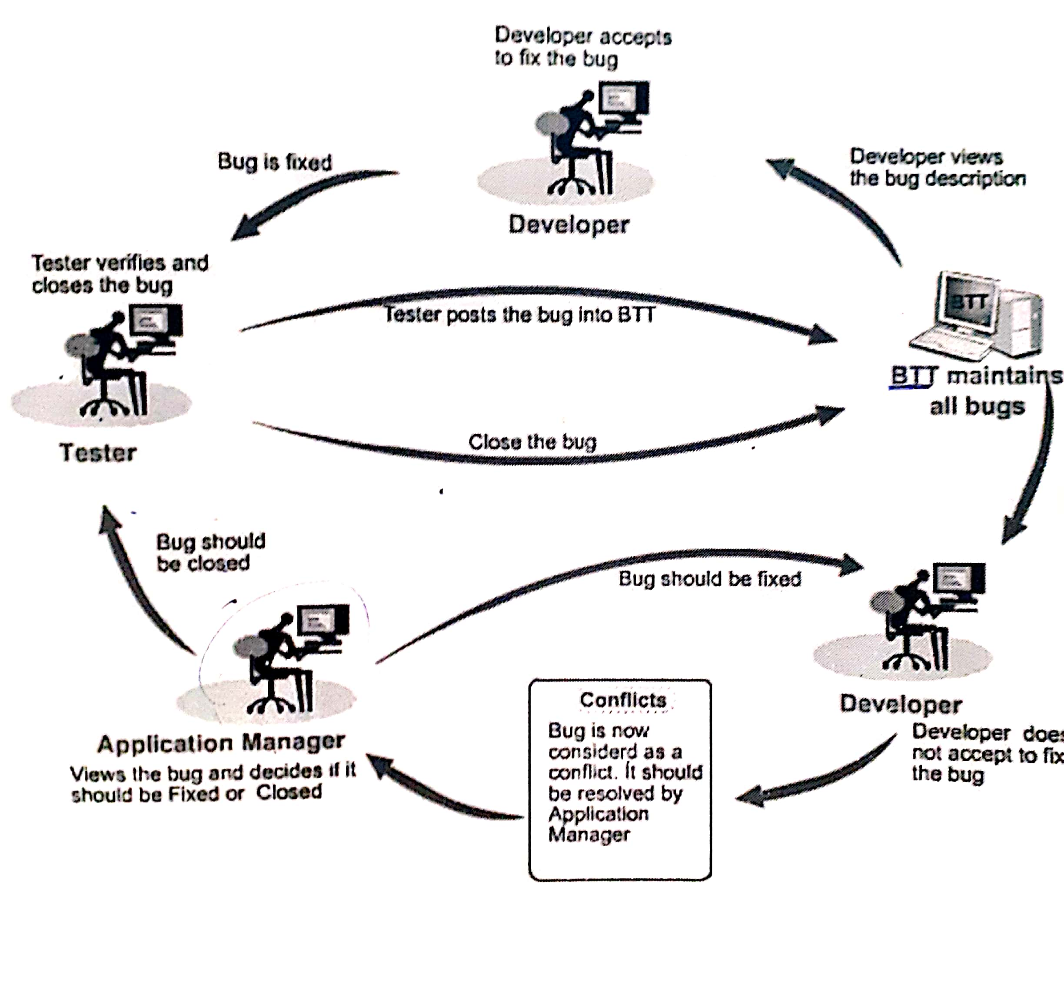
Cont….

Slide 47
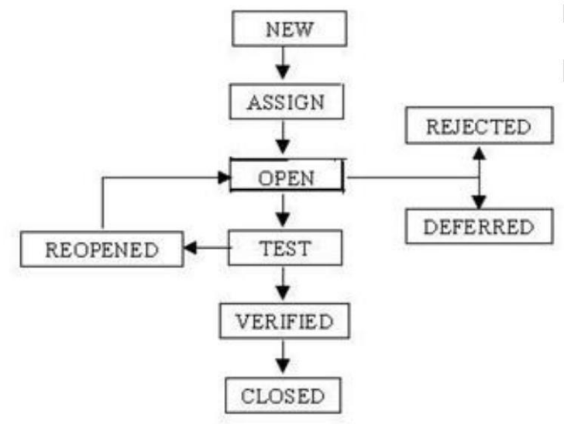
Phases of BLC

Slide 48
Cont…
1. New :- When a defect is logged and posted for the first time. It’s state is given as new.
2. Assigned:- After the tester has posted the bug, the lead of the tester approves that the bug is genuine and he assigns the bug to corresponding developer and the developer team. It’s state given as assigned.
3. Open:- At this state the developer has started analyzing and working on the defect fix.

Slide 49
Cont…
4. Fixed:- When developer makes necessary code changes and verifies the changes then he/she can make bug status as ‘Fixed’ and the bug is passed to testing team.
5. Verified:- The tester tests the bug again after it got fixed by the developer. If the bug is not present in the software, he approves that the bug is fixed and changes the status to “verified”.
6.Reopen:- If the bug still exists even after the bug is fixed by the developer, the tester changes the status to “reopened”. The bug goes through the life cycle once again.

Slide 50
Cont…
7. Closed:- Once the bug is fixed, it is tested by the tester. If the tester feels that the bug no longer exists in the software, he changes the status of the bug to “closed”. This state means that the bug is fixed, tested and approved.
8. Rejected:- If the developer feels that the bug is not genuine, he rejects the bug. Then the state of the bug is changed to “rejected”.
9. Deferred: The bug, changed to deferred state means the bug is expected to be fixed in next releases. Reason for decleaning are priority of the bug may be low, lack of time for the release or the bug may not have major effect on the software.

Slide 51
Defect Attributes:-
1- Type (Functionality, UI,etc)
2-Priority
3-Severity
4-Product Module
5-Component (part of that module)
6-Version Entered
7-Version Fixed
8-Reproducible(Always, sometimes, etc)
9- Operating system

Slide 52
Cont..
10- Description about Bug/Defect
11-Steps to Reproduce.

Slide 53
Severity and Priority
What is Priority?
Priority is defined as the order in which a defect should be fixed. Higher the priority the sooner the defect should be resolved.
Defects that leave the software system unusable are given higher priority over defects that cause a small functionality of the software to fail.

Slide 54
Priority Types:-
Priority Types:-
Types of Priority of bug/defect can be categorized into three parts :
Low: The Defect is an irritant but repair can be done once the more serious Defect has been fixed
Medium: During the normal course of the development activities defect should be resolved. It can wait until a new version is created.
High: The defect must be resolved as soon as possible as it affects the system severely and cannot be used until it is fixed

Slide 55
Severity:-
Bug Severity or Defect Severity in testing is a degree of impact a bug or a Defect has on the software application under test. A higher effect of bug/defect on system functionality will lead to a higher severity level. A Quality Assurance engineer usually determines the severity level of a bug/defect.
Severity is the degree of impact that a defect has on the operation of the product.

Slide 56
Types of Severity:-
Critical: This defect indicates complete shut-down of the process, nothing can proceed further
Major: It is a highly severe defect and collapses the system. However, certain parts of the system remain functional.
Medium: It causes some undesirable behavior, but the system is still functional.
Low: It won't cause any major break-down of the system

Slide 57
Example of Priority & Severity:-
A very low severity with a high priority: A logo error for any shipment website, can be of low severity as it not going to affect the functionality of the website but can be of high priority as you don't want any further shipment to proceed with the wrong logo.
A very high severity with a low priority: Likewise, for flight operating website, a defect in reservation functionality may be of high severity but can be a low priority as it can be scheduled to release in a next cycle.

Slide 58
Guidelines for new testers
It is impossible to test a program completely.
You can’t guarantee quality:- As a software tester, you cannot test everything and are not responsible for the quality of the product.
No application is 100% bug free:- It is more reasonable to recognize there are priorities, which may leave some less critical problems unsolved or unidentified.

Slide 59
Cont…
Be the customer:- Try to use the system as a lay user. To get a glimpse of this, get a person who has no idea of the application to use it for a while and you will be amazed to see the number of problems the person seem to come across.
Test what you observe:- It is very important that you test what you can observe and have access to.
Follow standards and processes:- As a tester, your need to conform to the standards and guidelines set by the organization.

Slide 60
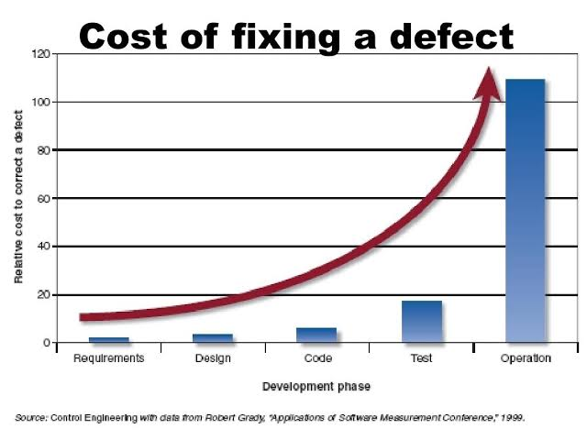
Cost of bug
Costs are logarithmic
It increase in size tenfold as the time increases.eg. of A &B company

Slide 61
Cont…
During coding, a swiftly spotted mistake may take only very less effort to fix.
During integration testing, it costs the paperwork of a bug report and a formally documented fix, as well as the delay and expense of a re-test.
During system testing it costs even more time and may delay delivery.
Finally, during operations it may cause to a system failure

Slide 62
reduced
It is difficult to determine when exactly to stop testing. Tester decide when they can stop or reduce testing:
• Deadlines (release deadlines, testing deadlines, etc.)
• Test cases completed with certain percentage passed
• Test budget depleted
• Coverage of code/functionality/requirements reaches a specified point
• Bug rate falls below a certain level and no high priority bug are identified.

Slide 63
Software development Life Cycle – 3rd Session:-

Slide 64
Software Development Life Cycle (SDLC)
SDLC is a process followed for a software project, within a software organization.
It consists of a detailed plan describing how to develop, maintain, replace and alter or enhance specific software
SDLC ensure success in process of software development.

Slide 65
Phases of SDLC
Phases of SDLC
• Initial
• Analysis
• Design
• Coding
• Testing
• Delivery & Maintenance

Slide 66
Phase 1: Initial
“Business requirements are gathered in this phase. “
This phase is the main focus of the project managers and stake holders. Meetings with managers, stake holders and users are held in order to determine the requirements like;
- Who is going to use the system?
- How will they use the system?
- What data should be input into the system?
- What data should be output by the system?

Slide 67
Phase2: Analysis
“After requirement gathering these requirements are analyzed for their validity and the possibility of developing the requirements in the system.”
Requirement analysis is the most important and fundamental stage in SDLC. It is performed by both development team and testing team.

Slide 68
Phase 3: Design
“During this part of the design phase, the consultants/architects break down the system into pieces that can be programmed.”
System Design helps in specifying hardware and system requirements and also helps in defining overall system architecture.
The system design specifications serve as input for the next phase of the model.

Slide 69
Phase 4: Coding
The actual development starts and the product is built in coding phase.
The work is divided in modules/units and actual coding is started in this coding phase and it is the main focus for developer.
Coding is one of the longest phase of SDLC.

Slide 70
Phase 5: Testing
In Testing phase testers execute the test cases against the application, report the defects and retested the fixed defects.
During this phase unit testing, integration testing, system testing, acceptance testing are done.

Slide 71
Phase 6: Delivery & Maintenance
After successful testing the product is delivered / deployed to the customer.
During the Delivery phase, customer will perform user acceptance testing (UAT) in a real time environment.
Once when the customers starts using the developed system then the actual problems comes up and needs to be solved from time to time. This process where the care is taken for the developed product is known as Maintenance.

Slide 72
SDLC Models:- 4th Session

Slide 73
SDLC Models
Waterfall Model
V-Shape Model
Prototype Model
Spiral Model
Agile Model

Slide 74
Waterfall Model
In a waterfall model, each phase must be completed fully before the next phase started.
The Waterfall Model was first Process Model to be introduced.
It is also referred to as a linear-sequential life cycle model.
It is very simple to understand and use.
This type of model is basically used for the project which is small and there are no uncertain requirements.

Slide 75
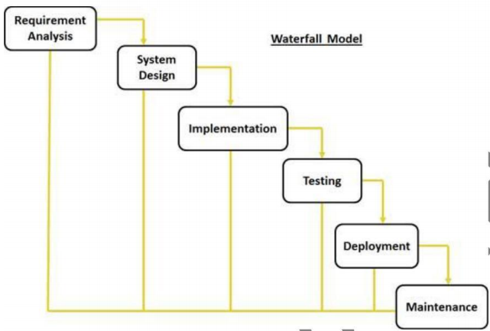
Cont....

Slide 76
Phases of Waterfall Model-
Requirement Gathering and analysis − All possible requirements of the system to be developed are captured in this phase and documented in a requirement specification document.
System Design − The requirement specifications from first phase are studied in this phase and the system design is prepared. This system design helps in specifying hardware and system requirements and helps in defining the overall system architecture.
Implementation − With inputs from the system design, the system is first developed in small programs called units, which are integrated in the next phase. Each unit is developed and tested for its functionality, which is referred to as Unit Testing.

Slide 77
Cont..
Integration and Testing − All the units developed in the implementation phase are integrated into a system after testing of each unit. Post integration the entire system is tested for any faults and failures.
Deployment of system − Once the functional and non-functional testing is done; the product is deployed in the customer environment or released into the market.
Maintenance − There are some issues which come up in the client environment. To fix those issues, patches are released. Also to enhance the product some better versions are released. Maintenance is done to deliver these changes in the customer environment.

Slide 78
Cont...
When to use the waterfall model:
- This model is used only when the requirements are very well known, clear and fixed.
- The project is short.
Advantages of waterfall model:
- This model is simple and easy to understand and use.
- It is easy to manage due to the rigidity of the model.
- In this model phases are processed and completed one at a time

Slide 79
Cont...
Disadvantages of waterfall model:
- Once an application is in the testing stage, it is very difficult to go back and change
- No working software is produced until late during the life cycle.
- High amounts of risk.
- Not a good model for complex and object-oriented projects.
- Poor model for long and ongoing projects.

Slide 80
V-Shape Model
The V-model is a SDLC model where execution of processes happens in a sequential manner in V-shape.
V-Shaped life cycle is a sequential path of execution of processes. Each phase must be completed before the next phase begins.
Testing of the product is planned in parallel with a corresponding phase of development.

Slide 81
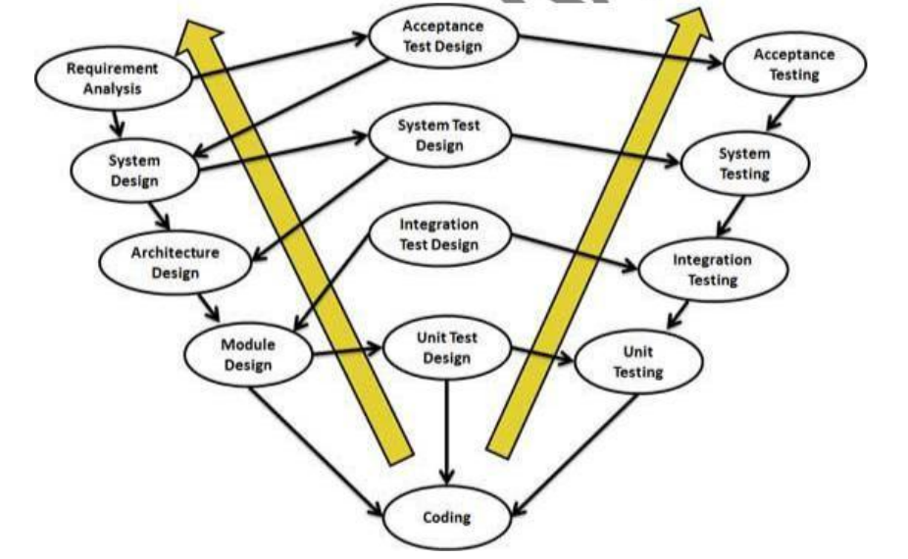
Cont...

Slide 82
Phases of V Model -
Business Requirement Analysis
This is the first phase in the development cycle where the product requirements are understood from the customer’s perspective. This phase involves detailed communication with the customer to understand his expectations and exact requirement. This is a very important activity and needs to be managed well, as most of the customers are not sure about what exactly they need.
System Design
Once you have the clear and detailed product requirements, it is time to design the complete system. The system design will have the understanding and detailing the complete hardware and communication setup for the product under development. The system test plan is developed based on the system design. Doing this at an earlier stage leaves more time for the actual test execution later.
Architectural Design
Architectural specifications are understood and designed in this phase. Usually more than one technical approach is proposed and based on the technical and financial feasibility the final decision is taken.

Slide 83
Cont…
Module Design
In this phase, the detailed internal design for all the system modules is specified, referred to as Low Level Design (LLD). It is important that the design is compatible with the other modules in the system architecture and the other external systems.
Coding Phase
The actual coding of the system modules designed in the design phase is taken up in the Coding phase. The best suitable programming language is decided based on the system and architectural requirements.

Slide 84
V-Model Phases-
Validation Phases
The different Validation Phases in a V-Model are explained in detail below.
Unit Testing
Unit tests designed in the module design phase are executed on the code during this validation phase. Unit testing is the testing at code level and helps eliminate bugs at an early stage, though all defects cannot be uncovered by unit testing.
Integration Testing-
Integration testing is associated with the architectural design phase. Integration tests are performed to test the coexistence and communication of the internal modules within the system.
System Testing-
System testing is directly associated with the system design phase. System tests check the entire system functionality and the communication of the system under development with external systems. Most of the software and hardware compatibility issues can be uncovered during this system test execution.

Slide 85
Cont..
Acceptance Testing
Acceptance testing is associated with the business requirement analysis phase and involves testing the product in user environment. Acceptance tests uncover the compatibility issues with the other systems available in the user environment. It also discovers the non-functional issues such as load and performance defects in the actual user environment.

Slide 86
Cont..
When to use the V-model:
- The V-shaped model should be used for small to medium sized projects where requirements are clearly defined and fixed.
- The V-Shaped model should be chosen when ample technical resources are available with needed technical expertise.
Advantages of V-model:
- Simple and easy to use.
- Testing activities like planning, test designing happens well before coding. This saves a lot of time.
- Proactive defect tracking – that is defects are found at early stage.

Slide 87
Cont...
Disadvantages of V-model:
- Software is developed during the implementation phase, so no early prototypes of the software are produced.
- If any changes happen in midway, then the test documents along with requirement documents has to be updated.

Slide 88
Prototype Model
Prototype means a approximate version of a final system or product.
It is used when prototype is built tested and then reworke as necessary until an acceptable prototype is finally achived.
When to use Prototype model:
- Prototype model should be used when the desired system needs to have a lot of interaction with the end users.

Slide 89
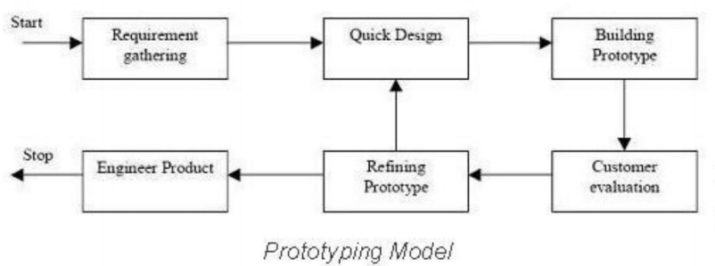
Cont...

Slide 90
Cont...
Advantages of Prototype model:
- Users are actively involved in the development
- Since in this methodology a working model of the system is provided, the users get a better understanding of the system being developed.
- Errors can be detected much earlier.
- Quicker user feedback is available leading to better solutions.
- Missing functionality can be identified easily
- Confusing or difficult functions can be identified

Slide 91
Cont...
Disadvantages of Prototype model:
- Practically, this methodology may increase the complexity of the system as scope of the system may expand beyond original plans.
- Incomplete application may cause application not to be used as the full system was designed

Slide 92
Agile Model
Agile SDLC model is a combination of iterative and incremental process models with focus on process adaptability and customer satisfaction by rapid delivery of working software product.
Agile Methods break the product into small incremental builds. These builds are provided in iterations.
Agile model believes that every project needs to be handled differently and the existing methods need to be tailored to best suit the project requirements.

Slide 93
Cont...
Iterative approach is taken and working software build is delivered after each iteration.
Each build is incremental in terms of features; the final build holds all the features required by the customer.
In Agile, the tasks are divided to time boxes (small time frames) to deliver specific features for a release.

Slide 94
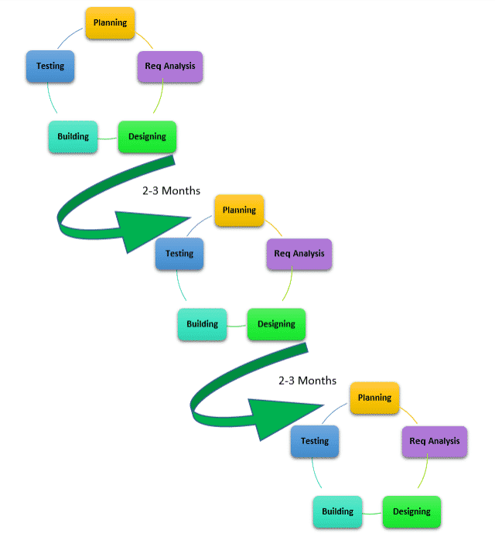

Slide 95
Cont...
When to use Agile model:
- New changes can be implemented at very little cost
- To implement a new feature the developers need to lose only the work of a few days.
- Unlike the waterfall model in agile model very limited planning is required to get started with the project.

Slide 96
Cont...
Advantages of Agile model:
- Customer satisfaction by continuous delivery of software.
- Customers, developers and testers constantly interact with each other.
- Working software is delivered frequently
- Continuous attention to technical excellence and good design.
- Even late changes in requirements are welcomed

Slide 97
Cont..
Disadvantages of Agile model:
- It is difficult to assess the effort required at the beginning of the software development life cycle.
- The project can easily get taken off track if the customer representative is not clear what final outcome that they want.
- Only senior programmers are capable of taking the kind of decisions required during the development process.

Slide 98
Spiral Model
The spiral model combines the idea of iterative development with the systematic, controlled aspects of the waterfall model.
The Spiral Model is widely used in the software industry as it is in sync with the natural development process of any product, i.e. learning with maturity which involves minimum risk for the customer as well as the development firms.

Slide 99
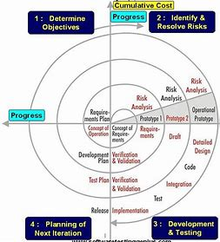

Slide 100
Phases
Objectives determination and identify alternative solutions: Requirements are gathered from the customers and the objectives are identified, elaborated, and analyzed at the start of every phase. Then alternative solutions possible for the phase are proposed in this quadrant.
Identify and resolve Risks: During the second quadrant, all the possible solutions are evaluated to select the best possible solution. Then the risks associated with that solution are identified and the risks are resolved using the best possible strategy. At the end of this quadrant, the Prototype is built for the best possible solution.
Develop next version of the Product: During the third quadrant, the identified features are developed and verified through testing. At the end of the third quadrant, the next version of the software is available.

Slide 101
Cont…
Review and plan for the next Phase:
In the fourth quadrant, the Customers evaluate the so far developed version of the software. In the end, planning for the next phase is started.

Slide 102
Cont...
When to use Spiral model:
- When there is a budget constraint and risk evaluation is important.
- For medium to high-risk projects.
- Customer is not sure of their requirements which is usually the case.
- Requirements are complex and need evaluation to get clarity.
-New product line which should be released in phases to get enough customer feedback.
-Significant changes are expected in the product during the development cycle.

Slide 103
Cont...
Advantages of Sprial Model
- Changing requirements can be accommodated.
- Allows extensive use of prototypes.
- Requirements can be captured more accurately.
- Users see the system early.
-Development can be divided into smaller parts and the risky parts can be developed earlier which helps in better risk management.

Slide 104
Cont...
Disadvantages of Sprial Model
- Management is more complex.
- End of the project may not be known early.
- Not suitable for small or low risk projects and could be expensive for small projects.
- Process is complex
- Large number of intermediate stages requires excessive documentation.

Slide 105
Scrum Methodology and Artifacts :-5th Session:-

Slide 106
Scrum Methodology:-
Scrum is an agile development methodology used in the development of Software based on an iterative and incremental processes. Scrum is adaptable, fast, flexible and effective agile framework that is designed to deliver value to the customer throughout the development of the project. The primary objective of Scrum is to satisfy the customer’s need through an environment of transparency in communication, collective responsibility and continuous progress.

Slide 107
Benefits of Scrum:-
Benefits of Scrum Methodology
Scrum has many advantages over other agile development methodologies. It is currently the most used and trusted framework of reference in the software industry. Below are some of the known benefits of Scrum:
Easily Scalable: Scrum processes are iterative and are handled within specific work periods, which makes it easier for the team to focus on definite functionalities for each period. This not only has the benefit of achieving better deliverables in line with the needs of the user, but also gives the ability to the teams to scale the modules in terms of functionality, design, scope and characteristics in an orderly, transparent and simple manner.

Slide 108
Cont…
Compliance of expectations: The client establishes their expectations indicating the value that each requirement/ history of the project brings, the team estimates them and with this information the Product Owner establishes its priority. On a regular basis, in the sprint demos, the Product Owner verifies that the requirements have been met and transmits feedback to the team.
Flexible to changes: Quick reaction to changes in requirements generated by customer needs or market developments. The methodology is designed to adapt to the changing requirements that complex projects entail.

Slide 109
Cont…
Time to Market reduction: The client can start using the most important functionalities of the project before the product is completely ready.
Higher software quality: The working method and the need to obtain a functional version after each iteration, helps to obtain a higher quality software.

Slide 110
Advantages of Scrum
Scrum can help teams complete project deliverables quickly and efficiently
Scrum ensures effective use of time and money
Developments are coded and tested during the sprint review
Works well for fast-moving development projects

Slide 111
Disadvantages of Scrum
Adopting the Scrum framework in large teams is challenging
The framework can be successful only with experienced team members
Daily meetings sometimes frustrate team members
If any team member leaves in the middle of a project, it can have a huge negative impact on the project
Quality is hard to implement until the team goes through an aggressive testing process

Slide 112
Scrum Artifacts:-
Scrum Artifacts
Scrum Artifacts are designed to guarantee the transparency of key information in decision making.
Product Backlog (PB): The product backlog is a list that collects everything the product needs to satisfy the potential customers. It is prepared by the product owner and the functions are prioritized according to what is more and less important for the business. The goal is for the product owner to answer the question “What should be done”.
Sprint Backlog (SB): It is a subset of items of the product backlog, which are selected by the team to perform during the sprint on which they are going to work. The team establishes the duration of each Sprint. Usually the sprint backlog, is displayed on physical boards called as Scrum board – that makes the development process visible to everyone who enters the development area.

Slide 113
Cont…
Product Increment and Sprint Review
The result of every sprint in Scrum is a potentially shippable product increment that can be demonstrated to the customer. After each iteration, the development team creates a new version of a software product with increased value.

Slide 114
Three Roles Of Scrums:-
Scrum Master
Scrum Team
Product Owner

Slide 115
Product Owner:-
A Product Owner owns the Product backlog and writes user stories and acceptance criteria.
A Product Owner is responsible for prioritizing the Product Backlog is prioritized and decides the release date and the content.
A Product Owner accepts or rejects product backlog item.
A Product Owner has the power to cancel the Sprint, if he thinks the Sprint goal is redundant.
A Product Owner is the one who is responsible for the Return on Investment (ROI) of the product.

Slide 116
Scrum Master:-
A Scrum Master protects the team from external and internal distractions.
A Scrum Master is not typically a manager or lead, but he is an influential leader and coach who does not do direct command and control.
A Scrum Master removes impediments so the team can focus on the work at hand and follow scrum practices.

Slide 117
Scrum Team:-
The Development Team includes all the expertise necessary to deliver the potentially shippable product each Sprint
The Development Team is self-organizing, with a very high degree of autonomy and accountability.
The Development Team decides how many items to build in a Sprint, and how best to accomplish that goal.
The Development Team is a cross functional, small and self-organizing team which owns the collective responsibility of developing, testing and releasing the Product increment.

Slide 118
Sprints in Scrum:-
"Sprints make projects more manageable, allow teams to ship high-quality work faster and more frequently, and gives them more flexibility to adapt to change.“
A sprint is a short, time-boxed period when a scrum team works to complete a set amount of work. Sprints are at the very heart of scrum and agile methodologies, and getting sprints right will help your agile team ship better software with fewer headaches.
“With Scrum, a product is built in a series of iterations called sprints that break down big, complex projects into bite-sized pieces," said Megan Cook, Group Product Manager for Jira Software at Atlassian.

Slide 119
How to plan and execute scrum sprints:-
In order to plan your upcoming sprint, you use the sprint planning meeting! Sprint planning is a collaborative event where the team answers two basic questions: What work can get done in this sprint and how will the chosen work get done?
Choosing the right work items for a sprint is a collaborative effort between the product owner, scrum master, and development team. The product owner discusses the objective that the sprint should achieve and the product backlog items that, upon completion, would achieve the sprint goal.

Slide 120
Cont…
Increment: The Increment is the sum of all the tasks, use cases, user stories, product backlogs and any element that was developed during the sprint and that will be made available to the end user in the form of Software.
Planning in Scrum-
The Sprint Planning Meeting is held at the beginning of each Sprint. All the members of the Team participate in the meeting, i.e., the Product Owner, Scrum Master and all the Development Team.

Slide 121
V&V Process- 6th Session:-

Slide 122
V-V Process
Verification
- “The process of evaluating work-products (not the actual final product) of a development phase to determine whether they meet the specified requirements
- Verification is done at the starting of the development process. It includes reviews and meetings, walkthroughs, inspection, etc. to evaluate documents, plans, code, requirements and specifications.

Slide 123
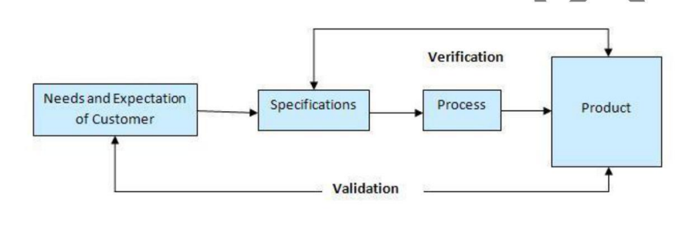
Cont...
Validation
- The process of evaluating software during or at the end of the development process to determine whether it satisfies specified business requirements.”

Slide 124
Cont...
Verification | Validation
To ensure that the product is being built according to the requirements and design specifications. In other words, to ensure that work products meet their specified requirements. | To ensure that the product actually meets the user‟s needs, and that the specifications were correct in the first place. In other words, to demonstrate that the product fulfills its intended use when placed in its intended environment.
It is static proess o analyzing the documentsand no the actual end product | It involves dynamic testing of a software product by runnung it.

Slide 125
Verification | Validation
Verification is process -oriented approach. | Validation is a product-oriented approach.
Answers the question - “Are we building the product right ? ” | Answers the question - “Are we building the right product ? ”
Errors foun during verification require lesser cost/resouces to get fixed as compared tobe foun uing the validation phase. | Errors found during validation require more cost/resources. Later the error is discovered higher is the cost to fix it.
It involves activities like document , test cases review, walk-throughs, inspection etc. | It involves activities like function testing, automation testing etc.

Slide 126
Levels of Testing:- 7th Session:-

Slide 127
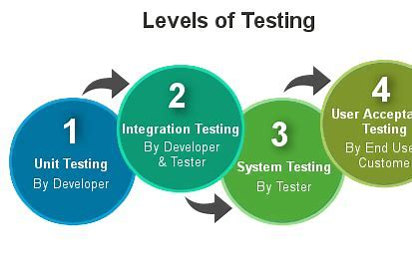
5. Levels of testing
In software development life cycle models there are defined phases like require coding or implementation, testing and deployment. Each phase goes through the testing.

Slide 128
1. Unit Testing
Unit Testing
- A unit is the smallest testable part of an application procedures like function interfaces.
- Unit testing is a method by which individual units of source code are tested to determine if they are fit for use.
- The purpose is to validate that each unit of the software code performs as expected.
- Unit Testing is done during the development (coding phase) of an application by the developers.
- Unit testing is a WhiteBox testing technique that is usually performed by the developer.
Notes:
- Unit tests help to fix bugs early in the development cycle and save costs.
- It helps the developers to understand the code base and enables them to make changes quickly
- Good unit tests serve as project documentation
- As you can see, there can be a lot involved in unit testing. It can be complex or rather simple depending on the application being tested and the testing strategies, tools and philosophies used. Unit testing is always necessary on some level. That is a certainty.

Slide 129
2. Integration Testing
Integration Testing :-
- Is defined as a type of testing where software modules are integrated logically and tested as a group.
- A typical software project consists of multiple software modules, coded by different programmers.
- The purpose of this level of testing is to expose defects in the interaction between these software modules when they are integrated
- Integration Testing focuses on checking data communication amongst these modules.
- Hence it is also termed as 'I & T' (Integration and Testing), 'String Testing' and sometimes 'Thread Testing'.

Slide 130
Approach for Integration testing
Software Engineering defines variety of strategies to execute Integration testing, viz.
Big Bang Approach :
Incremental Approach: which is further divided into the following
- Top Down Approach
- Bottom Up Approach

Slide 131
Big Bang Approach
Here all component are integrated together at once and then tested.
Advantages:
- Convenient for small systems.
Disadvantages:
- Fault Localization is difficult.
- Since the Integration testing can commence only after "all" the modules are designed, the testing team will have less time for execution in the testing phase.
- Since all modules are tested at once, high-risk critical modules are not isolated and tested on priority.

Slide 132
Incremental Approach
In this approach, testing is done by joining two or more modules that are logically related.
Then the other related modules are added and tested for the proper functioning.
The process continues until all of the modules are joined and tested successfully.
Incremental Approach, in turn, is carried out by two different Methods:
- Bottom Up
- Top Down

Slide 133
Cont...
What is Stub and Driver?
- Incremental Approach is carried out by using dummy programs called Stubs and Drivers.
- Stubs and Drivers do not implement the entire programming logic of the software module but just simulate data communication with the calling module.
Stub: Is called by the Module under Test.
Driver: Calls the Module to be tested.

Slide 134
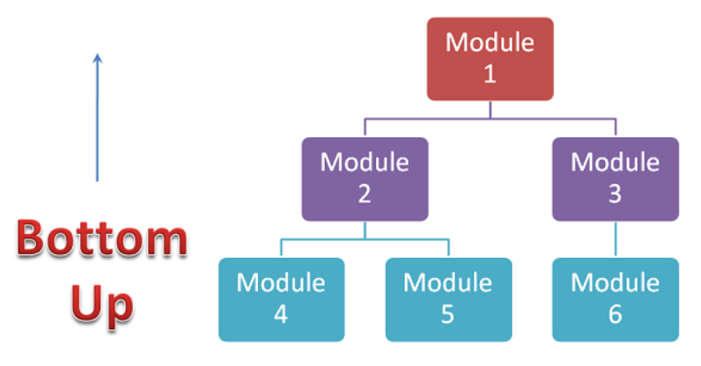
Bottom-up Integration
In the bottom-up strategy, each module at lower levels is tested with higher modules until all modules are tested. It takes help of Drivers for testing

Slide 135
Cont...
Advantages:
- Fault localization is easier.
- No time is wasted waiting for all modules to be developed unlike Big-bang approach
Disadvantages:
- Critical modules (at the top level of software architecture) which control the flow of application are tested last and may be prone to defects.
- An early prototype is not possible

Slide 136
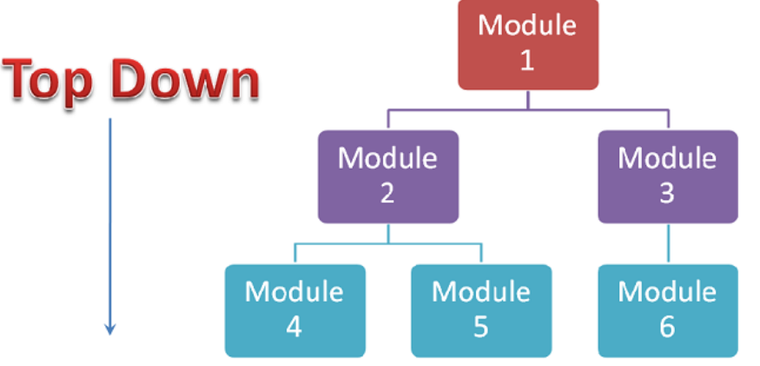
Top-down Integration
In Top to down approach, testing takes place from top to down following the control flow of the software system.
Takes help of stubs for testing.

Slide 137
Cont...
Advantages:
- Fault Localization is easier.
- Possibility to obtain an early prototype.
- Critical Modules are tested on priority; major design flaws could be found and fixed first.
Disadvantages:
- Needs many Stubs.
- Modules at a lower level are tested inadequately.

Slide 138
3. System Testing
- It is a level of testing that validates the complete and fully integrated software product.
- The purpose of a system test is to evaluate the end-to-end system specifications.
- System Testing is actually a series of different tests whose sole purpose is to exercise the full computer-based system.
- Once all the components are integrated, we have to check the application it meets the requirements or not?”
- System testing is most often the final test to verify that the system to be delivered meets the specification and its purpose.

Slide 139
4. User Acceptance Testing
User Acceptance Testing (UAT)
- It is a type of testing performed by the end user or the client to verify/accept the software system before moving the software application to the production environment.
- UAT is done in the final phase of testing after functional, integration and system testing is done.
- User Acceptance Testing is carried out in a separate testing environment with production-like data setup.
- It is a kind of black box testing where two or more end-users will be involved.

Slide 140
Cont..
Alpha Testing
- Alpha Testing is referred to a kind of acceptance testing.
- It is performed with the intent of identifying all issues/bugs present in a product before it is released for end users or the public.
- This test aims at carrying out all the tasks that typical users might perform. It is performed on applications when their development is about to be completed.
- In case any minor changes are needed, they can be performed after the alpha testing is done.
- These tests are carried out under laboratory conditions at the developer’s site only.

Slide 141
Cont..
Beta Testing
- Beta Testing is carried out by "real users" in real environment by software application users.
- The Beta version of any software product is released to restricted number of end-users with the intent of obtaining feedback on the quality of the product.
- Beta tests reduce the risks of product failure and provide enhanced product quality with the help of customer validations.
- Beta testing is the final phase of testing done before a product is shipped out to the end customer.
- The main advantage of this test lies in the direct customer feedback being received by developers as the product tests are carried out in the customer's environment.

Slide 142
Cont...
Testing Methodologies:-

Slide 143
Testing Methodologies-
Black box Testing –
The technique of testing without having any knowledge of the interior workings of the application is called black-box testing. The tester is oblivious to the system architecture and does not have access to the source code. Typically, while performing a black-box test, a tester will interact with the system's user interface by providing inputs and examining outputs without knowing how and where the inputs are worked upon.

Slide 144
Advantages of Black box-
Well suited and efficient for large code segments.
Code access is not required.
Large numbers of moderately skilled testers can test the application with no knowledge of implementation, programming language, or operating systems.

Slide 145
Disadvantages of Black box
Limited coverage, since only a selected number of test scenarios is actually performed.
Inefficient testing, due to the fact that the tester only has limited knowledge about an application.
The test cases are difficult to design.

Slide 146
White Box Testing-
White-box testing is the detailed investigation of internal logic and structure of the code. White-box testing is also called glass testing or open-box testing. In order to perform white-box testing on an application, a tester needs to know the internal workings of the code.

Slide 147
Advantages of White Box-
As the tester has knowledge of the source code, it becomes very easy to find out which type of data can help in testing the application effectively.
It helps in optimizing the code.
Extra lines of code can be removed which can bring in hidden defects.

Slide 148
Disadvantages:-
Due to the fact that a skilled tester is needed to perform white-box testing, the costs are increased.
Sometimes it is impossible to look into every nook and corner to find out hidden errors that may create problems, as many paths will go untested.
It is difficult to maintain white-box testing, as it requires specialized tools like code analyzers and debugging tools.

Slide 149
Gray Box Testing:-
Grey-box testing is a technique to test the application with having a limited knowledge of the internal workings of an application. In software testing, the phrase the more you know, the better carries a lot of weight while testing an application.

Slide 150
Advantages:-
Offers combined benefits of black-box and white-box testing wherever possible.
Based on the limited information available, a grey-box tester can design excellent test scenarios especially around communication protocols and data type handling.

Slide 151
Disadvantages:-
Testing every possible input stream is unrealistic because it would take an unreasonable amount of time; therefore, many program paths will go untested.
Since the access to source code is not available, the ability to go over the code and test coverage is limited.

Slide 152
Statement coverage:-
Statement Coverage is a white box testing technique in which all the executable statements in the source code are executed at least once. It is used for calculation of the number of statements in source code which have been executed. The main purpose of Statement Coverage is to cover all the possible paths, lines and statements in source code.

Slide 153
Example of Statement Cov:-
For Statement Coverage we would only need one test case to check all the lines of the code.
INPUT A & B
C=A+B
If C≥100
“Print its DONE”
If I consider test case _01 to be (A=40 and B=70)
Then all the lines of the code will be Executed.

Slide 154
Decision Coverage:-
Decision Coverage (Branch Coverage):-
Decision Coverage is a white box testing technique which reports the true or false outcomes of each boolean expression of the source code. The goal of decision coverage testing is to cover and validate all the accessible source code by checking and ensuring that each branch of every possible decision point is executed at least once.

Slide 155
Cont
Decision coverage =
No. of outcomes Excercised
Total number of Decision Outcomes

Slide 156
Non Functional Testing:-9th Session

Slide 157
Non-Functional Testing
Non- Functional Testing: It is a testing technique that is used to test the surrounding condition in which a software is going to test.
1. User Interface Testing :- Graphical User Interface (GUI) testing is checking the application design of an application.
2. Usability Testing :- In usability testing basically the testers tests the ease with which the user interfaces can be used. It tests that whether the application is user-friendly or not. “

Slide 158
Cont...
3. Load Testing :- Load testing is performed to determine a system’s behavior under both normal and at peak conditions.
4. Performance Testing :- Performance testing is testing that is performed, to determine how fast some aspect of a system performs under a particular workload.
5. Compatibility Testing: Compatibility Testing ensure compatibility of the application built with various other objects such as other web browsers, hardware platforms, operating systems etc.

Slide 159
Cont...
6. Installation Testing :- Installation testing is performed to ensure that all necessary components are installed properly and working as per the requirements of the software, post installation. Installation process may include partial, full or upgrade install.
7. Recovery Testing:- Recovery testing is done in order to check how fast and better the application can recover after it has gone through any type of crash or failure

Slide 160
Cont…
11. Volume Testing:- It is a type of Software Testing, where the software is subjected to a huge volume of data. It is also referred to as flood testing. Volume testing is done to analyze the system performance by increasing the volume of data in the database.
12. Internationalization Testing:- Internationalization testing is the process of verifying the application under test to work uniformly across multiple regions and cultures. The main purpose of internationalization is to check if the code can handle all international support without breaking functionality that might cause data loss or data integrity issues. Globalization testing verifies if there is proper functionality of the product with any of the locale settings.
13. Localization Testing : It is a software testing technique in which the behavior of a software is tested for a specific region, locale or culture. The purpose of doing localization testing for a software is to test appropriate linguistic and cultural aspects for a particular locale.

Slide 161
Cont…
8. Security Testing:- Security Testing is a type of Software Testing that uncovers vulnerabilities of the system and determines that the data and resources of the system are protected from possible intruders. It ensures that the software system and application are free from any threats or risks that can cause a loss.
9. Configuration Testing:- Configuration Testing is a software testing technique in which the software application is tested with multiple combinations of software and hardware in order to evaluate the functional requirements and find out optimal configurations under which the software application works without any defects or flaws.
10. Parallel Testing is a software testing type in which multiple versions or subcomponents of an application are tested with same input on different systems simultaneously to reduce test execution time. The purpose of parallel testing is finding out if legacy version and new version are behaving the same or differently and ensuring whether new version is more efficient or not.

Slide 162
Functional Testing:- 10th Session-

Slide 163
Cont…
Functional Testing:- Functional testing is a (QA) process and a type of black-box testing that bases its test cases on the specifications of the software component under test.

Slide 164
Cont….
Smoke Testing: Functional testing by smoke testing. Smoke testing includes only the basic (feature) functionality of the system. Smoke testing is known as "Build Verification Testing." Smoke testing aims to ensure that the most important function work.
For example, Smoke testing verifies that the application launches successfully will check that GUI is responsive.
Sanity Testing: Sanity testing involves the entire high-level business scenario is working correctly. Sanity testing is done to check the functionality/bugs fixed. Sanity testing is little advance than smoke testing.
For example, login is working fine; all the buttons are working correctly; after clicking on the button navigation of the page is done or not.

Slide 165
Cont…
3. Regression Testing: This type of testing concentrate to make sure that the code changes should not side effect the existing functionality of the system. Regression testing specifies when bug arises in the system after fixing the bug, regression testing concentrate on that all parts are working or not. Regression testing focuses on is there any impact on the system.
4. Retesting: Retesting is a type of testing performed to check the test cases that were unsuccessful in the final execution are successfully pass after the defects fixed. Usually, tester assigns the bug when they find it while testing the product or its component. The bug allocated to a developer, and he fixes it. After fixing, the bug is assigned to a tester for its verification. This testing is known as retesting.

Slide 166
Cont…
6. Monkey Testing :-
Monkey testing is a software testing technique in which the testing system under test randomly. The Input data that is used to test also generated.
7. End to End Testing:-
End-to-end testing is a methodology used to test whether the flow of an application is performing as designed from start to finish.
8. Exploratory System:-
Testing of Software without any documents (test cases or test planning) and identify the functionality of application by exploring the application and exploring and learning.

Slide 167
Process of Testing :-
Test Planning-
Test Analysis-
Test Design-
Construction and Verification-
Testing cycles:-
Final testing and Implementation:-
Post Implementation:-

Slide 168
Test plan:-
A Test Plan is a detailed document that describes the test strategy, objectives, schedule, estimation, deliverables, and resources required to perform testing for a software product. Test Plan helps us determine the effort needed to validate the quality of the application under test. The test plan serves as a blueprint to conduct software testing activities as a defined process, which is minutely monitored and controlled by the test manager.

Slide 169
Test Analysis:-
Test Analysis in software testing is a process of checking and analyzing the test artifacts in order to base the test conditions or test cases. The goal of test analysis is to gather requirements and define test objectives to establish the basis of test conditions. Hence, it is also called Test Basis.
The source from which you derive test information could be
SRS (Software Requirement Specification)
BRS (Business Requirement Specification)
Functional Design Documents

Slide 170
Cont…
Consider a scenario, where the client sends the following
Add search functionality to an E- Commerce Store Even though the application is yet to be developed, try and develop a few test cases for this requirement. Pause here, do your homework and move the solution ahead:
A few test cases among the many you could have thought of are listed below
Check the search results when no keyword is entered
Check the search results when no corresponding product is available for the keyword searched
Check the search results when a number of corresponding products are available for the keyword searched

Slide 171
Cont..
Here, you look into Test Basis (requirement send by the client), analyze it, and convert it into Test Conditions. This is what happens during the different phases of V- Model. Test Plan/Cases are created using the corresponding documents available at different phases.

Slide 172
Cont…
Test design is a process that describes “how” testing should be done. It includes processes for the identifying test cases by enumerating steps of the defined test conditions. The testing techniques defined in test strategy or plan is used for enumerating the steps.

Slide 173
Construction and Verification-
Software construction It is the detailed creation of working meaningful software through a combination of coding, verification unit testing, integrationtesting , and debugging.
Constructing for verification
Constructing for verification means building software in such a way that faults can be ferreted out readily by the software engineers writing the software, as well as during independent testing and operational activities. Specific techniques that support constructing for verification include following coding standards to support code reviews, unit testing, organizing code to support automated testing, and restricted use of complex or hard-to-understand language structures, among others.

Slide 174
Test Design:-
An effective test program, incorporating the automation of software testing, involves a mini-development lifecycle of its own, complete with strategy and goal planning, test requirement definition, analysis, design, and coding. Similar to software application development, test requirements must be specified before test design is constructed. Test requirements need to be clearly defined and documented, so that all project personnel will understand the basis of the test effort. Test requirements are defined within requirement statements as an outcome of test requirement analysis.

Slide 175
Testing Life cycle-
Software Testing Life Cycle
(STLC) is a sequence of specific activities conducted during the testing process to ensure software quality goals are met. STLC involves both verification and validation activities.

Slide 176
Testing Cycles:-
Requirements Analysis:-
Test Planning:-
Test Case Development:-
Test Environment Setup:-
Test Execution:-
Test Reporting:-

Slide 177
Requirements:-
Requirements Analysis is the first step of STLC
In this phase Quality assurance team understands the requirements like what is to be tested.
If anything is missing or not understandable then Quality assurance team meets with the stakeholders to better understand the detail knowledge of Requirements.

Slide 178
Test planning:-
Test planning is most efficient phase of software testing life cycle where all the testing plans are defined.
This phase gets started once the Requirement gathering phase is completed.
On what basis the planning is done?
only Requirement.

Slide 179
Test case Development-
The test case development activity is started once the test planning activity is finished.
Once the test cases are ready then test cases are reviewed by peer members or QA lead also the requirements traceability Matrix ( RTM ) is prepared.

Slide 180
Test Data Preparations:-
In order to test a software applications you need to enter some data for testing
Types of Test Cases:-
Functional test cases:- The test cases based on functional requirement specifications.
Positive Test case:-
Test cases with valid input and also verifying that the outputs are correct.
Negative cases:-
This testing involves activity exercising application functionality using a combination of invalids inputs some unexpected operating conditions and by some other out of bounds scenarios.

Slide 181
Non Functional Test cases:-
The test cases based on functional requirement specification lie performance load stress, security etc.
Test case Review:-
Reviewing is a form of testing to the verification past of the V & V also called static Testing.

Slide 182
Cont…
Self Review:-
Review our own work by us”.
Peer review- Review our own work by colleague.
Lead Review:-Review our work by Test lead or Manager./ Client Review…..

Slide 183
Test Environment Setup:-
Set up the test environment is vital part of the STLC.
Basically test environment decides on which conditions software is tested.
This is independent activity and can be started parallel with test case Development.
In this process of setting up testing environment test team is not involved in it based on company to company may be developer or customer creates the testing Environ.ment

Slide 184
Test Execution:-
Once the defects are fixed some failed or blocked test cases can be executed again to retest the functionality.
Ideally every failed test case should be associated with at least single bug.
Once the bug fixed by development team then same test case can be executed based on your test planning .

Slide 185
Cont…
The following points need to be considered for Test Execution
.
In this phase, the QA team performs actual validation of AUT based on prepared test cases and compares the stepwise result with the expected result.
The entry criteria of this phase is completion of the Test Plan and the Test Cases Development phase, the test data should also be ready.

Slide 186
Activities of Test Execution:-
Test cases are executed based on the test planning.
Status of test cases are marked , like passed, failed , blocked run and others.
Retesting once the defects are fixed.
Defect are track till closure.

Slide 187
Guidelines for Test Execution:-
Test execution is done in Quality Assurance (QA) environment.
Test team size is not constant since the beginning of the project.
Test execution phase consists Executing the test scripts , test script maintenance (correct gaps in the scripts), reporting (defects, status, metrics, etc.)
Exploratory Tests are carried out once the build is ready for testing.

Slide 188
Entry Criteria for Test Execution:-
Baselined RTM, Test Plan , Test case/scripts are available.
Test environment is ready.
Test data set up is done.
Unit/Integration test report for the build to be tested is available.

Slide 189
Exit Criteria:-
All tests planned are executed
Defects logged and tracked to closure

Slide 190
Test Cycle Closure:-
Test case and bug report will analyze to find out the defect distribution by type and severity.
Once complete the test cycle then test closure report and test metrics will be prepared.
Test Result analysis to find out the defect distribution by type and severity.

Slide 191
Result Analysis and Reporting
After test Execution phase if the test case is passed then same can be marked as passed.
The Software tester have to decided what is the severity and priority of the bug.

Slide 192
Final Testing:-
Acceptance testing is the final stage of the QA test cycle. It evaluate if the application is ready to released for user consumption.
Typically, testers carry out this phase with the help of representatives of the customer who test the application by using it.
During this phase the user will test the system to find out whether the application meets their business needs.

Slide 193
Final Testing:-
Acceptance testing is the final stage of the QA test cycle. It evaluate if the application is ready to released for user consumption.
Typically, testers carry out this phase with the help of representatives of the customer who test the application by using it.
During this phase the user will test the system to find out whether the application meets their business needs.

Slide 194
Implementation:-
Software Test Implementation
Implementation is the process of converting a new or revised system desin into an operational one.
Conversion is one aspect of Implementation.
There are Three Types of Implementation:-
Implementation of a computer system to replace a manual system.
Implementation of a new computer system to replace an existing one.
Implementation of a modified application to replace an existing one.

Slide 195
Post Implementation:-
A post implementation review is conducted after completing the project Its activities aim to evaluate whether project objectives were met, how effectively the project was run, lessons for the future and the actions required to maximise the benefits from the project outputs.

Slide 196
Test Closure Activities:-
Test closure activities are those activities which are performed at the end of the testing process. These are usually performed after the product is delivered, like generating test report etc. According to test process it is essential to guarantee that processes for delivering source information essential for evaluating exit criteria and reporting are available and effective.

Slide 197
Cont…
1. Checking for completion of tests
Here the Test Manager ensures that every test work has actually been completed. For instance, each planned test must have been run or avoided deliberately.

Slide 198
Cont…
2. Handing over test objects
The relevant work products must be passed on to the relevant people. For instance, known bugs must be conveyed to the system maintenance team.
Tests and its setup information must be conveyed to the maintenance testing team. Sets of manual as well as automated regression tests must be recorded and passed on to the system maintenance team.

Slide 199
Cont..
4. Archiving
Test documents like Test reports and logs and work products must be archived in configuration management system.
Say, both test and project plans – with clear relationship with version and system used for testing – must be available in planning archive.
The tasks mentioned above are very important but they are usually missed by the testing teams. So, they must be clearly built into the test plan.

Slide 200
Cont…
3. Learning Experience
An important component of test closure activities is the meetings that discuss and document lessons learned from the testing as well as the complete Software Development Life Cycle.

Slide 201
Cont…
One or more of these tasks may be left out due to any of these reasons:
Untimely reassignment
Removal of team members
Demand for resources for other projects
Team fatigue

Slide 202
Test Design for Functional Testing (Session)

Slide 203
Black Box Techniques:-Session:-

Slide 204
Boundary Value Analysis:-
It is the widely used black-box testing, which is also the basis for equivalence testing. Boundary value analysis tests the software with test cases with extreme values of test data. BVA is used to identify the flaws or errors that arise due to the limits of input data.
For example: Taking inputs for a test case data for an age section should accept a valid data of anything between 1-100. According to BVP analysis, the software will be tested against four test data as -1, 1, 100, and 101 to check the system’s response using the boundary values.

Slide 205
Cont…
Types of black box techniques:-
Boundary Value Analysis:
Equivalence partitioning:
State Transition Testing:
Decision Table Testing:
Graph-Based Testing:
Error Guessing Technique:

Slide 206
Equivalence partitioning:-
This test case designing techniques checks the input and output by dividing the input into equivalent classes. The data must be tested at least once to ensure maximum test coverage of data. It is the exhaustive form of testing, which also reduces the redundancy of inputs.

Slide 207
State Transition Testing:-
This testing technique uses the inputs, outputs, and the state of the system during the testing phase. It checks the software against the sequence of transitions or events among the test data.
Based on the type of software that is tested, it checks for the behavioral changes of a system in a particular state or another state while maintaining the same inputs.

Slide 208
Cont…
For example, A login page will let you input username and password until three attempts. Each incorrect password will be sent the user to the login page. After the third attempt, the user will be sent to an error page. This state transition method considers the various states of the system and the inputs to pass only the right sequence of the testing

Slide 209
Decision Table Testing:-
This approach creates test cases based on various possibilities. It considers multiple test cases in a decision table format where each condition is checked and fulfilled, to pass the test and provide accurate output. It is preferred in case of various input combinations and multiple possibilities.

Slide 210
Cont…
For example, A food delivery application will check various payment modes as input to place the order — decision making based on the table.
Case1: If the end-user has a card, then the system will not check for cash or coupon and will take action to place the order.
Case2: If the end-user has a coupon will not be checked for a card or cash and action will be taken.

Slide 211
Cont…
Case3: if the end-user has cash, the action will be taken.
Case4: If the end-user doesn’t have anything, then action will not be taken.
5- Graph-Based Testing:
It is similar to a decision-based test case design approach where the relationship between links and input cases are considered.

Slide 212
Error Guessing Technique:
This method of designing test cases is about guessing the output and input to fix any errors that might be present in the system. It depends on the skills and judgment of the tester.
Comparison testing
This method uses the two different versions of the same software to compare and validate the results.

Slide 213
Introduction to test Design:-
Test design is a phase with the goal to create test cases. A test case is the result of applying a test design technique to a specific location in the software system application (or part thereof). Some test design techniques will, when applied, result in a set of test

Slide 214
RTM :-
Requirement Traceability Matrix (RTM) is a document that maps and traces user requirement with test cases. It captures all requirements proposed by the client and requirement traceability in a single document, delivered at the conclusion of the Software devlopement life cycle.

Slide 215
Cont…
The main purpose of Requirement Traceability Matrix is to validate that all requirements are checked via test cases such that no functionality is unchecked during Software testing.

Slide 216
Cont….
Why RTM is Important?
The main agenda of every tester should be to understand the client’s requirement and make sure that the output product should be defect-free. To achieve this goal, every QA should understand the requirement thoroughly and create positive and negative test cases.

Slide 217
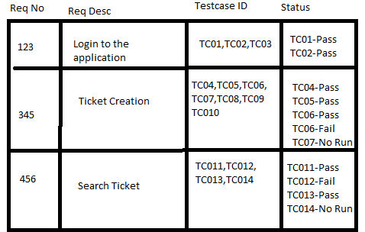
est Cases with Status
Above is a sa
Example of RTM:-

Slide 218
Parameters of RTM:-
Requirement ID
Requirement Type and Description
Test Cases with Status

Slide 219
Test Cases:-
A test case is a document, which has a set of test data, preconditions, expected results and post conditions, developed for a particular test scenario in order to verify compliance against a specific requirement.

Slide 220
Cont…
Test Case acts as the starting point for the test execution, and after applying a set of input values, the application has a definitive outcome and leaves the system at some end point or also known as execution post condition.

Slide 221
Test case Parameters:-
Test Case ID
Test Scenario
Test Case Description
Test Steps
Prerequisite
Test Data
Expected Result
Test Parameters
Actual Result
Environment Information
Comments

Slide 222
Cont…
Status
Created by
Date of creation
Executed by
Date of execution

Slide 223
Test Cases Management:-
Test case management software visualizes the trends in quality over time. This allows the development teams and testers to clearly see the weak points of the software. It also enables the teams to estimate the time it takes to perform automated testing which is useful especially when releasing critical updates

Slide 224
Benefits:-
The test case management software allows the startup to optimize the testing efforts, identify and issues. By improving the processes, the startups are able to stay within budget and deliver quality products on time.
Among the things a management solution does is to:-
Help the startup teams to organize and keep the testing efforts through properly defined processes
Keep all stakeholders informed and on the same page
Improve relationships and collaboration between different team members
Maintain and update the test cases that the startup wants to re-use

Slide 225
Best Practices of Test Cases:-
1) Keeping it Simple and Easy to Understand
A good test case is the one which is easy to understand and execute for the testers. To be a good test case, it should be simple and organized category-wise. Different grouping techniques could be splitting the test cases based on user story or modules like browser specific behaviors etc. This makes it easy to review and maintain. Information given in the test cases should be clear to testers, developers and other stakeholders involved in the project.
2) Including End User Perspective
The end user perspective is a key element when it comes to maintaining the quality of software. Therefore, before drafting a test case, it’s important to think like an end user. Understanding the requirement and the functionality aspects covered by the end user’s perspective will help in identifying test scenarios that arise in real life business conditions.

Slide 226
Cont…
3) Using Correct Naming Conventions
Naming the test cases in a way that makes it easy for stakeholders to identify as it will help create good and readable test cases. These also help in traceability as per requirements.
4) Providing Test Case Description
A proper test case description will allow users to understand what is being tested and how. Relevant details like the test environment, test data and tools to be used should also be provided.
5) Including Assumptions
All the assumptions and preconditions that are applicable to the test case should be specified clearly in the test case document.

Slide 227
Cont…
6) Providing Steps Involved:-
Steps involved to test a test case should be clearly specified so that if any other person performs the test they would be clear about what all steps to follow.
7) Giving Details Of Test Data:-
The details of the test data for execution of the test case especially in cases where the same data can be reused helps in saving time for the creation of the test data for each cycle to be run. Aim for maximum coverage by choosing a few select values from each equivalence class.

Slide 228
Test Data:-
Test Data in Software Testing is the input given to a software program during test execution. It represents data that affects or affected by software execution while testing. Test data is used for both positive testing to verify that functions produce expected results for given inputs and for negative testing to test software ability to handle unusual, exceptional or unexpected inputs.

Slide 229
Types of Test Data:-
Boundary Test Data:-
Valid Test Data:-
Invalid Test Data:-
Absent Data:-

Slide 230
Boundary Test Data:-
This type of data helps in removing the defects that are connected while processing the boundary values. The data included in this data type is a combination of boundary values which are sufficient to handle the application. And, if the tester goes beyond this, then it may break the application.

Slide 231
Valid Test Data:-
These data types are valid and are supported by the application. These help to verify the system functions and when an input is provided, it helps to receive the expected output.

Slide 232
Invalid Test Data:-
These data types include unsupported data formats. The data is used by the teams to examine whether the application is working correctly or not. By providing the invalid values, the app should show a relevant error message and notify that the data is improper to function.

Slide 233
Absent Data:-
No data or the blank files are referred to the files which do not contain any data. The use of blank data helps in verifying how the app responds when a blank or no data is entered into the software.

Slide 234
Test scenario:-
A TEST SCENARIO is defined as any functionality that can be tested. It is also called Test Condition or Test Possibility. As a tester, you should put yourself in the end user’s shoes and figure out the real-world scenarios and use cases of the Application Under Test.

Slide 235
Example 1:
Test Scenario for E- Commerce Application
For an E-Commerce Application, a few test scenarios would be
Test Scenario 1: Check the Login Functionality

Slide 236
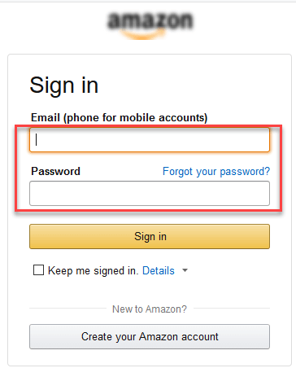

Slide 237
In order to help you understand the difference Test Scenario and Test Cases, specific test cases for this Test Scenario would be
Check system behavior when valid email id and password is entered.
Check system behavior when invalid email id and valid password is entered.
Check system behavior when valid email id and invalid password is entered.

Slide 238
Check system behavior when invalid email id and invalid password is entered.
Check system behavior when email id and password are left blank and Sign in entered.
Check Forgot your password is working as expected
Check system behavior when valid/invalid phone number and password is entered.

Slide 239
Cont…
Check system behavior when "Keep me signed" is checked
Test Scenario 2: Check the Search Functionality
Test Scenario 3: Check the Product Description Page

Slide 240
Cont…
Test Scenario 4: Check the Payments Functionality
Test Scenario 5: Check the Order History

Slide 241
Apart from these 5 scenarios here is the list of all other scenarios
Check Home Page behavior for returning customers
Check Category/Product Pages
Check Customer Service/Contact Pages
Check Daily Deals pages..

Slide 242
Challenges in Manual Testing | Software Testing
In manual testing, a tester carries out tests on the software by following a set of predefined test cases. In this testing, testers make test cases for the codes and test the software and give the final report about that software.
There are various challenges or problems with manual testing and some of them are listed below :

Slide 243
Not Reliable – This testing is not reliable as there is no standard or criteria available to check out that whether the actual and expected results have been compared. In this testing, we are dependent upon the words of software testers.

Slide 244
Understanding the client’s requirements – In software testing the software testers nice needs to make sure that the software application act in accordance with the particular needs of the client therefore they need to be familiar with the necessity of the customer very clearly at the same time

Slide 245
Higher chance of Risk – In manual testing, there is a higher chance of risk involved of oversight and mistakes. In the testing process, testers may get tired, may not be very attentive as they have too many tasks to be done. Therefore, there will be unexpected errors or mistakes that can happen in enterin

Slide 246
Selecting the right Testers – The technical skills and experiences of individual professionals may vary why manual testing needs great communication, analytical and technical skills. It become essential for the business to deploy the right testis to test their software. the testing team must build an efficient team so that they can Concentrate on their expertise and skills.

Slide 247
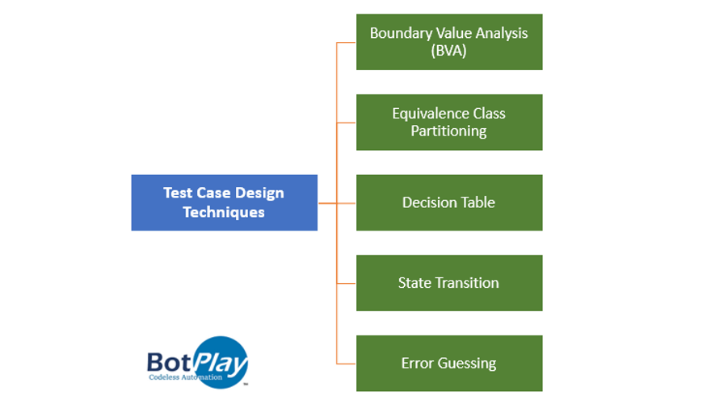
How to Design Test Cases and Execute?

Slide 248
1. Boundary Value Analysis (BVA)
BVA is a technique based on testing the boundaries of the test data. It includes maximum, minimum, inside or outside boundaries, and error values. This technique is based on the likeliness that developers will make mistakes at the boundaries conditions. In essence, a number of errors occur at the boundaries rather than the center of the input domain. Its working principle is that if a system works for these particular boundary values then it will work for all values between two boundary values.
For eg.
Test scenario - A text field accepts input between 1 to 10
Test cases as per Boundary values analysis - 0,1,2 and 9,10,11

Slide 249
2. Equivalence Class Partitioning
Equivalence class partitioning is another technique used in black-box testing. This technique partitions the input domain into a number of classes or partitions. This is based on that software will behave in the same way for test data within the same classes. Hence testing for one input per class shall ensure coverage for all the other possible inputs in that class. Then the test cases are then designed for each class.
The working principle behind this technique is that the test case of a representative value of each class is the same as the test case value for any other input within the same class. It allows you to identify valid as well as invalid equivalence classes.
For eg.
Test scenario - A text field accepts input between 1 to 10
Test cases as per Equivalence class partitioning are -
There are three equivalence classes
infinity to 0 (invalid)
1 to 10 (valid)
11 to infinity(invalid)
Test cases from each class,
-2, 5, 15

Slide 250
3. Decision Table Based Testing
A decision table, also known as the cause-effect table, is a tool used for test case designing. It provides a tabular view of the inputs and expected outcomes to test how the system behaves for different input combinations. It provides a systemic way to write test conditions and provides better test coverage where input plays a role to define the outcome of the software.
Decision Table Testing is used for functions that respond to a combination of inputs or events.
For example, Let take a hypothetical example to build software that ensures only valid people should get the covid-19 vaccine.
Rule - 'Only people with age > 60 years or anyone above 45 years with either diabetics or hypertension history should be allowed vaccination'.

Slide 251
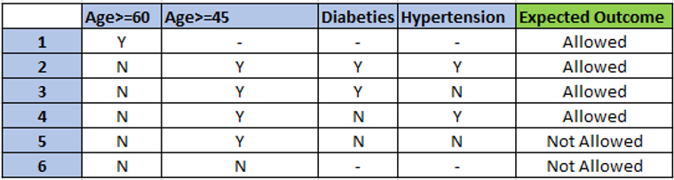
Design Table:

Slide 252
4. State Transition Testing
In this technique, the software is considered to have a finite number of states. The transition from one state or another of Application Under Test (AUT) happens in the responses to the action of the users.
This technique allows the tester to enter action bases input conditions and thereby, testing the behavior of the AUT. Both positive and negative input values are provided for the evaluation of the system behavior.
For example, Let take a simple example of an application with just a login functionality.

Slide 253
Rule - User (assuming an existing user) can only login with valid credentials and should get a welcome message. With invalid credentials, the user should get an error message.
Now using the state transition technique. Following would come as the state of the system.

Slide 254
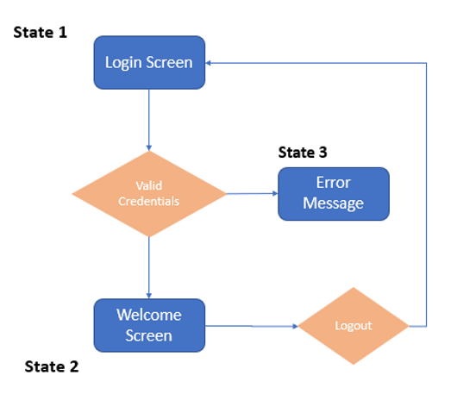

Slide 255
5. Error Guessing
This technique is an experience-based technique. Its success depends majorly on the level of experience and knowledge that the test analyst has about software testing, the application’s functionality, and behavior. The tester anticipates the possible errors using their experience, knowledge of edge cases, and exception scenarios in the software flow.

Slide 256
What is given to you? We have a Signup form requirement for the user registration of a popular website. You need to understand the requirements, Design Test Cases and Execute them. A document comprising of the Sample screen, Functional requirements and Error Messages are given to you as separate categories below. SignUp Form: The below image is the Sample screen which consists of the fields.

Slide 257
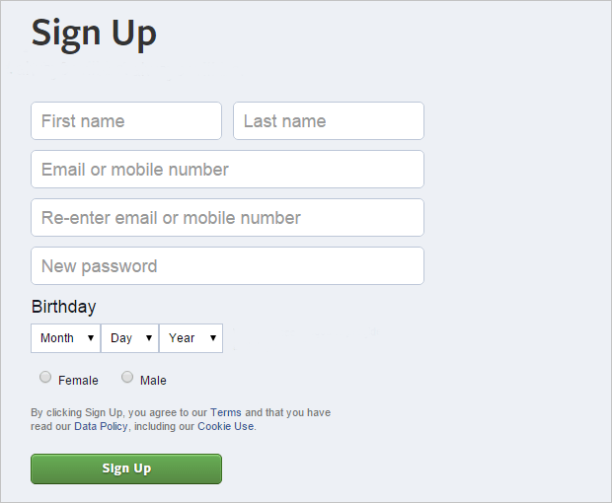

Slide 258
Functional Requirements:
Required Fields:
First Name & Last Name
Email or Phone
Re-enter Email or Phone
Password
Birthday
Gender

Slide 259
Validations:
No limitation for First name and Surname field length.
Valid email id should be entered.Ex: xxxx@yyyy.com
Phone number should contain exactly 10 digits.
Email id of existing facebook account is not accepted.
Email/ phone number and Re enter Email/Phone number should be same.
Password should contain at least 6 characters with combination of numbers, letters and punctuation marks.
At least 14 years old to sign up.
*Note: All fields are mandatory
Error Messages:
The error messages are additions to the requirements. You need to add the error messages as per the document below. The same is provided to the developers as well.

Slide 260


Error Messages:
When mandatory fields are left blank or invalid, An Error symbol to be displayed, On Clicking the symbol Error messages are displayed.
1. First Name and Last Name:
Error message should be displayed if user tries to submit without entering First name/ Last name or both.
Message: “What’s your name?”
2. Email or Phone:
Tries to submit without entering the value.
Message: “You’ll use this when you log in and if you ever need to reset your password.”
If invalid data entered, Ex: xxx@.com.
Message: “Please enter a valid email address or mobile numbe

Slide 261
3. Re-enter Email or Phone:
Tries to submit without entering the value.
Message: “Please enter a valid email address or mobile number.”
Invalid data. If both the emails are not same then the below error message should be displayed.
Message: “Your emails or mobile numbers do not match.Please try again.”
6. Gender:
Submit without selection of gender.
Error message: “Please select either Male or Female.”

Slide 262
4. Password:
Tries to submit without entering the value.
Message: “Password should contain at least 6 characters with combination of numbers, letters and punctuation marks (like! and &).”
Enter Invalid data and submit
Ex: 123a
Message: “Your password must be at least 6 characters long. Please try another.”
5. Birth Day:
If all the 3 fields (Month, Day, Year) or any one of them is not selected then below error message should be displayed.
Message: “Select your birthday. You can change who can see this later.”

Slide 263
6. Gender:
Submit without selection of gender.
Error message: “Please select either Male or Female.”

Slide 264
Test case design:
Its not mandatory that everyone should follow the same approach or guidelines for designing test cases. It varies from tester to tester and from organisation to organisation. The ultimate goal is the quality of the product that matters the most.
The Test case template comprises of the following fields.

Slide 265
Test Case Name
Test Case Description
Prerequisite/Test Data
Step Number
Steps to execute
Expected Result
The below are some of the important points to note down:
Design the test cases in such a way that, even a fresher can be able to execute them with minimal knowledge.
On reeading the Test case name and Description, one should be able to understand what the test case is all about.

Slide 266
Test Cases for Your Reference:
Send Us the Status:
Once you complete the execution of test cases. Send us the status mail / Enter in the comments sections below with the below mentioned parameters. This is what happens when your are working real time. You will be given the test cases list to execute and at the end of the day you need to send them the status.
Number of test cases executed.
Number of test cases passed.
Number of test cases failed.
Number of test cases require updates.

Slide 267
End of the Session :-

