Slide 1
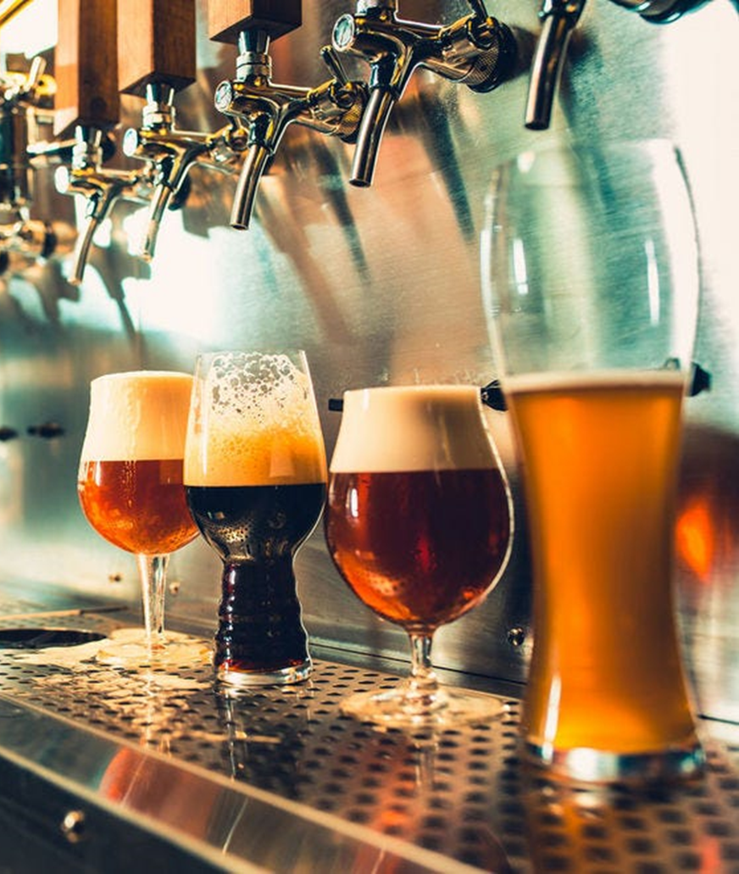
Beer Case Study
Will Rogers
Lauren Nelson

Slide 2
Data Introduction
Data is a combination of two data sets to for 2410 unique observations
A beer dataset containing information about the beer and its alcohol content and its IBU score
A brewery dataset containing information about various breweries throughout the US
Obs | Brewery_id | Beer Name | Beer_ID | ABV | IBU | Style | Ounces | Brewert Name | City | State
2018 | 414 | Black Thunder | 340 | 0.052 | NA | Schwarzbier | 12 | Austin Beerworks | Austin | TX
400 | 58 | Weissenheimer | 2550 | 0.052 | 16 | Hefeweizen | 12 | Destihl Brewery | Bloomington | IL
1070 | 176 | Freedom Fries | 2109 | 0.055 | NA | American Stout | 16 | Spiteful Brewing Company | Chicago | IL
1963 | 396 | The One They Call Zoe | 1004 | 0.051 | NA | American Pale Lager | 12 | Hops & Grain Brewery | Austin | TX
723 | 124 | Summer Ale | 2376 | 0.049 | NA | American Blonde Ale | 12 | Ipswich Ale Brewery | Ipswich | MA
456 | 67 | Texicali | 2526 | 0.065 | 33 | American Brown Ale | 12 | Freetail Brewing Company | San Antonio | TX
466 | 69 | Farmer's Daughter Blonde | 2516 | 0.051 | 17 | American Blonde Ale | 16 | Red Shedman Farm Brewery and Hop... | Mt. Airy | MD
1203 | 206 | Mound Builder IPA | 2175 | 0.065 | 77 | American IPA | 12 | People's Brewing Company | Lafayette | IN
1981 | 402 | Desolation IPA | 837 | 0.062 | 43 | American IPA | 16 | Amnesia Brewing Company | Washougal | WA
1190 | 203 | Upland Wheat Ale | 1951 | 0.045 | 15 | Witbier | 16 | Upland Brewing Company | Bloomington | IN

Slide 3
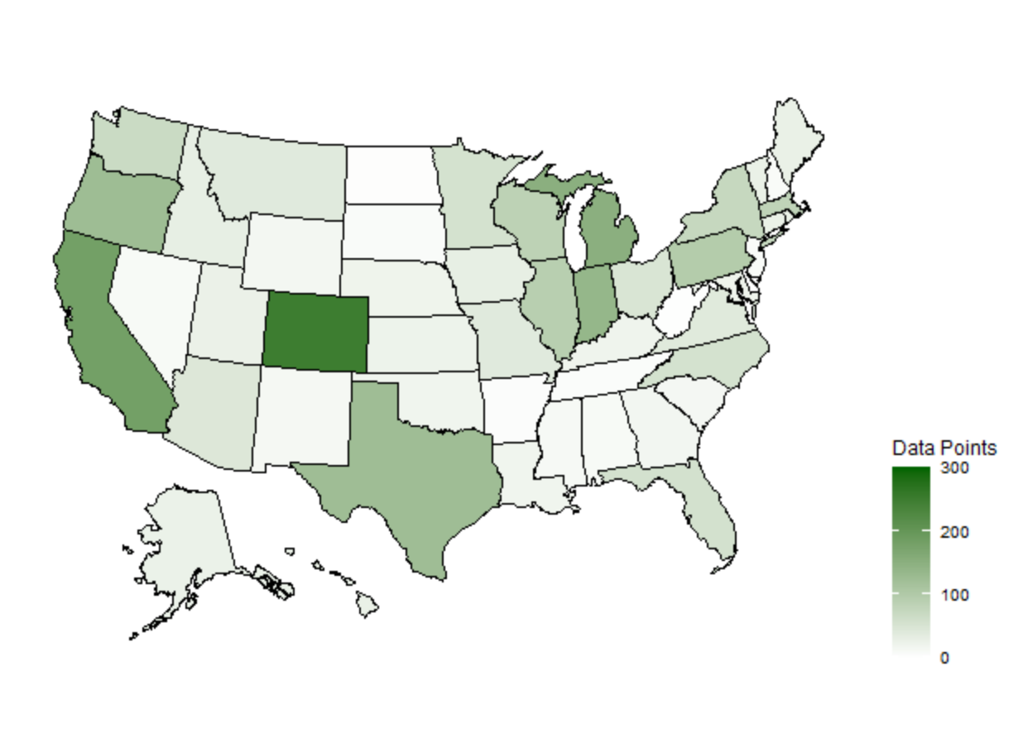
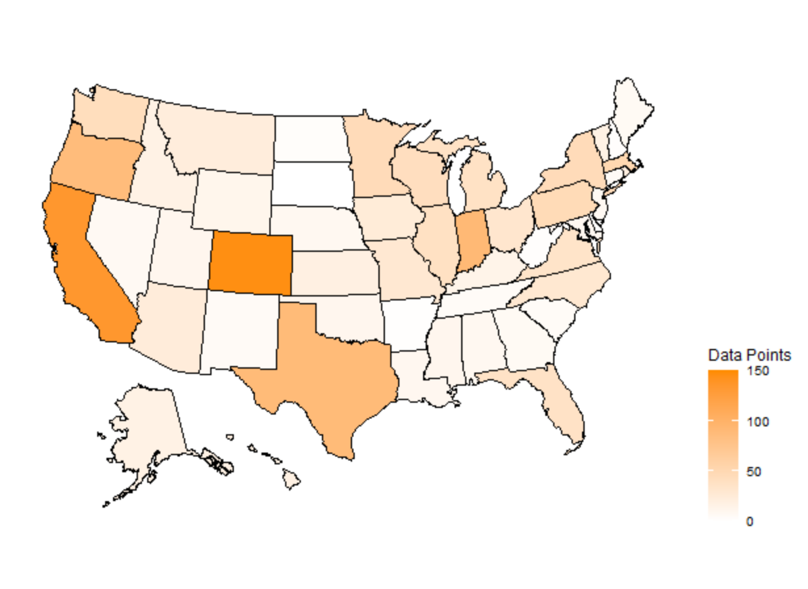
Missing Data
ABV has 62 missing values (~2.5%). The approach for these data points is to remove the missing observations from the analysis has there is a enough observations without them.
IBU has 1005 missing values (~41.7%). The approach to dealing with these will be addressed on a case-by-case basis.

Slide 4
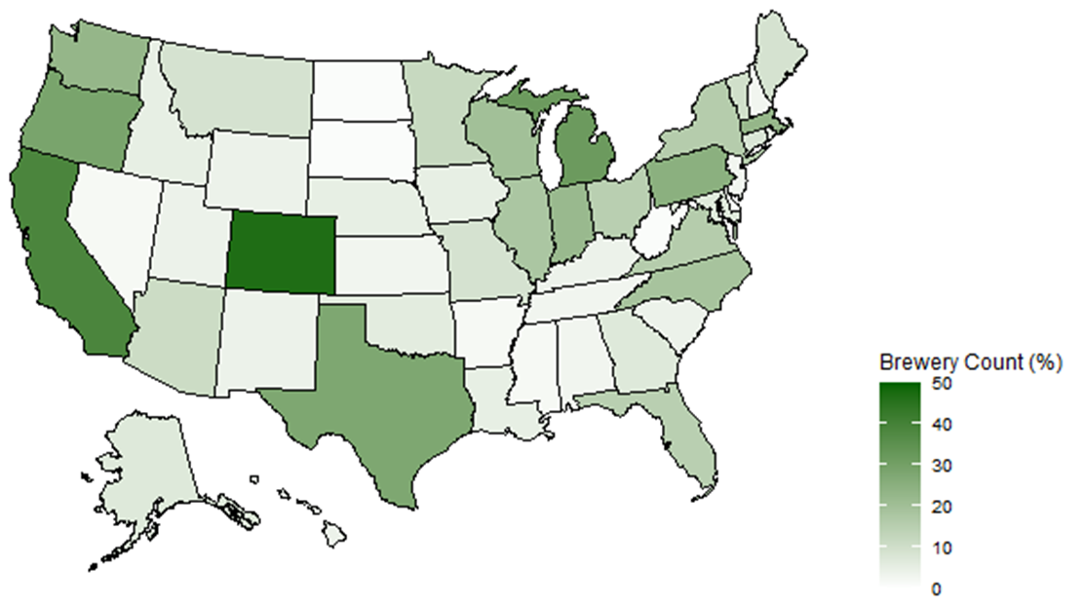
Breweries in Each State
Top 5 States
Colorado (47)
California (39)
Michigan (32)
Oregon (29)
Texas (28)

Slide 5
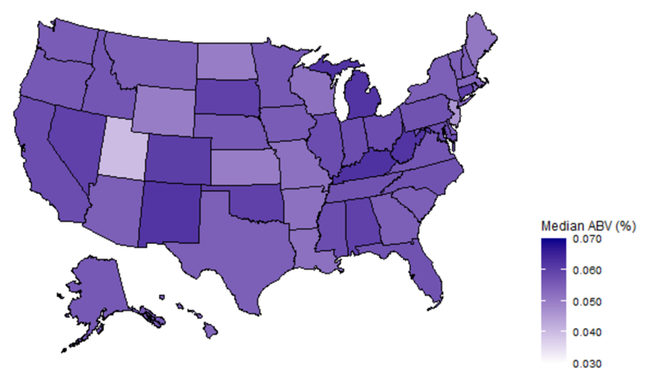
Alcohol Content by State
Top States
Washington D.C. (.0625)
Kentucky (.0625)
Michigan (.062)
New Mexico (.062)
West Virginia (.062)
Bottom States
Utah (.04)
New Jersey (.046)
Kansas (.05)
North Dakota (.05)
Wyoming (.05)

Slide 6
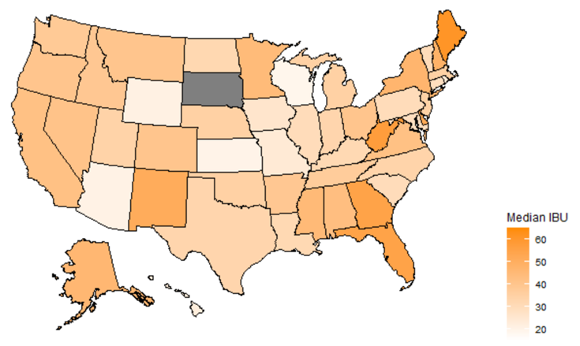
Bitterness by State
Top States
Maine (61)
West Virginia (57.5)
Florida (55)
Georgia (55)
Delaware (52)
Bottom States
Wisconsin (19)
Kansas (20)
Arizona (20.5)
Wyoming (21)
Hawaii (22.5)
* Missing Data was removed for analysis
** No Data Available for North Dakota

Slide 7
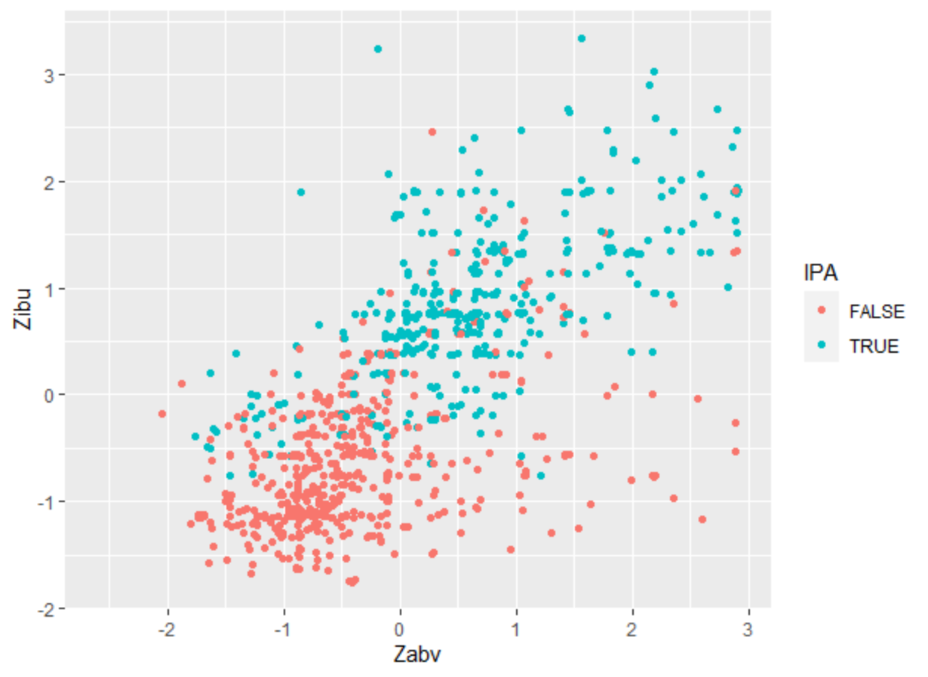
Alcohol Content and Bitterness
Appears to be positive correlation between alcohol content and bitterness.
Appears to be balance between IPA and Non-IPA ale beers
Will remove all observation with either ABV or IBU missing
Normalized data to Z score to help KNN classifier.

Slide 8
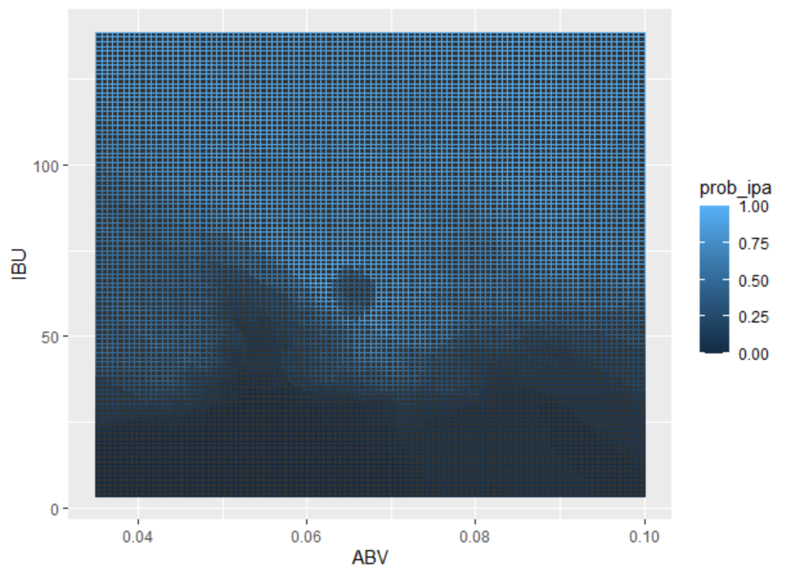
Alcohol Content and Bitterness
IPA tend to have a higher IBU score than Non-IPA ales.

Slide 9
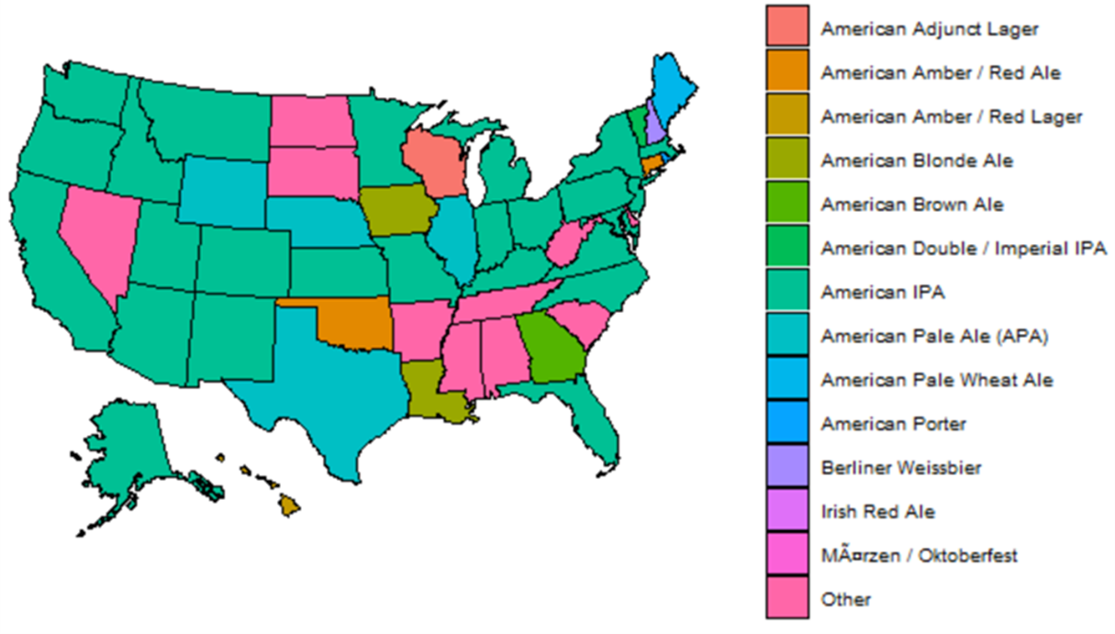
Most Popular Style by State

