Slide 1
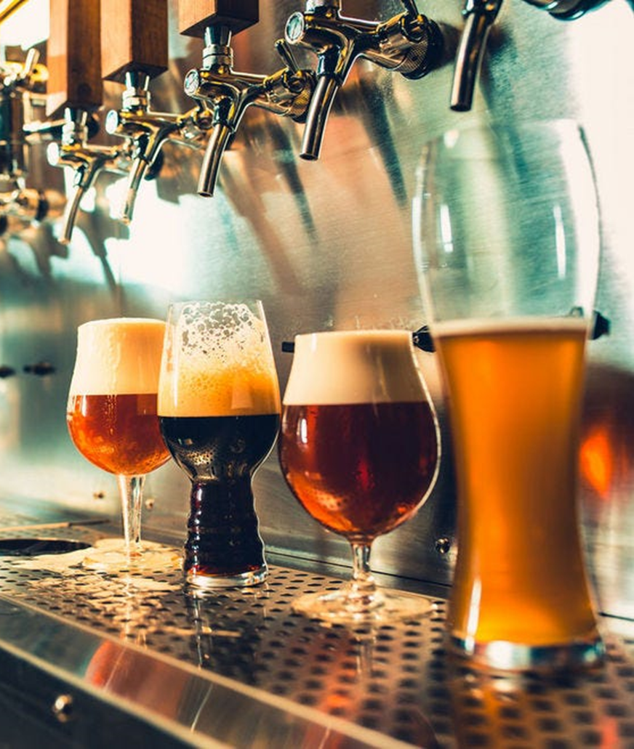
Beer Case Study
Will Rogers
Lauren Nelson

Slide 2
Data Introduction
Data is a combination of two data sets to for 2410 unique observations
A beer dataset containing information about the beer and its alcohol content and its IBU score
A brewery dataset containing information about various breweries throughout the US
Obs | Brewery_id | Beer Name | Beer_ID | ABV | IBU | Style | Ounces | Brewert Name | City | State
2018 | 414 | Black Thunder | 340 | 0.052 | NA | Schwarzbier | 12 | Austin Beerworks | Austin | TX
400 | 58 | Weissenheimer | 2550 | 0.052 | 16 | Hefeweizen | 12 | Destihl Brewery | Bloomington | IL
1070 | 176 | Freedom Fries | 2109 | 0.055 | NA | American Stout | 16 | Spiteful Brewing Company | Chicago | IL
1963 | 396 | The One They Call Zoe | 1004 | 0.051 | NA | American Pale Lager | 12 | Hops & Grain Brewery | Austin | TX
723 | 124 | Summer Ale | 2376 | 0.049 | NA | American Blonde Ale | 12 | Ipswich Ale Brewery | Ipswich | MA
456 | 67 | Texicali | 2526 | 0.065 | 33 | American Brown Ale | 12 | Freetail Brewing Company | San Antonio | TX
466 | 69 | Farmer's Daughter Blonde | 2516 | 0.051 | 17 | American Blonde Ale | 16 | Red Shedman Farm Brewery and Hop... | Mt. Airy | MD
1203 | 206 | Mound Builder IPA | 2175 | 0.065 | 77 | American IPA | 12 | People's Brewing Company | Lafayette | IN
1981 | 402 | Desolation IPA | 837 | 0.062 | 43 | American IPA | 16 | Amnesia Brewing Company | Washougal | WA
1190 | 203 | Upland Wheat Ale | 1951 | 0.045 | 15 | Witbier | 16 | Upland Brewing Company | Bloomington | IN

Slide 3
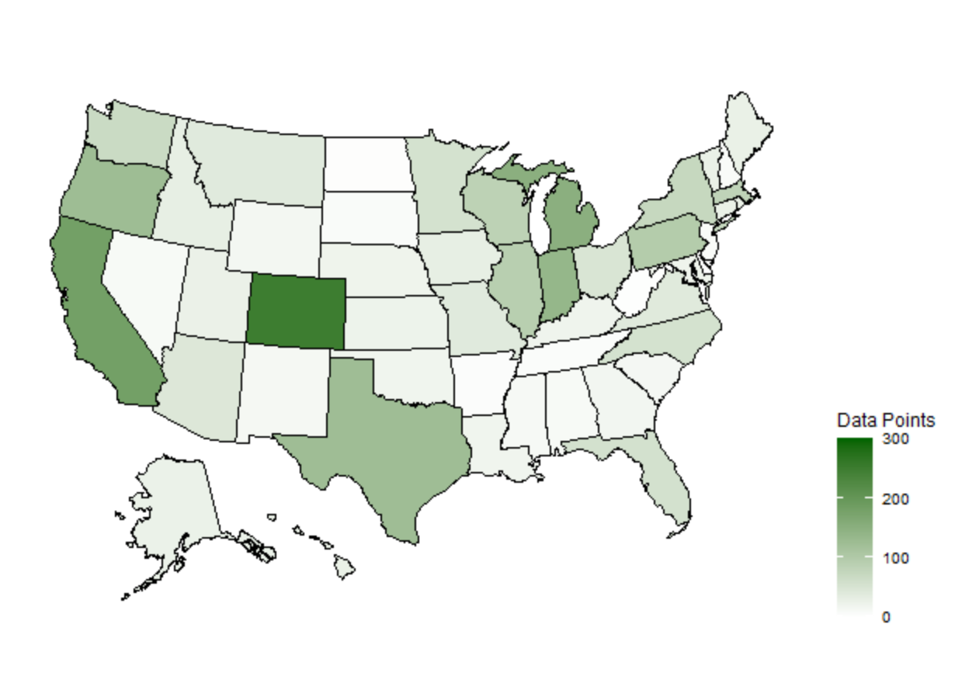
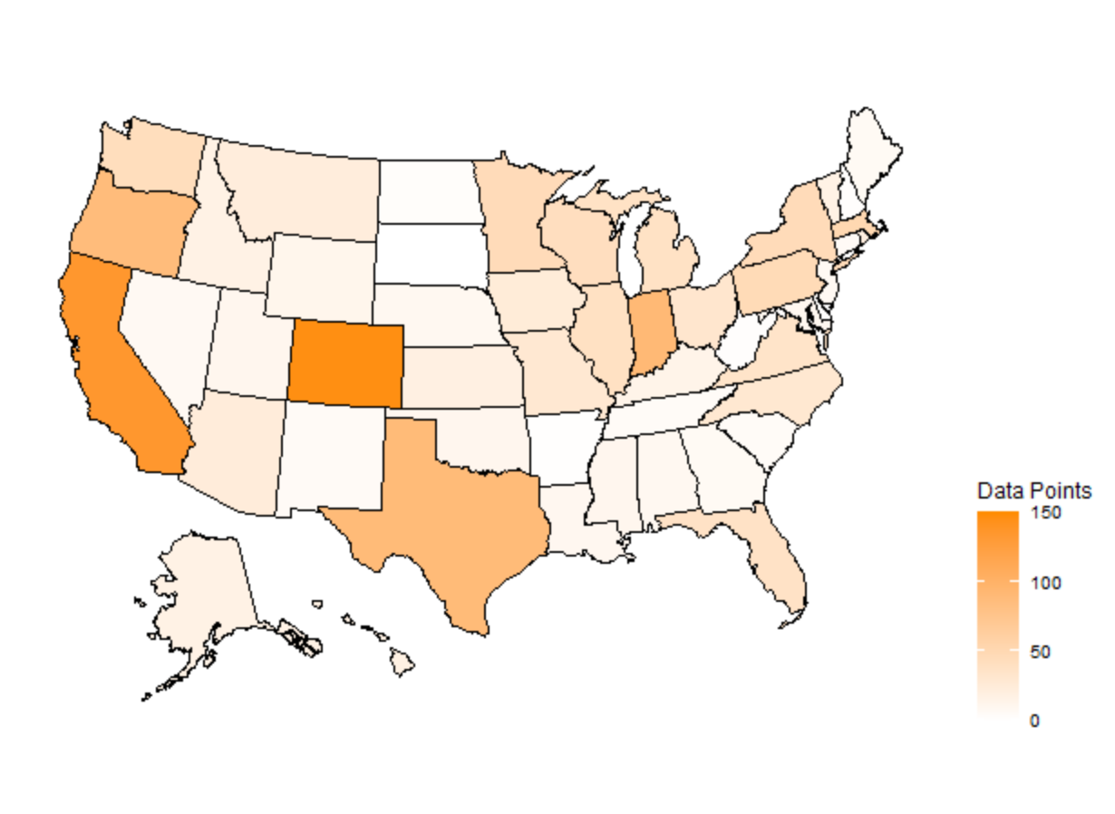
Missing Data
ABV has 62 missing values (~2.5%). The approach for these data points is to remove the missing observations from the analysis has there is a enough observations without them.
IBU has 1005 missing values (~41.7%). Will remove these values from analysis.

Slide 4
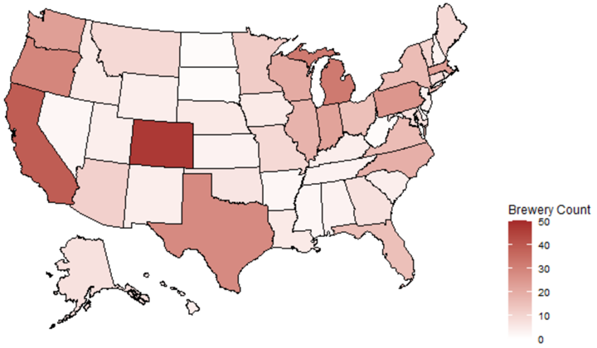
Breweries in Each State
Top States
Colorado (47)
California (39)
Michigan (32)
Oregon (29)
Texas (28)
Bottom States
District of Columbia (1)
North Dakota (1)
South Dakota (1)
West Virginia (1)
Arkansas (2)
Delaware (2)
Mississippi (2)
Nevada (2)
There are a total of 558 breweries for this analysis
The top 5 states account for about 30% of data, top 10% account for about (50%)
Breweries are most popular:
West Coast (3 of top ten)
Great Lakes Area (3 of top ten)
Colorado (Top State)

Slide 5
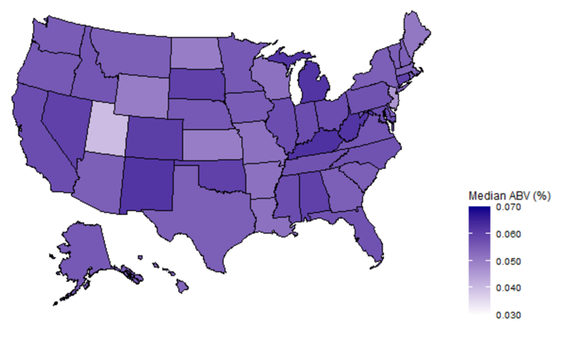
Alcohol Content by State
Alcohol Laws in Utah prevent ABV above 4%
The state with highest ABV beer is Colorado.
Top States
Washington D.C. (.0625)
Kentucky (.0625)
Michigan (.062)
New Mexico (.062)
West Virginia (.062)
Bottom States
Utah (.04)
New Jersey (.046)
Kansas (.05)
North Dakota (.05)
Wyoming (.05)
* Missing Data was removed for analysis (62 / 2410 data points)

Slide 6
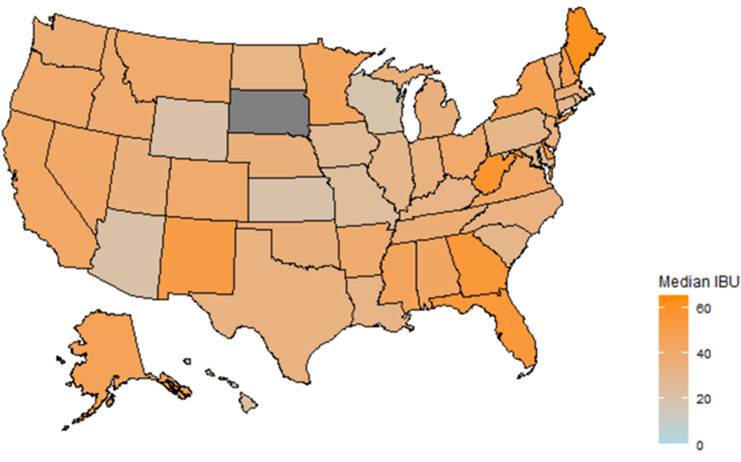
Bitterness by State
Top States
Maine (61)
West Virginia (57.5)
Florida (55)
Georgia (55)
Delaware (52)
Bottom States
Wisconsin (19)
Kansas (20)
Arizona (20.5)
Wyoming (21)
Hawaii (22.5)
East Coast has highest concentration of bitter beer.
The state with the single most bitter beer according to its IBU score is Oregon.
* Missing Data was removed for analysis (1005 / 2410 data points)
** No Data Available for North Dakota

Slide 7
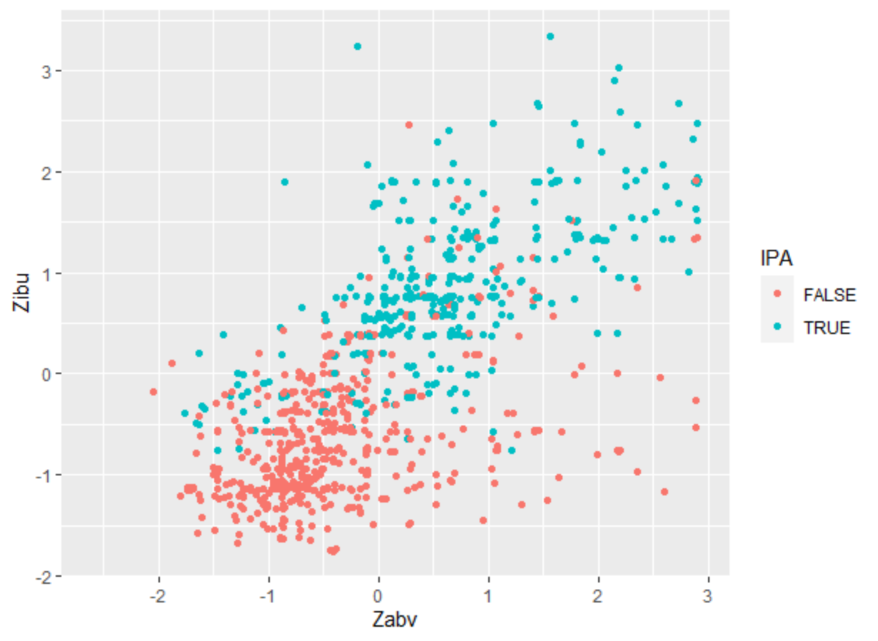
Alcohol Content and Bitterness
Appears to be positive correlation between alcohol content and bitterness.
Brewers typically add more hops to a beer with high alcohol content to help balance out the flavor by removing more of the ‘alcohol’ taste.
Appears to be balance between IPA and Non-IPA ale beers
Will remove all observation with either ABV or IBU missing
Normalized data to Z score to help KNN classifier.
A clear separation can be seen between IBU and ABV when between the IPA ales and other ales.
These are good values to use when trying to classify whether or not any Ale is an IPA.

Slide 8
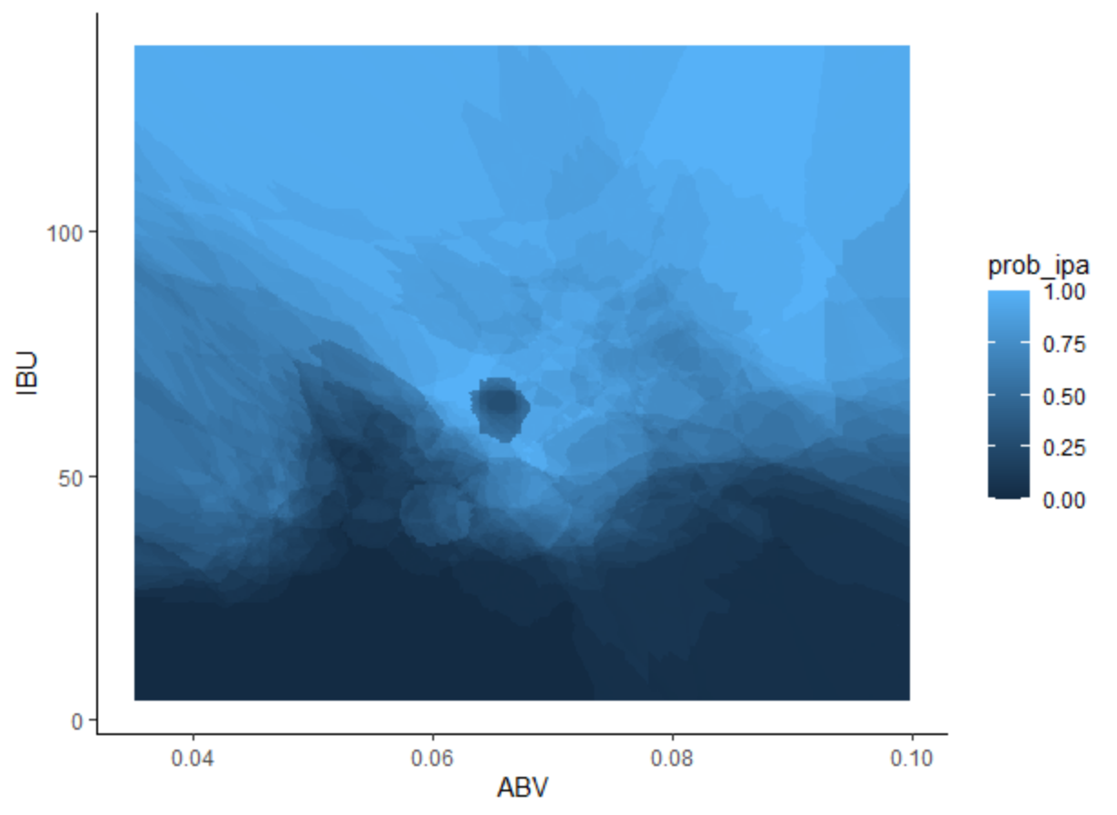
Alcohol Content and Bitterness
IPA tend to have a higher IBU score than Non-IPA ales.
IBU scores above ~75 are strong indicators that a beer is an IPA
Alcohol content has a weak relationship to determining if a beer is an IPA
More Hops => More Bitter Beer
More Hops =/= More Sugar => More Alcohol

Slide 9
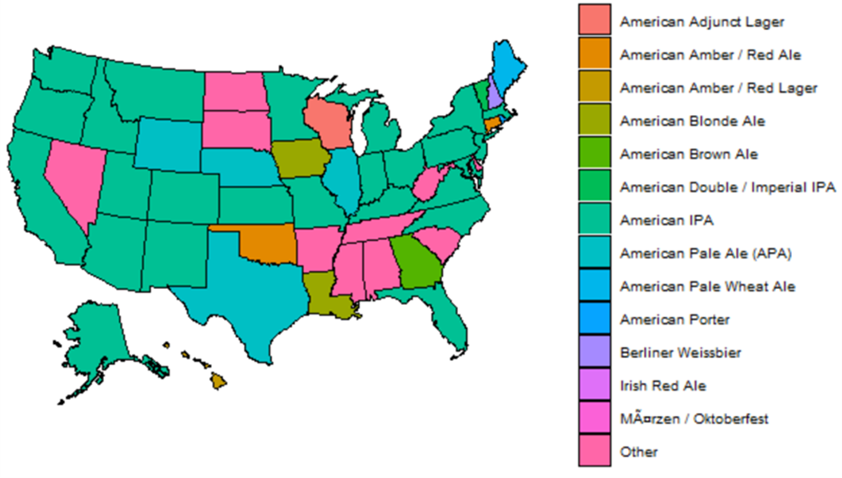
Most Popular Style by State
According to data, the most popular style of beer in the US is the IPA.
The gulf coast and southeastern states do not share the same fondness of IPAs.

