Slide 1

Attrition Case Study
Will Rogers

Slide 2
Objectives
Identify top three factors that lead to employee attrition
Build model to predict employee attrition
Build model to predict employee salary

Slide 3
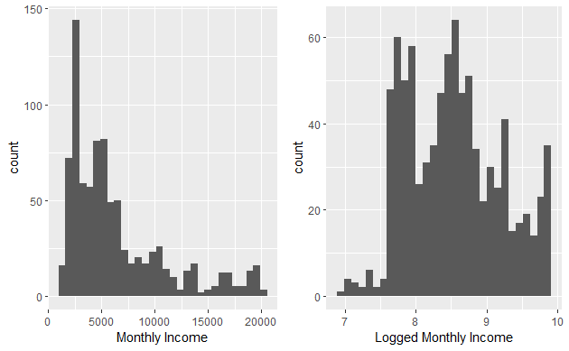
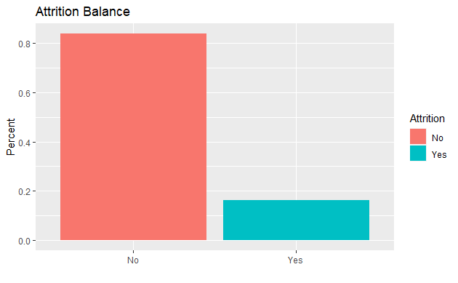
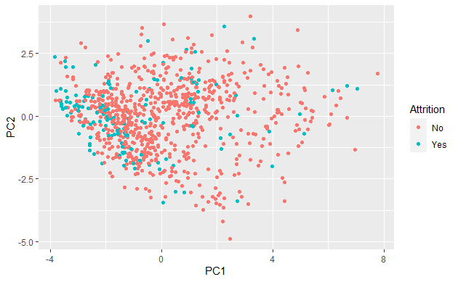
Data Introduction
870 Observations
No Missing Data
Some Variables Removed
Imbalanced Attrition Data
ID | Age | Attrition | NumCompaniesWorked
BusinessTravel | DailyRate | Department | PercentSalaryHike
DistanceFromHome | Education | EducationField | StandardHours
EmployeeCount | EmployeeNumber | EnvironmentSatisfaction | TrainingTimesLastYear
Gender | HourlyRate | JobInvolvement | YearsInCurrentRole
JobLevel | JobRole | JobSatisfaction | Over18
MaritalStatus | MonthlyIncome | MonthlyRate | PerformanceRating
WorkLifeBalance | OverTime | YearsSinceLastPromotion | StockOptionLevel
RelationshipSatisfaction | TotalWorkingYears | YearsAtCompany | YearsWithCurrManager

Slide 4
Interesting Findings
Increase Attrition
Decrease Attrition
Sales Representatives
Overtime Positive
Single
Human Resources Education
Technical Education
Potential
Healthcare Representative
Overtime Negative
Divorced
Manager
Manufacturing Director
Research Director
Tenure

Slide 5
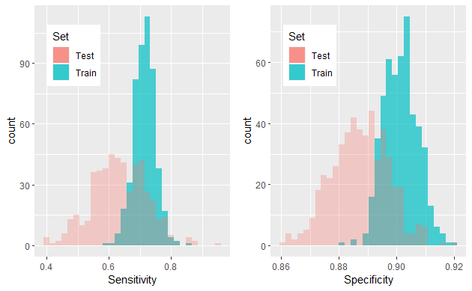
Predicting Attrition
Sensitivity | Estimate | 95% CI | P-value (Est < .6)
Train | .716 | [.713, ∞] | 2.2e-16
Test | .636 | [.630, ∞] | 2.2e-16
Attain attrition model with sensitivity and specificity above .6
Naïve Bayes model
Handles both numeric and categorical variables
Top Attrition Factors
Marital Status
Tenure
Job Role
Specificity | Estimate | 95% CI | P-value (Est < .6)
Train | .901 | [.900, ∞] | 2.2e-16
Test | .887 | [.887, ∞] | 2.2e-16

Slide 6
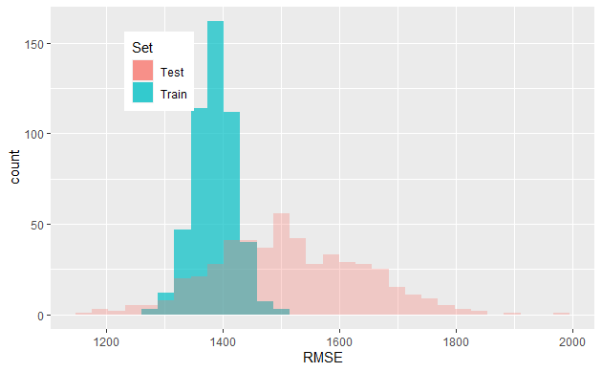
Predicting Salary
Attain salary model with RMSE below $3000
Linear Regression
Handles both numerical and categorical variables
Biggest Influencers of Salary
Job Level
Job Role
Education Field
Department
Specificity | Estimate | 95% CI | P-value (Est > 3000)
Train | 1386 | [-∞, 1389] | 2.2e-16
Test | 1460 | [-∞, 1487] | 2.2e-16

Slide 7
THANK YOU

Slide 8
Video Link
https://youtu.be/KjhYMem92B4

