Slide 1


Memory Management
Operating Systems – EDA093/DIT401
Vincenzo Gulisano
vincenzo.gulisano@chalmers.se

Slide 2
What to read (main textbook)
Sections 3.1, 3.2, and the introduction to Section 3.7 (stop before Section 3.7.1).
Optional additional reading: Sections 8.1–8.5 of Operating System Concepts from Silberschatz.

Slide 3
Objective
Discuss how different types of memory are used
Discuss how information is continuously moved between “slow memory” and “fast memory” (accessed directly by the CPU)
Discuss why a process’ view of memory and physical memory are kept separated
Notes:
This lecture and the virtual-memory lecture form one block. The next lecture builds on the concepts introduced here.

Slide 4
Agenda
Introduction
Base and limit registers
Logical/virtual versus physical addresses
Dynamic loading and dynamic linking [self-study]
Swapping
Memory allocation
  Contiguous allocation
  Segmentation
  Paging

Slide 5
Agenda
Introduction
Base and limit registers
Logical/virtual versus physical addresses
Dynamic loading and dynamic linking [self-study]
Swapping
Memory allocation
  Contiguous allocation
  Segmentation
  Paging

Slide 6
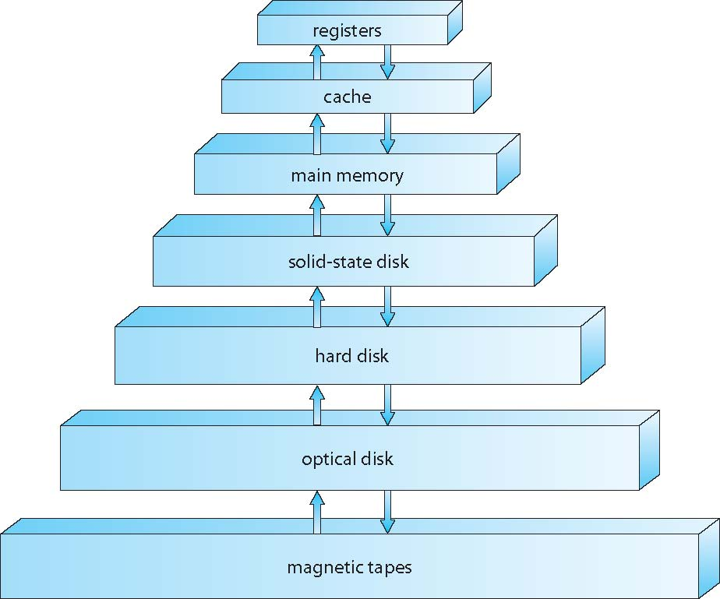
Background and basic hardware (I)
One goal of the OS is to keep the CPU busy by allowing multiple processes to share physical memory safely and efficiently
We first have to move it up here!
1 cycle
Can be accessed directly by the CPU
Many cycles
If some data the CPU wants to access is here
Cannot be accessed directly by the CPU
Notes:
[click] The goal of the OS is to maximize CPU …
[click] As you most likely know, this is the organization of memory in our computers…
[click] Some memories can be accessed directly by the CPU
[click] Some are very fast
[click] Some take more time
[click] some others no
[click] Which means, If the CPU needs data stored on secondary storage, the system must first transfer that data into main memory.

Slide 7
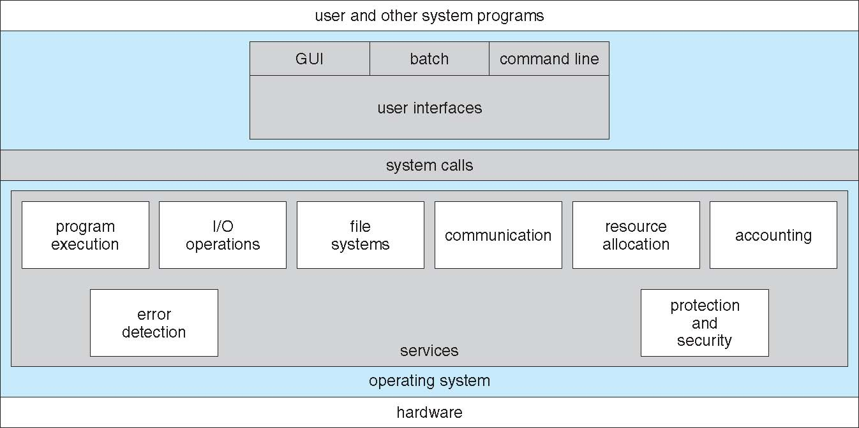
Background and basic hardware (II)
Need for fast CPU access to registers / caches and main memory? → The hardware performs ordinary register, cache, and memory accesses without invoking the OS for every access.
CHALLENGE: how does the OS configure the protection and address-translation mechanisms.?
Notes:
[click] since we want to speed up operation, we can think of hardware support for the CPU to access registers / caches and main memory. But the challenge then is:

Slide 8
Agenda
Introduction
Base and limit registers
Logical/virtual versus physical addresses
Dynamic loading and dynamic linking [self-study]
Swapping
Memory allocation
  Contiguous allocation
  Segmentation
  Paging

Slide 9
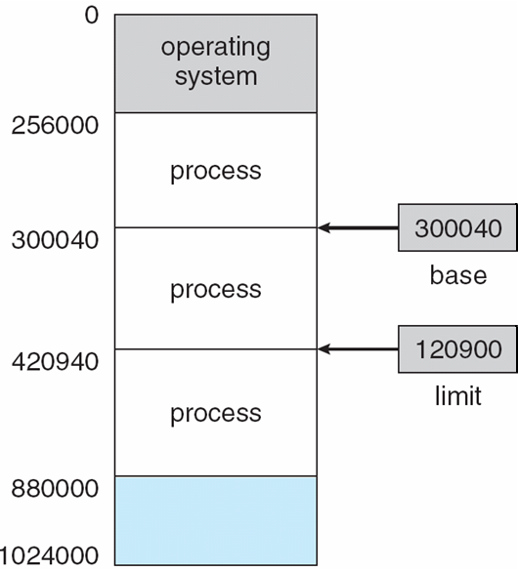
Base and Limit register (I)
For each process, the CPU maintains two registers:
  Base register: first address that can be accessed by the process
  Limit register: number of addresses (starting from the base register) that can be accessed by the process
The registers are loaded by the OS during a context switch
Example: process A can only access addresses from 300040 to 420939
A
Notes:
[c] It works like this: we have two registers ….
[c] So for example, process A
[c] This shows the how the CPU checks whether a trap should be sent
Possible question: is this for the cache, is it for the main memory or for both of them?

Slide 10
Base and Limit register (II)
The OS loads the base and limit registers during a context switch using privileged instructions.

Slide 11
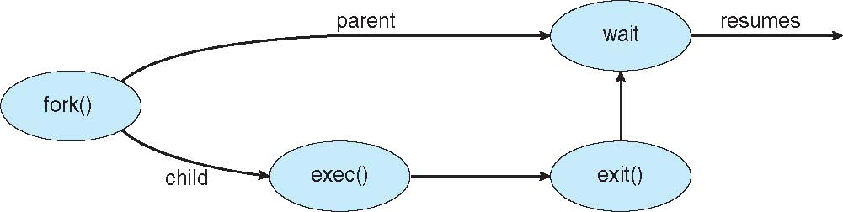
Base and Limit register (III)
In this simplified base-and-limit model, kernel-mode code can access all physical memory.
A previous example is exec(): it replaces the current process image with a new program.
Replace the memory of the process with that of a new program
Notes:
Exceptional case: dedicated hardware

Slide 12
Agenda
Introduction
Base and limit registers
Logical/virtual versus physical addresses
Dynamic loading and dynamic linking [self-study]
Swapping
Memory allocation
  Contiguous allocation
  Segmentation
  Paging

Slide 13
Address binding
…
a = b + 2
…
Where do we store a?
Once we load it into memory, we know the address
If the program is not loaded in memory, we do not know the address
Note: The compiler and linker assign logical addresses to program instructions and data. These logical addresses may be bound to physical addresses when the program is loaded or translated dynamically during execution by the MMU (this is when we use Virtual Memory, we discuss that in a dedicated lecture).
Notes:
[c] Suppose we write a program with this instruction, we are saying we should store the value of b + 2 in a, somewhere in memory. Where exactly?
[c] While the program is on disk we don’t know
[c] once we load it in memory we do
Discussions always depend on what hardware we are thinking of / OS and programs... dedicated hardware we might know...

Slide 14
Logical/Virtual vs Physical address space (i)
Logical/Virtual address
…
a = b + 2
…
First address of the program 00000
Address of variable a 346
Physical address (main memory)
…
a = b + 2
…
First address of the program 14000
Address of variable a 14346
Notes:
[c] Each program sees its virtual addresses, starting in 0 (it is easier)
[c] But of course, once it runs in memory it will actually be allocated in a given region of the physical memory
here link back to question about addresses...
Note: In a real process’s mapped virtual memory: the first valid mapping does not necessarily start at zero.

Slide 15
Logical/Virtual vs Physical address space (ii)
Address 346
Address 14346
Logical/Virtual
address
Physical
address
How are logical/virtual addresses converted into physical addresses?

Slide 16
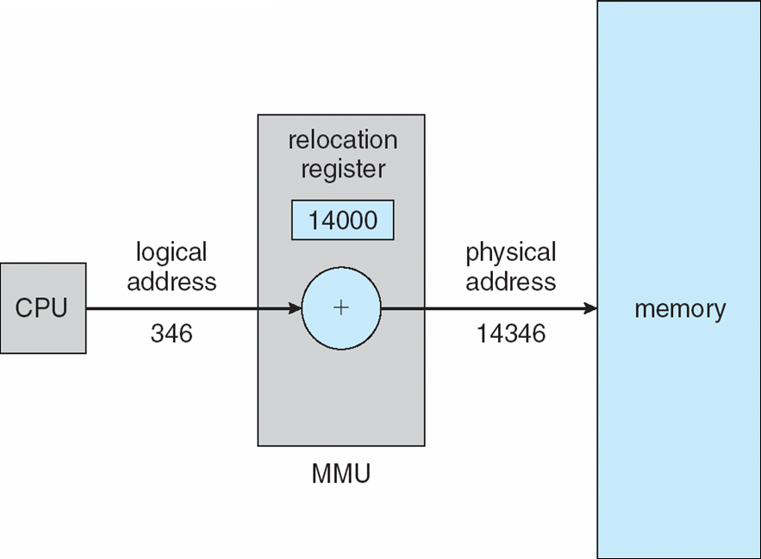
Memory-Management Unit (MMU) – Relocation Register
Logical/Virtual addresses [0,max]
Physical addresses [R+0,R+max]
Notes:
This is one way of doing it, using the relocation register. There can be other ways too, will see later

Slide 17
Agenda
Introduction
Base and limit registers
Logical/virtual versus physical addresses
Dynamic loading and dynamic linking [self-study]
Swapping
Memory allocation
  Contiguous allocation
  Segmentation
  Paging

Slide 18
Optimizations – Dynamic loading
We assumed so far the entire program A is loaded
If program A is large but rarely uses some routines, loading the entire program wastes time and memory.
Dynamic loading loads a routine only when it is first needed.
A

Slide 19
Optimizations – Dynamic Linking (i)
Use library from
Program A
Program B
Program D
Program C
Static linking
A
B
C
D
D
D
D
Wastes disk space
May create a separate in-memory copy of the library for each process
Programs must be relinked when the library changes

Slide 20
Optimizations – Dynamic Linking (ii)
Use library from
Program A
Program B
Program D
Program C
Dynamic linking
Stub for D
A
B
C
D
Uses less disk space
Allows compatible library code to be shared in memory
A compatible shared library can be updated without relinking each program

Slide 21
Agenda
Introduction
Base and limit registers
Logical/virtual versus physical addresses
Dynamic loading and dynamic linking [self-study]
Swapping
Memory allocation
  Contiguous allocation
  Segmentation
  Paging

Slide 22
Swapping (i)
Moving a process from memory to backing store
Why?
size(all logical addresses of all processes)
>
size(real physical memory)
Notes:
Question
Say also we will see more when we discuss Virtual Memory

Slide 23
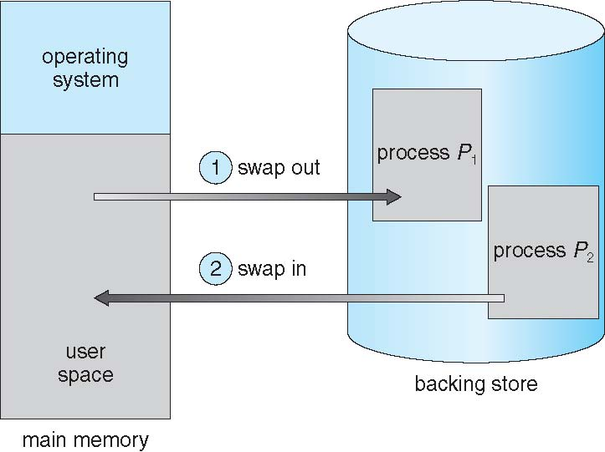
Swapping (ii)
Basic idea:
Questions:
Which processes can we swap?
How much time does it take?
When does it make sense to use swapping?

Slide 24
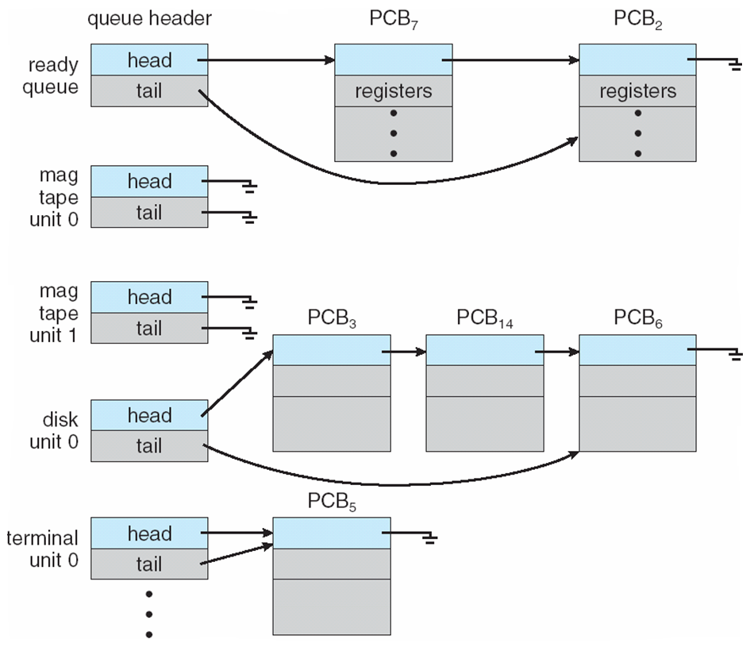
Swapping - Which processes can we swap?
Depends on the pending I/O…
Can the I/O results be buffered at the OS?
A process with pending I/O cannot safely be swapped out if the device will transfer data directly into that process’s memory.
Possible solutions include waiting for the I/O to complete or using OS buffers.
Notes:
make a drawing here

Slide 25
Swapping – How much time does it take?
Process in memory 100 MB
Disk transfer rate 50 MB/s
→ 100 MB / 50 MB/s = 2 seconds
→ Swap out + Swap in = 4 seconds
(Notice: being optimistic! Disk writes/reads might be requested by other processes, interrupts will occur in the meantime, etc…)
It is slow and expensive (because write/read to disks are slower and more expensive than memory ones)!

Slide 26
Swapping – When does it make sense to use it?
Not used “as it is”…
Modified versions are used in UNIX, Linux and Windows
  Swapping is activated when free memory goes below a certain threshold
  Swapping is deactivated when free memory goes above a certain threshold
Modified swapping (swap out / in only parts of the process) used in conjunction with Virtual Memory (next lecture…)

Slide 27
Agenda
Introduction
Base and limit registers
Logical/virtual versus physical addresses
Dynamic loading and dynamic linking [self-study]
Swapping
Memory allocation
  Contiguous allocation
  Segmentation
  Paging

Slide 28

Memory allocation
Memory contains
  The operating system itself
  User processes
Challenge: how to allocate memory efficiently?
We will see 3 cases
  Contiguous allocation
  Segmentation
  Paging
Logical and physical memory more and more separated
Less fragmentation (better memory utilization)
Protection
Faster loading / swapping

Slide 29
Agenda
Introduction
Base and limit registers
Logical/virtual versus physical addresses
Dynamic loading and dynamic linking [self-study]
Swapping
Memory allocation
  Contiguous allocation
  Segmentation
  Paging

Slide 30
Contiguous allocation
The OS occupies a reserved region of physical memory, shown here at low addresses.
Each process occupies one contiguous physical-memory region.
Free holes may exist between processes.
Notes:
Say similar things hold also for file systems

Slide 31

Contiguous allocation – memory protection
A

Slide 32
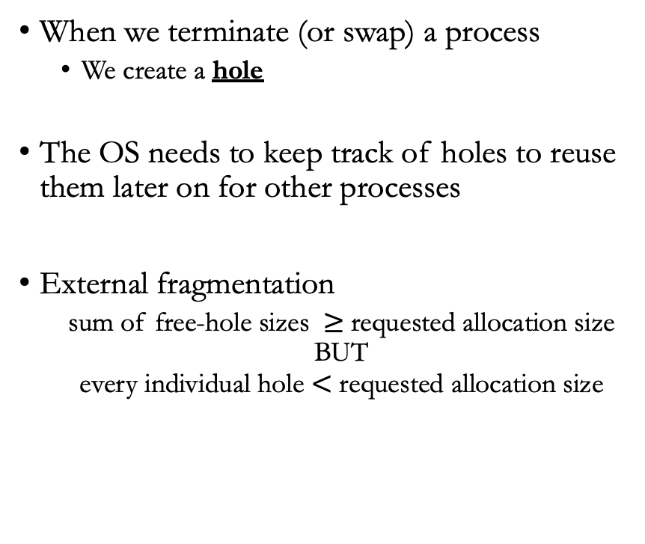
Contiguous allocation - limitations
When we terminate (or swap) a process
  We create a hole
The OS needs to keep track of holes to reuse them later on for other processes
External fragmentation
  sum of free-hole sizes $≥$requested allocation size
  BUT
  every individual hole $<$ requested allocation size
Notes:
drawing?

Slide 33
Contiguous allocation – which hole to assign to a new process?
First fit → allocate the first hole that is big enough
Best fit → allocate the smallest hole that is big enough
  PROS: produces the smallest leftover hole
  CONS: Search entire list (or keep list of holes sorted)
Worst fit → allocate the largest hole
  PROS: produces the largest leftover hole
  CONS: Search entire list (or keep list of holes sorted)
Notes:
We will see (also when discussing virtual memory / file systems) that the best strategy might depend on things we do not know yet (how the size of a process might evolve over time)

Slide 34
Agenda
Introduction
Base and limit registers
Logical/virtual versus physical addresses
Dynamic loading and dynamic linking [self-study]
Swapping
Memory allocation
  Contiguous allocation
  Segmentation
  Paging

Slide 35
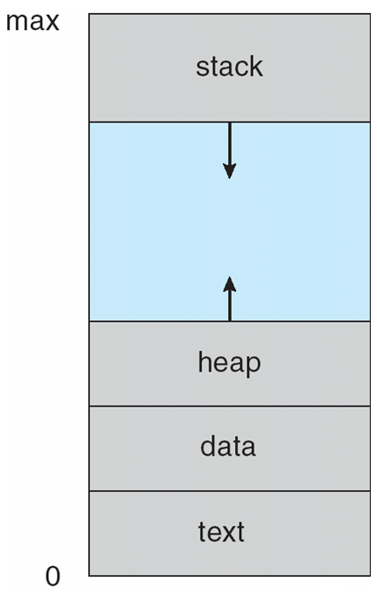
Segmentation (i)
So far, we referred to the memory of a process as a single one-dimensional space [0,max]
Nevertheless, from the programmer/program perspective:
  Different parts have different meaning, and might need different access permissions
  Different parts have different and variable size
A

Slide 36
Segmentation (ii)
With segmentation, a logical address is a pair <segment number, offset>.
Segment 3
The hardware verifies that the offset lies within the selected segment and that the requested access is permitted.
Allows to have different permissions for the different segments!
Different segments can occupy different physical-memory regions.
Each segment must still occupy a contiguous physical region, so segmentation can suffer from external fragmentation.
0
Read/write
n₃-1
n₂-1
Read/write
0
Segment 2
n₁-1
Read/write
0
Segment 1
n₀-1
Execute
0
Segment 0

Slide 37
Segmentation – segment table
The segment table maps each logical segment number to a physical base address and a segment limit.

Slide 38
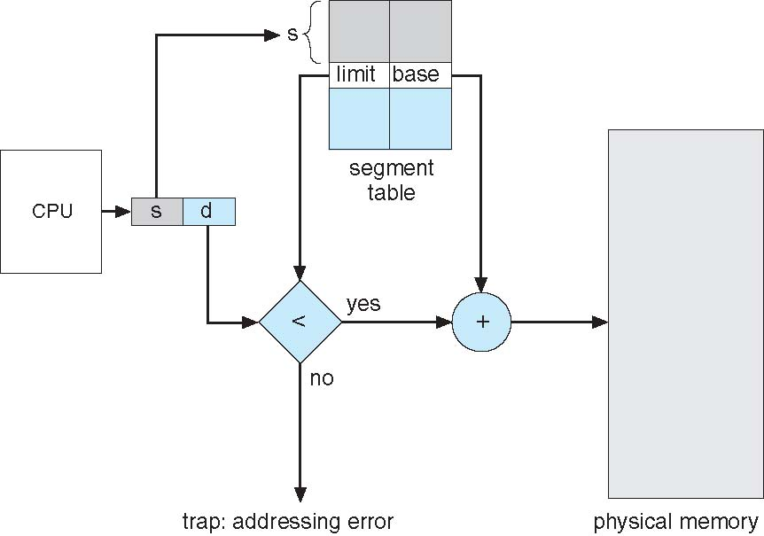
Segmentation – hardware support
The hardware can do this conversion automatically (and check whether the process is trying to access memory outside the segment)

Slide 39
Agenda
Introduction
Base and limit registers
Logical/virtual versus physical addresses
Dynamic loading and dynamic linking [self-study]
Swapping
Memory allocation
  Contiguous allocation
  Segmentation
  Paging

Slide 40
Paging
Mechanism that allows for the physical address space used by a process to be non-contiguous
Used in most modern OSes (from mainframes to smartphones)
Requires cooperation between OS and hardware (as common)

Slide 41


Paging – Basic idea
Split logical memory in pages
Split physical memory in frames
Keep a program (disk) organized in pages
Page size = Frame size!
How do we keep track of where each page is?

Slide 42
Paging – the page table
Page 0 → Frame 1
Page 1 → Frame 4
Page 2 → Frame 3
Page 3 → Frame 7

Slide 43
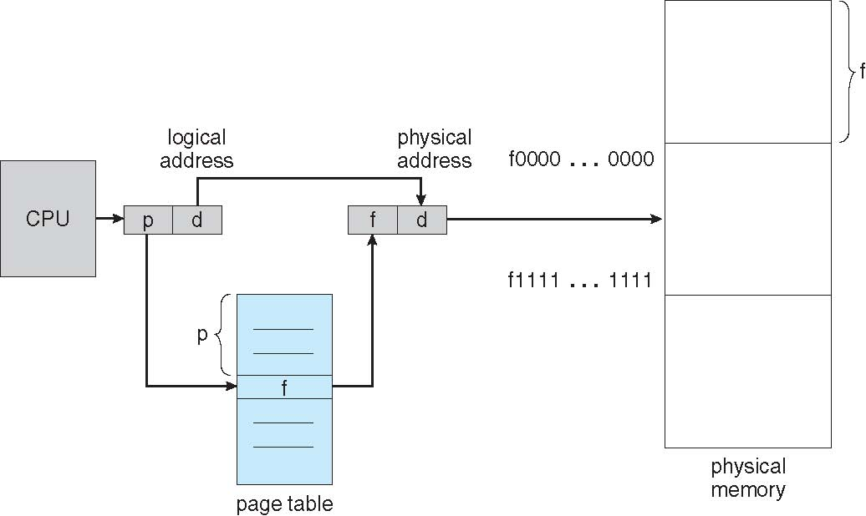
Paging – hardware support
How does the CPU know which page it should access?
Similarly to Segmentation, we can access physical memory specifying page + offset

Slide 44
Paging – from logical address to physical address (i)
If page/frame size is power of 2 → 2^{n}
If size of logical space is power of 2 → 2^{m}
Logical address (binary) 101101001110110
m-n
page
n
offset

Slide 45
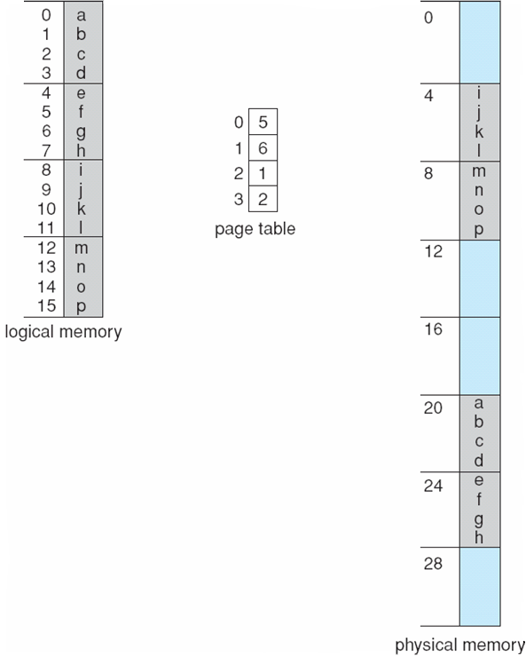
Paging – from logical address to physical address (ii)
Page size = 2² bytes (n=2)
Size of logical space = 2⁴ bytes (m=4)
→ logical space = 4 pages
Physical address of logical address 7?
0 1 1 1
Frame 6 offset 3
→ 6x4+3=27
page
1
offset
3

Slide 46
Paging - Fragmentation
No external fragmentation
  Process needs a page? Can take any free frame
Internal fragmentation
  Last frame assigned to a process’ page might not be full
  On average, half a page/frame is wasted for each process
            Small pages → less fragmentation / more overhead (e.g., page table size)
            Large pages → more fragmentation / less overhead

Slide 47
Questions

Slide 48
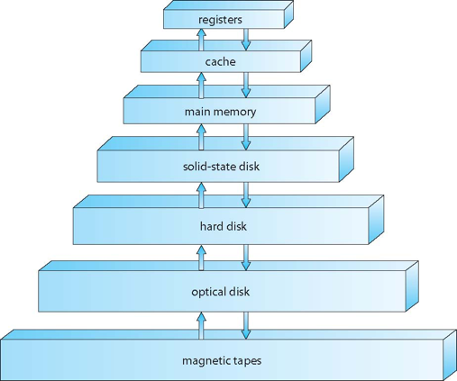
Which of these memories can be accessed directly by the CPU?
Registers, cache and main memory
Registers, cache, main memory and disk (solid-state)
Registers, cache, main memory and disk (any)
Notes:
1

Slide 49
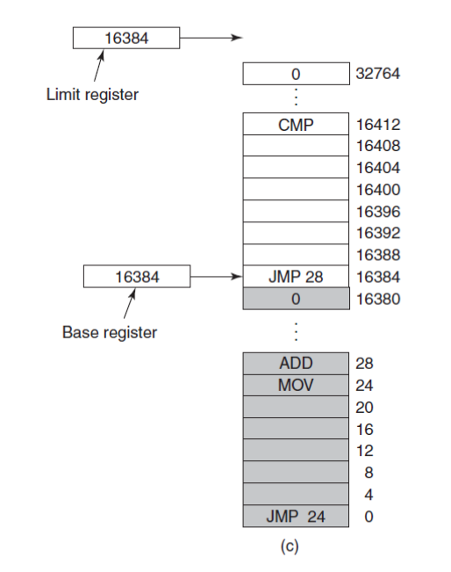
The base and limit registers in the figure contain the same value. Is it OK?
Yes, it is.
No, it is not.
Notes:
1

Slide 50
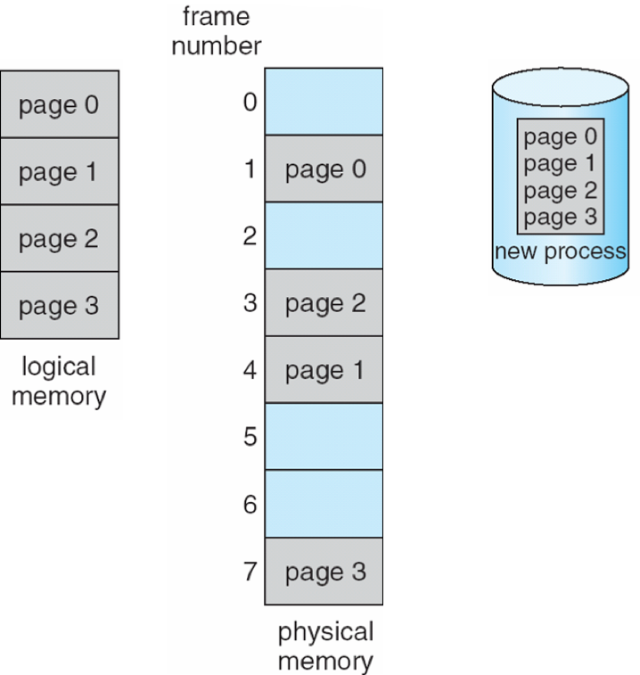
Paging suffers from...
External fragmentation
Internal fragmentation
Does not suffer fragmentation
Notes:
2

Slide 51
Process p address space is 128K. There are 16K of physical memory available (page size is 1K).
The page table contains 128 entries
The page table contains 16 entries
The page table contains 8 entries
Notes:
1

Slide 52
Suppose a process P has size of 100 bytes. Compute (1) the number of wasted bytes caused by internal fragmentation if the page and frame sizes are set to 2^4 bytes and (2) the size of the page table (suppose each page-table entry occupies 1 byte).
Notes:
Page size = 16 bytes
Number of pages required = ceil(100/16) = 7
Wasted bytes because of internal fragmentation 16 –100%16 = 12 bytes
Page table = 7 * bytes

Slide 53
Assuming a 1 KB page size, what are the page numbers and offsets for the following address references (provided as decimal numbers):
2375
19366
30000
256
16385
Notes:
1 KB = 2^10
2375 → 0000100101000111
Offset last 10 bits, so 327
Page is then 2

Slide 54
Consider the following segment table:
Segment Base Length
0 219 600
1 2300 14
2 90 100
3 1327 580
4 1352 96
Tell which physical address would be accessed for the following logical addresses
0,430
1,10
2,500
3,400
4,112
Notes:
219 + 430 = 649
2300 + 10 = 2310
illegal reference, trap to operating system
1327 + 400 = 1727
illegal reference, trap to operating system

