Slide 1

ECE 593 - Fundamentals of Pre-Silicon Validation
Design & Verification of AHB to APB Bridge
Team Members:-
Raghavendra Davarapalli - 955118446
Maithreyi Venkatesan - 900119348
Neil Austin Tauro - 956372423
Suraj Vijay Shetty - 967611331

Slide 2
Project Introduction:
Raghavendra Davarapalli:
Milestone 1:
Verification plan
Interface for modules
AHB Master module
Milestone 2 & 3:
Transaction
Generator
Environment classes
Verification plan
Milestone 4:
AHB sequence
Driver
Monitor
Environment
test components
Milestone 5: a. Bug Injection b. Presentation
Maithreyi Venkatesan:
Milestone 1:
Verification plan
Testbench development
Milestone 2 & 3:
Driver
functional coverage
test class
Verification plan
Milestone 4:
APB sequence
Driver
monitor components
Milestone 5:
a. Bug injection
b. Presentation

Slide 3
Project Introduction:
Neil Austin Tauro:
Milestone 1:
Design Spec Doc
Bridge Controller (Half)
Milestone 2 & 3:
scoreboard
Design Spec Doc
Milestone 4:
scoreboard
Functional Coverage
Milestone 5:
Presentation slides.
Suraj Vijay Shetty:
Milestone 1:
Design Spec Doc
APB slave interface
Milestone 2 & 3:
Monitor
Design Spec Doc
Milestone 4:
Transaction
Interface
monitor classes
Milestone 5: a. Assertions b. Functional coverage c. Modifications to test sequences.

Slide 4
Project Introduction:
The AHB2APB Bridge is a hardware component that connects the high-speed AMBA AHB bus with the lower-speed APB bus, allowing data transfer between them. Provides a seamless interface between the high-performance AHB bus and the low-power APB peripheral bus, handling the necessary protocol conversions and signal timing requirements between the two interfaces.
It acts as a translator, converting AHB transactions into APB transactions to enable communication with peripheral devices like timers and UARTs.
The Design is verified in Conventional, Class-based and UVM Testbenches.

Slide 5
Design Features:
The design features an integrated address decoder that generates peripheral select signals (psel) based on the AHB address, simplifying peripheral interfacing and improving design modularity.
Implements separate read and write data paths with configurable data widths (32-bit standard), enabling efficient data transfer between the AHB and APB domains.
Supports different transfer types on the AHB interface, including NONSEQUENTIAL, SEQUENTIAL, IDLE, and BUSY transfers, ensuring proper transaction flow control and efficient bus utilization.

Slide 6
Design Features:
Input Signals:
hclk - Clock signal for the AHB interface.
hresetn - Active low reset signal for the AHB interface.
hsize[2:0] - Size of the transfer on the AHB interface.
hburst[2:0] - Specifies the type of burst operation. (Future Scope)
haddr[31:0] - 32-bit address for the AHB transfer.
htrans[1:0] -Transfer type on the AHB interface (NONSEQUENTIAL, SEQUENTIAL, IDLE or BUSY).
hwrite - When HIGH this signal indicates a write transfer, and when LOW, a read transfer.
hwdata[31:0] - 32-bit write data on the AHB interface.
hreadyin - Ready signal indicating the availability of the AHB interface.
prdata[31:0] - Read data on the APB interface.

Slide 7
Design Features:
Output Signals:
hrdata[31:0] - 32-bit read data from the AHB interface.
hreadyout - Ready signal indicating the readiness of the AHB interface.
hresp[1:0] - Response indicating the status of the AHB transfer.
psel[2:0] - The signal indicates that the slave device is selected, and that a data transfer is required. It has the same timing as the peripheral address bus. It becomes HIGH at the same time as PADDR, but will be set LOW at the end of the transfer.
penable - Enable signal for the APB interface.
paddr[31:0] - 32-bit address for the APB transfer.
pwrite - This signal indicates a write to a peripheral when HIGH, and a read from a peripheral when LOW. It has the same timing as the peripheral address bus.
pwdata[31:0] – 32-bit write data on the APB interface.

Slide 8
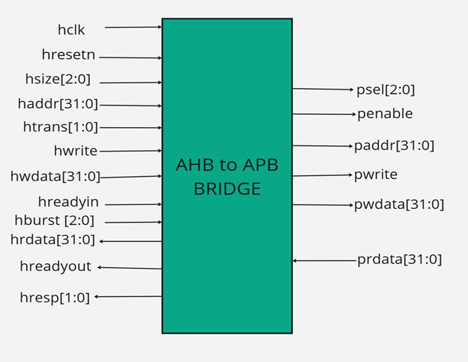
Design Implementation:

Slide 9
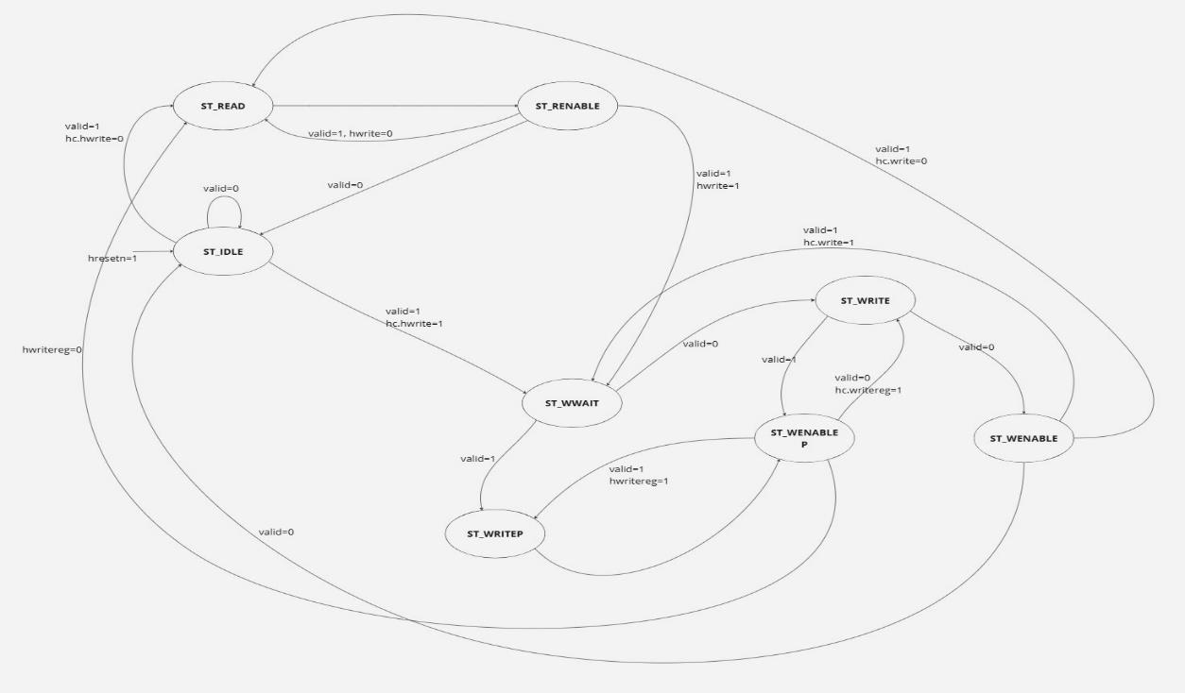
Design Implementation:

Slide 10
VIP Implementation:
The verification plan aims to outline the strategy and methodology employed to validate the functionality of the AHB (Advanced High-Performance Bus) to APB (Advanced Peripheral Bus) bridge.
As a crucial component of the AMBA (Advanced Microcontroller Bus Architecture) system, the AHB to APB bridge facilitates seamless communication between high-performance master devices on the AHB bus and lower-bandwidth peripheral devices on the APB bus.
The AHB Master module consists of two tasks: one for handling read operations and the other for managing write operations. These tasks streamline interactions with the design under test (DUT) by encapsulating the read and write logic into reusable procedural blocks.

Slide 11
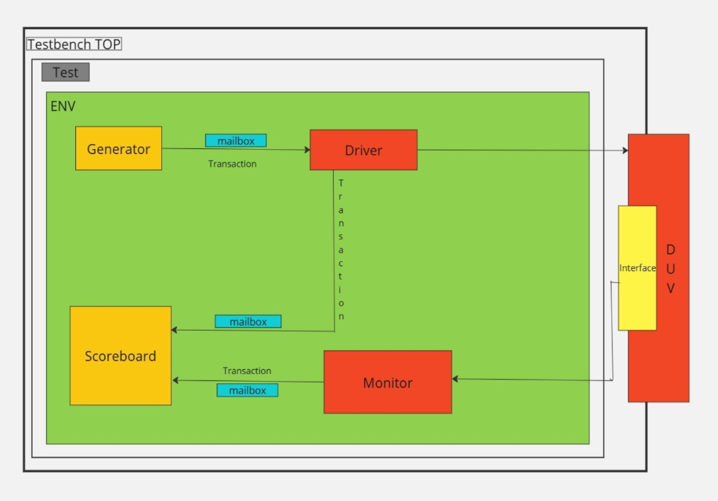
VIP Implementation:
Class-based VIP Implementation:

Slide 12
VIP Implementation:
The verification process will be conducted at two levels: block (module) level and top level. At the block level, individual components such as the AHB Master, APB FSM Controller, and APB Slave will be independently verified. At the top level, the fully integrated AHB-APB Bridge will be tested as a complete system.
While the design includes distinct modules (AHB Master, AHB Slave Interface, APB FSM Controller, and APB Interface), the verification strategy will be driven by the AMBA specification document rather than module boundaries and will extract the required bridge functionalities from this specification and verify them against our RTL implementation.

Slide 13
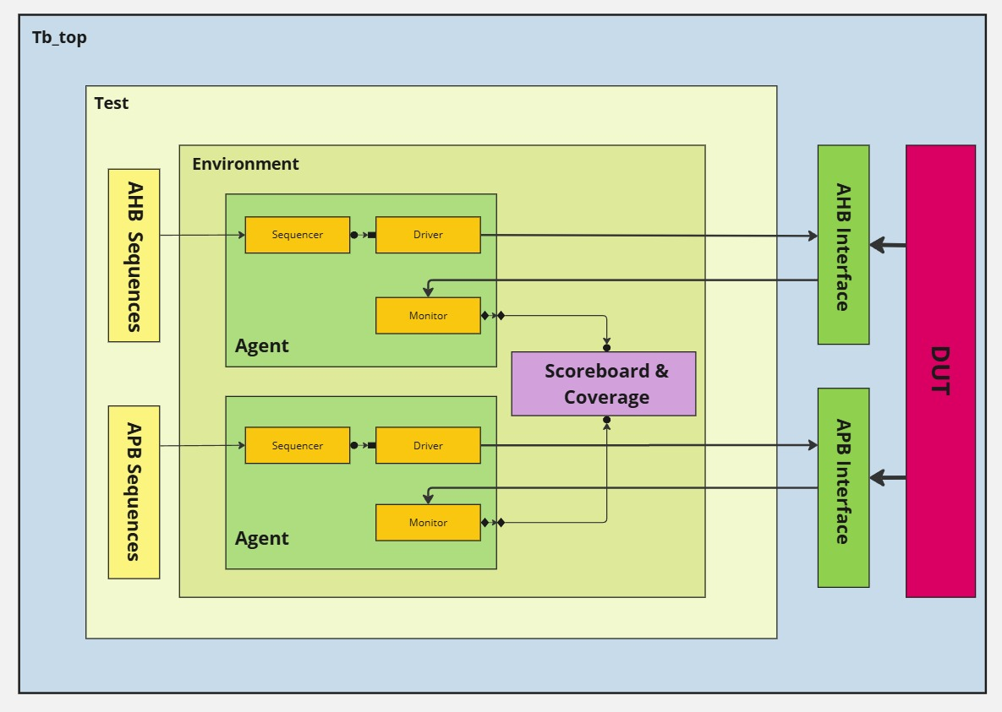
VIP Implementation:
UVM based VIP Implementation:

Slide 14
VIP Implementation:
Test-case Scenarios
APB Sequence
APB Sequence
APB Random Sequence
APB Single Write Sequence
APB Single Read
AHB sequence
AHB Sequence
AHB Random Sequence
AHB Single Write Sequence
AHB Single Read Sequence
Combined AHB sequence

Slide 15
VIP Implementation:
The testbench is designed with a layered architecture and comprises the following components:
Tb_top (Testbench Top): The top-level module that integrates all testbench components.
Test: Defines the verification scenarios, applies stimuli, and captures results.
AHB and APB Sequences: Generates transaction-based stimuli for AHB and APB protocols.
Agents (AHB and APB):
Sequencer: Generates stimulus transactions and sends them to the driver in a controlled manner, ensuring correct execution order and managing transaction flow during simulation.
Driver: Converts transactions received from the sequencer into pin-level signals for interaction with the DUT, mimicking real hardware behavior to ensure accurate communication.
Monitor: Passively observes interface signals, capturing DUT responses without driving any signals. It forwards the collected data to the scoreboard and coverage components for validation and analysis.

Slide 16
VIP Implementation:
A verification environment comprising agents, a scoreboard, and coverage components:
Scoreboard: Compares the expected and actual DUT outputs to validate functionality.
Coverage: Collects functional coverage to monitor and track tested scenarios.
AHB-APB Verification Environment (ahb_apb_env): The ahb_apb_env class acts as the central verification environment for the AHB-APB Bridge, integrating all essential components. It manages the setup, connection, and execution of the verification process by incorporating AHB and APB agents, along with a scoreboard for result validation.
Key Methods:
Constructor (new) – Initializes the environment component by assigning its name and parent.
Build Phase (build_phase) – Creates the required environment components based on configuration settings. It determines which agents and the scoreboard should be instantiated. For example, if the AHB agent is enabled in the configuration, it is instantiated accordingly, along with the APB agent and the scoreboard.
Connect Phase (connect_phase) – Establishes connections between components. If both the AHB agent and the scoreboard are enabled, the AHB monitor output port is linked to the scoreboard AHB analysis port, ensuring transactions are forwarded for validation.

Slide 17
VIP Implementation:
Run phase(run_phase) - Governs the execution of test scenarios by coordinating stimulus generation, driving transactions, and monitoring responses. This phase manages the execution of sequences within agents and ensures that stimulus is applied to the DUT. For example, if both the AHB and APB agents are enabled, their respective sequencers generate transactions, which are driven onto the interfaces, while the monitors capture and forward responses for analysis. The run phase continues execution until the test completes or a termination condition is met.
Counters:
Maintain transaction statistics, tracking the total number of processed packets and successfully verified transactions. Key counters include ahb_pkt_count, apb_pkt_count, and verified_data_count.

Slide 18
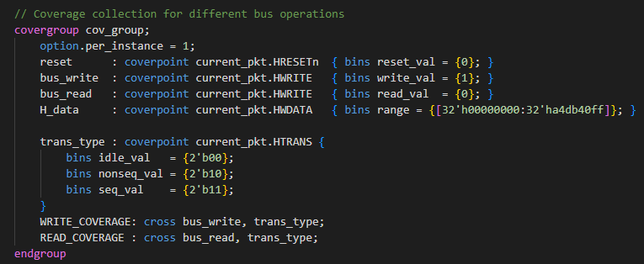
VIP Implementation:
Covergroup (cov_group):
Gathers functional coverage data to evaluate the extent of design verification.
Monitors critical operations such as reset behavior, read/write transactions, and different transaction types to ensure thorough testing.

Slide 19
Coverage:
Functional Coverage: In our UVM-based verification environment, functional coverage ensures that all possible scenarios, states, and transitions of the design are thoroughly tested. SystemVerilog's covergroup construct defines coverage points and bins representing different values or value ranges.
Coverpoints: Specific points in the design or verification environment where coverage is measured. In our cov_group, we define multiple coverpoints, including reset, bus_write, bus_read, H_Data, and trans_type.
Bins: Each coverpoint utilizes bins to divide the value space into subsets, capturing specific values or value ranges. For instance, the write_val bin within the bus_write coverpoint records scenarios where HWRITE is 1, indicating a write operation.
Cross Coverage: Cross coverage enables tracking combinations of multiple coverpoints.
WRITE_COVERAGE monitors write operations (bus_write) in combination with different transaction types (trans_type).
READ_COVERAGE tracks read operations paired with various transaction types.
H_Data captures the range of values assigned to HWDATA.

Slide 20
Code coverage and functional coverage:
Achieved a 65.53% code coverage, a substantial increase from the initial 21%. Improving coverage was challenging due to limited toggle activity, which restricted the effective exercise of certain logic paths. Additionally, timing constraints made it difficult to reach deeper design states, as some test scenarios were impacted by timing violations. Other limiting factors included unreachable conditions in the RTL and constraints in the testbench stimulus, further restricting coverage improvement.
Achieved 100% functional coverage with the defined coverpoints and bins. Additionally, 100% assertion coverage was attained, leveraging assertions to detect functional bugs in the RTL.

Slide 21
Assertion:
The assertions validate key functional aspects, including:
AHB Protocol Compliance:
Ensures HTRANS carries valid transaction types (IDLE, NONSEQ, SEQ).
Verifies that HRESP remains OKAY during normal operation.
Data Transfer Mechanisms:
Validates address pipelining by ensuring Haddr1 correctly retains the previous address value.
Checks the correct generation of the valid signal based on address ranges and HTRANS types.
Reset Behavior:
Ensures Penable is de-asserted when Hresetn is active low.
Verifies that reset transitions properly restore the bridge to a known state.
Basic Transaction Validations:
Confirms that a basic write transaction (Hwrite asserted with NONSEQ transfer) completes successfully with Hreadyout.
Ensures that a basic read transaction (non-Hwrite with NONSEQ transfer) completes successfully with Hreadyout.

Slide 22
Steps to run:
1) Download the ece593w25_team_14_AHB2APB_Bridge_M5.zip file and unzip the folder and open it.
2) Copy the location of M5/CLASS/ file.
3) Open QuestaSim and in the terminal enter the command “cd {path_name for CLASS/}”
4) Now enter the command “do run_normalMode.do”, this should produce the output transcript along with the coverage reports. The coverage files names are code_coverage.txt, functional_coverage.txt and assertion_coverage.txt.

Slide 23
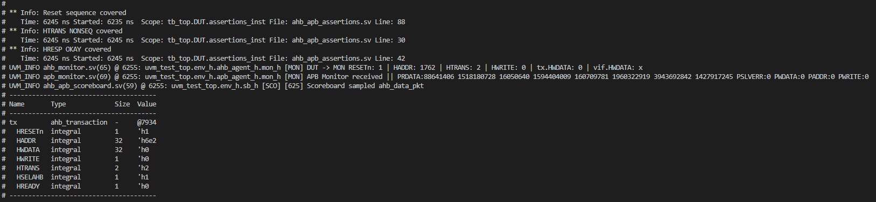
Output:

Slide 24
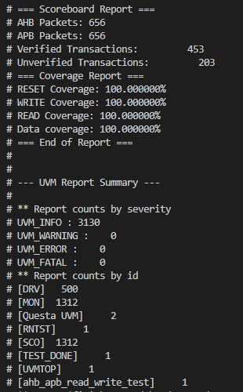
Output:

Slide 25
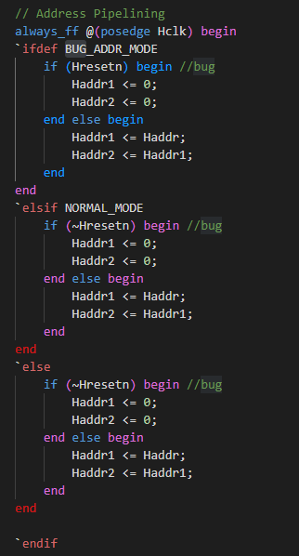
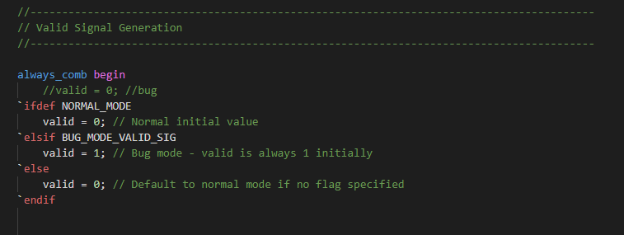
Bug Injection:
We have injected bugs in our RTL, in the address pipelining logic and the valid signal generation logic. These injected bugs are clearly marked with comment lines (//bug) for easy identification. The functional assertions written in the testbench will monitor these logic errors and trigger the uvm_error reporting macro upon detection. This ensures that any deviations from expected behavior are immediately flagged during simulation, allowing us to debug and validate the design efficiently.
We utilized conditional compilation with `ifdef..`endif to inject bugs and have three separate run.do files for this namely, run_normalMode.do, run_bugData.do and run_bugValidSig.do.

Slide 26
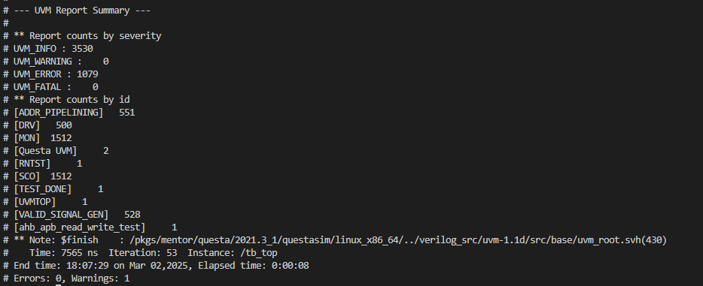
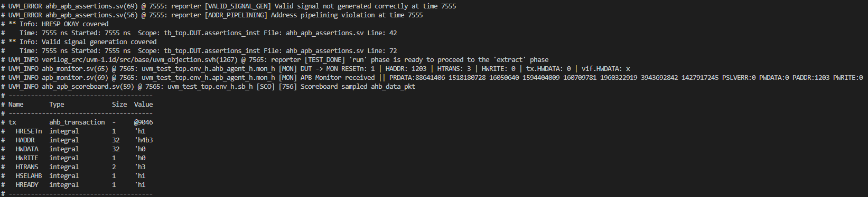
Bug Injection:

Slide 27
Conclusion:
•Design and verification of AHB to APB Bridge using SV and UVM ensure correctness and reliability.
•Techniques include code functional coverage, assertions, and meticulous design implementation.
•SV and UVM facilitate modularity, reusability, and scalability in verification.
•Directed testing targets critical scenarios, while random testing uncovers edge cases.
•Integration of these techniques ensures the design meets requirements and operates reliably.

Slide 28
References:
Utilized ClaudeAI for adding comments into the code and paraphrasing the document.
RTL Design code referenced from “https://github.com/prajwalgekkouga/AHB-to-APB-Bridge”
ARM Documentation “https://developer.arm.com/documentation/ihi0033/latest/”
UVM testbench scoreboard model referenced from “https://github.com/Ghonimo/Pre_Silicon-AHB-to_APB-Verification/blob/main/Checkpoint%204_UVM_Based%20Testbench/AHB_APB_UVM_VIP/ahb_apb_scoreboard.sv”

