Slide 1

AURA-Twin
Automated Understanding & Real-time Analysis Twin
Prepared by
Rawan Suliman Raghad Shaaban
Supervised by
Dr.Kadan Aljouma
Eng.Zeinab Baghdadi
Eng.Wesam Alsouhli

Slide 2
Baseline Phase: Binary Engine Anomaly Detection (FordA)
Dataset & Scope
Utilized the benchmark FordA dataset for binary engine health monitoring, categorizing operations into Normal vs. Faulty/Anomaly based on 1D raw acoustic/vibration signals (500 time-steps per sample(
Model Architecture
Implemented a Hybrid 1D-CNN + LSTM deep learning architecture, combining 1D-CNN layers for local spatial/frequency feature extraction with LSTM layers to capture long-term temporal dependencies in vibration dynamics.
Results
High diagnostic accuracy—exceeding 95%—was achieved in test partitions using robust sequence learning.
2

Slide 3
Problem Statement & Scientific Challenges
Manual Feature Limitations:
Traditional methods (FFT/Wavelets) require tedious manual tuning and fail to capture early non-linear degradation.
Industrial Noise Interference:
Severe operational noise and vibrations significantly degrade shallow model reliability.
Binary Diagnostic Shortcomings:
Binary classification (Normal/Faulty) lacks component localization and defect severity estimation
3

Slide 4
Objectives
  Zero-Downtime Reliability:
  Proactive real-time health monitoring to eliminate sudden failures and reduce costs.
  Precision Wear Tracking:
  Early sub-millimeter degradation detection for timely, pre-failure component replacement.
  Autonomous Diagnostics:
  Self-contained intelligence pipeline analyzing raw operational signals without manual intervention
4

Slide 5
Proposed Solution
Building an end-to-end diagnostic system that ingests raw vibration signals, segments them using overlapping time windows (2,048 samples), and feeds them into a 1D Deep Convolutional Neural Network with a wide first-layer kernel to automatically suppress noise, extract fault signatures, and classify them across 10 distinct categories with real-time accuracy.
5

Slide 6
Research Papers
Paper Title | Year | Dataset Used | Training Approach | AI Model | Feature Extraction | Evaluation& Results
Bearing Fault Diagnosis Using CNN-LSTM Hybrid Model For Predictive Maintenance | 2026 | CWRU Bearing Dataset (DE & FE signals) | 70/15/15 Split, Data Augmentation, Adam Optimizer ) 20 epochs( | Dual-Branch Hybrid CNN-LSTM (Conv 1D +LSTM & STFT+Conv 2D( | Automated End-to-End Extraction (Time & Frequency( | 96.00% Accuracy (F1: 95.00%), Outperformed KNN, DT, and ResNet-50
6

Slide 7
Research Papers
Paper Title | Year | Dataset Used | Training Approach | AI Model | Feature Extraction | Evaluation& Results
Vibration-based condition monitoring and fault diagnosis of rotating machinery: Fundamentals, signal processing techniques, standards, and emerging trends. | 2026 | Review Article (238 papers, ISO 10816, API 670( | Supervised, Unsupervised, Transfer & Physics-Informed Learning | SVM, Random Forest, 1D CNN, LSTM, Autoencoders, XAI | RMS, Kurtosis, FFT, STFT, Wavelets, VMD, Envelope Analysis | High accuracy for non-stationary signals; highlights Digital Twins & Edge AI
7

Slide 8
Research Papers
Paper Title | Year | Dataset Used | Training Approach | AI Model | Feature Extraction | Evaluation& Results
Predictive Maintenance Using Machine Learning for Engineering Systems Through Real-Time Sensor Data and Anomaly Detection Models | 2026 | IIoT Sensor Data (Vibration, Temp, Pressure - CNC, Turbines) | Supervised, Unsupervised, Semi-Supervised, Federated Learning . | RF, XGBoost, Isolation Forest, Autoencoders, 1D CNN, LSTM . | RMS, Kurtosis, FFT, Spectral Entropy, Deep Feature Learning | High F1-Score & Low False Positives; RUL Estimation
8

Slide 9
Research Papers
Paper Title | Year | Dataset Used | Training Approach | AI Model | Feature Extraction | Evaluation& Results
Trustworthy bearing fault diagnosis based on evidential deep learning and quadratic convolution neural network | 2026 | CWRU dataset (12 kHz drive-end bearing, 10 fault classes) contaminated with Gaussian white noise at 0 dB and -6 dB | Evidential Deep Learning (EDL) via Dirichlet distribution; improved loss function combining relaxed evidential loss, Fisher Information Matrix penalty, and KL divergence regularization; trained via SGD and ReLinear strategy | EQCNN (Evidential Quadratic Convolutional Neural Network built on Wide Deep CNN architecture) | Wide quadratic convolutional kernel (64 \times 1 \times 16) in Layer 1, embedded attention mechanism (Qttention), BN, ReLU, and Max Pooling across 6 QConv blocks | - Accuracy: 97.53%–99.91% at -6 dB SNR across motor loads, and 100% at 0 dB[ - Uncertainty Quantification: Over 80% uncertainty for misclassifications and under 40% for correct predictions.Interpretability: Qttention maps accurately locate fault impact pulses
9

Slide 10
Research Papers
Paper Title | Year | Dataset Used | Training Approach | AI Model | Feature Extraction | Evaluation& Results
Interpretable and Noise-Robust Bearing Fault Diagnosis for CNC Machine Tools via Adaptive Shapelet-Based Deep Learning Model | 2026 | CWRU (10 classes) and IMS run-to-failure datasets (4 classes) with Gaussian, Uniform, and Impulse noise (-6 dB to +8 dB) | Composite loss function (L_{CE} + \lambda_1 L_{cont} + \lambda_2 L_{cons}) combining cross-entropy, supervised contrastive loss (\lambda_1=0.05), and multi-scale consistency regularization (\lambda_2=0.02) with K-means++ initialization | Adaptive Shapelet-based CNN-BiLSTM | Multi-scale shapelets (lengths 16–256) with correlation-based distance, Gated parallel CNN (kernels 3, 5, 7), and Residual-enhanced BiLSTM | Accuracy: 87.67% (Gaussian), 85.65% (Uniform), and 82.33% (Impulse) at -6 dB on CWRU; 99.58% on IMS (clean) Superiority: Statistically significant improvement (p < 0.01) over standard baselines .Interpretability: FFT spectrum aligns with theoretical fault frequencies (e.g., BPFO = 107.4 Hz)
10

Slide 11
System Block Diagram
1
Data Source
2
Signal Preprocessing
3
Deep Feature Extraction
12 kHz Vibration Data
CWRU Drive End (DE)
Multi-condition (HP)
Sliding Window (2048)
50% Overlap
Z-Score Normalization
1D Convolution Layers
Batch Norm + ReLU
Max Pooling (Downsampling)
6
Deployment Cockpit
5
Multi-Class Inference
4
Deep Representation
92%
Streamlit Dashboard
Real-time Waveforms
Engine Health Score
10-Class Softmax Output
Fault Severity Scoring
Component Localization
Multi-layer 1D Convolutions
Dense Layer + Dropout (0.5)
Flatten Layer
11

Slide 12
Execution Flowchart
Start
Raw Vibration Acquisition
Segment Signals into Windows
(N = 2048)
Apply Z-Score Standardization
(Signal − μ) / σ
Train / Validation / Test Split
(70 / 15 / 15)
1D-CNN Forward Pass
Convolutional Feature Learning
Output:
Fault Type & Severity
Confidence
> Threshold?
Softmax Layer
Predicts Fault Probabilities
Deep Conv & Pooling Layers
Extract Hidden Patterns
Yes
No
End
Update Industrial Digital Twin & Health Score
Flag Low-Confidence / Retest
12

Slide 13
Data set Description
Utilizes the benchmark CWRU dataset (12 kHz Drive End vibration signals) encompassing 10 operating states: healthy baseline alongside 3 defect locations (Inner Race, Outer Race, Ball) across 3 severity levels (0.007", 0.014", 0.021").
13

Slide 14
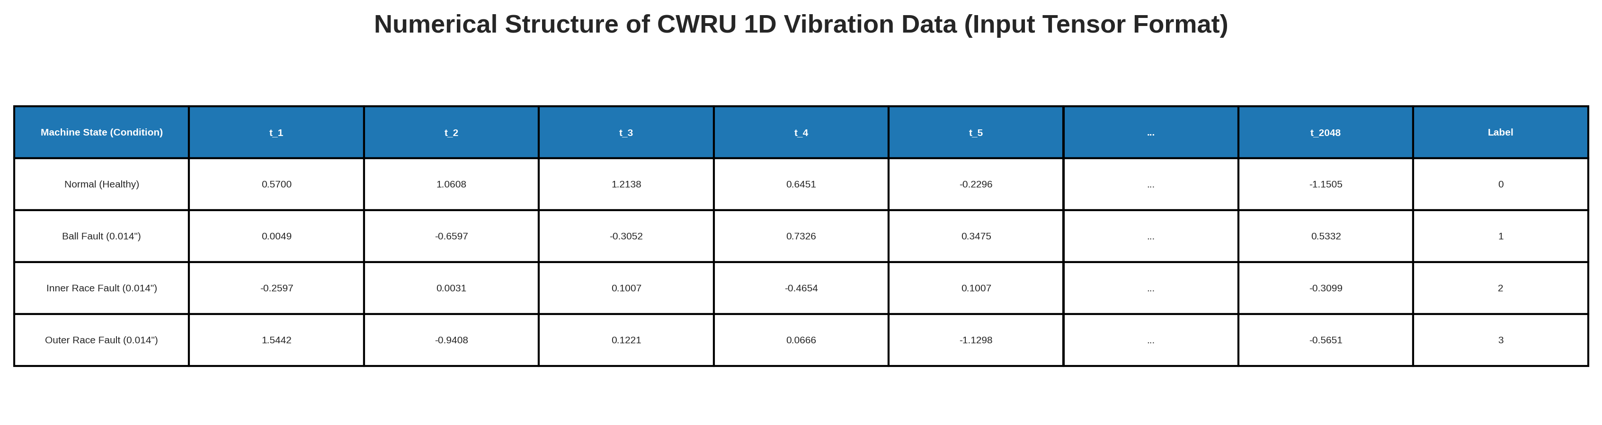
Data set Description
Utilizes the benchmark CWRU dataset (12 kHz Drive End vibration signals) encompassing 10 operating states: healthy baseline alongside 3 defect locations (Inner Race, Outer Race, Ball) across 3 severity levels (0.007", 0.014", 0.021").
14

Slide 15
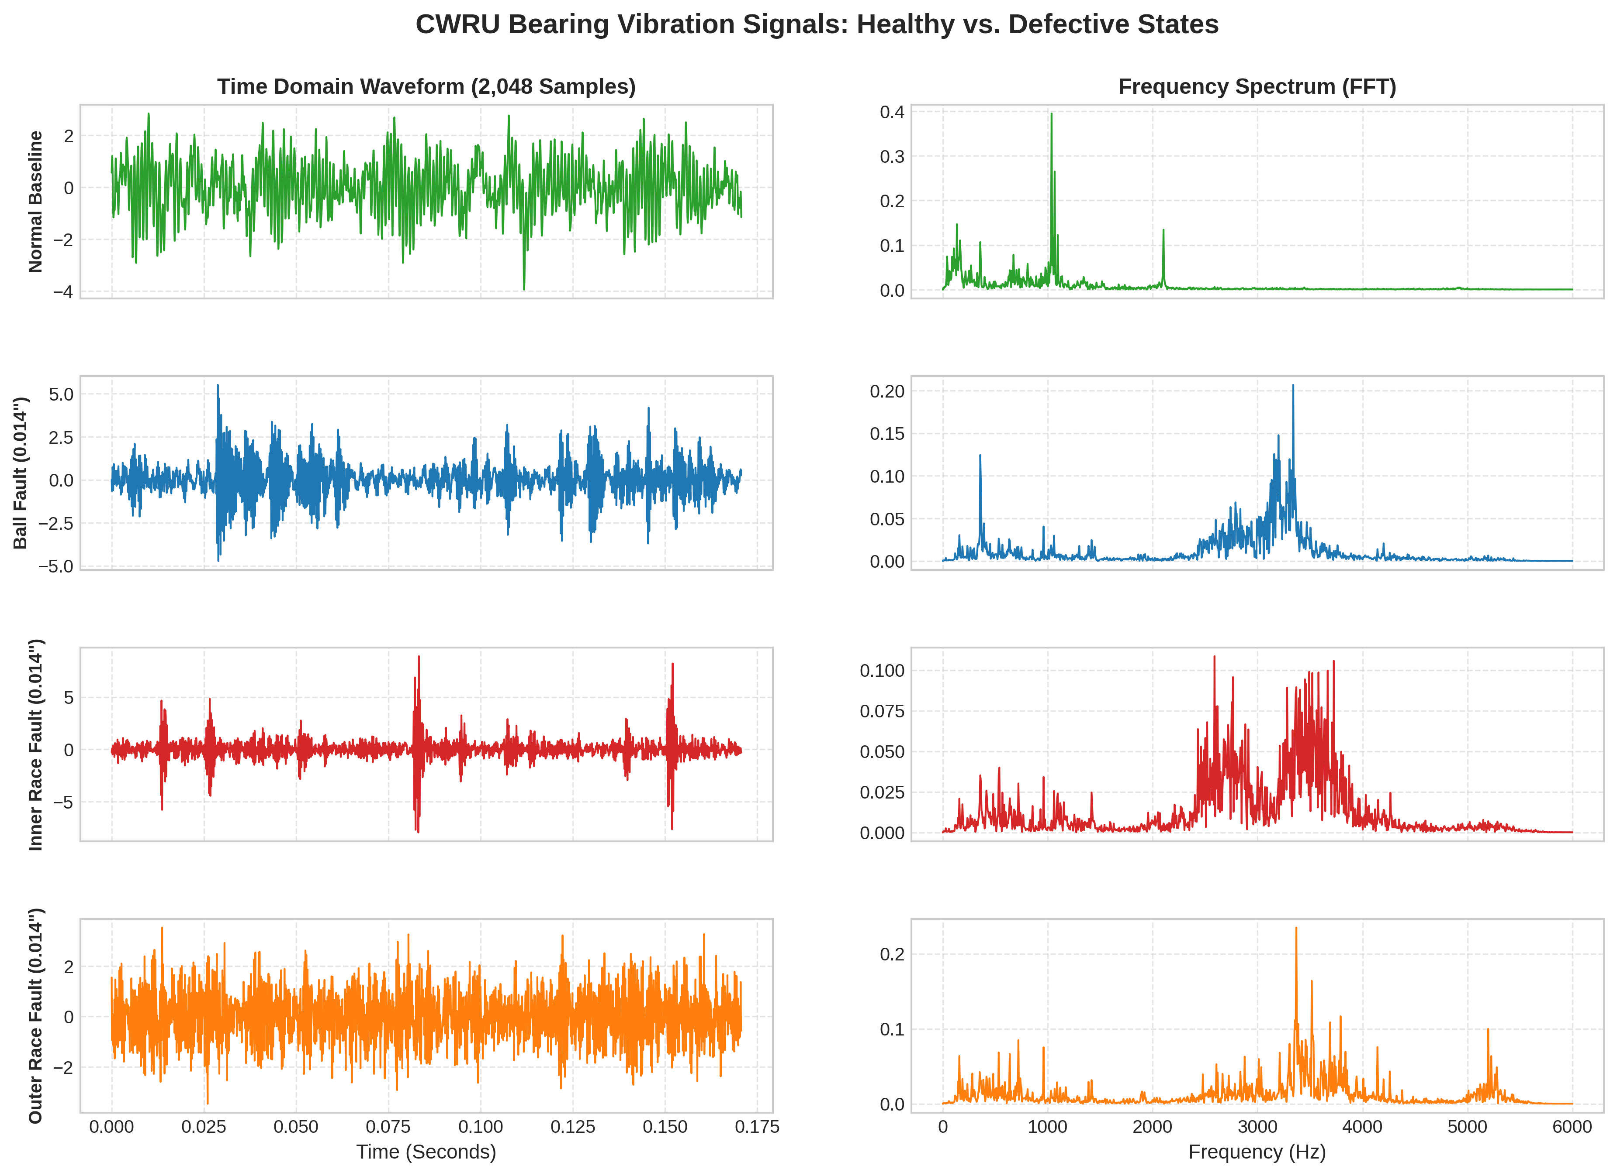
Data set Description
15

Slide 16
Model Architecture
I will train everything using a baseline hybrid model combining CNN & LSTM, as well as another model combining CNN & ResNet. Additionally, I will experiment with a further model to achieve better accuracy.
16

