Slide 1

AES Project
Done by: Raghad Abu Sammour (217099)
Instructor: Dr.Mousa Farajallah

Slide 2
What is AES (Advanced Encryption Standard) Encryption?
In short, AES is a symmetric type of encryption, as it uses the same key to both encrypt and decrypt data.
It also uses the SPN (substitution permutation network) algorithm, applying multiple rounds to encrypt data. These encryption rounds are the reason behind the impenetrability of AES, as there are far too many rounds to break through.
There are three lengths of AES encryption keys. Each key length has a different number of possible key combinations:
128-bit key length: 3.4 x 10³⁸
192-bit key length: 6.2 x 10⁵⁷
256-bit key length: 1.1 x 10⁷⁷
Even though the key length of this encryption method varies, its block size - 128-bits (or 16 bytes) - stays fixed.

Slide 3
The advantages of AES
Safety aside, AES encryption is very appealing to those who work with it. Why? Because the encryption process of AES is relatively easy to understand. This allows for easy implementation, as well as really fast encryption and decryption times.
In addition, AES requires less memory than many other types of encryption (like DES), which makes it a true winner when it comes to choosing your preferred encryption method.
Finally, when an action requires an extra layer of safety, you can combine AES with various security protocols like WPA2 or even other types of encryption like SSL.

Slide 4
How does AES encryption work?
1. Dividing data into blocks
2. Key expansion
3. Adding round key
4. Byte substitution
5. Shifting rows
6. Mixing columns
7. Adding round key
8. Rinse and repeat

Slide 5
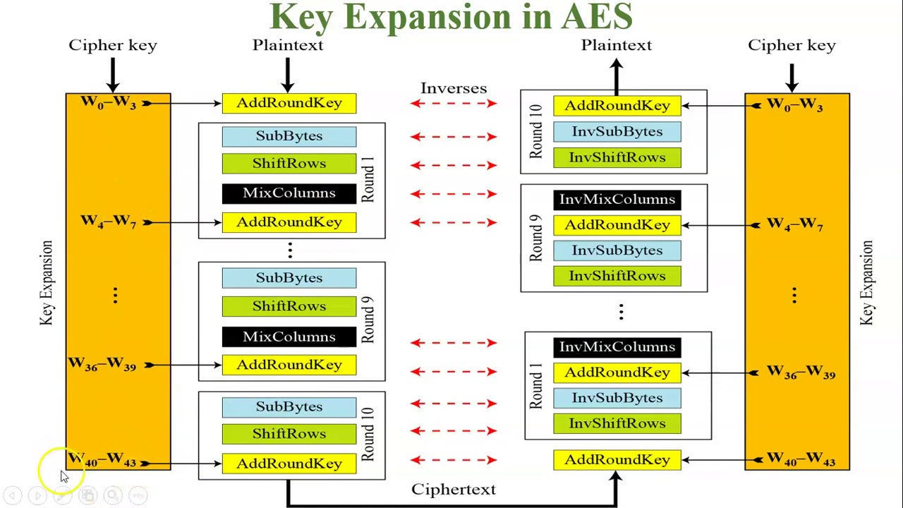

Slide 6
AES decryption
With the help of inverse encryption, the AES ciphertext can be restored to its initial state.
As mentioned before, the advanced encryption standard implements the method of symmetric cryptography. In other words, it uses the same key for both data encryption and decryption.
In this way, it differs from the algorithms that use asymmetric encryption, when both public and private keys are required.
So, in our case, AES decryption begins with the inverse round key. Afterwards, the algorithm reverses every single action (shift rows, byte substitution, and, later on, column mixing), until it deciphers the original message.

Slide 7
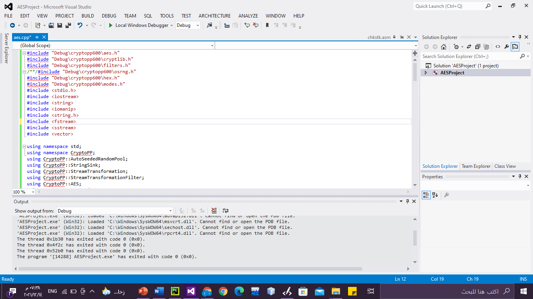
Download Crypto++ 6.0.0 from crypto website.
Write AES code on cpp project with visual studio 2012
Some error appeared as shown in figure
After add the crypto++ library to the cpp project, the errors will solved.

Slide 8
IN AES CODE:
1.Initialization of key data code WITHOUT RC4:
void InitKey(byte* key, size_t size) {
for ( size_t i = 0; i < size; ++i ) {
key[i] = rand();
}
}

Slide 9
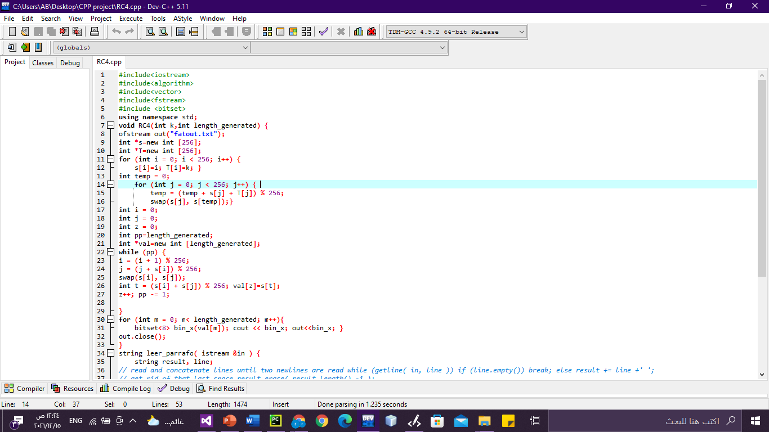
IN AES CODE:
1.Initialization of key data code WITH RC4:

Slide 10
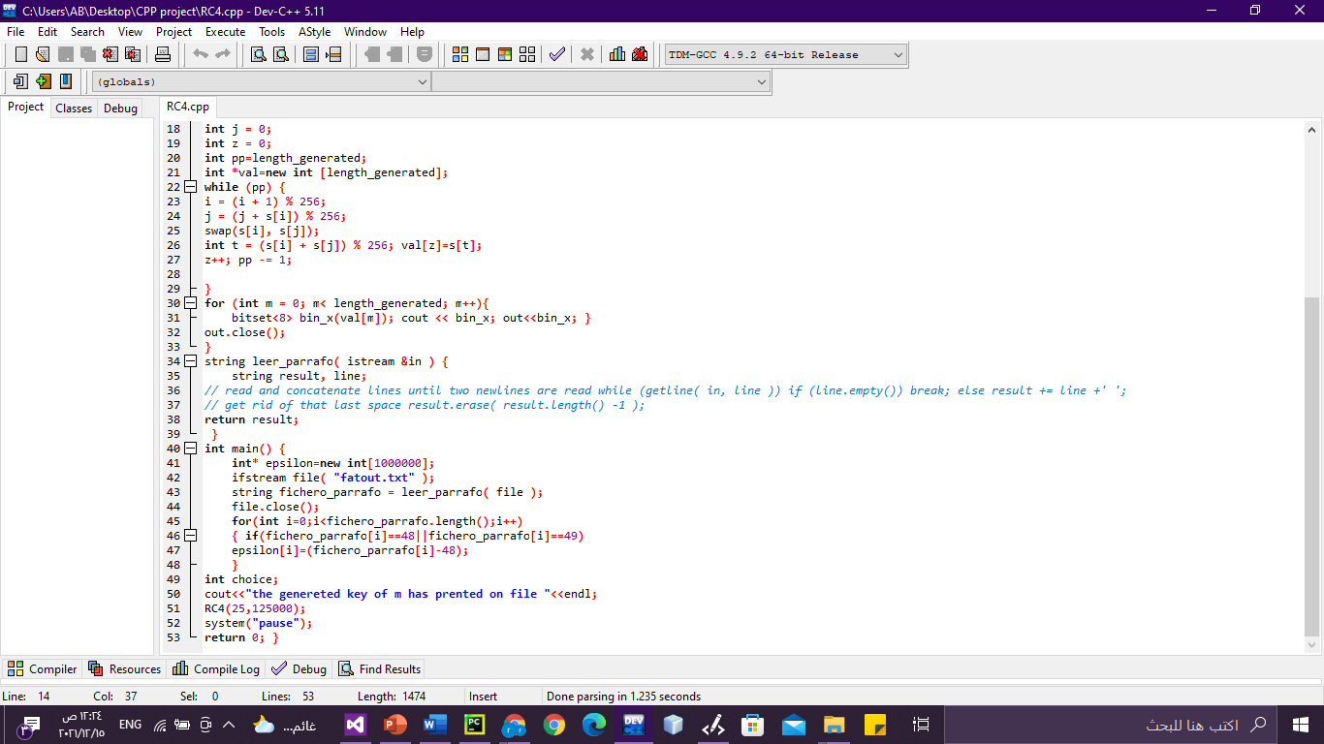

Slide 11
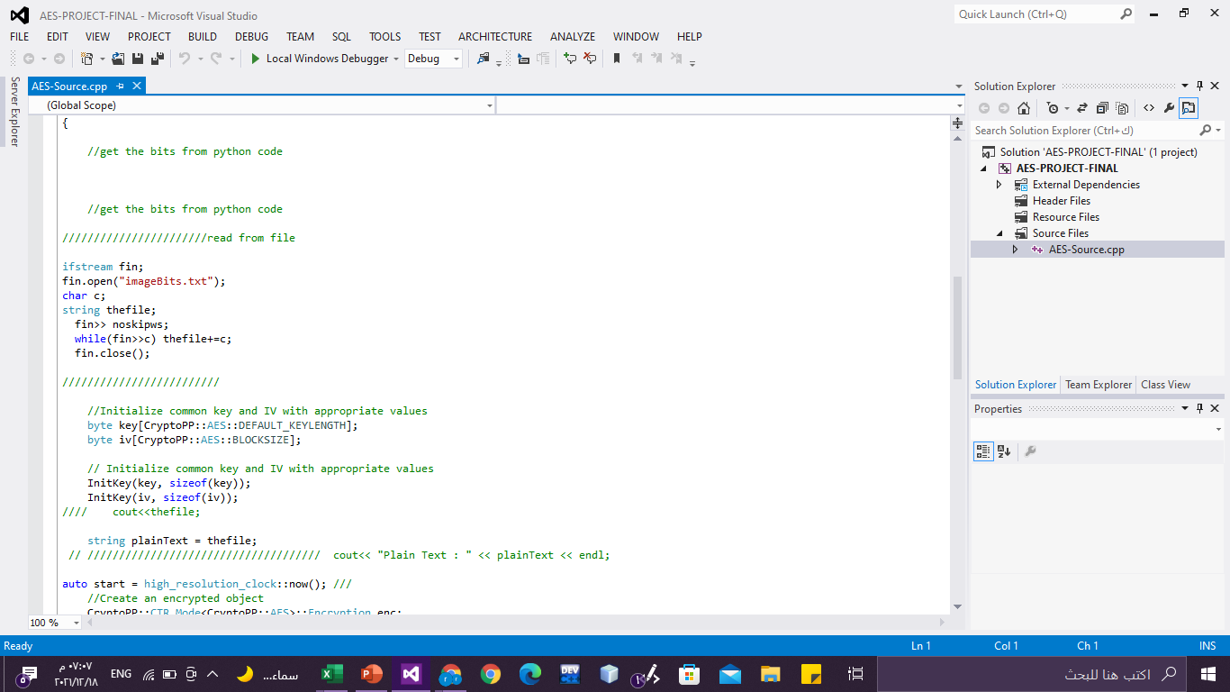
get the bits from python code.

Slide 12
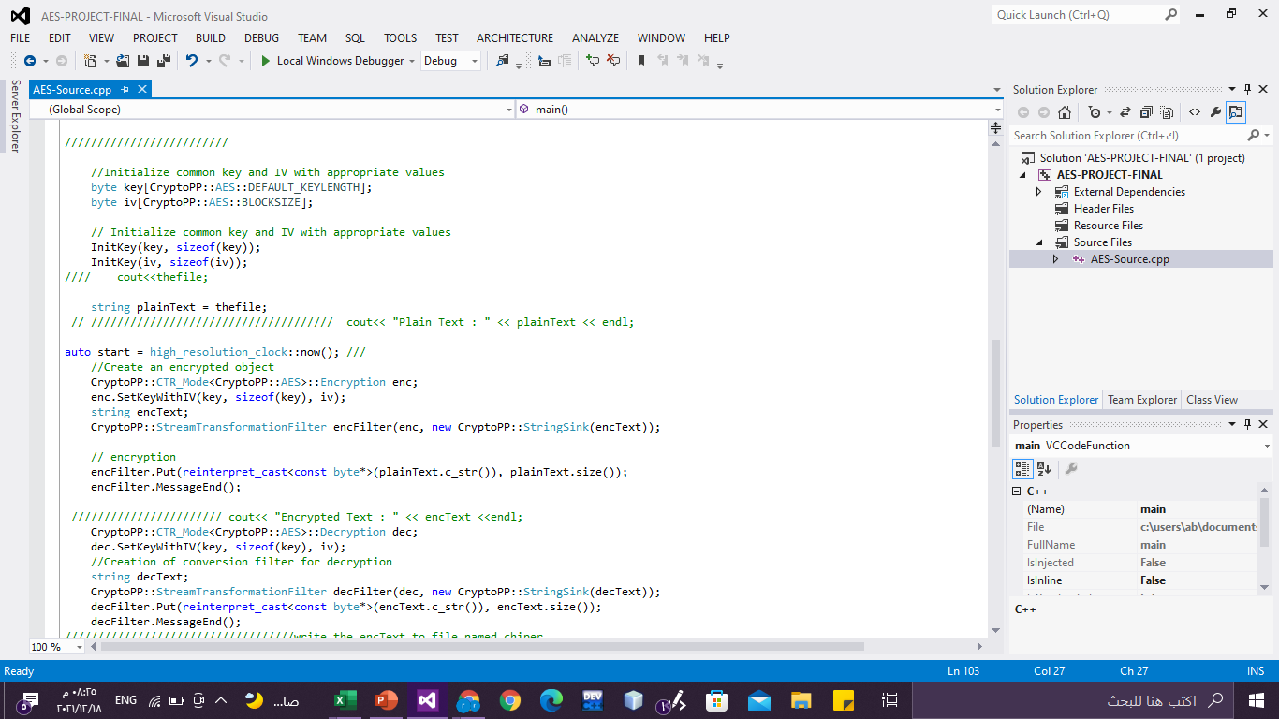
Encryption code .

Slide 13
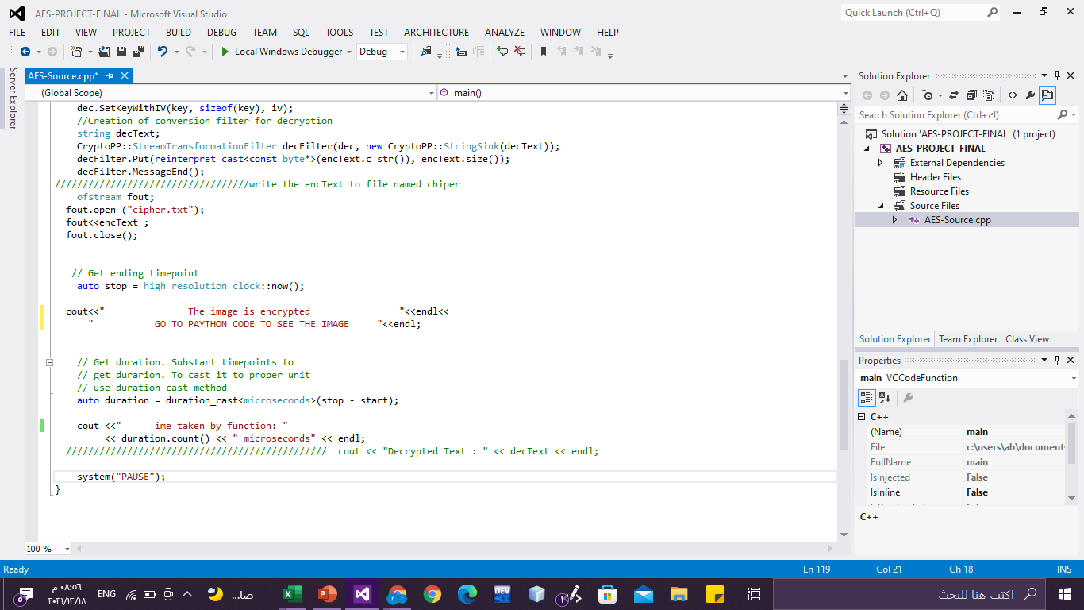
write the encText to file named chipper and calculate the excution time.

Slide 14
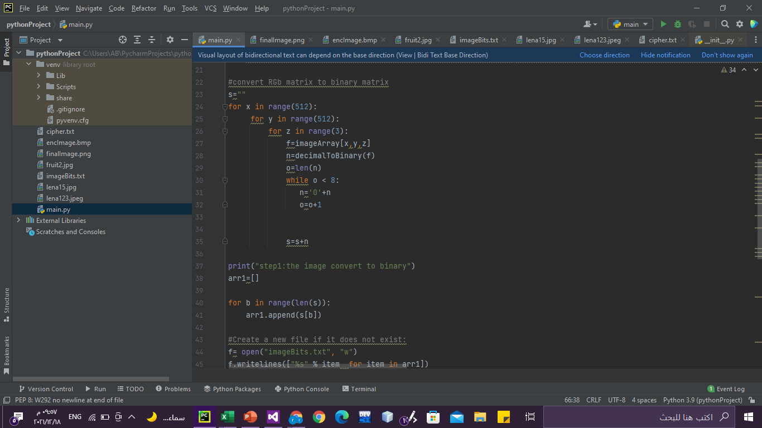
convert RGb matrix to binary matrix code.

Slide 15
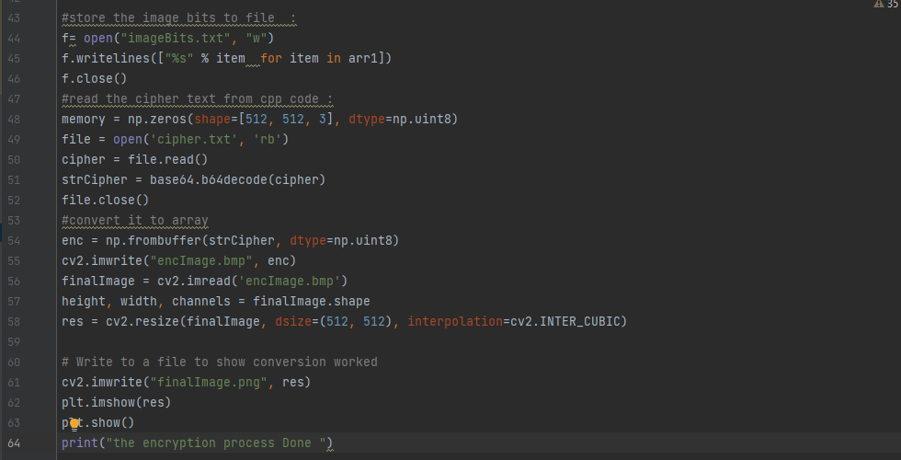
store the image bits to file, read the cipher text from cpp code and convert it to array :

Slide 16
Some errors:
Module level import not at top of file (E402)
THE SOLUTION: All module level imports should be at the top of the file. This means that there should be no statements in between module level imports.
FileNotFoundError: [Errno 2] No such file or directory: 'fruit2.jpg’
Add the photo to the project directory.

Slide 17
fout= open('chiper.txt', 'rb');FileNotFoundError: [Errno 2] No such file or directory: ‘cihper.txt’
THE SOLUTION: bulid and run the cpp code befor
FileNotFoundError: [Errno 2] No such file or directory: 'fruit2.jpg’
Add the photo to the project directory.

Slide 18
Attribute Error: 'None Type' object has no attribute 'shape'
THE SOLUTION : add )assert not isinstance(image,type(None)), 'image not found )TO THE CODE
https://stackoverflow.com/questions/39833796/opencv-nonetype-object- has-no-attribute-shape
Collecting opencv Could not find a version that satisfies the requirement opencv (from versions: ) No matching distribution found for opencv
THE SOLUTION : pip3 install opencv-python
cv2.error: OpenCV(4.1.1) /io/opencv/modules/imgcodecs/src/loadsave.cpp:75: error: (-215:Assertion failed) pixels <= CV_IO_MAX_IMAGE_PIXELS in function 'validateInputImageSize'
THE SOLUTION : os.environ["OPENCV_IO_MAX_IMAGE_PIXELS"] = pow(str2,40)
https://github.com/opencv/opencv/issues/15829

Slide 19
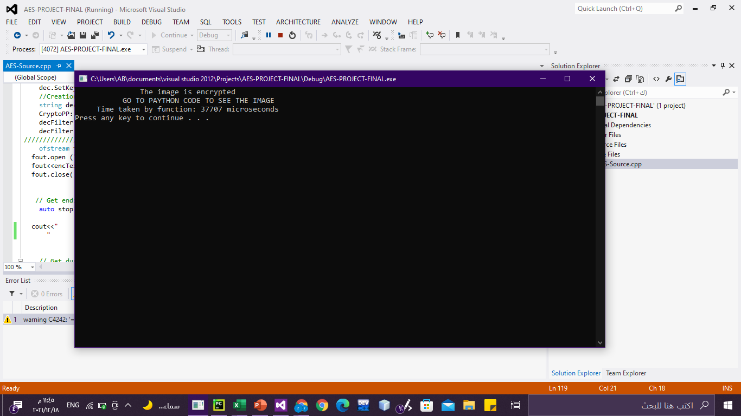
Execution time
#include <chrono> using namespace std::chrono; auto start = high_resolution_clock::now(); auto duration = duration_cast<microseconds>(stop - start);
// To get the value of duration use the count()
// member function on the duration object cout << duration.count() << endl;

Slide 20
Thank y0u

