Slide 1
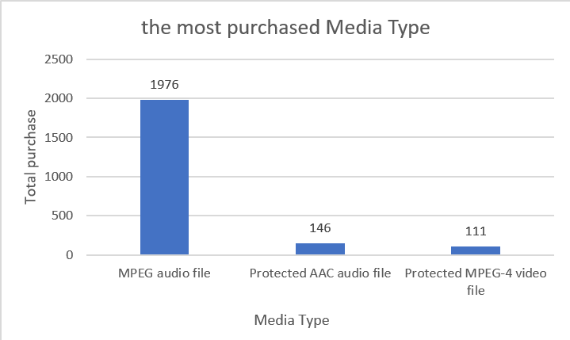
What is the most purchased Media Type
<visualization>
MPEG audio file the highest number of media type with 1976

Slide 2
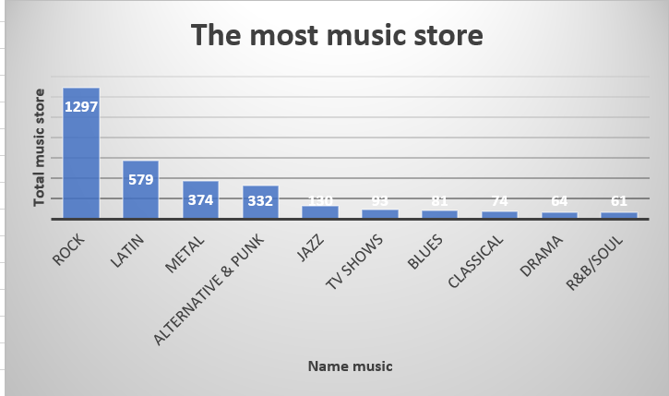
Which songs per genre the music store has?
As you can see, ROCK genre is most music track in the store as it has the 1297 and second is LATINA music it has the 579.

Slide 3
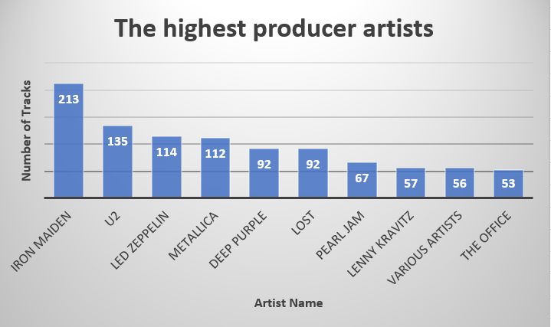
Which artists who produce the most tracks?
Iron Maiden produced the highest number of tracks with 213.

Slide 4
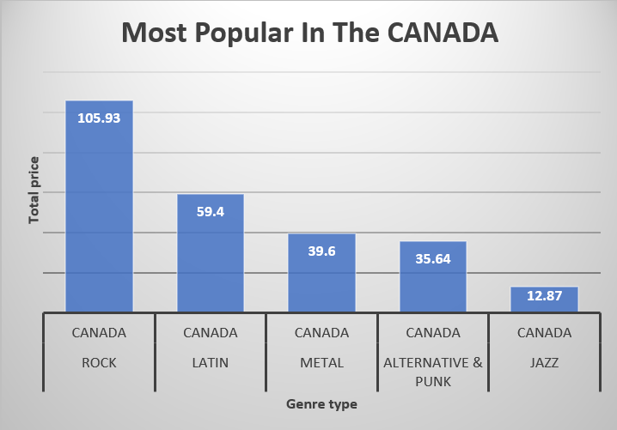
What is the most popular genre in the CANADA?
As you can see, ROCK genre is most popular track in the CANADA as it has the highest paid with 105.93.

