Slide 1
Predicting Bitcoin Transaction Confirmation Time
Raghad Alkhudhair
22-9-2021

Slide 2
Background
Bitcoin Definition
Confirmation Time Definition
Problem Definition

Slide 3
Data
From coinmarketcap.com using Web Scrapping
28-4-2013 To 16-09-2021
3064 rows , 7 columns
Date, Open_Price, Highest_Price, Lowest_price, Close_Price, Volumn, Market_Cap

Slide 4
More Features merged
As csv from Nasdaq.com
Daily_Transactions, Miners_Revenue, Difficulty, Cost_Per_Transaction, Average_Block_Size, Total_Bitcoins, Average_Transaction_Confirmation_time

Slide 5
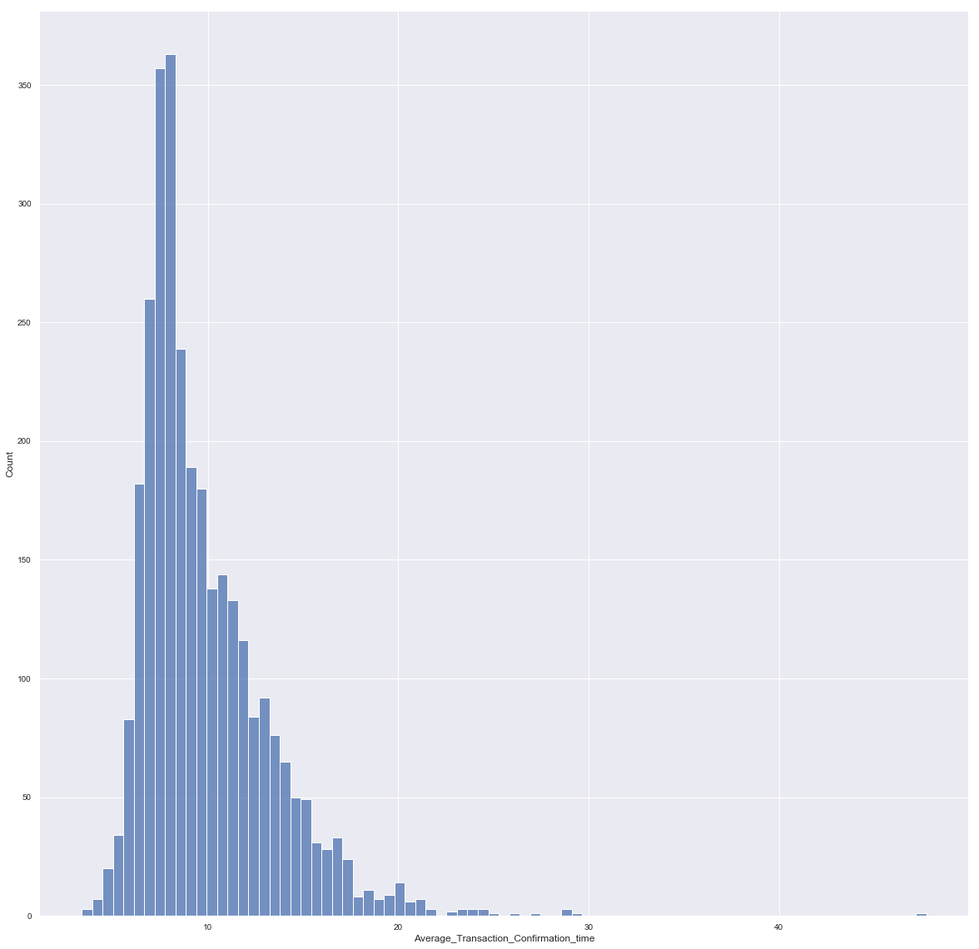
Cleaning Data
No nulls
Outliers matter so are kept
Datatypes formatting

Slide 6
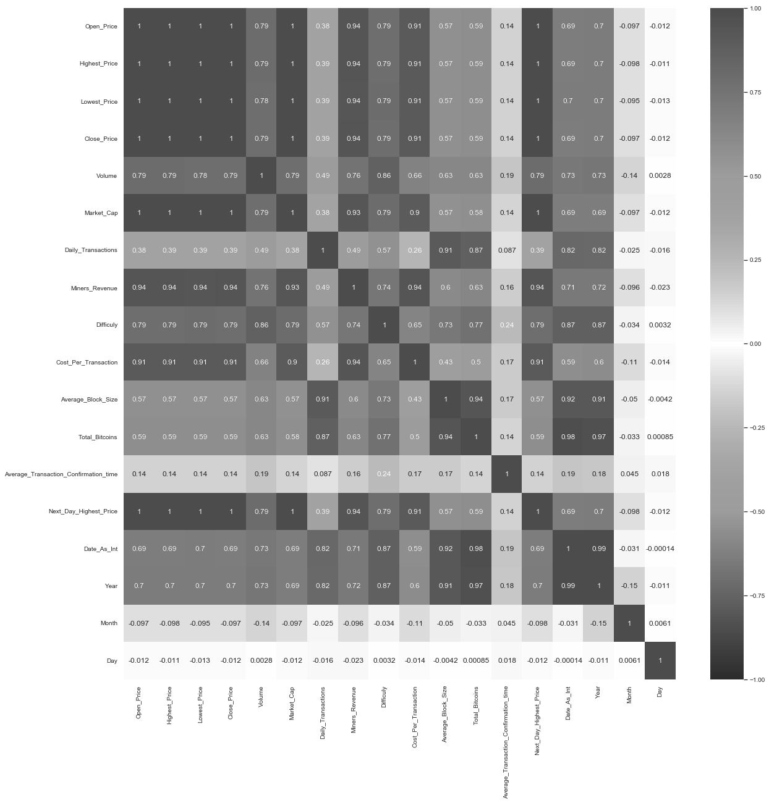
Heatmap

Slide 8
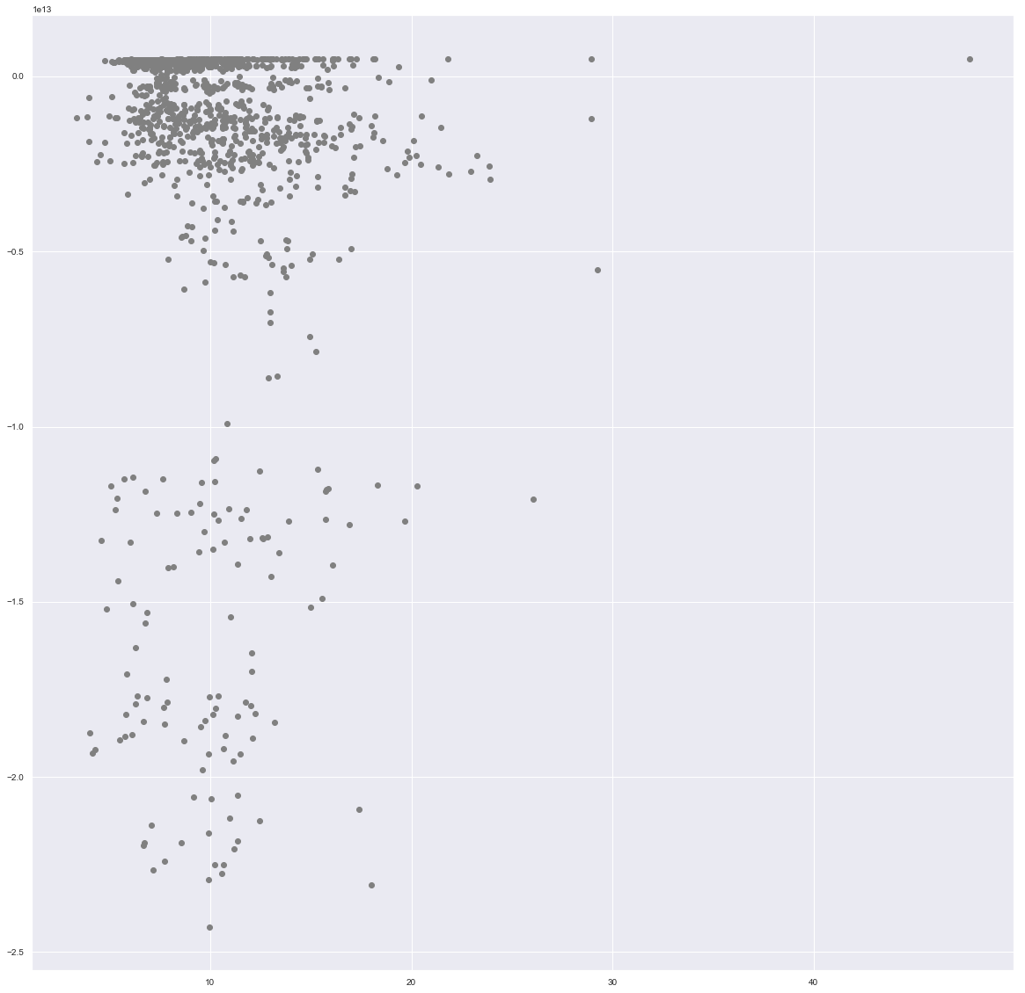
Regression
Baseline Model Performance:
Training score 0.22373174024731457
Testing score 0.1897938346383976

Slide 9
Feature Engineering
Scaling
Adding Date as integer counter
Separating Date to year, month and day
Polynomial degree 2, and 3 and 4

Slide 10
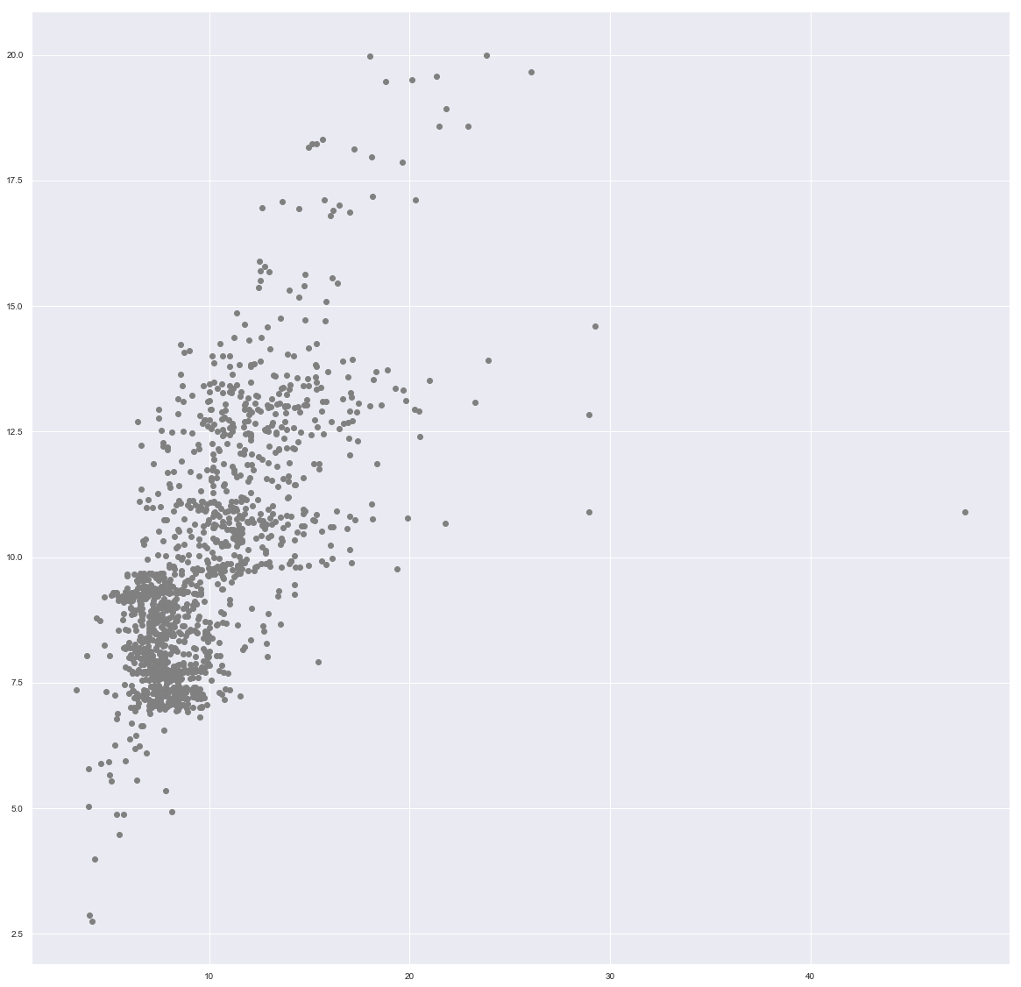
Enhanced Model
Polynomial Regression with degree 3
Improvement 100% compared to base model
Training score 0.4600579268120043
Testing score 0.43091318064826

