Slide 1
Information Systems Security
Introduction to Information Systems Security
Lecture 1
Notes:
ISO/IEC 27000: 2018
Information technology — Security techniques — Information security management systems — Overview and vocabulary

Slide 2
Outline
Attack Examples
What is Information Systems Security?
ISS Objectives
Security terms
Security Policies
Conclusion

Slide 3
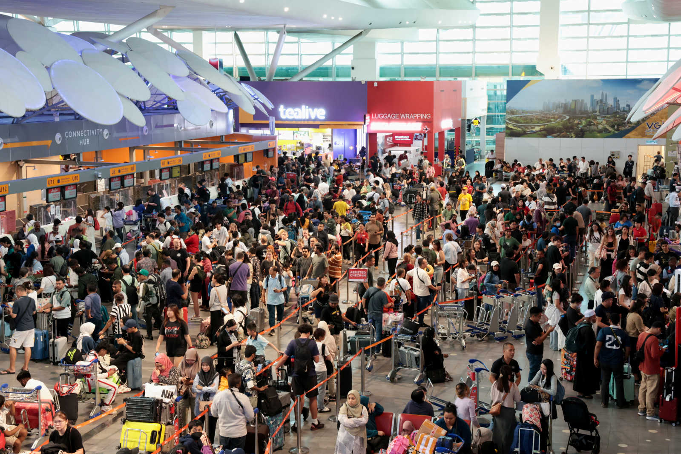
Security-Related News
July 2024,
a flawed software update from the security firm CrowdStrike took down Windows computers across the world.

Slide 4
Attack Examples
June 2022, a Google Cloud Armor customer was targeted with a series of HTTPS DDoS attacks which peaked at 46 million requests per second.
10 sec of attack’s traffic = Wikipedia’s daily requests
Targeted by 5,256 source IP @s from 132 countries

Slide 5
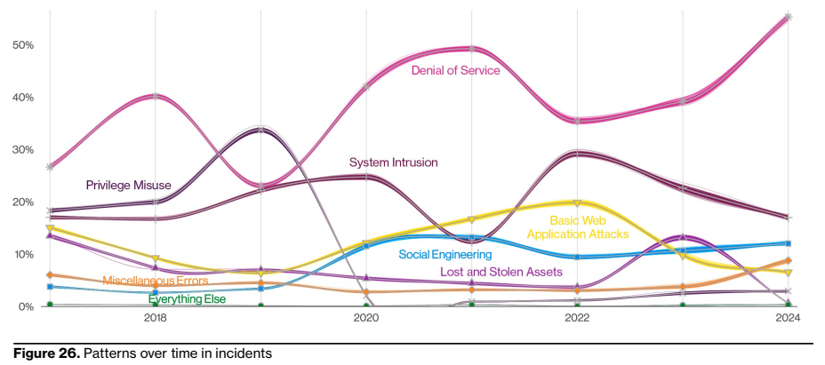
Verzion’s 2024 Data Breach Investigations Report

Slide 6
Outline
Attack Examples
What is Information Systems Security?
ISS Objectives
Security terms
Security Policies
Conclusion

Slide 7
2. What is ISS?
Information system
set of applications, services, information technology assets, or other information-handling components
Assets: Data/information, software, hardware, communication facilities, physical facilities
physical facilities
Nets
HW
SW systems
applications
Data
Notes:
According to ISO 27000,
An information system set of applications, services, information technology assets, or other information-handling components. Information systems include servers, PCs, routers, switches, applications, services, OSes, …
The assets (what is important and need protection) of a computer system can be categorized as follows:
• Hardware: Including computer systems and other data processing, data storage,
and data communications devices
• Software: Including the operating system, system utilities, and applications.
• Data: Including files and databases, as well as security-related data, such as
password files.
• Communication facilities and networks: Local and wide area network
communication links, bridges, routers, and so on.

Slide 8
2. What is ISS?
Information Systems Security (ISS)
is the protection of information systems against unauthorized access to or modification of information, whether in storage, processing or transit, and against the denial of service to authorized users, including those measures necessary to detect, document, and counter such threats.
Notes:
According to NIST,
Information Systems Security is the protection of information systems against unauthorized access to or modification of information, whether in storage, processing or transit, and against the denial of service to authorized users, including those measures necessary to detect, document, and counter such threats
ISS refers to the processes and methodologies involved with keeping information confidential, available, and assuring its integrity.

Slide 9
What is ISS?
synonymous with Computer Security
part of information security
Information security includes
Computer security
Information systems security
Database security
Network security
Web security
Digital forensics
Information security management
…
Notes:
ISS is part of Information security.
According to NIST,
Computer Security: Measures and controls that ensure confidentiality, integrity, and availability of information system assets including hardware, software, firmware, and information being processed, stored, and communicated.
In this context Computer security = ISS

Slide 10
What is ISS?
information security [ISO 27000: 2018]
preservation of confidentiality, integrity and availability of information
also preservation of authenticity, accountability, non-repudiation, and reliability
Notes:
According to ISO 27000
Information security: preservation of confidentiality, integrity and availability of information
It also preservation of authenticity, accountability, non-repudiation, and reliability
Confidentiality: property that information is not made available or disclosed to unauthorized individuals, entities, or processes.
Integrity: property of accuracy and completeness.
Availability: property of being accessible and usable on demand by an authorized entity.
Authenticity: property that an entity is what it claims to be.
non-repudiation: ability to prove the occurrence of a claimed event or action and its originating entities
Reliability: property of consistent intended behavior and results
Accountability: the ability to identify principals responsible for past actions

Slide 11
Outline
Attack Examples
What is Information Systems Security?
ISS Objectives
Security terms
Security Policies
Conclusion

Slide 12
ISS Objectives
Confidentiality: property that information is not made available or disclosed to unauthorized individuals, entities, or processes
Privacy: individual’s information is under her/his control
means: encryption, access control
Notes:
Confidentiality: property that information is not made available or disclosed to unauthorized individuals, entities, or processes.
- A process: set of interrelated or interacting activities which transforms inputs into outputs. Example: change management process which is carried out by a manager.
- Examples of entities: users, groups, roles (as in sql), application processes, ….
Privacy: Assures that individuals control or influence what information related to them may be collected and stored and by whom and to whom that information may be disclosed

Slide 13
ISS Objectives
Integrity: property of accuracy and completeness
Integrity: covers two related concepts
Data integrity: assures that information and programs are changed only in a specified and authorized manner
System integrity: assures that a system performs its intended function as specified, free from unauthorized manipulation
means: cryptographic checksums, access control,…
Notes:
Integrity: property of accuracy and completeness .
Integrity: This term covers two related concepts:
—Data integrity: Assures that information and programs are changed only in a specified and authorized manner.
in other words, ensuring information has not been altered by unauthorized or unknown means.
—System integrity: Assures that a system performs its intended function in an unimpaired manner, free from deliberate or inadvertent unauthorized manipulation of the system.

Slide 14
ISS Objectives
Availability
property of being accessible and usable on demand by an authorized entity.
means: protection from disruption, intentional deletion, …
Notes:
Availability: property of being accessible and usable on demand by an authorized entity.

Slide 15
ISS Objectives
Other Objectives:
Authenticity
property that an entity is what it claims to be
2 related terms are usually used
Entity authentication
corroboration of the identity of an entity (e.g., a person, a credit card)
Message authentication
corroborating the source of information;
also known as data origin authentication.
Notes:
ISO 27000: 2018:
authenticity
property that an entity is what it claims to be
خاصية أن الكيان هو ما يدعي كونه
authentication
provision of assurance that a claimed characteristic of an entity is correct
تقديم ضمان بأن خاصية مزعومة لكيان هي صحيحة

Slide 16
ISS Objectives
Non-repudiation
preventing the denial of previous commitments or actions
Accountability
the ability to identify entities responsible for past actions.

Slide 17
Computer Security Challenges
1. Computer security is not as simple as it might first appear to the novice
2. In developing a particular security mechanism or algorithm, one must always consider potential attacks on those security features
3. Procedures used to provide particular services are often counterintuitive
4. Physical and logical placement needs to be determined
5. Security mechanisms typically involve more than a particular algorithm or protocol and also require that participants be in possession of some secret information which raises questions about the creation, distribution, and protection of that secret information
6. Attackers only need to find a single weakness, while the designer must find and eliminate all weaknesses to achieve perfect security
9. There is a natural tendency on the part of users and system managers to perceive little benefit from security investment until a security failure occurs
8. Security requires regular and constant monitoring
7. Security is still too often an afterthought to be incorporated into a system after the design is complete, rather than being an integral part of the design process
10. Many users and even security administrators view strong security as an impediment to efficient and user-friendly operation of an information system or use of information
Notes:
Computer security is both fascinating and complex. Some of the reasons follow:
1. Computer security is not as simple as it might first appear to the novice. The
requirements seem to be straightforward; indeed, most of the major requirements
for security services can be given self-explanatory one-word labels:
confidentiality, authentication, nonrepudiation, and integrity. But the mechanisms
used to meet those requirements can be quite complex, and understanding
them may involve rather subtle reasoning.
2. In developing a particular security mechanism or algorithm, one must always consider
potential attacks on those security features. In many cases, successful attacks
are designed by looking at the problem in a completely different way, therefore
exploiting an unexpected weakness in the mechanism.
3. Because of Point 2, the procedures used to provide particular services are often
counterintuitive. Typically, a security mechanism is complex, and it is not obvious
from the statement of a particular requirement that such elaborate measures are
needed. Only when the various aspects of the threat are considered do elaborate
security mechanisms make sense.
4. Having designed various security mechanisms, it is necessary to decide where to
use them. This is true both in terms of physical placement (e.g., at what points in
a network are certain security mechanisms needed) and in a logical sense [e.g.,
at what layer or layers of an architecture such as TCP/IP (Transmission Control
Protocol/Internet Protocol) should mechanisms be placed].
5. Security mechanisms typically involve more than a particular algorithm or
protocol. They also require that participants be in possession of some secret
information (e.g., an encryption key), which raises questions about the creation,
distribution, and protection of that secret information. There may also be a reliance
on communications protocols whose behavior may complicate the task of
developing the security mechanism. For example, if the proper functioning of the
security mechanism requires setting time limits on the transit time of a message
from sender to receiver, then any protocol or network that introduces variable,
unpredictable delays may render such time limits meaningless.
6. Computer security is essentially a battle of wits between a perpetrator who tries
to find holes, and the designer or administrator who tries to close them. The great
advantage that the attacker has is that he or she need only find a single weakness,
while the designer must find and eliminate all weaknesses to achieve perfect
security.
7. There is a natural tendency on the part of users and system managers to perceive
little benefit from security investment until a security failure occurs.
8. Security requires regular, even constant monitoring, and this is difficult in today’s
short-term, overloaded environment.
9. Security is still too often an afterthought to be incorporated into a system after
the design is complete, rather than being an integral part of the design process.
10. Many users and even security administrators view strong security as an impediment
to efficient and user-friendly operation of an information system or use
of information.

Slide 18
Outline
Attack Examples
What is Information Systems Security?
ISS Objectives
Security terms
Security Policies
Conclusion

Slide 19
4. Security Terms
A vulnerability: is a weakness in system design/implementation/operation and can be in hardware or software.
Example: a software bug exists in the OS, or no password rules are set.
A threat:
Something that can potentially cause damage
Refers to a situation in which either a person could do something undesirable
or a natural occurrence could cause an undesirable outcome
Notes:
Vulnerabilities: is a weakness in system design or implementation and can be in hardware or software.
hardware
accidental: fires, floods, mice
malicious: fires, theft
software:
accidental: Bugs (buffer overflows), bad design (fails to an insecure state)
Malicious: deletion, spyware, Trojans,
is an indication of potential undesirable event
A Threat is something that can potentially cause damage to the network or computer system.
It is an indication of a potential undesirable event. It refers to a situation in which either a person could do something undesirable (e.g., initiating a denial-of-service attack against an organization's email server) or a natural occurrence could cause an undesirable outcome (a fire damaging an organization's information technology hardware).

Slide 20
Security terms
Vulnerabilities: Examples
Unprotected data under transmission
Mistakes in firewall or router
Software bugs exist.
Passwords posted near the computer
Threats: Examples
Virus
Illegal Passwords use
Illegal access to the Internet
Pretending to be a desk helper

Slide 21
Security terms
A Risk: the expected loss due to harmful future events,
An attack: is a realization of a threat
An attacker: is a person who exploits a vulnerability
An attacker must have means, opportunity, and motive
Synonyms: enemy, adversary, opponent, eavesdropper, intruder
Notes:
Risk: is the possibility of suffering harm or loss
Risk: the expected loss due to harmful future events,

Slide 22
Threats from hackers
hackers are computer or network expert
They Conduct illegal access only to satisfy their interest, or try out their technology (no damage to other people)
They cause damage by stealing information from networks/servers they accessed illegally, or by forcing services to shutdown
Crackers
Examples of threats from crackers’ actions:
Illegally use IDs or passwords that they stole
Illegally access servers and steal personal information, etc.
Destroy systems
Notes:
A hacker:
A person who have advanced knowledge of operating systems and programming languages
Might discover holes within systems and the reasons for such holes
Share what they discover but never intentionally damage data
A cracker:
The one who breaks into or violates the system integrity of remote machines with the malicious intent, i.e., gaining unauthorized access
Might destroy vital data, deny legitimate users services

Slide 23
Types of Attack
Interruption, delay, denial of receipt or denial of service
System assets or information become unavailable or are rendered unavailable
Interception or snooping
Unauthorized party gains access to information by browsing through files or reading communications.
Modification or alteration
Unauthorized party changes information in transit or information stored for subsequent access.

Slide 24
Types of Attack
Masquerade or spoofing
Spurious information is inserted into the system or network by making it appears as if it is from a legitimate entity.
Repudiation
False denial that an entity created something.
Traffic analysis
Monitoring traffic in order to get information about exchanged data (regardless the content itself)
Replay attack
Intercepting a message in order to re-send it later
Notes:
Spurious info معلومات زائفة

Slide 25
Assets and Examples of Threats

Slide 26
Countermeasures
include techniques for ensuring:
Prevention: such as encryption, user authentication, one time password, anti-virus, firewall, etc.
Detection: such as IDS (Intrusion Detection Systems), Monitoring tools, Firewall logs, digital signature, etc.
Reaction (or recovery): Such as Backup systems, OS’s recovery points, etc.

Slide 27
A Model for Computer Security
Notes:
Figure 1.2, based on [CCPS12a], shows the relationship among some of these terms.
We start with the concept of a system resource , or asset , that users and owners wish to protect.
Adversary (threat agent): Individual, group, organization, or government that conducts or has the intent to conduct detrimental activities.
Countermeasure: A device or techniques that has as its objective the impairment of the operational effectiveness of undesirable
or adversarial activity, or the prevention of espionage, sabotage, theft, or unauthorized access to or use of
sensitive information or information systems.
System Resource (Asset): A major application, general support system, high impact program, physical plant, mission critical system, personnel, equipment, or a logically related group of systems

Slide 28
ISS- another definition
What needs to be protected, i.e., assets
Why (security requirements which include CIA),
What we need to protect from (Threats, vulnerabilities, risks)
and how (Countermeasures) to protect it for as long as it exists
Then operate, monitor, review, improve
All steps are implemented according to the security policy
Notes:
Information security:
Is more than setting up a firewall, running an anti-virus software, using passwords to control access to databases, or discovering vulnerabilities in your system software.
Is about:
what needs to be protected, i.e., assets such as PCs, software, applications, etc.
Why assets need protection, i.e., security requirements such as Confidentiality, Integrity, and Availability (C.I.A.)
what do we need to protect from? (e.g., threats, vulnerabilities, risks),
how to protect assets, i.e., what security measures we need to protect assets
Security measures include techniques for:
Prevention: techniques, to prevent occurrence of threats, such as encryption, firewalls, etc.
Detection: techniques, to discover illegal actions, or attempted illegal access, such as IDSs (Intrusion Detection Systems), monitoring tools, etc.
Reaction or recovery: techniques to minimizes the damages and restore the CIA of damages assets (eg, backup of systems).
Security measures are an implementation of a security policy.

Slide 29
5. Security Policy
a document describing intentions and direction of an organization regarding information security
Example 1:
personal information must be treated as confidential.
services must be available 24/7
states what is/is not allowed
examples:
account names must not be used in passwords.
Surfing the www is prohibited.
Notes:
Policy: intentions and direction of an organization, as formally expressed by its top management

Slide 30
Security Policy
security policy does not specify technologies.
A security Policy is a guideline for implementing security measures.
Example:
Use a firewall to block ports 80 and 443 (as to prevent leakage of confidential information)
Encrypt email containing sensitive data (as to protect private information)

Slide 31
Security Lifecycle
Develop sec policy
Draw blueprints
Determine sec requirements (objectives)
Analyze threats, vulnerabilities (i.e., analyze risks)
Analyze
Design
Design architecture,
Choose countermeasures
Continue developing sec policy
Implement countermeasures
Test
Carry out training and awareness
Implement
Operate
Monitor
review

Slide 32
6. Conclusion
Security terms
ISS
Security objectives
Vulnerabilities and Threats,
Security measures
Security Policy
Next lectures:
Covering these terms in detail

Slide 33
Questions?

Slide 34
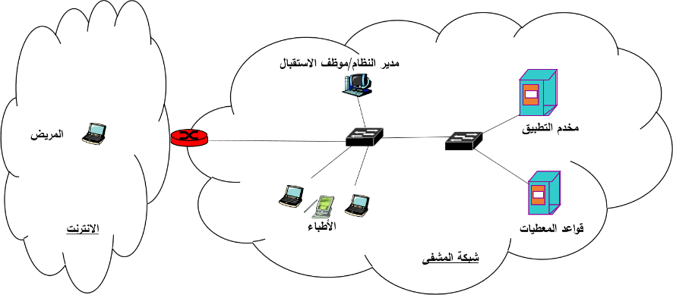
Case Study 1 – Hospital system
Notes:
نظام المعلومات في المشفى
يعتمد نظام المعلومات في المشفى عمارة ثلاثية الطبقات (three-tier architecture): طبقة العرض وتتمثل بالواجهة التي يستخدمها مستثمرو النظام لإنجاز وظائفهم، وطبقة التطبيق التي تعالج طلبات المستخدمين/الزبائن وتخاطب طبقة البيانات للإجابة على طلبات المستخدمين وترسل لهم نتائج المعالجة، وطبقة البيانات التي تحتوي على بيانات شخصية عامة للمرضى مثل الاسم والعنوان وتاريخ الميلاد وتخزن ضمن الجدول pnt_info ، وبيانات شخصية صحية ترتبط بالتشخيص والعلاج وتحفظ ضمن الجدول pnt_records. مستخدمو النظام هم مدير النظام وموظف القبول، والطبيب، والمريض.
يُسمح لمدير النظام بإدارة (إنشاء، إلغاء، تعديل، منح صالحيات، تدقيق/مراجعة عمليات...) حسابات المستخدمين من أطباء وموظفي القبول ومرضى للدخول إلى نظام المعلومات.
يستطيع موظف القبول فتح حساب للمريض لدى الدخول لأول مرة إلى المشفى، وقراءة وتعديل البيانات الشخصية العامة للمريض، وتسجيل معلومات عن مراجعات المريض وحالات القبول في المشفى والمغادرة.
يمكن للطبيب المعالج أن يطلع على كامل بيانات المريض وتعديل البيانات الصحية (إضافة تشخيص، إضافة علاج، تعديل علاج، ...).
يُسمح للمريض patient بالاطلاع على كامل بياناته الشخصية، وتعديل بياناته الشخصية العامة. ويحق للمريض فقط الدخول إلى النظام من خارج شبكة المشفى.
يَنفذ كل من المريض ومدير النظام والطبيب والموظف إلى النظام عبر الويب بعد تسجيل الدخول (login) بالاعتماد على اسم مستخدم (معرف) وكلمة مرور، وذلك من خلال واجهة ويب، وتتاح لهم واجهة تستعرض العمليات التي يسمح لكل منهم القيام بها.
يمكن للمستخدم بعد تسجيل الدخول إلى النظام من القيام بالعمليات التي يحتاجها (قراءة، كتابة،...) من خلال طلب استعلام query_request يحتوي على معرف المستخدم ونوع العملية (قراءة، تعديل، إضافة، حذف،....) واسم المريض ومعرفه إن كان متاحاً. وفي حال كانت العملية من النوع تعديل بيانات أو إضافة بيانات جديدة فسيحتوي طلب الاستعلام على البيانات المراد تعديلها أو إضافتها. ويعيد النظام إلى المستخدم نتيجة المعالجة ضمن جواب استعلام reply_ query يحتوي على اسم المريض ومعرفه ونتيجة معالجة طلب الاستعلام.
المتطلبات الأمنية للنظام: تريد إدارة المشفى من نظام المعلومات تحقيق المتطلبات التالية:
1) يجب أن يسمح نظام المعلومات للكادرين الطبي والإداري وللمريض فقط بالنفاذ إلى بيانات المريض حسب الحاجة والصلاحيات آنفة الذكر.
2) يجب أن تكون بيانات المرضى (الشخصية العامة، والصحية) متاحة بشكل دائم لمستخدمي النظام وفق الصلاحيات الممنوحة لهم.
3) يجب أن يسمح النظام بمراجعة العمليات التي تجرى على بيانات المرضى.
4) يجب أن يؤخذ بعين الاعتبار أهمية وحساسية البيانات الصحية للمرضى لذلك سيسمح فقط للطبيب المعالج بتعديل بيانات المريض الصحية بطريقة لا تسمح له انكار إجراء أي تعديل (إضافة، حذف، تحديث).
5) يجب على المشفى التقيد بقوانين الخصوصية.
6) يسمح لوزارة الصحة بالقيام بعمليات إحصائية على قواعد المعطيات.

Slide 35
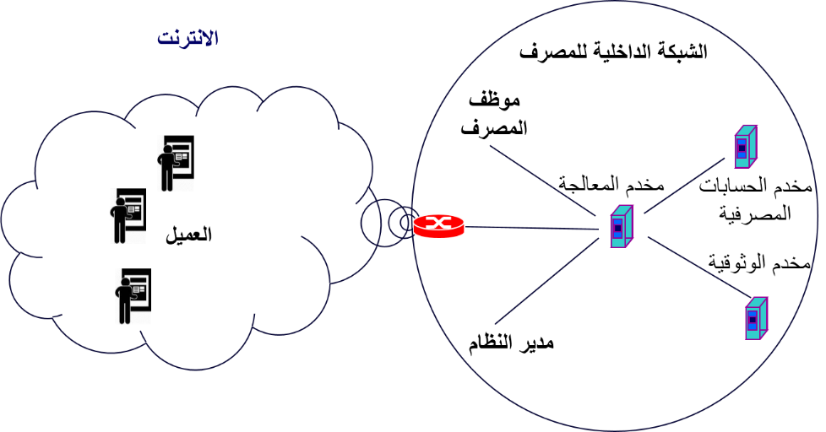
Case Study 2 – Online bank
Notes:
إدارة الحسابات المصرفية عبر الشبكة
تعد عمليات السحب عن طريق الصرافات الآلية (ATM) والتحويل الداخلي من الخدمات الأساسية المقدمة لأصحاب الحسابات المصرفية. تود إدارة المصرف XYZ أتمتة خدماتها المقدمة للزبائن مالكي الحسابات المصرفية. يجب أن يسمح النظام المؤتمت لإدارة المصرف بتقديم الخدمات بطريقة آمنة. يقدم الشكل التالي الشبكة الداخلية للمصرف والصرافات الموزعة جغرافيا في مناطق مختلفة وترتبط بشبكة المصرف الداخلية عن طريق الانتنرت.
تود إدارة المصرف التقيد بالأنظمة والقوانين التي تحمي الخصوصية.
المطلوب:
1. حلل النظام (الجزء المتعلق بالتهديدات والثغرات والمتطلبات الأمنية)
2. صمم النظام (الجزء المتعلق بالآليات الأمنية)
3. نفذ النظام (الجزء المتعلق بالأدوات الخاصة بتنفيذ الآليات)
4. اختبر النظام (الجزء المتعلق بالسرية والسلامة والإتاحة)

