Slide 1

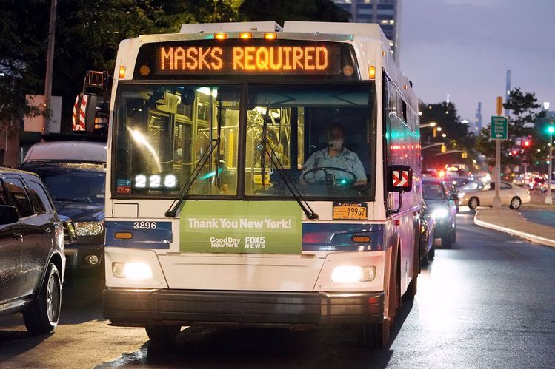
Kingdom of Saudi Arabia
SDAIA Academy
T5_bootcamp
EDA|Exploratory Data Analysis
For RSTABUS Imaginary Bus Company
Prepared by
Raghad Rashed Al-Saqer
Supervised by
Dr. Mohamed Baddar.
1443 H -2021 G

Slide 2

bus company covering several regions in the United States of America. It is concerned with carrying passengers from several specific centres to the destination stations throughout the day. want attract more customers to benefit from its services and also to expand the field of work and cover a larger space for the geographical area at the level of the USA.
R
B
C
“RSTABUS Bus Company "
1

Slide 3

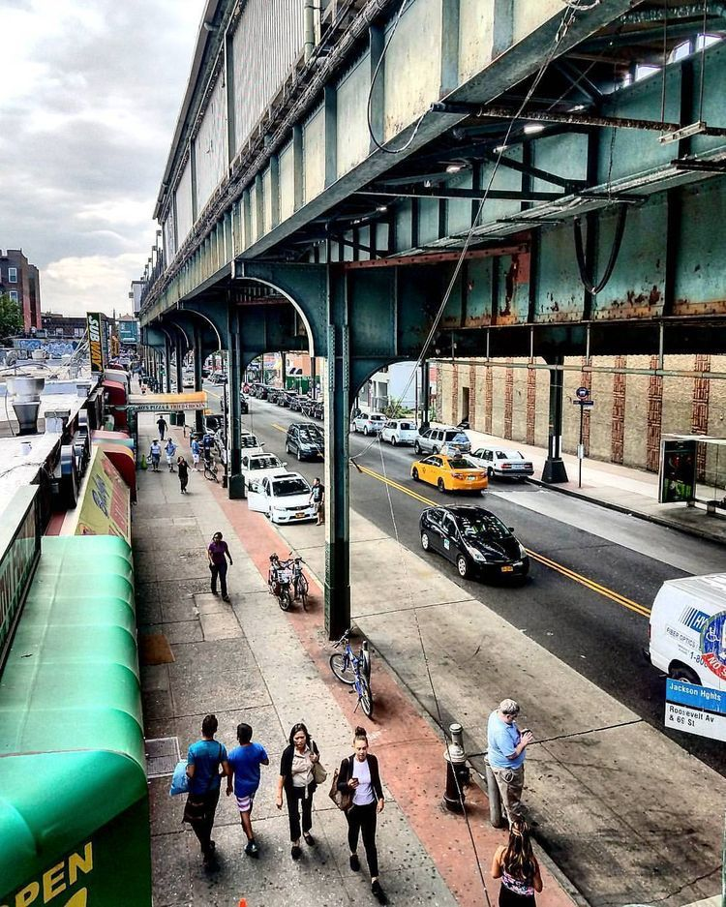
Assumptions
the busiest stations of demographic or location and
do not have bus service. is an aim to work on most of my analysis.
2. I assumed that the date of the event would be on the period
form (Jul to Oct 2021), to focus on collecting only the last
data from the MTA and to get the latest results.
After knowing the locations of the highest stations
traffic and not having bus service, RSTABUS will be able to
start drawing up a business plan to provide the service to customers.
4. Knowing the traffic throughout the day will be sufficient to determine the number of buses that will be provided and to determine their operating times.
5. Bus stations will be built based on the most traffic stations only.
A
1
2
2

Slide 4
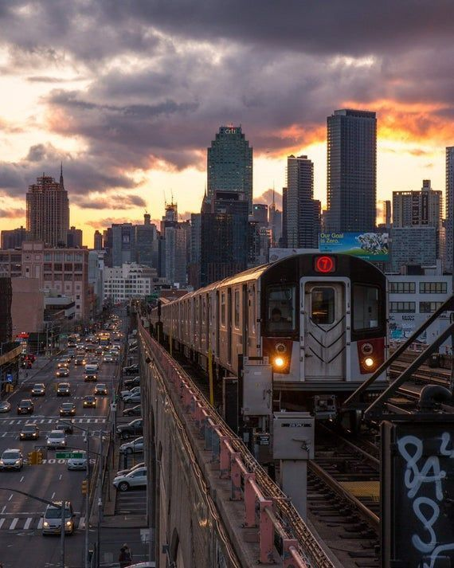
DATA PREPARATION
Data cleaning
Check full summary
A quick trip to decode the information from provided on datasets.
Solving Problem –
Cumulative ,Rest, and Revers Issue -Outliers
Extremely high counts (outliers)
23

Slide 5
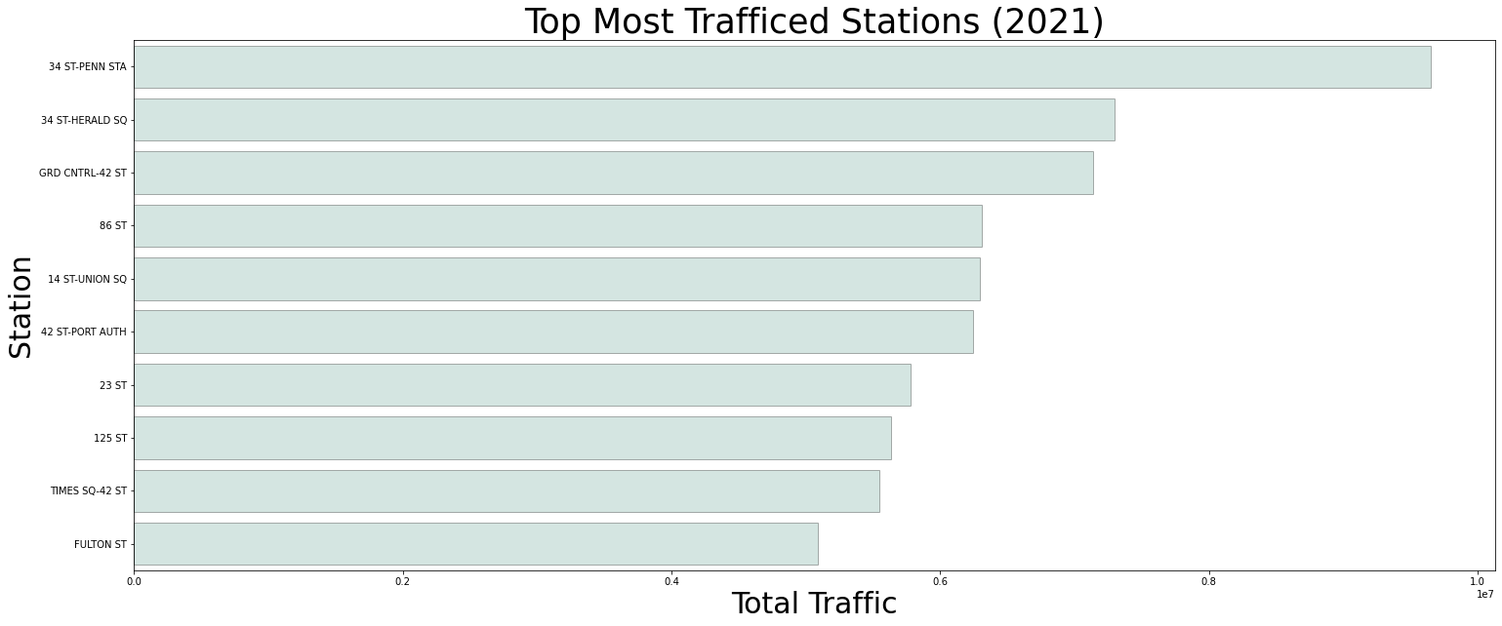
RESULTS
8

Slide 6
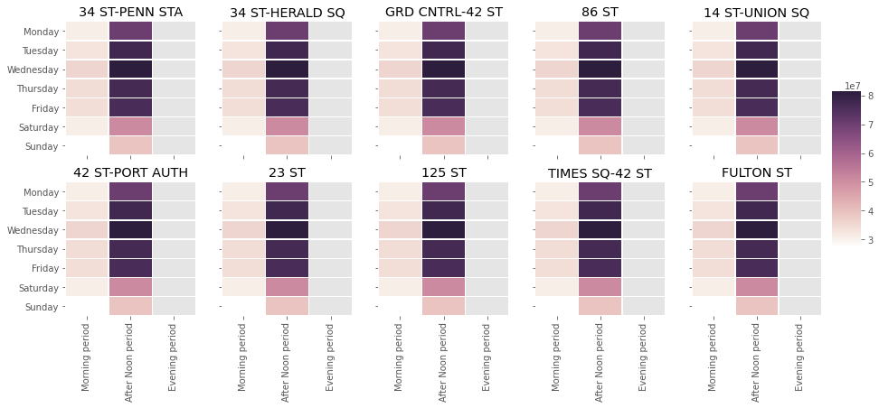
RESULTS
8

Slide 7
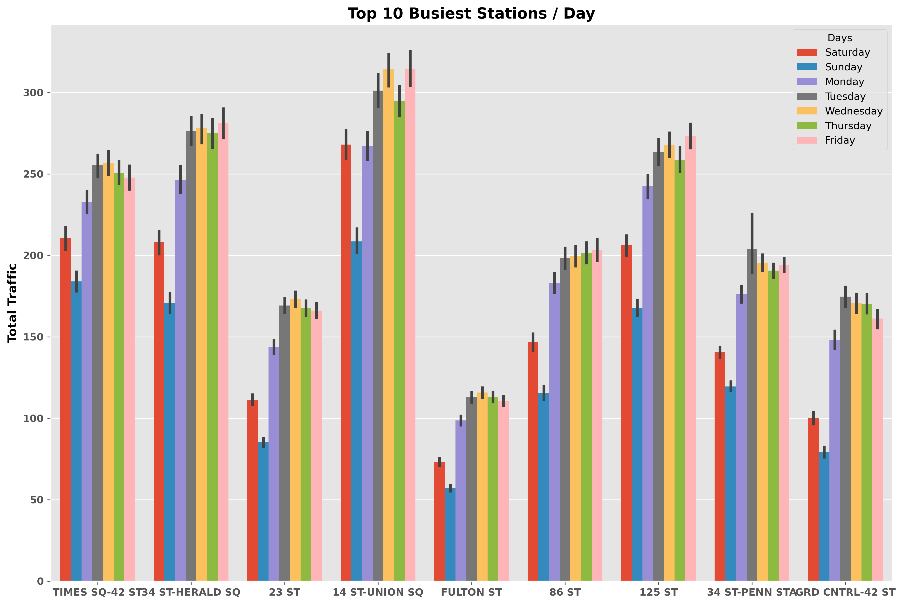
RESULTS
8

Slide 8
During the analysis, it was not feasible to rely only on the daylie_traffic of the station, but the linename must be taken into account to know the number of stations that will be served as well as the location and the distance to the linename of another line to serve remote stations
3

Slide 9
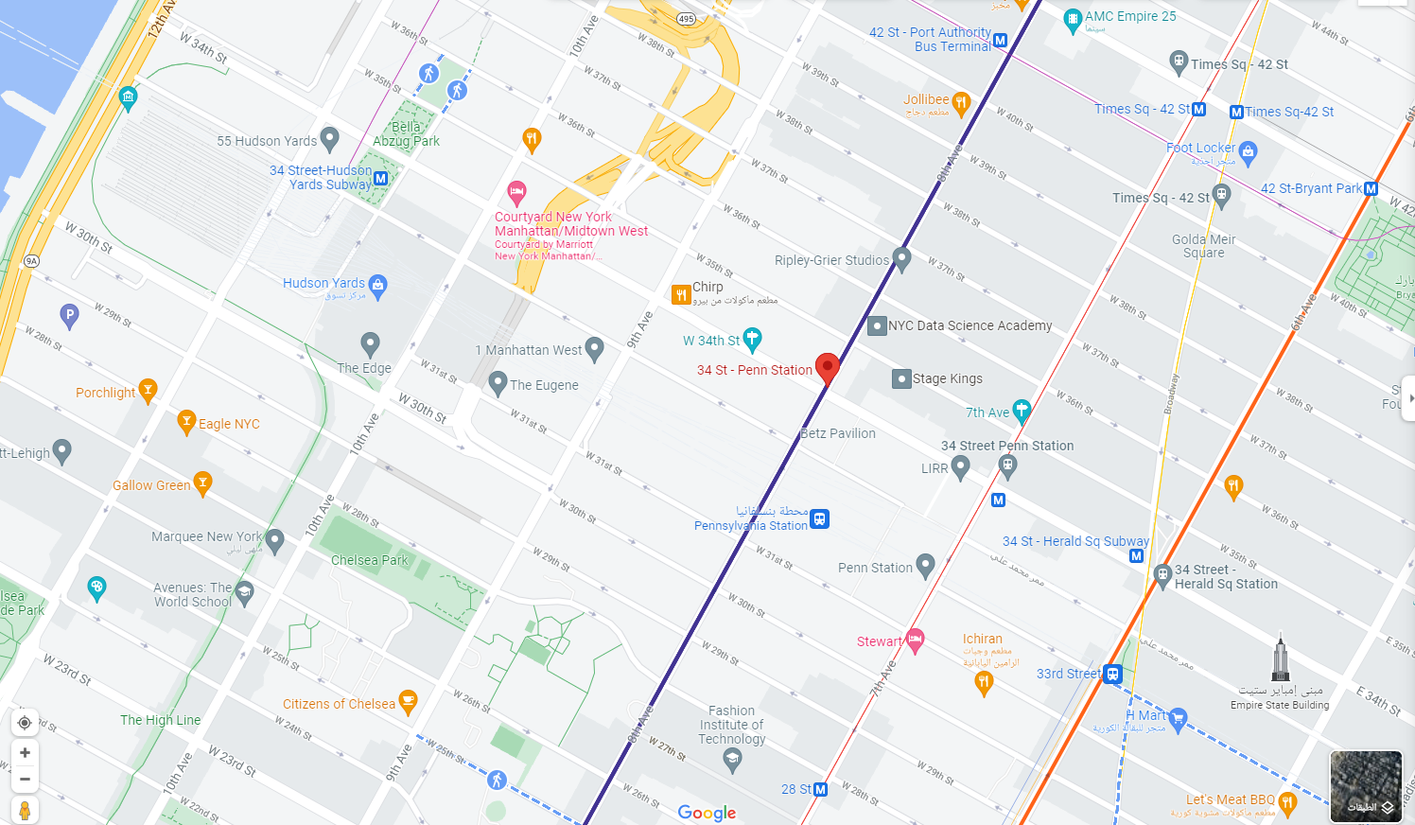
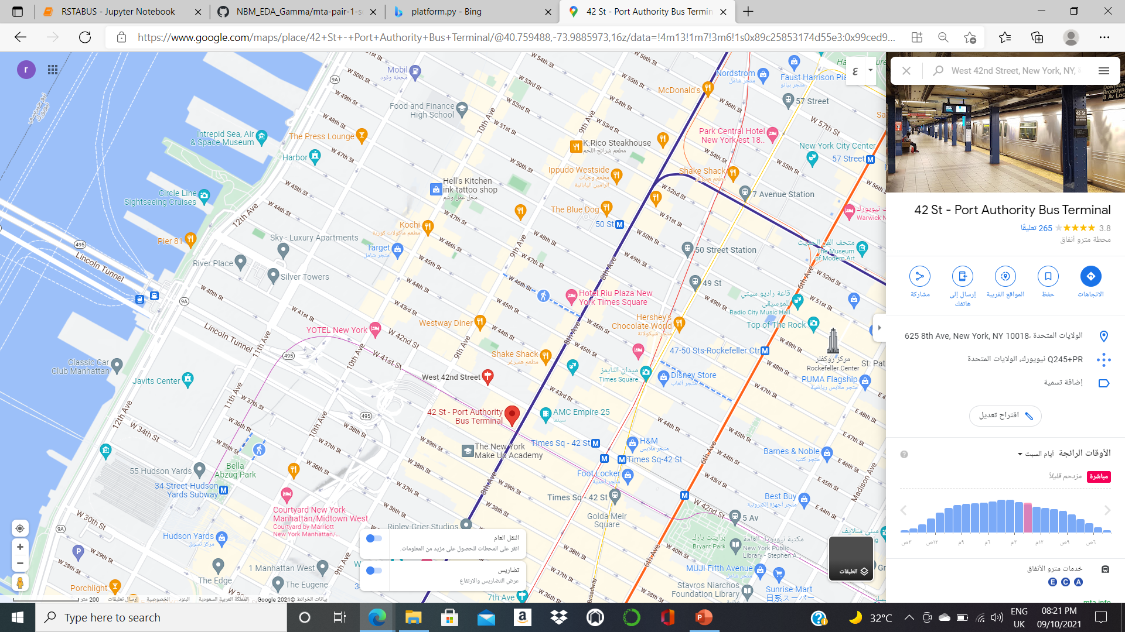
West 42nd Street
34 St - Penn Station
6

Slide 10
Feature work
-• GeoMapping –
Connect the database to the map to know the right location
Analysis with line name
Bus service for low-traffic areas
• Other visualizations such as interactive plots
• Plotly, Bokeh
23

Slide 11
Thank you for listening.
1443 H -2021 G

