Slide 1
Employee Data Analysis using Excel
STUDENT NAME: Nandhini R
REGISTER NO: 312216822
DEPARTMENT: III BCOM A/F
COLLEGE : Shri krishnaswamy college for women

Slide 2
PROJECT TITLE
Employee Performance Analysis using Excel

Slide 3


AGENDA
Problem Statement
Project Overview
End Users
Our Solution and Proposition
Dataset Description
Modelling Approach
Results and Discussion
Conclusion
3/21/2024 Annual Review

Slide 4

PROBLEM STATEMENT
Improve employee engagement and motivation by recognizing and rewarding top performers.
Enhance productivity and efficiency by addressing performance gaps and providing targeted support.

Slide 5

PROJECT OVERVIEW
.
Provide insights and recommendations for employee development and growth.
Conduct statistical analysis and data visualization

Slide 6

WHO ARE THE END USERS?
Human resources (HR) team :
HR managers, recruiters, talent management specialists who need to identify trends, strengths and improvement in employee performance.

Slide 7

OUR SOLUTION AND ITS VALUE PROPOSITION
Formulas and Functions (e.g., AVERAGE, IF) to calculate performance metrics and analyze data.
PivotTables to summarize and segment data for in-depth analysis.

Slide 8
Dataset Description
Start date :
Date employee started working with the company
Performance Score :
Employee performance score (1-5) based on recent evaluations
Business Unit :
Department or team employee belongs to (e.g., Sales, Marketing, IT)

Slide 9

THE "WOW" IN OUR SOLUTION
`=IF(A1>3,"Med",IF(A1>4,"High","Low"))`
- If the value in A1 is greater than 3, the formula returns "Med".
- If the value in A1 is greater than 4, the formula returns "High".
- If the value in A1 is less than or equal to 3, the formula returns "Low".
3/21/2024 Annual Review

Slide 10
MODELLING
Performance analysis:
Analyze employee performance data to:
- Identify top performers.
Summary visualization:
Present findings and insights using clear and concise visualizations, such as:
- Executive summary reports
- Dashboards

Slide 11
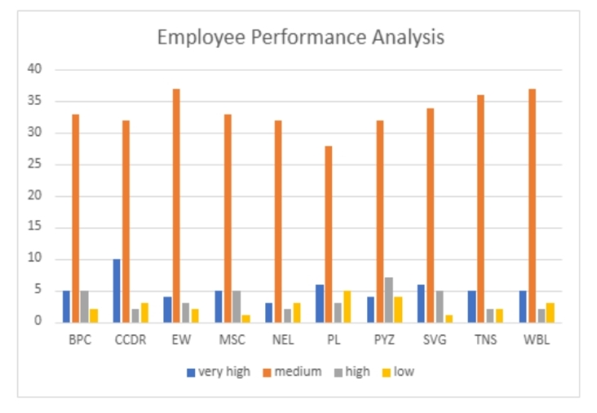
RESULTS

Slide 12
conclusion
The employee performance analysis project revealed valuable insights into employee status, type, and performance rating for improvement. The results showed varying performance levels across business units, with Sales and Marketing teams demonstrating higher performance ratings. Based on these findings, targeted recommendations were made to enhance employee development. By implementing these strategies, the organization can optimize employee performance, drive business growth

