Slide 1
SALTSTACK
push based configuration management tool

Slide 2
Salt is a simple IT automation framework that automates provisioning(Providing), configuration management, application deployment, service arrangements and many other IT needs.
Remote execution of commands is the important highlight of using Salt.
Unlike other competitors, Salt uses ZeroMQ message bus for the communication.
{ ZeroMQ API provides sockets , each of which can represent a many-to-many connection between endpoints. }
It offers high speed effective communication between remote machines.
Additionally, the remote execution can target a group of machines simultaneously.

Slide 3
The relevance of Salt and its applications
Salt (commonly known as SaltStack) is a widely accepted tool for Configuration management.
Consider that hundreds of machines need to be configured identically - install software, run some services, and make it more awesome.
Rather than performing these tasks manually, scripts can be used to simplify it. Since the same task needs to be executed in hundreds of machines, if the script is placed in a location that can be send to all these machines will further simplify the repetitive task.
With the help of Salt, we can manage this activity from a single system (named Salt master) and complete this in a swift manner. Just write the task once, specify the machines to be modified and execute the script remotely. The result from all machines will be send back to Salt master.

Slide 4
Features of Salt
1. Simplicity - The Salt setup and usage is very simple process. Still it is powerful enough to manage hundreds of distributed systems in quick and efficient manner
2.Parallel Execution - The Salt remote execution is effected in nodes parallelly, not serially. Hence, the time taken will be very less
3. Open Source - It is a open source tool
4. Fast, Flexible, Scalable - By making use of ZeroMQ message bus, the configuration management will be fast and it supports various types of models like master and minion, master-only, minion-only or combination of these models. The support to include ten thousands of minions per single master displays the effectiveness of scalability
5. Simple Interfaces - Salt can be accessed from the command line, as well as from any simple Python API

Slide 5
Salt Architecture:
Salt remote execution is built on top of an event bus unlike other configuration management tools. Event bus makes communication between senders and receivers simple and fast.
It is specifically optimized for high performance. In Salt , the salt master is a server where the salt-master service is running. It issues commands to salt-minions, that are servers where the salt-minion service is running.
Public keys are used for authentication with master daemon, for communication it uses faster AES (Advanced Encryption Standard) encryption.
After the execution of job in minion, the job return data is sent back to master.
By default two ports are used by Salt, for the minions to communicate with master.
These ports work together to receive and send data to the Message Bus.
Salt uses ZeroMQ message bus. ZeroMQ provides the fastest communication possible.

Slide 6
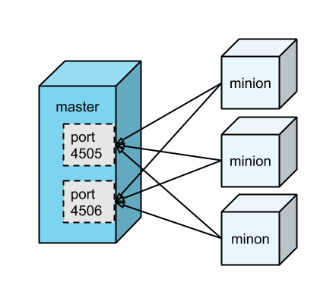
Salt minions are responsible for connecting to the Salt master. Minions receive jobs (i.e., instructions) via the open connection to port 4505, and send results (i.e., status updates) via the open connection to master 4506.
That is, Salt masters publish jobs to all connected minions, and it is the responsibility of each minion itself to determine whether or not it is an intended target (i.e., whether or not to run the job).
Communication between master and minions is done using ZeroMQ, an asynchronous messaging library.

Slide 7
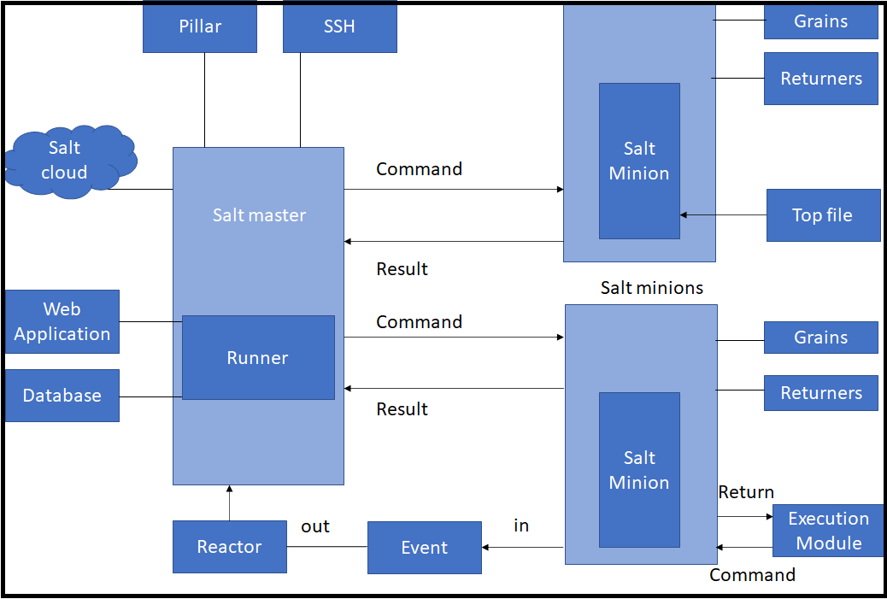

Slide 8
Salt-master - The central management system. It is used to send commands and configurations to the salt-minion that is running on managed nodes.
Salt-minion - The managed system which receives commands and configuration from the salt-master.
Execution Modules - Ad hoc commands executed from the master’s command line that reflect on the minions. It performs real-time monitoring.
Formulas - A declarative or imperative representation of a system configuration. They are used for tasks such as installing a package, setting up users or permissions, configuring and starting a service and other common tasks.
Grains - Grains provides information specific to a minion. It includes information like operating system, memory, and other system properties. Grains get loaded when the salt-minion starts. Grains are system variables.
Pillar - They are user-defined variables. These variables store highly sensitive data specific to a particular minion, such as passwords and cryptographic keys. They are stored on salt-master and then using targets its assigned to one or more minions.

Slide 9
Top file - It contains the mapping between groups of machines on the network and the configuration roles.
Runners – It is a module within salt-master that executes to perform supporting tasks. Salt runners reports job status read data from external APIs, connection status, query connected salt-minions, and much more.
Returners − Returns data from salt-minions to another system like a database. It can run on salt-minion or salt-master.
Reactor – It triggers reactions when events occur in SaltStack environment.
SaltCloud − Provision systems on cloud providers / hypervisors and bring them under management of salt-master.
SaltSSH − Run Salt commands over SSH on the systems not having salt-minion.

