Slide 3
What is GIT?
✽ Git is Distributed Version Control System Tool.
✽ Git is not acronym and hence no expansion. But most of the people abbreviated as
✽ "Global Information Tracker".
✽ GIT is developed by Linus Torvalds(Finnish software engineer), who also developed Linux Kenel.
✽ Most of the companies like Microsoft, Facebook, Yahoo, LinkedIn, Intel using Git as Version Control System Tool.

Slide 4
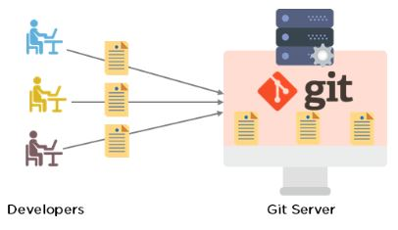

Slide 5
Features of Git:
Git is very popular because of the following features:
Tracks history
Free and open source
Supports non-linear development
Creates backups
Scalable
Supports collaboration
Branching is easier
Distributed development

Slide 6
Git is very popular because of the following features:
Distributed
Git is developed based on Distributed Version Control System Architecture.
Because of Distributed Architecture it has several advantages:
A) Every Developer has his own local repository. All the operations can be performed locally. Hence local repo and remote repo need not be connected always.
B) All operations will be performed locally, and hence performance is high when compared with other VCSs. i.e. it is very speed
C) Most of operations are local. Hence we can work offline most of the times.
D) There is no single point failure as Every Developer has his own local repository.
E) It enables parallel development & automatic-backups.

Slide 7
2) Staging Area:
It is also known as index area.
There is logical layer/virtual layer in git between working directory and local repository.
Working Directory
→ Staging Area
→ Local Repository
We cannot commit the files of working directory directly. First we have to add to the staging area and then we have to commit.
This staging area is helpful to double check/cross-check our changes before commit.
This type of layer is not available in other Version Control System Tools like CVS, SVN etc.
Git stores files in repository in some hash form, which saves space.
GIT will uses internally snapshot mechanism for this. All these conversions and taking snapshots of our data will be happened in staging area before commit.
Eg: If a sample repository takes around 12 GB space in SVN where as in GIT it takes hardly 420 MB.
Hence Staging Area is the most important Strength of GIT.

Slide 8
3) Branching and Merging:
We can create and work on multiple branches simultaneously and all these are branches are isolated from each other. It enables multiple work flows.
We can merge multiple branches into a single branch. We can commit branch wise also.
4. Moving files in GIT is very easy as GIT automatically tracks the moves. Whereas in other VCS we need to create a new file & then delete the old one.
5. Freeware and Open Source
6. It provides support for multiple platforms.

Slide 9
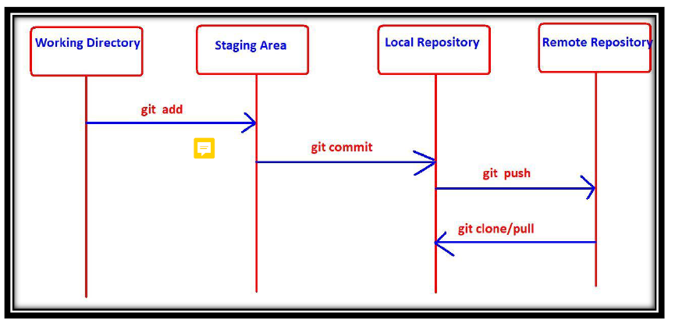
GIT Architecture:

Slide 10
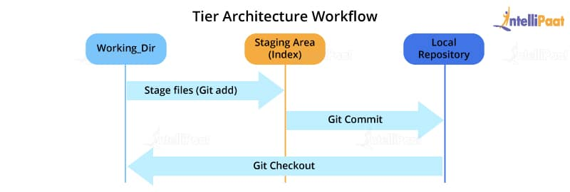

Slide 11
Most of the version control systems have a two-tier architecture. However, Git has a layer more, making it a three-tier architecture. But, why are there three layers of Git? Let’s find out.
The three layers are:
Working directory: This is created when a Git project is initialized onto your local machine and allows you to edit the source code copied.
Staging area: Post the edits, the code is staged in the staging area by applying the command, git add. This displays a preview for the next stage. In case further modifications are made in the working directory, the snapshots for these two layers will be different. However, these can be synced by using the same ‘git add’ command.
Local repository: If no further edits are required to be done, then you can go ahead and apply the git
commit command. This replicates the latest snapshots in all three stages, making them in sync with each other.
After reading about the architecture and getting a better knowledge of Git, this ‘What is Git?’ blog will help you understand how you can make use of Git.

Slide 12
How to use Git?
Much of Git’s popularity is attributed to its user-friendly nature. You can check out these simple concepts to perform certain basic operations and get acquainted with Git basics.
Commit: This is an object that takes the current state of the repository.
Pull: This operation copies the changes made to a project to the local repository from the remote one.
Push: This operation copies the changes made to a project to the remote repository from the local one.
Now, let’s take a look at some of the basic and commonly used commands in Git.

Slide 13
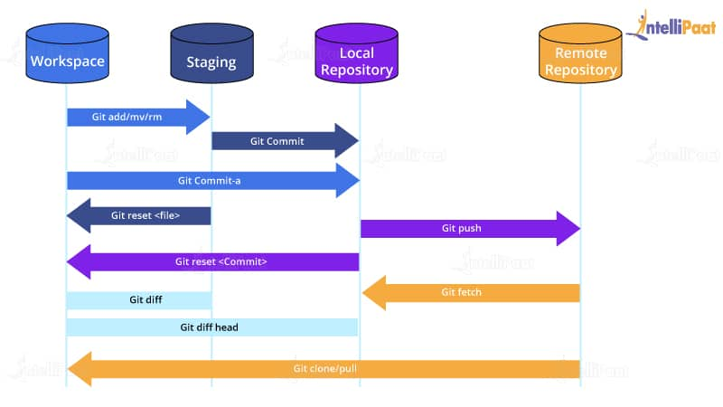

Slide 14
Now, let’s take a look at some of the basic and commonly used commands in Git.
Git Commands
Based on what you work with, be it remote or local repositories, the Git commands change. Let’s take a look at the various commands in Git.
Git Commands When Working with Local Repositories
git init: This Git command converts a directory into an empty repository. This is the initial step you need to take to build a repository. Once you run git init, you will be able to add and commit files and directories.
git add: This command allows you to add files in the Git staging area. The file must be added to the index of Git before being available to commit to any particular repository. You can use this command to add directories, files, etc.
git commit: The commit command in Git allows you to track the changes in the files in a local repository. Each commit has its own unique ID for reference.
git status: The git status command returns the present state of a repository, like if the file is in the staging area but has not been committed.

Slide 15
git config: There are numerous configurations and settings possible in Git, and this command allows you to assign these settings. User.name and user. Email are the two significant settings that set the name and email address of a user.
git branch: This command determines the branch of the local repository and allows you to add or delete a branch.
git checkout: You can use this command to switch to another branch.
git merge: The merge command allows you to integrate two or more branches together. It combines the changes made in the branches.

Slide 16
Git Commands When Working with Remote Repositories
git remote: This Git command allows you to connect a remote repository to a local repository.
git clone: You can use the clone command to create a local copy of an already existing remote repository. This allows you to copy and download the required repository to the system. It is similar to the init command while working with remote repositories as it allows you to build a local directory, consisting of all the necessary files and history of the repository.
3.git pull: The pull command is used to run the latest version of any repository. This pulls all the changes made from the remote to the local repository.
4.git push: This command sends local commits to the respective remote repository. It needs two parameters, i.e., the remote repository and the specific branch where it needs to be pushed.
There are numerous other Git commands that are of more advanced level, such as git stash, git log, git rm, etc.
Now, you will learn about the use of Git in DevOps.

Slide 17
Life Cycle of File in GIT
Every file in GIT is in one of the following states:
1) Untracked:
The files which are newly created in working directory and git does not aware of these files are said to be in untracked state.
2) Staged:
✽ The files which are added to staging area are said to be in staged state.
✽ These files are ready for commit.
3) In Repository/ Committed:
Any file which is committed is said to be In Repository/Committed State.
4) Modified:
Any file which is already tracked by git, but it is modified in working directory is said to be in Modified State.

Slide 18
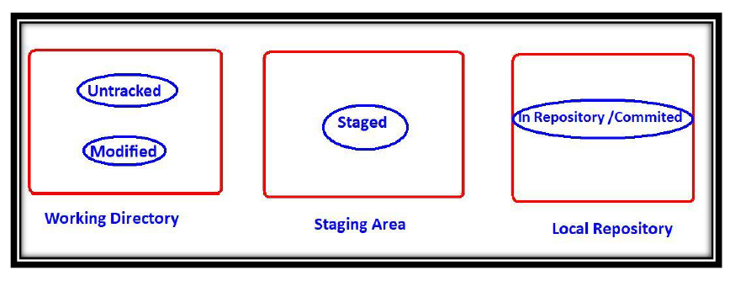

Slide 19
Role of Git in DevOps
Git plays a vital role in DevOps. DevOps is responsible for the development and operation processes of software. It allows non-linear workflows in a distributed manner by providing data assurance to create quality software. This tool offers a space for developers to work. All the users are notified when any of the developers make changes in the file.
Git allows developers to collaborate and makes it easy for them to visualize the work, saving a lot of time and effort. Further, Git helps in code management that can be pushed to the shared repository, making the code ready to be integrated, tested, and deployed. It eases the communications between the development department and the operations department, making it the best suitable tool in DevOps.

Slide 20
Advantages of Git
There are numerous advantages of Git.
Performance
Git is much stronger and reliable than other VCSs. Professionals can easily commit changes, compare version branches, and merge them. Besides, it allows for the better optimization of code for improved performance. The algorithms that are used to develop Git take complete advantage of the stored knowledge of attributes that help in developing source code files, types of file access patterns that help in recalling code files whenever required, and so on.
Security
Git is mainly built to secure the source code and maintain its integrity. All the data in the file, the relationship between the directories and files, commits, tags, versions, etc. are guarded through cryptographic algorithms like SHA-1. This algorithm secures the code and changes history from accidental and malicious attacks. Git ensures that the files, data, and the change history of the source code are secure.
Flexibility
Git is designed to be flexible, which allows it to support various types of non-linear workflows. It is also one of the most efficient tools in terms of dealing with small-scale and large-scale protocols and projects. Besides, its unique design makes it possible to support branching and tagging various business operations, storing all the user activities as an important part of the change history. Git is one of the very few VCSs that have this feature.
Wide Acceptance
Most developers need the security, performance, flexibility, and functionality that Git offers to build their projects. It is the most widely accepted VCS comparatively, and it provides universally accepted performance standards and usability.

Slide 21
Disadvantages of Git
Even though Git seems like the perfect solution for various problems related to the software development life cycle (SDLC), it has its shortcomings.
Its steep learning curve itself is a disadvantage, which is due to the non-intuitive nature of its commands. You need a much deeper understanding of the internals of Git to avoid inconsistencies while executing.
Binary files are not Git’s forte. Whenever files containing non-text content are updated or used frequently, Git gets dragged and slowed down.
It does create a conducive environment for a large number of developers distributed over a large geographical area but, at the same time, creates a lot of conflict and confusion while merging codes. To solve this problem, developers can establish an open communication channel before merging their bits of changes with the project.
Git is being used by large companies to achieve their benchmark goals. As products are developed all around the world, it is increasingly becoming the platform of integration. The introduction to Git has contributed to the building of a large community by following the mantra of developing ecosystems for SDLC. With a long way ahead for more technological advancements, Git has definitely found its place at the top. Hopefully, this ‘What is Git?’ blog helped you understand the basics of Git and inspired you to start the coding journey with it.

