Slide 1
What is GitHub?
GitHub is a Git repository hosting service that provides a web-based graphical interface. It is the world’s largest coding community. Putting a code or a project into GitHub brings it increased, widespread exposure.
Programmers can find source codes in many different languages and use the command-line interface, Git, to make and keep track of any changes.
GitHub helps every team member work together on a project from any location while facilitating collaboration. You can also review previous versions created at an earlier point in time.

Slide 2
GitHub is a Git repository hosting service. GitHub also facilitates with many of its features, such as access control and collaboration. It provides a Web-based graphical interface.
GitHub is an American company. It hosts source code of your project in the form of different programming languages and keeps track of the various changes made by programmers.
It offers both distributed version control and source code management (SCM) functionality of Git. It also facilitates with some collaboration features such as bug tracking, feature requests, task management for every project.
Features of GitHub
GitHub is a place where programmers and designers work together. They collaborate, contribute, and fix bugs together. It hosts plenty of open source projects and codes of various programming languages.

Slide 3
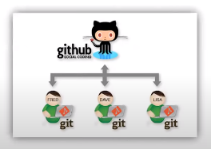

Slide 4
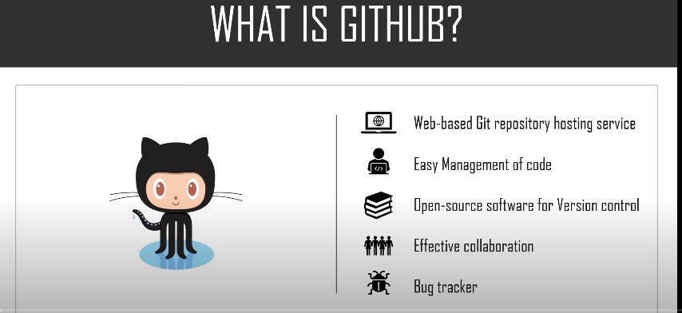

Slide 5
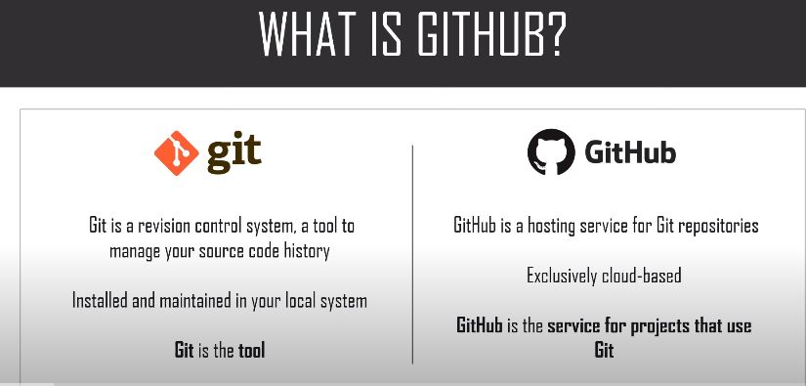

Slide 6
Easy Project Management
GitHub is a place where project managers and developers come together to coordinate, track, and update their work so that projects are transparent and stay on schedule.
2. Increased Safety With Packages
Packages can be published privately, within the team, or publicly to the open-source community. The packages can be used or reused by downloading them from GitHub.
3. Effective Team Management
GitHub helps all the team members stay on the same page and organized. Moderation tools like Issue and Pull Request Locking help the team to focus on the code.
4. Improved Code Writing
Pull requests help the organizations to review, develop, and propose new code. Team members can discuss any implementations and proposals through these before changing the source code.

Slide 7
5. Increased Code Safety
GitHub uses dedicated tools to identify and analyze vulnerabilities to the code that other tools tend to miss. Development teams everywhere work together to secure the software supply chain, from start to finish.
6. Easy Code Hosting
All the code and documentation are in one place. There are millions of repositories on GitHub, and each repository has its own tools to help you host and release code.

Slide 8
Benefits of GitHub
GitHub can be separated as the Git and the Hub. GitHub service includes access controls as well as collaboration features like task management, repository hosting, and team management.
The key benefits of GitHub are as follows.
It is easy to contribute to open source projects via GitHub.
It helps to create an excellent document.
You can attract recruiter by showing off your work. If you have a profile on GitHub, you will have a higher chance of being recruited.
It allows your work to get out there in front of the public.
You can track changes in your code across versions.

Slide 9
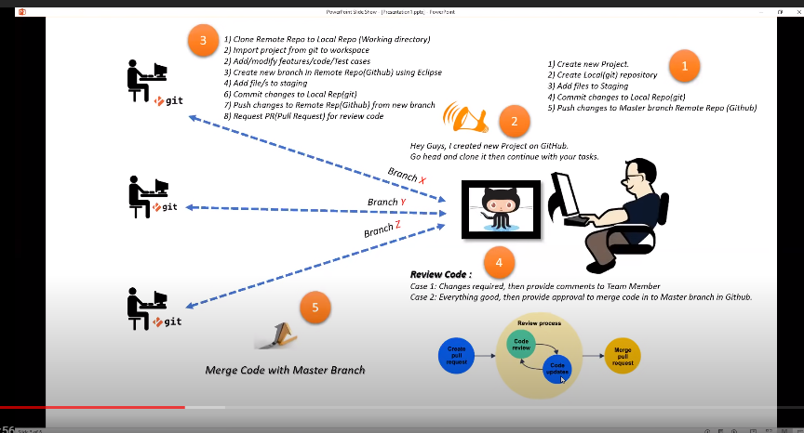
GITHUB PROCESS

Slide 10
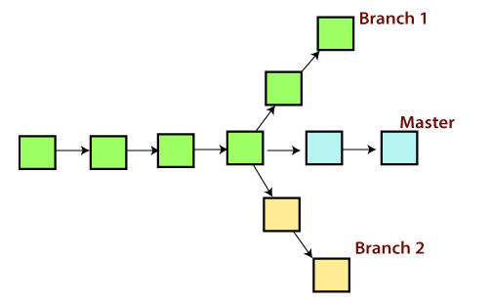
Git Branch
A branch is a version of the repository that diverges from the main working project. It is a feature available in most modern version control systems. A Git project can have more than one branch.
These branches are a pointer to a snapshot of your changes. When you want to add a new feature or fix a bug, you spawn a new branch to summarize your changes. So, it is complex to merge the unstable code with the main code base and also facilitates you to clean up your future history before merging with the main branch.

Slide 11
Git Master Branch
The master branch is a default branch in Git. It is instantiated when first commit made on the project. When you make the first commit, you're given a master branch to the starting commit point.
When you start making a commit, then master branch pointer automatically moves forward. A repository can have only one master branch.
Master branch is the branch in which all the changes eventually get merged back. It can be called as an official working version of your project.
Operations on Branches
We can perform various operations on Git branches. The git branch command allows you to create, list, rename and delete branches. Many operations on branches are applied by git checkout and git merge command. So, the git branch is tightly integrated with the git checkout and git merge commands.
Git Checkout
In Git, the term checkout is used for the act of switching between different versions of a target entity. The git checkout command is used to switch between branches in a repository. Be careful with your staged files and commits when switching between branches.

Slide 12
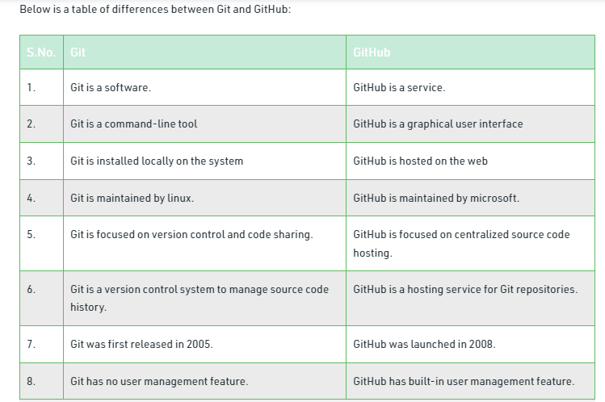

Slide 13
Roles and code
From a DevOps point of view, it is important to leverage the natural meeting point that a source code management tool.
Many different roles have a use for source code management in its wider meaning. It is easier to do so for technically-minded roles but harder for other roles, such as project management.
Operations personnel also favor managing the descriptions of infrastructure in the form of code, scripts, and other artifacts
Quality assurance personnel can store their automated tests in codified form in the source code repository. This is true for software testing frameworks such as Selenium and Junit, among others.
There is a problem with the documentation of the manual steps needed to perform various tasks, though. This is more of a psychological or cultural problem than a technical one.
While many organizations employ a wiki solution such as the wiki engine powering Wikipedia, there is still a lot of documentation floating around in the Word format on shared drives and in e-mails.

