Slide 1
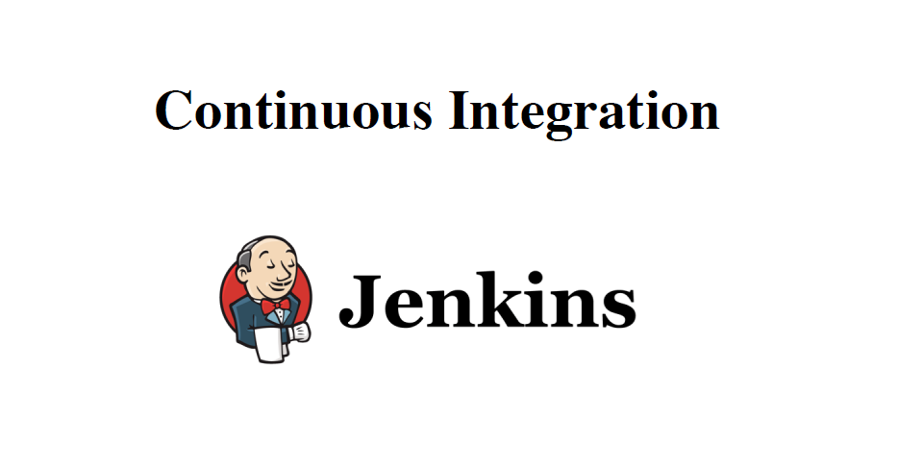

Slide 2
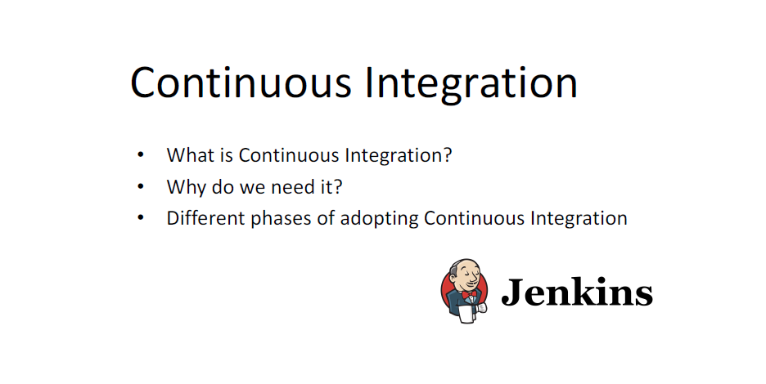

Slide 3
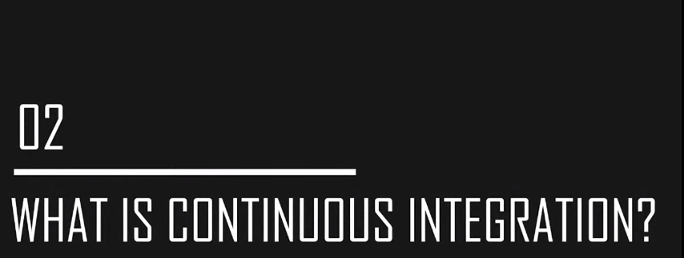

Slide 4
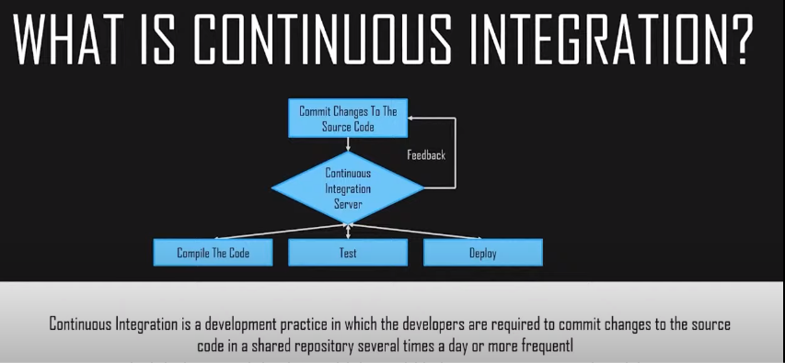

Slide 5
What is Continuous Integration? Continuous Integration is a development practice in which the developers are required to commit changes to the source code in a shared repository several times a day or more frequently. Every commit made in the repository is then built. This allows the teams to detect the problems early. Apart from this, depending on the Continuous Integration tool, there are several other functions like deploying the build application on the test server, providing the concerned teams with the build and test results, etc.

Slide 6

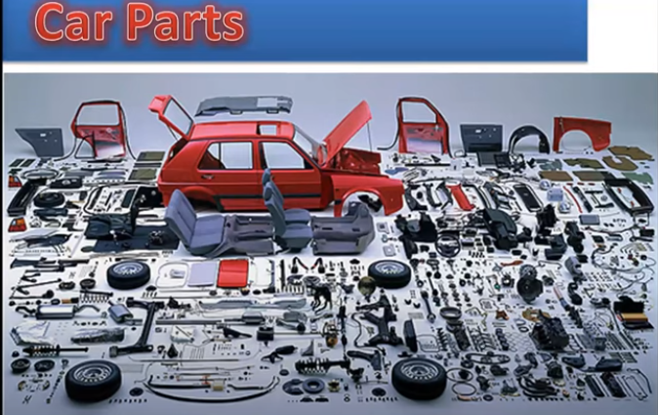
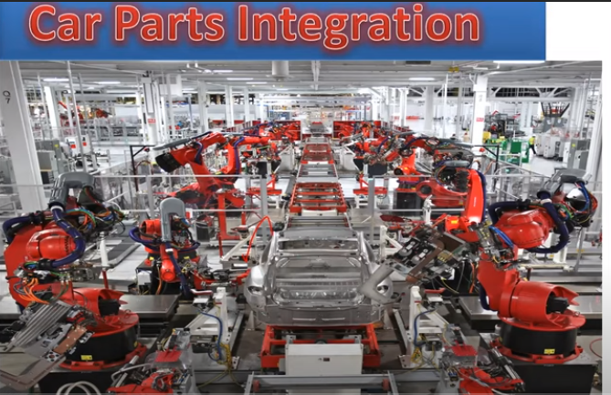


Slide 7
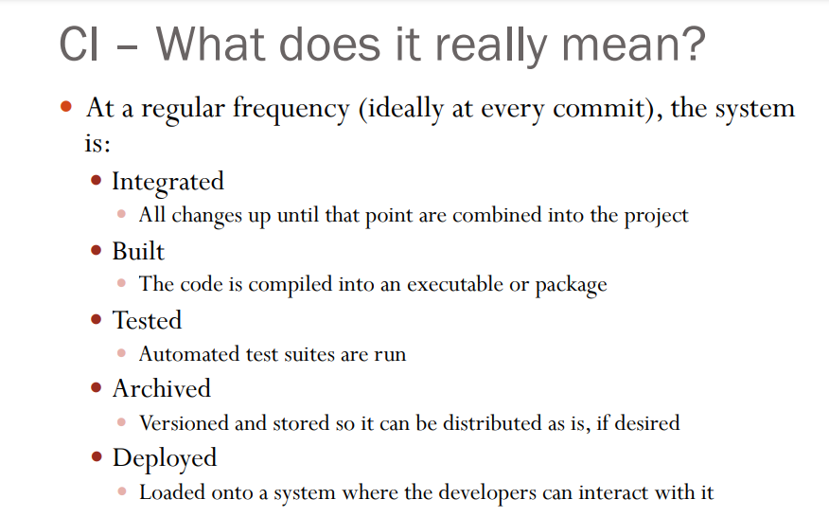

Slide 8
What is a build server? A build server, also called a continuous integration server (CI server), is a centralized, stable and reliable environment for building distributed development projects. ... A build server can also speed the development process by freeing up resources on developers' local machines.
Jenkins, a continuous build tool, enables teams to focus on their work by automating the build, artifact management, and deployment processes Jenkins’ core functionality and flexibility allow it to fit in a variety of environments and can help streamline the development process for all stakeholders involved

Slide 9
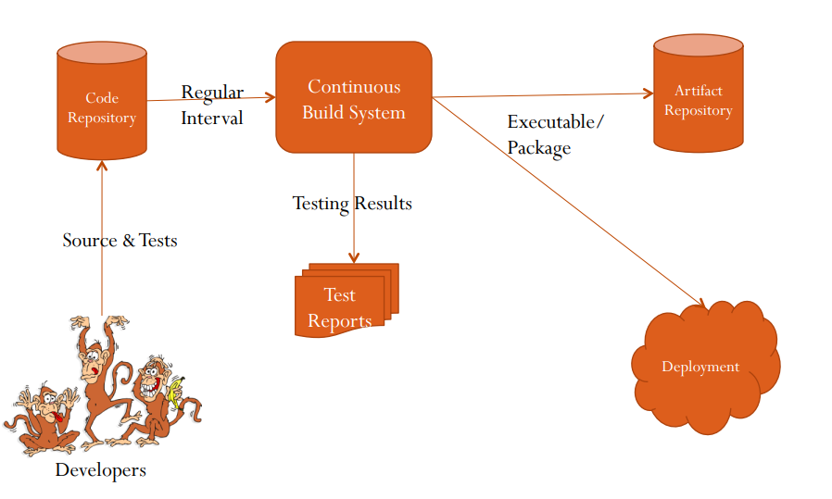
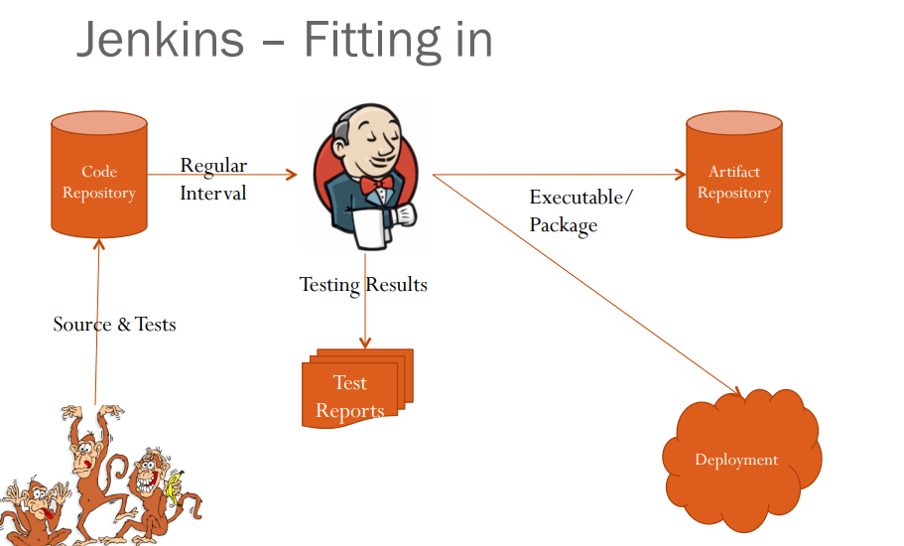

Slide 10
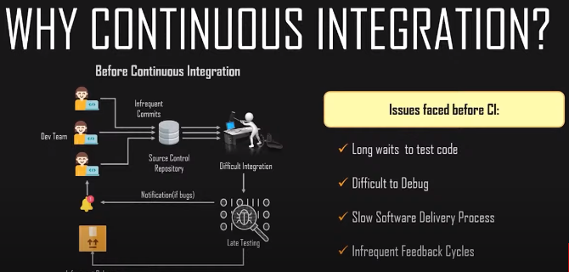

Slide 11
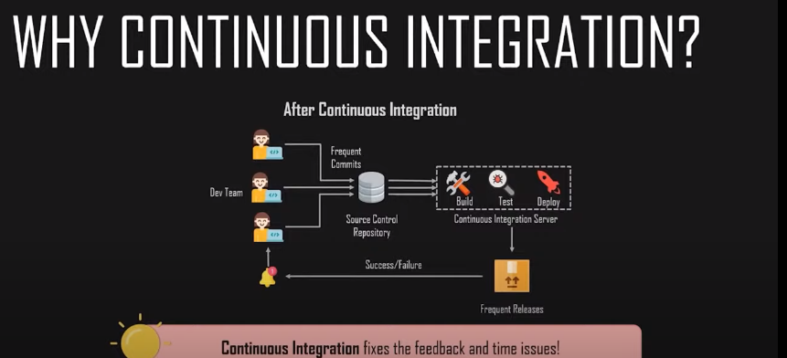

Slide 12
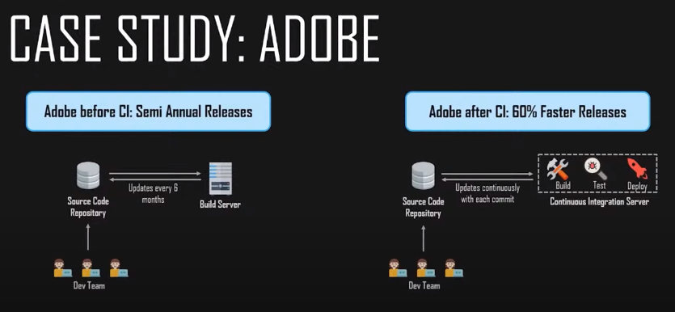

Slide 13
Continuous Integration Example: Nokia
I am pretty sure you all have used Nokia phones at some point in your life. In a software product development project at Nokia, there was a process called Nightly builds.
Nightly builds can be thought of as a predecessor to Continuous Integration.
It means that every night an automated system pulls the code added to the shared repository throughout the day and builds that code. The idea is quite similar to Continuous Integration, but since the code that was built at night was quite large, locating and fixing of bugs was a real pain.
Due to this, Nokia adopted Continuous Integration (CI). As a result, every commit made to the source code in the repository was built. If the build result shows that there is a bug in the code, then the developers only need to check that particular commit. This significantly reduced the time required to release new software.

Slide 14
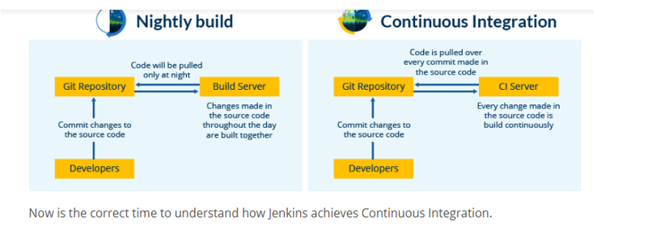

Slide 15
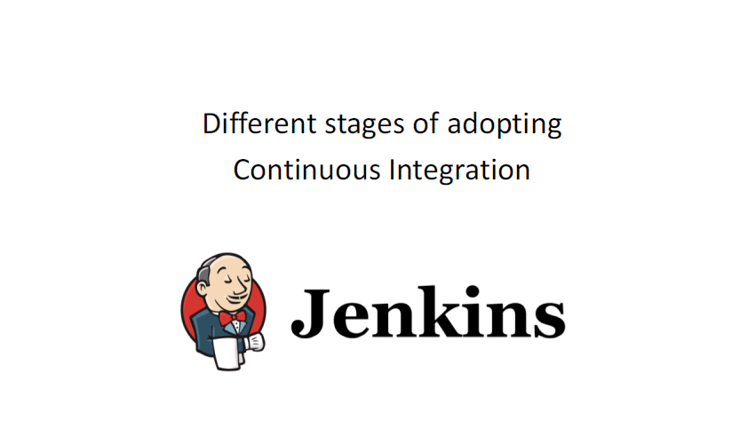

Slide 16
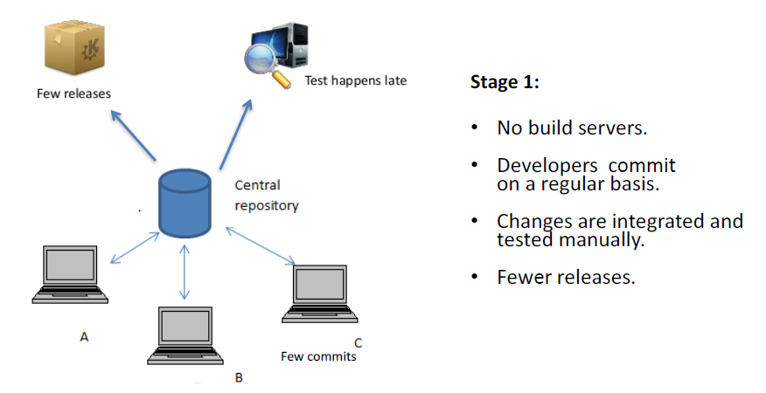

Slide 17
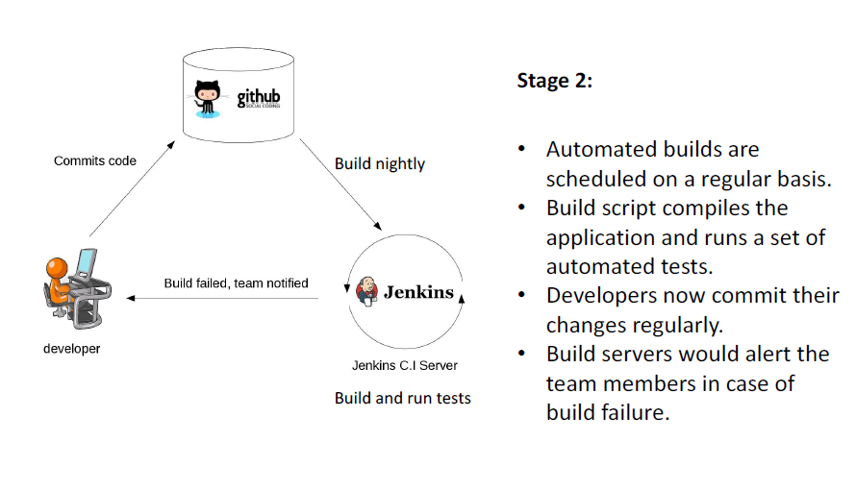

Slide 18
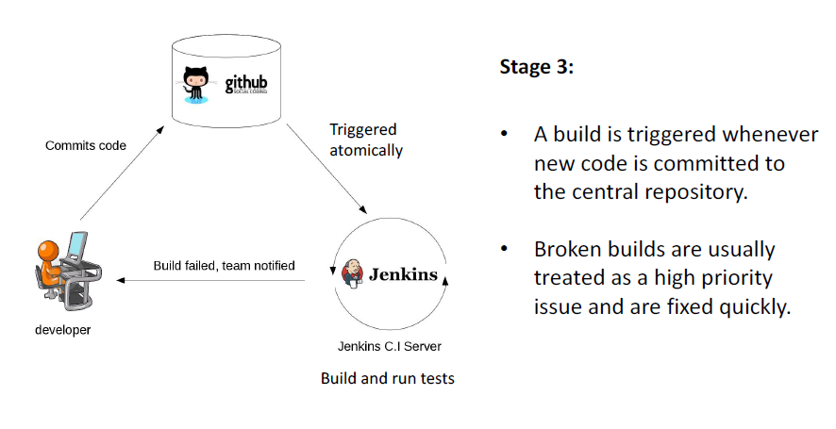

Slide 19
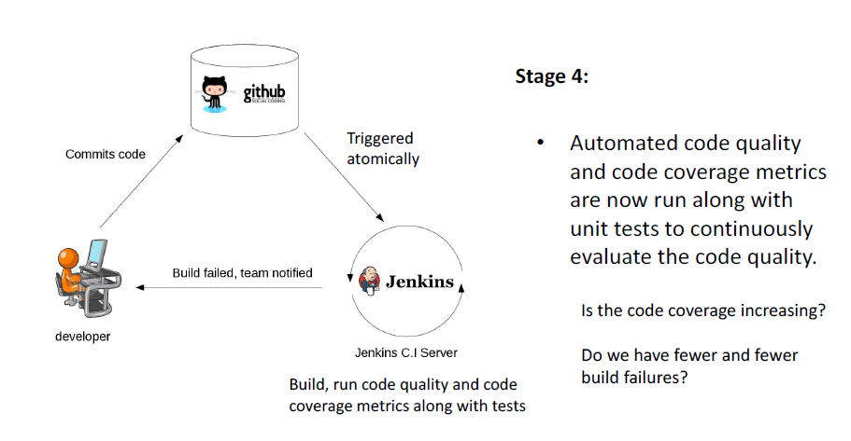

Slide 20
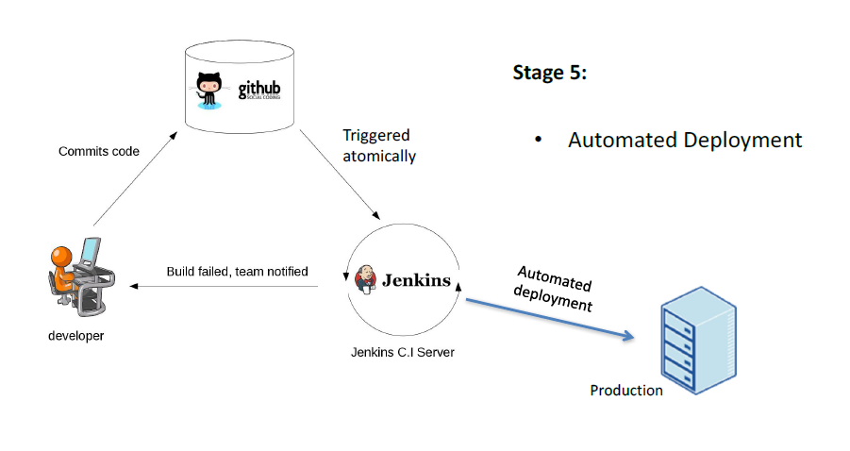

Slide 21
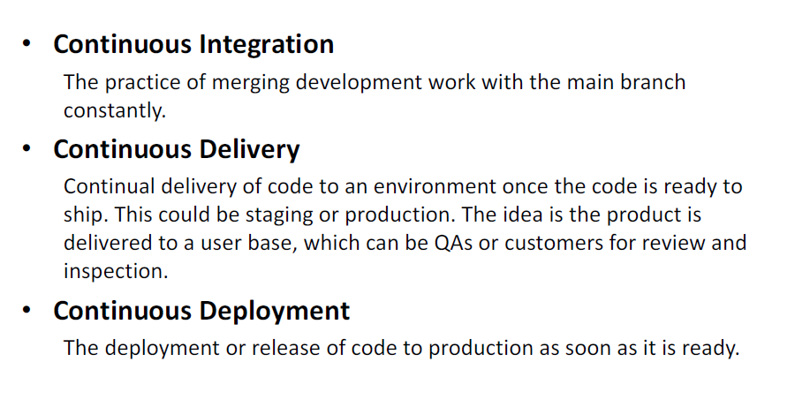

Slide 22
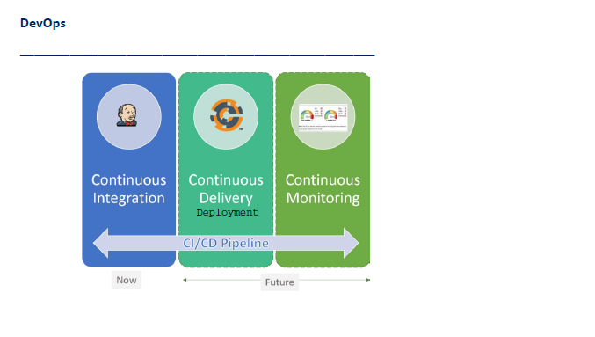

Slide 23
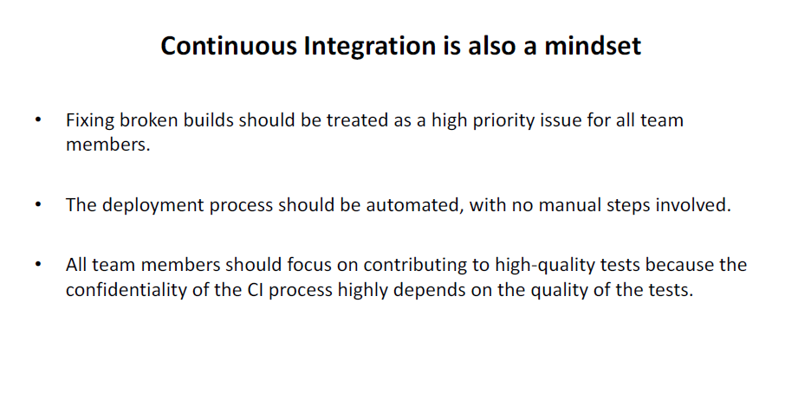

Slide 24
Continuous Integration is the most important part of DevOps that is used to integrate various DevOps stages. Jenkins is the most famous Continuous Integration tool
What is Jenkins?
Jenkins to the rescue! As a Continuous Integration tool, Jenkins allows seamless, ongoing development, testing, and deployment of newly created code.
Continuous Integration is a process wherein developers commit changes to source code from a shared repository, and all the changes to the source code are built continuously.
This can occur multiple times daily. Each commit is continuously monitored by the CI Server, increasing the efficiency of code builds and verification.
This removes the testers' burdens, permitting quicker integration and fewer wasted resources.

Slide 25
What is Jenkins and why we use it?
Jenkins is an open-source automation tool written in Java with plugins built for Continuous Integration purposes.
Jenkins is used to build and test your software projects continuously making it easier for developers to integrate changes to the project, and making it easier for users to obtain a fresh build. It also allows you to continuously deliver your software by integrating with a large number of testing and deployment technologies.
With Jenkins, organizations can accelerate the software development process through automation. Jenkins integrates development life-cycle processes of all kinds, including build, document, test, package, stage, deploy, static analysis, and much more.
Jenkins achieves Continuous Integration with the help of plugins. Plugins allow the integration of Various DevOps stages.

Slide 26
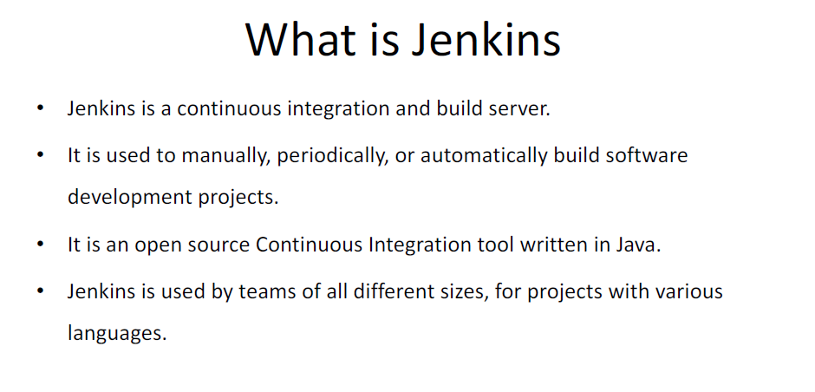

Slide 27
Advantages of Jenkins include:
It is an open-source tool with great community support.
It is easy to install.
It has 1000+ plugins to ease your work. If a plugin does not exist, you can code it and share it with the community.
It is free of cost.
It is built with Java and hence, it is portable to all the major platforms.

Slide 28
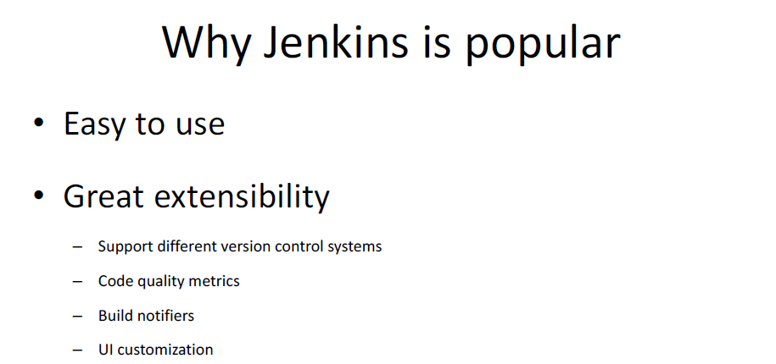

Slide 29
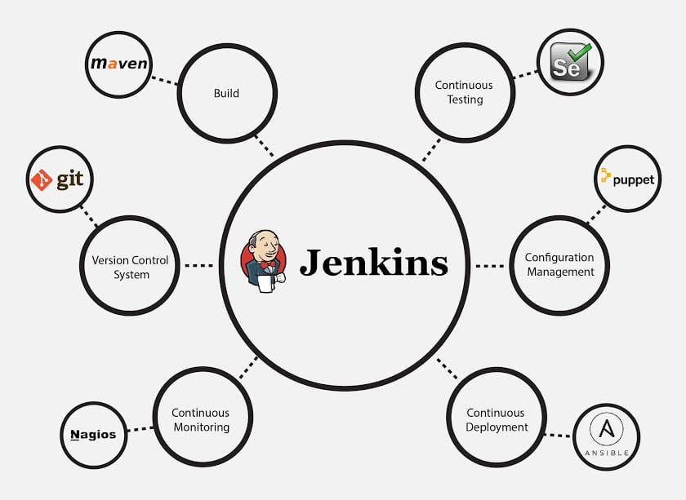

Slide 30
Jenkins Features
The following are some facts about Jenkins that makes it better than other Continuous Integration tools:
Adoption: Jenkins is widespread, with more than 147,000 active installations and over 1 million users around the world.
Plugins: Jenkins is interconnected with well over 1,000 plugins that allow it to integrate with most of the development, testing and deployment tools.
It is evident from the above points that Jenkins has a very high demand globally. Before we dive into Jenkins it is important to know what is Continuous Integration and why it was introduced.

Slide 31
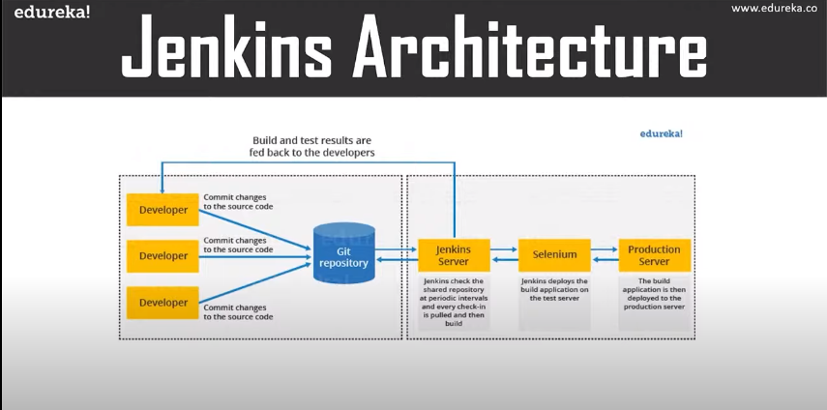

Slide 32
This single Jenkins server was not enough to meet certain requirements like:
Sometimes you might need several different environments to test your builds. This cannot be done by a single Jenkins server.
If larger and heavier projects get built on a regular basis then a single Jenkins server cannot simply handle the entire load.
To address the above-stated needs, Jenkins distributed architecture came into the picture.
Jenkins Distributed Architecture
Jenkins uses a Master-Slave architecture to manage distributed builds. In this architecture, Master and Slave communicate through TCP/IP protocol.

Slide 33
Jenkins Master/The host server
Your main Jenkins server is the Master. The Master’s job is to handle:
Scheduling build jobs.
Dispatching builds to the slaves for the actual execution.
Monitor the slaves (possibly taking them online and offline as required).
Recording and presenting the build results.
A Master instance of Jenkins can also execute build jobs directly.

Slide 34
Jenkins Slave
A Slave is a Java executable that runs on a remote machine. Following are the characteristics of Jenkins Slaves:
It hears requests from the Jenkins Master instance.
Slaves can run on a variety of operating systems.
The job of a Slave is to do as they are told to, which involves executing build jobs dispatched by the Master.
You can configure a project to always run on a particular Slave machine or a particular type of Slave machine, or simply let Jenkins pick the next available Slave.
The diagram is self-explanatory. It consists of a Jenkins Master which is managing three Jenkins Slave.

Slide 35
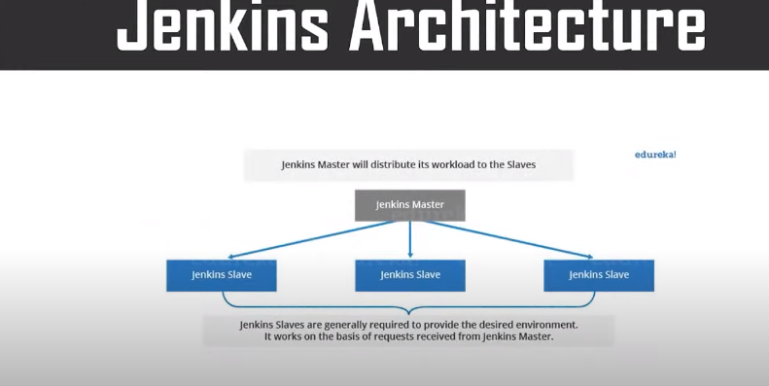

Slide 36
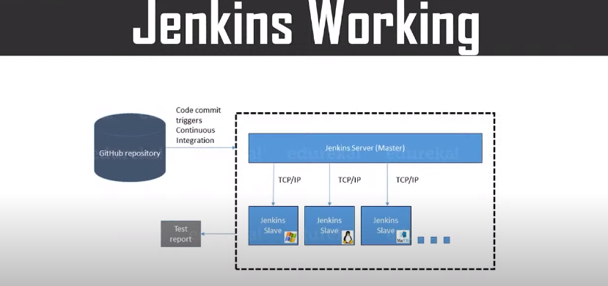
How Jenkins Master and Slave Architecture works?
Now let us look at an example in which we use Jenkins for testing in different environments like Ubuntu, MAC, Windows, etc.
The diagram below represents the same:

Slide 37
The above image represents the following functions:
Jenkins checks the Git repository at periodic intervals for any changes made in the source code.
Each builds requires a different testing environment which is not possible for a single Jenkins server. In order to perform testing in different environments, Jenkins uses various Slaves as shown in the diagram.
Jenkins Master requests these Slaves to perform testing and to generate test reports.

Slide 38
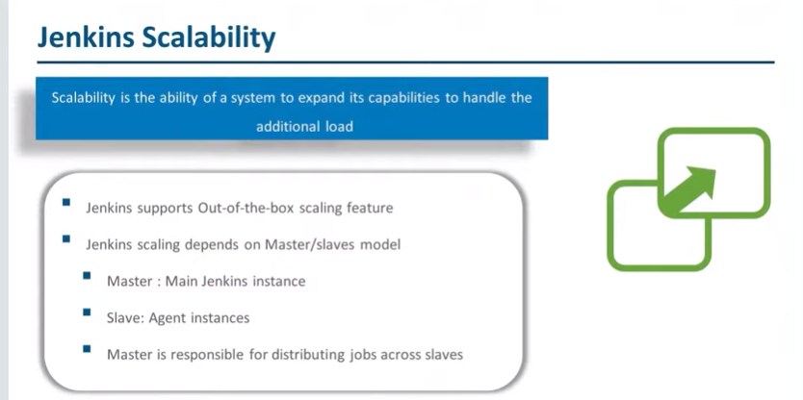

Slide 39
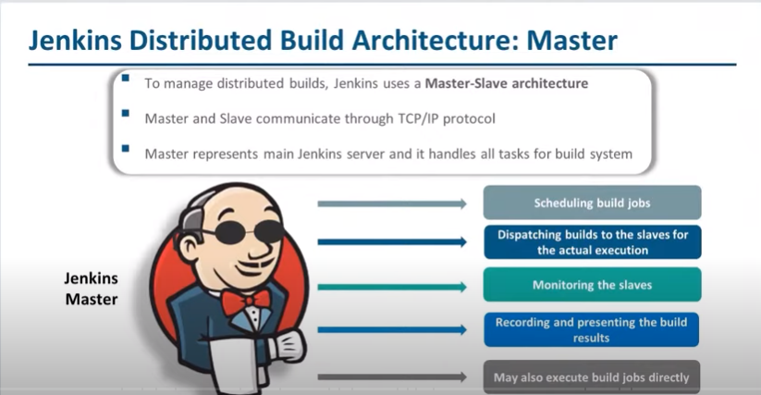

Slide 40
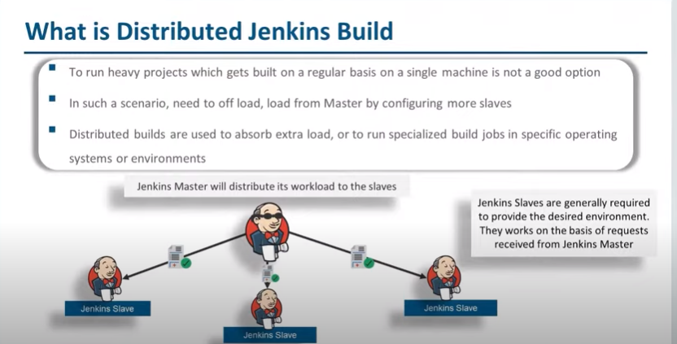

Slide 41
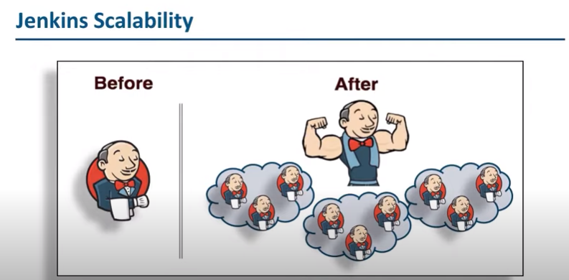

Slide 42
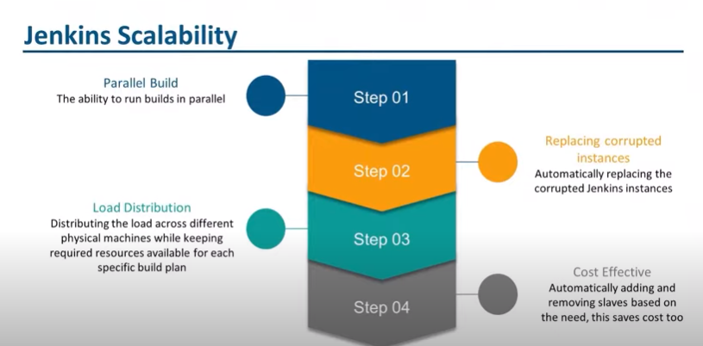

Slide 43
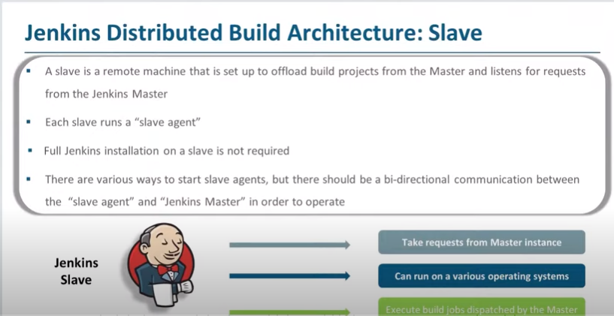

Slide 44
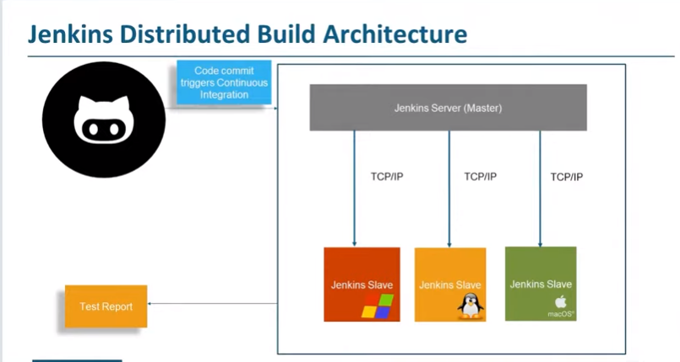

Slide 45
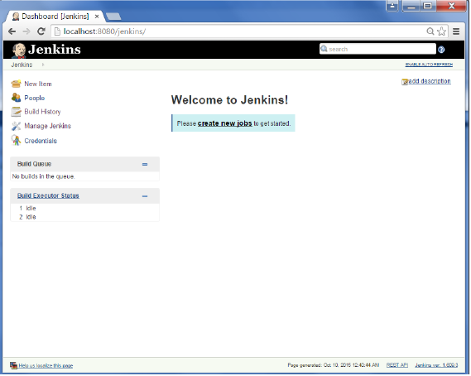
The Jenkins build server
For this exercise, we will create a job in Jenkins which picks up a simple HelloWorld application, builds and runs the java program.
Step 1 − Go to the Jenkins dashboard and Click on New Item

Slide 46
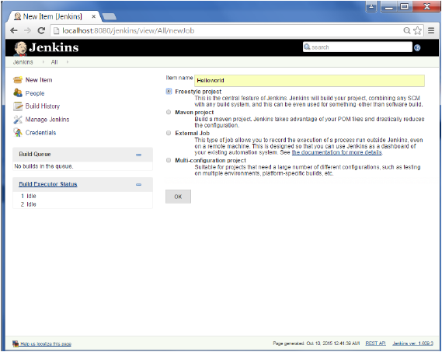
Step 2 − In the next screen, enter the Item name, in this case we have named it Helloworld. Choose the ‘Freestyle project option’

Slide 47
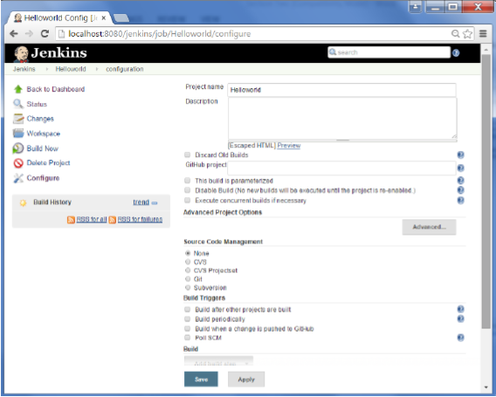
Step 3 − The following screen will come up in which you can specify the details of the job

Slide 48
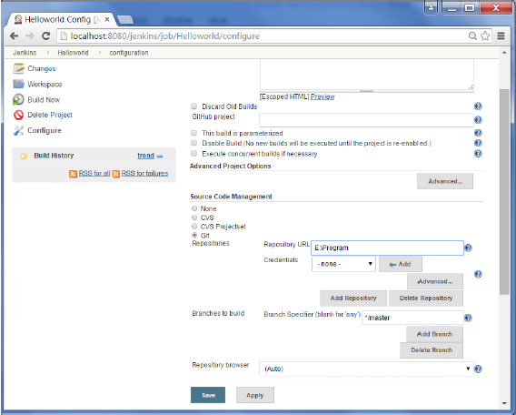
Step 4 − We need to specify the location of files which need to be built. In this example, we will assume that a local git repository(E:\Program) has been setup which contains a ‘HelloWorld.java’ file. Hence scroll down and click on the Git option and enter the URL of the local git repository.
Note − If you repository if hosted on Github, you can also enter the url of that repository here. In addition to this, you would need to click on the Add button for the credentials to add a user name and password to the github repository so that the code can be picked up from the remote repository.

Slide 49
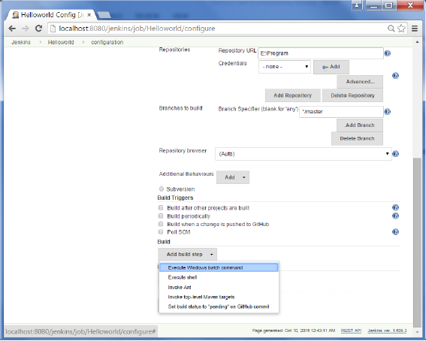
Step 5 − Now go to the Build section and click on Add build step → Execute Windows batch command

Slide 50
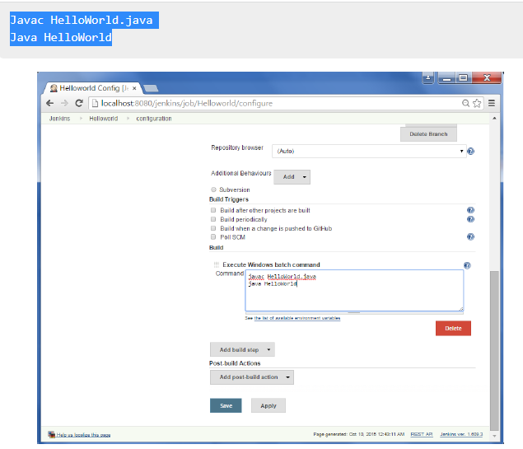
Step 6 − In the command window, enter the following commands and then click on the Save button.

Slide 51
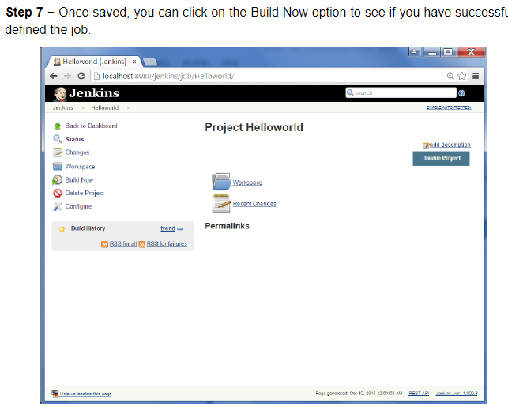

Slide 52
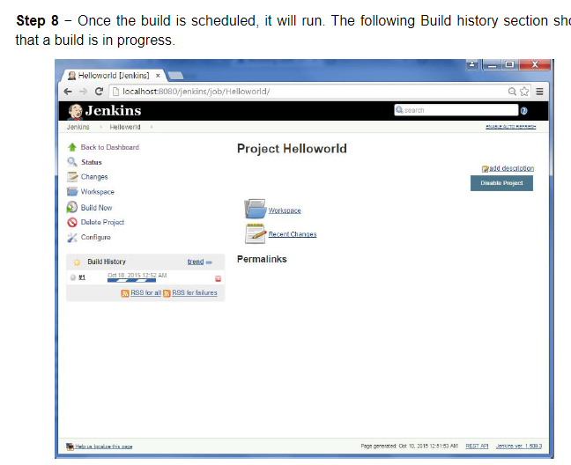

Slide 53
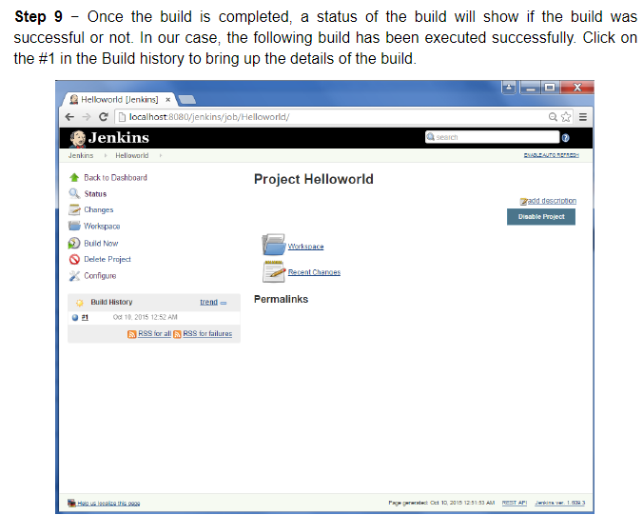

Slide 54
How to Manage Inter-Project Dependencies using Jenkins
how Jenkins can be used to work with inter-dependent projects.
Managing the CI environment with multiple inter-dependent projects is quite important, as it is general scenario with projects. If there are multiple projects having dependencies, then requirements would be:
If Project A is dependent on Project B, then a successful build of Project B should trigger the build for Project A also.
In generic words, the build of current project should trigger the build for other dependent projects also. It is required to ensure the integrity of whole project dependency chain after any change.
The dependent projects should be able to pick the latest jars from Projects on which these are dependent.

Slide 55
This way, finally whole project chain will be built again on change in any of the project (from down to up)
Now, how we can achieve these requirements in Jenkins.
Here we are describing this with an example.
Suppose there are three projects, Project 1, Project 2 and Project 3.
Project 1 is dependent on Project 2. Project 2 is dependent on Project 3.
Assumption is that build of every project produce the distribute-able jar etc in a specific folder
Now update the 'build' for Project 3 in a way, so that before compiling its own code base, it picks the output of Project 2 build from its output folder and synchronize it in its own library folders.

Slide 56
Similarly update the 'build' for Project 2 in a way, that before compiling its own code base, it picks the output of Project 1 'build' from its output folder and synchronize it in own library folders.
Create a Job in Jenkins for Project1, as described with previous article
Add post build actions to this job to trigger the build of Project2
Create a Job for Project2
Add post build actions to this job to trigger the build of Project 3
Create job for Project3
Using this setup, whenever Project1 will be build, it will trigger the job for Project2
Project 2 will pick the dependencies from Project1 output folder and will build its own code base.
Build will place the output files in some specific folder.
Similarly Project3 build will be triggered and it will pick the dependencies from Project2 output folders
Using this approach, we shall be able to have a perfectly integrated build system and will be able to track if any of the project in whole dependency chain breaks due to any commit. On change in any project, it will trigger the build of all dependent projects. Inter-project dependencies will be synchronized automatically.

Slide 57
Jenkins plugins
Jenkins has a plugin system to add functionality to the build server.
A plugin is a software add-on that is installed on a program, enhancing its capabilities. For example, if you wanted to watch a video on a website, you may need a plugin to do so. If the plugin is not installed, your browser will not understand how to play the video.
There are many different plugins available, and they can be installed from within the Jenkins web interface.
Many of them can be installed without even restarting Jenkins. Productivity
1. Dashboard View Plugin
The ‘Dashboard view plugin’ provides a new Jenkins dashboard that allows you to monitor the status of all the tasks. Ideally, this also has time tracking capabilities for the duration taken by each job and also shows the entire time execution. These are fundamentals that help you manage Jenkins.

Slide 58
2. View Job Filters Plugin
The ‘View Job Filters plugin’ is an method to build different views for all your Jenkins jobs. Whether it’s build status or trends and triggers, with the ‘View Job Filters plugin,’ you will find all these filtering options in addition to many others.
3. Folders Plugin
The ‘Folder’s plugin’ is a great method for grouping your Jenkins tasks. Furthermore, organize your CI server can be arranged perfectly with the nestable folders available in this plugin.
Monitoring
4. Monitoring Plugin
The Monitoring plugin provides charts for CPU, memory, system load average, HTTP response time, and so on. Performance Enhancers

Slide 59
5. Performance Plugin
You can watch your project’s performance via trend reports and graphs, and set your build status to either right, unstable or failed.
6. Performance Publisher Plugin
An outstanding feature of Performance Published plugin is that it is designed to work with every testing tool by generating trend and global reports for test result analysis.
7. Amazon ECS Container Service
Use the ‘Amazon ECS Container Service’ plugin to manage Jenkins cloud slaves and deploy Docker-based applications on a cluster.
8.Tests Analysis Plugins
Jenkins is the ultimate companion for performing your tests as part of CI. However, Jenkins doesn’t provide any way of studying test results after execution, which is an essential aspect of testing.

Slide 60
Pipeline / Flow
9.Build Pipeline Plugin
This plugin provides a view of the jobs that make up your build pipeline, upstream and also downstream.
10.Multijob Plugin
This plugin allows you to express complex tasks and then organize them according to their structures in the Jenkins. You can use this plugin whenever you need to clean up the mess for chain definitions with upstream or downstream jobs. You may also use it when you need to create a hierarchy of tasks to be executed sequentially.
11.Pipeline Plugin
‘Pipeline’ attempts to automate your continuous delivery pipeline and performs other complex tasks in Jenkins using traditional plugins and freestyle projects.

Slide 61
The Jenkins filesystem layout
It is often useful to know where builds wind up in the filesystem.
the Jenkins jobs are stored here:
/var/lib/jenkins/jobs
Each job gets its own directory, and the job description XML is stored in this directory as well as a directory for the build called workspace.
The job's XML files can be backed up to another server in order to be able to rebuild the Jenkins server in the event of a catastrophic failure.
There are dedicated backup plugins for this purpose as well.
Building the Code
Builds can consume a lot of space, so it may sometimes happen that you need to clean out this space manually.
This shouldn't be the normal case, of course. You should configure Jenkins to only leave the number of builds you have space for. You can also configure your configuration management tool to clear out space if needed.

Slide 62
Software on the host
Depending on the complexity of your builds, you might need to install many different types of build tool on your build server. Remember that Jenkins is mostly used to trigger builds, not perform the builds themselves.
it's most convenient to have a Linux-based host operating system. Most of the build systems are available in the distribution repositories, so it's very convenient to install them from there.
To keep your build server up to date, you can use the same deployment servers that you use to keep your application servers up to date.

Slide 63
Triggers
You can either use a timer to trigger builds, or you can poll the code repository for changes and build if there were changes.
It can be useful to use both methods at the same time:
Git repository polling can be used most of the time so that every check in triggers a build.
Nightly builds can be triggered, which are more stringent than continuous builds, and thus take a longer time. Since these builds happen at night when nobody is supposed to work, it doesn't matter if they are slow.
An upstream build can trigger a downstream build. You can also let the successful build of one job trigger another job.

Slide 64
JOB Chaining process with Jenkins.
1. Create container image that’s has Jenkins installed using dockerfile
2. When we launch this image, it should automatically starts Jenkins service in the container.
3. Create a job chain of job1, job2, job3 and job4 using build pipeline plugin in Jenkins
4. Job1 : Pull the Github repo automatically when some developers push repo to Github.
5. Job2 : By looking at the code or program file, Jenkins should automatically start the respective language interpreter install image container to deploy code ( eg. If code is of PHP, then Jenkins should start the container that has PHP already installed ).
6. Job3 : Test your app if it is working or not.
7. Job4 : if app is not working , then send email to developer with error messages.
8. Create One extra job job5 for monitor : If container where app is running. fails due to any reson then this job should automatically start the container again.

Slide 65
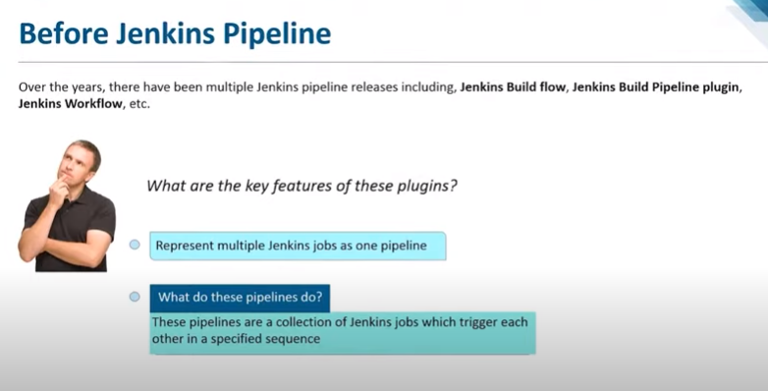

Slide 66
Job chaining and build pipelines
It's often useful to be able to chain jobs together. In its simplest form, this works by triggering a second job in the event that the first job finishes successfully. Several jobs can be cascaded this way in a chain. Such a build chain is quite often good enough for many purposes. Sometimes, a nicer visualization of the build steps as well as greater control over the details of the chain is desired.
In Jenkins terminology, the first build in a chain is called the upstream build, and the second one is called the downstream build.
While this way of chaining builds is often sufficient, there will most likely be a need for greater control of the build chain eventually. Such a build chain is often called a pipeline or workflow.
There are many plugins that create improved pipelines for Jenkins, and the fact that there are several shows that there is indeed a great desire for improvements in this area.

Slide 67
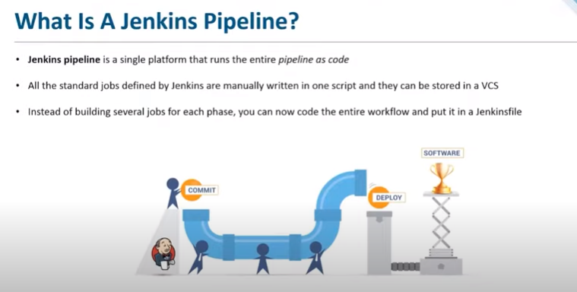

Slide 68
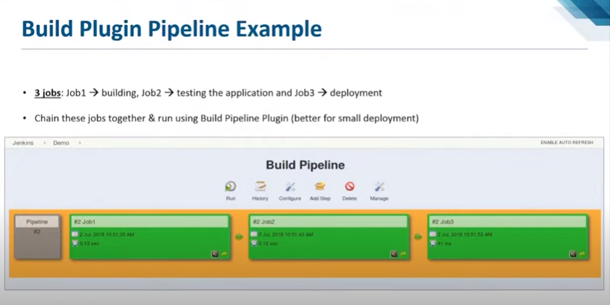

Slide 69
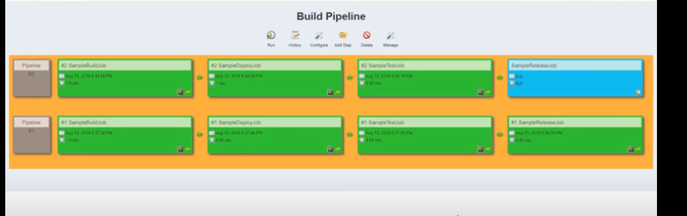

Slide 70
Infrastructure as Code (IaC)
In the past, managing IT infrastructure was a hard job. System administrators had to manually manage and configure all of the hardware and software that was needed for the applications to run.
However, in recent years, things have changed dramatically. Trends like cloud computing revolutionized—and improved—the way organizations design, develop, and maintain their IT infrastructure.
One of the critical components of this trend is called “infrastructure as code,”
Infrastructure as Code (IaC) is the management of infrastructure (networks, virtual machines, load balancers, and connection topology) in a descriptive model, using the same versioning as DevOps team uses for source code.
Like the principle that the same source code generates the same binary, an IaC model generates the same environment every time it is applied.
infrastructure as code is the concept of managing your operations environment in the same way you do applications or other code for general release. Rather than manually making configuration changes or using one-off scripts to make infrastructure adjustments, the operations infrastructure is managed instead using the same rules and strictures that govern code development—particularly when new server instances are spun up.

Slide 71
Infrastructure as Code enables DevOps teams to test applications in production-like environments early in the development cycle. These teams expect to provision multiple test environments reliably and on demand. Infrastructure represented as code can also be validated and tested to prevent common deployment issues.
Teams who implement IaC can deliver stable environments rapidly and at scale. Teams avoid manual configuration of environments and enforce consistency by representing the desired state of their environments via code. Infrastructure deployments with IaC are repeatable and prevent runtime issues caused by configuration drift or missing dependencies. DevOps teams can work together with a unified set of practices and tools to deliver applications and their supporting infrastructure rapidly, reliably, and at scale.
The need for written documentation is also all but eliminated. The code itself is documents the state of the machine, meaning that infrastructure documentation will always be up to date. This is important because I need to ask why, probably just costs less

Slide 72
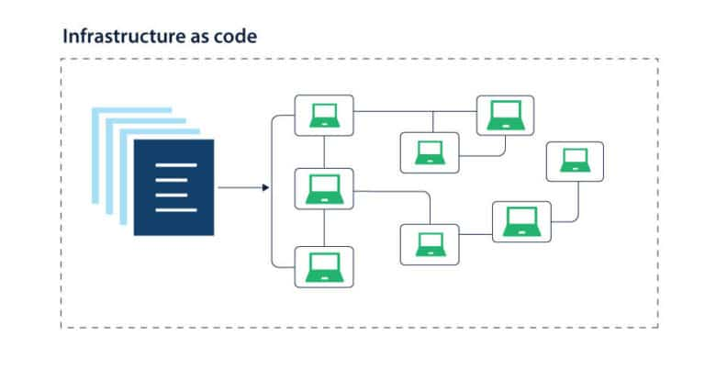

Slide 73
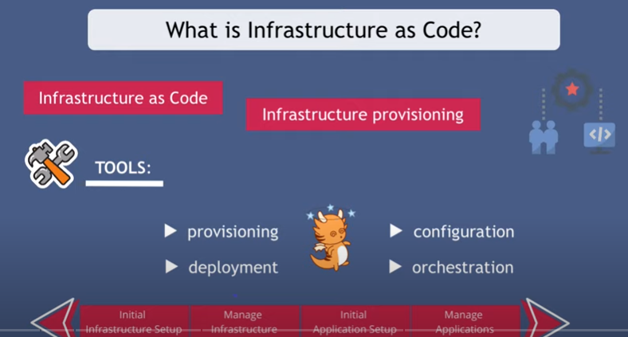

Slide 74


Slide 75


Slide 76


Slide 77


Slide 78


Slide 79


Slide 80
Infrastructure as Code (IaC) refers to the process of provisioning and managing IT infrastructures such as networks, load balancers, virtual machines, data centers, and connection topology in a descriptive model through machine-readable definition files with the help of versioning being used by the DevOps team as source code.
This makes redundant the use of shared configuration tools or physical hardware configuration.

Slide 81
Benefits of Infrastructure as Code (IaC)
Improved system performance with assured risk prevention
Software delivery at high velocity
Safer and efficient change management
Scalability
Improves customer satisfaction.

Slide 82
Building by dependency order
Many build tools have the concept of a build tree where dependencies are built in the order required for the build to complete, since parts of the build might depend on other parts.
In Make-like tools, this is described explicitly; for instance, like this:
a.out : b.o c.o
b.o : b.c
c.o : c.c
So, in order to build a.out, b.o and c.o must be built first.

Slide 83
Build phases
Lets take an example of any build system or build tool and lets see the various phases or lifecycle phases involved in creating and managing builds:
Lets consider maven build tool:
Maven is a powerful project management tool that is based on POM (project object model), used for projects build, dependency and documentation. It is a tool that can be used for building and managing any Java-based project. Maven makes the day-to-day work of Java developers easier and helps with the building and running of any Java-based project.
the sequence of steps which is defined in order to execute the tasks and goals of any maven project is known as build life cycle in maven. Maven 2.0 version is basically a build life cycle oriented and clearly says that these steps are well defined to get the desired output after the successful execution of the build life cycle.
Maven comes with 3 built-in build life cycles as shown below :
Clean - this phase involves cleaning of the project (for a fresh build & deployment)
Default - this phase handles the complete deployment of the project
Site - this phase handles the generating the java documentation of the project.

Slide 84
Now we will dig more into the detailed phases involved in the above mentioned built-in build life cycles.
A build lifecycle consists of several phases. When a phase command is given, Maven runs every phase in the sequence up to and including the defined phase.
This power-tool for Maven lifecycle phases and goals in project management is typically used for projects documentation, dependency and build, making the life of Java developer’s day-to-day work easy and manageable.
The open-source tool for enterprise- build takes the burden out of the build process, making it easy to maintain and reduce the time involved in script builds. Besides, it promotes standards for development that is company-wide.
Maven build lifecycle goes through a set of stages, they are called build phases. For example, the default lifecycle is made up of the following phases.
Maven build phases or Lifecycle: Below is a representation of the default Maven lifecycle and its 8 steps: Validate, Compile, Test, Package, Integration test, Verify, Install and Deployment

Slide 85


Slide 86
The default Maven lifecycle consists of 8 major steps or phases for compiling, testing, building and installing a given Java project as specified below:
Validate: This step validates if the project structure is correct. For example – It checks if all the dependencies have been downloaded and are available in the local repository.
Compile: It compiles the source code, converts the .java files to .class and stores the classes in target/classes folder.
Test: It runs unit tests for the project.
Package: This step packages the compiled code in distributable format like JAR or WAR.
Integration test: It runs the integration tests for the project.
Verify: This step runs checks to verify that the project is valid and meets the quality standards.
Install: This step installs the packaged code to the local Maven repository.
Deploy: It copies the packaged code to the remote repository for sharing it with other developers.
Maven follows a sequential order to execute the commands where if you run step n, all steps preceding it (Step 1 to n-1) are also executed. For example – if we run the Installation step (Step 7), it will validate, compile, package and verify the project along with running unit and integration tests (Step 1 to 6) before installing the built package to the local repository.

Slide 87

Jenkins can use Maven as its build tool.
Maven is building tool/environment. Jenkins is a CI (continuous integration) tool.
Here phase represents a stage in life cycle. As an example, a typical Maven Build Lifecycle consists of the following sequence of phases.
Build phases:
validate: check if all information necessary for the build is available.
compile: compile the source code.
test-compile: compile the test source code.
test: run unit tests.

Slide 88
The Best Alternatives to Jenkins for Developers:
GitLab CI/CD tool is a part of GitLab and a powerful alternative to Jenkins. It is an open-source web interface that can be used to apply all the continuous methods like integration, delivery, and deployment to your project without any third-party application. It provides a user-friendly interface along with distributed version control services.
Some of the top features that make it one of the best alternatives to Jenkins are:
Just like Jenkins, it is an open-source tool too.
You can test your build in parallel, thereby reducing time.
It allows docker integration and helps in automating release and application delivery.
It provides better support.

Slide 89


Slide 90
CircleCI :
Circle CI is a flexible tool with easy maintenance and can run in almost any environment. Every commit leads to automatic build execution.
Travis CI
Travis CI is a continuous integration and testing CI/CD tool. It is free of cost for open source projects and provides seamless integration with GitHub. It supports more than 20 languages, like Node.js, PHP, Python, etc. along with Docker.
Some of the key features of Travis CI includes:
Very easy to set up with broad user community support.
No project is merged before tests are passed successfully.
You can easily customize the build environment as per your requirements.
BuildMaster
Build Master is one of the best Jenkins alternatives that offers continuous integration on different platforms. With Build Master, you can manage your apps and deploy them to the environment without any hassle.

Slide 91
Collating quality measures
A useful thing that a build server can do is the collation of software quality metrics. Jenkins has some support for this out of the box. Java unit tests are executed and can be visualized directly on the job page.
Another more advanced option is using the Sonar code quality visualizer, which is shown in the following screenshot. Sonar tests are run during the build phase and propagated to the Sonar server, where they are stored and visualized.
A Sonar server can be a great way for a development team to see the fruits of their efforts at improving the code base.
The drawback of implementing a Sonar server is that it sometimes slows down the builds. The recommendation is to perform the Sonar builds in your nightly builds, once a day.

Slide 92


Slide 93
SonarQube is an excellent application that will capture, analyze, and visualize the functional bugs and Security Vulnerabilities.
SonarQube is an excellent tool for measuring code quality, using static analysis to find code smells, bugs, vulnerabilities, and poor test coverage. Rather than manually analysing the reports, why not automate the process by integrating SonarQube with your Jenkins continuous integration pipeline? This way, you can configure a quality gate based on your own requirements, ensuring bad code always fails the build.

Slide 94
About Jenkins:
https://www.youtube.com/watch?v=dDFv5cSyHNs
Installation:
https://www.youtube.com/watch?v=gT9qnZi3f74
About Pipeline:
https://www.youtube.com/watch?v=mk2FBuTMwDc
https://www.youtube.com/watch?v=1ji_9scA2C4

