Slide 1
PUPPET

Slide 2
Consider a system administrator working with multiple servers. If one of the servers has an issue, they can easily fix it. The situation becomes problematic, however, when multiple servers are down, This is where Puppet can help
What is Puppet?
Puppet is a system management tool for centralizing and automating the configuration management process. Puppet is also used as a software deployment tool.
It is an open-source configuration management software widely used for server configuration, management, deployment, and orchestration(Orchestration is the automated configuration.) of various applications and services across the whole infrastructure of an organization.
Puppet is specially designed to manage the configuration of Linux and Windows systems. It is written in Ruby.

Slide 3
What is Configuration Management?
Configuration management is the process of maintaining software and computer systems (for example servers, storage, networks) in a known, desired and consistent state. It also allows access to an accurate historical record of system state for project management and audit purposes.
System Administrators mostly perform repetitive tasks like installing servers, configuring those servers, etc. These professionals can automate this task, by writing scripts.
However, it is a difficult job when they are working on a massive infrastructure. The Configuration Management tool like a Puppet was introduced to resolve such issues.

Slide 4
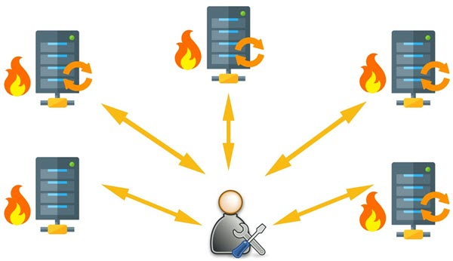
What Puppet can do?
For example, you have an infrastructure with about 100 servers. As a system admin, it’s your role to ensure that all these servers are always up to date and running with full functionality.

Slide 5
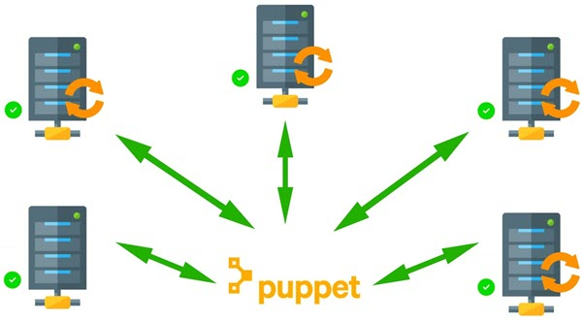
To do this, you can use Puppet, which allows you to write a simple code which can be deployed automatically on these servers. This reduces the human effort and makes the development process fast and effective.

Slide 6
Puppet performs the following functions:
Puppet allows you to define distinct configurations for every host.
The tool allows you to continuously monitor servers to confirm whether the required configuration exists or not and it is not altered. If the config is changed, Puppet tool will revert to the pre-defined configuration on the host.
It also provides control over all the configured system, so a centralized change gets automatically effected.
It is also used as a deployment tool as it automatically deploys software to the system. It implements the infrastructure as a code because policies and configurations are written as code.

Slide 7
Deployment models of configuration management tools
There are two deployment models for configuration management tools :
Push-based deployment model: initiated by a master node.
Pull-based deployment model: initiated by agents.
Push-based deployment model:
In this deployment model master server pushes the configurations and software to the individual agents. After verifying a secure connection, the master runs commands remotely on the agents. For example, Ansible and Salt Stack.
Pull-based deployment model.
In this deployment model, individual servers contact a master server, verify and establish a secure connection, download their configurations and software and then configure themselves accordingly — for example, Puppet and Chef.

Slide 8
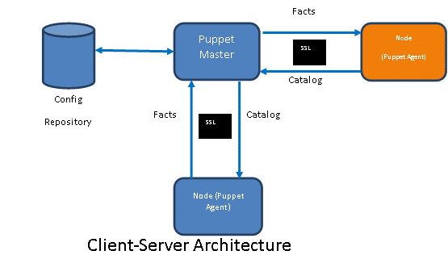
Understanding the Puppet Architecture and Puppet Components

Slide 9
How Puppet works?
Puppet is based on a Pull deployment model, where the agent nodes check in regularly after every 1800 seconds with the master node to see if anything needs to be updated in the agent. If anything needs to be updated the agent pulls the necessary puppet codes from the master and performs required actions.
Example: Master – Agent Setup:
The Master:
A Linux based machine with Puppet master software installed on it. It is responsible for maintaining configurations in the form of puppet codes. The master node can only be Linux.
The Agents:
The target machines managed by a puppet with the puppet agent software installed on them.
The agent can be configured on any supported operating system such as Linux or Windows or Solaris or Mac OS.
The communication between master and agent is established through secure certificates.

Slide 10
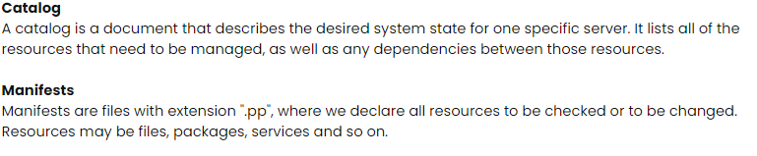
Config repository: Config repository is where the entire server-related configurations and nodes are stored. They can be pulled at any time as required.

Slide 11
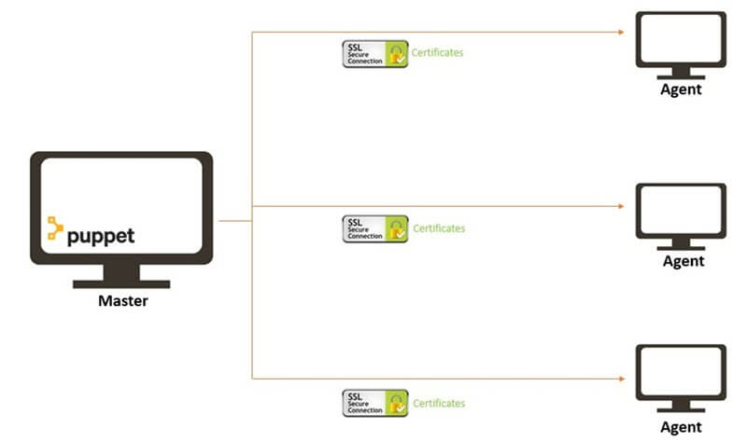
Puppet Master Agent Communication
Secure Sockets Layer

Slide 12
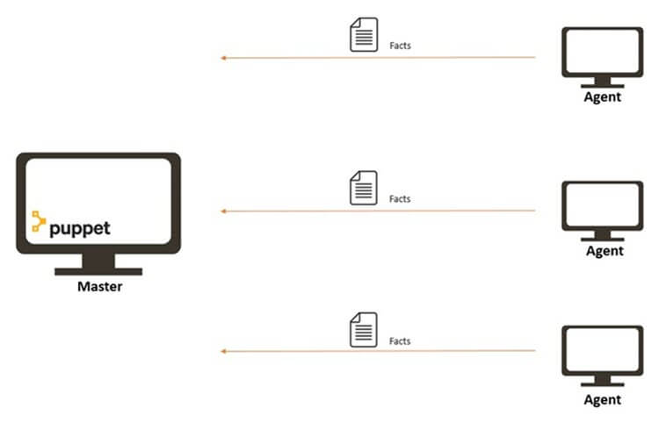
Communication between the Master and the Agent:
Step 1) Once the connectivity is established between the agent and the master, the Puppet agent sends the data about its state to the Puppet master server. These are called Facts: This information includes the hostname, kernel details, IP address, file name details, etc.…
Agent Sends Facts to Master

Slide 13
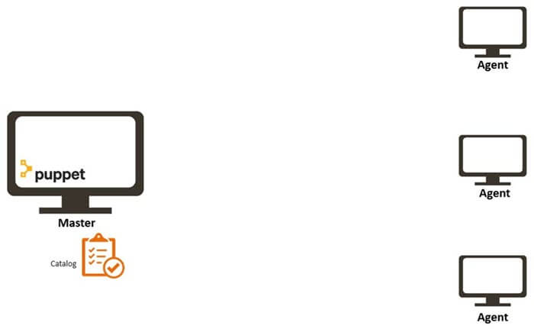
Step 2) Puppet Master uses this data and compiles a list with the configuration to be applied to the agent. This list of configuration to be performed on an agent is known as a catalog. This could be changed such as package installation, upgrades or removals, File System creation, user creation or deletion, server reboot, IP configuration changes, etc.
Master sends a catalog to Agent

Slide 14
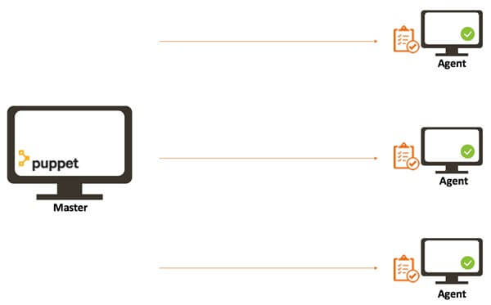
Step 3) The agent uses this list of configuration to apply any required configuration changes on the node.
In case there are no drifts in the configuration, Agent does not perform any configuration changes and leaves the node to run with the same configuration.
Agent applies configuration
Step 4) Once it is done the node reports back to puppet master indicating that the configuration has been applied and completed.

Slide 15
The Connection Between Puppet Master Server and Puppet Agent Nodes
As we can see, the Puppet master and the Puppet agents have to communicate with each other in order to let Puppet work seamlessly, but how exactly do they communicate?
Let’s understand the workflow of Puppet step by step:
The nodes that the Puppet master controls have Puppet agents installed on them. The agents collect all the configuration information about their particular nodes using facts. Agents then send facts to the Puppet master.

Slide 16
After gaining all the information, the Puppet master compiles a catalog based on how the nodes should be configured. The Puppet master then sends back the catalog to the agents.
Each agent uses these catalogs and the information in them to make necessary configuration updates on their nodes and then reports back to the Puppet master.
The Puppet master can also share the reports with a third-party tool if needed.
The Puppet master communicates with a Puppet agent via HTTPS (HyperText Transfer Protocol Secure) with client verification.
The Puppet master provides an HTTP interface. Whenever the Puppet agent has to make a request or submission to the Puppet master,
it just makes an HTTPS request to one of the endpoints available in the HTTP interface provided by the Puppet master.

Slide 17
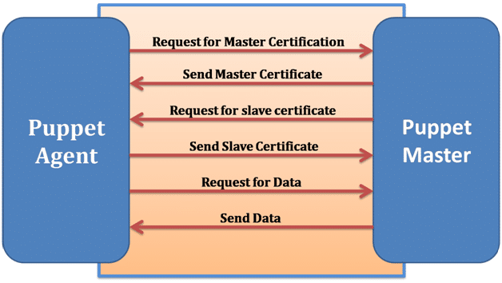

Slide 18
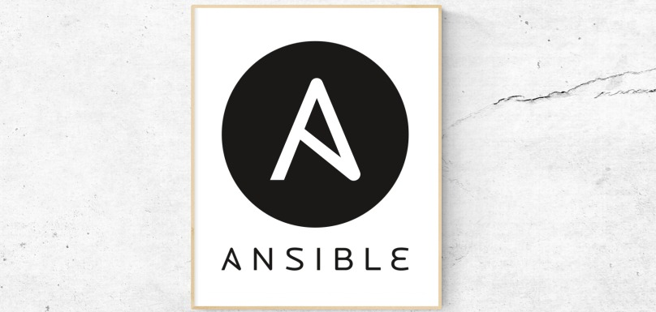

Slide 19
What is Ansible?(Push based)
Ansible is an open source DevOps tool which can help the business in configuration management, deployment, provisioning(the process of setting up IT infrastructure), etc.
It leverages SSH(Secure Shell is a network communication protocol that enables two com(http or hypertext transfer protocol, which is the protocol used to transfer hypertext such as web pages) to communicate.. and share data to communicate between servers.
Ansible provides reliability, consistency, and scalability to your IT infrastructure. You can automate configurations of databases, storage, networks, firewalls using Ansible.
It makes sure that all the necessary packages and all other software are consistent on the server to run the application.

Slide 20
Let’s take an example; you’ve got a debug version of an application that is built on visual C++.
Now if you want to run that application on a computer, you would need to meet some prerequisites like Microsoft Visual C++ library DLLs, and you would need visual C++ installed in your computer.
So, this is the part where Ansible will make sure that all these basic packages and all the software’s are installed in your computer so that your application can run smoothly on all the environments, may it be test or production environment.
It also holds all the historical data of your application, so if at any time you want to roll back to the previous version, or you want to upgrade it, you can easily do that.

Slide 21
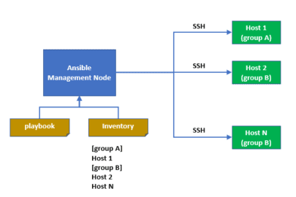
How Ansible Works?
What are playbook tasks?
A task is the smallest unit of action you can automate using an Ansible playbook. Playbooks typically contain a series of tasks that serve a goal, such as to set up a web server, or to deploy an application to remote environments. Ansible executes tasks in the same order they are defined inside a playbook.

Slide 22
Ansible Workflow
Ansible works by connecting to your nodes and pushing out a small program called Ansible modules to them.
Then Ansible executed these modules and removed them after finished. The library of modules can reside on any machine.
In the above image, the Management Node is the controlling node that controls the entire execution of the playbook.
The inventory file provides the list of hosts where the Ansible modules need to be run.
The Management Node makes an SSH connection and executes the small modules on the host's machine and install the software.
Ansible removes the modules once those are installed so expertly. It connects to the host machine executes the instructions, and if it is successfully installed, then remove that code in which one was copied on the host machine.

Slide 23
Let’s take a look at some of the following features.
Agentless – Which means there is no kind of software or any agent managing the node like other solution such as puppet and chef.
Python – Built on top of python, which is fast and one of the robust programming languages in today’s world.
SSH – Very simple password less network authentication protocol which is secure. So, your responsibility is to copy this key to the client
Push architecture – Push the necessary configurations to them, clients. All you have to do is, write down those configurations (playbook) and push them all at once to the nodes. You see how powerful it can be to push the changes to thousands of servers in minutes.
Setup – a minimal requirement and configuration needed to get it to work.

Slide 24
Benefits of Ansible
Free: Ansible is an open-source tool.
Very simple to set up and use: No special coding skills are necessary to use Ansible’s playbooks (more on playbooks later).
Powerful: Ansible lets you model even highly complex IT workflows.
Flexible: You can orchestrate the entire application environment no matter where it’s deployed. You can also customize it based on your needs.
Agentless: You don’t need to install any other software or firewall ports on the client systems you want to automate. You also don’t have to set up a separate management structure.
Efficient: Because you don’t need to install any extra software, there’s more room for application resources on your server.
Next, in our path to understanding what ansible is, let us find out the features and capabilities of Ansible.

Slide 25
CHEF

Slide 26
Chef is an automation platform that configures and manages your network infrastructure.(PULL BASED) Chief transforms infrastructure into code. “Infrastructure into code” here means “deploy your code/application/configuration and policy” on many machines or instances automatically via your code.
Chef is a tool used for Configuration Management which closely competes with Puppet. Chef is an automation tool that provides a way to define infrastructure as code.
As shown in the diagram below, there are three major Chef components:
Workstation
Server
Nodes

Slide 27
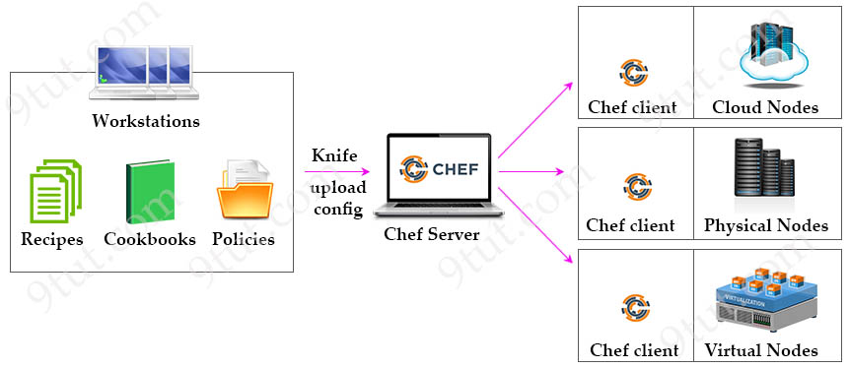
Knife ..tool

Slide 28
Workstations: simply personal computers where all development configuration code is created, tested, and changed before uploading to the Chef Server.
Each Chef workstation also has a command line tool called “Knife”, which will be used to upload configuration changes to the Chef Server.
Workstations are the place to write Recipes and Cookbooks:
Recipes: A Recipe is a collection of resources that describes a particular configuration ,how to implement,code.
Cookbooks: Multiple Recipes can be grouped together to form a Cookbook. A Cookbook defines a scenario and contains everything that is required to support that scenario.
policy. It describes everything that is required to configure part of a system and in which order it is to be used. The user writes Recipes that describe
how Chef manages applications and utilities (such as Apache HTTP Server, MySQL, or Hadoop) and how they are to be configured.

Slide 29
Cookbooks: Multiple Recipes can be grouped together to form a Cookbook. A Cookbook defines a scenario and contains everything that is required to support that scenario.
A Cookbook also includes attributes, libraries, metadata, and other files that are necessary for supporting each configuration.
Cookbooks are created using Ruby language is used for specific resources.
Writing Cookbooks and Recipes that will later be pushed to the central Chef Server

Slide 30
Chef Server: The centralized store of our infrastructure’s configuration. The Chef server stores, manages and provides configuration to all nodes that make up the infrastructure.
Nodes: are the servers where your code needs to run. Chef server manages Nodes by Chef client, which is a software installed on each Node.
Chef client retrieving configuration information from the Chef Server. Nodes can be a cloud-based/virtual/physical server in your own data center.
Any changes made to your infrastructure code must pass through the Chef server in order to be applied to nodes. Prior to accepting or pushing changes, the Chef server authenticates all communication via its REST API using public key encryption.
Chef client periodically pulls Chef server to see if there are any changes in cookbooks or settings. If there are changes then Chef server sends the latest configuration information to Chef client. Chef client applies these changes to nodes.

Slide 31
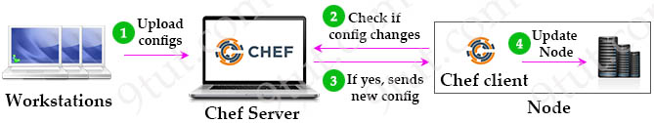

Slide 32
SALTSTAKER

Slide 33
Why Saltstack?
SaltStack Architecture is developed for providing speed and scale.
This is the reason why this architecture is used for managing the thousands of servers at Google, Linked In, and many more companies.
For example - If a user has thousands of servers and the user wants to perform functions on every server. A user would be required to log in to every server and perform functions one at a time. This process will be very complicated and time-consuming as functions like software installation and configuration based on particular criteria may consume a lot of time.
To overcome this problem, SaltStack Architecture has been introduced as one can perform different functions just by typing one command. Thus, SaltStack is a single solution to overcome all such issues

Slide 34
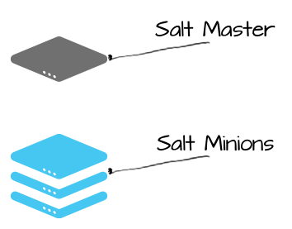
Salt uses a server-agent communication model, The server component is called the Salt master, and the agent is called the Salt minion.

Slide 35
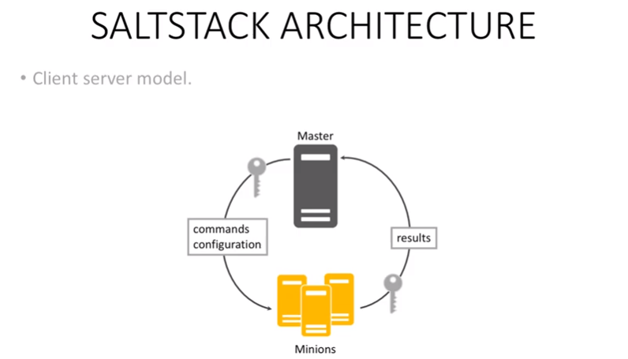
The Salt master is responsible for sending commands to Salt minions, and then aggregating and displaying the results of those commands. A single Salt master can manage thousands of systems.

Slide 36
