Slide 1
Selenium

Slide 2
What is Selenium?
Selenium is a free (open-source) functional automated testing framework used to validate web applications across different browsers and platforms.
You can use multiple programming languages like Java, C#, Python etc to create Selenium Test Scripts.
Testing done using the Selenium testing tool is usually referred to as Selenium Testing.
Selenium Software is not just a single tool but a suite of software, each piece catering to different Selenium QA testing needs of an organization.
Here is the list of tools
Selenium Integrated Development Environment (IDE)
Selenium Remote Control (RC)
WebDriver
Selenium Grid
At the moment, Selenium RC and WebDriver are merged into a single framework to form Selenium 2. Selenium 1, by the way, refers to Selenium RC.

Slide 3
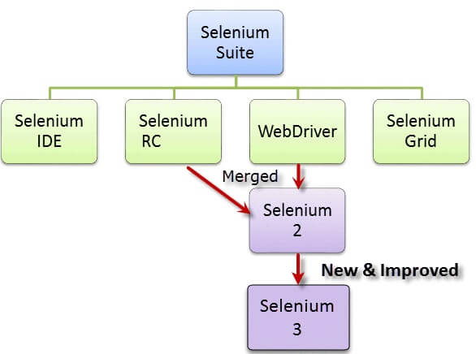

Slide 4
Note:
Selenium 1 version consisted of the combination of Selenium IDE, Selenium Remote Control, and Selenium Grid.
2. Version of Selenium 2 = Selenium IDE + Selenium Remote Control + Selenium WebDriver + Selenium Grid
3. Since Selenium RC was completely removed from the version of Selenium 3, therefore, this version consisted of IDE, WebDriver, and Grid.
4. Selenium 4.

Slide 5
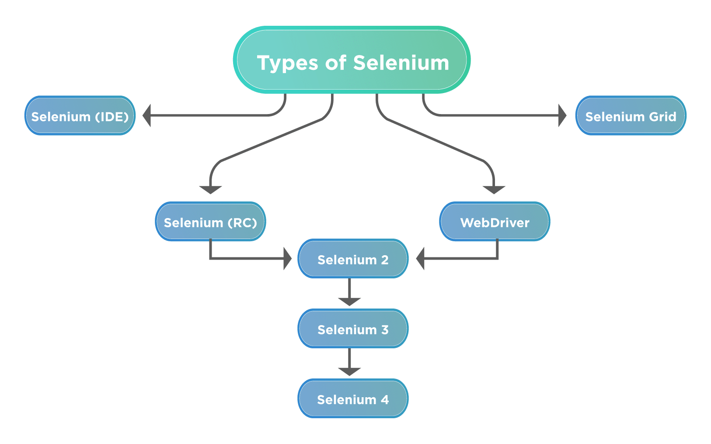

Slide 6
Selenium IDE
Selenium Integrated Development Environment (IDE) is the simplest framework in the Selenium suite and is the easiest one to learn.
It supports Edit, Record, and debugging features, also named Record/Replay or Record/Playback.
It is a Firefox Add-on/Extension which works only in the old version of the Firefox browser.
Selenium- Integrated Development Environment is very user-friendly.
However, because of its simplicity, Selenium IDE should only be used as a prototyping tool.
Static pages we can execute, but not support dynamic pages.
If you want to create more advanced test cases, you will need to use either Selenium RC or WebDriver.

Slide 7
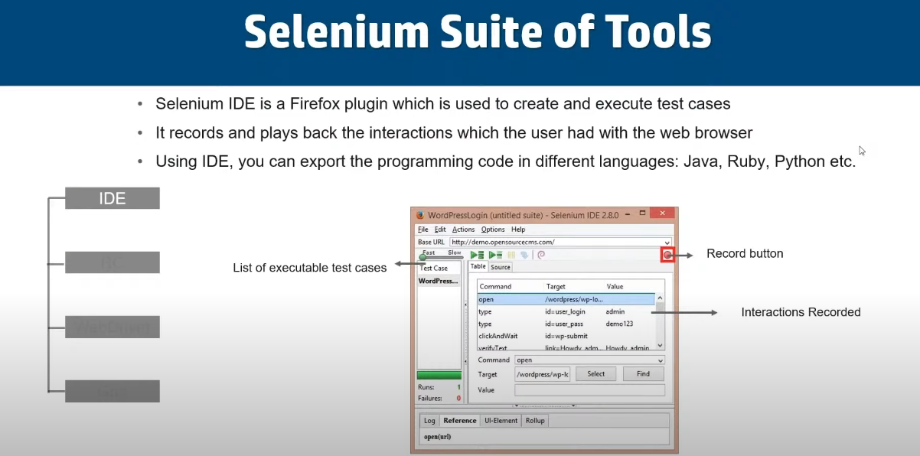

Slide 8
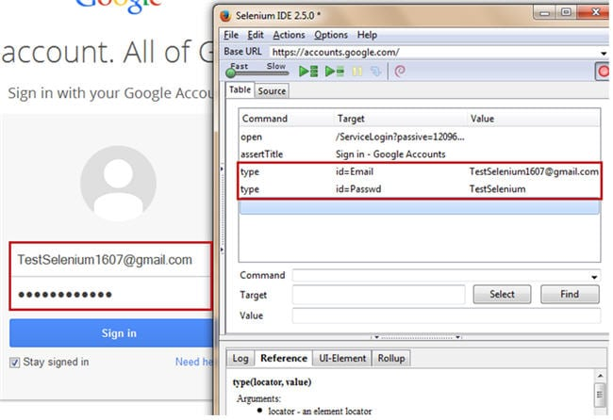

Slide 9
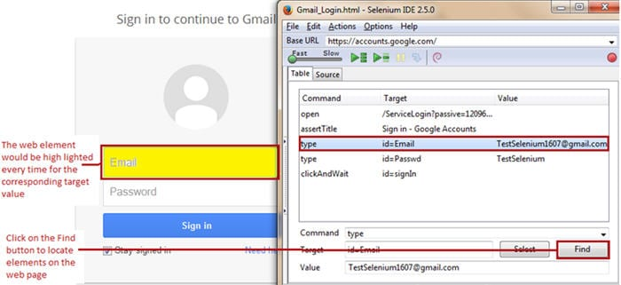
We can play back…

Slide 10
Selenium RC- It was one of the first tools of Selenium Suite. Previously it was called as JavaScript Executor.
Remote Control was the tool that made Selenium prominent in the market. It was one of the first tools which provided support for multiple programming languages (Perl, PHP, JAVA, Ruby, Python, and C#).
It also supported almost all the major names of Browsers like Google Chrome, Internet Explorer Mozilla Firefox, etc. Selenium RC is also known as Selenium 1.

Slide 11
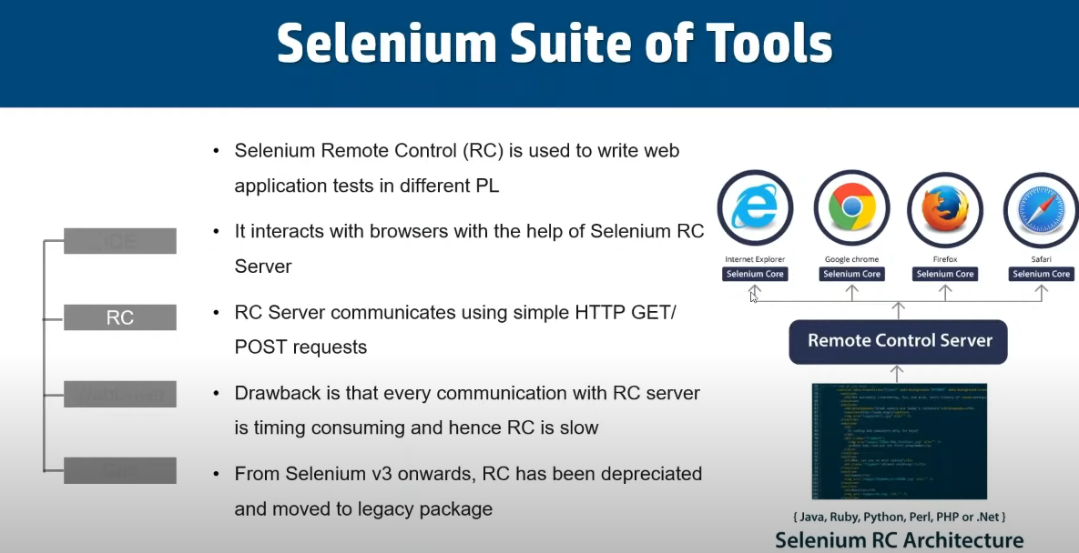

Slide 12
Selenium WebDriver is a web framework that permits you to execute cross-browser tests.
This tool is used for automating web-based application testing to verify that it performs expectedly.
Selenium WebDriver allows you to choose a programming language to create test scripts. As discussed earlier, it is an advancement over Selenium RC to overcome a few limitations.
In WebDriver, test scripts can be developed using any of the supported programming languages and can be run directly in most modern web browsers.
Languages supported by WebDriver include C#, Java, Perl, PHP, Python and Ruby.

Slide 13
Features of Selenium WebDriver:
Open source
Supports all the key vendors of the browser like Mozilla Firefox, Internet Explorer, Google Chrome, Safari, etc.
Support Multiple languages like C#, JAVA, Ruby, Perl, Python, and PHP.
Supports multiple platforms like Linux, Windows, MAC, etc.
No middleman like Selenium RC server is required.
Easy to integrate with Testing frameworks.
Parallel Testing capabilities.

Slide 14
Selenium WebDriver performs much faster as compared to Selenium RC because it makes direct calls to the web browsers.
Most commonly used WebDriver's include:
Google Chrome Driver
Internet Explorer Driver
Opera Driver
Safari Driver

Slide 15
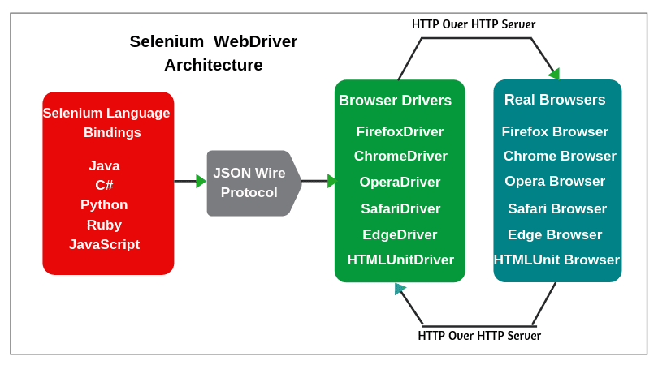
Selenium WebDriver- Architecture
Selenium WebDriver API provides communication facility between languages and browsers.
The following image shows the architectural representation of Selenium WebDriver.

Slide 16
There are four basic components of WebDriver Architecture:
Selenium Language Bindings
JSON Wire Protocol
Browser Drivers
Real Browsers
Selenium Client Libraries/Language Bindings
Selenium supports multiple libraries such as Java, Ruby, Python, etc. Selenium Developers have developed language bindings to allow Selenium to support multiple languages.

Slide 17
2. JSON WIRE PROTOCOL Over HTTP Client
JSON stands for JavaScript Object Notation. It is used to transfer data between a server and a client on the web. JSON Wire Protocol is a REST API that transfers the information between HTTP server. Each BrowserDriver (such as FirefoxDriver, ChromeDriver, etc.) has its own HTTP server.
How does JSON wire protocol work?
Json Wire Protocol: A client has an object that has to be sent to a server. The client converts this object into a JSON object and sends it to the server. The server parses the JSON object and converts it back to object for use. The server converts the response object into a JSON object and sends it back to the client.
3. Browser Drivers
Each browser contains a separate browser driver. Browser drivers communicate with the respective browser without revealing the internal logic of the browser’s functionality. When a browser driver has received any command then that command will be executed on the respective browser and the response will go back in the form of an HTTP response.
4. Browsers
Selenium supports multiple browsers such as Firefox, Chrome, IE, Safari, etc.

Slide 18
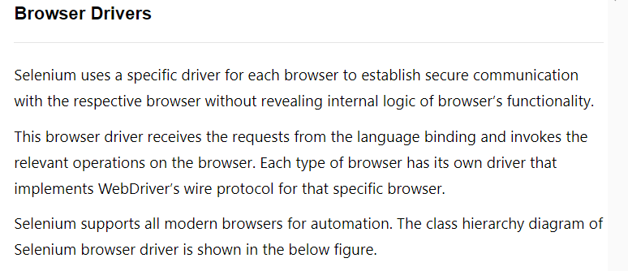

Slide 19
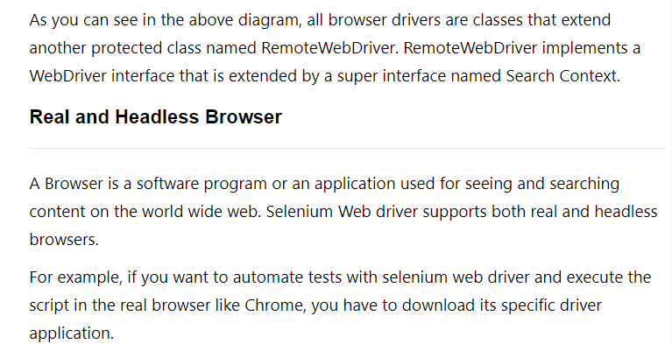

Slide 20
4. Selenium Grid
It is the last component of the selenium suite and is used for parallel testing or distributive testing or as well as remote execution.
It allows us to execute test scripts on different machines at same time.
Selenium Grid allows running tests in parallel on multiple machines and to manage different browser versions and browser configurations centrally (instead of in each individual test).
The ability to run tests on remote browser instances is useful to spread the load of testing across several machines and to run tests in browsers running on different platforms or operating systems.

Slide 21
If we want to execute the test cases, say 6 different test cases with 3 different nodes connected to a hub, then the hub's responsibility is to distribute the six different test cases among 3 different nodes which are connected to a hub.
If Chrome, Firefox, and Opera are connected to a hub then two cases will be executed in Chrome, two in Firefox, and two in Opera. With the help of parallel as well as remote execution, the test cases will be executed in various machines which are connected via LAN network which saves a lot of time and human resources.
Features of the Grid:
Parallel Execution on multiple nodes
Platform Independent, support almost all Operating System
Language Independent.
Browser Independent supports almost all the main vendors of Browser.
Fast Execution, reduces the execution time as test cases are executed parallelly

Slide 22
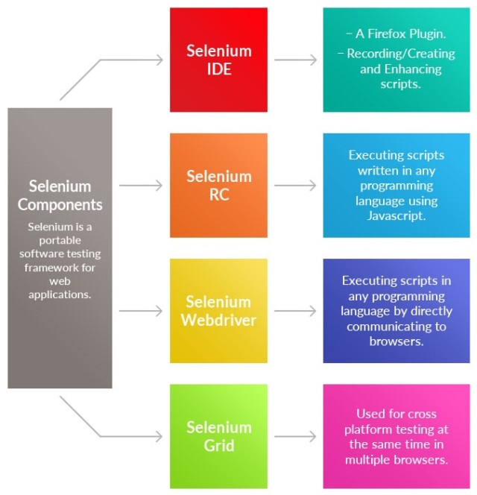

Slide 23
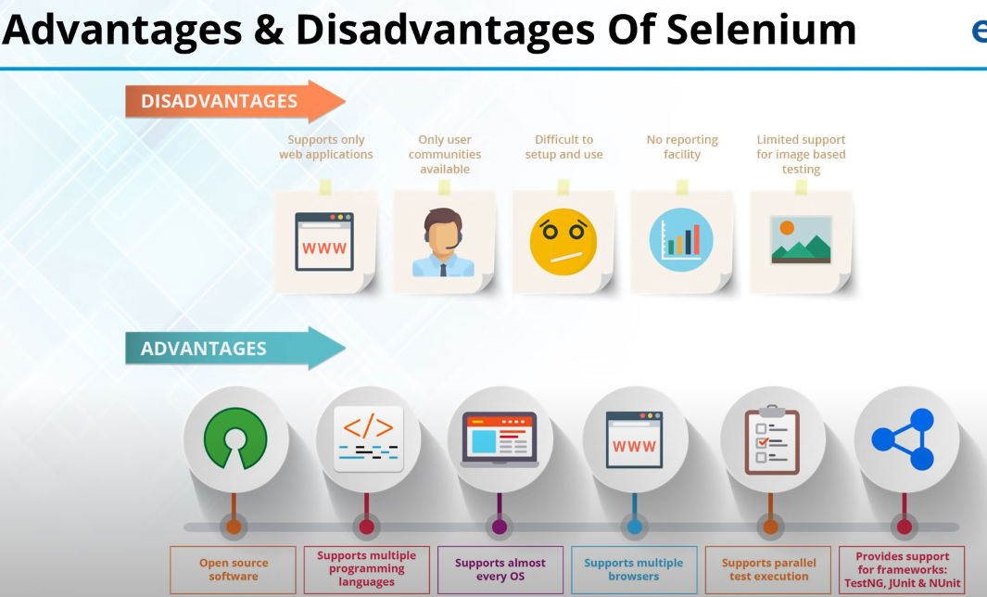

Slide 24
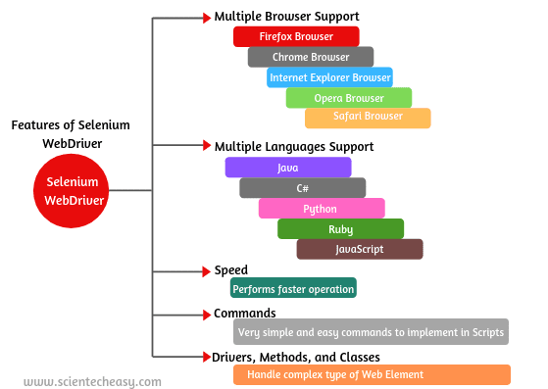

Slide 25
1. Multiple Browser Support: Selenium WebDriver supports a diverse range of multiple web browser and their version such as Firefox, Chrome, Internet Explorer, Safari, Opera, etc.
2. Multiple Languages Support: WebDriver also supports most of the commonly used programming languages such as Java, C#, Python, Ruby, Pearl, PHP, JavaScript.
You don’t have to know all of them. WebDriver provides facilities to choose any one of the programming languages based on competency and starts to create test scripts.
3. Speed: WebDriver performs the faster operation as compared to other tools of Selenium Suite. It provides direct communication between WebDriver Client Libraries and Web Browser.
4. Simple and Easy Commands: Selenium WebDriver provides very simple and easy commands to implement in the scripts. For example, If you want to launch the browser using web driver, the following commands have to use:

Slide 26
5. Drivers, Methods, and Classes: Selenium web driver offers multiple solutions to handle some potential challenges in automation testing. It also helps the testers in an easy way to handle the complex type of web elements such as check boxes, dropdowns, and alerts with the help of dynamic finders.
6. Record and Playback: Web driver does not support record and playback features like Selenium IDE.
7. Dynamic Finder: It also supports dynamic finder for locating the web element on the web pages.
9. Easy to install and configure.

Slide 27
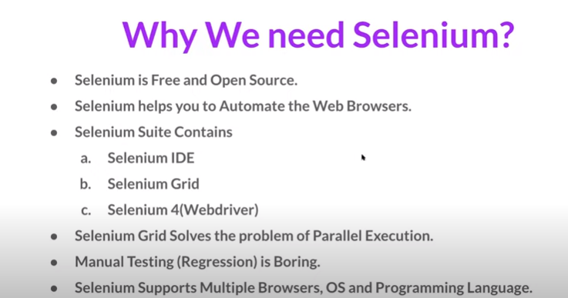

Slide 28
Test Driven Development (TDD)?
What is Test Driven Development (TDD)?
Test Driven Development (TDD) is a software development practice that focuses on creating unit test cases before developing the actual code. It is an iterative approach that combines programming, the creation of unit tests, and refactoring.
Test Driven Development is the process in which test cases are written before the code that validates those cases.i.e., test cases are developed to specify and validate what the code will do.
In simple terms, Test-Driven Development starts with designing and developing tests for every small functionality of an application.
In TDD, developers start creating small test cases for every feature based on their initial understanding.

Slide 29
The primary intention of this technique is to modify or write new code only if the tests fail. The simple concept of TDD is to write and correct the failed tests before writing new code (before development). It is a process of modifying the code in order to pass a test designed previously.
test cases for each functionality are created and tested first and if the test fails then the new code is written in order to pass the test and making code simple and bug-free. The test might fail as the tests are developed even before the development. Development team then develops and refactors the code to pass the test.
TDD framework instructs developers to write new code only if an automated test has failed. This helps to avoid duplication of code as we write a small amount of code at a time in order to pass tests.
As Test-Driven development is a process of developing and running automated test before actual development of the application. Hence, TDD sometimes also called as Test First Development.

Slide 30
The TDD approach derives its roots from the Agile manifesto principles and Extreme programming. As the name suggests, the test process drives software development. Moreover, it’s a structuring practice that enables developers and testers to obtain optimized code that proves to be resilient in the long term.
It more emphasis on production code rather than test case design.
The following sequence of steps is generally followed:
Add a test – Write a test case that describe the function completely. In order to make the test cases the developer must understand the features and requirements using user stories and use cases.
Run all the test cases and make sure that the new test case fails.
Write the code that passes the test case
Run the test cases
Refactor code – This is done to remove duplication of code.
Repeat the above mentioned steps again and again

Slide 31
TDD is usually described as a sequence of events, as follows:
• Implement the test: As the name implies, you start out by writing the test and write the code afterwards. To be able to write the test, the developer must find all relevant requirement specifications, use cases, and user stories. The shift in focus from coding to understanding the requirements can be beneficial for implementing them correctly.
• Verify that the new test fails: The newly added test should fail because there is nothing to implement the behaviour properly yet, only the stubs and interfaces needed to write the test. Run the test and verify that it fails.
• Write code that implements the tested feature: The code we write doesn't yet have to be particularly elegant or efficient. Initially, we just want to make the new test pass.
• Verify that the new test passes together with the old tests: When the new test passes, we know that we have implemented the new feature correctly. Since the old tests also pass, we haven't broken existing functionality.
• Refactor the code: The word "refactor" has mathematical roots. In programming, it means cleaning up the code and, among other things, making it easier to understand and maintain. We need to refactor since we cheated a bit earlier in the development.
TDD is a style of development that fits well with DevOps, but it's not necessarily the only one. The primary benefit is that you get good test suites that can be used in Continuous Integration tests.

Slide 32
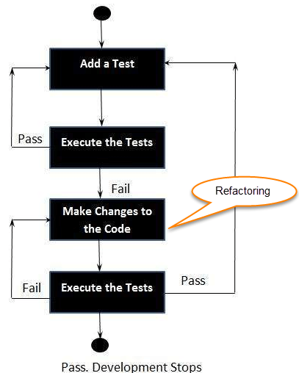

Slide 33
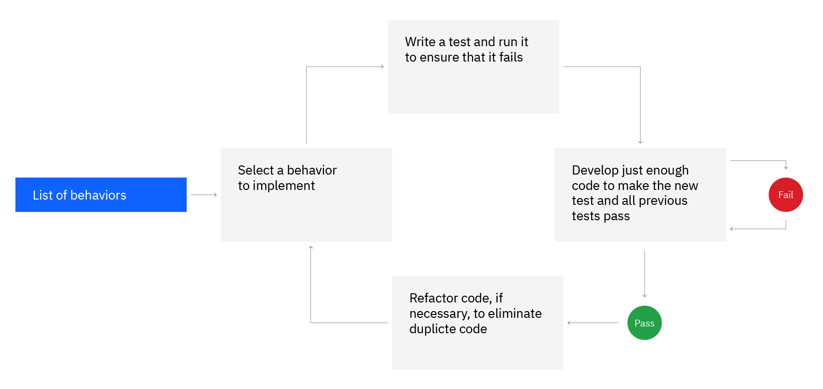
Red/Green/Refactor cycle red – Create a test case and make it fail Green – Make the test case pass by any means. Refactor – Change the code to remove duplicate/redundancy

Slide 34
Benefits of TDD:-
Much less debug time
Code proven to meet requirements
Mostly zero defects
Shorter development cycle
Following are the main advantages of Test Driven Development in Software Engineering:
Early bug notification.
Developers test their code but in the database world, this often consists of manual tests or one-off scripts. Using TDD you build up, over time, a suite of automated tests that you and any other developer can rerun at will.
Better Designed, cleaner and more extensible code.
It helps to understand how the code will be used and how it interacts with other modules.
It results in better design decision and more maintainable code.
TDD allows writing smaller code having single responsibility rather than monolithic procedures with multiple responsibilities. This makes the code simpler to understand.
TDD also forces to write only production code to pass tests based on user requirements.

Slide 35
Confidence to Refactor
If you refactor code, there can be possibilities of breaks in the code. So having a set of automated tests you can fix those breaks before release. Proper warning will be given if breaks found when automated tests are used.
Using TDD, should results in faster, more extensible code with fewer bugs that can be updated with minimal risks.
Good for teamwork
In the absence of any team member, other team members can easily pick up and work on the code. It also aids knowledge sharing, thereby making the team more effective overall.
Good for Developers
Though developers have to spend more time in writing TDD test cases, it takes a lot less time for debugging and developing new features. You will write cleaner, less complicated code.
It can enable faster innovation and continuous delivery because the code is robust.
It makes your code flexible and extensible. The code can be refactored or moved with minimal risk of breaking code.
The requirements are implemented with little to no wasted effort because only the function that is needed is written.

