Slide 1
Virtualization stacks

Slide 2
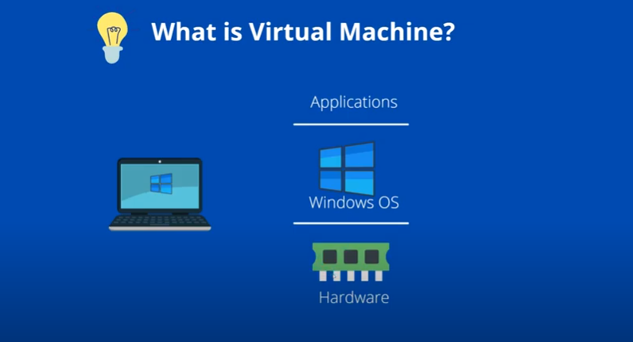

Slide 3
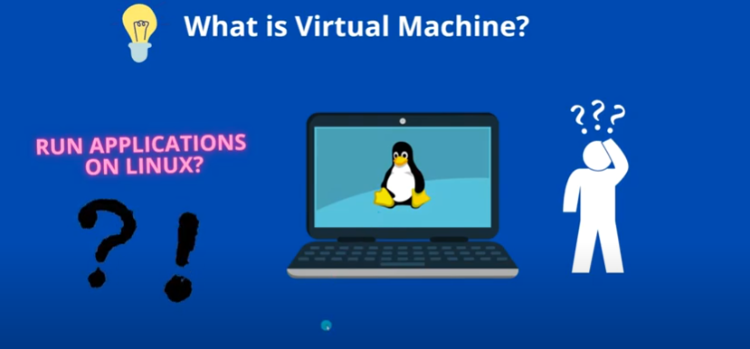

Slide 4
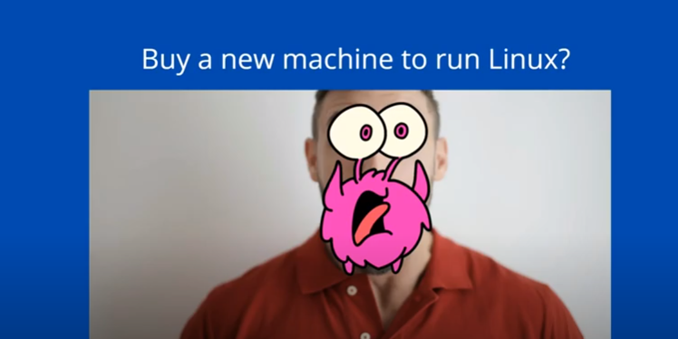

Slide 5
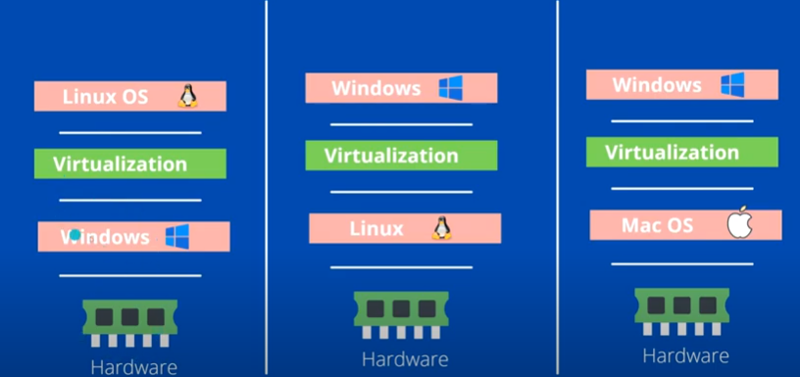

Slide 6
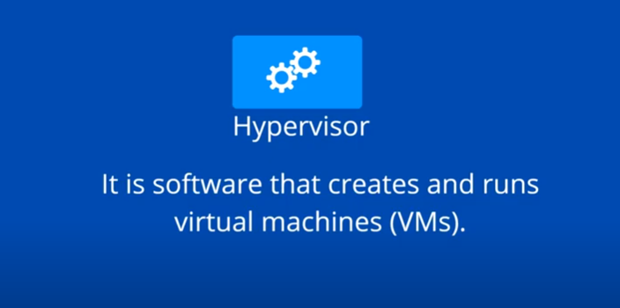

Slide 7
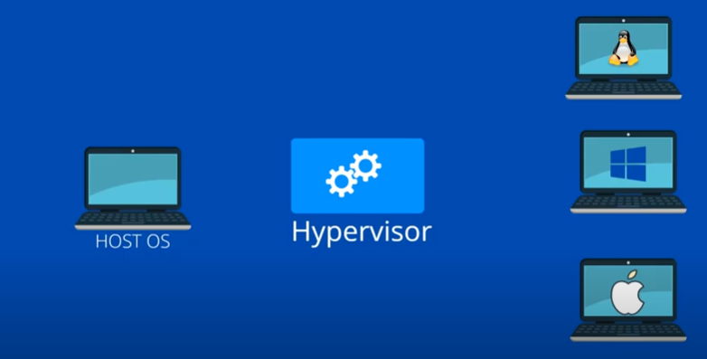

Slide 8
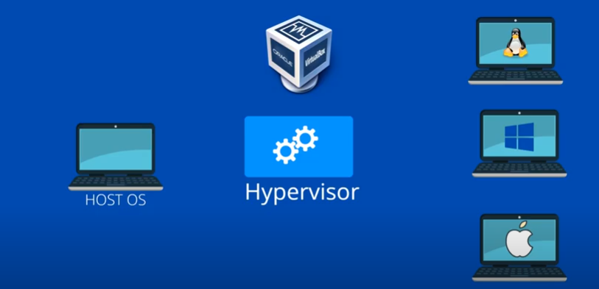
Example :
Oracle VM VirtualBox is a free and open-source hosted hypervisor for x86 virtualization, developed by Oracle Corporation.
Oracle VM VirtualBox is cross-platform virtualization software. It allows users to extend their existing computer to run multiple operating systems including Microsoft Windows, Mac OS X, Linux, and Oracle Solaris, at the same time.

Slide 9
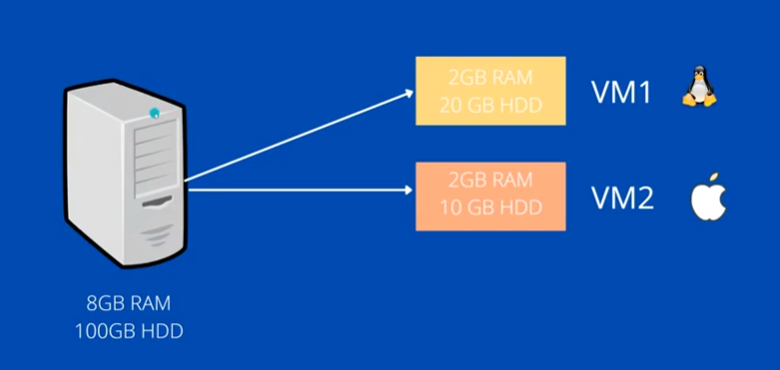

Slide 10
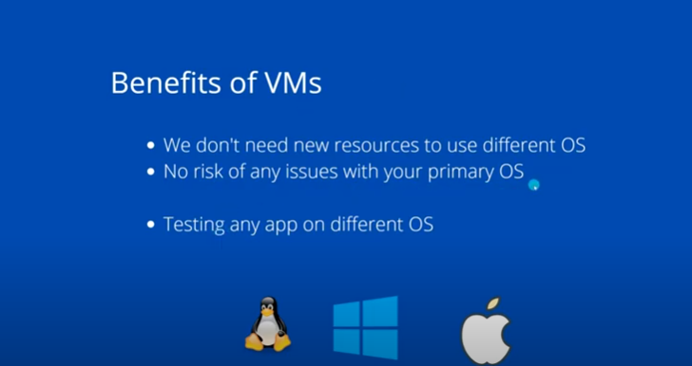

Slide 11
Virtualization is the process of creating several virtual systems on a single server. This practice maximizes a physical machine’s capacity by distributing its resources between multiple users and environments.
A single digital container is usually designed to operate one operating system, with designated spaces for each of the computer’s resources. The traditional container bears one central processing unit (CPU), a designated area for storage, and a fixed space for memory.
Virtualization treats all these items as a pool, so they can be expanded or rearranged as necessary.
DevOps teams use virtualization to create virtual machines (VMs), copying of hardware and software configurations. Each VM has an operating system and acts as an independent computer even though it runs on a portion of the physical device.

Slide 12
A virtual machine mimics all components of a computer, including:
CPU.
RAM.
Storage.
Networks.
With virtualization, a piece of hardware can host numerous VM configurations simultaneously without performance issues. The main benefits of virtualization are:
More computing capabilities with fewer resources.
Running multiple independent systems on a single hardware.
Consistent environments throughout the continuous integration and continuous delivery (CI/CD) process.

Slide 13
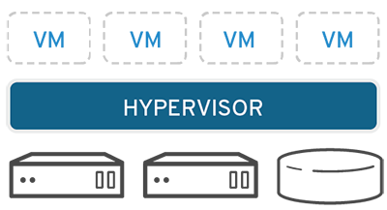
How does virtualization work?
Software called hypervisors separate the physical resources from the virtual environments—the things that need those resources. Hypervisors can sit on top of an operating system (like on a laptop) or be installed directly onto hardware (like a server), which is how most enterprises virtualize. Hypervisors take your physical resources and divide them up so that virtual environments can use them.

Slide 14
Different Types of Virtualization
There are four primary types of virtualization:
Server virtualization.
Network virtualization.
Desktop virtualization.
Operating system virtualization.
Server Virtualization
Server virtualization enables a single physical server to perform multiple independent functions. This form of virtualization leads to:
Reduced operating costs.
Increased server performance.
Faster workload capacity.
Server virtualization also lowers managing costs and physical server complexity.

Slide 15
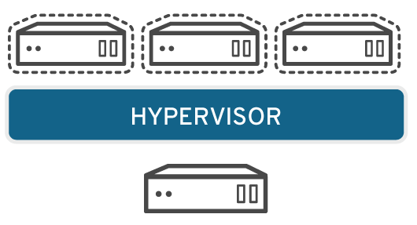
Servers are computers designed to process a high volume of specific tasks really well so other computers—like laptops and desktops—can do a variety of other tasks. Virtualizing a server lets it to do more of those specific functions and involves partitioning it so that the components can be used to serve multiple functions.

Slide 16
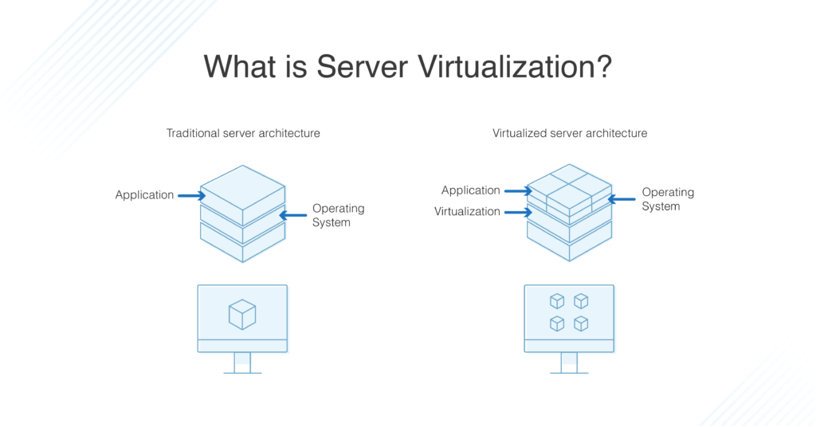

Slide 17
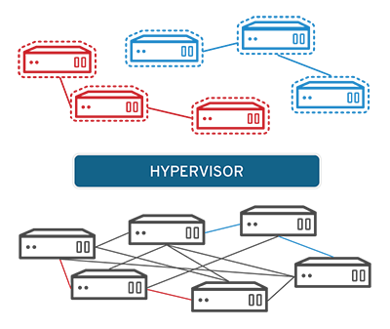
Network Virtualization
Network virtualization mimics a network in a virtual environment. This virtualization process distributes network functions (directory services, file sharing, IP configurations) among virtual environments.

Slide 18
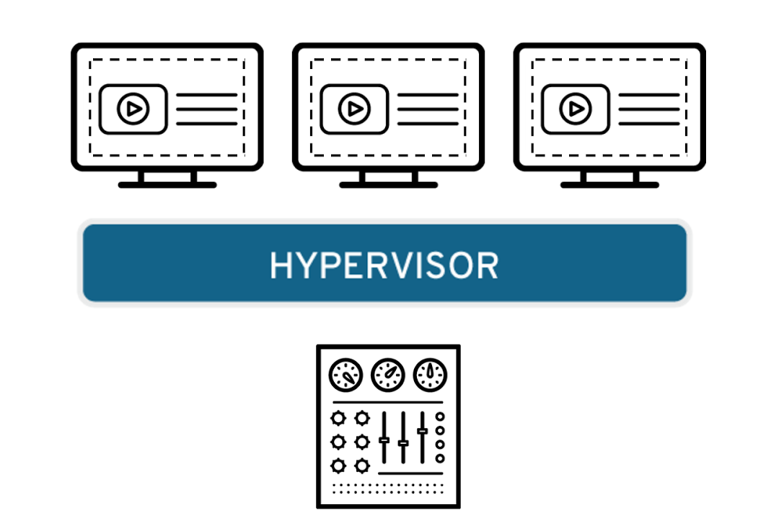
Desktop Virtualization
Desktop virtualization creates a virtual environment that imitates the settings and applications of a desktop device.
This virtualization form allows an administrator (either a person or a tool) to deploy desktop environments to multiple physical machines. Admins can perform mass configurations, updates, and security checks on all virtual desktops simultaneously.
Virtual desktop infrastructure is ideal for providing a secure, centralized work environment accessible from any device.

Slide 19
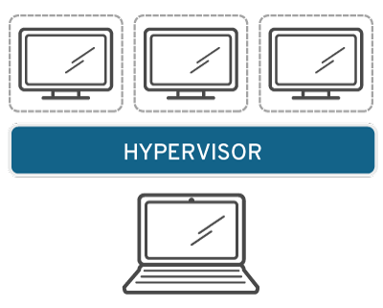
Operating System Virtualization
Operating system virtualization allows a developer to deploy multiple operating systems on a single machine. This virtualization type helps a team to:
Reduce bulk hardware costs.
Test an app in multiple operating systems on a single machine.
Increase security due to the isolation of virtual instances (e.g., test unapproved software solutions).
Speed up IT services.
Operating system virtualization is a popular option when a team needs to run Linux and Windows environments on a single device.

Slide 20
virtualization stack
A virtualization stack is a group of software components used to support a virtual environment. Items include the management console, virtual machine processes, emulated devices, management services and the user interface combined with the hypervisor.
Hardware Virtualization:
Network Virtualization:
Desktop Virtualization:
Storage Virtualization:
Application Virtualization:
Server Virtualization:

Slide 21
Hardware Virtualization
It may be considered as the most common type of virtualization these days. The best example of hardware virtualization is a Virtual Machine. A virtual machine works and looks like a real system with the same or a different operating system.
Network Virtualization:
Network virtualization is a process in which a combination of software and hardware network resources form a single software network, which is commonly known as Virtual Network. Also, the available bandwidth is divided into several independent channels, which can be used by real devices and servers.
Desktop Virtualization:
In the case of desktop virtualization, the logical or virtual desktop is separate from the physical desktop. Here, instead of accessing the desktop using the computer hardware like keyboard, mouse of the system, the desktop is located remotely from another system by using a network connection.

Slide 22
The network can be a wired/wireless LAN or the internet. So, the user can access their files from any system without physically operating the order that contains the data.
Storage Virtualization:
In this case, a combination of several storage disks forms a storage pool or group. These groups are virtual storage units. These can then be assigned to servers for use. Logical volumes are one of the examples of storage virtualization, which represent the storage as a coherent unit rather than a physical unit.
Application Virtualization:
In application virtualization, applications are virtualized and encapsulated. Virtual applications are not installed like traditional applications but are used as they are installed.
Server Virtualization:
This type of virtualization comes in handy when we need to run a single physical server on multiple operating systems simultaneously. With this process, the performance, capacity and efficiency of the server are increased, while managing costs and complexity are reduced.

Slide 23
The value of virtualization in DevOps.
(how virtualization enables engineers to set up flexible and consistent systems throughout the software development life cycle (SDLC).)
The goal of DevOps is to improve the speed and quality of software development. Traditional teams must evolve to reach faster deployments, and embracing virtualization is a major part of the DevOps transition.
Virtualization offers the consistency and agility a team requires to make the most out of modern development.

Slide 24
Role of Virtualization in DevOps
Virtualization plays a vital role in devops.
DevOps, automates various software development processes, including testing and delivery. With the help of virtualization, the devops teams can develop and test within virtual and simulated environments using similar devices and systems to the end-users.
This way, the development and testing become more efficient and less time-consuming.
Virtual live environments can also be provided to test the software at the deployment level.
This helps in real-time testing, as the team can check the effect of every new change made to the software. By doing these tasks in virtualized environments, the amount of computing resources is reduced.
This real-time testing helps in increasing the quality of the product. Working with a virtual environment reduces the time for retesting and rebuilding the software for production.
Thus, the virtualization reduces the extra efforts for the devops team, while ensuring faster and reliable delivery.

Slide 25
Advantages of Virtualization in Devops
There are many perks of virtualization in Devops; some of these are:
The workload is reduced
The providers of virtualization continuously update the hardware and software used for virtualization, so there is no need to do these updates locally. The IT staff of a company can focus on other important things and save time and cost for the organization.
Testing Environment
With the help of virtualization, we can set up a local testing environment. This environment can be used for various kinds of testing for software. Even if a server crashes, there won’t be any data loss. So, the reliability is increased, and the software can be tested on this virtual environment until it is ready for live deployment.
Energy-saving
Virtualization saves energy as instead of using local software or servers; the virtualization takes place with the help of virtual machines, which lowers the power or energy utilization. By saving this energy, the cost is reduced, and this saved money can be used for other useful operations. Improving Hardware utilization
With virtualization, the need for physical systems decreases. Thus, maintenance costs and power utilization is reduced. The use of CPU and memory is improved.
Improving Hardware utilization
With virtualization, the need for physical systems decreases. Thus, maintenance costs and power utilization is reduced. The use of CPU and memory is improved.

