Slide 1
EE-299: Design of a Single Phase Inverter
Project Presentation
M. Raghav Gopal
Supervisor: Prof. Ragavan K.

Slide 2
Inverter – DC to AC converter
Use Cases:
Grid – tie inverter.
VFD for electrical machines.
Classification:
VSI vs CSI
Pure Sine Wave vs Modified Sine wave
Notes:
Grid tie inverters converts DC to AC suitable to inject into the grid at the same voltage and frequency as of the power grid.
It should have minimal distortion from pure sine wave.
VFD is used as electric drives for motors. Has the capability of changing the frequency for more control over the machine.

Slide 3
Voltage source vs Current source inverters
VSI
CSI
Constant output voltage
Large capacitor placed in parallel to the voltage source
Does not have built in protection against short circuits
Constant output current
Large inductor placed in series with the voltage source
Has built in protection against short circuits
Notes:
Due to the large value of the inductor placed in series with the DC source in CSI. When a short circuit situation arises, the current takes time to rise.
In fact when a H – bridge is used, you should never interrupt the path of current, so it is preferred to short the source before moving on to the next combination of switches.
This would not turn out so good in VSI, where dead zones are specifically added in order to not short circuit the voltage source.
Since I am designing this inverter for electrical machine application its important to also note that:
VSI = Speed Control
CSI = Torque Control

Slide 4
Pure Sine vs Modified Sine wave inverters
Pure Sine
Modified Sine Inverters
Smooth Sinusoidal Waveform
Very Low THD (<5%)
Lower Efficiency due to complex control, filtering and high switching frequency
Can be used for sensitive loads too
Square-like stepped waveform
High THD (20% - 40%)
Higher efficiency with reduced performance with complex loads
Mainly used for simple loads (Resistive)
Notes:
Due to the large value of the inductor placed in series with the DC source in CSI. When a short circuit situation arises, the current takes time to rise.
In fact when a H – bridge is used, you should never interrupt the path of current, so it is preferred to short the source before moving on to the next combination of switches.
This would not turn out so good in VSI, where dead zones are specifically added in order to not short circuit the voltage source.
Since I am designing this inverter for electrical machine application its important to also note that:
VSI = Speed Control
CSI = Torque Control

Slide 5
Effect of harmonics on motor
Harmonic content makes it harder to magnetize the core. It increases eddy current losses and hysteresis losses.
These losses manifest as additional heat. Heat is always bad for a motor.
Positive sequence harmonics such as the 7th, 13th, 19th increase the torque production.
Negative sequence harmonics such as the 5th, 11th, 17th decrease the torque and act as a brake.

Slide 6
Why switching, why not amplification?

Slide 7
Types of Switches

Slide 8
Gate Driver Types

Slide 9
Inverter topologies
Simple H – bridge inverter
Multi-level inverter
Cascaded H – bridge inverter
Transformer based multi-level inverter
Diode clamped multi-level inverter
Flying Capacitor multi-level inverter
Notes:
Talk about switches here: Mainly there are three switches 1. BJT
2. MOSFET
3. IGBT
BJT requires current in its base to turn on, less switching frequency.
MOSFET requires voltage at its gate to turn on, high switching frequency, has moderate voltage blocking capability, suitable for high voltage and moderate current
IGBT requires voltage at its gate to turn on, high switching frequency, has high voltage blocking capability, suitable for high voltage and current. So this can be chosen to make electric drives.

Slide 10
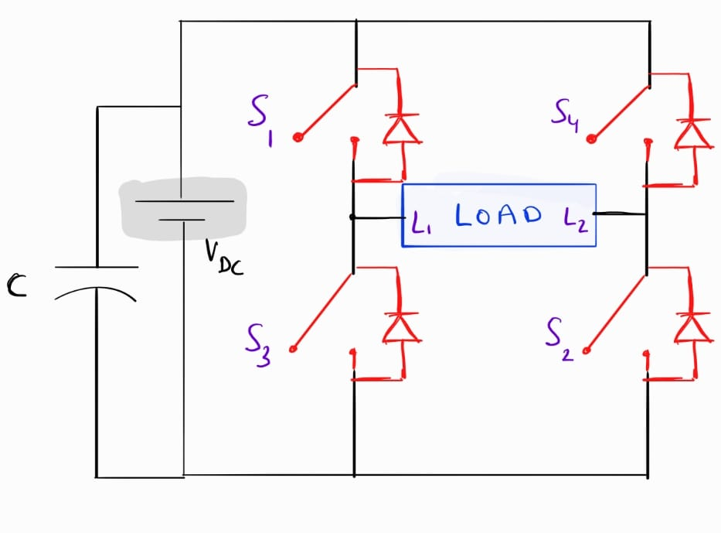
Simple H – bridge inverter
Switching scheme:
S1 | S2 | + V_{DC}
S2 | S3 | 0
S3 | S4 | -V_{DC}
S4 | S1 | 0
Notes:
Here L1 & L2 are the terminals of the load
Since this is a Voltage source inverter, it is important to note that (S1 S3) and (S2 S4) are forbidden combinations.
Mention the reason why you’re switching instead of amplifying.

Slide 11
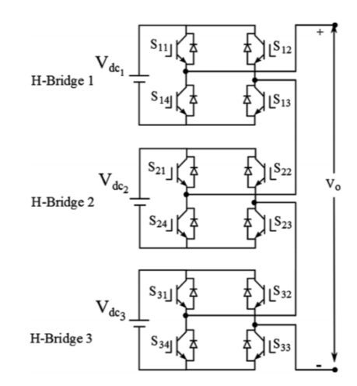
Cascaded H – Bridge inverter
Requires isolated DC voltage sources.
At the expense of more switches, they allow for multiple voltage levels at the output.

Slide 12
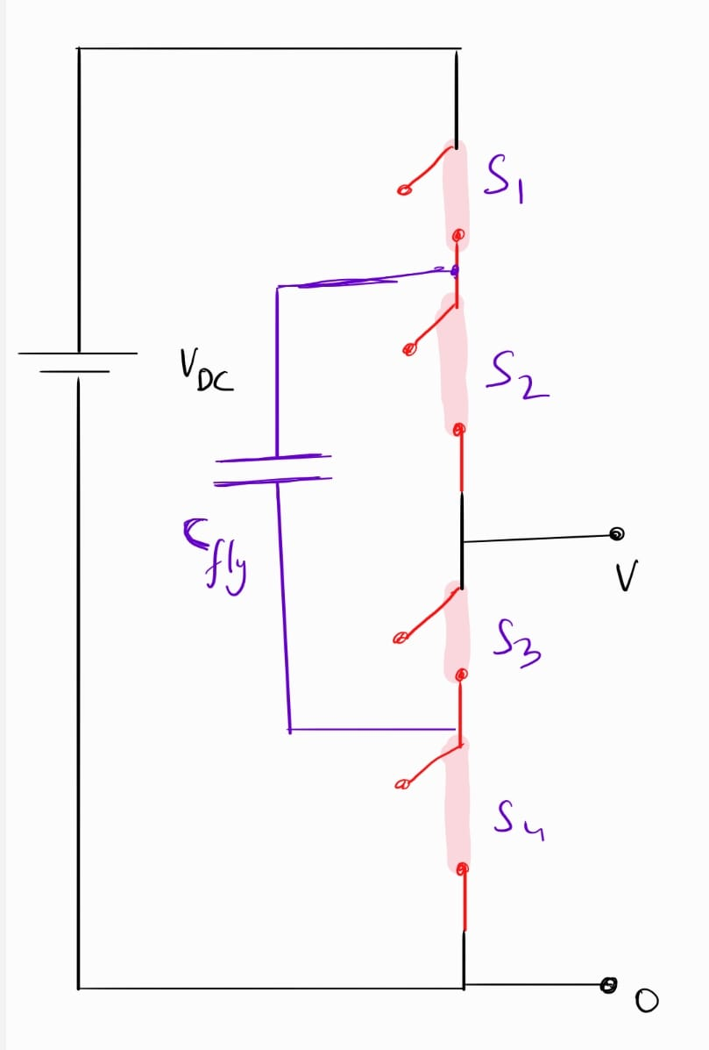
Flying Capacitor Multi – Level inverter
The figure shows one leg of a multilevel flying capacitor inverter.
The flying capacitor is maintained at 0.5 V_{DC} voltage.
S1 | S2 | +V_{DC} | -
S2 | S3 | 0 | -
S2 | S4 | +0.5 V_{DC} | Discharge
S1 | S3 | +0.5 V_{DC} | Charge
Notes:
To get 0.5 Vdc on this leg of the inverter, there are 2 choices. One option would discharge the capacitor and the other option would charge the capacitor. Switching must be such that the capacitor is maintained at 0.5 V_{DC}.

Slide 13
Why are diodes required?
Inductors cause voltage spikes, these spikes if not mitigated are enough to damage the transistor.
Hence a diode is used to clamp the voltage across the switch.
MOSFETs have body diodes but usually that is not enough.

Slide 14
Types of Control
Square Wave
Selective Harmonic Elimination
Sinusoidal – Pulse Width Modulation

Slide 15
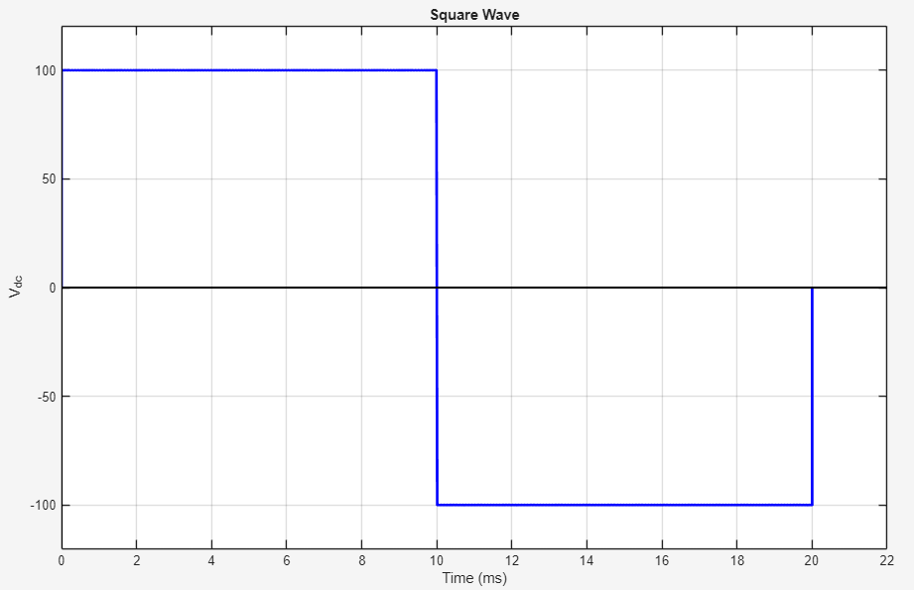
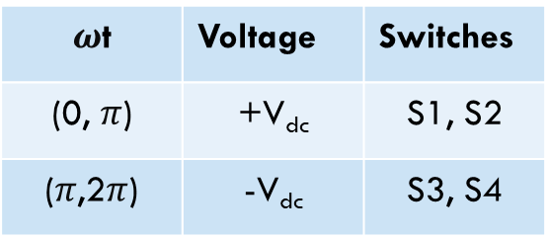
Square Wave Control
Simplest method of control for inverters.
180º Conduction Mode.
Switching Frequency = Fundamental Frequency
$ω$t | Voltage | Switches
(0, $π$) | +V_{dc} | S1, S2
($π$,2$π$) | -V_{dc} | S3, S4
Square Wave
Notes:
+ vdc = S1 S2
-vdc = S3 S4
Describe the switching sequence to generate this wave
Each switch conducts for 180 degrees hence this method is known as 180 conduction mode.
This has a very low switching frequency, hence the switching losses are minimized at the cost of waveform quality.
The peak value of this w

Slide 16
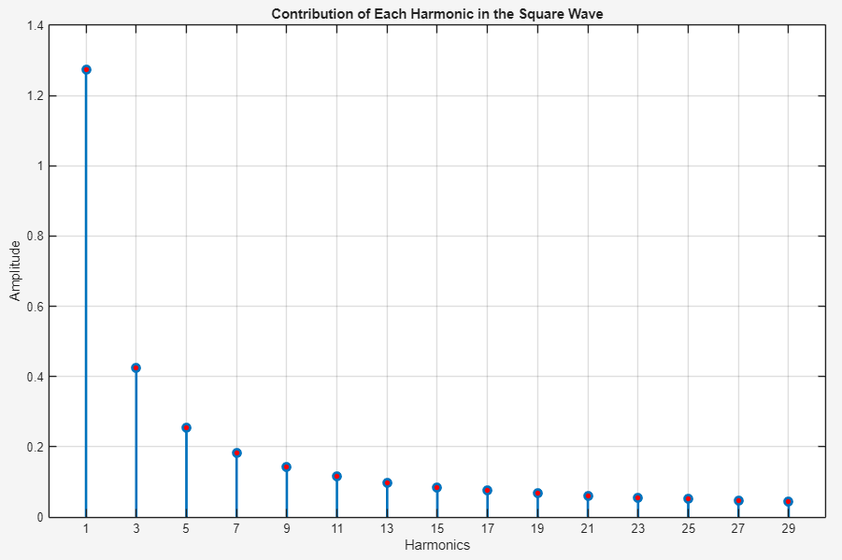
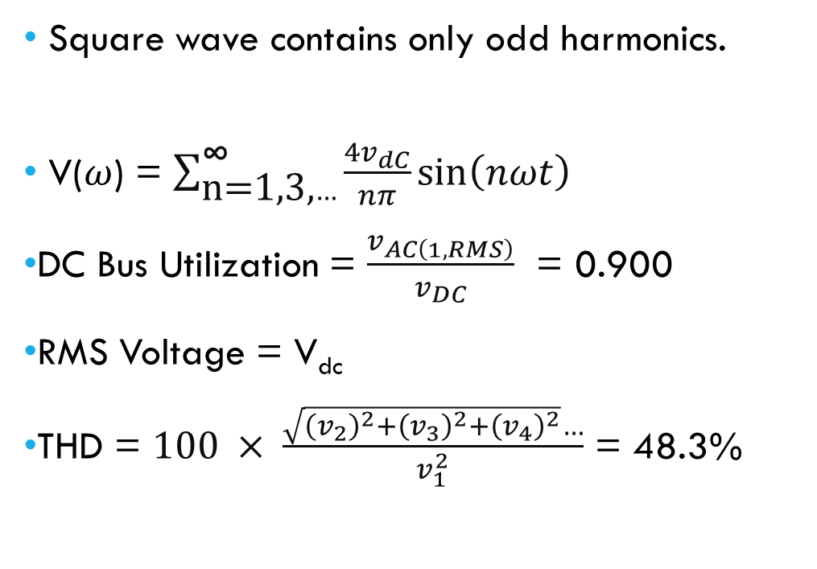
FFT – square wave control
Square wave contains only odd harmonics.
V($ω$) = $\sum_{\text{n}\text{=1,3,}…}^{\text{∞}}{\frac{4v_{ⅆC}}{nπ}sin\left(nωt\right)}$
DC Bus Utilization = $\frac{v_{AC\left(1,RMS\right)}}{v_{DC}}$ = 0.900
RMS Voltage = V_{dc}
THD = $100 × \frac{\sqrt{{\left(v_{2}\right)}^{2}+{\left(v_{3}\right)}^{2}+{\left(v_{4}\right)}^{2}}…}{v_{1}^{2}}$ = 48.3%
Frequency Domain Representation of a Square Wave
Notes:
By substituting n = 1, we find that the DC bus utilization is 127%.
Fundamental harmonic magnitude = 1.273V_{dc}

Slide 17
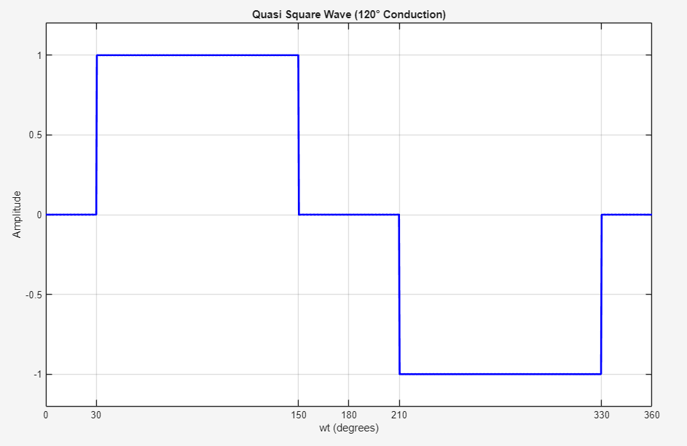
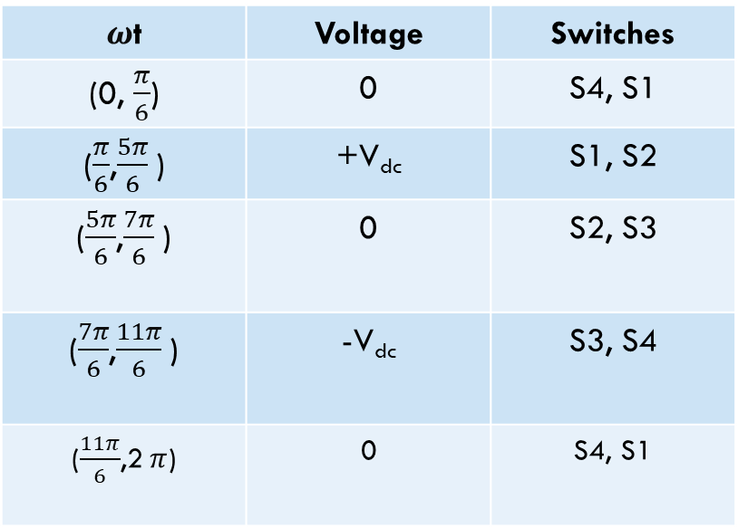
Quasi - Square Wave Control
Eliminates all multiples of the 3rd harmonic.
120º Conduction Mode.
$ω$t | Voltage | Switches
(0, $\frac{π}{6}$) | 0 | S4, S1
($\frac{π}{6}$,$\frac{5π}{6}$) | +V_{dc} | S1, S2
($\frac{5π}{6}$,$\frac{7π}{6}$) | 0 | S2, S3
($\frac{7π}{6}$,$\frac{11π}{6}$) | -V_{dc} | S3, S4
($\frac{11π}{6}$,2$π$) | 0 | S4, S1
Quasi - Square Wave
Notes:
+ vdc = S1 S2
-vdc = S3 S4
Describe the switching sequence to generate this wave
Each switch conducts for 180 degrees hence this method is known as 180 conduction mode.
This has a very low switching frequency, hence the switching losses are minimized at the cost of waveform quality.
The peak value of this w

Slide 18
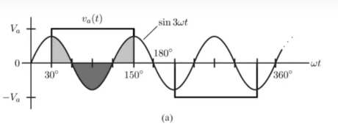
Quasi - Square Wave Control
Switching Frequency = 2 x Fundamental Frequency
Type of Selective Harmonic Elimination
Quasi - Square Wave
Notes:
+ vdc = S1 S2
-vdc = S3 S4
Describe the switching sequence to generate this wave
Each switch conducts for 180 degrees hence this method is known as 180 conduction mode.
This has a very low switching frequency, hence the switching losses are minimized at the cost of waveform quality.
The peak value of this w

Slide 19
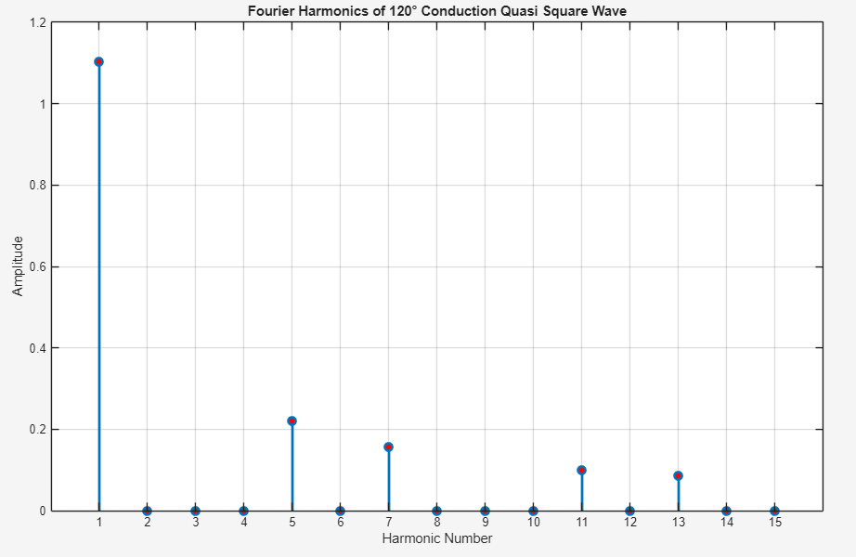
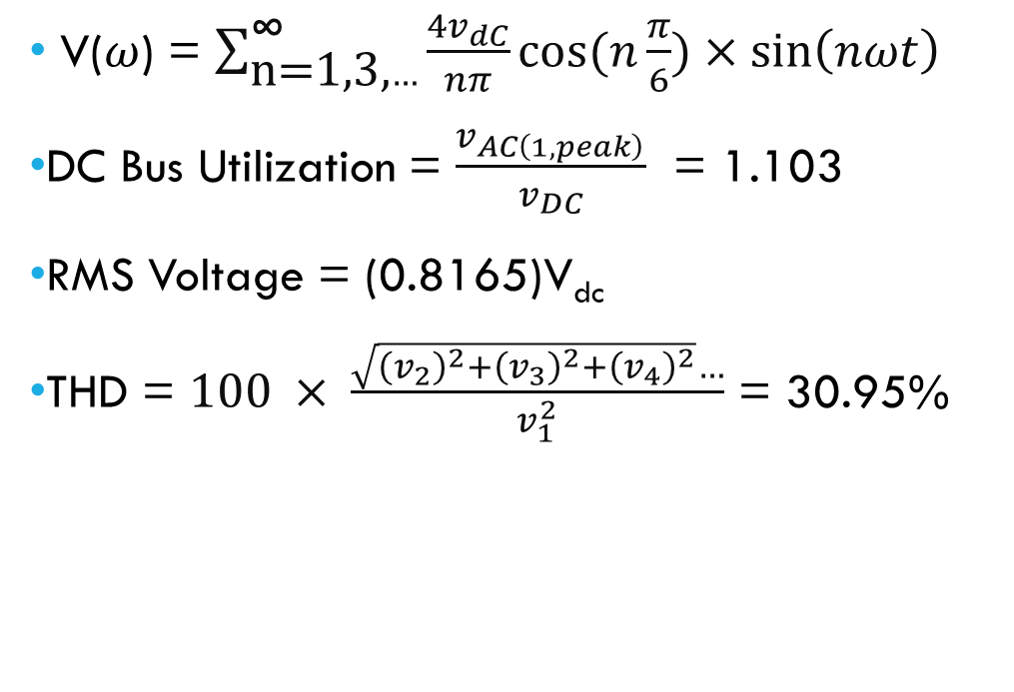
FFT – quasi square wave control
V($ω$) = $\sum_{\text{n}\text{=1,3,}…}^{\text{∞}}{\frac{4v_{ⅆC}}{nπ}cos(n\frac{π}{6})×sin\left(nωt\right)}$
DC Bus Utilization = $\frac{v_{AC\left(1,peak\right)}}{v_{DC}}$ = 1.103
RMS Voltage = (0.8165)V_{dc}
THD = $100 × \frac{\sqrt{{\left(v_{2}\right)}^{2}+{\left(v_{3}\right)}^{2}+{\left(v_{4}\right)}^{2}}…}{v_{1}^{2}}$ = 30.95%
Frequency Domain Representation
Notes:
By substituting n = 1, we find that the DC bus utilization is 127%.
Fundamental harmonic magnitude = 1.273V_{dc}

Slide 20
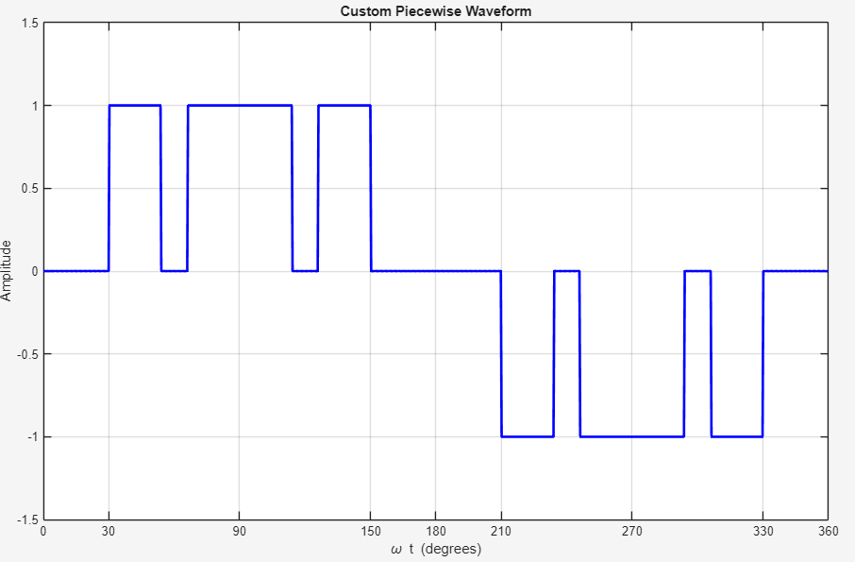
SHE – 3rd and 5th Elimination
Eliminates all multiples of the 3rd and 5th harmonics.
Increased switching frequency.
Other harmonics can also be selectively eliminated by adding more segments to this waveform.
Quasi - Square Wave
Notes:
+ vdc = S1 S2
-vdc = S3 S4
Describe the switching sequence to generate this wave
Each switch conducts for 180 degrees hence this method is known as 180 conduction mode.
This has a very low switching frequency, hence the switching losses are minimized at the cost of waveform quality.
The peak value of this w

Slide 21
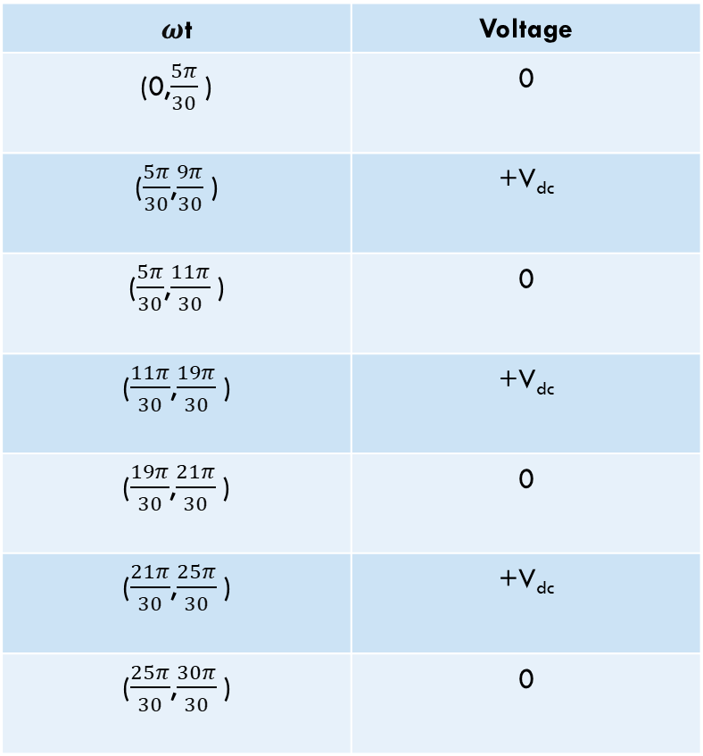
SHE – 3rd and 5th Elimination
$ω$t | Voltage
(0,$\frac{5π}{30}$) | 0
($\frac{5π}{30}$,$\frac{9π}{30}$) | +V_{dc}
($\frac{5π}{30}$,$\frac{11π}{30}$) | 0
($\frac{11π}{30}$,$\frac{19π}{30}$) | +V_{dc}
($\frac{19π}{30}$,$\frac{21π}{30}$) | 0
($\frac{21π}{30}$,$\frac{25π}{30}$) | +V_{dc}
($\frac{25π}{30}$,$\frac{30π}{30}$) | 0
Quasi - Square Wave
Notes:
+ vdc = S1 S2
-vdc = S3 S4
Describe the switching sequence to generate this wave
Each switch conducts for 180 degrees hence this method is known as 180 conduction mode.
This has a very low switching frequency, hence the switching losses are minimized at the cost of waveform quality.
The peak value of this w

Slide 22
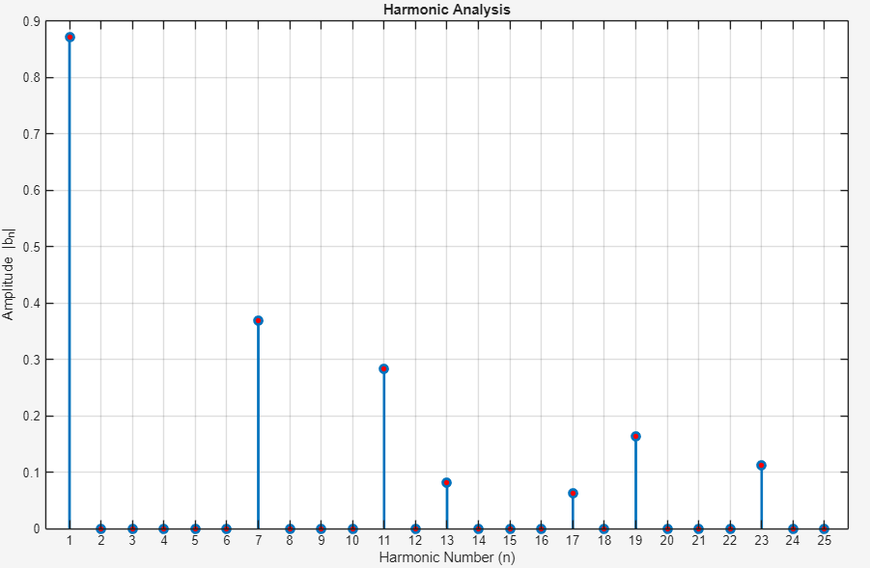
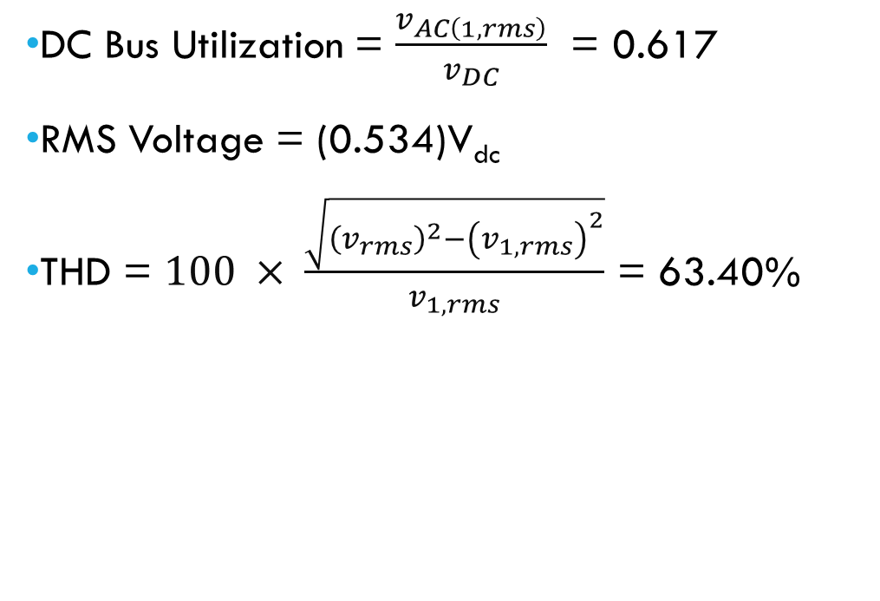
FFT – SHE 3rd and 5th Elimination
DC Bus Utilization = $\frac{v_{AC\left(1,rms\right)}}{v_{DC}}$ = 0.617
RMS Voltage = (0.534)V_{dc}
THD = $100 × \frac{\sqrt{{\left(v_{rms}\right)}^{2}−{\left(v_{1,rms}\right)}^{2}}}{v_{1,rms}}$ = 63.40%
Frequency Domain Representation
Notes:
By substituting n = 1, we find that the DC bus utilization is 127%.
Fundamental harmonic magnitude = 1.273V_{dc} $$\sum_{\text{n}\text{=1}}^{\text{∞}}{\frac{−2v_{ⅆC}}{nπ}(cos\left(n\frac{9π}{30}\right) −cos\left(n\frac{5π}{30}\right)+cos\left(n\frac{19π}{30}\right) −cos\left(n\frac{11π}{30}\right)+cos\left(n\frac{25π}{30}\right) −cos\left(n\frac{21π}{30}\right))×sin\left(nωt\right)}$$

Slide 23
Selective harmonic elimination - general
The goal in SHE is to prevent certain harmonics from appearing in the waveform at all.
Achieved by precisely choosing the switching angles, so that specific harmonics are mathematically zeroes out in the Fourier Series.
The waveform is shaped to directly avoid producing those frequencies.
Example: 3rd Harmonic elimination, 3rd and 5th Harmonic elimination.
Notes:
Based on the number of harmonics, the waveform shape is decided. Based on the specific harmonics to eliminate the switching angles are decided.

Slide 24
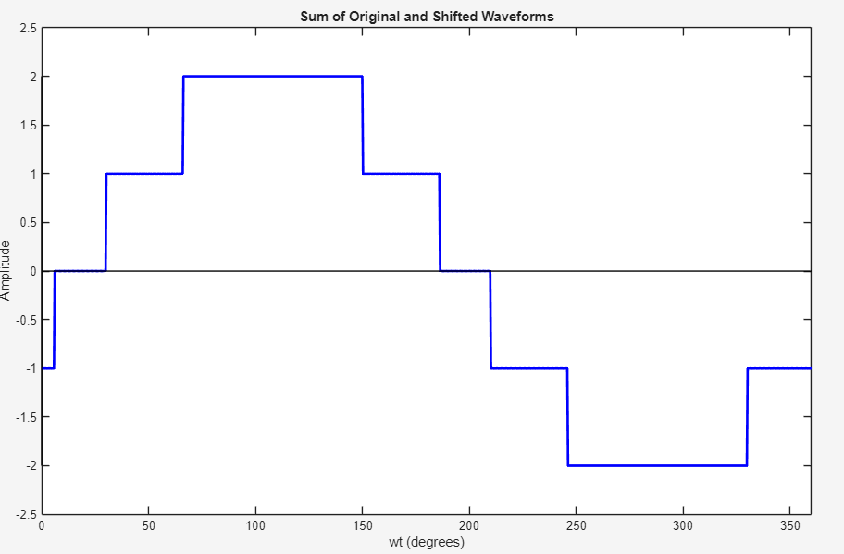
Harmonic cancellation - general
Two similar waveforms, phase shifted in time are added to cancel out specific harmonics.
Happens to 3 phase systems naturally. The line voltages do not have multiples of three harmonics.
Needs extra hardware.
Notes:
This waveform is made by shifting the 120 conduction mode by 36 degrees.
₃rd _{and 5}^{th} are eliminated. (multiples also).
When you make 3 phase inverters, you need not worry about limiting 3rd multiple harmonics, because they get cancelled out automatically in a balanced system.

Slide 25
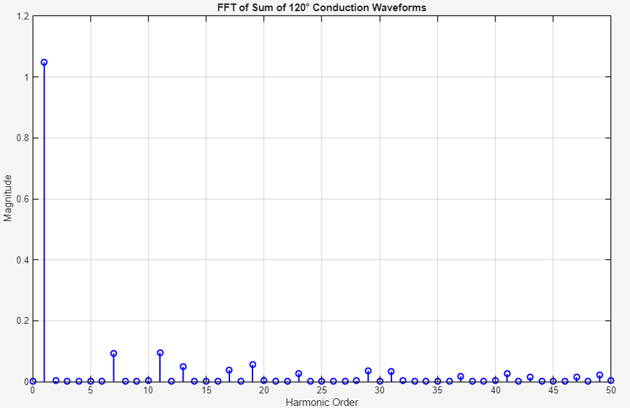
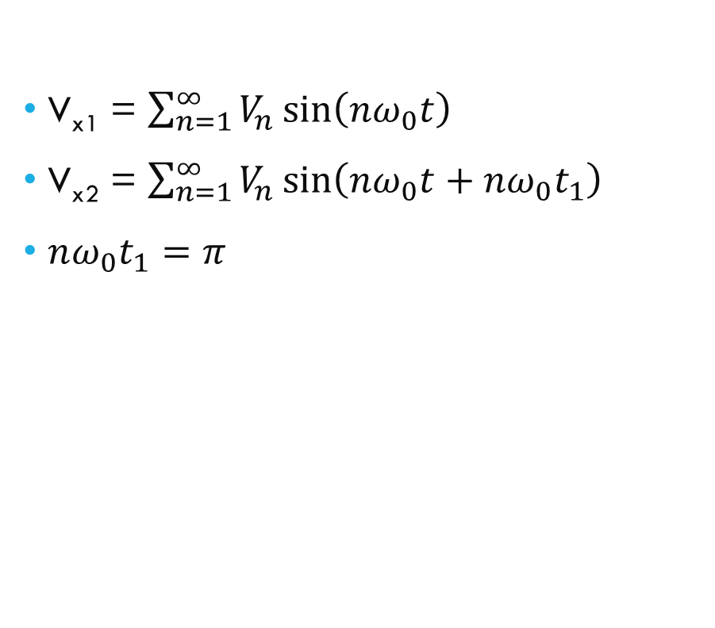
Harmonic cancellation - general
V_{x1} = $\sum_{n=1}^{∞}{V_{n}\sin\left(nω_{0}t\right)}$
V_{x2} = $\sum_{n=1}^{∞}{V_{n}\sin\left(nω_{0}t+nω_{0}t_{1}\right)}$
$nω_{0}t_{1}=π$
Notes:
This technique is used very widely in computers. Buck converters don’t output a smooth voltage, they have a ripple. So using a multi phase buck converter you can double the frequency of the ripple and halve the magnitude of it. This makes it 4 times easier for the capacitor to filter it out. Multi phase buck converters.

Slide 26
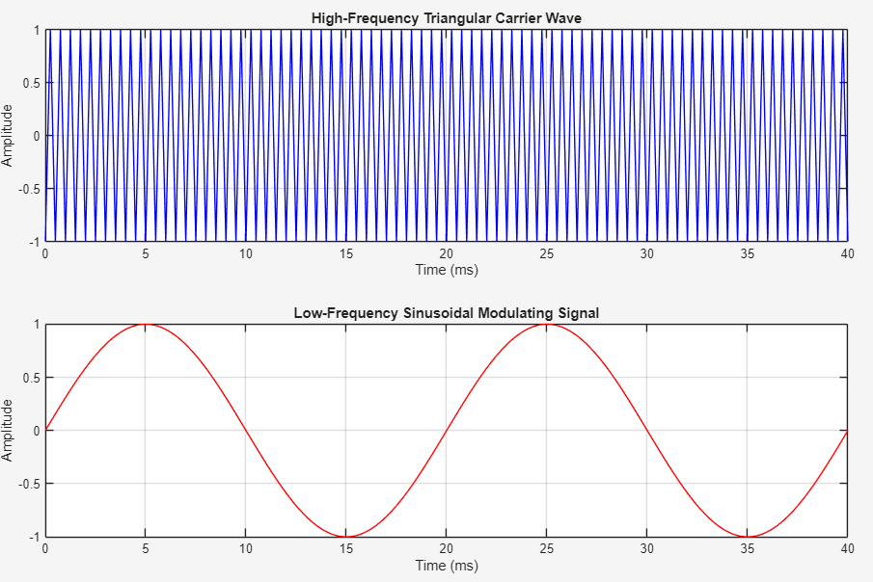
Sinusoidal - pwm
Outputs a high frequency square wave with varying pulse widths.
Pulses obtained for:
First Leg: Compare message signal with the carrier signal.
Second Leg: Compare inverse of message signal with the carrier signal.
Requires high switching frequencies.
Easy to filter out the high frequency harmonics.
Carrier signal and Message signal for SPWM
Notes:
SPWM is a technique used to approximate a sinusoidal output voltage by switching the inverter on and off rapidly in a specific pattern. Instead of generating a true sine wave, the inverter outputs a high-frequency square wave with varying pulse widths, such that the average voltage follows a sine wave.

Slide 27
Numerical Quantities in SPWM
V_{m} = Message signal = Sine wave
V_{c} = Carrier signal = Sawtooth wave
m_{a} = V_{m}/V_{c} – Modulation index
m_{f} = f_{c}/f_{m} – Carrier Frequency Ratio
When m_{a} is greater than one, the waveform starts clipping. It is called overmodulation.
Higher m_{f} means more pulses per cycle. It gives better approximation of sine.
Notes:
If the sawtooth wave used, is not triangular, then the rising time width and falling time width will no longer be the same. Symmetry in the wave is lost, and even harmonics will also start to appear.
Clipping = Low order harmonics are created.

Slide 28
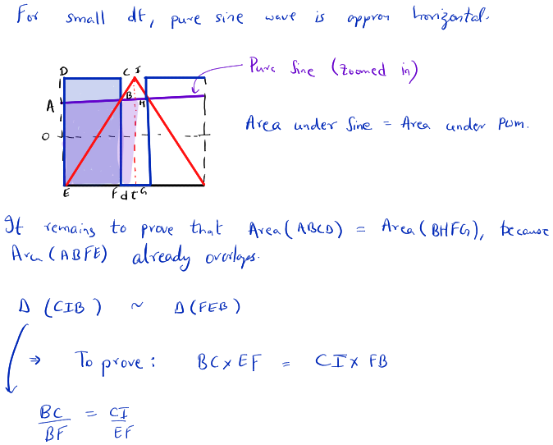
How does SPWM work?
A good signal is generated if the integral in a small interval dt, is same for pure sine and pwm.
Notes:
If the sawtooth wave used, is not triangular, then the rising time width and falling time width will no longer be the same. Symmetry in the wave is lost, and even harmonics will also start to appear.
Clipping = Low order harmonics are created.

Slide 29
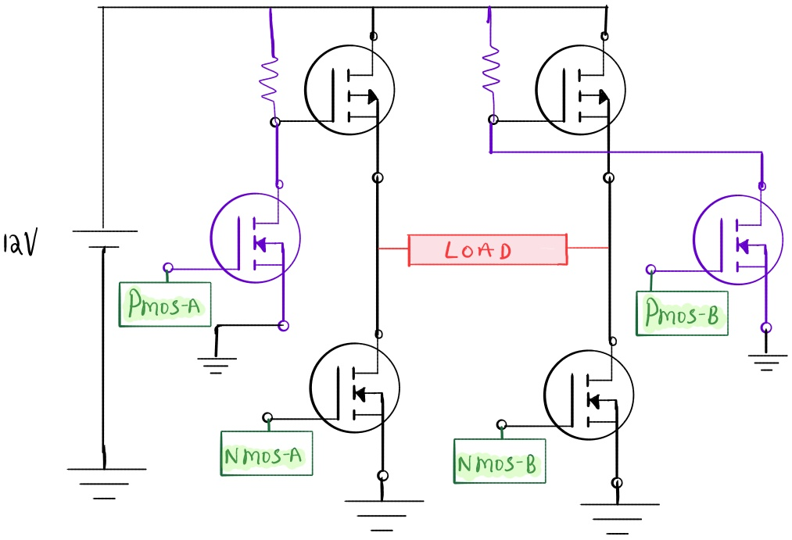
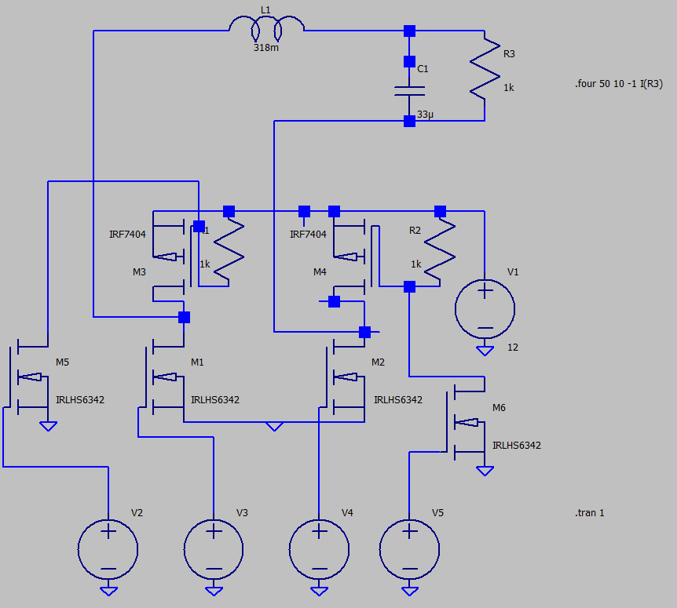
Implementation – Simple circuit

Slide 30
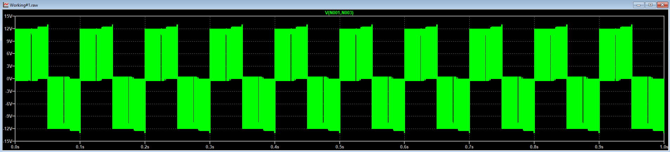
Simulation – LTSPICE

Slide 31
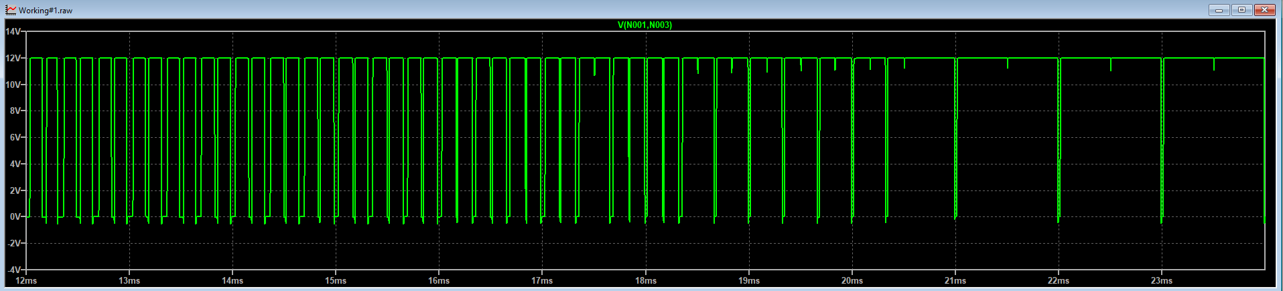
Simulation – LTSPICE

Slide 32
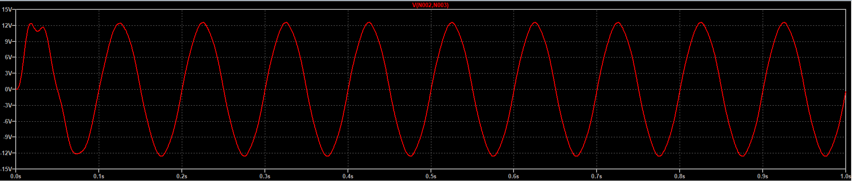
Simulation – LTSPICE

Slide 33
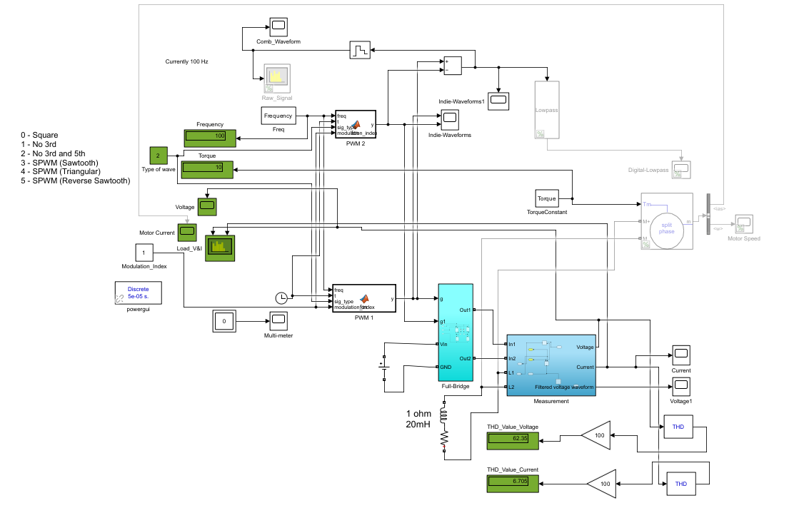
Simulation - Simulink

Slide 34
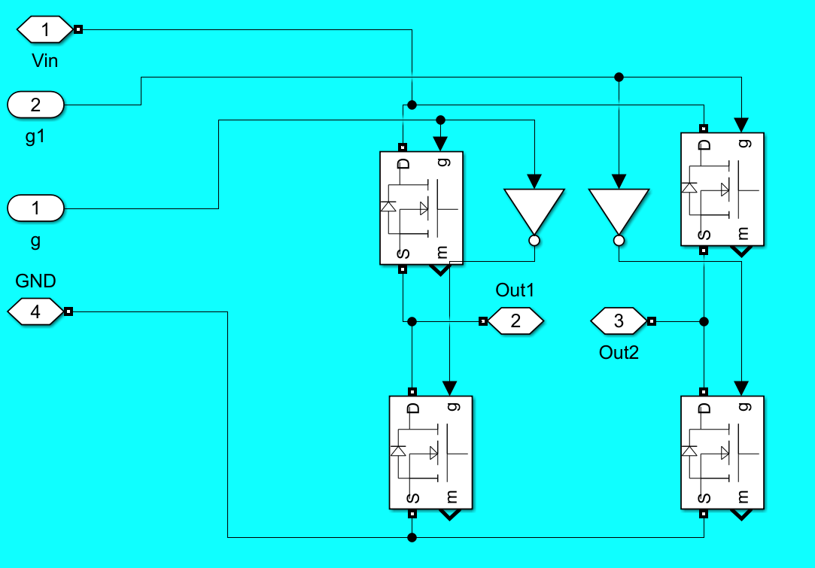
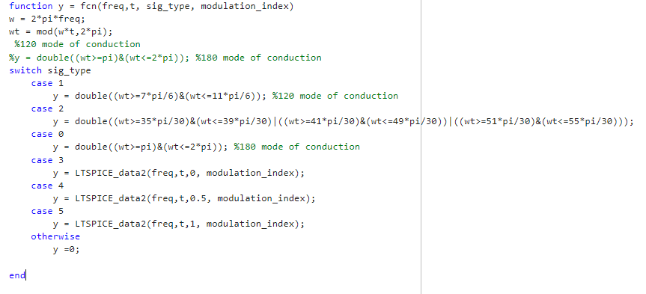
Simulation - Simulink

Slide 35
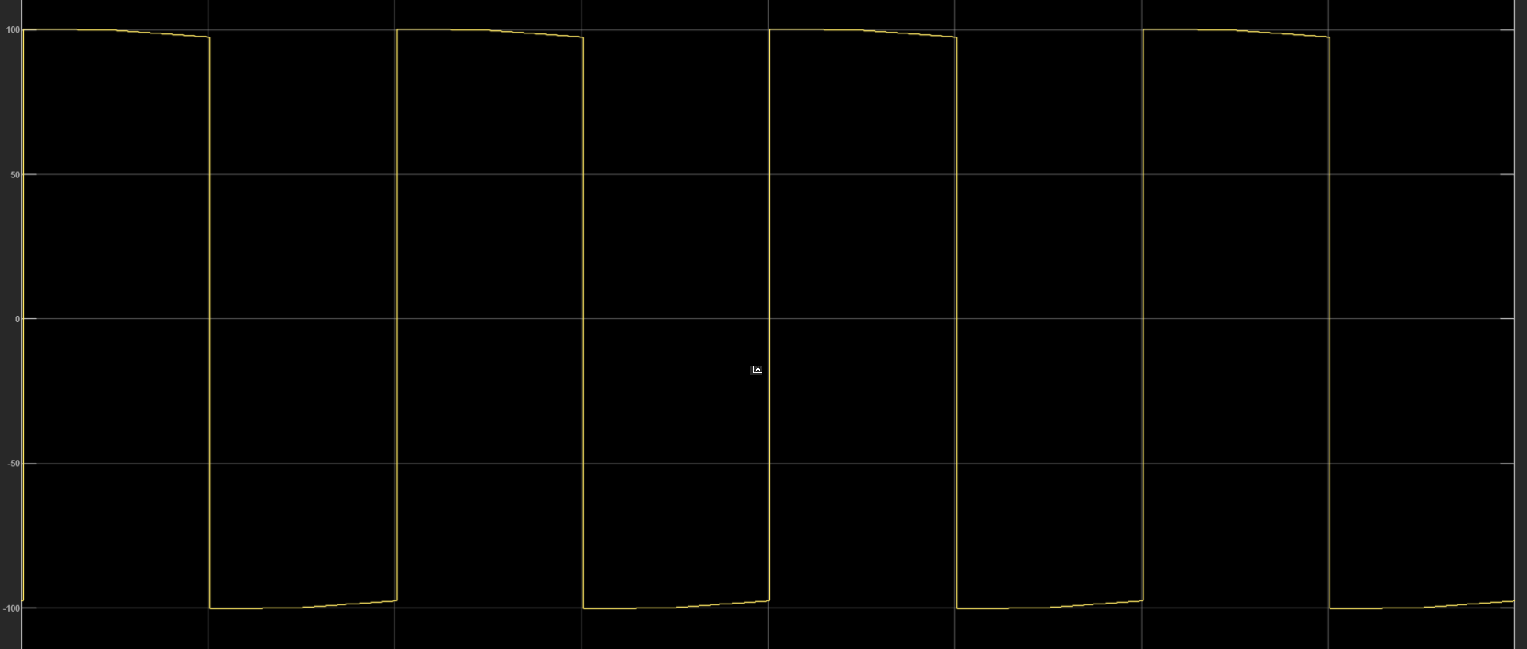
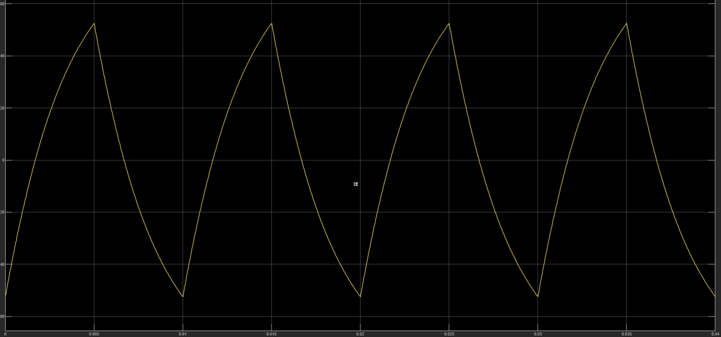
Simulink – Square Wave
Output Voltage Waveform
Current through RL load waveform

Slide 36
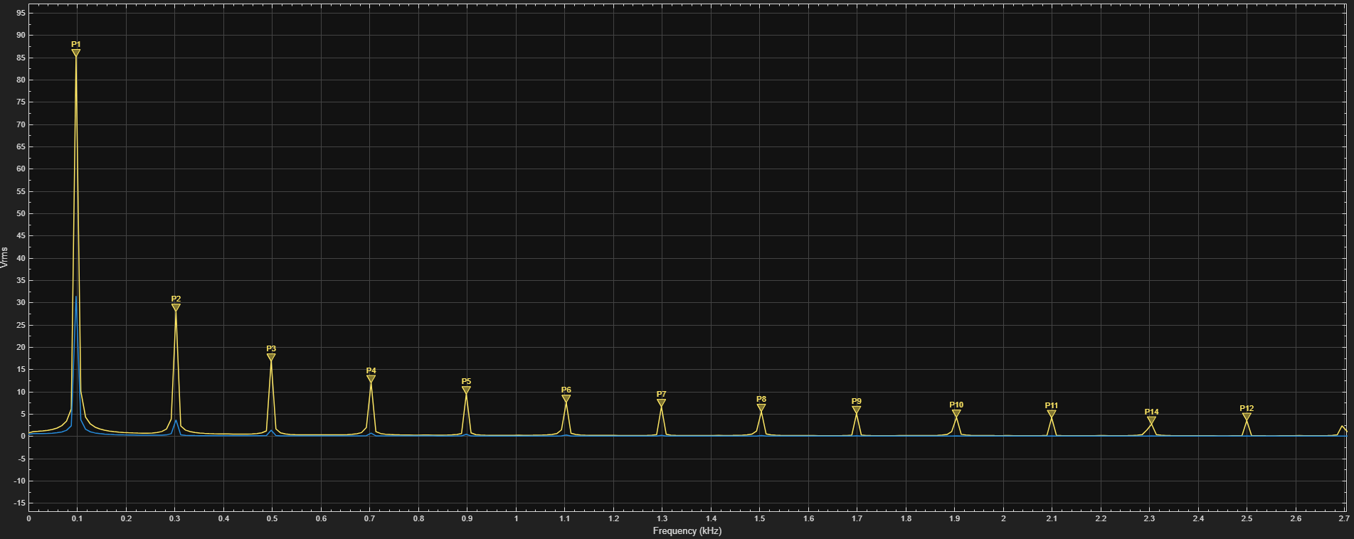
Simulink – Square Wave
Frequency Spectrum of Square Wave

Slide 37
Simulink – Square Wave
Results:
THD_Voltage = 47.72 %
Load = 1 ohm + 4mH in series
THD_Current = 12.76 %

Slide 38
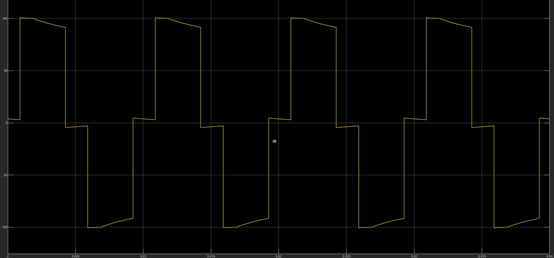
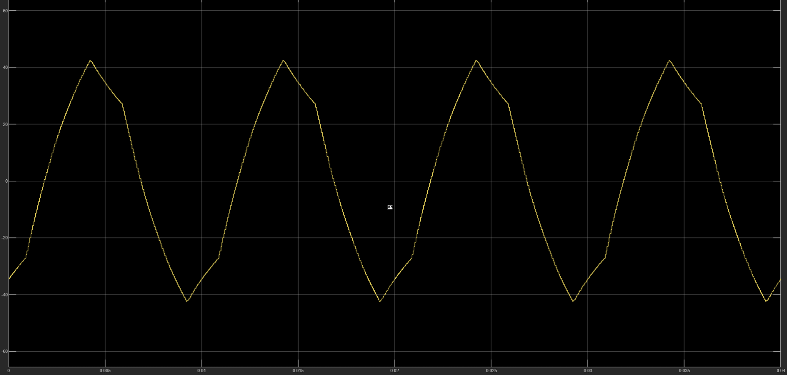
Simulink – SHE – 3rd Elimination
Output Voltage Waveform
Current through RL load waveform

Slide 39
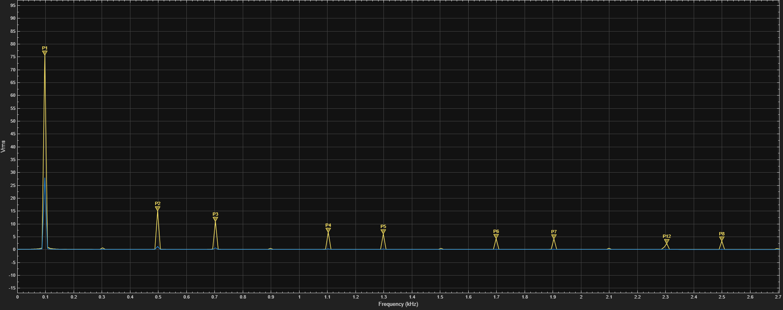
Simulink – SHE – 3rd Elimination
Frequency Spectrum of Square Wave

Slide 40
Simulink – SHE – 3rd Elimination
Results:
THD_Voltage = 31.01 %
Load = 1 ohm + 4mH in series
THD_Current = 4.99 %

Slide 41
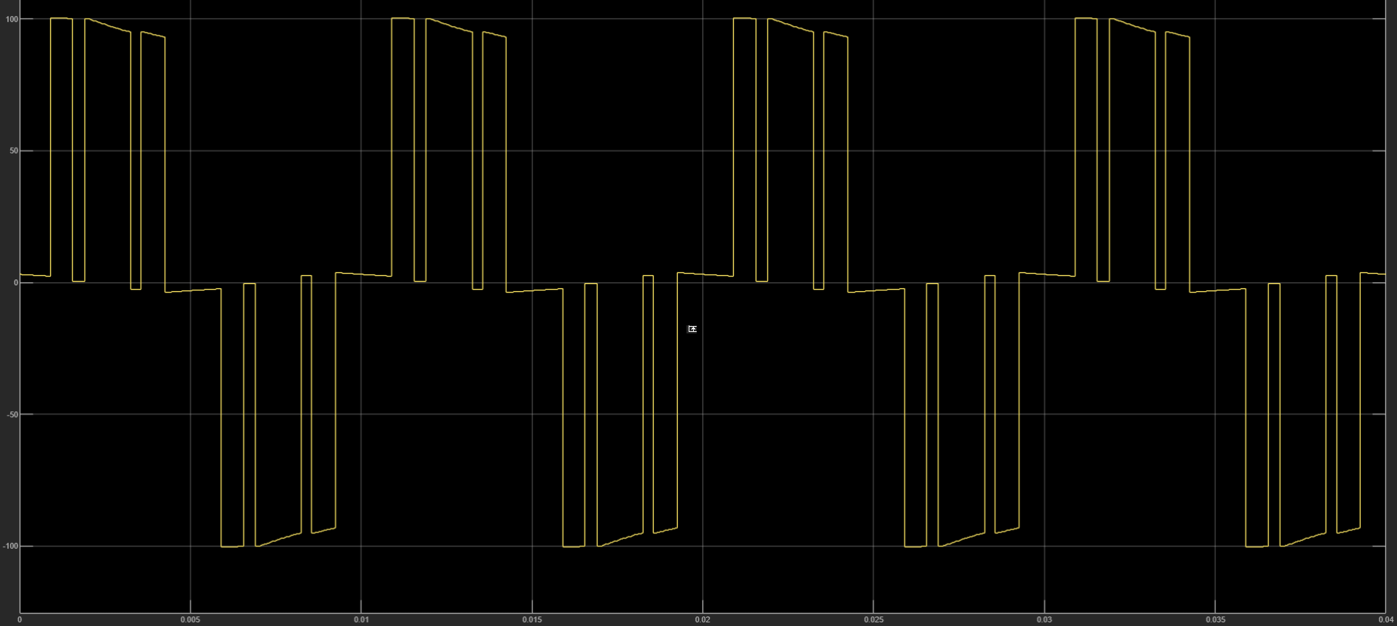
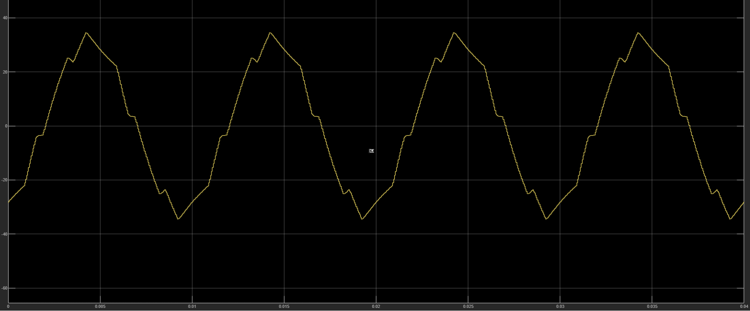
Simulink – SHE – 3rd & 5th Elimination
Output Voltage Waveform
Current through RL load waveform

Slide 42
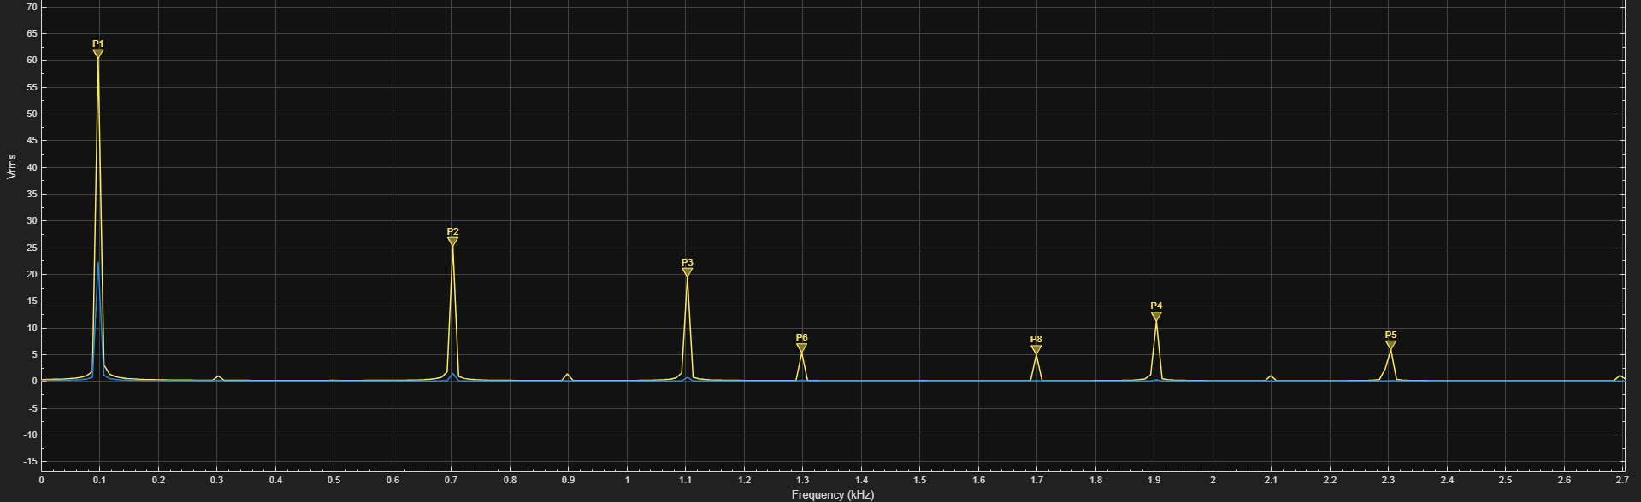
Simulink – SHE – 3rd & 5th Elimination
Frequency Spectrum of Square Wave

Slide 43
Simulink – SHE – 3rd & 5th Elimination
Results:
THD_Voltage = 63.14 %
Load = 1 ohm + 4mH in series
THD_Current = 7.242 %
Observation – THD of current is greater here than 120 conduction mode.

Slide 44
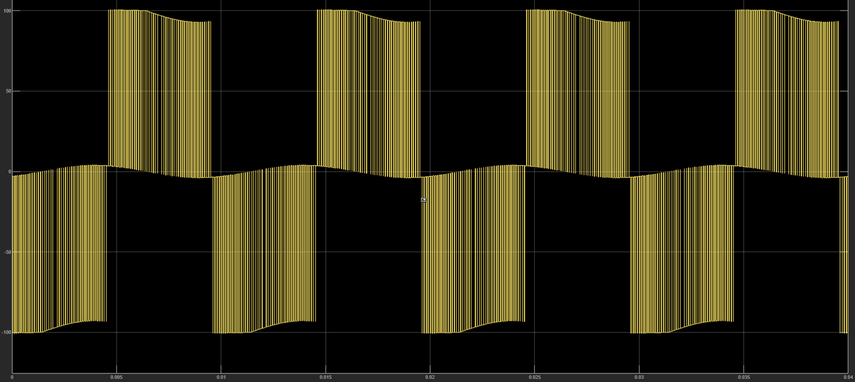
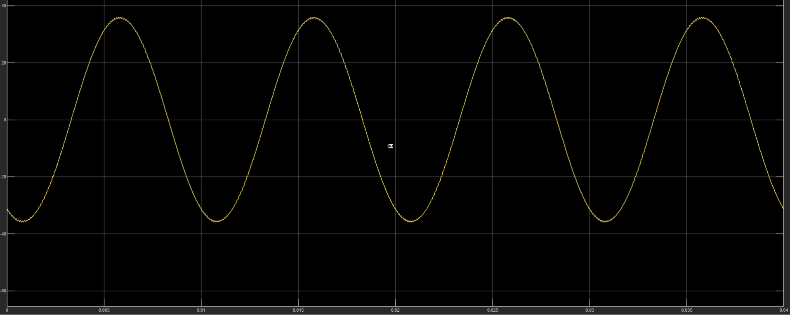
Simulink – SPWM
Output Voltage Waveform
Current through RL load waveform

Slide 45
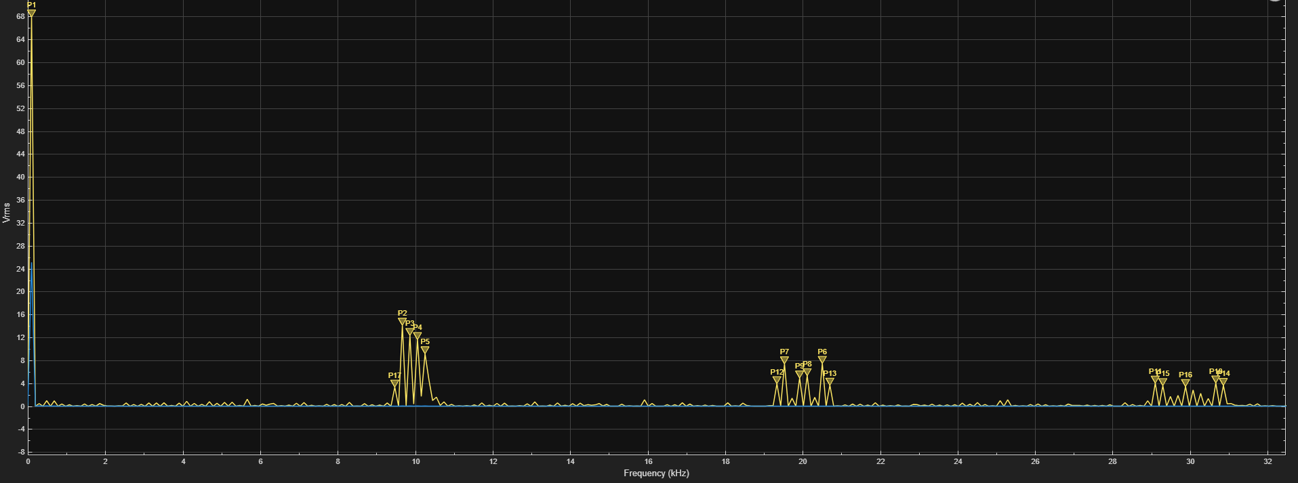
Simulink – SPWM
Frequency Spectrum of Square Wave

Slide 46
Simulink – SPWM
Results:
THD_Voltage = 55.26 %
Load = 1 ohm + 4mH in series
THD_Current = 0.5434 %
Carrier Frequency = 5 kHz

Slide 47
Future work on this project
Implement Bipolar PWM and analyse harmonic content and efficiency.
Extend the design to three phase inverter.
Explore SVPWM technique.
Drive an actual motor with the inverter.
Integrate current control features and enable regenerative braking.

