Slide 1
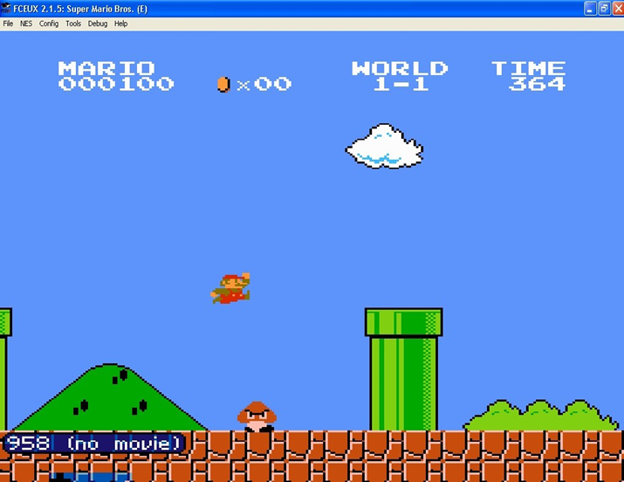
Training Neural Network to play Super Mario
IIT2015032 Rohan M R
IIT2015039 Nishant Verma
IIT2015042 Raghav Saboo
IIT2015045 Harsh Vardhan

Slide 2
Problem Statement
To train neural network models to play Super Mario.

Slide 3
Why training games?
In the quest of developing a universal learning algorithm , a game is a perfect and simple environment with a predefined set of rules , actions , rewards.

Slide 4
Plan of action
1 Set up environment
- Tools used Open AI gym , Tensor Flow , FCEUX
2 Generate Initial Population
3 Train the Neural Network
4 Complete training of the model

Slide 5
FCEUX Emulator
Super Mario. nes
Pixel Data and Score
Command
Open AI Gym

Slide 6


Environment Characteristics
Action
Our Code
Feature Set
Prediction

Slide 7
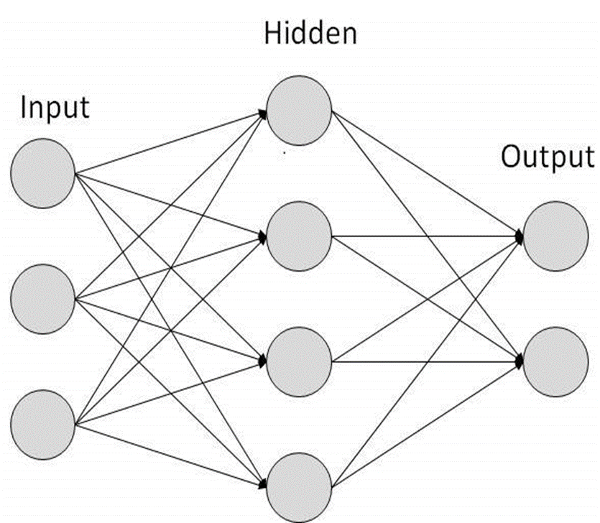
Neural Network
Feature Set
Prediction

Slide 8
Approach
Supervised learning
Pros -
Significant performance
Faster training

Slide 9
Performance of Supervised Learning

Slide 10
However ….
Cons –
Not a generic solution
Can not be applied in all situations

Slide 11
Future Scopes
Reinforcement learning
Pros-
Contemporary
Generic solution
Environment generalization

Slide 12
Estimation of the time required to achieve this performance
No of games | Time Required
1 | 2 seconds
10 | 20 seconds
100 | 3 minutes
1000 | 30 minutes
10000 | 5 hours
100000 | 2 days
1000000 | 20 days

Slide 13
Performance through Reinforcement Learning

Slide 14
Conclusion
Thus we developed a model which can successfully complete the initial level of the game Super Mario Bros.

Slide 15
Thank you!!

