Slide 1
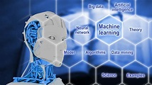

Slide 2
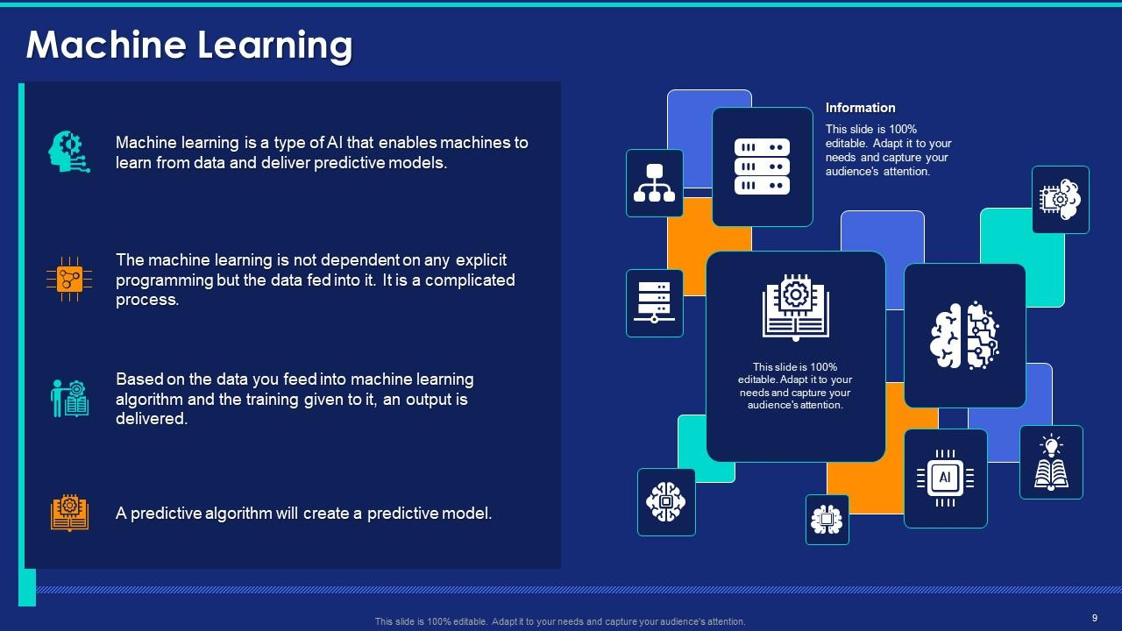

Slide 3
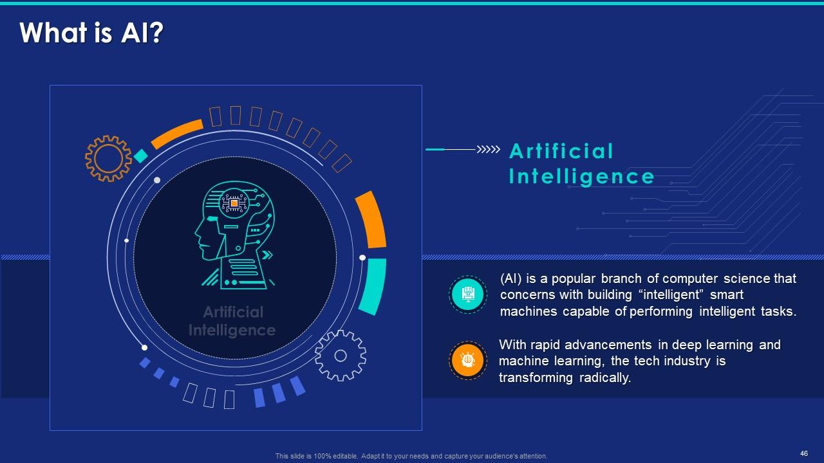

Slide 4
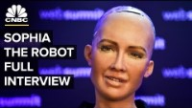
https://www.youtube.com/watch?v=S5t6K9iwcdw

Slide 5
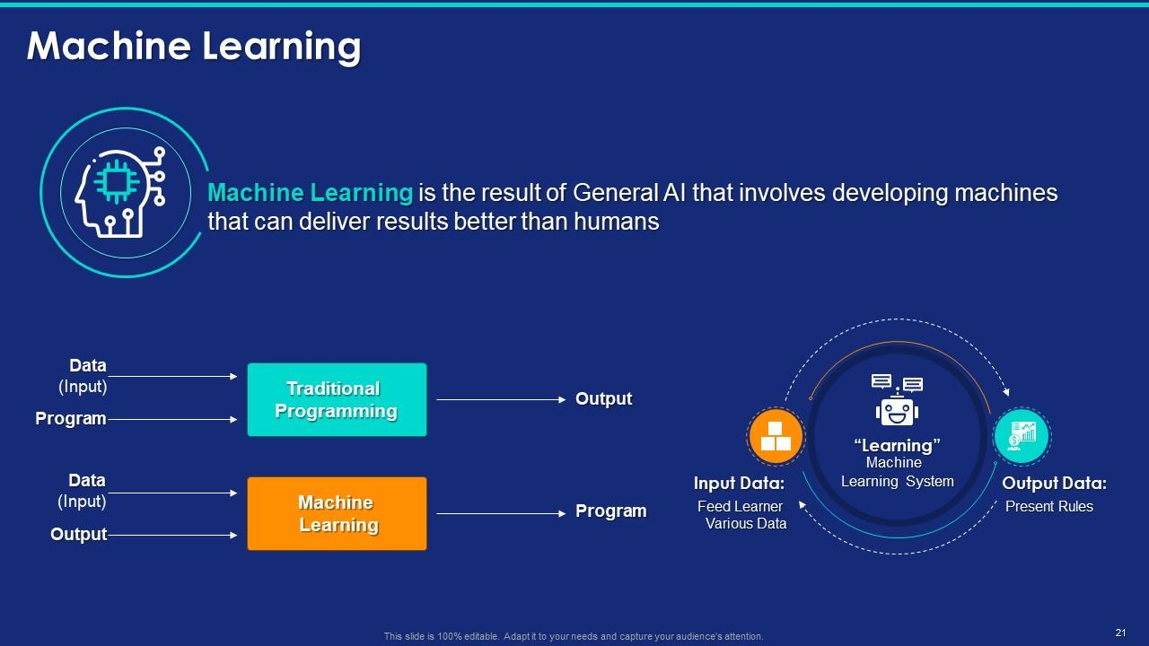

Slide 6
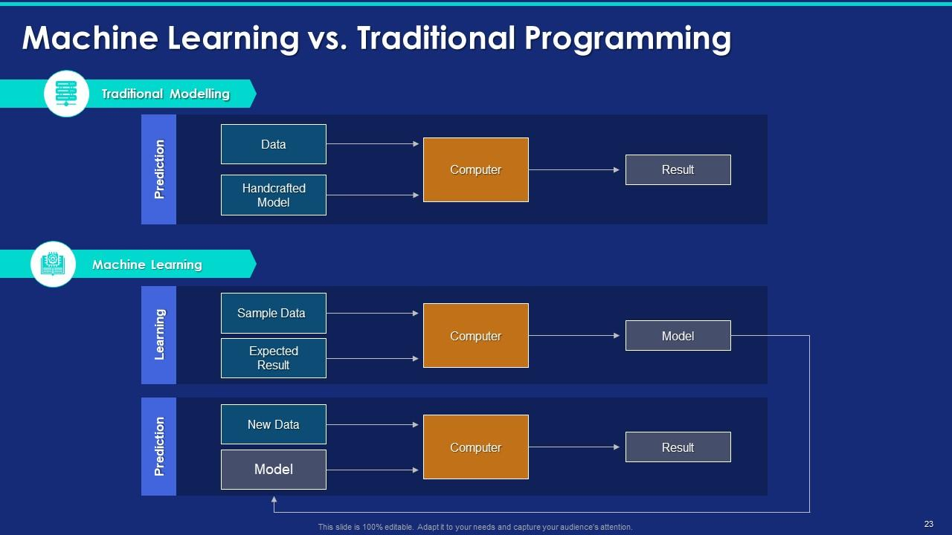

Slide 7
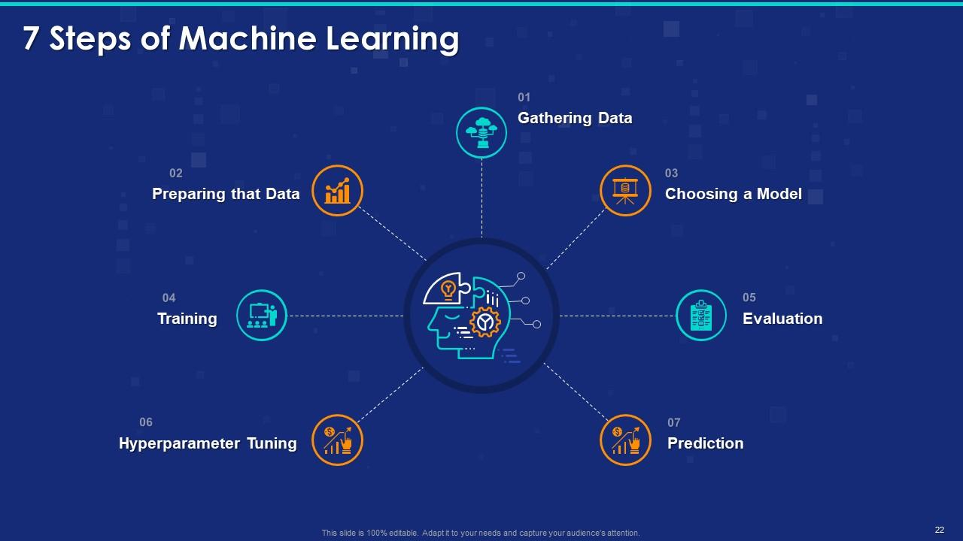

Slide 8
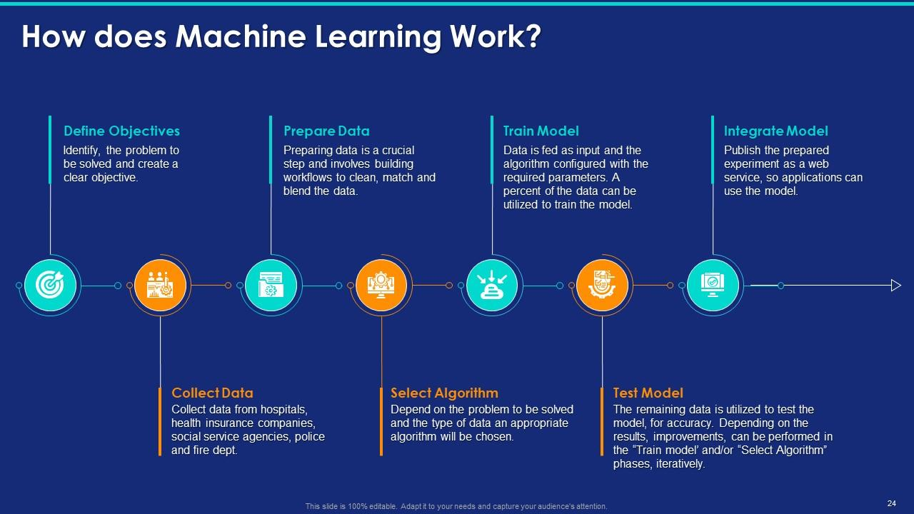

Slide 9
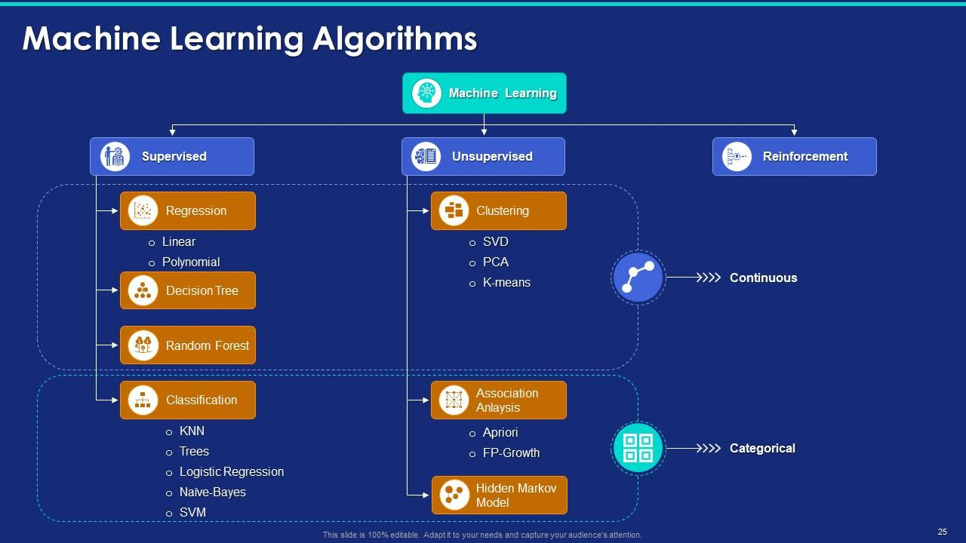

Slide 10
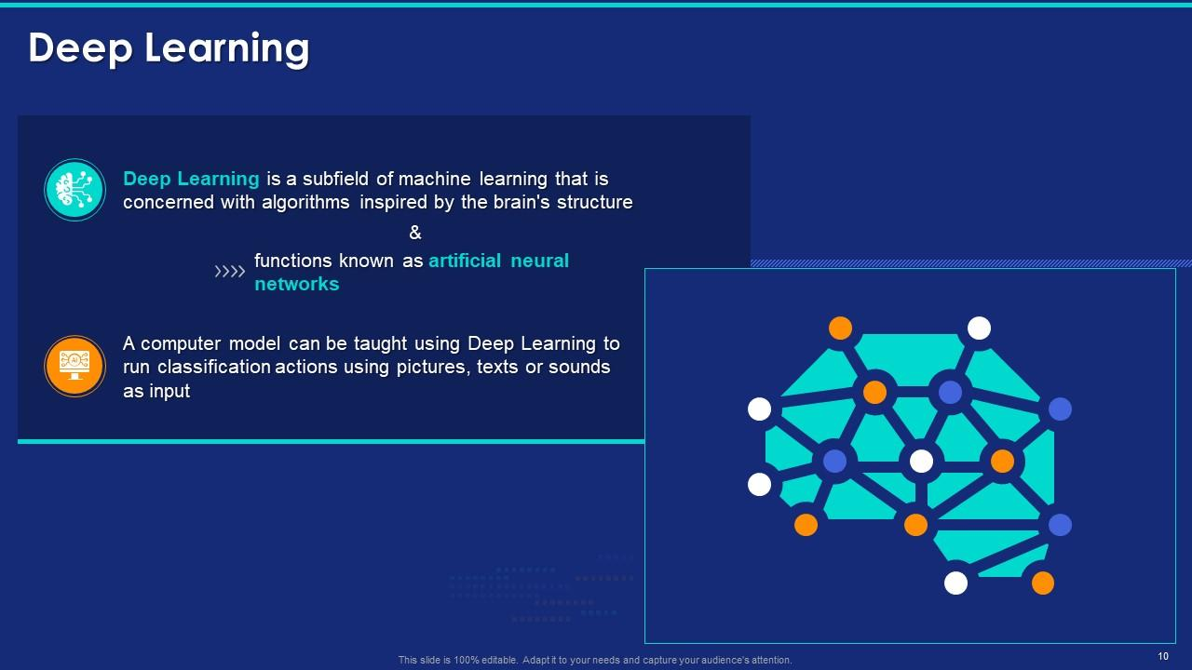

Slide 11
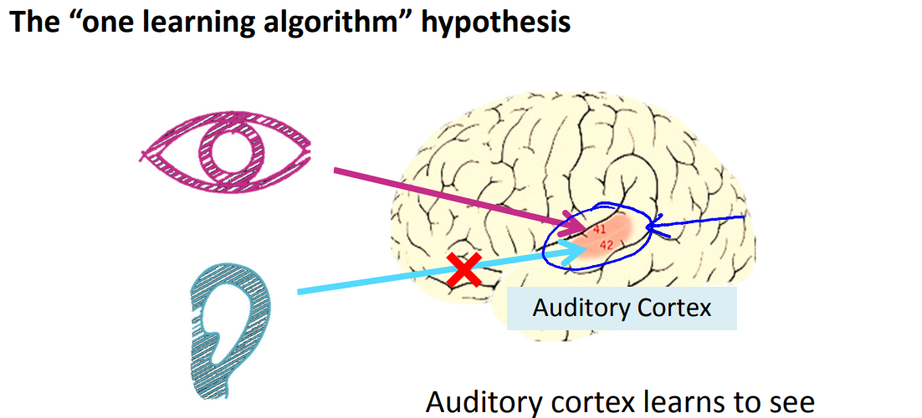
Neural Networks and Brain

Slide 12
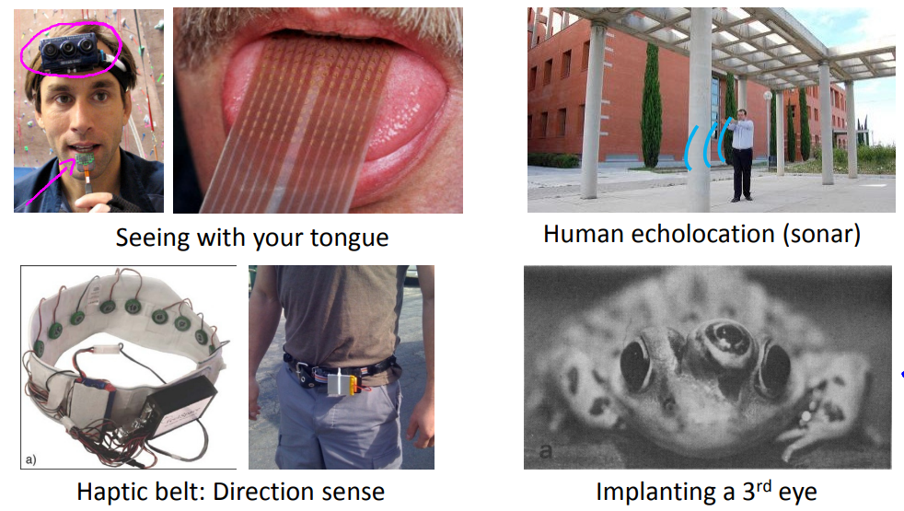
Sensor representations in the brain

Slide 13
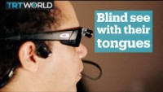
https://www.youtube.com/watch?v=1wRoRfub2HY

Slide 14
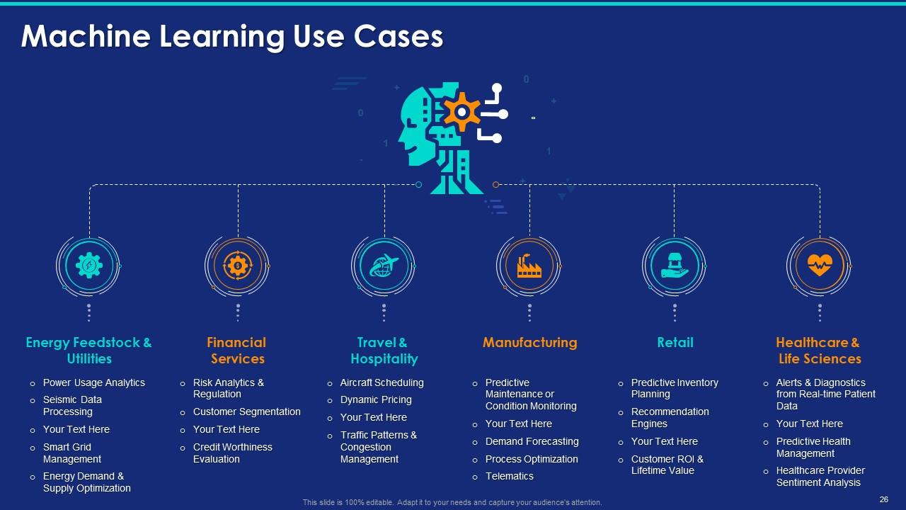

Slide 15
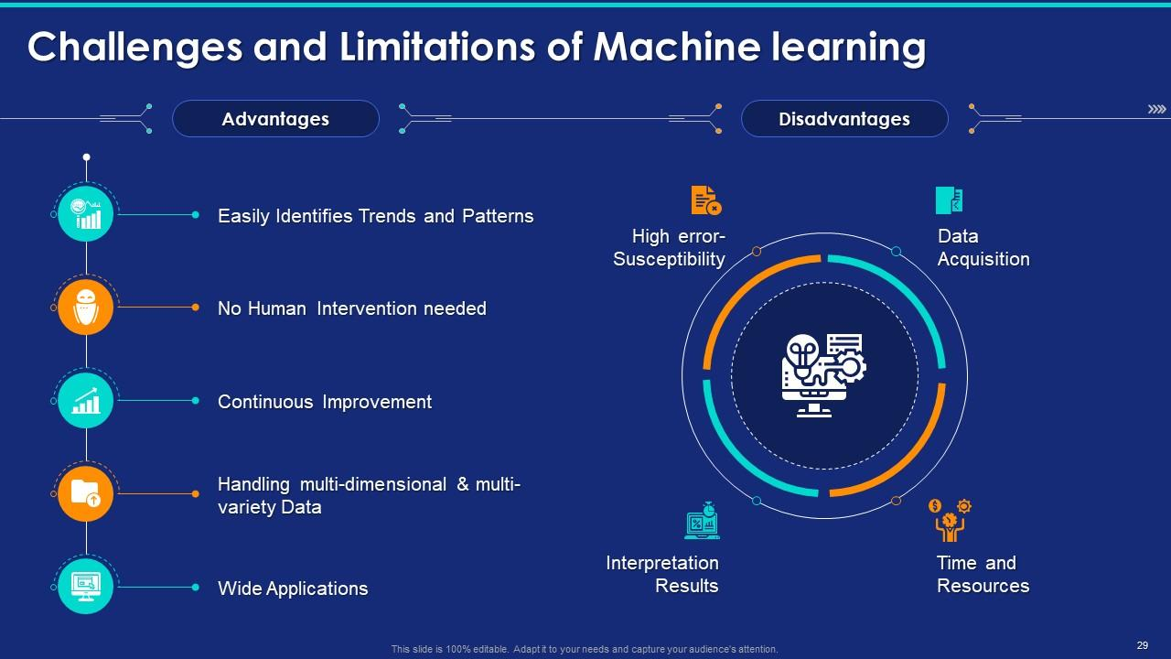

Slide 16
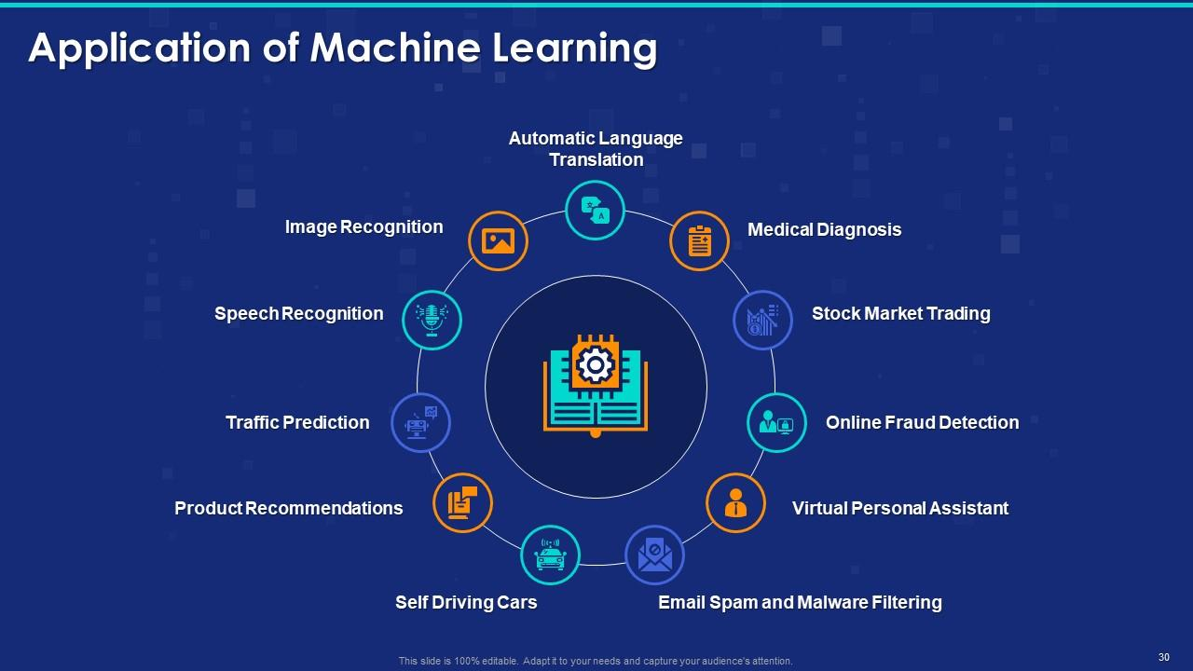

Slide 17


Resources
Book
Hands-on Machine Learning with Scikit-Learn, Keras & TensorFlow
Coursera Courses:
https://www.coursera.org/learn/ai-for-everyone/home/welcome
https://www.coursera.org/learn/machine-learning/home/welcome
https://www.coursera.org/specializations/deep-learning
Youtube Channels:

Slide 18


Coding Platform

Slide 19
